Slide 1
Africa Postcard Project
Chapter 13, Lessons 1-2

Slide 2
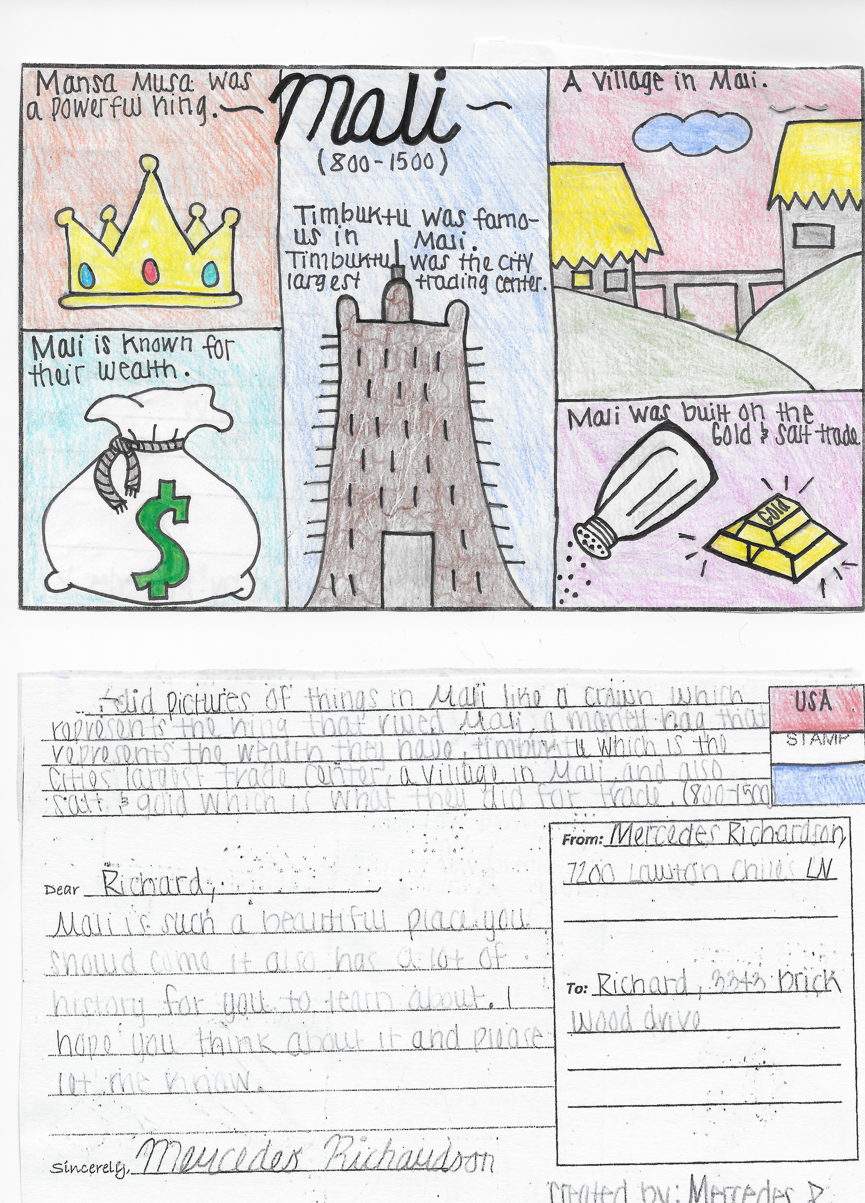
Create your own Africa Postcard

Slide 3
1. SELECT A KINGDOM -- Ghana -- Mali -- Songhai

Slide 4
2. Create a Postcard that includes: Title 5 Historical Images Description Front Color Time Period Location Why famous? To/From & Stamp

Slide 5
2. Create a Postcard that includes: Title 5 Historical Images Description Front Color Time Period Location Why famous? To/From & Stamp

Slide 6
2. Create a Postcard that includes: Title 5 Historical Images Description Front Color Time Period Location Why famous? To/From & Stamp

Slide 7
2. Create a Postcard that includes: Title 5 Historical Images Description Front Color Time Period Location Why famous? To/From & Stamp

Slide 8
2. Create a Postcard that includes: Title 5 Historical Images Description Front Color Time Period Location Why famous? To/From & Stamp
Where is Mali?

Slide 9
2. Create a Postcard that includes: Title 5 Historical Images Description Front Color Time Period Location Why famous? To/From & Stamp

Slide 10
2. Create a Postcard that includes: Title 5 Historical Images Description Front Color Time Period Location Why famous? To/From & Stamp

Slide 11
3. Grading follows the rubric given to you 4. To earn all possible points, Postcard must be: -- legible -- easily identifiable -- accurate -- within the proper time period (800-1500)

