Slide 1
Unit 2 – part iA: population
Population and migration

Slide 2
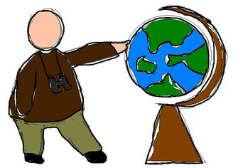
Enduring Understanding (2.a)
By the end of this section, you will understand that knowledge of the geographic patterns and characteristics of human populations facilitates understanding of cultural, political, economic, and urban systems.

Slide 3
Learning objective (2.a.1)
By the end of this section, you will be able to analyze the distribution of human populations at different scales.
Factors that explain patterns of population distribution vary according to the scale of analysis (i.e., local to global)
Physical factors (e.g., climate, land forms, water bodies) and human factors (e.g., cultural, economic, historical, political) inﬂuence the distribution of population

Slide 4
Population distribution
Essential question: How does understanding where people live help to explain how they live?
“Half the world’s population lives in just 1 percent of the land.” – Max Galka, Metrocosm, January 4, 2016

Slide 5
Population distribution
Human geography tries to explain why people live where they do through two distinct but related concepts:
Population distribution
Population density

Slide 6
Population distribution
Population distribution is the pattern of human settlement – the spread of people across the earth.
Population density is a measure of the average population per square mile or kilometer of an area – how crowded a place is.

Slide 7
Population distribution
Why does it matter?
Set boundaries for electoral districts
Develop new housing

Slide 8
Population distribution
Population density has increased significantly but population distribution has not. Why?
Because the vast majority of growth occurs in places that are already settled
Example: eastern China was one of the most populated parts of the world in 1800 – and it still is today

Slide 9
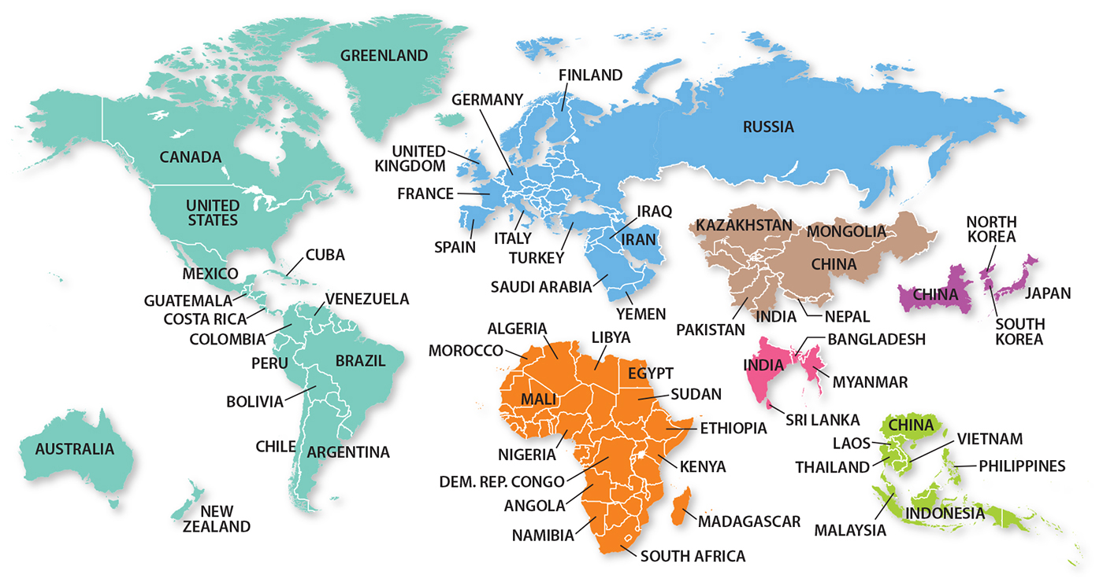
Population distribution
Each of the seven portions indicated by color in this figure contains approximately 1 billion inhabitants

Slide 10
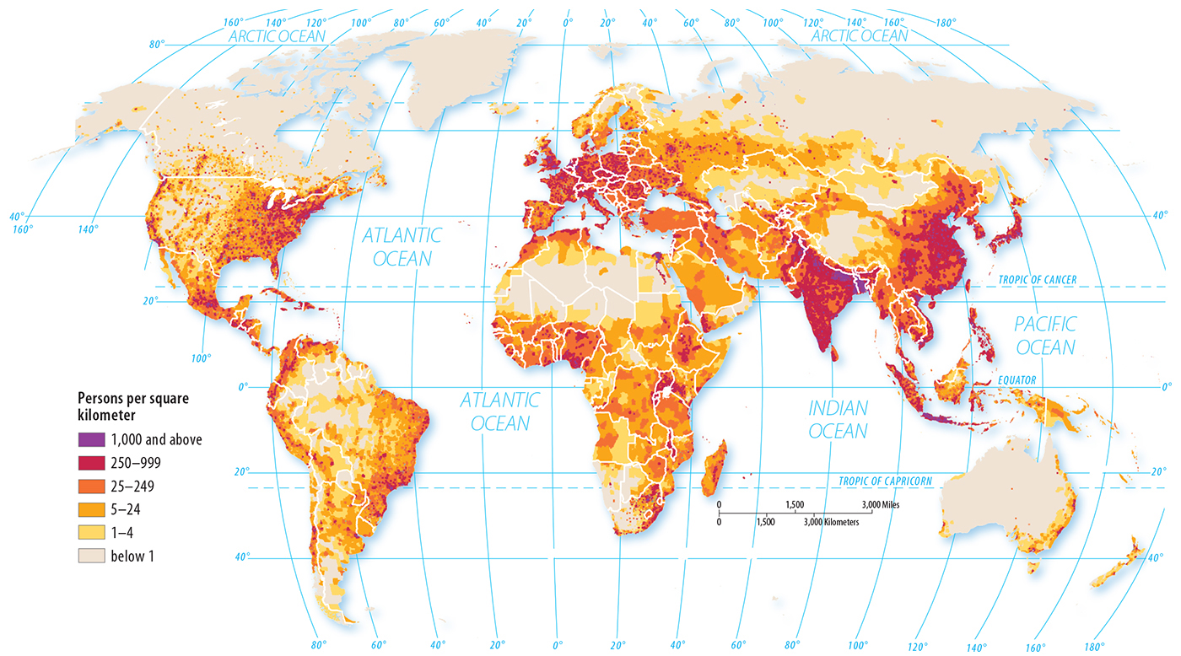
Population distribution
Distribution is not uniform – 2/3 of the world’s inhabitants are clustered in four regions
East Asia
South Asia
Europe
SE Asia
3
1
2
4

Slide 11
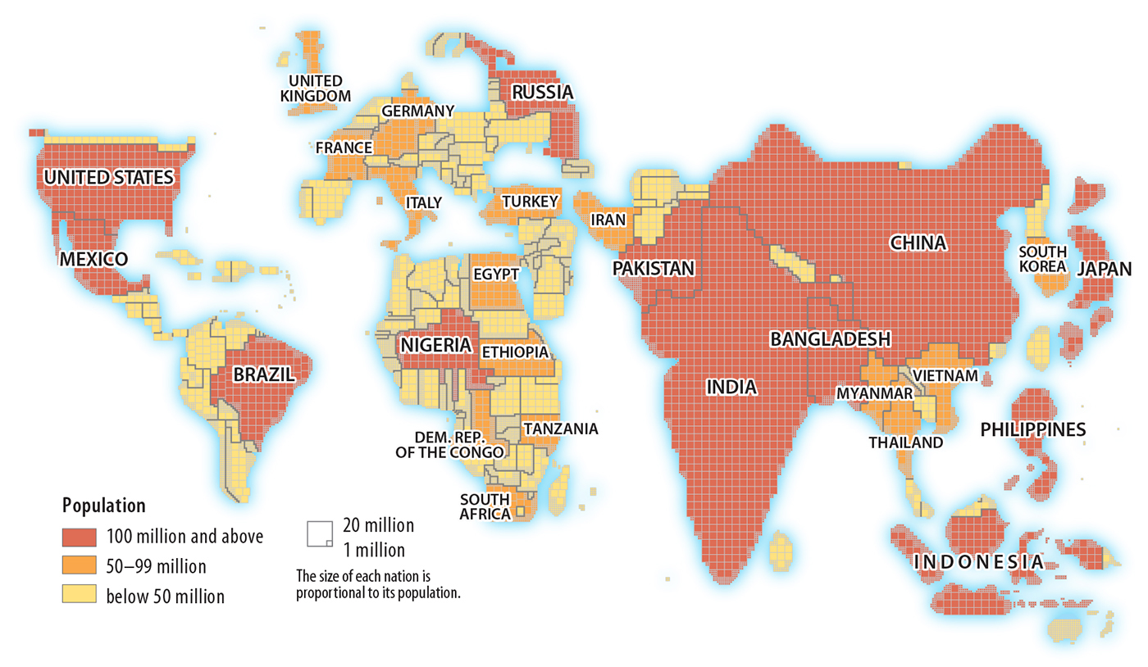
Population distribution
Canada is the 2nd largest country in land area but 37th in population
Bangladesh is 92nd in land area but 8th in population

Slide 12
Where people live – physical factors
Ecumene is a term used by geographers to mean inhabited land
People want to live in places where survival is easy – raise or obtain food and water and moderate climates
Where don’t people live?
Wetlands, Drylands, Coldlands, Highlands
Wet, dry, cold, and high

Slide 13
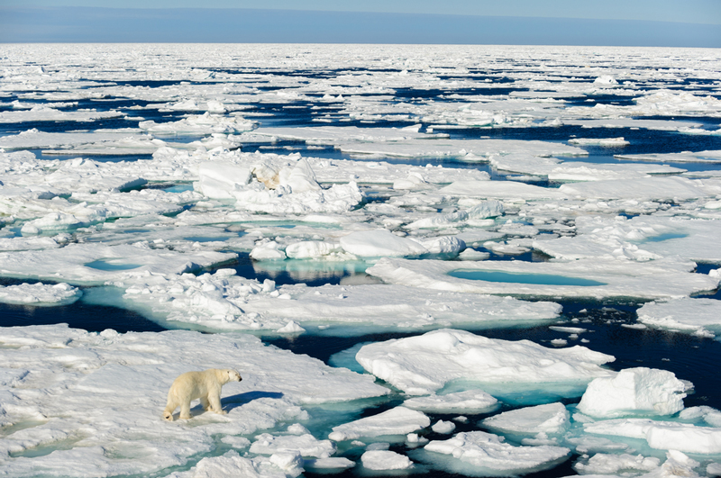
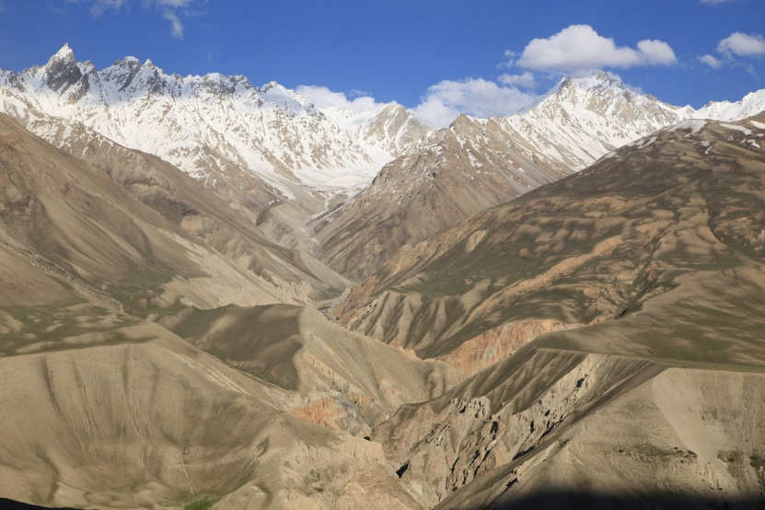
Where people live – physical factors

Slide 14
Where people live – physical factors
Early survival depended on food, water, and shelter
Today is not much different – as population increases, population density increases
Most people live in midlatitudes – more moderate climates and better soils
Low-lying areas typically have better soil and are often close to oceans (transportation, source of food, moderate temperatures)
Fresh water – lakes and rivers (drink, irrigation, transportation, food)
Other resources – natural resources (forest products and materials)

Slide 15
Where people live – human factors
At first, people settled near natural resources but eventually, the people themselves became an attraction
Jobs, friends, family, etc.
People prefer to live close to trade routes (transportation networks – roads, train lines, rivers, etc.)
Political decisions – Canadian military base called Alert is the most northerly community in the world. It was close to the Soviet Union and allowed them to watch for hostile military activities.

Slide 16
Learning objective (2.a.2)
By the end of this section, you will be able to use population density to explain the relationship between people and the environment.
The three methods for calculating population density are arithmetic, physiological, and agricultural.

Slide 17
Population density - arithmetic
Calculated by dividing a region’s population by total area
Example:
United States population (07/2015) – 321,368,864
United States total area – 3,841,999 square miles
Arithmetic density – 83.6 people per square mile
Says little about population distribution – where they live

Slide 18
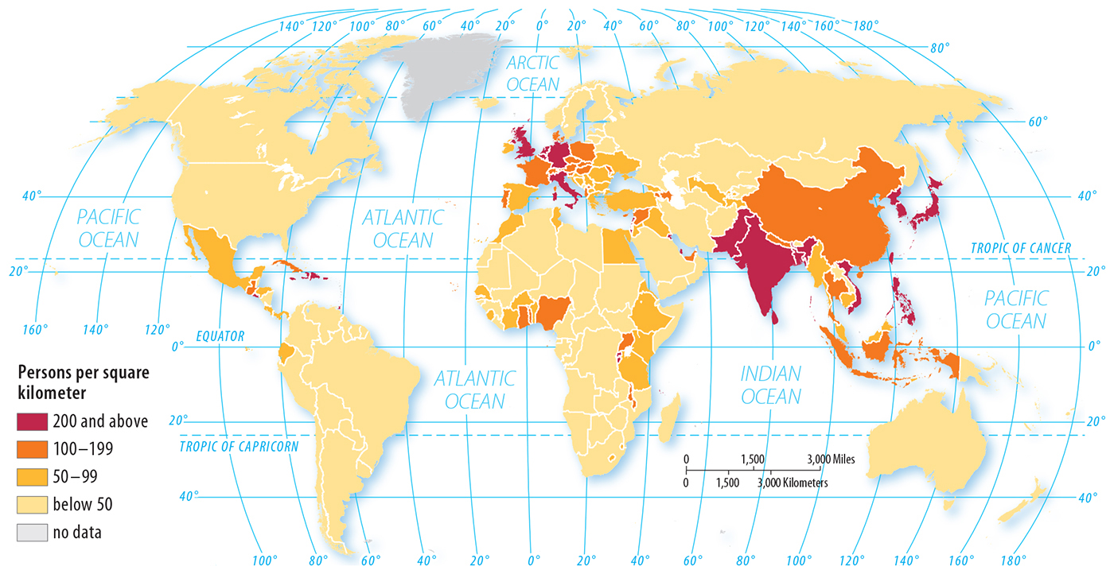
Population density - arithmetic

Slide 19
Population density - physiological
Calculated by dividing population by the amount of arable land (suitable for growing crops)
Example:
Egypt – 2.8% arable land with a high population
Physiological density is 8,078/sq. mile
Arithmetic density is 226/sq. mile
This large gap indicates that a small percentage of land is capable of growing crops and indicates the need for greater crop yields or other food sources

Slide 20
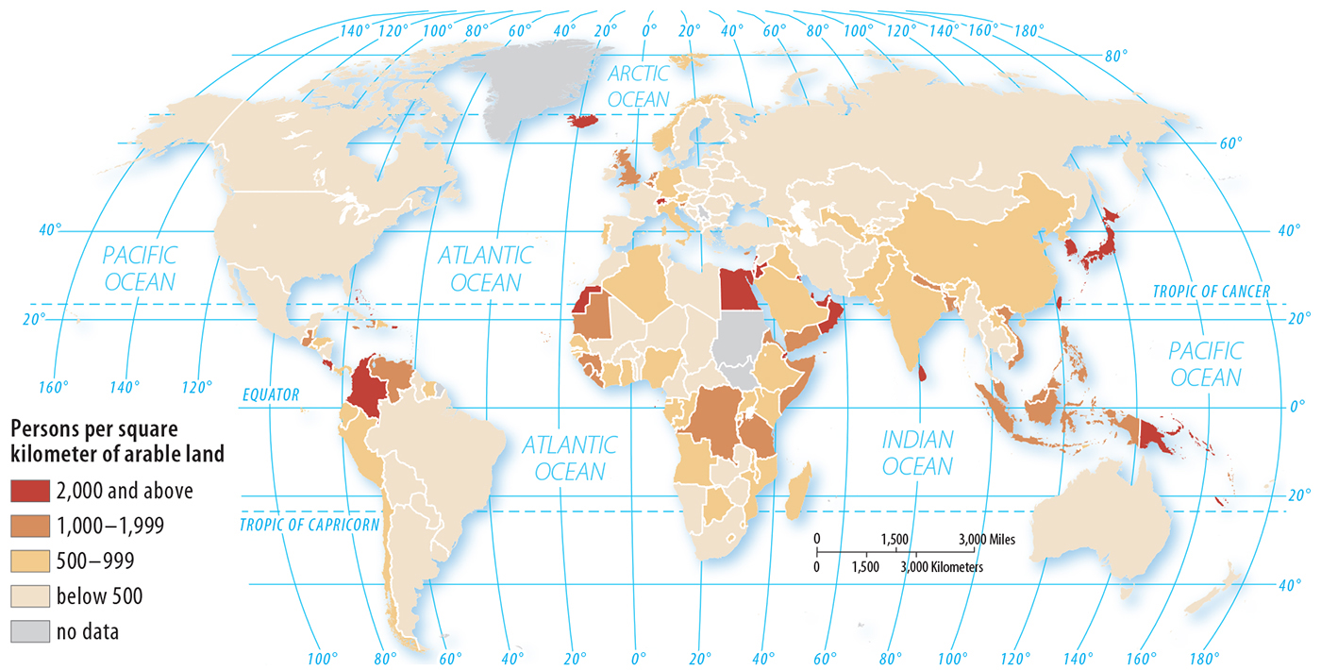
Population density - physiological

Slide 21
Population density - physiological
The physiological density is more useful than arithmetic density when trying to determine a region’s carrying capacity - the population it can support without significant environmental deterioration.
Not all countries can produce higher yields and must import food
Egypt and Japan both supplement crops through the fishing industry and with imported food – but paying for it is easier for developed countries (Japan) than less developed countries (Egypt)

Slide 22
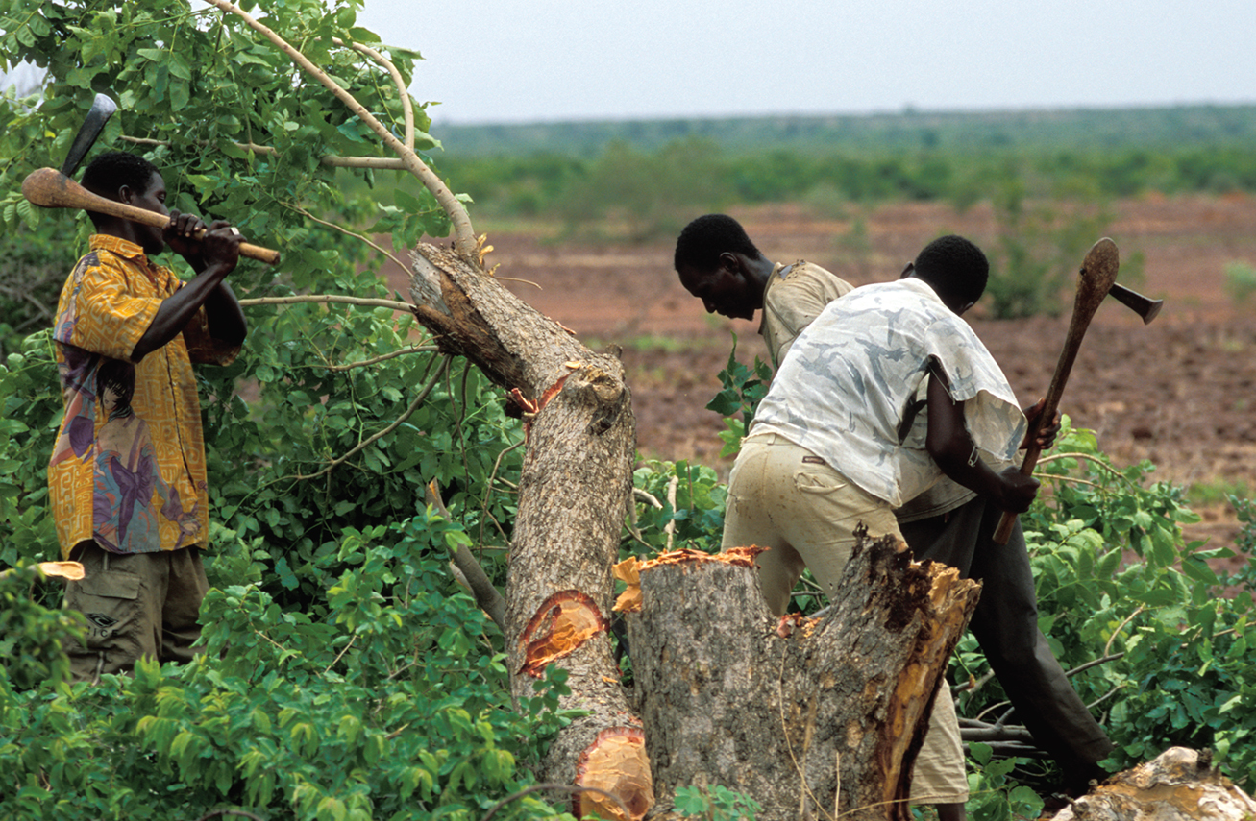
Population density – physiological
The Sahel region of Africa, including much of the country of Mali, is threatened by overpopulation. The number of people living here is not very high, but the capacity of the environment to support life is extremely low. These people are chopping down one of the few remaining trees in this region.
Carrying capacity – population that can be supported without significant environmental deterioration

Slide 23
Population density - agricultural
Compares the number of farmers to the area of arable land – provides an indication of the efficiency of the region’s farmers
Developed countries – less farmers (technology)
Less developed countries – more farmers (labor)
Compare Bangladesh to the Netherlands

Slide 24
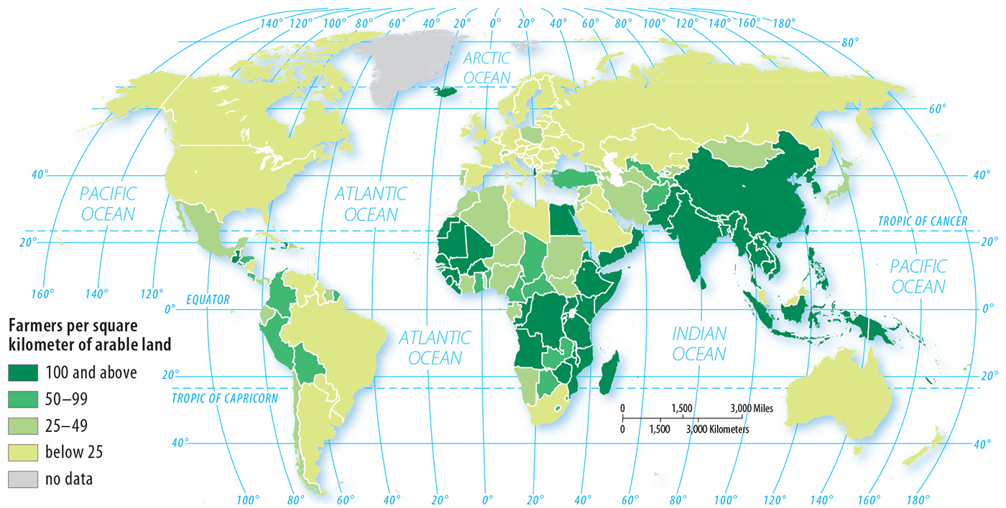
Population density - agricultural

Slide 25
Population density and time
Density also varies by time of year
Snowbirds
Time of day
Commuters – Manhattan, New York City
1.5 million people live in Manhattan
During the workday, the population increased to 3 million
Water, sewer, fire, services, etc.

Slide 26
Learning objective (2.a.3)
By the end of this section, you will be able to explain the implications of population distributions and densities.
Population distribution and density inﬂuence political, economic, and social processes (e.g., redistricting, provision of services such as medical care)
Population distribution and density impact the environment and natural resources (e.g., carrying capacity)
Population distribution and density affect the need for infrastructure (e.g., housing) and urban services (e.g., sanitation)

Slide 27
Implications of distribution and density
Economic, Political, and Social
Businesses earn more when located near large customer base
Manufacturing plants are closer to a large labor force
The Supreme Court requires state legislatures to create electoral districts of reasonably equal population size so each representative serves approximately the same people – redistricting occurs every 10 years to adjust boundaries
Urban districts are usually smaller than rural
Services – schools, police stations, etc. are usually positioned close to concentrations of population (closer in rural areas)

Slide 28
Learning objective (2.a.3)
By the end of this section, you will be able to explain the implications of population distributions and densities.
Population distribution and density inﬂuence political, economic, and social processes (e.g., redistricting, provision of services such as medical care)
Population distribution and density impact the environment and natural resources (e.g., carrying capacity)
Population distribution and density affect the need for infrastructure (e.g., housing) and urban services (e.g., sanitation)

Slide 29
Implications of distribution and density
Environment and Natural Resources
Overpopulation – more people than it can support
Carrying capacity – higher population density creates a strain on the environment
Cities could be built on land with low carrying capacity, such as areas with poor soil, but for historical reasons, many are located on land with the greatest carrying capacity
Other areas: pollution and depletion of resources (many lakes and rivers no longer provide drinkable water and must be piped in)

Slide 31
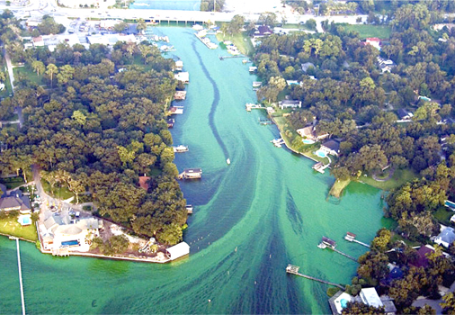

Slide 33
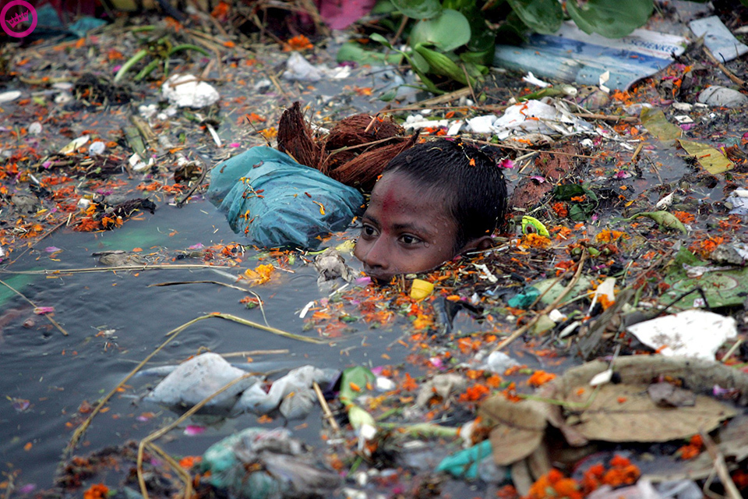

Slide 34
Learning objective (2.a.3)
By the end of this section, you will be able to explain the implications of population distributions and densities.
Population distribution and density inﬂuence political, economic, and social processes (e.g., redistricting, provision of services such as medical care)
Population distribution and density impact the environment and natural resources (e.g., carrying capacity)
Population distribution and density affect the need for infrastructure (e.g., housing) and urban services (e.g., sanitation)

Slide 35
Implications of distribution and density
Infrastructure and Urban Services
When people want to live in a particular region, they drive up the population density
High-density housing vs. single-family homes
Centers of big cities usually feature apartments and condos
Example: Chicago, The Loop, 21,000 people/sq. mile (Orlando has an estimated population density of 2,327 people per sq. mile)

Slide 36
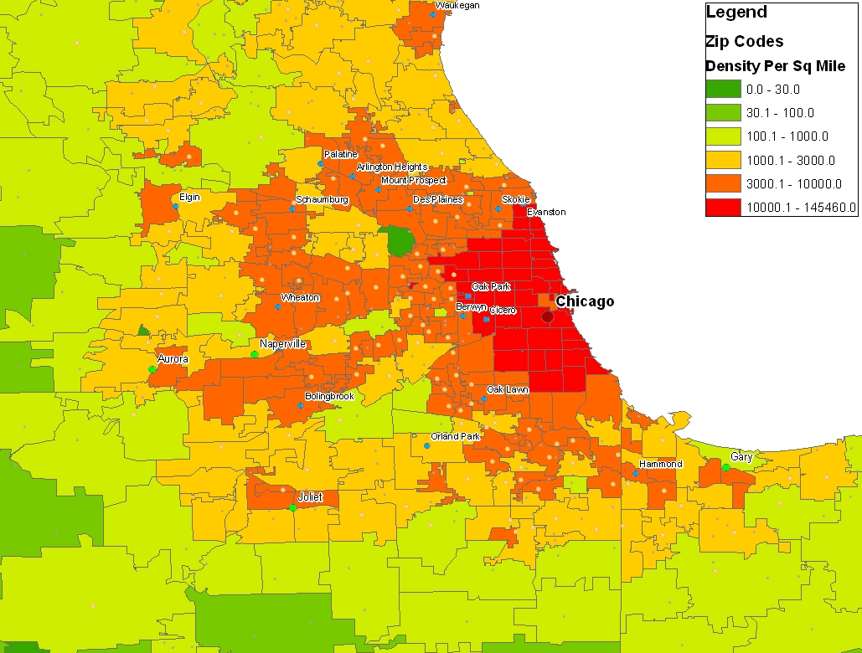
Implications of distribution and density

Slide 37
Implications of distribution and density
Infrastructure and Urban Services
Benefits: providing services (sewer, water, snowplowing, and policing) is more cost-effective in high-density areas. The cost mostly comes from labor, not the size of the pipe being used.
Challenges: contamination of the water supply for a downtown area can make thousands of people ill; disease spreads quickly and is hard to manage.

Slide 38
Learning objective (2.a.4)
By the end of this section, you will be able to analyze population composition.
Age, sex, and ethnicity are elements of population composition that may be mapped and graphed at various scales
Population pyramids are used to project population growth and decline and to predict markets for goods and services

Slide 39
Population composition
Ethnicity
Members of a particular ethnic group tend to cluster in particular regions – culture, religion, discrimination
Example: historically, many cities limited the neighborhoods where African Americans could live
Many neighborhoods are named for ethnic clusters – Little Italy, Chinatown, Little Havana, Little Haiti

Slide 40
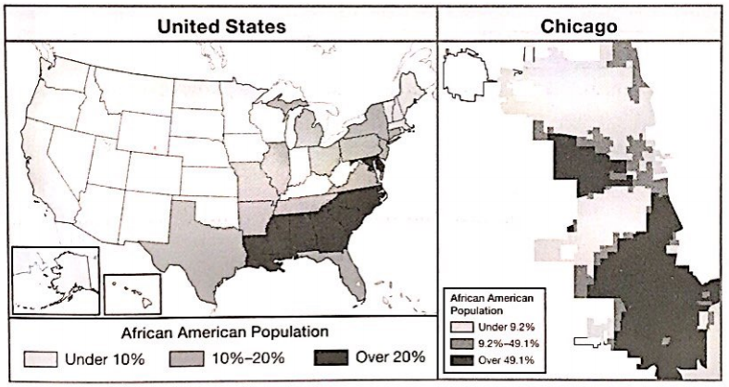
Population composition
Scale – concentrated in the Southeastern US; clustered in large cities and in particular neighborhoods

Slide 42
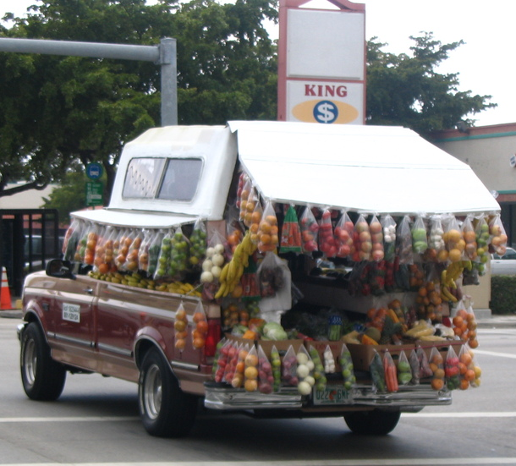

Slide 43
Chinatown: New York City, NY

Slide 44
Chinatown: San Francisco, California

Slide 45
Population composition
Age
In 2013, Utah had the youngest average age in the U.S. at 29.9 years old, while the oldest average age was in Maine at 43.5
Shapes public policy – school-aged children vs. senior citizen services
Sex
Affected by wars, migrations, and government policies
Mining towns and military bases often have significantly more men
Colleges offering courses that tend to attract students of one sex

Slide 46
Learning objective (2.a.4)
By the end of this section, you will be able to analyze population composition.
Age, sex, and ethnicity are elements of population composition that may be mapped and graphed at various scales
Population pyramids are used to project population growth and decline and to predict markets for goods and services

Slide 47
Population Pyramids
One of the most useful tools to study population is the age-sex composition graph – or population pyramid
Based solely on age and sex data
Provides information on birth rates, death rates, average life span, and economic development
Reflects natural disasters, wars, political changes, and epidemics

Slide 48
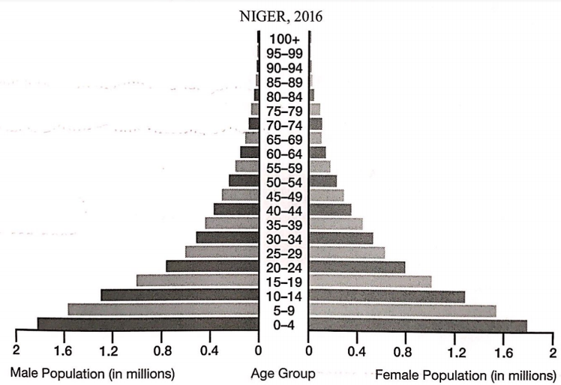
Population Pyramids
Reading a pyramid
Vertical axis shows age groups, called cohorts, usually shown in the middle
Males on the left and females on the right
Horizontal axis may be percentages or absolute numbers
Usually on a country scale

Slide 49
Population Pyramids
Determining Population Trends
Wide base and tapers upward – population growth

Slide 50
Population Pyramids
Common Patterns
The Niger pyramid is nearly symmetrical, or balanced, left to right, indicated a balance of males and females until approximately age 65 – women live longer
Look for sudden bulges or indentations
Symmetry and gradual change is normal, assuming there have been no circumstances such as war, natural disaster, epidemics, or government interference.

Slide 51
Population Pyramids
Impact of War
Clearest impact is death
Oftentimes, half or more of deaths in wartime are civilians and therefore affect people of all ages
However, the loss of fighting-age people, traditionally males between the ages of 18 and 40, is often noticeable
Men and women are usually separated or delay having children creating a slowdown of births called a birth deficit

Slide 52
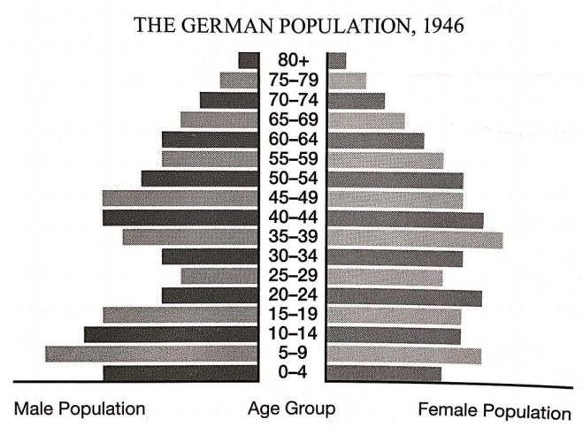
Population Pyramids
The post-WWII 1946 graph of Germany shows the loss of life of both males and females in the 20 to 40 age cohorts, with a greater loss of men than women
The birth deficit is evident in the 0-4 cohort

Slide 53
Population Pyramids
Baby Booms, Busts, and Echoes
Once hostilities end and peace continues, the birth rate often spikes, an increase known as a baby boom
The WWII baby boom lasted from 1946 to 1965
Baby booms are followed by a baby bust, which continues until the boomers reach child-bearing age, resulting a bulge in the pyramid – this is called an echo
Anomalies remain in the pyramid and move upward until the cohort dies

Slide 54
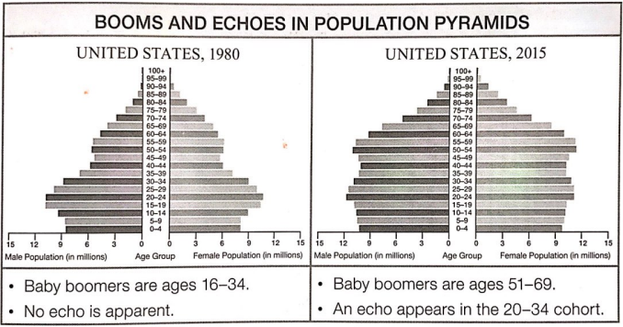

Slide 55
Population Pyramids
Migration and Other Anomalies
Many factors can affect a population pyramid and an asymmetrical pyramid, one with significant differences between cohorts, suggests that something notable happened in the population
It is your job to determine what historical event caused the irregularity.

Slide 56
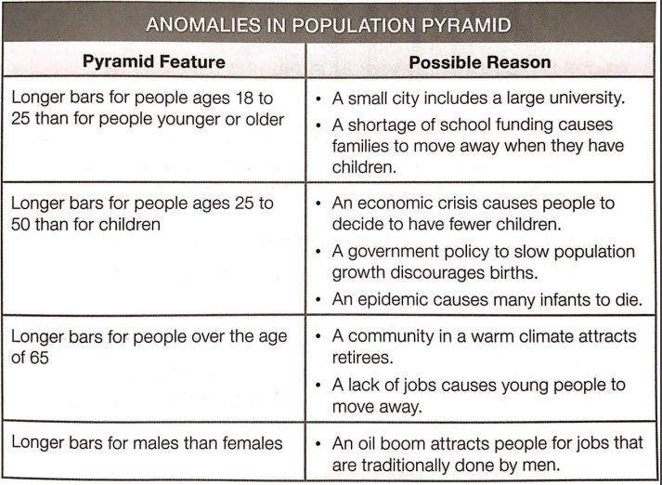

Slide 57
Population Pyramids
Dependency Ratio
Population pyramid data is often used to estimate the dependency ratio (DR), a value comparing the working to the nonworking parts of a population
Potential workforce: 15-64
Dependent population: people under 15 and over 64
Dividing potential workforce by dependent population results in the dependency ratio (only a rough estimate)

Slide 58
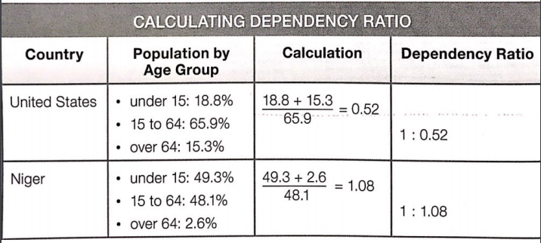

Slide 59
Population Pyramids
Interpreting DR
Suggests differences in how people live in each place
Each person in the US supported himself or herself plus an average of .52 additional people
Each person in Niger supported 1.08 additional people
Japan, Australia, and most of Europe have DRs similar to the United States.
Countries throughout Africa and parts of South America and Asia look more like Niger

