Slide 1
3.5/4.3 Systems with Three Variables
Learning goals
solve systems in three variables using substitution and elimination

Slide 2
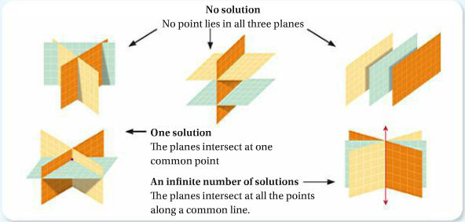
Visualization of Possible Solutions

Slide 3
Ex 1 Solve using elimination

Slide 4
Ex 2 Solve using substitution

Slide 5
THEY SAY THAT ONLY PEOPLEWITH AN IQ OF 120 AND OVER ARE ABLE TO FIGURE THIS OUT!
IF:
2 + 3 = 10
7 + 2 = 63
6 + 5 = 66
8 + 4 = 96
THEN:
9 + 7 = ???

Slide 6
Ex 3

Slide 7
Homework
Pg 171 #1-4

