Slide 1
¡Bienvenidos a la clase de español!
Dra. Vogel
7-207

Slide 2
Am I in the right room?
Teacher name:
Dr. Vogel
Room: 7-207
If yes, you are in the right room!

Slide 3
Where am I supposed to sit?
I will assign seats based on alphabetical order
New seats will be assigned every quarter.
If you have any special needs, please let me know so that I may make any necessary changes.

Slide 4
How do I contact my teacher?
Email: vogele2@leonschools.net

Slide 5
Materials
3- ring binder
Pen/pencil
Workbook
Index cards
Dry erase markers
BRING TO CLASS EVERY DAY!

Slide 6
How will I be graded in this class?
Grading Scale:
A - 90 to 100
B - 80 to 89
C - 70 to 79
D - 60 to 69
F – 59-0
Assessments 70%
(Tests, Projects, and Quizzes)
Daily Work 20% (Homework and Classwork)
Speaking Participation 10%
**No extra credit will be given in any category except for your weekly participation grade or if there is an extra credit section on a test or quiz
Notes:
B

Slide 7
EXPECTATIONS
What I expect of you:
Patience and Respect.
Enthusiastic participation.
Completion of the assigned work.
Being prepared for class.
Making every effort to communicate and participate in Spanish in class.
What you can expect from me:
Patience and Respect.
Enthusiasm.
Prompt evaluation of assignments.
Making every effort to help you communicate in Spanish.
Cultural presentations, songs, and supplementary learning material.

Slide 8
Classroom routines
Come to class on time.
Attend to personal needs before coming to class.
**Be seated and begin the Bell Work activity when the bell rings.**
**Do not disrupt class.**
Show respect for the teacher and your fellow peers.
Use polite speech and body language.
Keep your electronics off and in your backpacks.

Slide 9
Entering Our Classroom
Please enter quietly.
Have a seat.
Take out your materials.
Begin Bell Ringer assignment.

Slide 10
Bell Ringer Activity
Bell work will be on the front board every day.
You are to begin when the bell rings.
This activity should take approx. 5 min. or so.
Bell Work: ‘Verb of the day’ or ‘Word of the day’ or review of past material
You will be tested on Bell Ringers.

Slide 11
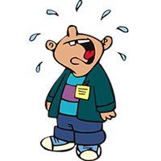
WHAT HAPPENS WHEN YOU DON’T FOLLOW THE RULES!

Slide 12
Big Trouble
Verbal Warning.
Lunch Detention.
Phone call to parents.
Referral.
Teacher-Parent conference.

Slide 13
Following the rules will result in:
A stress free learning environment.
A pleasant and orderly classroom atmosphere.
Verbal praise.
Little to no pop quizzes.
Little to no homework.

Slide 14
When you are tardy
Enter quietly.
Excused Tardy: Place excuse on my desk.
Have a seat and take out our materials.

Slide 15
Paper Heading
PLACE THIS HEADING ON ALL ASSIGNMENTS
Nombre:
Fecha:
Periodo:

Slide 16
Finish Class Work Early?
What can I do next?
Review vocabulary words.
Review the grammar.
Review for the next quiz or test.
Start working on tonight’s homework.
Make flashcards with vocabulary words and verb conjugations.

Slide 17
Absences
If you are absent from class, it is your responsibility to make up the work and get the notes from a classmate.
Tests and quizzes will be made up at lunch or after school, within one week of the absence.
Schedule a time on the calendar near the door.

Slide 18
Class schedule:
Classwork check (at the end of each week)- turn in classwork (on Fridays)
Quizzes (once or twice a week)
If I notice that students are not paying attention in class, there could be a pop quiz the following day or within the same class period.
Midterm & Final
1 cumulative exam each grading period
1 project per semester

Slide 19
Classroom Discussions
PLEASE participate!
I want to hear what you have to say.
If you do not participate your grade will be negatively affected.
It is okay to make errors in Spanish. That is how we learn.

Slide 20
Moving around the room
You may leave your seat to get tissue paper or to use the pencil sharpener. Find the appropriate time to take care of these personal needs (i.e., before class or at the end of class).
If you need to leave the classroom to go to the bathroom, make sure to sign-out and sign back in. Only one student can go to the bathroom at a time.
If bathroom use is excessive and becomes an issue, I will give you a warning. If the behavior continues, I will call home.
*DO NOT interrupt class instruction to ask to use the bathroom.
Remain in your assigned seat until the teacher dismisses you from class.
My computer, desk, and desk area are NEVER for student use.

Slide 21
Food and drink
You may not bring food into the classroom
You may not eat during class
You may bring a water bottle

Slide 22
Keep your cell phones in your backpack during class
Keep cell phones in your backpack during class unless you are using your phone to look up a word or a conjugation (i.e., during the Bell Ringer or during classwork).
I will collect your phones on quiz days. When you finish your quiz, you cannot re-collect your phone until MOST of the class has finished with their quiz. If I see you with your phone out during a quiz or test, it is an automatic ‘zero’.
If you are getting distracted by your phone and having trouble concentrating on the content for Spanish class, I will ask you to put your phone over by the charging station. If you continue to use your phone after I’ve asked you to put it away, you will get a detention and a phone call home.

Slide 23
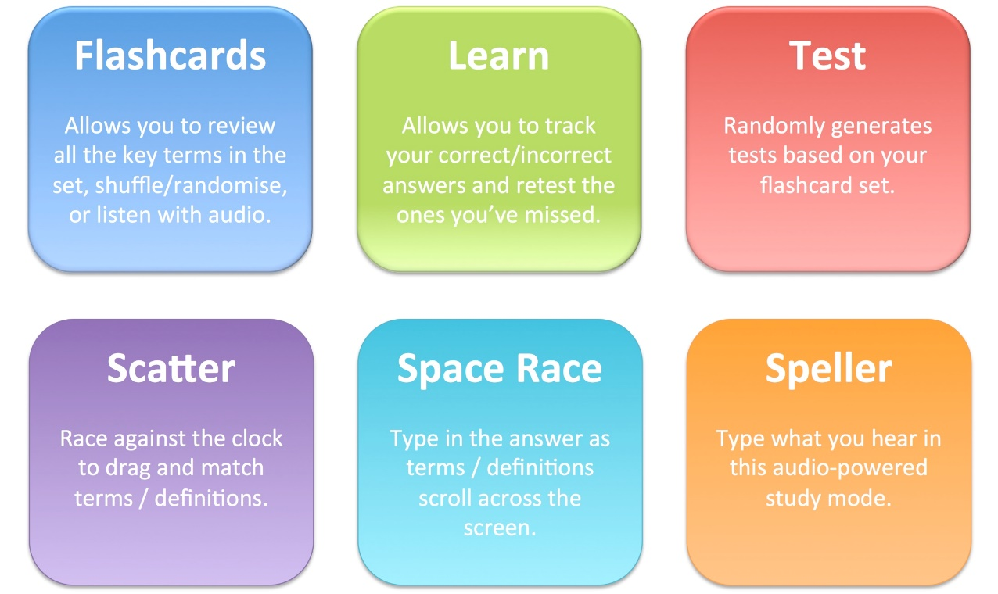
Quizlet:
https://quizlet.com/subject/spanish/

Slide 24
List of helpful study resources for Spanish 2 & 3:
Click on activities on the right hand side of the homepage:
https://personal.colby.edu/~bknelson/SLC/
Study Spanish grammar:
https://studyspanish.com/grammar
Drlemon.com:
https://www.drlemon.com/Grammar/verbs.html
Spanish Proficiency exercises:
https://www.laits.utexas.edu/spe/siteindex.php

Slide 25
List of helpful study resources for Spanish 2 & 3:
Todo-claro: Go to the intermediate level (B1/B2) and click on grammar:
https://www.todo-claro.com/e_index.php
Spanishdict.com:
https://www.spanishdict.com/guide/category/verbs
https://www.spanishdict.com/vocabulary
An interactive video drama and Spanish course:
http://www.bbc.co.uk/languages/spanish/mividaloca/full_details.shtml
Duolingo:
https://en.duolingo.com/course/es/en/Learn-Spanish

Slide 26
Curriculum for the school year
We will follow the Santillana textbook, workbook, and online resources in order of the book.
1st grading period:
Units 1 &2
2nd grading period:
Units 3 &4
3rd grading period:
Units 5 & 6
4th grading period:
Units 7 & 8

Slide 27
You can access Santillana through Classlink by downloading the Santillana- schoology application.

