Slide 1
Unit 5
Agriculture &
Rural Land Use
By: Carli Terrell (Orlando, Florida)
This PPT has been created using the information from the AMSCO Human Geography: Preparing for the Advanced Placement Examination book.
Palmer, David. AMSCO Advanced Placement Human Geography. Perfection Learning, 2019.

Slide 2
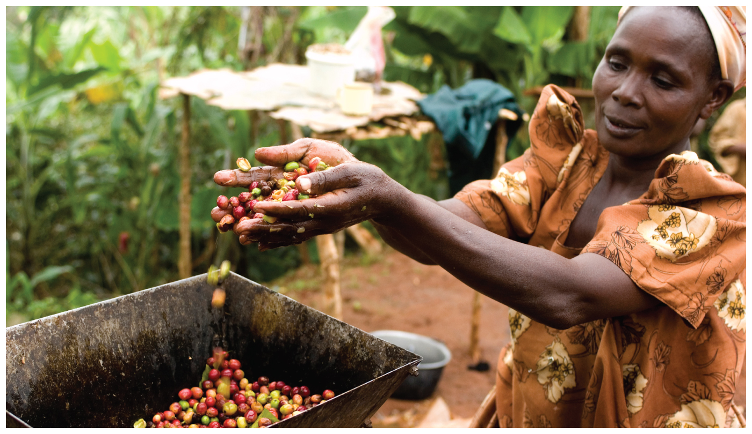
Unit 5 – Agriculture, food, & rural land use
Ch 13: AGRICULTURAL REGIONS

Slide 3
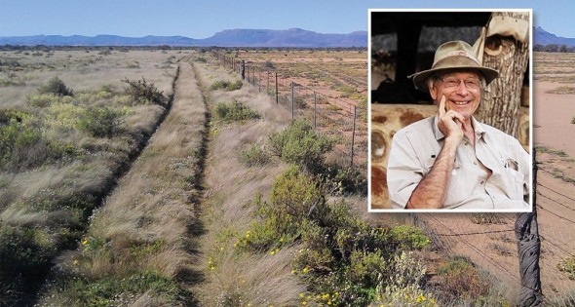
“Without agriculture it is not possible to have a city, stock market, banks, university, church or army. Agriculture is the foundation of civilization and any stable economy.”
-Allan Savory, biologist and farmer, Zimbabwe

Slide 4
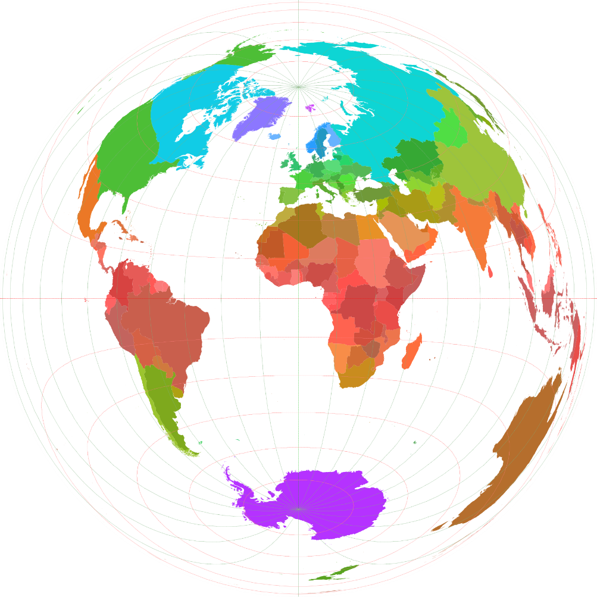
Essential Question
Why does agriculture vary so greatly around the world?

Slide 5
Overview
Two forces that shape agriculture are physical geography and climate.
Climate and landforms determine which crops can be grown and what animals can be raised (example: coffee in low latitudes)
Economics, the workings of supply and demand, influence the competing use of land. Consumer demand influences what farmers will decide to grow.

Slide 6
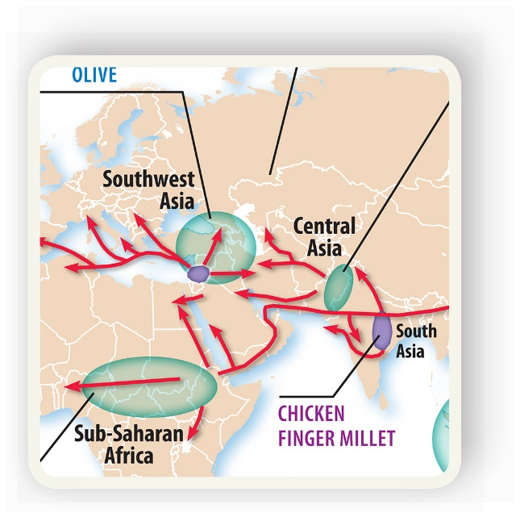
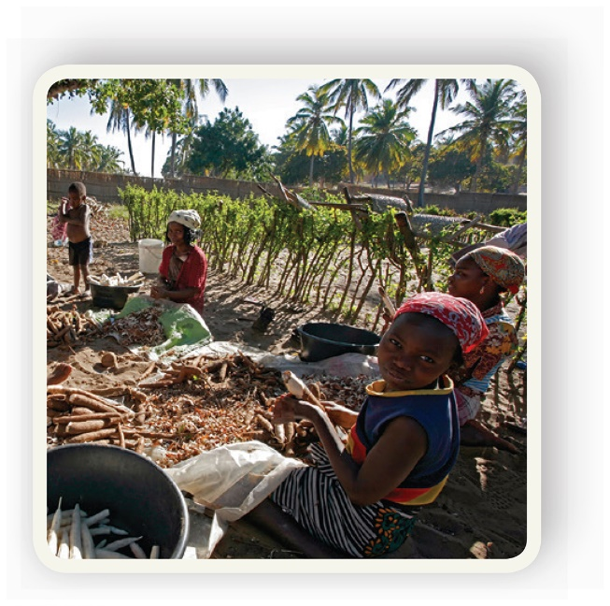
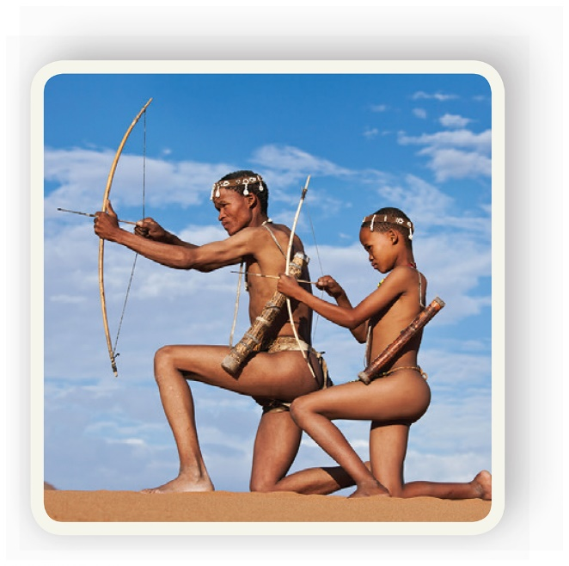
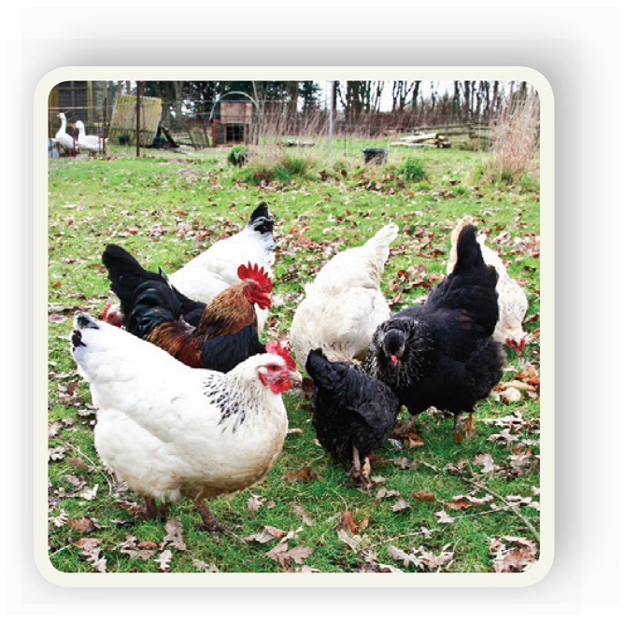
Enduring Understanding (5.B)
By the end of this section, you will understand that major agricultural regions reflect physical geography and economic forces.

Slide 7
Learning objective (5.B.1)
By the end of this section, you will be able to identify agricultural production regions associated with major bioclimatic zones.
Wait, what?!

Slide 8
Understanding the terms
Agricultural production region simply refers to where agriculture is practiced.
A bioclimatic zone is a broad zone of vegetation that corresponds to the average annual temperature at different latitudes and altitudes.

Slide 9
Learning objective (5.B.1)
So let’s try this again…
By the end of this section, you will be able to identify agricultural production regions associated with major bioclimatic zones.
Students will know that:
Plant and animal production is dependent on climatic conditions, including spatial variations in temperature and rainfall.
Some agricultural regions are associated with particular bioclimatic zones (e.g., Mediterranean, shifting agriculture, pastoral nomadism).

Slide 10
Climate and Agriculture (pg. 209)
Climate Conditions and Agricultural Production
Most of the earth’s land surface supports some type of agricultural activity.
Exceptions: high latitudes around the north and south poles and high altitudes like the tops of mountains.
Derwent Whittlesey
In 1936, Whittlesey identified eleven main agricultural regions.

Slide 11
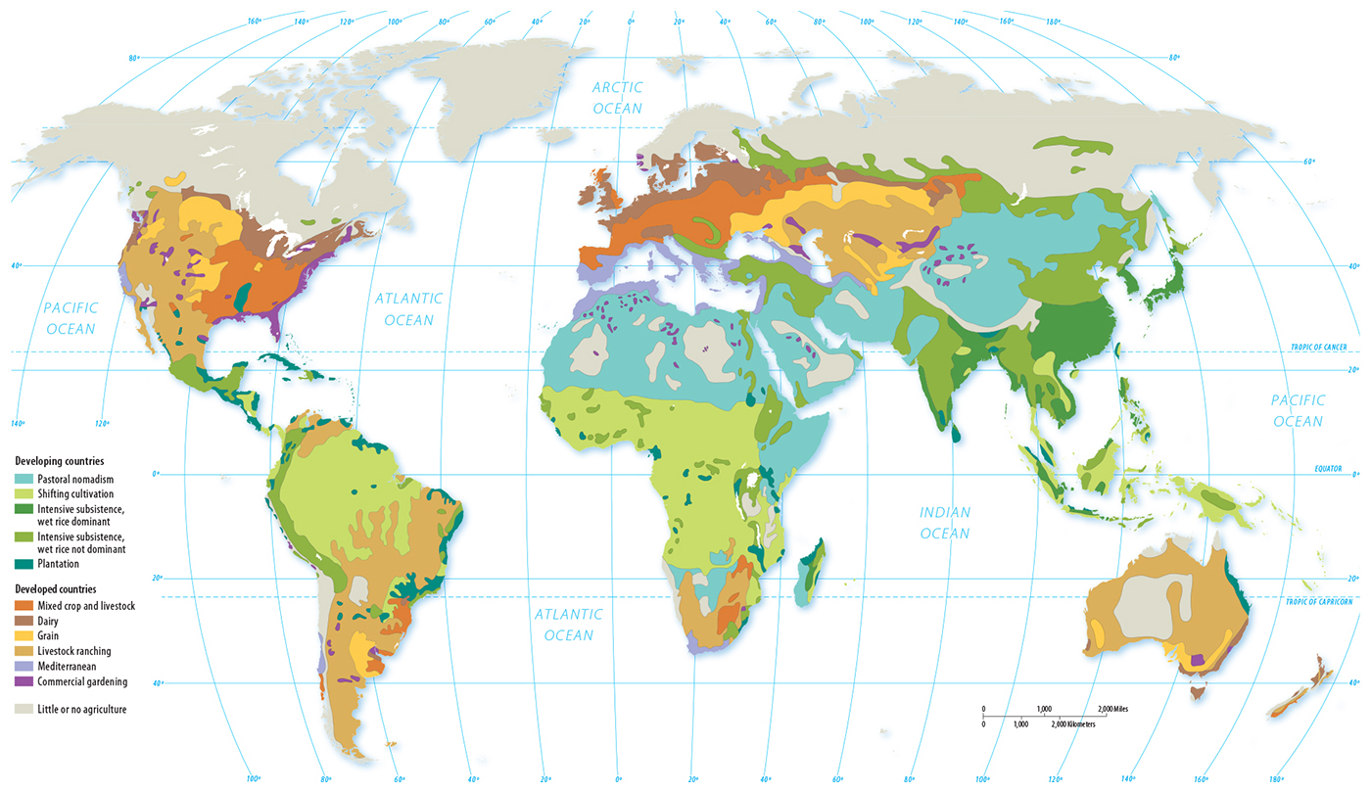

Slide 12
Climate and Agriculture (pg. 209)
Climate Conditions and Agricultural Production
Compare the two maps on the next slide.
Do the agricultural regions match the climate regions more closely in the developed regions of North America and Europe or in the developing regions of Latin America, Africa, and Asia?

Slide 16
Climate and Agriculture
Climate Conditions and Agricultural Production
Climate influences agriculture.
Example: animal herding takes place in drier climates (western U.S., North Africa, Southeast Asia)
However, economics can influence animal herding too.
Pastoral nomadism in the developing world – people travel from place to place with their herds of animals.
Ranching in the developed world – livestock graze over large areas while the owners stay in the same place.

Slide 17
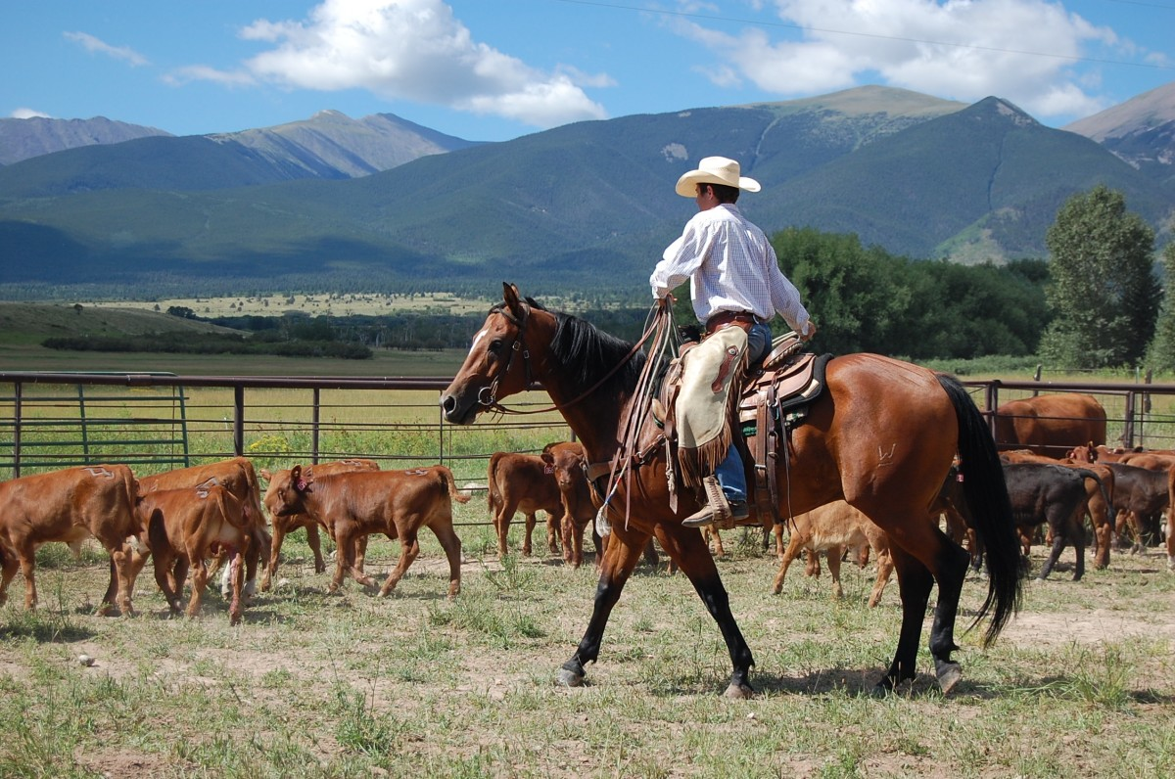

Slide 18
Climate and Agriculture
Climate Conditions and Agricultural Production
Technology can overcome climate.
Example: Iceland and Greenland are cold but farmers can grow crops in greenhouses.
Example: tomatoes, once grown mostly in Florida and California, are now grown in Canadian indoor facilities.
Culture can shape economic activity.
Example: consider food – southwest Asia is good for raising hogs but the region is mostly Muslims and Jews who object to eating hogs.

Slide 19
Climate and Agriculture
Agricultural Regions Associated with Bioclimatic Zones
Crops and livestock thrive best in specific bioclimates.
Pastoral nomadism
Shifting cultivation
Plantation agriculture
Mixed crop/livestock farming
Grain farming
Commercial gardening (truck farming)
Dairy farming
Mediterranean agriculture
Livestock ranching

Slide 20
Climate and Agriculture
Pastoral Nomadism
A form of subsistence agriculture practiced in the developing world
Arid and semi-arid climates
Nomadism: a way of life of peoples who do not live continually in the same place but move cyclically or periodically.
Rely on animals – cattle, camels, reindeer, goats, yaks, sheep, and horses provide meat, milk for food, and hides for clothing and shelter.
Nomads travel and trade meat for crops with other subsistence farmers.
Regional animals: south central Asia and east Africa (cattle adapt to hot climate); deserts of the Middle East (camels survive without water); northern Siberia (reindeer thrive in cold weather)

Slide 21
Climate and Agriculture
Shifting Cultivation
Subsistence agriculture where farmers in tropical climate regions move from one field to another.
Also called slash and burn or swidden agriculture
Clear the land with fire (enriches nutrient-poor soil by adding nitrogen to it), plant and harvest crops, and when the soil is less fertile, they move to another location and repeat the process.
Rice in SE Asia
Maize (corn) in South America
Millet and sorghum in sub-Sahara Africa
One field, usually communal, is used for a variety of crops.

Slide 22
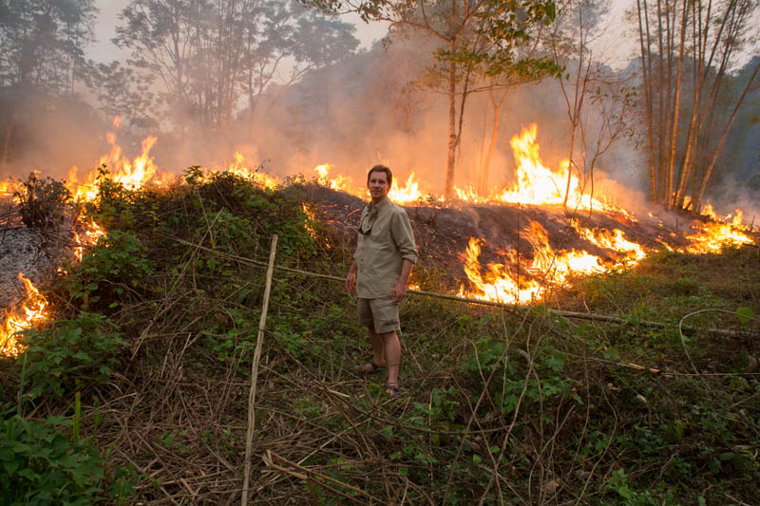

Slide 23
Climate and Agriculture
Plantation Farming
Biproduct of colonialism
Large commercial farm that specializes in one crop
Usually in low latitudes (the tropics) in hot, humid climates with a lot of rain.
Labor intensive and often exploit cheap labor in nearby villages
Processing may occur near plantation to reduce transportation costs.
Crops include coffee, cocoa, rubber, sugarcane, bananas, tobacco, tea, coconuts, and cotton.

Slide 24
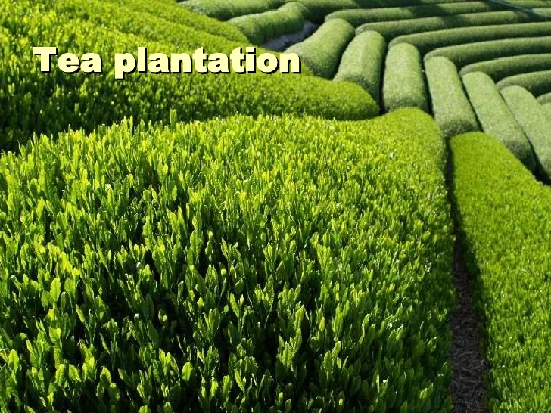

Slide 25
Climate and Agriculture
Mixed Crop/Livestock Farming
An integrated system common in developed regions, such as the Midwestern United States, northern Europe, and Canada but has diffused to the developing world.
Majority of crops raised are fed to livestock fattened for eventual slaughter or fed to dairy cows.
Animal manure is used as fertilizer.
Owners of land and animals may be different but there is a strong interrelationship between the two.
Most common in the United States: soybeans and corn

Slide 26
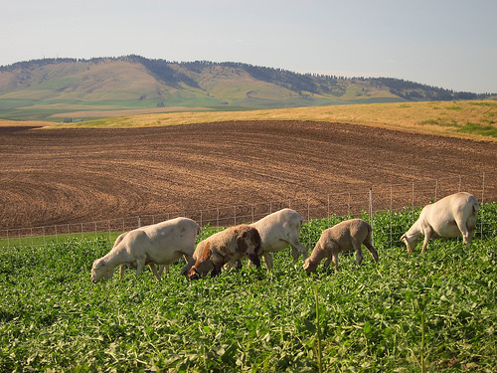

Slide 27
Climate and Agriculture
Grain Farming
Regions too dry for mixed crop, farmers often raise wheat
Prairies and plains
Top producers: China, India, Russia, and the United States
Type of wheat reflects climate
Spring wheat – planted in early spring and harvested in the fall; cold regions like North Dakota, South Dakota, Montana, and parts of Canada
Winter wheat – planted in the fall and harvested in early summer; warmer regions like Kansas, Oklahoma, and Colorado

Slide 28
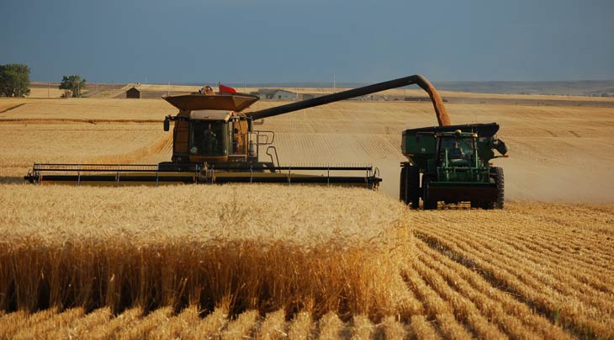

Slide 29
Climate and Agriculture
Commercial Gardening
In the United States, commercial gardening and fruit farming is known as market gardening and is found mostly in California and the Southeast (long growing seasons)
Also called truck farming as products were traditionally driven to urban markets to sell.
Today, most products are sold to companies for canning or freezing.
Most common in United States: lettuce, broccoli, apples, oranges, and tomatoes.

Slide 30
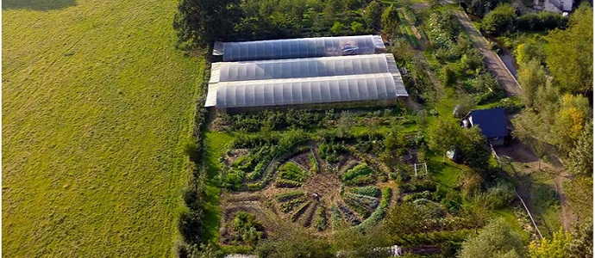

Slide 31
Climate and Agriculture
Dairy Farming
Traditionally, dairies and creameries were local and supplied to customers in small geographic areas; currently in LDCs.
Late 1900s, improvements in refrigeration and transportation expanded the milk shed, geographic distance that milk is delivered.
Large corporate dairy operations replaced smaller family-owned farms (decreased farms but increased milk production).
Most commercial dairy farms are in the US, Canada, Europe, and other highly developed countries near urban centers and transportation corridors.
Some countries (Argentina, Brazil) saw an increase in a demand without an increase in consolidation, leading to more dairy farms.

Slide 32
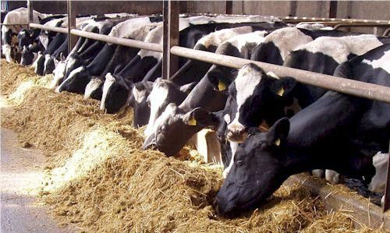
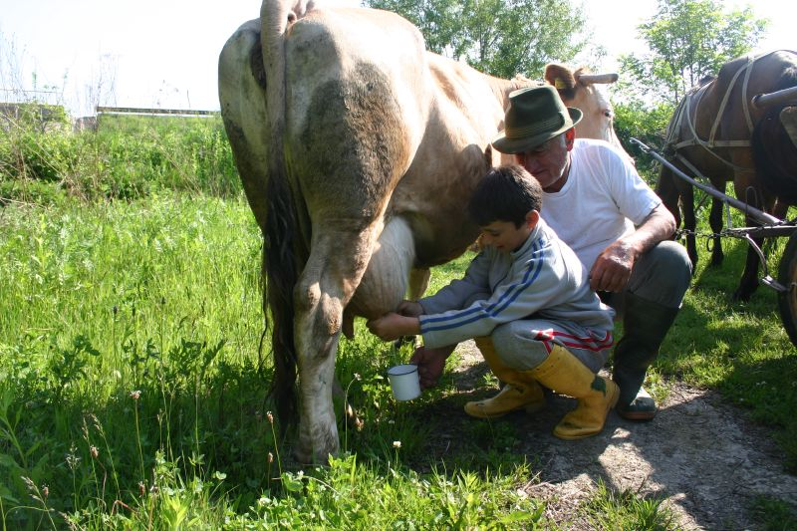
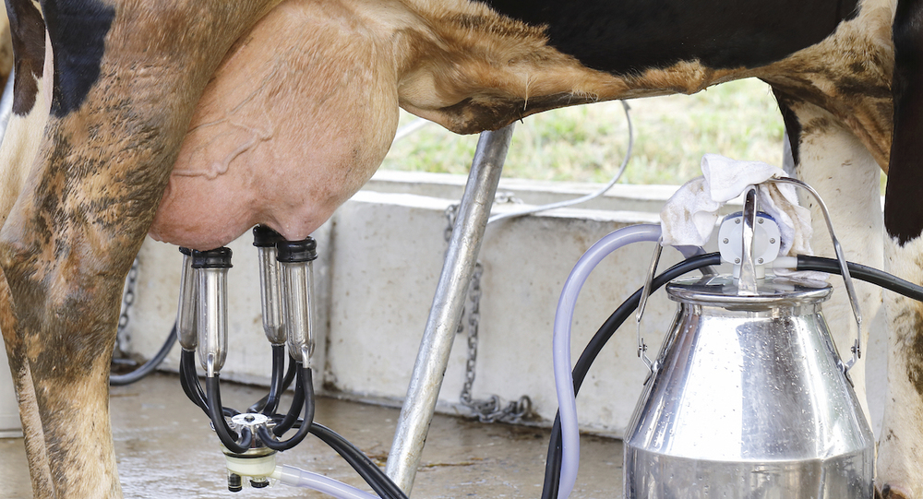

Slide 33
Climate and Agriculture
Mediterranean Agriculture
Regions with hot-dry summers, mild winters, narrow valleys, and often some type of irrigation system.
Examples: southern Europe, northern Africa, southwestern Africa, southwestern Asia, southwestern Australia, California, and central Chile.
Crops: figs, dates, olives, and grapes
Herders practice transhumance, seasonal herded of animals from higher elevations in the summer to lower elevations in the winter.
Principal livestock: goats and sheep (due to rugged terrain)

Slide 34
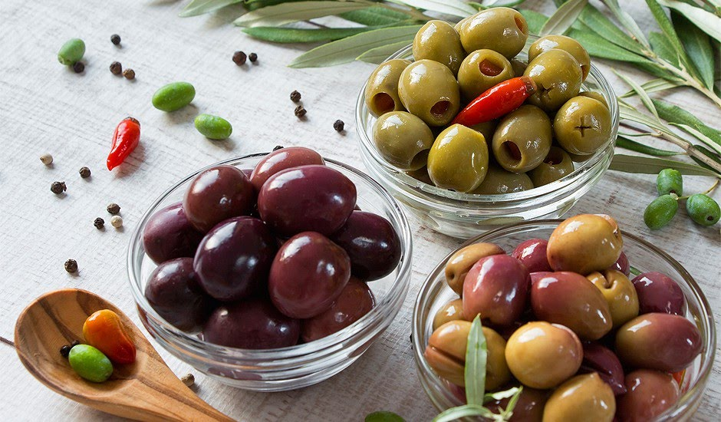
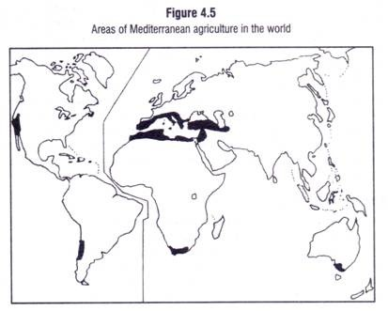

Slide 35
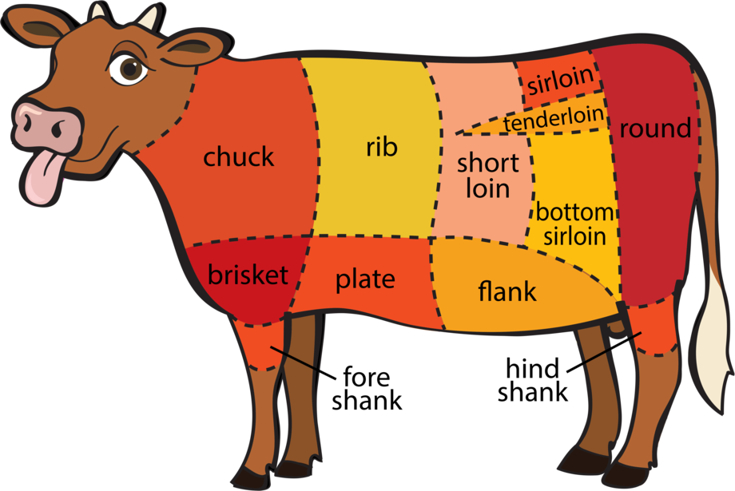
Climate and Agriculture
Livestock Ranching
Commercial grazing of animals confined to a specific area.
Regions that are too dry for growing crops in large quantities
Prevalent in the western United States, pampas of Argentina, southern Brazil, Uruguay, parts of Spain and Portugal, China, and central Australia.

