Slide 1
By: Carli Terrell (Orlando, Florida)
This PPT has been created using the information from the AMSCO Human Geography: Preparing for the Advanced Placement Examination book. Please do not delete this and give credit where credit is due.

Slide 2
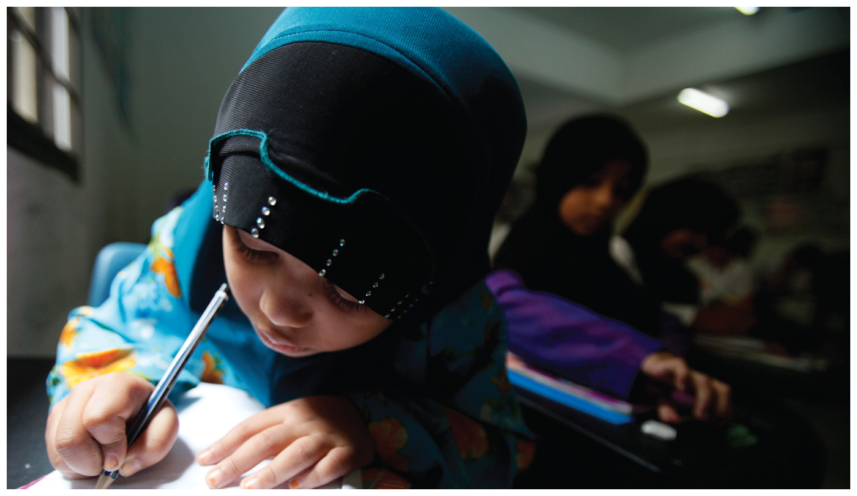
Unit 3 – Cultural patterns and processes
Part 3: Religious and ethnic landscapes
Notes:
http://www.pbs.org/thelinguists/For-Educators/Video-Extras.html

Slide 3
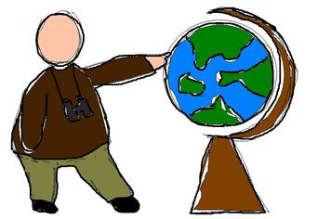
Enduring Understanding (3.B)
By the end of this section, you will understand that culture varies by place and region.

Slide 4
Cultural values are, in themselves, neutral as well as universal, and so much depends on how individuals or ethnic groups use them. Values are influenced by so many factors such as geography, climate, religion, the economy, and technology.
F. Sionil Jose, Filipino novelist

Slide 5
Essential Question
Essential Question
How do religious and ethnic groups both reflect and influence the geography of places at different scales?

Slide 6
Learning Objective (3.B.1.A)
By the end of this section, you will be able to explain cultural patterns and landscapes as they vary by place and region.
Regional patterns of language, religion, and ethnicity contribute to a sense of place, enhance place making, and shape the global cultural landscape.

Slide 7
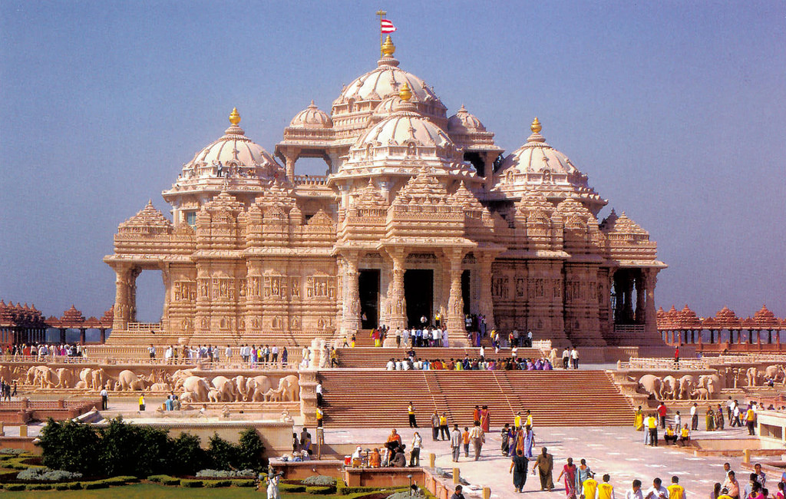
Cultural landscape
Remember, the cultural landscape refers to the earth’s surface as modified by human action. Naturally occurring phenomena (forests, shorelines, wetlands, mountains) are not included.

Slide 8
Religious and Ethnic Landscapes
Compared to other aspects of culture, religion is relatively resistant to decay over time and distance.
Example: descendants of immigrants may adopt a new language but continue to practice the faith of their ancestors.
Your goal is to develop strong mental maps of the origins, diffusion, and distribution of major religions and their divisions.

Slide 9
Religion, Ethnicity, and Nationality
Ethnicity refers to a group of people who share characteristics such as ancestry, language, customs, history, and common experiences; based up group cultural traits.
Nationality describes people’s connection to a particular country.
Example: Russian Jews make up a different ethnicity than Russians in general. Their nationality may be the same but they have different cultural traits (religion).

Slide 10
Spatial dimensions of religious/ethnic groups
To analyze religious and ethnic groups
Define
Locate
Study
Religion and ethnicity are easier to define than is the process of examining each group’s space, place, identity, and movement.
Geographers map cultural hearth and track movement

Slide 11
Cultural variation by place and region
Patterns and landscapes vary by place and region at various scales.
Regional level: Baptists are the most common religious group in the southeastern U.S.
State level: Same is true for most states, including South Carolina.
County level: counties of South Carolina have more Methodists or Lutherans than any other group.

Slide 12
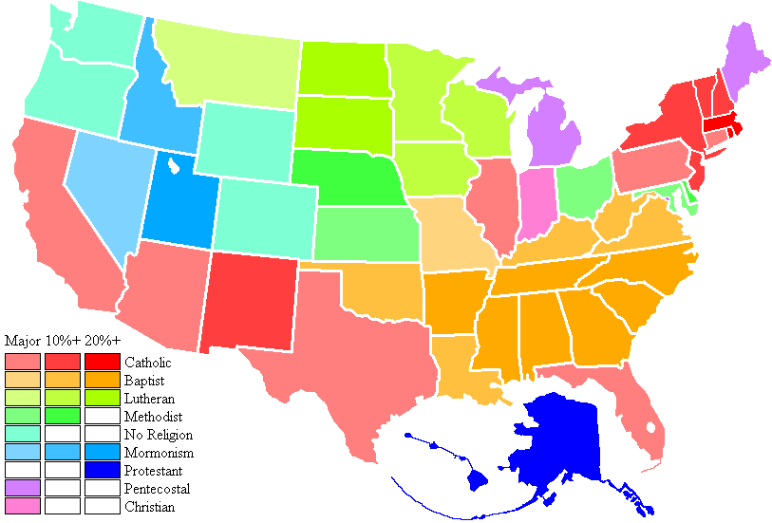
Cultural variation by place and region
Southeastern U.S. is predominately Baptist

Slide 13
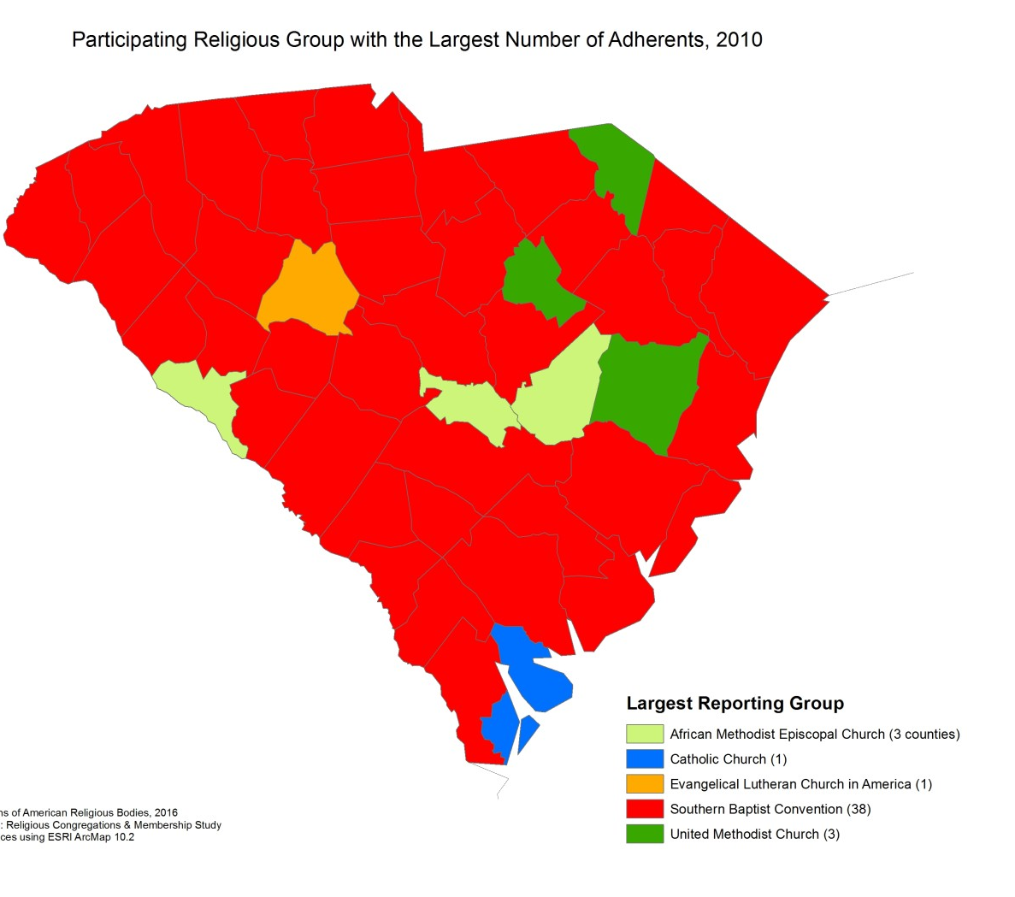
Cultural variation by place and region
Some South Carolina counties report having more Lutherans, Catholics, or Methodists

Slide 14
Cultural variation by place and region
Degree of adherence
Fundamentalism – an attempt to follow a literal interpretation of a religious faith; believe that people should live traditional lifestyles similar to those prescribed in the faith’s holy writings.
Examples: girls leave school at a young age, live in an arranged marriage, and avoid working outside the home; often enforce strict standards of dress and personal behavior

Slide 15
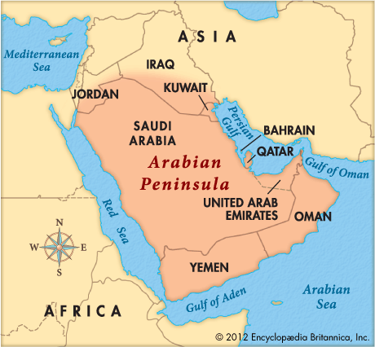
Cultural variation by place and region
Strength of Fundamentalism
Often diminishes with greater distance from the religious hearth.
Example: the hearth of Islam is the Arabian Peninsula, where fundamentalism has long been strongest but is less prevalent in Muslim-majority countries farther from the hearth, like Malaysia and Indonesia.

Slide 16
Cultural variation by place and region
Role of Sharia
Sharia is the Islamic framework for a country and is strongest in countries of the Arabian Peninsula, such as Saudi Arabia and Yemen.
Theocracies
Countries whose governments are run by religious leaders through the use of religious laws (examples: Iran, Afghanistan, Mauritania, Saudi Arabia, Sudan, Yemen, and Vatican City)
Theos – Greek for God
Kratia – Greek for power, rule
Notes:
http://www.worldatlas.com/articles/countries-with-theocratic-governments-today.html

Slide 17
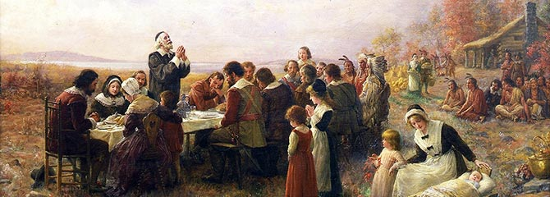
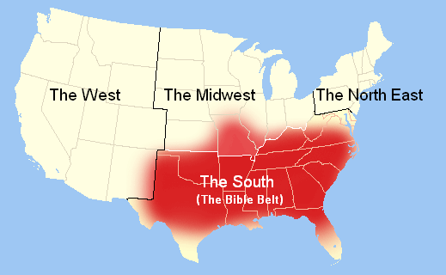
Regional Patterns in U.S. Religion
Congregationalists
New England – English settled in the 1600s
Baptists and Methodists
Southeast – traveling preachers in the 1800s
Lutherans
Midwest – German or Scandinavian settlers in late 1800s found land

Slide 18
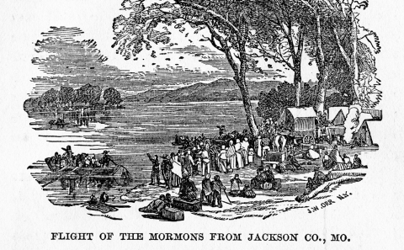
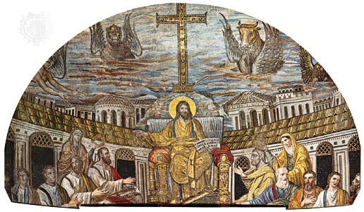
Regional Patterns in U.S. Religion
Mormons
Utah – settled after religious persecution drove them out of Missouri and Illinois
Roman Catholics
Southwest and Urban Northeast

Slide 19
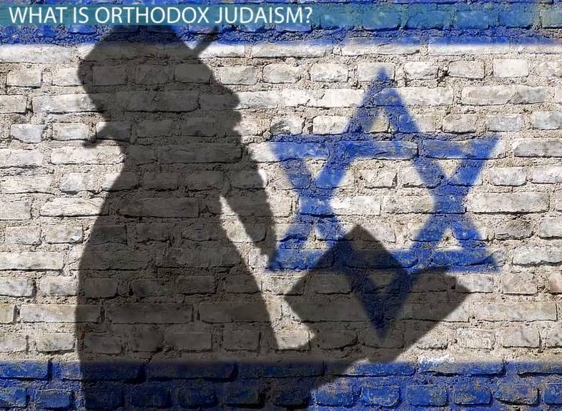
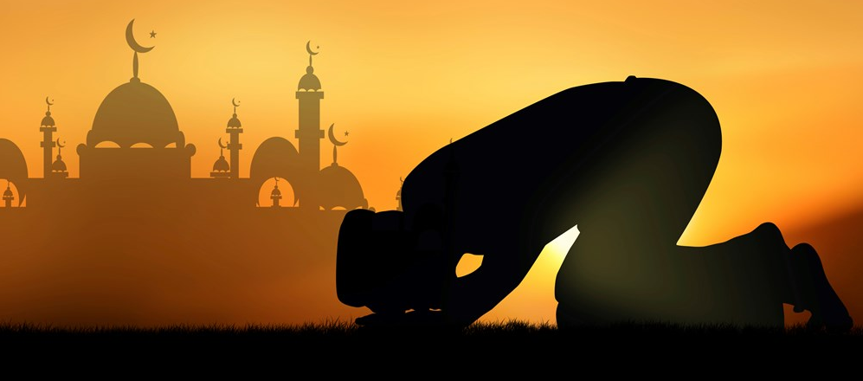
Regional Patterns in U.S. Religion
Jews, Muslims, and Hindus
Mostly urban areas – the traditional home to immigrants

Slide 20
Learning objective (3.B.1.c)
By the end of this section, you will be able to explain cultural patterns and landscapes as they vary by place and region
Religious patterns and distributions can be represented on maps and charts.
Notes:
2006 MC – 36, 38, 59

Slide 21
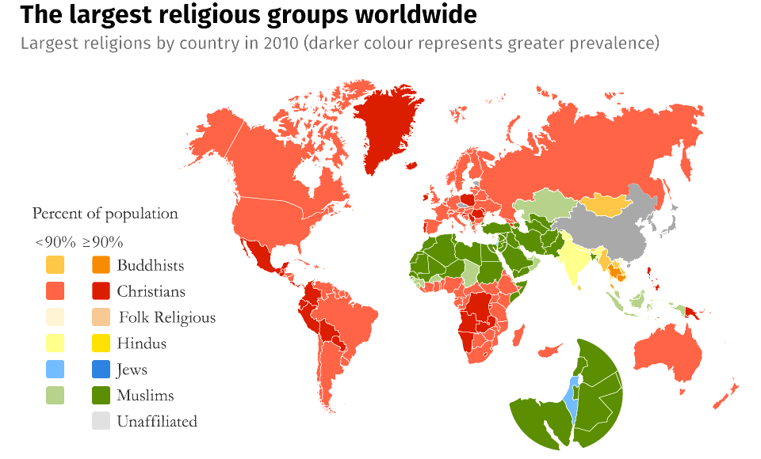
Globalization and religion
Religious Patterns and Distributions
Religions diffuse outward from their hearths and contribute to the sense of place and of belonging, greatly shaping the cultural landscape.

Slide 22
Learning objective (3.B.3)
By the end of this section, you will be able to compare and contrast ethnic and universalizing religions and their geographic patterns.
Ethnic religions (Hinduism and Judaism) are generally found near the hearth or spread through relocation diffusion.
Universalizing religions (Christianity, Islam, and Buddhism) are spread through expansion and relocation diffusion.
Notes:
2006 MC – 36, 38, 59

Slide 23
Ethnic vs. Universalizing religions
Types of Religion
Ethnic religions appeal primarily to one group of people living in one place and emphasize strong cultural characteristics among their followers.
Members are born or adopted in and share historical experience or struggle that creates strong bonds.
Rarely recruit new followers but spread through relocation
Examples: The Jewish Diaspora and global migration of Hindus from India
Notes:
Define diaspora: the settling of scattered colonies of Jews outside ancient Palestine after the Babylonian exile.

Slide 24
Ethnic vs. Universalizing religions
Types of Religion
Universalizing religions actively seek converts to its faith regardless of their ethnic backgrounds.
Spread far from their original hearths because existing members spread their beliefs to others (missionaries perform charitable work and convert nonbelievers)
Christianity and Islam are the two biggest.

Slide 25
Two Major Eastern Religions
Hinduism (ethnic)
Hearth: India
Polytheistic: includes the worship of many deities (gods or idols)
Polu: Greek for many
Theos: Greek for god
However, Hindus consider all deities as manifestations of one god, so they consider Hinduism to be monotheistic (one god)

Slide 26
Two Major Eastern Religions
Hinduism
Beliefs
Karma, the idea that behaviors have consequences in present life or a future life.
Dharma: righteous path
History
For part of its history, Hinduism worked closely with the caste system, a rigid class structure

Slide 27
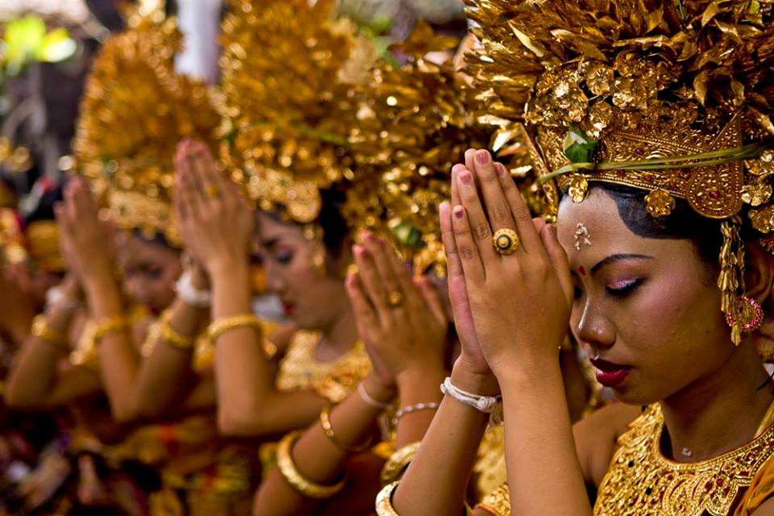
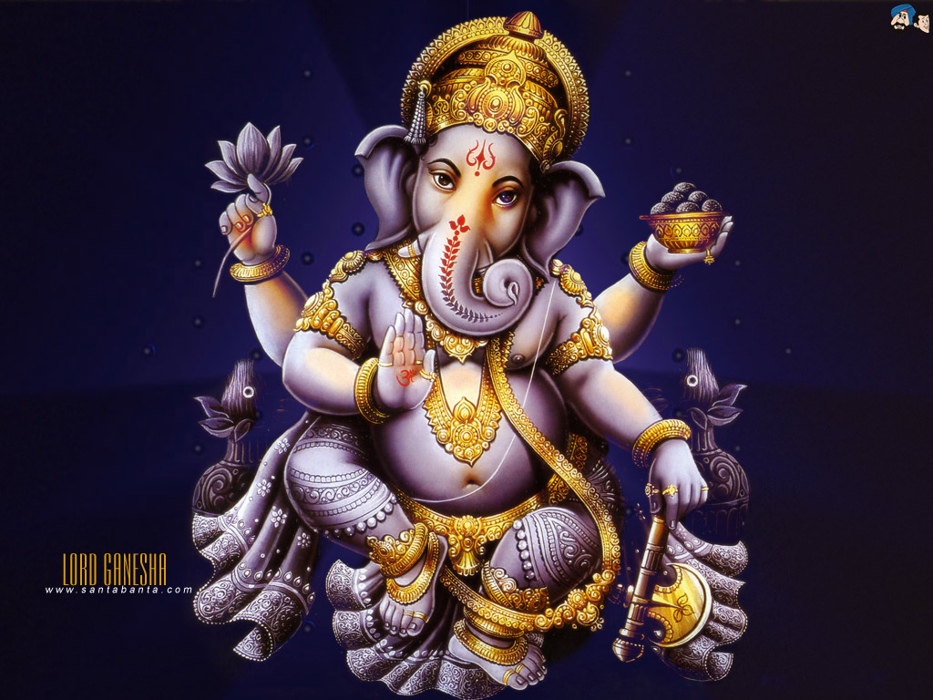
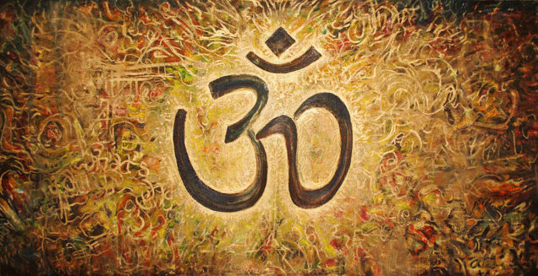

Slide 28
Two Major Eastern Religions
Buddhism (universalizing)
Hearth: India
Grew out of teachings of a prince named Siddhartha (600 B.C.E.)
Siddhartha accepted many Hindu beliefs and became known as the Buddha (“enlightened one”)
He advised followers to escape the cycle of suffering through “right” views, hopes, speech, conduct, livelihood, effort, and mindful meditation.

Slide 29
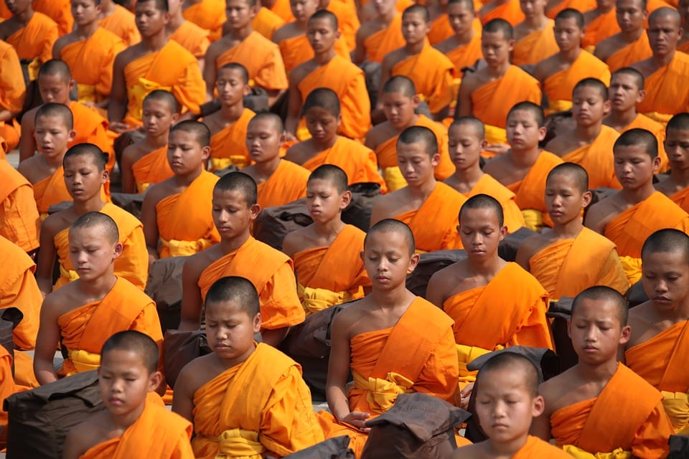
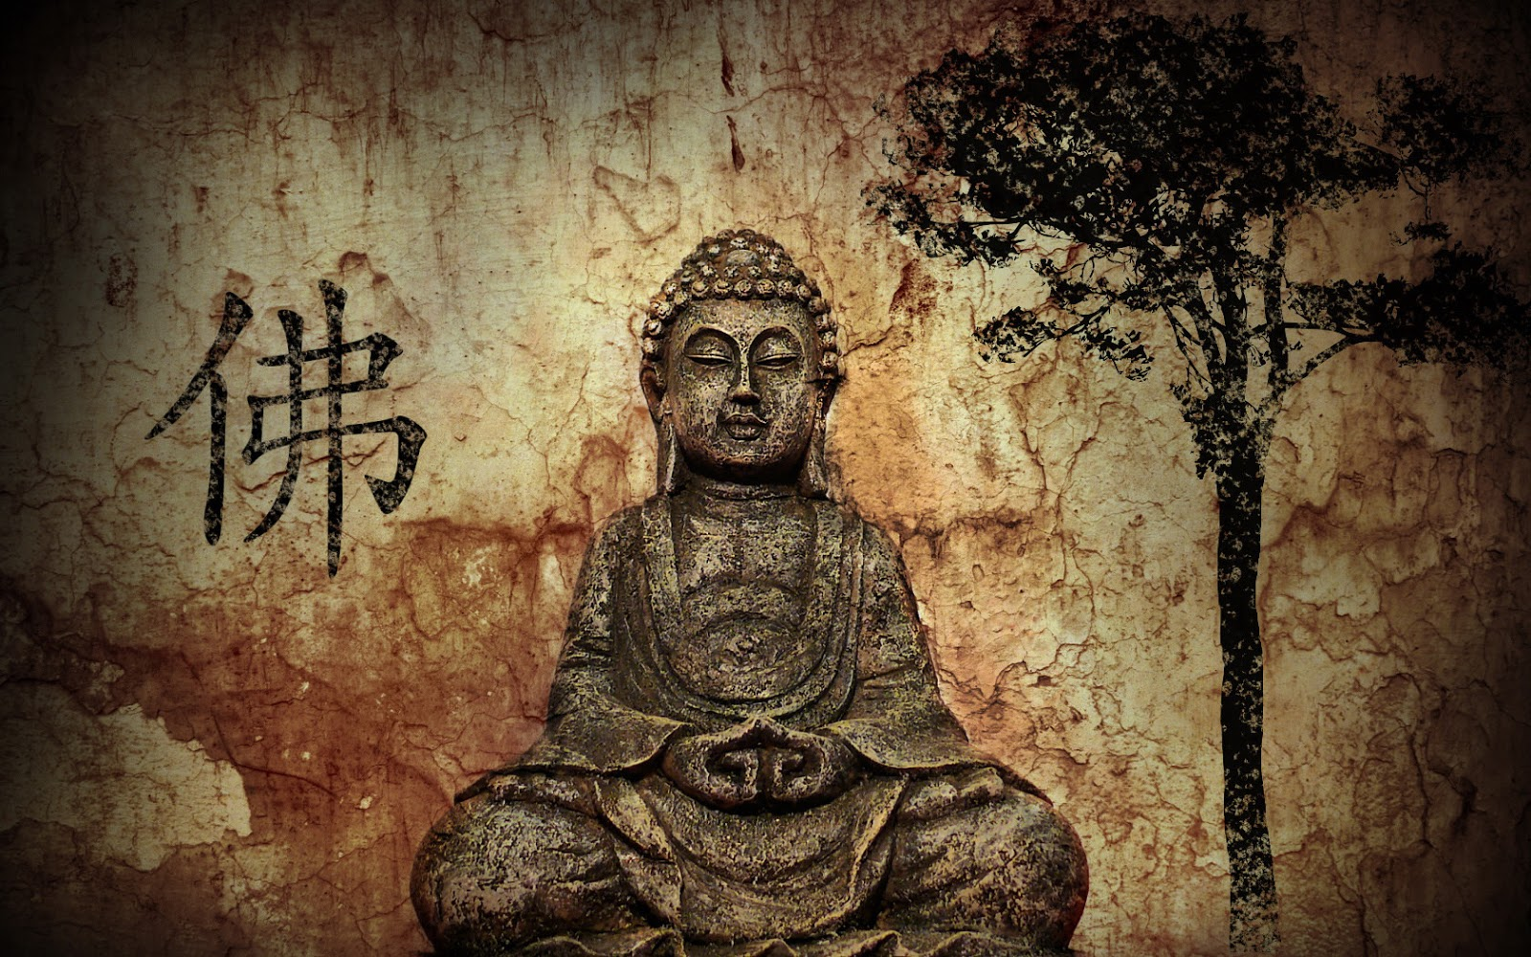
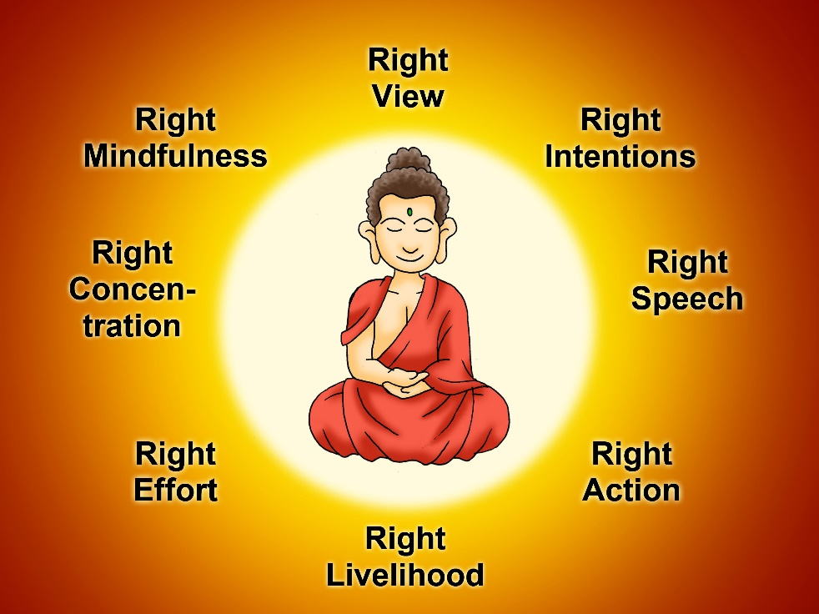

Slide 30
Three Major Middle Eastern Religions
Judaism (ethnic)
Trace history back to Abraham – religious leader who lived in the Middle East around 1800 B.C.E.
Monotheistic (one god)
Holy book: Torah – expresses divine will
Supplemented by other writings and other unwritten laws

Slide 31
Three Major Middle Eastern Religions
Judaism (ethnic)
History
Past 2000 years – most lived in Europe and North Africa and, as a small minority, were often persecuted
Late 1800s, attempted to establish a homeland in the Middle East and migrated to the United States
WWII: the Holocaust strengthened the movement to create a predominantly Jewish state in the Middle East.
1948: Israel was formed and Jews around the world migrated

Slide 32
Natalie Portman was born in Israel. Her birth name is Neta Lee Herschlag.
Adam Sandler
Mila Kunis comes from a Russian-Jewish family, who left Russia due to antisemitism.
Ivanka Trump
(converted)
Believe it or not, Drake is in fact Jewish! His mom is 100% Jewish.

Slide 33
Three Major Middle Eastern Religions
Christianity (universalizing)
Began when followers of a Jewish teacher, Jesus, evolved into their own religion based on the belief that Jesus was the son of God and the savior of humans.
Emphasized faith, love, and peace.
Found mostly in Europe in the 15th century and added millions of followers (sometimes violently) when Christian missionaries accompanied the European explorers and conquerors to the Western Hemisphere, southern Africa, and Australia.

Slide 34
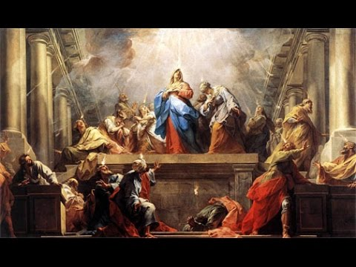
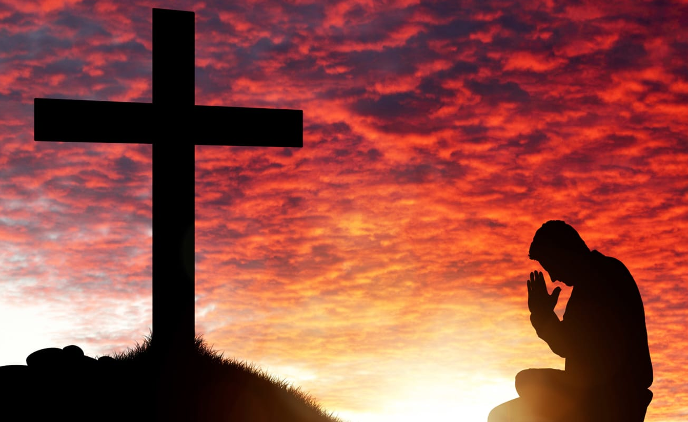
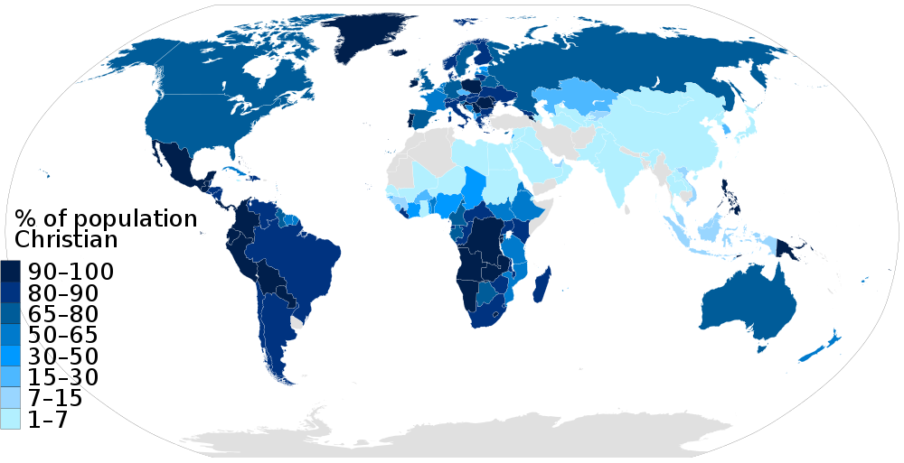

Slide 35
Three Major Middle Eastern Religions
Islam (universalizing)
Religion followed by Muslims
Believe that Allah (Arabic for God) revealed his teaching through prophets
Muhammad lived in now Saudi Arabia (6th and 7th centuries C.E.)
Holy book: Koran (or Quran)
Spread like Christianity – through the Middle East, North Africa, and Asia

Slide 36
Religious diffusion and hearths
Hinduism
Hearth: along Indus River in present-day Pakistan
Diffusion: contagious (across Indian subcontinent) and relocation (in recent decades to Europe and the United States)
Buddhism
Hearth: South Asia in present-day Nepal
Diffusion: contagious (as teachings spread throughout East and Southeast Asia) and relocation (throughout the world)

Slide 37
Religious diffusion and hearths
Judaism
Hearth: Eastern Mediterranean and southwestern Asia
Diffusion: relocation (throughout North Africa and Europe forced by the Romance around 70 CE) and relocation to the US and other countries
Christianity
Hearth: Eastern Mediterranean and southwestern Asia
Diffusion: contagious (through the Middle East, Europe, and Central Asia), hierarchical through conversion of rulers, who then forced their followers to adopt the faith, and relocation (throughout the world)

Slide 38
Religious diffusion and hearths
Islam
Hearth: Southwest Asia
Diffusion: contagious (trade and conquest to Spain, Africa, and much of Asia) and relocation (throughout the world)

Slide 39
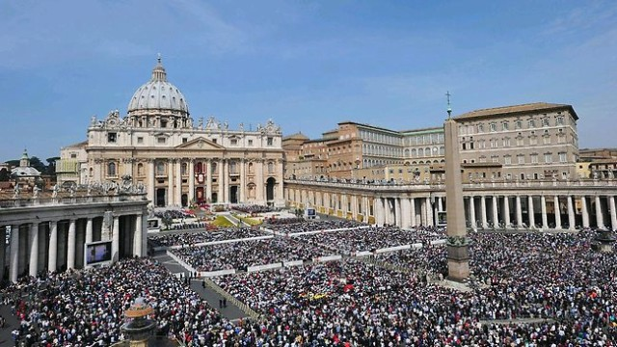
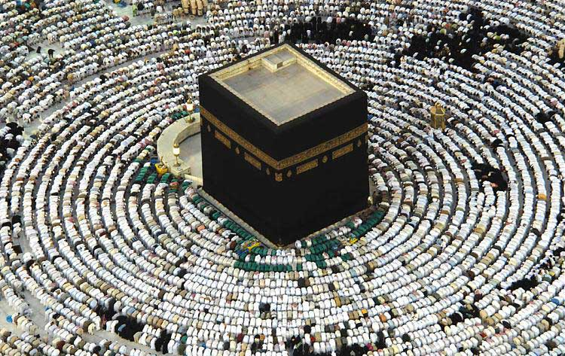
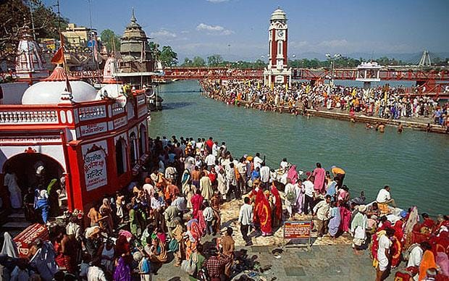
Religious diffusion and hearths
Pilgrimage
A religious journey taken by a person to a sacred place of his or her religion.
Hindus: Ganges River
Muslims: Mecca (the hajj)
Christians: Rome

Slide 40
Learning objective (3.B.2.C)
By the end of this section, you will be able to explain the diffusion of culture and cultural traits through time and space.
Colonialism, imperialism, and trade helped to shape patterns and practices of culture (e.g., language, religion)

Slide 41
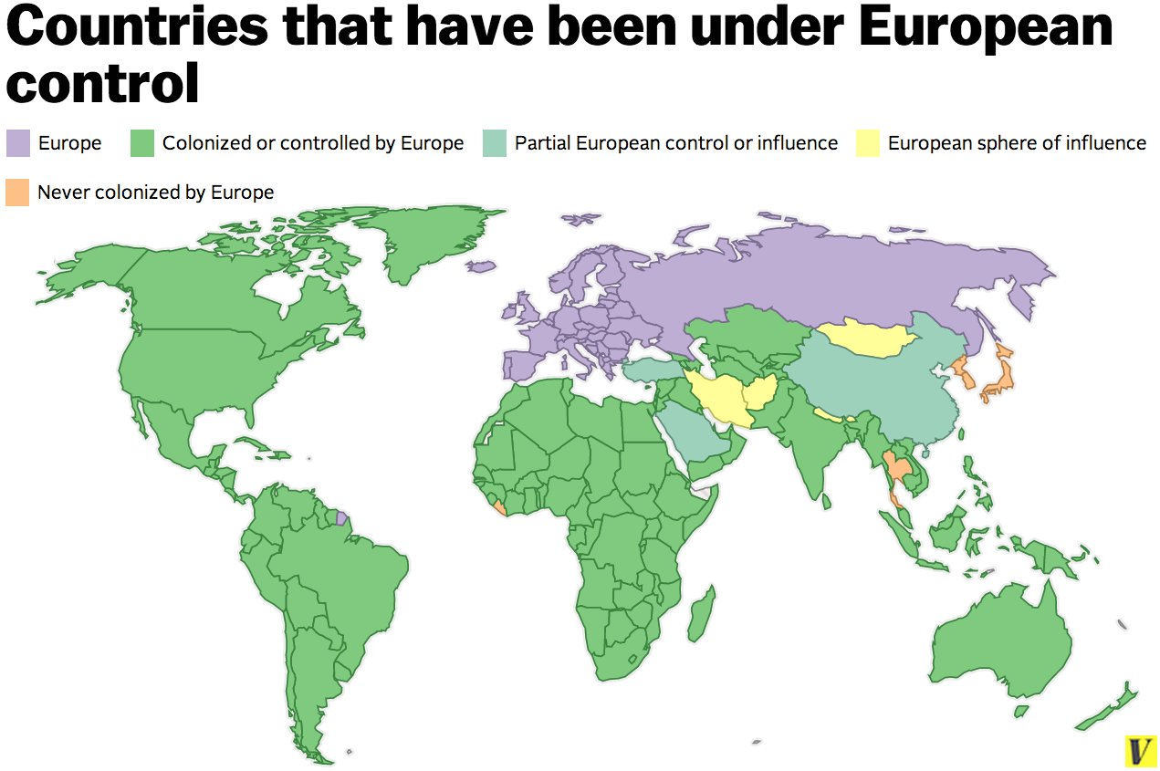
Influences (colonialism, imperialism, trade)
Colonialism, imperialism, and trade have played a powerful role in spreading religion and culture.
European colonialism
1500s-1800s: Europeans colonized the Americas and South Asia.
1800s-mid-1900s: European powers colonized most of Africa and Southwest Asia.

Slide 42
Influences (colonialism, imperialism, trade)
Imposed cultural traits
Example: Religions of the native people of Africa and North America were forms of animism (belief that non-living objects have a spirit), but were forced to convert to Christianity.
Example: the Spanish and French spread Roman Catholicism throughout Latin America, North America, and Quebec.
Example: the English, Belgians, and Dutch spread forms of Protestantism in their colonies.

Slide 43
Influences (colonialism, imperialism, trade)
Imposed cultural traits
Although few formal colonies remain in the world today, the practices left behind by European powers are present in their former colonies.
Example: the afternoon break for tea, a British tradition, is still practiced in Kenya and India.

Slide 44
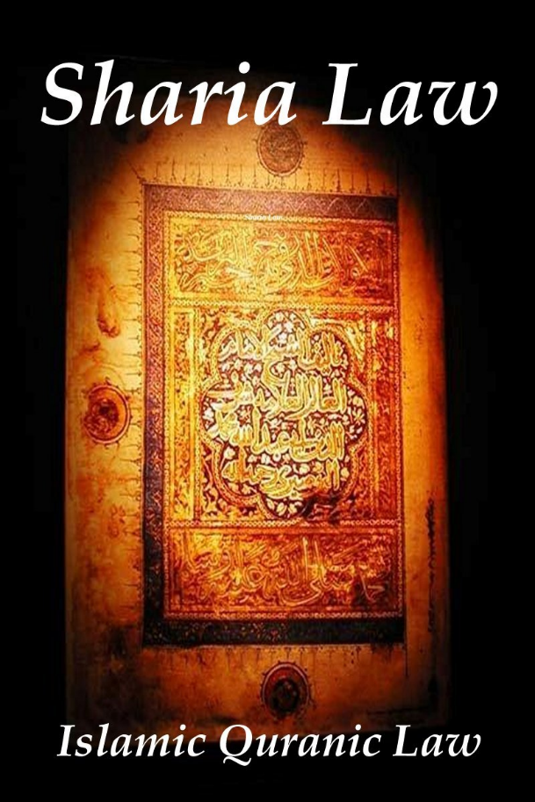
Religion’s impact on laws and customs
Religion predates government and, therefore, is often the source for many present-day laws and punishments.
Some religions have strict laws that have been adopted fully by some governments.
Example: Sharia, or Islamic law, is based entirely on the teachings of Islam and has been adopted by some fundamentalist religious groups, such as the Taliban in Afghanistan, as the law of the land.

Slide 45
Religion’s impact on laws and customs
No highly industrialized countries have fully adopted religious laws but their legal codes often show influence of religion.
United States: blue laws (laws that restrict certain activities, such as the sale of alcohol on Sundays).
Colorado (and some other states): all car dealerships must be closed on Sundays.

Slide 46
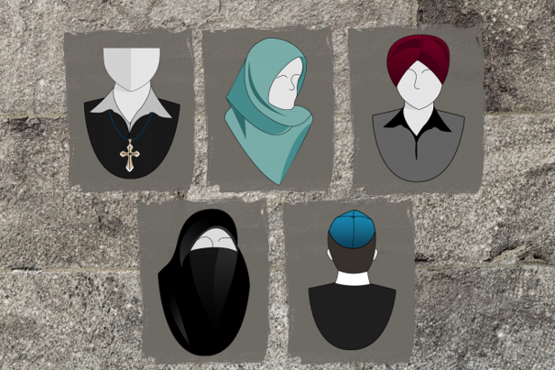
Religion’s impact on laws and customs
In most countries, religious beliefs are more influential as guides to personal behavior.
Example: what clothes to wear; how to cut your hair; when to pray; when to gather; holy days.
Food taboos
Hindus do not eat beef
Jews and Muslims do not eat pork

Slide 47
Religion and the landscape
Religion influences how people think about natural features and what people build
Physical landscape
Sacred spaces where deities dwell: followers of Shinto view certain mountains and rocks as the homes of spirits
Other spaces are not sacred but important for what occurred at them: Mt. Sinai is honored by Jews, Christians, and Muslims because they believe it is where God handed the Ten Commandments to Moses
Some entire cities are sacred: Jerusalem (Israel), Mecca (Saudi Arabia), and Lhasa (Tibet)

Slide 48
Religion and the landscape
Cultural landscape
Sacred physical features are important, but rare. More commonly, beliefs are express through the cultural landscape.
Memorial spaces to the dead are traditionally close to worship spaces
Restaurants and food markets often cater to particular religious groups by offering religiously approved food.
Signs often are written in the language and sometimes the alphabet that reflects the ethnic heritage of the group.

Slide 49
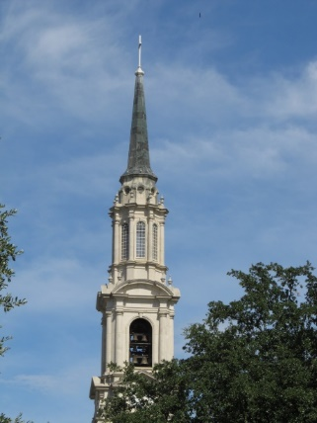
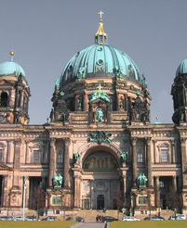
Religion and the landscape
Architecture - Christianity
Churches often feature a tall steeple topped by a cross
They also reflect original architecture style based on environment and available materials.
Eastern Mediterranean churches have dome-shaped roofs (Roman)
Northern Europe churches have steep-pitched roofs (snowfall)
Christians usually bury the dead in cemeteries but they vary greatly. Most are underground, but in New Orleans, where the water table is very high, they are above ground.

Slide 50
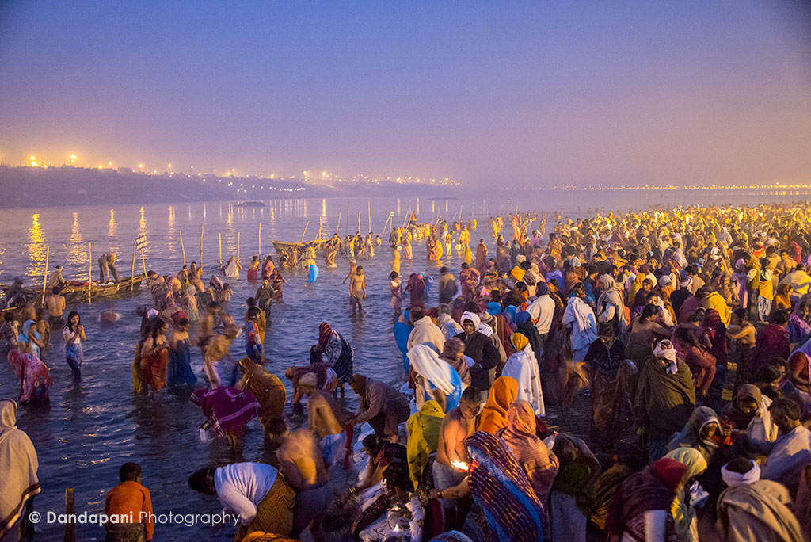
Religion and the landscape
Architecture - Hinduism
Temples often have elaborately carved exteriors and thousands of shrines and temples dot the landscape of India.
Ganges River (sacred) provide pilgrims a place to bathe for the purpose of purification.
Hindus practice cremation and the ashes are often spread in the Ganges River (raised concerns about pollution)

Slide 51
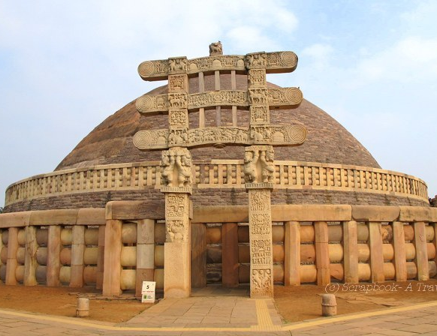
Religion and the landscape
Architecture - Buddhism
Differs widely from place to place, from ethnic group to ethnic group.
Most Buddhists emphasize meditating and living in harmony with nature.
Represented in stupas, structures built to symbolize five aspects of nature – earth, water, fire, air, and space – where people can meditate.
Burial of the dead is a personal choice.

Slide 52
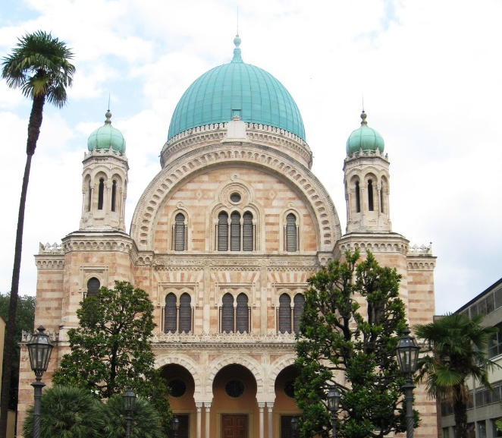
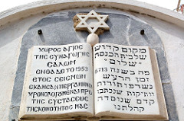
Religion and the landscape
Architecture - Judaism
Worship in synagogues or temples
Once concentrated in the Middle East, Jews spread throughout the world because of exile or persecution, or through voluntary migration
Scattering is called Diaspora
Temples vary in size based on population and burial of the dead occurs before sundown on the day following the death.

Slide 53
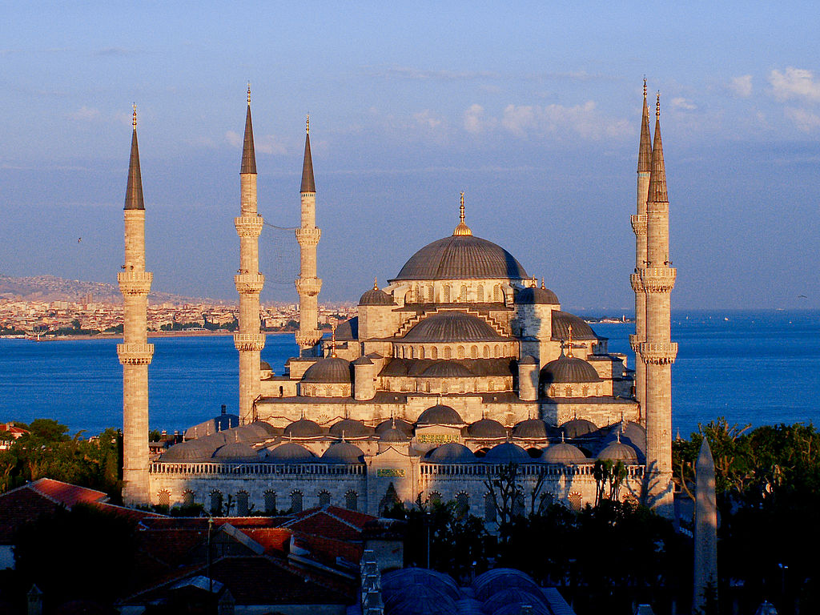
Religion and the landscape
Architecture - Islam
In places where Islam is widely practiced, the mosque is the most prominent structure on the landscape is usually located in the center of the town.
Mosques have domes surrounded by a few minarets (Arabic for beacon) from which daily prayer is called.
Burial is as soon as possible and burials are in cemeteries.

Slide 54
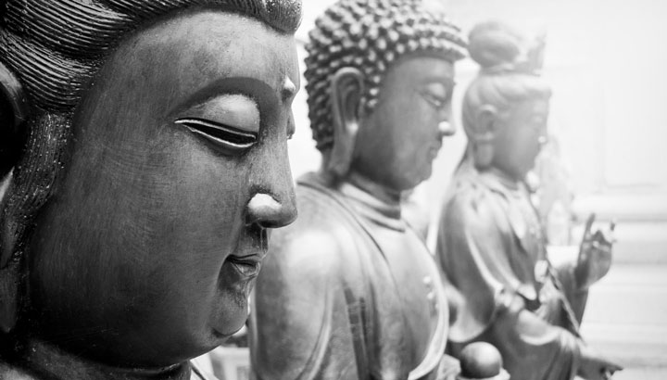
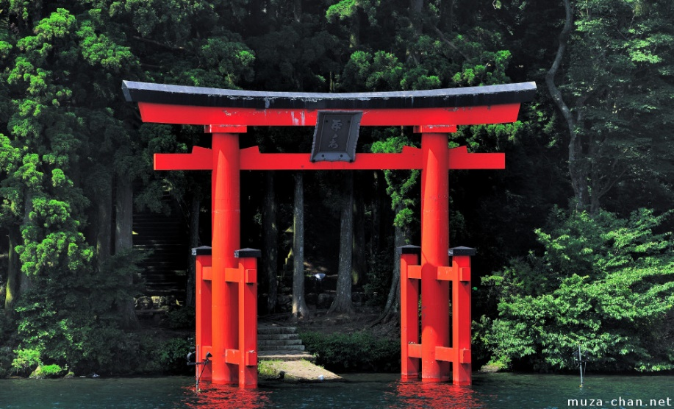
Religion and the landscape
Architecture - Shinto
Cultural hearth in Japan
Emphasizes honoring one’s ancestors and the relationship between people and nature
Common landscape: impressive gateway, or tori, to mark the transition from the outside world to a sacred space.

Slide 55
Geographic perspectives – Muslims in the us
Muslims have been in the Americas since Columbus
Muslims Among Enslaved Africans
First concentration of Muslims was in what is now the southeastern US. About 15 percent of the enslaved Africans brought to the Americas were followers of Islam.
Migrants to Industrial Cities
Between 1890 and 1917, a new wave of Muslim immigrants entered the US from Bosnia, Turkey, Syria, and other lands in the Middle East.

Slide 56
Geographic perspectives – Muslims in the us
Muslims have been in the Americas since Columbus
Muslims Among Enslaved Africans
First concentration of Muslims was in what is now the southeastern US. About 15 percent of the enslaved Africans brought to the Americas were followers of Islam.
Migrants to Industrial Cities
Between 1890 and 1917, a new wave of Muslim immigrants entered the US from Bosnia, Turkey, Syria, and other lands in the Middle East.

Slide 57
Geographic perspectives – Muslims in the us
Migrants to Industrial Cities
Pulled by the lure of industrial jobs, most settled in the growing cities of the North and Midwest.
Some of the first mosques were founded in small communities in Iowa, Maine, and North Dakota.
Industrial cities in the 1920s and 1930s also attracted millions of African Americans from the rural South and some joined the Black Muslims (concentrated in New York, Detroit, and Chicago).
Today, about ¼ of American Muslims are African American.

Slide 58
Geographic perspectives – Muslims in the us
Diverse Immigrants
In recent decades, Muslim immigrants have come from around the world.
Middle East, South Asia, Nigeria, Indonesia, etc.
Primary places of settlement have been large urban areas, but increasingly in suburban communities, such as Dearborn, Michigan.
Today, Muslims constitute about 1 percent of the total population.

