Slide 1
Unit 5
Agriculture &
Rural Land Use
By: Carli Terrell (Orlando, Florida)
This PPT has been created using the information from the AMSCO Human Geography: Preparing for the Advanced Placement Examination book.
Palmer, David. AMSCO Advanced Placement Human Geography. Perfection Learning, 2019.

Slide 2
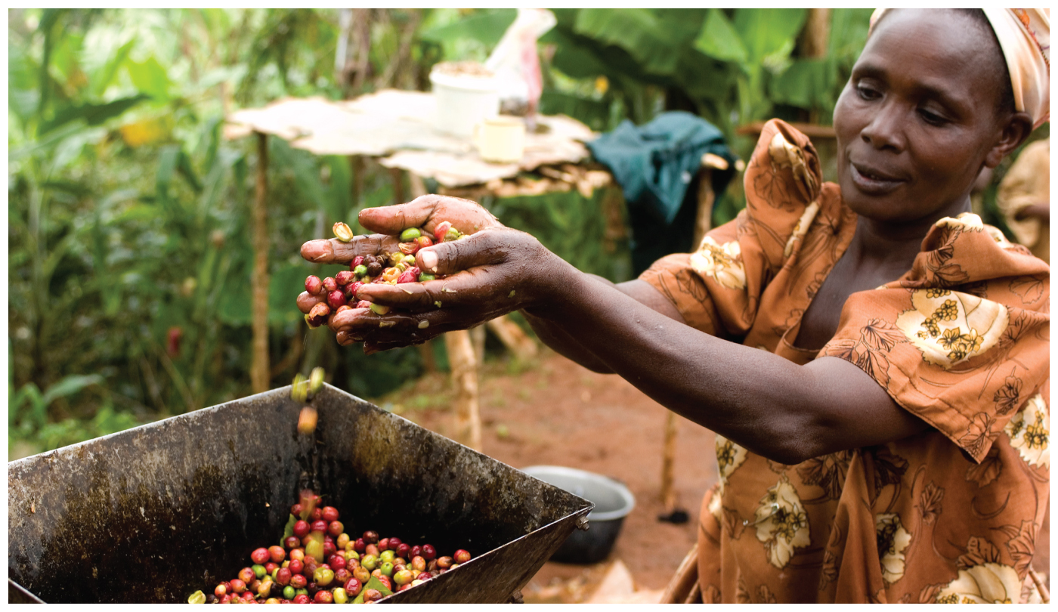
Unit 5 – Agriculture, food, & rural land use
Ch 12: The Development of Agriculture

Slide 3
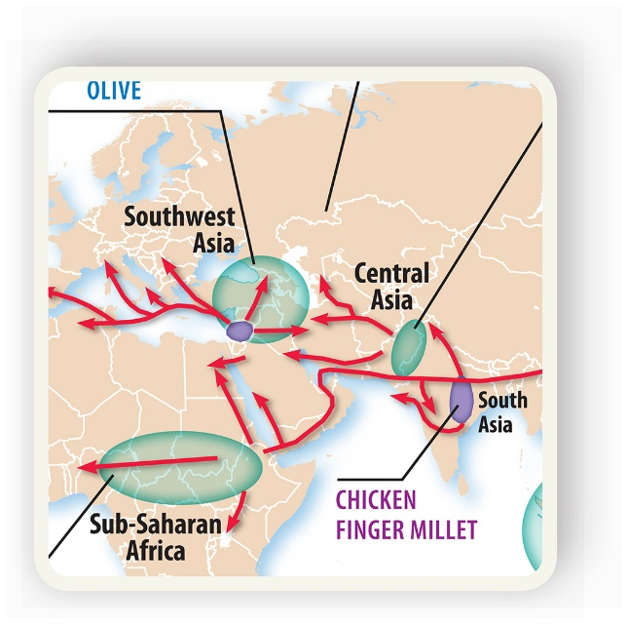
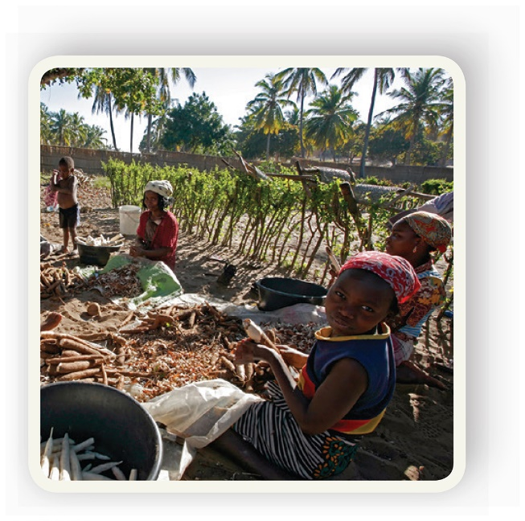
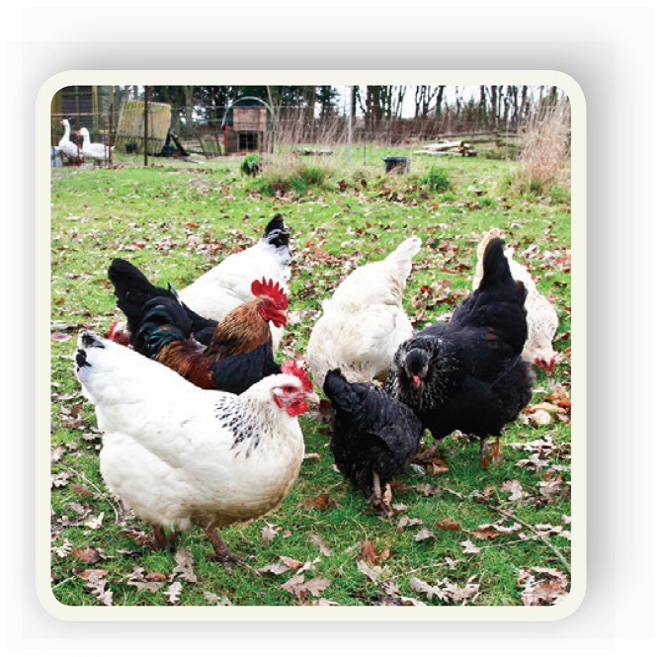
Enduring Understanding (5.A)
By the end of this section, you will understand that the development of agriculture led to widespread alteration of the natural environment.

Slide 4
Learning objective (5.A.4)
By the end of this section, you will be able to analyze the consequences of the Green Revolution on food supply and the environment.
Students will know that the Green Revolution began with the development of high-yield seeds (e.g., rice, wheat, maize), resulting in the increased use of chemical and mechanical farming.
Students will know that positive consequences of the Green Revolution include increased food production and a relative reduction in hunger at the global scale.
Students will know that negative consequences of the Green Revolution include environmental damage resulting from irrigation and chemical use (e.g., pesticides, herbicides, fertilizers) and the cost of technology and seeds.

Slide 5
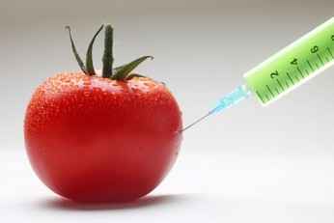
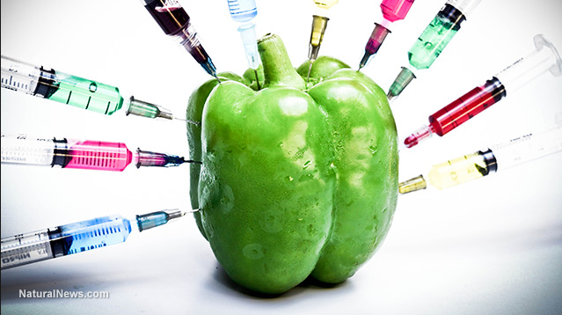
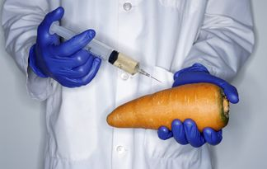
The Third Agricultural Revolution
Starting in the mid-20th century, science, research, and technology generated a Third Agricultural Revolution.
It involved the development and dissemination of better and more efficient farming equipment and practices, particularly in the area of vastly improved varieties of grain.

Slide 6
The Third Agricultural Revolution
The Green Revolution
The advances in plant biology that began in the mid-20th century are known as the Green Revolution.
The development of higher-yielding, disease-resistant, faster-growing varieties of grain.
Rice, corn, and wheat
Allowed for double-cropping (more than one crop per year)
Increased use of pesticides and fertilizer in developing countries in Asia and the Americas.
Some countries, like India, developed large-scale irrigation projects in order the make the most efficient use of water.

Slide 7
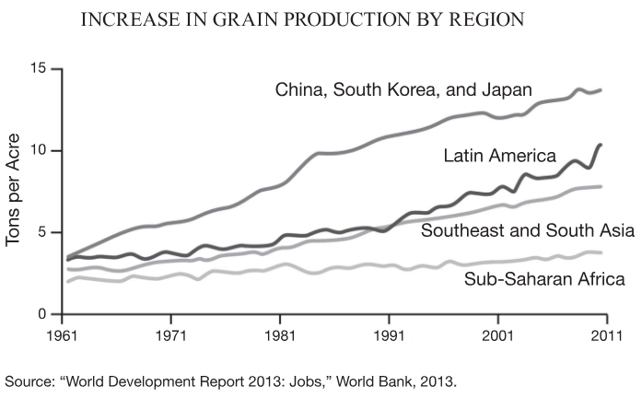

Slide 8
The Third Agricultural Revolution
The Green Revolution - Hybrids
Seed hybridization is the process of breeding together two plants that have desirable characteristics.
The Green Revolution scientists focused their attention on grains and globalization provided a much wider range of plants from which to crossbreed.
1960s: new strain of rice (long-grain Indonesian rice and the denser-grain Taiwan dwarf rice).
Helped turn Mexico into a wheat-importing country into a self-sufficient country with surplus.

Slide 9
The Third Agricultural Revolution
The Green Revolution - GMOs
Genetically modified organisms, or GMOs, are the result of a process in which humans use engineering techniques to change the DNA of a seed.
First used in the 1970s and became widely used in the 1990s.
In the US today, most corn, soybeans, and cotton are GMO varieties that have been developed in increase yield, or to resist diseases or the chemical used to kill weeds or pests.
GMOs seem to offer benefits but critics believe that their potential problems have not been adequately studied.

Slide 10
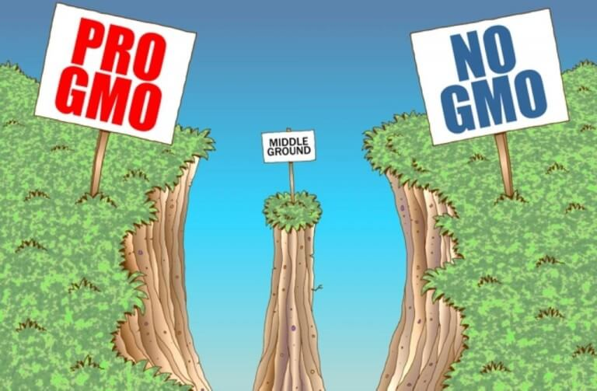

Slide 11
The Third Agricultural Revolution
The Green Revolution - Machinery
In addition to using hybrids, chemical fertilizers, and pesticides, supporters of the Green Revolution encouraged the transfer of mechanical technology as well.
Machinery introduced to the developing world included tractors, tillers, broadcast seeders, and grain carts.
Assisted in production and challenged traditional labor-intensive farming practices.

Slide 12
The Third Agricultural Revolution
Positive Impacts of the Green Revolution
Global food production increased dramatically.
New seed technology, mechanization, pesticides, chemical (manmade) fertilizers, and irrigation increased yields.
Increased yields led to reduced hunger, lower death rates, and a growing population in many parts of the developing world.

Slide 13
The Third Agricultural Revolution
Positive Impacts – Higher Yields
The Green Revolution was most successful in Latin America, South Asia, East Asia, and Southeast Asia.
India went from being an importer of wheat to harvesting a surplus of wheat within a few decades after WWII curbing hunger in the country.
By the year 2010, The World Bank estimated that 80% of the developing world had an adequate diet.
From 1960 to 2000, it was reported that wheat yield increased by 208%, corn by 157%, rice by 109% and potatoes by 78%.

Slide 14
The Third Agricultural Revolution
Positive Impacts – Money for Research and Business
The Green Revolution helped to create high rates of investment in both the public and private sectors.
Using grant money, many US universities and other developed countries were able to research seed hybridization, fertilizers, and pesticides.
The research was then used by for-profit corporations to create and market the products used by farmers.
Ultimately, it benefited hungry people in poor regions and financially benefited universities and corporations in more prosperous regions.

Slide 15
The Third Agricultural Revolution
Positive Impacts – Food Prices
Higher yields and increased production led to falling food prices.
As supply of wheat, corn, and rice increased, the prices dropped.
More food at affordable prices helped ease economic stress of hunger and famine on governments and economic systems in the developing world.
However, in 2005, global food prices began to climb.

Slide 16
The Third Agricultural Revolution
Negative Impacts of the Green Revolution
Like all large and rapid change, the Green Revolution had some negative consequences.
Environmental damage
Double cropping and aggressive irrigation led to soil erosion
Chemicals led to potentially hazardous runoff into streams, rivers and lakes impacting ecosystems, habitats, and communities.
Increased fossil-based fuel for machines increased air, water, and sound pollution
Lack of sustained investment
Disregard for local needs

Slide 17
The Third Agricultural Revolution
Impact on Gender Roles
Many participating countries had traditional economies where subsistence farming is the cornerstone of economic activity.
Much of the farming labor is performed by women while men dominate societies.
Therefore, it was the men who benefited from the Green Revolution and were given decision-making powers.
As a result, the men generally operated the machinery while women were excluded, thus further marginalizing the role of women in many societies.

Slide 18
The Third Agricultural Revolution
Poor Success in Africa
Africa has a greater diversity of climate and soils so developing the right fertilizers was very expensive.
Africa has many harsh environmental conditions. Insects, plants, and viral strains were challenging for the technology and the researchers.
Africa is so large and lacks sufficient transportation infrastructure making the cost of investment in research and development and transportation very high.
Africa’s staple crops such as sorghum, millet, cassava, yams, cowpeas, and peanuts were not always included in research.

