Slide 1
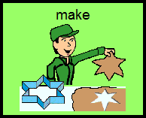
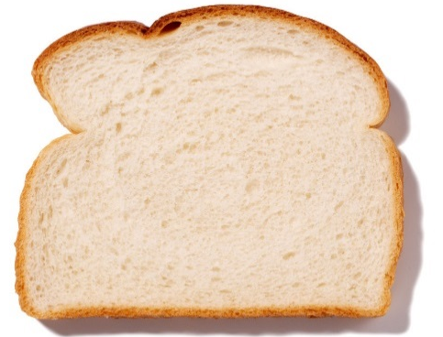
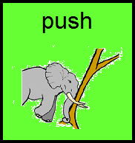
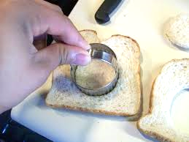
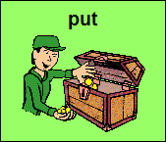
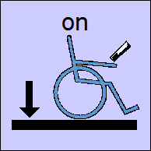
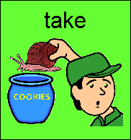
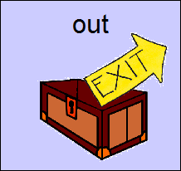
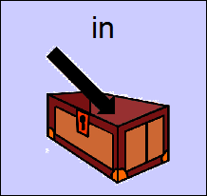
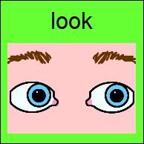
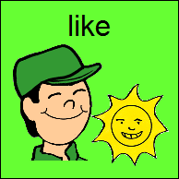
Let’s
Global Warming
Toast
By: Judy Slupecki SLP
Round
Cookie
cutter or
use a cup, etc.
1.
saucer of milk to
coat bread lightly
2.
bread circle
blue and green
food coloring
to
3.
the Earth

Slide 2
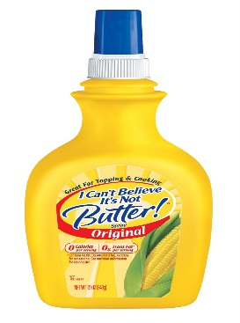
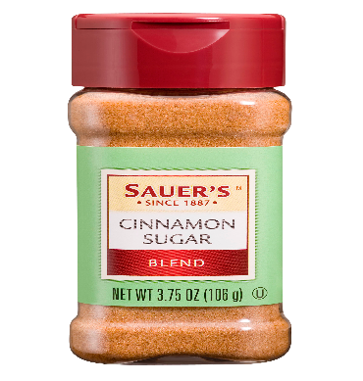
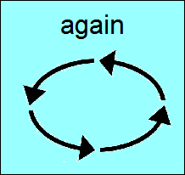
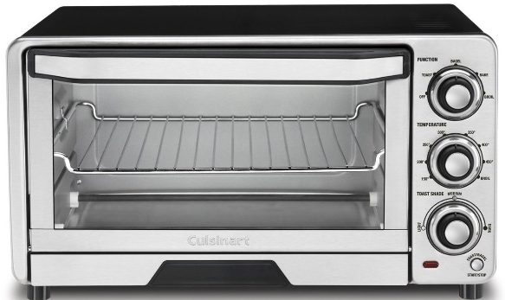
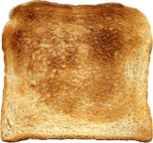
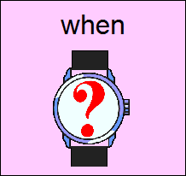
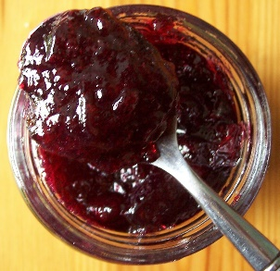
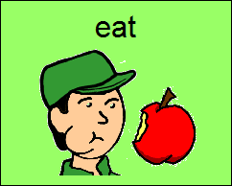
4.
cinnamon
sugar
the other
part of bread
spray butter
bread
Put the bread
circle back in
the other
part of bread.
5.
6.
toast bread
and
7.
jelly
toasted

Slide 3
Remember as you are talking to your child, use visual symbols. Point to the symbols as you say words such as: “put”, “turn”, “more”, “all done”, “make”, “like”, “want”, and “help”, “big”, “little”, “different”, “good”, “bad”, “again”, “ready”, “go”). You can use their communication system and/or a copy of the core 50 vocabulary communication board that was sent in the initial packet to parents on March 27th. These are “core” vocabulary words which means they are in the group of 50 words that we all use to communicate the most. If your child can learn these 50 words, they will be able to communicate some of the important basic information we all need to communicate. 2. You can substitute ingredients that you have at home vs. using the ones in the recipes. Example: use any kind of yogurt vs. Greek yogurt; or use sugar vs. agave nectar (refer to the conversion chart on next page). 3. Remember that the end product is not the important part. The process of making the recipe and using the communication symbols is the important part. Have fun….even if the recipe doesn’t turn out exactly. ☺

