Slide 1
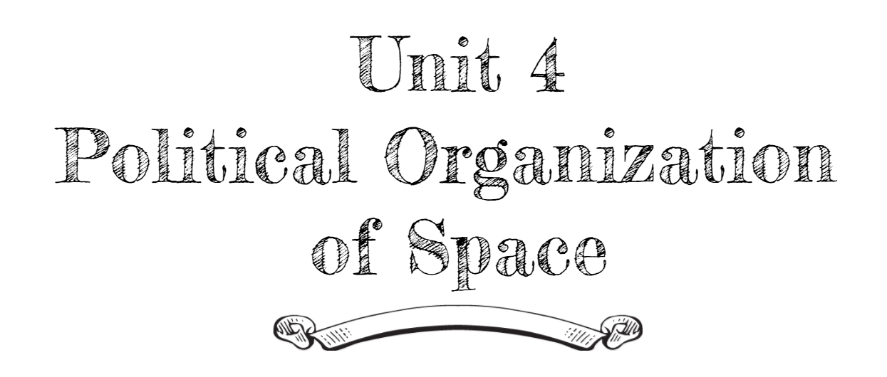
By: Carli Terrell (Orlando, Florida)
This PPT has been created using the information from the AMSCO Human Geography: Preparing for the Advanced Placement Examination book.
Palmer, David. AMSCO Advanced Placement Human Geography. Perfection Learning, 2019.

Slide 2
Unit 4 – political organization of space
Ch 10: Territory, Power, and Boundaries
Notes:
http://www.pbs.org/thelinguists/For-Educators/Video-Extras.html

Slide 3
Enduring Understanding (4.B)
By the end of this section, you will understand that spatial political patterns reflect ideas of territoriality and power at a variety of scales.
Territoriality: connection of people, culture, and their economic system to the land.
Power: geographic control over people, land, and resources.

Slide 4
Learning objective (4.B.4)
By the end of this section, you will be able to compare and contrast forms of governance.
Students will know that forms of governance include unitary states (centralized government) and federal states.
Students will know that power of the subdivisions of states vary according to the form of governance (e.g., the United States and Switzerland as federal states, France as a unitary state).
Students will know that state morphology (e.g., compact, elongated, perforated, fragmented, prorupted states) has economic, political, and social implications.

Slide 5
Different forms of Governance
Federal and Unitary States
Countries are governed on more than one level but different forms of governance determines how much power each level receives.
There are two main political spatial organizations: federal and unitary
Both administer day-to-day operations, are sovereign, and the national government is the final authority.
However, there are some major differences between the two.

Slide 6
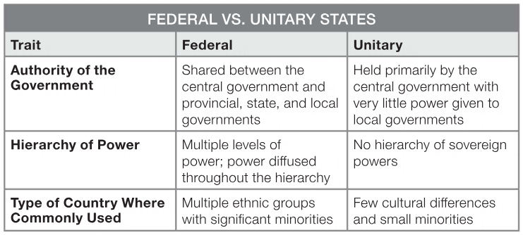
Different forms of Governance

Slide 7
Learning objective (4.B.4)
By the end of this section, you will be able to compare and contrast forms of governance.
Students will know that forms of governance include unitary states (centralized government) and federal states.
Students will know that power of the subdivisions of states vary according to the form of governance (e.g., the United States and Switzerland as federal states, France as a unitary state).
Students will know that state morphology (e.g., compact, elongated, perforated, fragmented, prorupted states) has economic, political, and social implications.

Slide 8
Different forms of Governance
Local Powers Vary by Government Type
In both federal and unitary, the local divisions have some degree of power.
Large landmass countries tend to be federal states – United States, Canada, Russia, etc.
Smaller landmass countries tend to be unitary states – Japan, Egypt, Spain, etc.
Of course, there are many exceptions – China (large but unitary), Belgium (small but federal – reflects the cultural differences between the Walloon and Flemish citizens)

Slide 9
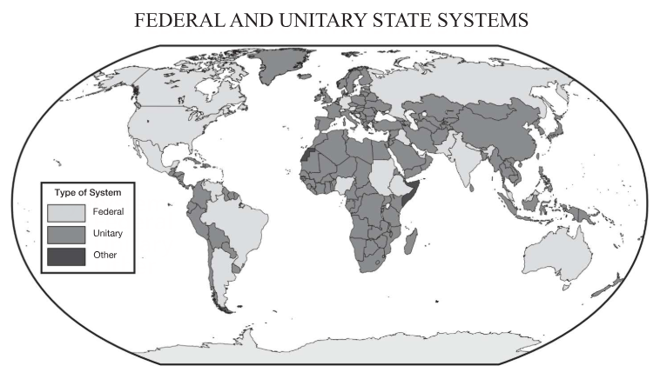
Different forms of Governance

Slide 10
Different forms of Governance
Local Powers Vary by Government Type
Federal governments are able to overcome many of the complications involved with governing a multicultural population by allowing local governments to manage either own affairs.
Example: provinces in northern Nigeria have enacted sharia (Islamic law) to accommodate their growing Muslim population.
Unitary states have strong centralized governments who hold most of the power and local governments are just extensions of it.
Can be undemocratic (China, Saudi Arabia) or fairly democratic (France, Indonesia).

Slide 11
Learning objective (4.B.4)
By the end of this section, you will be able to compare and contrast forms of governance.
Students will know that forms of governance include unitary states (centralized government) and federal states.
Students will know that power of the subdivisions of states vary according to the form of governance (e.g., the United States and Switzerland as federal states, France as a unitary state).
Students will know that state morphology (e.g., compact, elongated, perforated, fragmented, prorupted states) has economic, political, and social implications.

Slide 12
Different forms of Governance
The Effects of State Morphology
Morphology refers to the state’s shape and can influence how people in the state interact.
Example: a state with a highly populated central region and outlying areas far from its center, then those far away may face the following issues:
Difficulty receiving goods and services
May feel underrepresented in the government
May feel isolated from family or ethnic groups
May demand strong local control leading to internal conflict

Slide 13
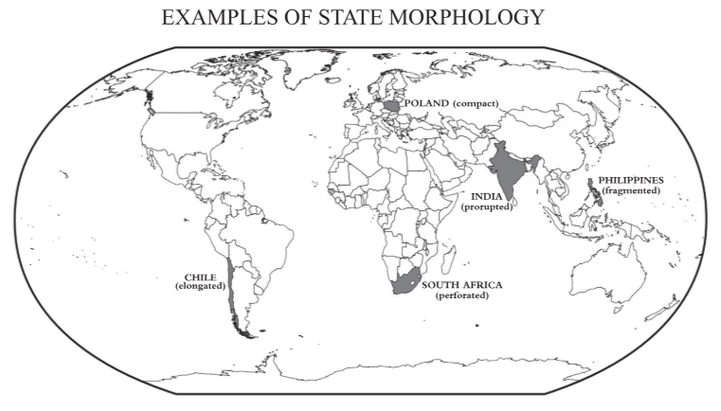
Different forms of Governance

Slide 14
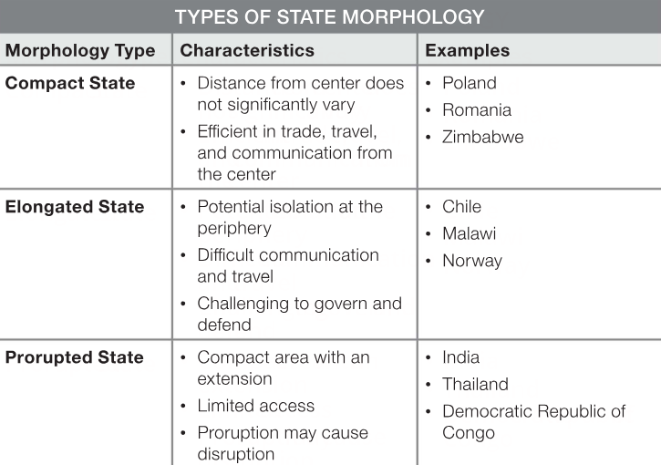
Different forms of Governance

Slide 15
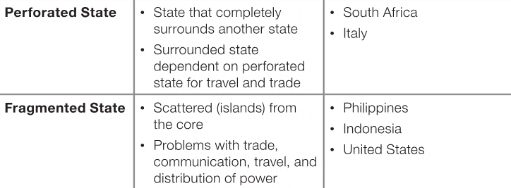
Different forms of Governance

