Slide 1
History of the yo-yo
By Jaylon W.

Slide 2
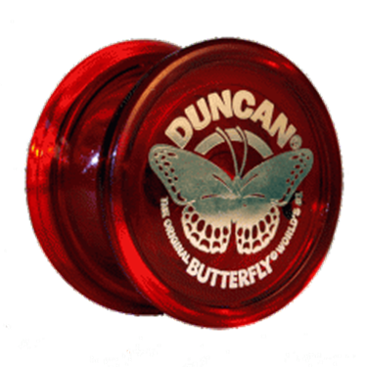
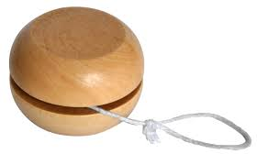
Origins
The origins of the yo-yo is still in debate as of today. Who came up with the idea? Who acted upon the idea and invented it? What country did all this happen in? Still unknown. But historians believe it originated in Greece or China around 1000 B.C.. Some historians theorize it was not even supposed to be used as a toy.

Slide 3
Stuff
Yo-yos were first made with wood metal or terra cotta disks. (By the way terra cotta is the stuff that ancient figurines and flower pots are made out of.) The yo-yos made with terra cotta were more fragile and weren’t played with as much.

Slide 4
Yo-Yos age
It is believed that the yo-yo is the worlds second oldest toy in the world.(after the doll) Few evidence to support this though.

Slide 5
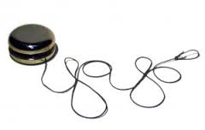
The Yo-yo as a weapon?
There are stories about the yo-yo being used as a weapon by the Filipinos. The assailant waited in a tree with a over sized yo-yo waiting for a victim. The yo-yo would be thrown towards the victims neck or head knocking him/her unconscious. If the assailant missed they could throw again. But there isn’t much evidence to support this.

Slide 6
18th Century
Historians believe around the 18th century the yo-yo was introduced to Europe from far east. During that same time period it became a very popular thing in France among only the nobility. Also during this period they weren’t called yo-yos they were called “bandalore” (French origin name.)

Slide 7
Origins in America
When the yo-yo was brought into North America is unknown. The first recording of the yo-yo being used in North America James L. Haven and Charles Hettrick making a better version of the yo-yo. The new yo-yo included a central rivet to hold the 2 halves together. Yo-yos could be made from metal now. I thought they were already were made from metal.

Slide 8
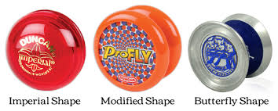
Modern day yoyo
There are a lot of types shapes sizes that I cant even explain. Yo-yo has come to be one of the oldest toys known to man.

