Slide 1
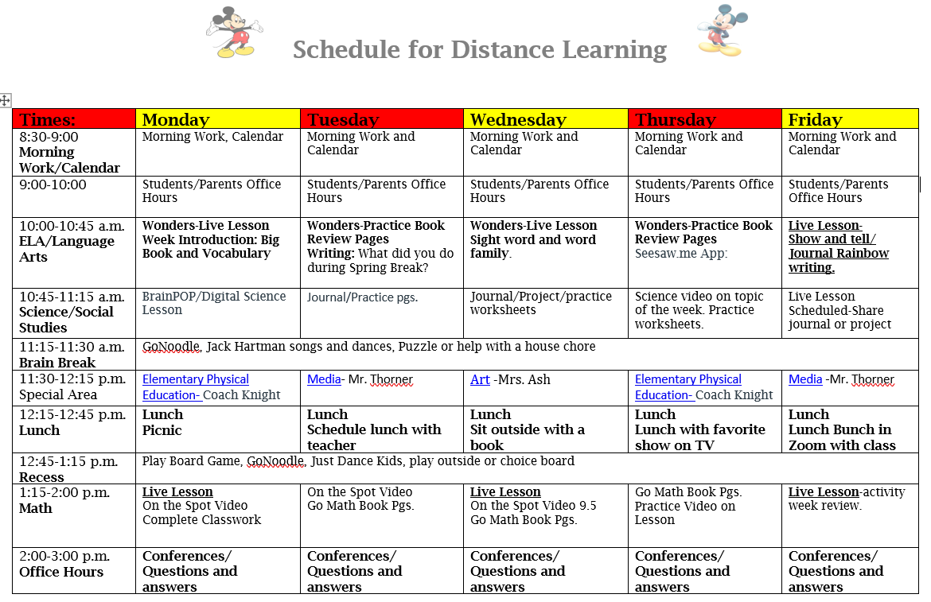

Slide 2
Week of April 13-17
Monday | Tuesday | Wednesday | Thursday | Friday
10:00-10:45 Live Lesson-Bringing down the Moon- Story Go outside and look up at the sky. Make a list of the things you see. Draw a picture to go with your work | Wonders Your Turn Practice Book Pgs. 233-238 | 10:00-10:30 Live Lesson Short i Write a sentence for each of the words- pig, fin, kit, wig, bin | Wonders Your Turn Practice Book Pgs. 239-244 | 10:00-10:30 Live Lesson-Show and Tell Sight Word Video Journal-Rainbow write each sight word
1:15-2:00 Live Lesson Ch. 9 Introduction On Spot Video 9.1 Story-School is Fun Journal-Draw a picture using only circles | On Spot Video 9.2 Go Math Book pgs. 355-360 | 1:15-2:00 Live Lesson Review On Spot Video 9.3 | Go Math Book pgs. 361-364 Count to 100 Practice writing your numbers to 100 | 1:15-2:00 Live Lesson-Scavenger Hunt Try to find the following shapes-Circle, square, rectangle, oval, triangle)
Watch video on Living/Nonliving | Journal-Look around your house. Find 3 things that are living and label them. | Journal-Look around your house. Find 3 things that are non-living and label them. | Living/Nonliving Living things need 3 things. List what they are. | Go outside and find 5 living things.
Physical Education- Coach Knight | Media- Mr. Thorner | Art -Mrs. Ash | Physical Education- Coach Knight | Media- Mr. Thorner
Reading
Math
Science/
Social Studies
Special Area

Slide 3
Learning Goals
Reading
Science
Social studies
Math
I can find the
Main idea and
Retell details in
the text.
LAFS.K.RI.1.2: With prompting and
support, identify the main topic
and retell key details of a text.
DOK 2
I can identify and
describe shapes
(circle, square,
rectangle, oval,
triangle, rhombus)
MAFS.K.G.1.Identigy and describe
shapes (squares, circles, triangles
rectangles, hexagons, cubes, cylinders,
and spheres)
I can observe how
animals and plants
are the same and
different.
SC.K.L.14.3: Observe plants and
animals, describe how they are alike
and how they are different in the way
they lookand in the things they do.
DOK 2
I can tell which are
things I want or
things I need.
SS.K.E.1.4: Identify the difference
between basic needs and wants.

Slide 4
This week’s skills
Essential Question
Phonics
Word Family
Sight Words
Vocabulary
What do you see in the Sky?
Review (u, g,w, x)
for, have, they, of, said, want, here, me, this, what)
recognize, surface, challenge, space
-big, wig, fig, pig
-fin, pin, tin, bin
-bit, kit, sit, hit

Slide 5
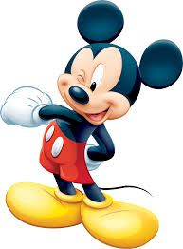
Morning Songs and Calendar 8:30-9:00
Calendar
Morning Songs

Slide 6
Lunch
Recess
Brain Breaks
GoNoodle, Jack Hartman songs and dances on youtube, Puzzle or help with a house chore
Have a Picnic, lunch bunch with your teacher, watch your favorite show or sit outside with a book
Play Board Game, GoNoodle, Just Dance Kids, play outside or choice board

Slide 7
Project
Assignments
I-Ready
-Complete weekly
assignments
-Read daily for
20 minutes
-Practice sight words
20 minutes
daily for
Reading and
Math
Science
Project

Slide 8
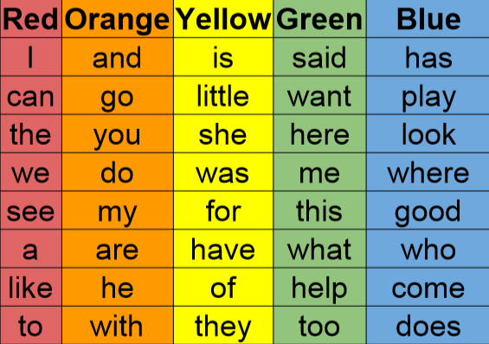

Slide 9
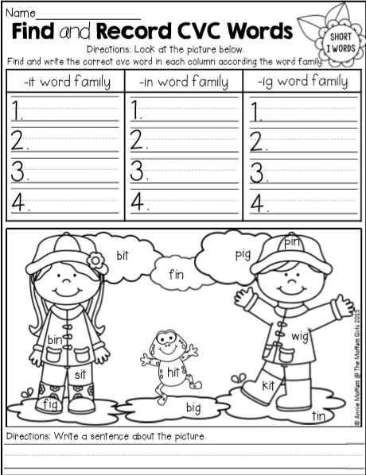
Homework Pages

Slide 10
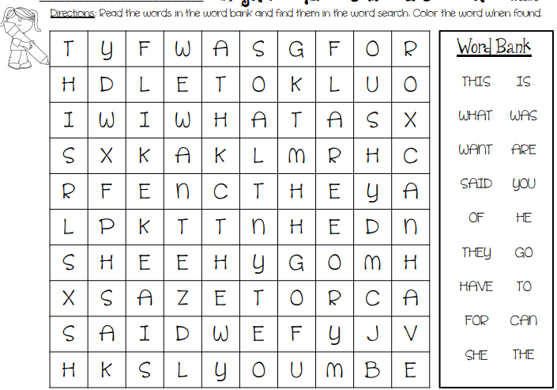

Slide 11
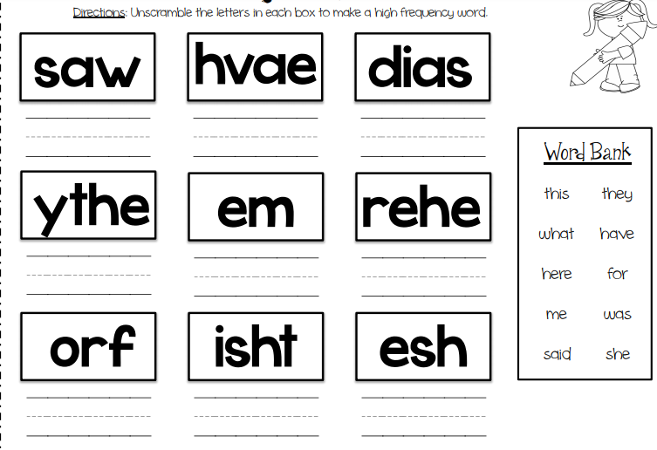

Slide 12
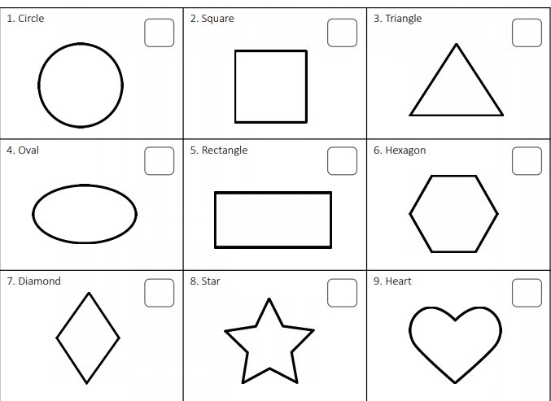
Make Flash
Cards

Slide 13
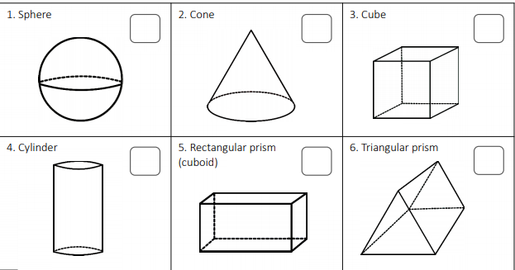

Slide 14
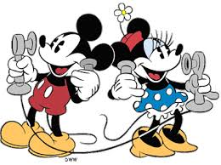
Ways of Communication
Office Hours
Remind App
Zoom and Teams Meetings
Monday-Friday
9:00-10:00
2:00-3:00
Questions or
additional
Help, text me
on remind as
needed.
-Live Lessons
-Student help
-Parent
conference

