Slide 1
Unit 1: Foundations
8,000 B.C.E.-600 B.C.E.

Slide 2
Big Geography & Peopling the Earth
Paleolithic Era- hunting-foraging bands migrated from E. Africa to Eurasia, Australia, & Americas
Adapt technology & culture to climate
Fire used for hunting, protection, & adaption to climate
Tools for different environments
Economic structures= small kinship groups

Slide 3
Neolithic Rev. & Early Agricultural Societies
Pastoral Society
Agricultural Society
Smaller
Mobile
Focus on hunting/gathering
Better adaption to environment
Animal husbandry
Dependent on same soil
Larger civilizations
Sedentary
Animal husbandry

Slide 4
Neolithic Rev. & Early Agricultural Societies
Neolithic Rev. began b/c:
Need for a long-term reliable source of food
People experimented with plants
Need for political and social organization
Accident
10,000 yrs ago, Neolithic Rev led to new complex economic & social systems
Specialized labor (metallurgy), irrigation

Slide 5
Neolithic Rev. & Early Agricultural Societies
In response to climate change, permanent settlements arose in:
Mesopotamia
Nile River
Sub-Sahara Africa
Indus River
Yellow/Huang He River
Mesoamerica & Andes
Pastoralism developed in Afro-Eurasia

Slide 6
Neolithic Rev. & Early Agricultural Societies
Different crops & animals domesticated
Cleared land, created water control systems (irrigation)
Agricultural practices impacted environmental diversity
Transformation of human societies
More reliable and abundant food supplies= increased pop.

Slide 7
Neolithic Rev. & Early Agricultural Societies
Specialization of labor (artisans, warriors, elites)
Technology led to improvements in agricultural production, trade, & transport
In both pastoralist and agrarian societies, elite groups accumulated wealth
Hierarchical social structures
Promoting patriarchal forms of social organization.

Slide 8
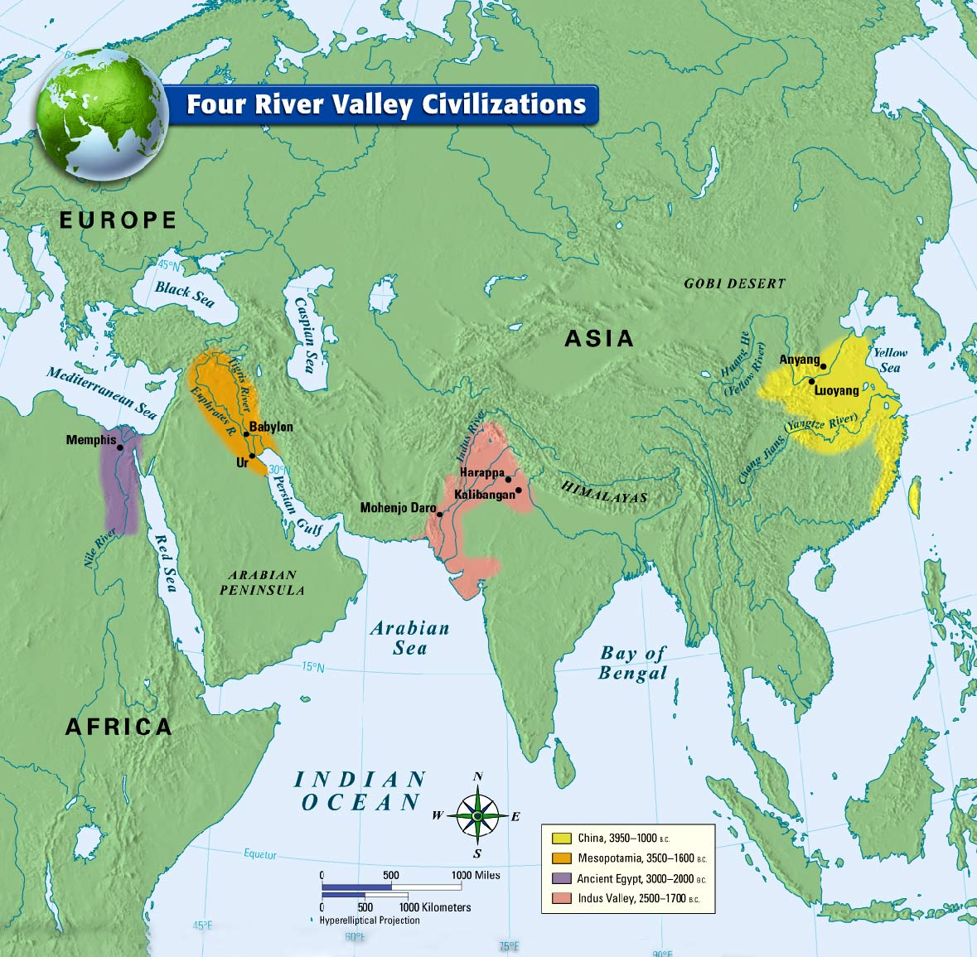
Development & Interaction of Early Societies
Foundation civilizations developed in various geographic locations where agriculture flourished
Notes:
Foundation civilizations developed in various geographic locations where agriculture flourished

Slide 9
Development & Interaction of Early Societies
Notes:
Development & Interaction of Early Societies

Slide 10
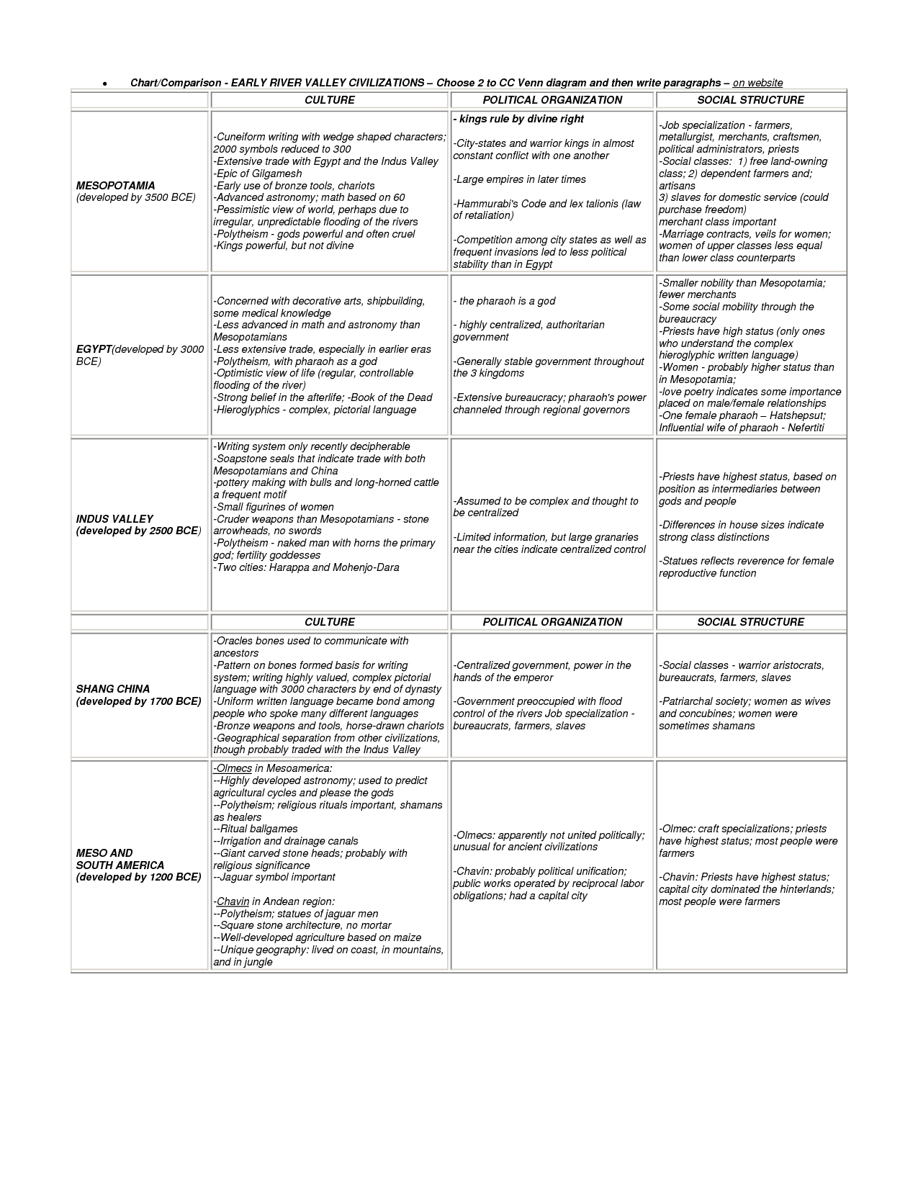

Slide 11
Development & Interaction of Early Societies
States mobilized labors over large areas
Rulers consolidated power through divine right
As states grew and competed for land and resources, the more favorably situated had greater access to resources
EX: Hittites' access to iron, produced more surplus food, and experienced growth populations
These states were able to undertake territorial expansion and conquer surrounding states.

Slide 12
Development & Interaction of Early Societies
Pastoralists developed new weapons & modes of transportation= transformed warfare in agrarian civilizations.
Culture unified states through law, language, literature, religion, myths and monumental art
Architecture & city-planning
Elites promoted arts
Record keeping
Legal Codes (Code of Hammurabi)

Slide 13
Development & Interaction of Early Societies
Trade expanded throughout this period from local to regional and trans-regional, with civilizations exchanging goods, cultural ideas, and technology.
Social and gender hierarchies intensified as states expanded and cities multiplied
Literature reflected culture (Epic of Gilgamesh, Book of the Dead)

Slide 14
Sumerian cities, in fact, arose where this sea network connected up with a newer network of caravan portage (caravan portage refers to group of merchants moving goods together from place to place, usually across a desert). Donkeys, the first important caravan animal, were domesticated about seven thousand years ago but since caravan management was almost as complicated as seafaring it presumably took a while for overland portage to become significant. But when local peoples learned that letting caravans pass for a negotiated protection fee assured a better supply of exotic and desirable items than plundering them did, overland portage across relatively long distances began to connect diverse populations more insistently than before. And it is surely not an accident that it was in Sumer, where an already ancient seagoing network intermeshed with a newly accessible hinterland (uncharted territory) that the first cities arose between 4000 and 3000 BCE. Goods and ideas moved along these communications networks and, where they converged, the Sumerians were in an optimal position to pick and choose, elaborating and improving upon skills and knowledge coming from near and far. -William H. McNeill, “A Short History of Humanity,”

Slide 15
Sumerian cities, in fact, arose where this sea network connected up with a newer network of caravan portage (caravan portage refers to group of merchants moving goods together from place to place, usually across a desert). Donkeys, the first important caravan animal, were domesticated about seven thousand years ago but since caravan management was almost as complicated as seafaring it presumably took a while for overland portage to become significant. But when local peoples learned that letting caravans pass for a negotiated protection fee assured a better supply of exotic and desirable items than plundering them did, overland portage across relatively long distances began to connect diverse populations more insistently than before. And it is surely not an accident that it was in Sumer, where an already ancient seagoing network intermeshed with a newly accessible hinterland (uncharted territory) that the first cities arose between 4000 and 3000 BCE. Goods and ideas moved along these communications networks and, where they converged, the Sumerians were in an optimal position to pick and choose, elaborating and improving upon skills and knowledge coming from near and far.
-William H. McNeill, “A Short History of Humanity,”
Which of the following best supports the author’s assertion?
States were unified as trade expanded from local to regional to interregional
Domestication of animals like donkeys led to the rise of powerful city-states
Pastoral populations were greater disseminators of exotic and desirable items
Other civilizations were in a better geographic position than the Sumerians to engage in trade
Notes:
A

Slide 16
Sumerian cities, in fact, arose where this sea network connected up with a newer network of caravan portage (caravan portage refers to group of merchants moving goods together from place to place, usually across a desert). Donkeys, the first important caravan animal, were domesticated about seven thousand years ago but since caravan management was almost as complicated as seafaring it presumably took a while for overland portage to become significant. But when local peoples learned that letting caravans pass for a negotiated protection fee assured a better supply of exotic and desirable items than plundering them did, overland portage across relatively long distances began to connect diverse populations more insistently than before. And it is surely not an accident that it was in Sumer, where an already ancient seagoing network intermeshed with a newly accessible hinterland (uncharted territory) that the first cities arose between 4000 and 3000 BCE. Goods and ideas moved along these communications networks and, where they converged, the Sumerians were in an optimal position to pick and choose, elaborating and improving upon skills and knowledge coming from near and far.
-William H. McNeill, “A Short History of Humanity,”
The developments described in the passage contributed most directly to which of the following?
Advanced city-states rising in Mesopotamia
Monumental architecture like ziggurats being constructed
Legal codes like the Code of Hammurabi being developed
New religious beliefs like Zoroastrianism emerging
Notes:
A

Slide 17
Sumerian cities, in fact, arose where this sea network connected up with a newer network of caravan portage (caravan portage refers to group of merchants moving goods together from place to place, usually across a desert). Donkeys, the first important caravan animal, were domesticated about seven thousand years ago but since caravan management was almost as complicated as seafaring it presumably took a while for overland portage to become significant. But when local peoples learned that letting caravans pass for a negotiated protection fee assured a better supply of exotic and desirable items than plundering them did, overland portage across relatively long distances began to connect diverse populations more insistently than before. And it is surely not an accident that it was in Sumer, where an already ancient seagoing network intermeshed with a newly accessible hinterland (uncharted territory) that the first cities arose between 4000 and 3000 BCE. Goods and ideas moved along these communications networks and, where they converged, the Sumerians were in an optimal position to pick and choose, elaborating and improving upon skills and knowledge coming from near and far.
-William H. McNeill, “A Short History of Humanity,”
Based on your knowledge of world history, which of the following contributed least to the origins of civilization
Establishment of land and sea-based trade networks
The geographical location of river-valleys
Presence of domesticable plants and animals
The development of writing systems as a means of record keeping
Notes:
D

Slide 18
“I have not committed evil against men.
I have not mistreated cattle.
I have not committed sin in the place of truth [that is, a temple or burial ground].
I have not blasphemed god…
I have not made (anyone) sick.
I have not made (anyone) weep.
I have not killed…
I have not held up water in its season [that is, denied flood-waters to others].
I have not built a dam against running water…”
-The Book of the Dead, Egyptian religious scripture, 1550 BCE
The existence of documents like the one excerpted above demonstrates that the Egyptians
Relied on the desert for protection rather than defensive walls.
Had a strong central authority.
Had developed a concept of the afterlife.
Relied on oaths to keep the military loyal to the pharaoh.
Notes:
C

Slide 19
“I have not committed evil against men.
I have not mistreated cattle.
I have not committed sin in the place of truth [that is, a temple or burial ground].
I have not blasphemed god…
I have not made (anyone) sick.
I have not made (anyone) weep.
I have not killed…
I have not held up water in its season [that is, denied flood-waters to others].
I have not built a dam against running water…”
-The Book of the Dead, Egyptian religious scripture, 1550 BCE
Which of the following statements can be inferred based on the passage?
The Egyptians had developed large-scale public works and urban planning.
The Egyptians relied solely upon cattle to meet their needs for food.
Military actions such as war were outlawed.
Gender equality was the norm in Egyptian society.
Notes:
A

Slide 20
“I have not committed evil against men.
I have not mistreated cattle.
I have not committed sin in the place of truth [that is, a temple or burial ground].
I have not blasphemed god…
I have not made (anyone) sick.
I have not made (anyone) weep.
I have not killed…
I have not held up water in its season [that is, denied flood-waters to others].
I have not built a dam against running water…”
-The Book of the Dead, Egyptian religious scripture, 1550 BCE
The above passage tells us what about Egyptian religious life?
The Egyptian afterlife was devoid of gods.
Moral action was enforced by religious ideals.
Egyptians lacked the essential framework for deep religious understanding.
Egyptians borrowed heavily from Mesopotamian religions.
Notes:
B

Slide 21
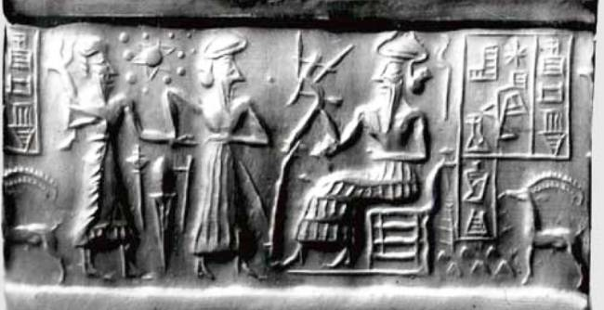
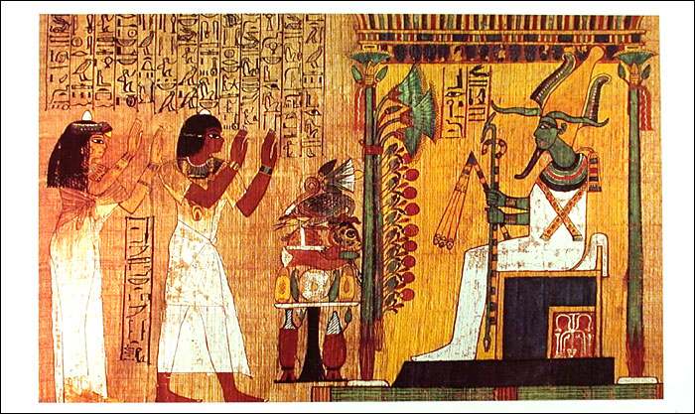
Based on the images and your knowledge of world history, answer the following question.
What do the images suggest about Egyptian and Mesopotamian civilization?
They both had a political system with a divine king at the head of power
They lacked a system of writing
There was widespread warfare amongst the two civilizations
Both had rituals centered on human sacrifice
Notes:
A

Slide 22
Short Answer Question 1
Directions: Read each question carefully and write your responses in the lined pages provided for that question. Answer A, B and C.
A. Identify and explain one political similarity shared by at least two River Valley Civilizations and explain why that similarity exists.
B. Identify and explain one political difference seen between the same two of the River Valley Civilizations you discussed in part A and explain why that difference exists.
C. Identify and explain one cultural similarity shared by at least two River Valley Civilizations and explain why that similarity exists.
Notes:
Use complete sentences; an outline or bulleted list alone is not acceptable. You may plan your answers on this exam sheet, but only your responses on the designated lined pages will be scored.

Slide 23
SAQ 2
Nomadic pastoralism survived long after the first advent of farming
A. Choose ONE Of the following and explain why your choice represents the key factor leading to this development:
Farming made urban life possible
Pastoralists have advantages over urban cultures
Nomadic peoples are more warlike
B. Contrast your choice against ONE of the other options, demonstrating why that option is not as significant as your choice.

Slide 24
SAQ 3
In Eurasia, the earliest civilizations emerged along great river valleys.
A) One ONE of the following and explain why your choice represents the key factor leading to this development
Trade was facilitated by waterways
Political centralization relied on communication
Agriculture necessitated reliable water supplies
B) Contrast your choice against ONE of the other options, demonstrating why that option is not as significant as your choice

