Slide 1
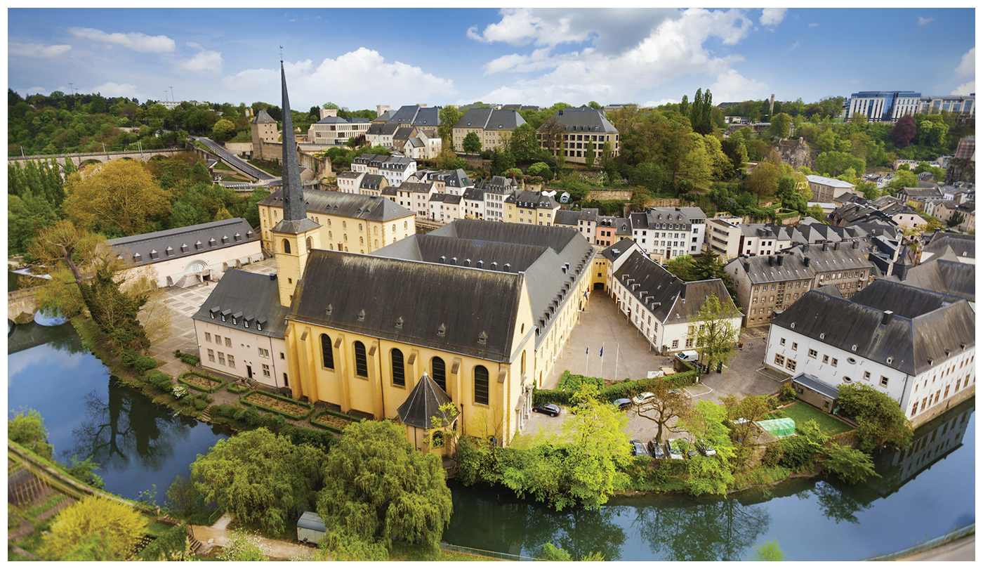
Unit 1 – Part 2
geography – its nature and perspectives

Slide 2
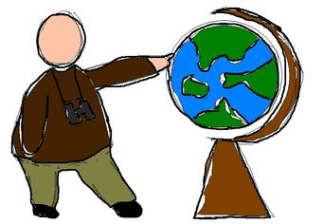
Enduring Understanding (1.C)
By the end of this section, you will understand that geographical skills provide a foundation for analyzing world patterns and processes.

Slide 3
Learning objective (1.C.1)
By the end of this slide, you will be able to use spatial thinking to analyze the human organization of space.
People apply spatial concepts to interpret and understand population and migration; cultural patterns and processes; political organization of space; agriculture, food production, and rural land use; industrialization and economic development; and cities and urban land use.

Slide 4
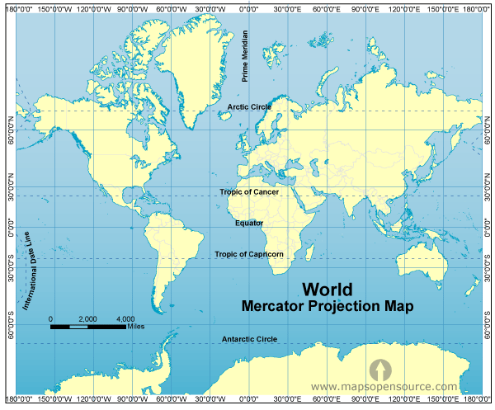
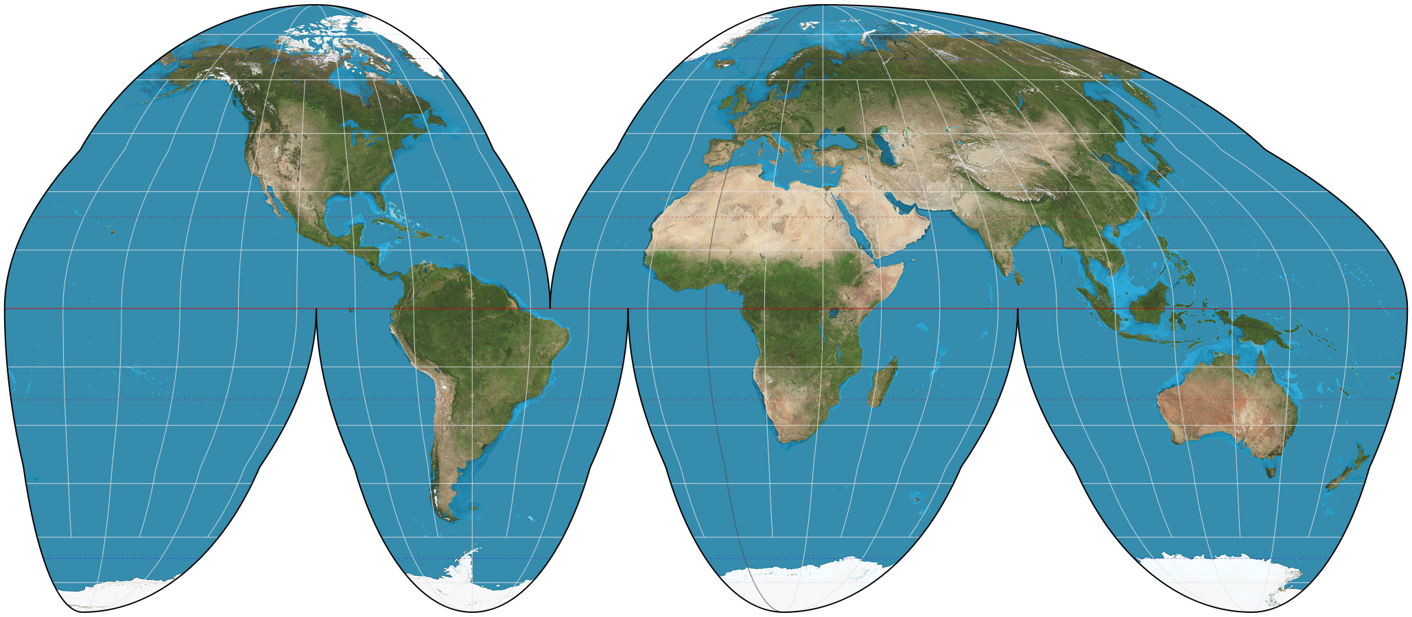
Learning objective (1.C.2)
By the end of this section, you will be able to use and interpret maps.
Maps are used to represent and identify spatial patterns and processes at different scales
Types of maps include reference maps and thematic maps
All map projections inevitably distort spatial relationships

Slide 5
Part II: patterns and processes
Essential question: What tools and techniques do geographers use to analyze the world?

Slide 6
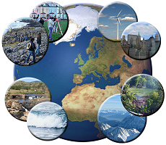
Part II: patterns and processes
Geographers emphasize spatial patterns, general arrangements of things being studied, and the processes, the repeated sequences of events, that create them.

Slide 7
Maps - scale
Scale
Maps are a reduction of the actual land it represents
Scale is the ratio between the size of things in the real world and the size of those same things on the map
Three types: cartographic, geographic, and scale of data

Slide 8
Maps - scale
Cartographic Scale
Refers to the way the map communicates the ratio of its size to the size of what it represents:
Words – one inch equals ten miles (2.5 inches would equal 25 miles on the surface of the earth
Ratio – 1/200,000 or 1:200,000 (1 unit on the map equals 200,000 units on the ground)
Line – length of the line indicates distance on the map

Slide 9
Maps - scale
Geographic Scale
Sometimes called relative scale, refers to the amount of territory that the map represents
Global scale means a map of the entire planet
Local scale means a map of a city – school attendance boundaries
A rise in unemployment might be explained differently depending on the scale

Slide 10
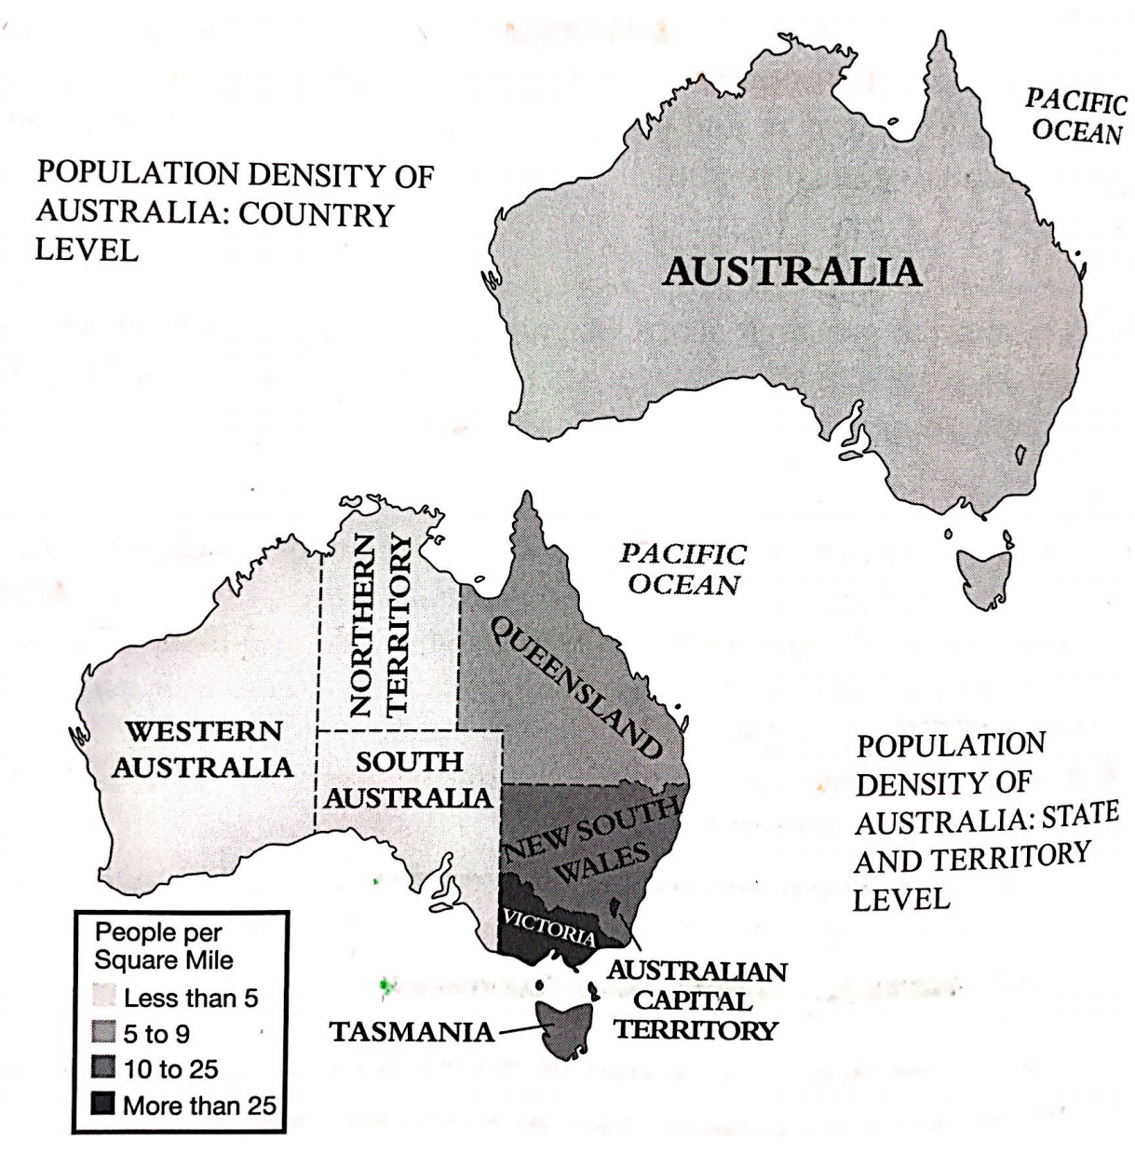
Maps - scale
Scale of the Data
The scale of the maps might be the same but the scale of the data may be different

Slide 11
Learning objective (1.C.2)
By the end of this section, you will be able to use and interpret maps.
Maps are used to represent and identify spatial patterns and processes at different scales
Types of maps include reference maps and thematic maps
All map projections inevitably distort spatial relationships

Slide 12
Maps – reference and thematic
Reference Maps
Political – human-created boundaries (states, cities, etc.)
Physical – natural features (mountains, rivers, deserts)
Road – highways, streets, and alleys
Plat – property lines and land ownership
Locator – used in books and advertisements to support ad

Slide 13
Maps – reference and thematic
Thematic Maps
Show spatial aspects of information or of a phenomenon
Four common types
Choropleth
Dot distribution
Graduated symbol
Isoline

Slide 14
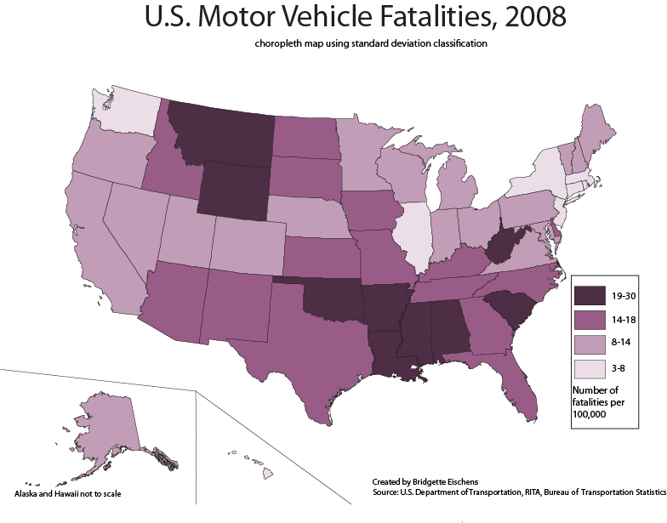
Maps –thematic: choropleth
Choropleth
Uses various colors, shades of one color, or patterns to show the location and distribution of spatial data

Slide 15
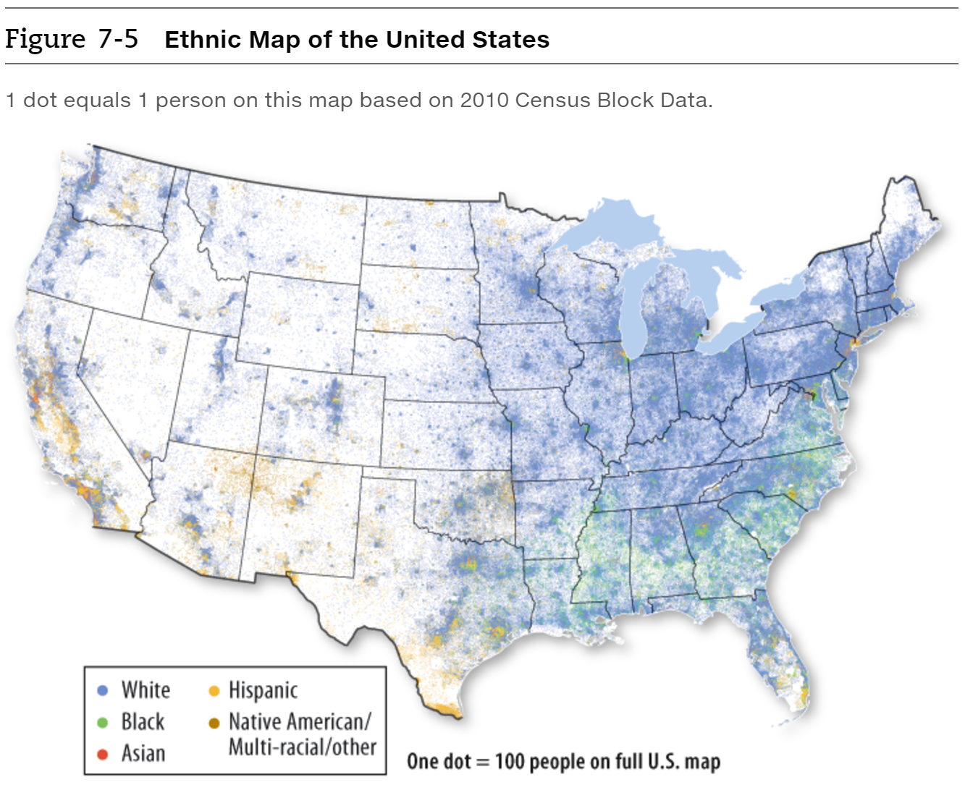
Maps –thematic: Dot distribution
Dot Distribution
Used to show the specific location and distribution of something across the territory of the map
Each dot represents a specified quantity

Slide 16
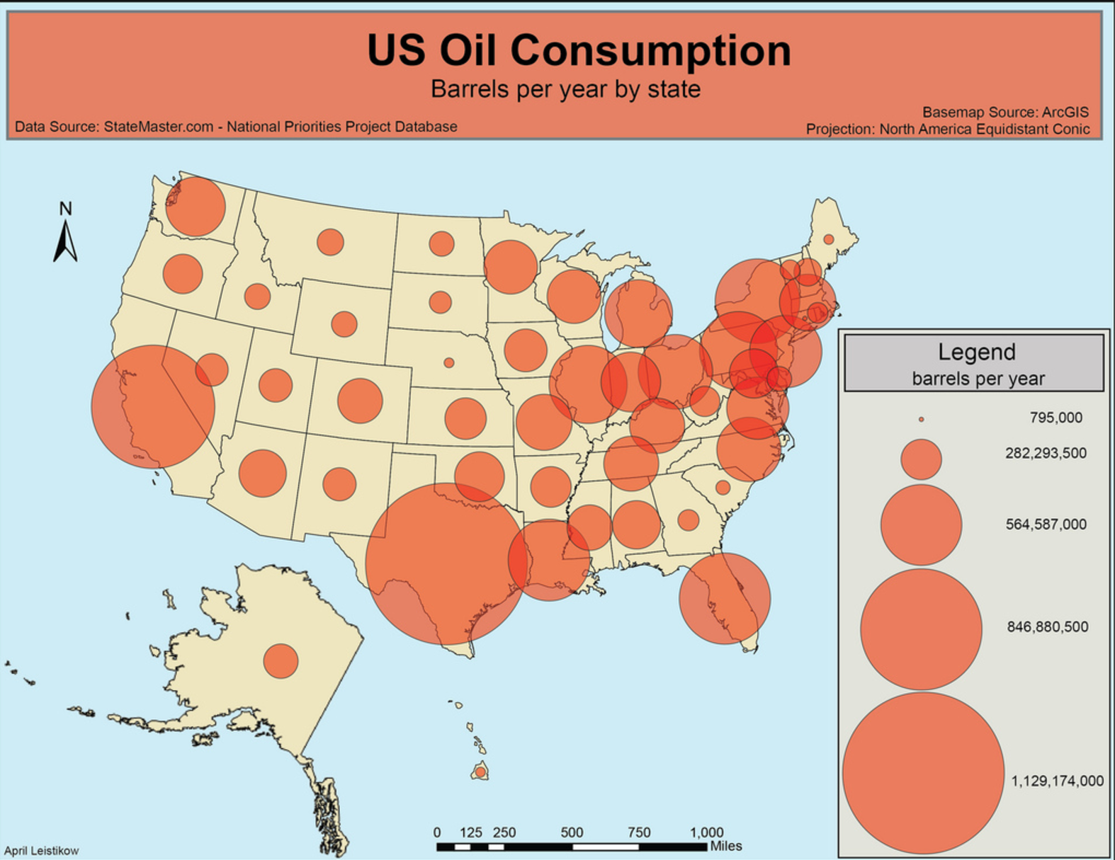
Maps –thematic: Graduated symbol
Graduated Symbol
Uses symbols of different sizes to indicate different amounts of something
The map key determines the exact amount

Slide 17
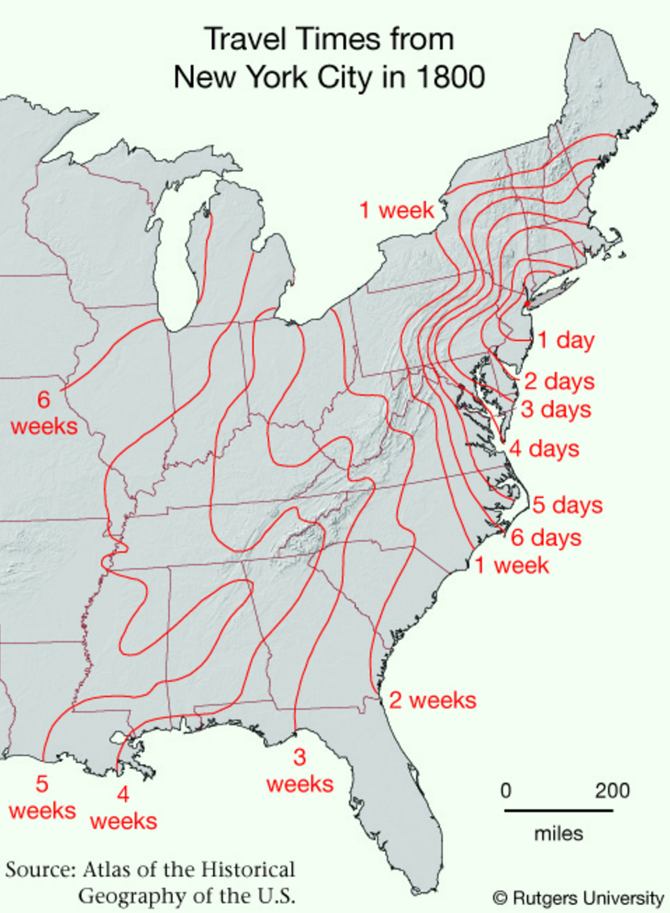
Maps –thematic: Isoline
Isoline
Uses lines that connect points of equal value to depict variations in the data across space
Where lines are close together, change is rapid
Most common type: topographic map

Slide 18
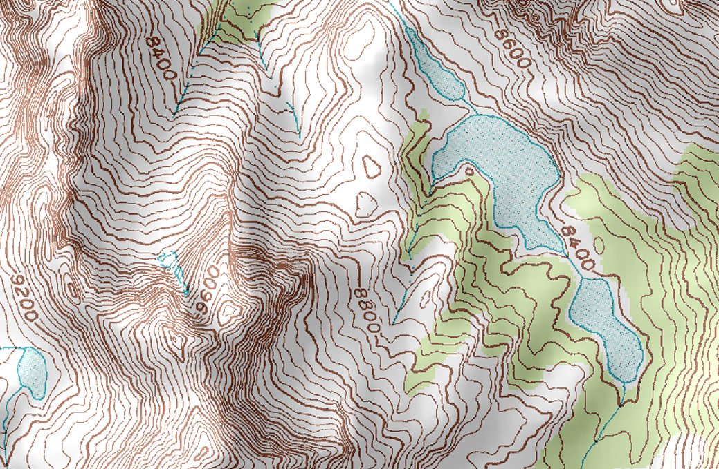
Maps –thematic: Isoline
Topographic
Popular among hikers
Points of equal elevation are connected creating contours that depict surface features

Slide 19
Maps – Cartograms
Cartograms
Sizes of countries are shown according to some specific statistic
Useful because they allow data to be compared, like a graph, and distance and distribution are also visible, like on a traditional map.

Slide 20
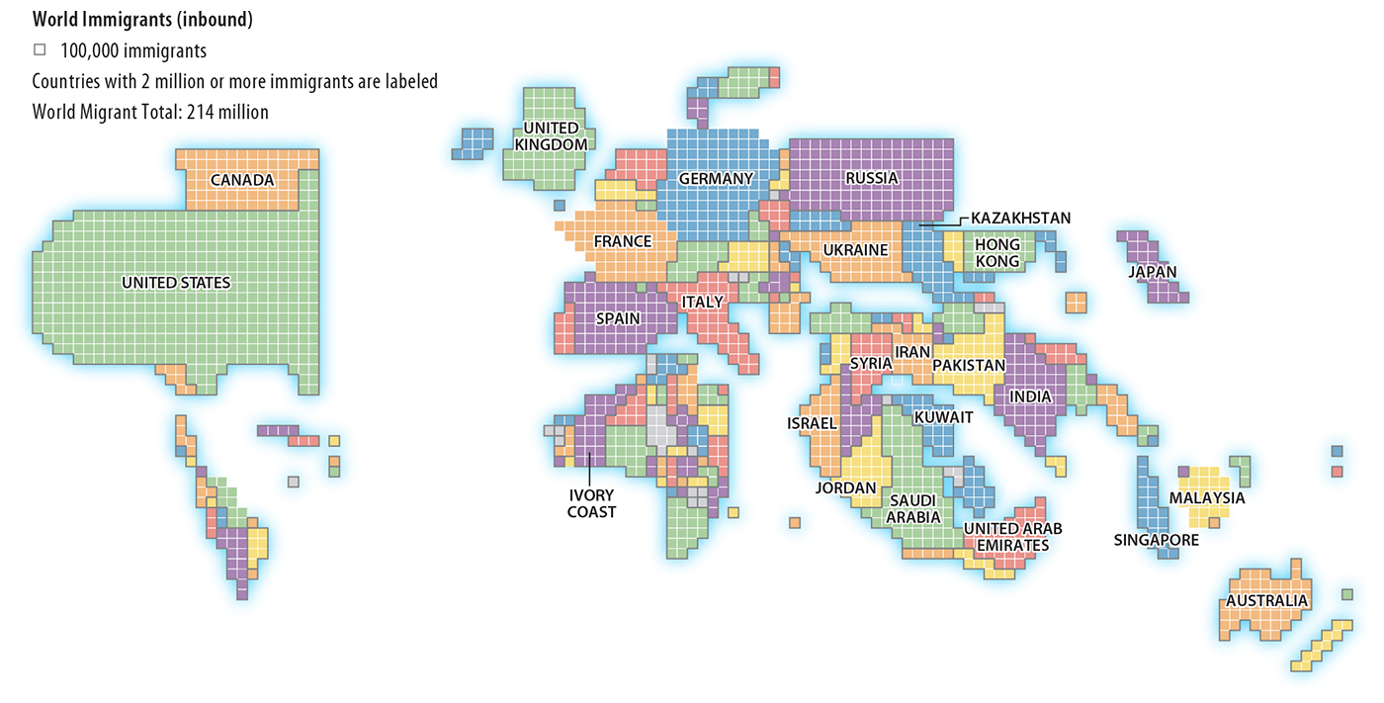
Maps – Cartograms

Slide 21
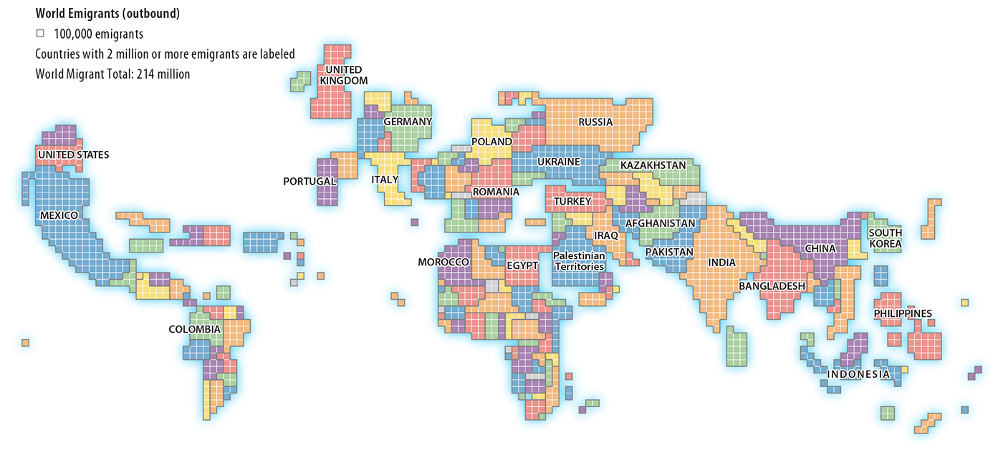
Maps – Cartograms

Slide 22
Learning objective (1.C.2)
By the end of this section, you will be able to use and interpret maps.
Maps are used to represent and identify spatial patterns and processes at different scales
Types of maps include reference maps and thematic maps
All map projections inevitably distort spatial relationships

Slide 23
Projections
We know that the earth is round and maps are flat
Therefore, all maps distort some aspect of reality (SADD – shape, area, distance, or direction)
The process of showing a curved surface on a flat surface is done using a map projection
There are 5 projections you need to know…

Slide 24
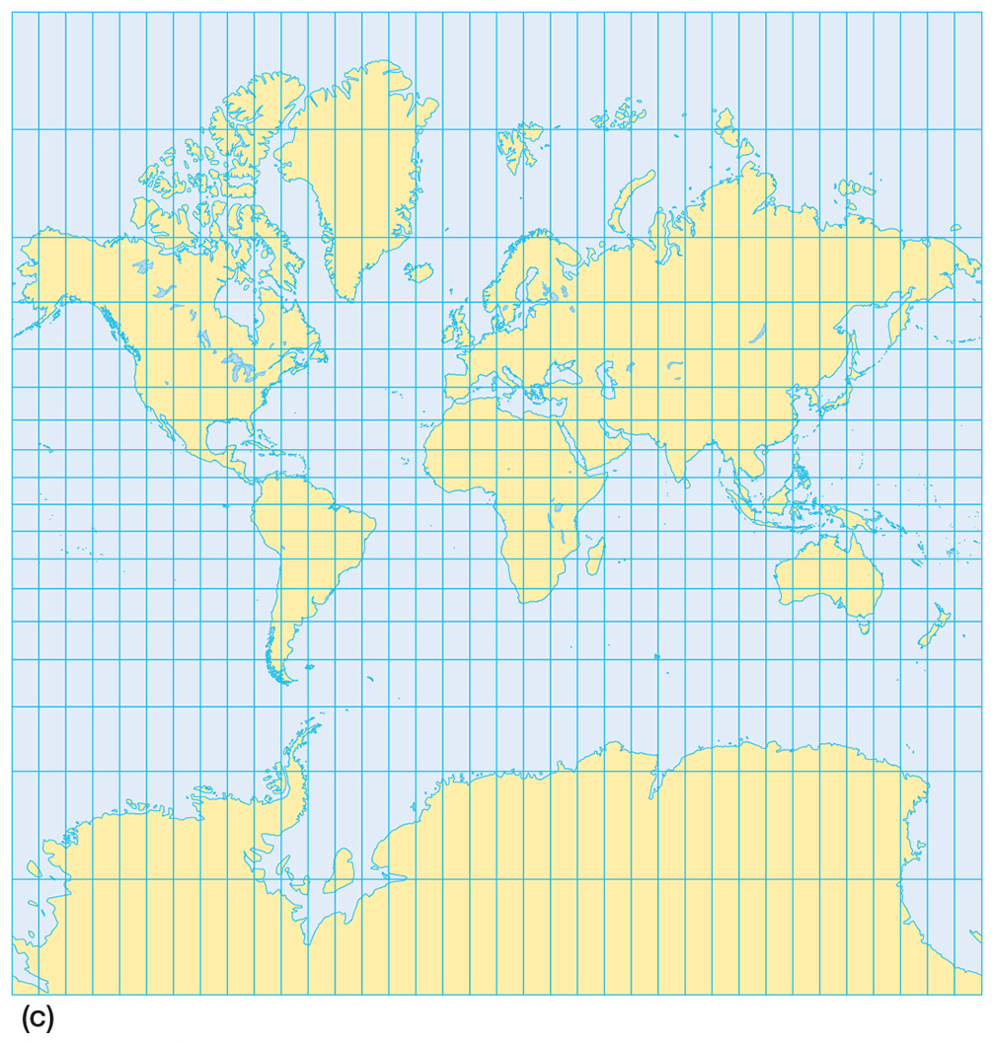
Projections - mercator
Purpose – navigation
Strengths – directions are accurate; lines of latitude and longitude meet at right angles
Distortion – distance between lines of longitude appear consistent; land masses near the poles appear large.

Slide 25
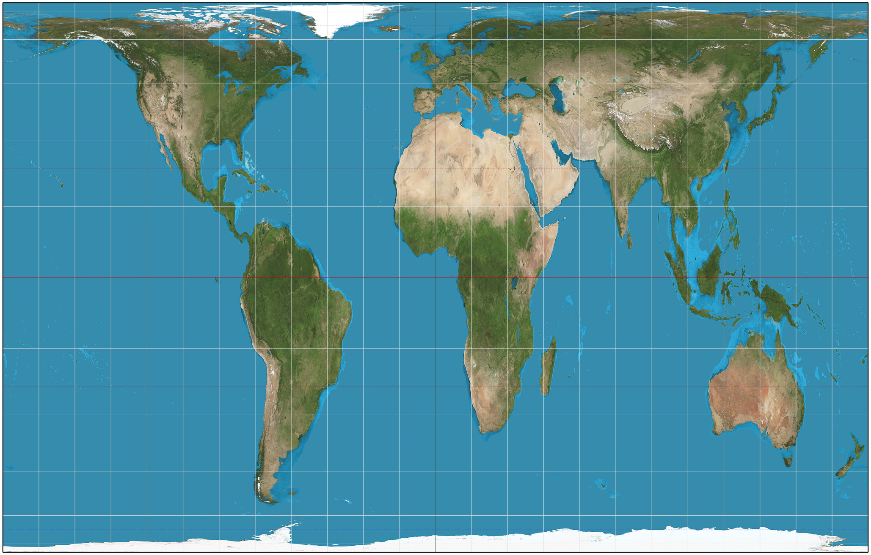
Projections - Peters
Purpose – spatial distributions related to area
Strengths – sizes of land masses are accurate
Distortion – shapes are inaccurate, especially near the poles

Slide 26
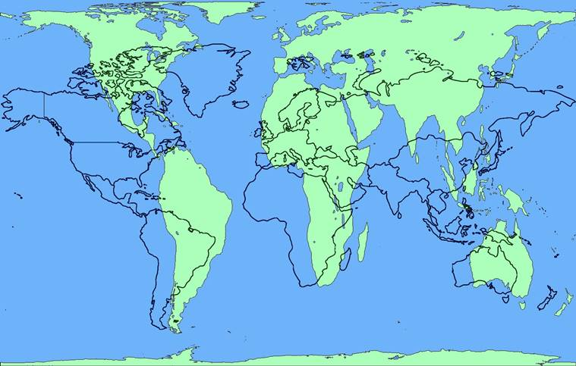
Projections – Peters over mercator

Slide 27
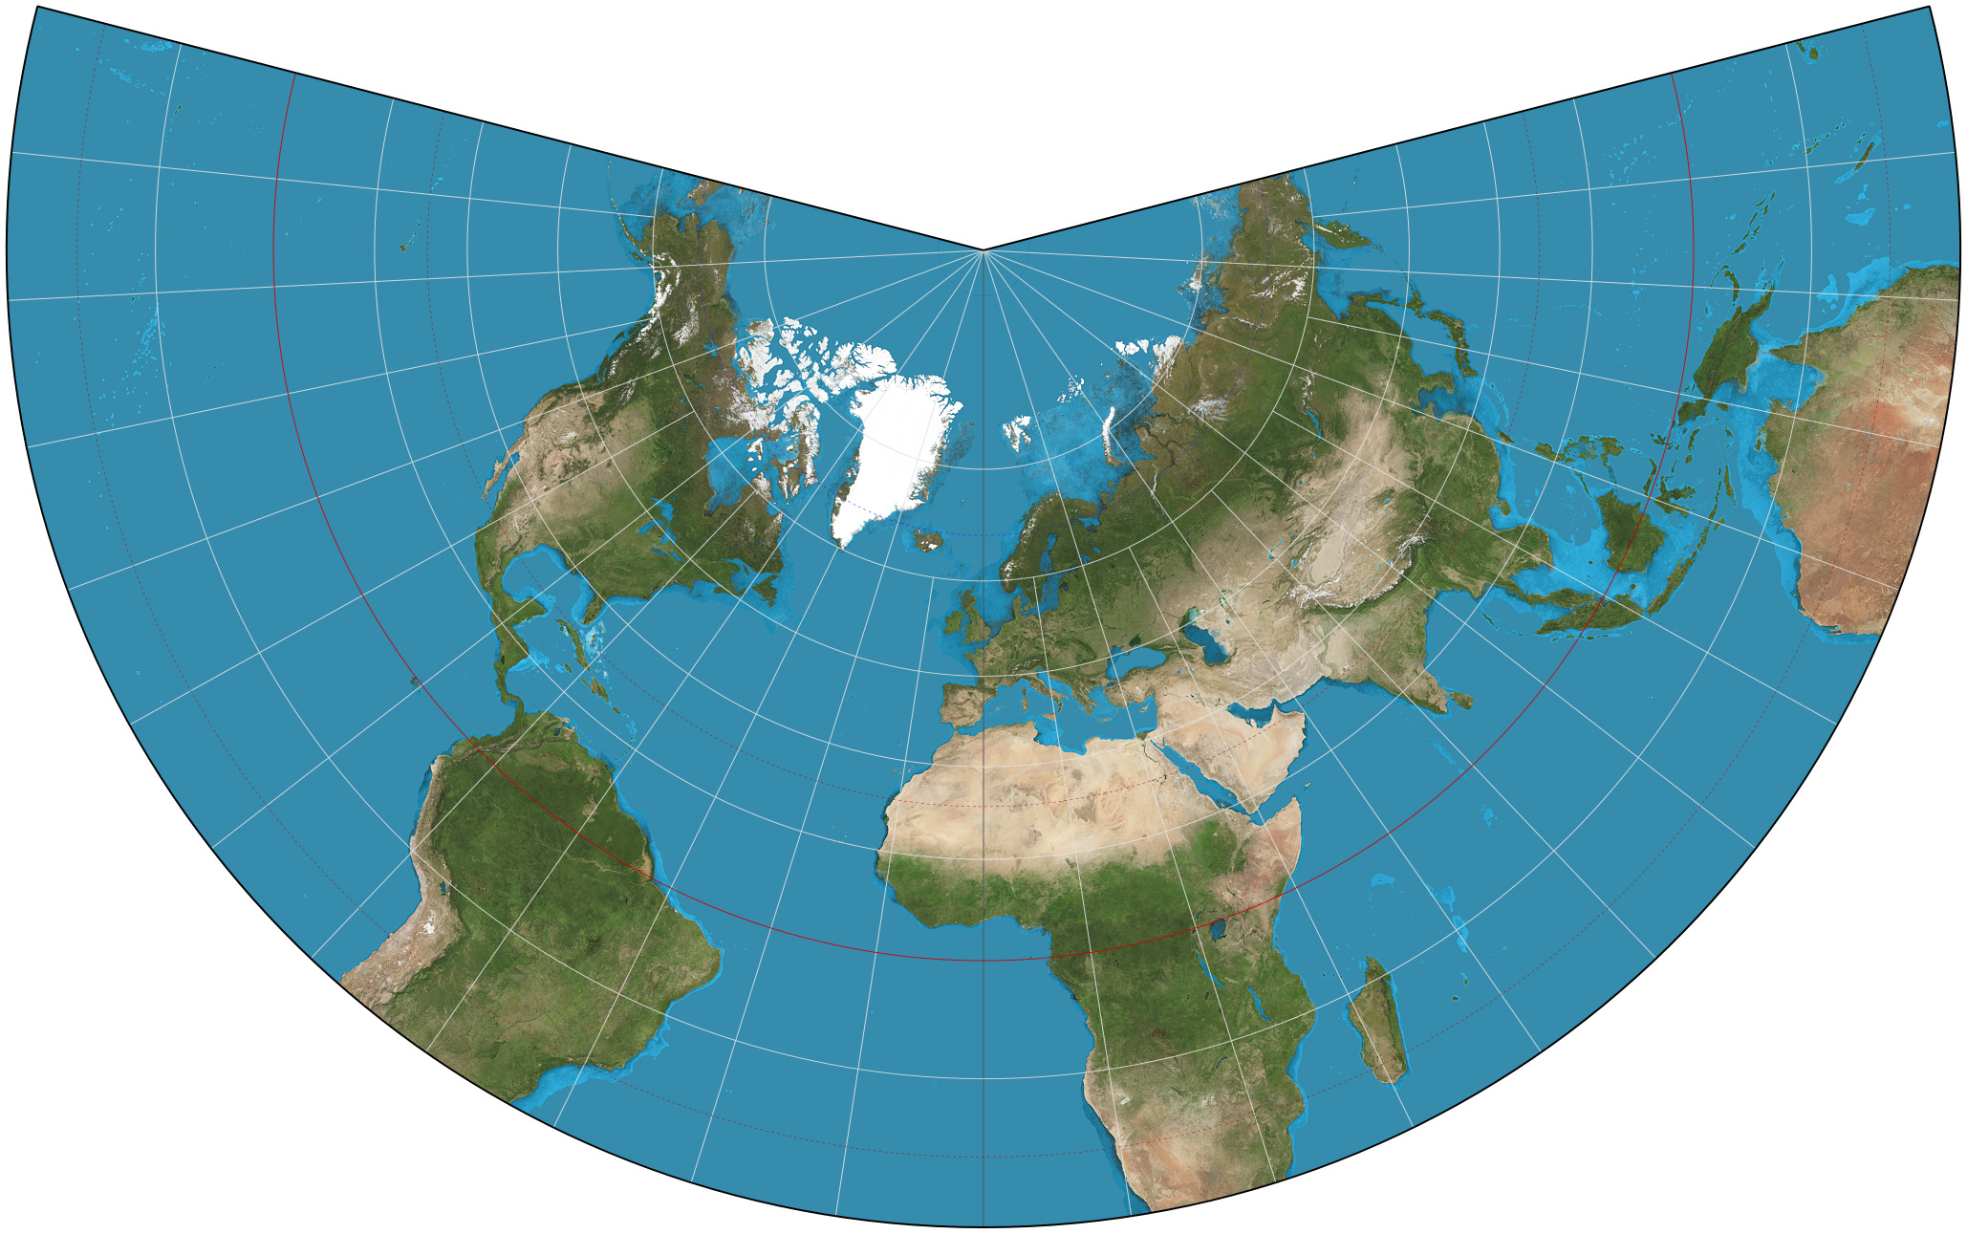
Projections - COnic
Purpose – general use in midlatitude countries
Strengths – lines of longitude converge; lines of latitude are curved; size and shape are close to reality
Distortion – directions are not constant; longitude lines converge at one pole

Slide 28
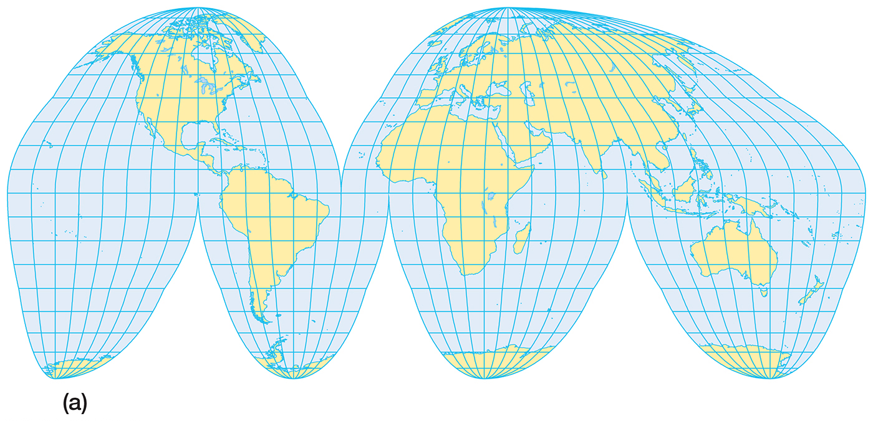
Projections – Goode-homolosine
Purpose – spatial distribution
Strengths – area and shape are preserved
Distortion – interrupts the oceans

Slide 29
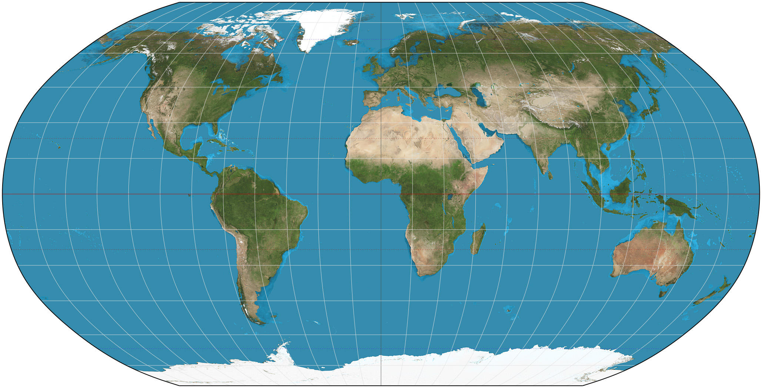
Projections – Robinson
Strengths – size is closer to accurate; ocean sizes look more accurate
Distortion – Antarctica looks very large and Greenland looks flattened north to south.

Slide 30
Enduring Understanding (1.C)
Remember, by the end of this section, you will understand that geographical skills provide a foundation for analyzing world patterns and processes.

Slide 31
Learning objective (1.C.4)
By the end of this section, you will be able to use and interpret geographic models
Geographers use models as generalizations to think systematically about topics such as land use (e.g., von Thünen model, Latin American city model), industrial location (e.g., Weber model), and the distribution of settlements (e.g., Christaller’s central place theory)

Slide 32
Models in geography
Geographic models are representations of reality or theories about reality to help them see general spatial patterns, focus on the influence of specific factors, and understand variations from place to place.
Models help explain, describe, and sometimes even predict spatial activity and phenomena.
Two basic types: spatial and non-spatial

Slide 33
Models in geography - spatial
Spatial models illustrate theories about spatial distributions
Example: agricultural land use – Von Thünen model
Example: industrial location – least cost theory
Example: distribution of cities – central place theory

Slide 34
Models in geography – Non-spatial
Non-spatial models illustrate theories and concepts using words, graphs, or tables. They often depict changes over time rather than across space.
Example: demographic transition model (DTM)
Example: Rostow’s modernization model
Example: Wallerstein’s world-systems theory combines both spatial and non-spatial

Slide 35
Formulas and Graphs
Formulas help geographers understand how the world works and function much like models
Mathematical calculations used to produce statistics
Determine CBR and CDR
Doubling times for population
Population densities
Theoretical formulas produce results that are more theoretical
Rank-size rule
Graphs illustrate population structures (pyramids), geographic concepts (distance-decay), and even models (DTM)

Slide 36
Use of models
Von Thünen Model
Generalization – based on what people did, he developed a general model about agricultural land use
Simplification – focused on two variables (transportation and distance)
Theoretical – could be applied around the world but would never exactly match reality
Models are never really right or wrong but are useful in understanding the world

Slide 37
Enduring Understanding (1.C)
Remember, by the end of this section, you will understand that geographical skills provide a foundation for analyzing world patterns and processes.

Slide 38
Learning objective (1.C.7-8)
By the end of this section, you will be able to define region as a concept, identify world regions, and understand regionalization processes.
Definition of region
Types of regions
World regions
By the end of this section, you will be able to explain and evaluate the regionalization process.
Regional thinking and regionalism

Slide 39
Regionalization and regions
Regionalization is the process geographers use to divide and categorize space into smaller areal units – the same way a writer divides a book into chapters and then names (classifies) them.
Three types of regions
Formal
Functional
Vernacular

Slide 40
Types of regions: formal
Formal regions, sometimes called uniform regions or homogenous regions, are united by one or more traits
Physical – the Sahara, a vast desert in North Africa
Cultural – southwestern Nigeria, an area where most people speak Yoruba
Economic – Gold Coast of Africa (Ghana), which exports gold

Slide 41
Types of regions: functional
Functional regions, or nodal regions, are organized around a focal point and are defined by an activity that occurs across the region
Often united by communication or transportation that are centered around a node
Region: pizza delivery area; Node: pizza shop
Region: a country; Node: capital city (political node)

Slide 42
Types of regions: Perceptual
Perceptual regions, or vernacular regions, are defined by the informal sense of place that people ascribe to them and vary widely
The American “South”
The Middle East
“Upstate” New York
The exact boundaries depend upon the person who is defining them

Slide 43
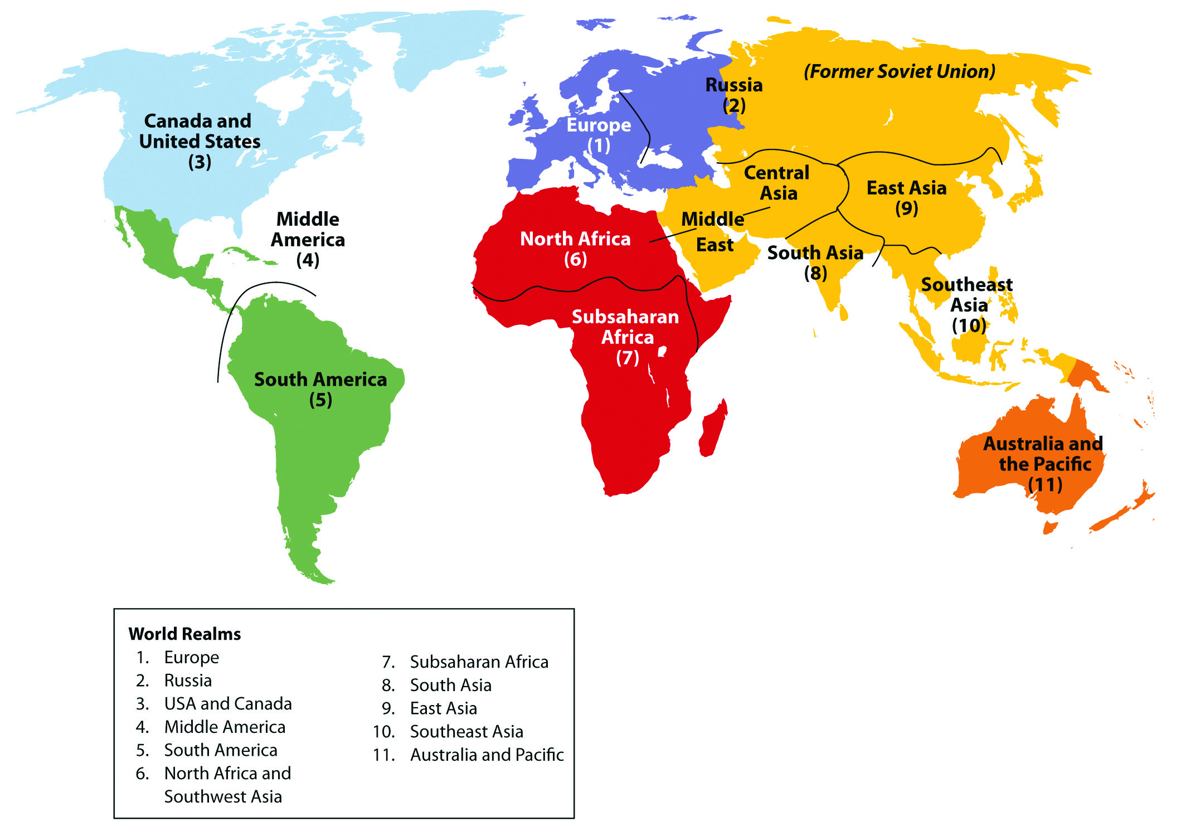
World regions – large regions
Geographers divide the world into regions and subregions

Slide 44
World regions – subregions
Subregions are large regions divided into smaller sections
They share some characteristics with the rest of the larger region but is distinctive in some ways
Example: Latin America covers parts of North and South America, from Mexico to Chile. As in most Latin American countries, most people in Brazil are Roman Catholics. However, most Brazilians speak Portuguese. Because of its language, Brazil is a distinct subregion.

Slide 45
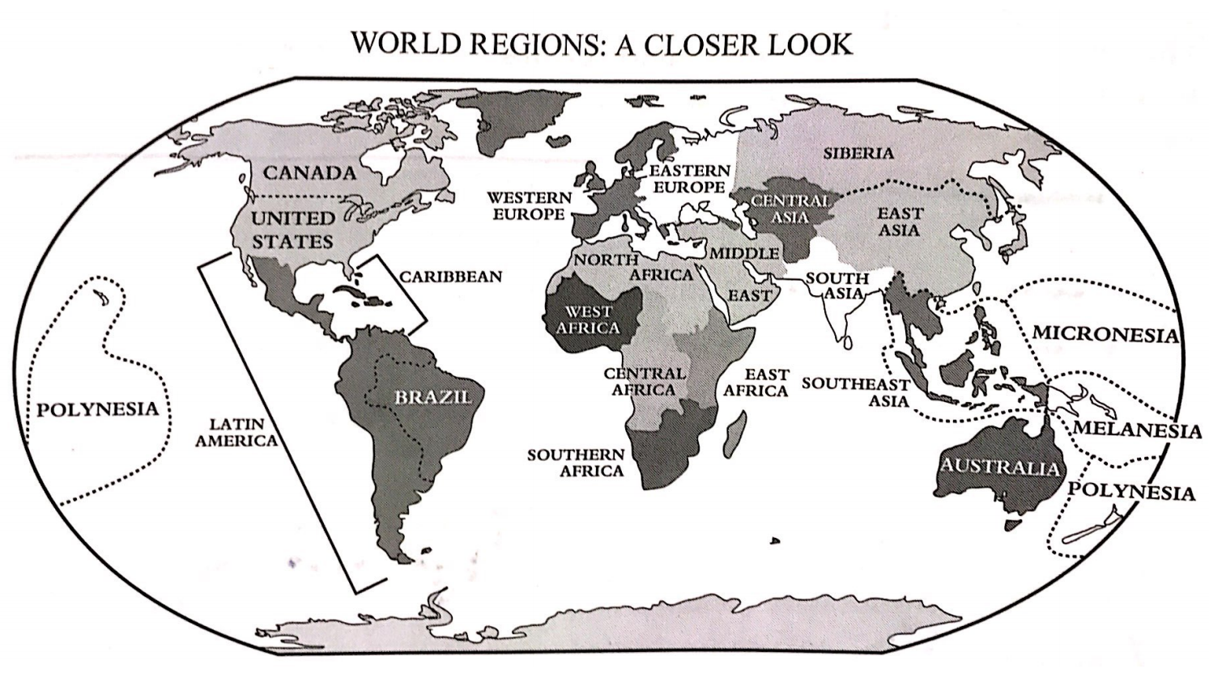
World regions – subregions

Slide 46
World regions – smaller regions
Subregions can be divided into smaller regions and can be based on elements of physical geography, such as climate and landform, or human geography, such as culture, politics, or economics
Any one place is part of many regions or subregions
Example: Florida is part of a climate region base on its warm weather, a cultural region known as the South, and an economic region known as the Sun Belt.

Slide 47
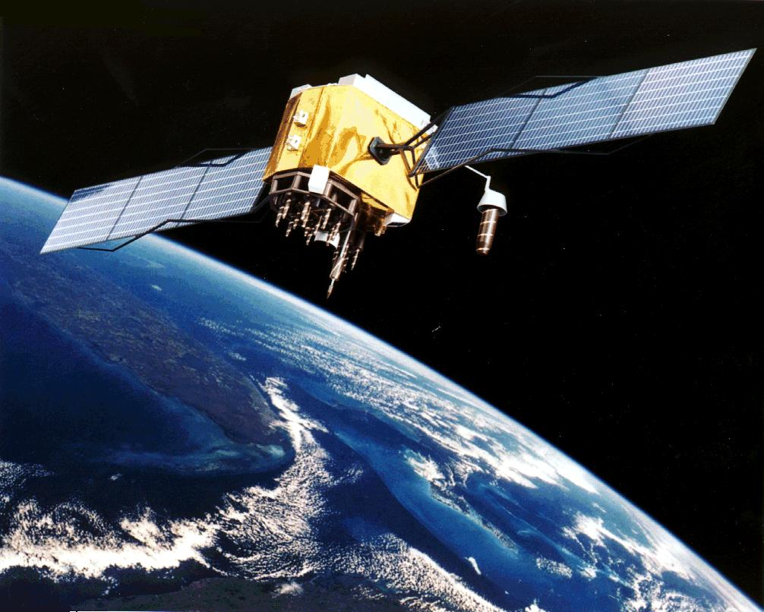
Enduring Understanding (1.D)
By the end of this section, you will understand that geospatial technologies increase the capability for gathering and analyzing geographic information with applications to everyday life.

Slide 48
Learning objective (1.D.1)
By the end of this section, you will be able to use and interpret geospatial data
Geospatial technologies include GIS, GPS, remote sensing, and online mapping and visualization
Geospatial data is used at all scales for personal (navigation), business (marketing), and governmental (environmental planning) purposes

Slide 49
Geospatial data
Geospatial data includes all information that can be tied to a specific place
Locations, human activities, and traits
Examples:
Where do speakers of Chinese live?
How common is poverty in each U.S. county?
Where is the dividing line in a city between students who attend one high school and those who attend another?

Slide 50
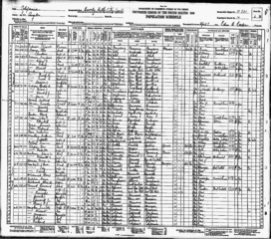
Geospatial data – obtaining data
Much of the data is obtained through fieldwork – observing and recording information on location
Census of the population, interviews, informal observations

Slide 51
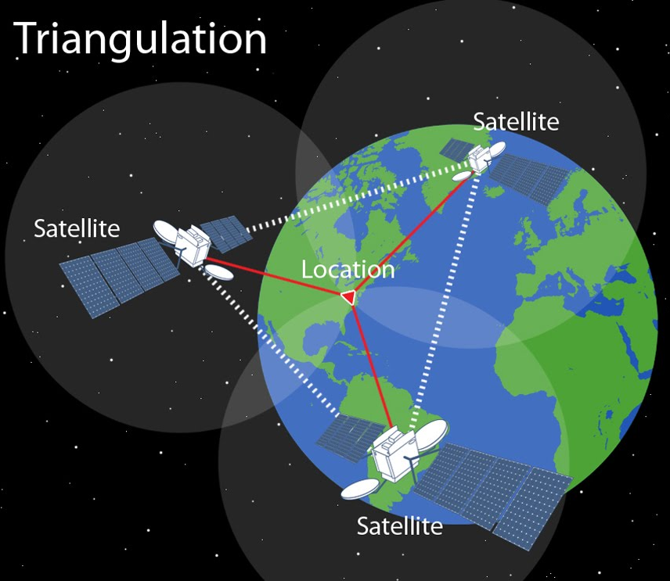
Geospatial data – technologies
Global Positioning System (GPS)
Description: GPS receivers on Earth’s surface use the locations of multiple satellites to determine and record a receiver’s exact location
Uses: precisely locating border; navigating ships, aircraft, and cars; mapping lines (trails) or points (fire hydrants)

Slide 52
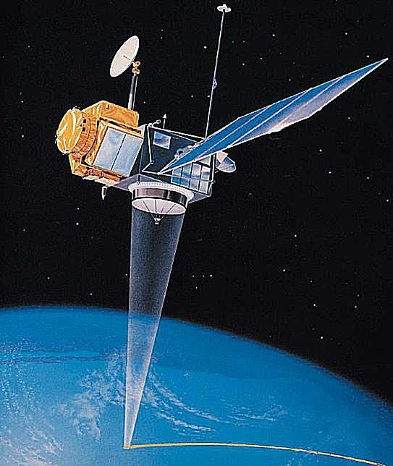
Geospatial data – technologies
Remote Sensing
Description: the use of cameras or other sensors mounted on aircraft or satellites to collect digital images of the earth’s surface
Uses: determining land cover and use; monitoring environmental changes; assessing spread of spatial phenomena; weather

Slide 53
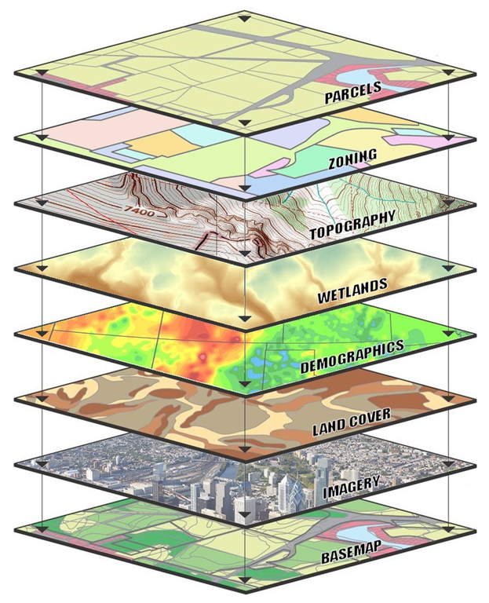
Geospatial data – technologies
Geographic Information Systems (GIS)
Description: computer system that can store, analyze, and display information from multiple digital maps or geospatial data sets
Uses: analysis of crime data; effects of pollution; transportation/travel time analysis; urban planning

Slide 54
The London subway map
One of the most useful, yet inaccurate, maps
Shows the value of the concept of relative location
Passengers did not need to know the twists and turns of the track or the actual distance between stops

Slide 55
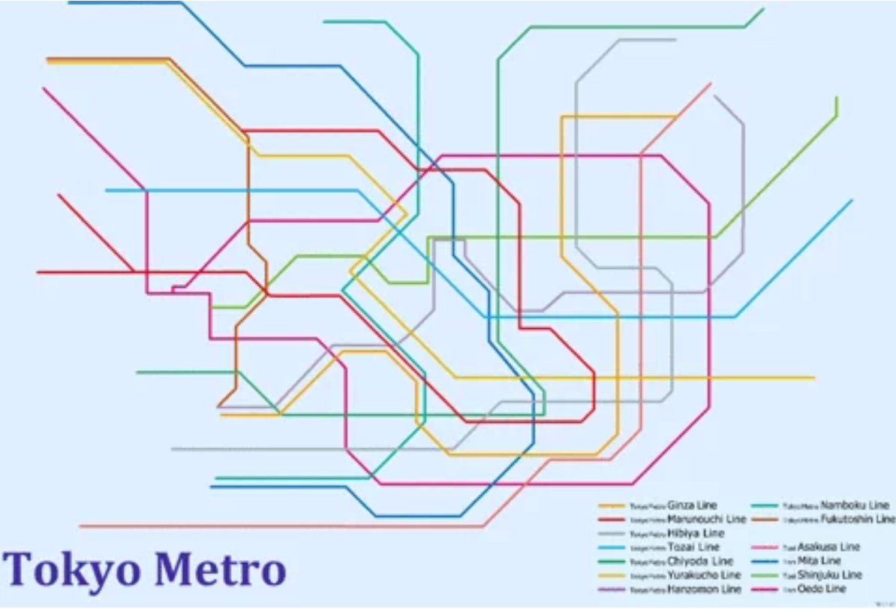
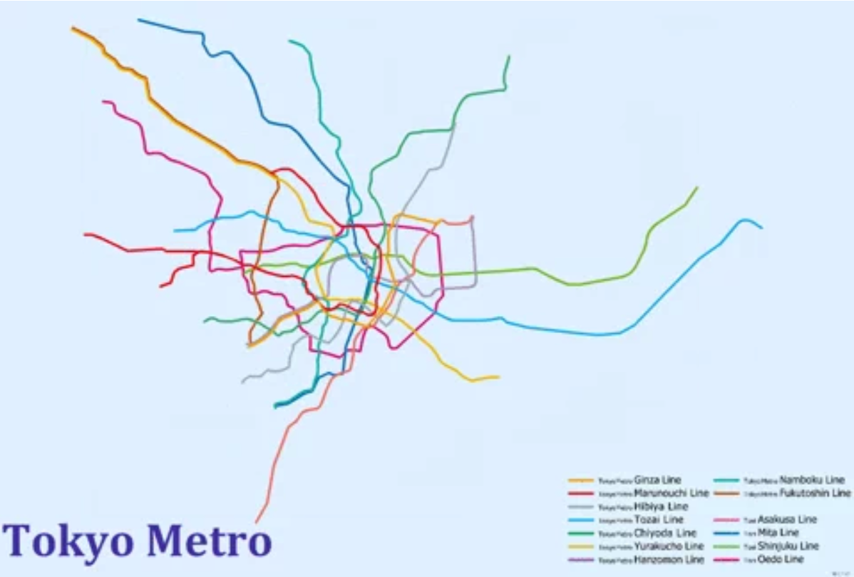
The London subway map

