Slide 1
The Kendama
Jaylon Watson

Slide 2
THE where
Many believe that the kendama originated in Japan.
Apparently there are some records showing that it really originated in France in 16th century.
The French version of this game was called bilboquet.
The real origins of this game are still disputed.

Slide 3
when
The kendama was believed to be imported through the Silk Road in Japan between 1777-1778.
The game gained popularity during 1600-1868
Then in the 20th century two cups were added and the Japanese name translates to sun and moon. (moon = small cup and Sun = big cup)

Slide 4
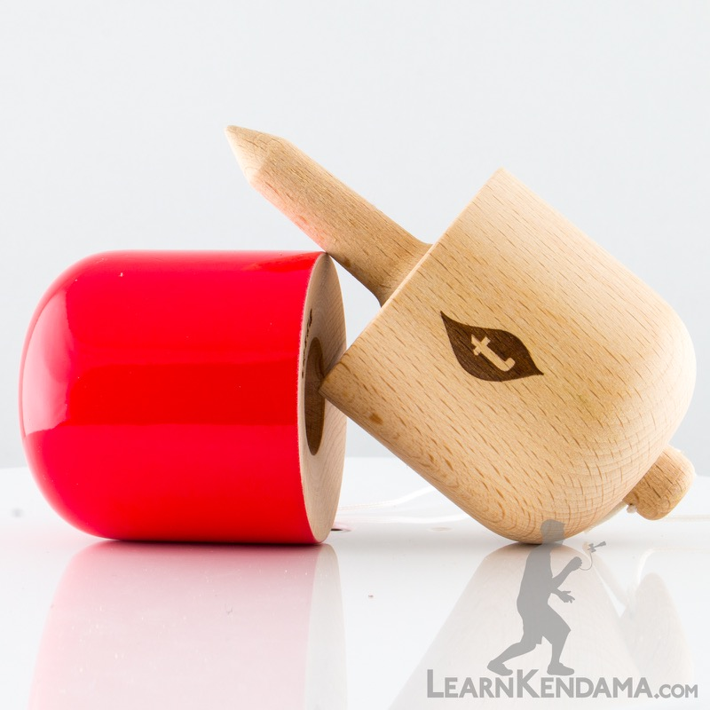
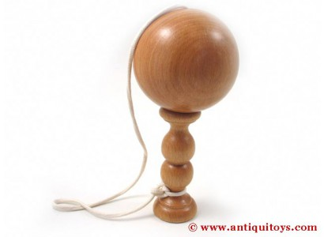
What
The kendama has many variations.( more than just listed here)
But the traditional kendama is a game where you try to catch the ball in three different cups or try to spear the ball with the spike.
Then there is a pill kendama where there isn’t any cups just a spike and the shape is that of a pill.
Then there is a bilboquet kendama has more of the traditional shape but no cups

Slide 5
How it was used
The kendama was used as part of a drinking game that if a player were to mess up a trick they would have to drink more.
Also it was just a traditional game that children and adult all over enjoyed.
The game even strengthens hand /eye coordination, reflex and balance.

Slide 6
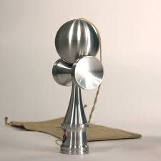
What they are made from
Also kendamas were traditionally made from wood.
But today they are still mostly mad from wood but they have been made from other materials such as plastic, and even metal.

Slide 7
Kendama Today
Today kendamas are more viral than they ever been.
This means for new tricks, types, means of creation etc.

