Slide 1
By: Carli Terrell (Orlando, Florida)
This PPT has been created using the information from the AMSCO Human Geography: Preparing for the Advanced Placement Examination book.
Palmer, David. AMSCO Advanced Placement Human Geography. Perfection Learning, 2019.

Slide 2
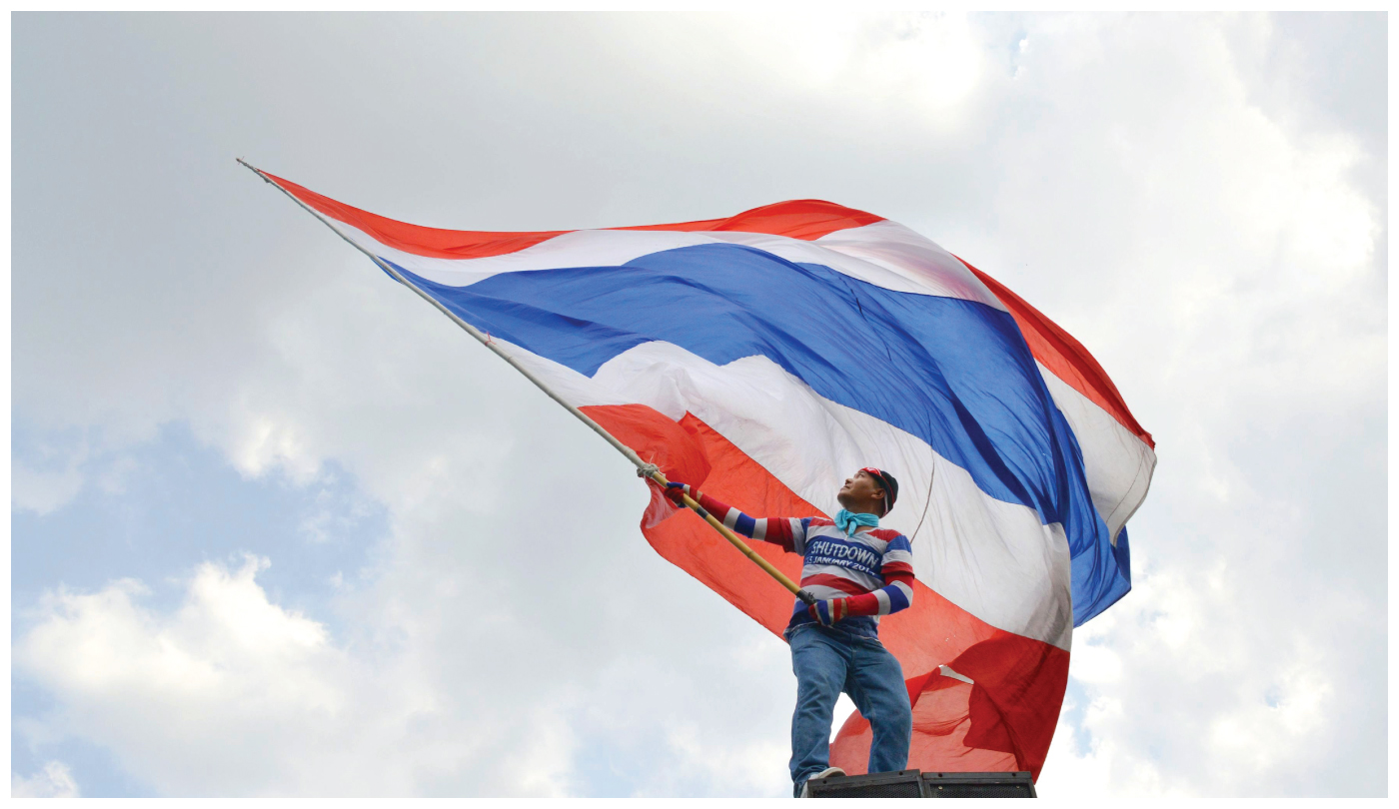
Unit 4 – political organization of space
Ch 10: Territory, Power, and Boundaries

Slide 3
Enduring Understanding (4.B)
By the end of this section, you will understand that spatial political patterns reflect ideas of territoriality and power at a variety of scales.
Territoriality: connection of people, culture, and their economic system to the land.
Power: geographic control over people, land, and resources.

Slide 4
Learning objective (4.B.2)
By the end of this section, you will be able to evaluate the nature and function of international and internal boundaries.
Students will know that
Boundaries are defined, delimited, demarcated, and administered
International boundaries establish the limits of sovereignty and can be the source of disputes
Boundaries can influence identity and promote or prevent international or internal interactions and exchanges
The Law of the Sea has enabled states to extend their boundaries offshore, which sometimes results in conflicts
Voting districts, redistricting, and gerrymandering influence the results of elections at various scales

Slide 5
International and Internal Boundaries
In theory, boundaries exist to add clarity
Political entities begin and end
What territories belong to which states
In reality, sometimes people disagree where the boundaries should be, and these uncertain boundaries have been a frequent cause of violence and war.
Crossing boundaries implies that some rules, expectations, or behaviors will change – these rules are called laws.
Examples of informal boundaries include spheres of influence and neighborhoods controlled by street gangs

Slide 6
International and Internal Boundaries
Categories of Boundaries
Defined – established by a legal document (ex: treaty) and could range from a country to a single plot of real estate.
Delimited – line drawn on a map to show the limits of space.
Demarcated – physical objects placed on the landscape (ex: a sign or fences and walls)
Simply, borders are first established, then placed on a map, and then placed on the earth.

Slide 7
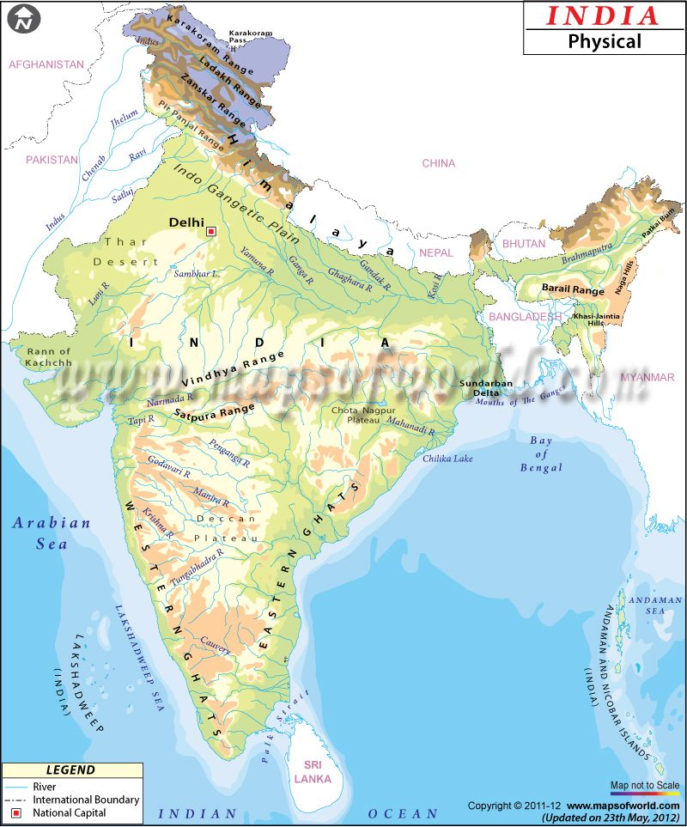
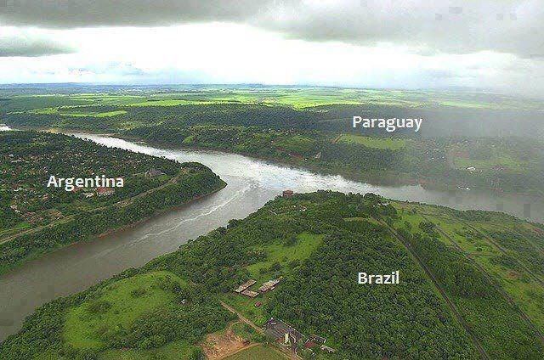
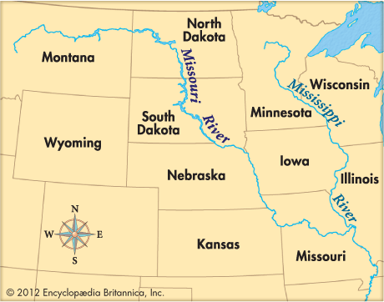
International and Internal Boundaries
Categories of Boundaries
Natural boundary – physical features that separate entities
Note that the Missouri River separates Iowa and Nebraska and the Himalayas separates India from China

Slide 8
International and Internal Boundaries
Categories of Boundaries
Geometric boundary – straight line drawn by people that does not follow any physical feature closely
Examples: large scale - division of Libya and Egypt; local scale – division of two suburbs of a city

Slide 9
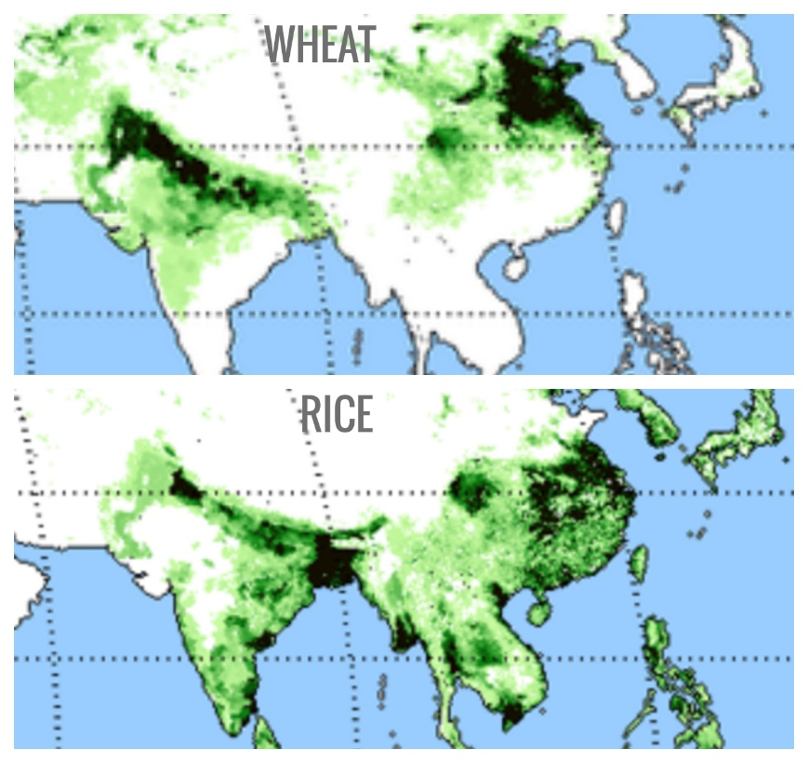
International and Internal Boundaries
Categories of Boundaries
Cultural boundary – based on human traits or behavior and often exists in the midst of a gradual change over space.
Example: historically, China cuisine was divided with wheat-based cuisine in the north and rice-based in the south but no line was ever drawn.

Slide 10
Learning objective (4.B.2)
By the end of this section, you will be able to evaluate the nature and function of international and internal boundaries.
Students will know that
Boundaries are defined, delimited, demarcated, and administered
International boundaries establish the limits of sovereignty and can be the source of disputes
Boundaries can influence identity and promote or prevent international or internal interactions and exchanges
The Law of the Sea has enabled states to extend their boundaries offshore, which sometimes results in conflicts
Voting districts, redistricting, and gerrymandering influence the results of elections at various scales

Slide 11
International and Internal Boundaries
Limited Sovereignty and International Boundary Disputes
Classifications of Boundaries
Antecedent
Subsequent
Relic (sometimes relict)
Superimposed
Militarized
Open

Slide 12
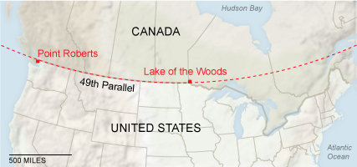
International and Internal Boundaries
Limited Sovereignty and International Boundary Disputes
Antecedent boundary
Ante means “before”
Definition: drawn before a large population was present
Example: Canada/USA at the 49th parallel – remember parallels are the lines of latitude

Slide 13
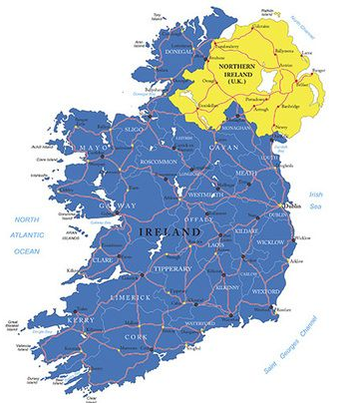
International and Internal Boundaries
Limited Sovereignty and International Boundary Disputes
Subsequent (or Ethnographic) boundary
Subsequi is Latin meaning “follow closely after”
Definition: accommodates religious, ethnic, linguistic, or economic differences.
Example: Northern Ireland (part of the United Kingdom) and the Republic of Ireland

Slide 14
International and Internal Boundaries
Limited Sovereignty and International Boundary Disputes
Relic boundary
Relic comes from Latin and means “something left behind”
Definition: no longer exists but evidence still exists on the landscape
Example: East and West Germany are united but the boundary can still be felt

Slide 15
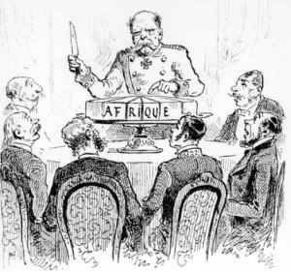
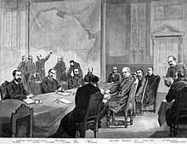
International and Internal Boundaries
Limited Sovereignty and International Boundary Disputes
Superimposed boundary
Superimposed means “to put upon, place over, place above”
Definition: boundary drawn by outside powers
Example: boundaries drawn over Africa after the Berlin Conference

Slide 16
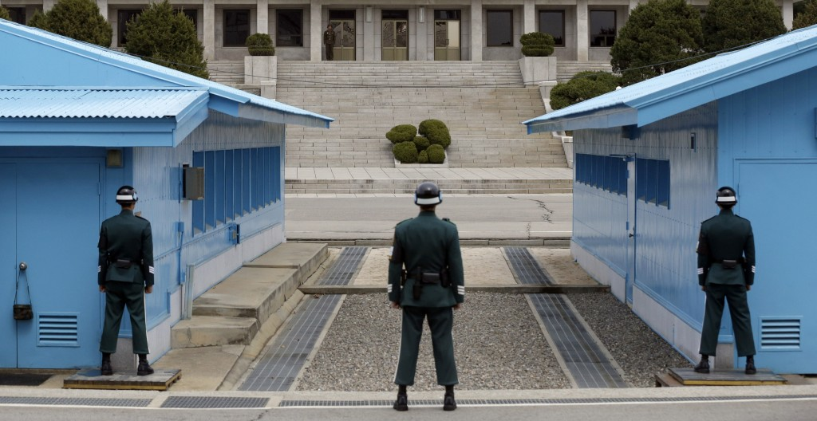
International and Internal Boundaries
Limited Sovereignty and International Boundary Disputes
Militarized boundary
Definition: boundary that is heavily guarded and discourages crossing and movement
Example: boundary between North Korea and South Korea

Slide 17
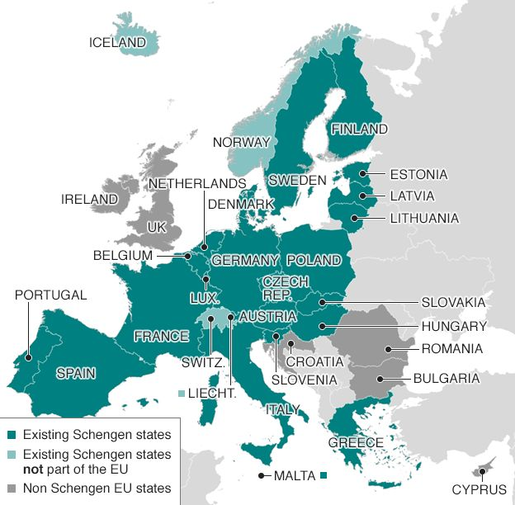
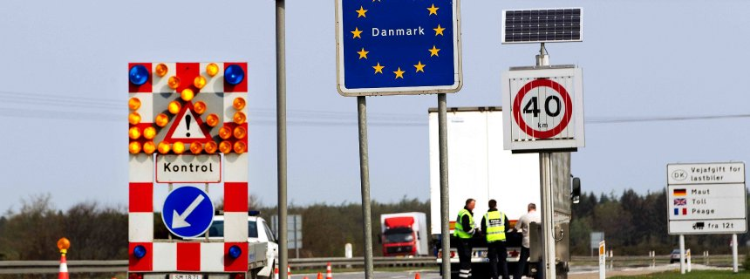
International and Internal Boundaries
Limited Sovereignty and International Boundary Disputes
Open boundary
Definition: boundary where crossing is unimpeded (not blocked)
Example: countries in Europe that signed the Schengen Agreement

Slide 18
International and Internal Boundaries
Limited Sovereignty and International Boundary Disputes
As the number of states has increased, so have boundary disputes
There are four main disputes
Definitional
Locational
Operational
Allocational

Slide 19
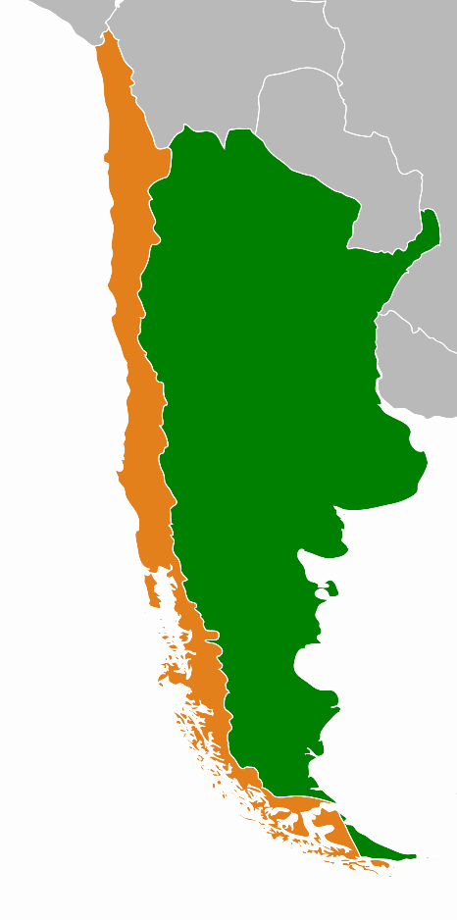
International and Internal Boundaries
Limited Sovereignty and International Boundary Disputes
Definitional: two or more parties disagree on how to interpret (or define) the legal documents or maps that identify the boundary.
Often occur with antecedent boundaries
Example: boundary between Chile and Argentina – the elevated crests of the Andes mountains serve as the boundary but since the southern land was neither settled nor accurately mapped, this territory lies in dispute.

Slide 20
International and Internal Boundaries
Limited Sovereignty and International Boundary Disputes
Locational: disputes that center on where a boundary should be.
Example: post-World War I boundary between Germany and Poland was set by treaty but the Germans disputed the location. Many ethnic Germans found themselves on the Polish side of the border.
This led to irredentism – when one country seeks to annex territory in another because it has ties to part of the population that lives there.

Slide 21
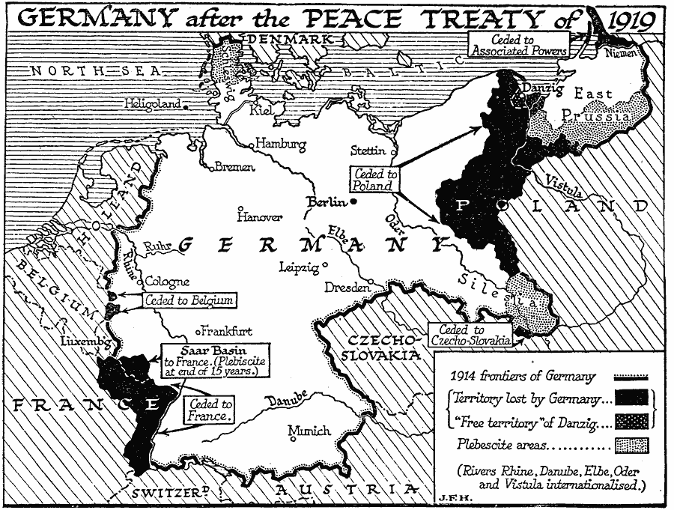

Slide 22
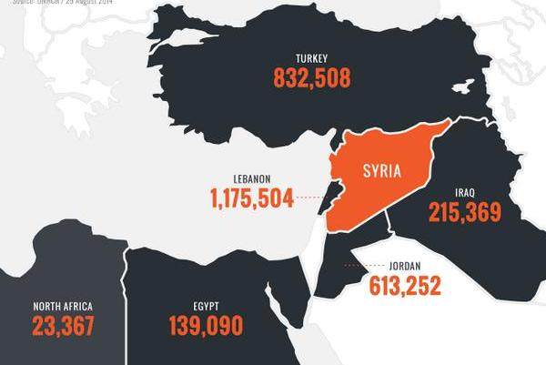
International and Internal Boundaries
Limited Sovereignty and International Boundary Disputes
Operational: disputes how a boundary functions (or operates)
Example: as refugees fled the civil war in Syria in 2011, then perspective of European boundaries shifted.
Responsibility for helping shifted from one country to another
Barriers to keep refugees out

Slide 23
International and Internal Boundaries
Limited Sovereignty and International Boundary Disputes
Allocational: when a boundary separates natural resources that may be used by both countries.
Natural resource boundaries are vertical planes that extend up into the sky and down into the earth
Example: in 1990, Iraq invaded Kuwait for drilling too many wells and using oblique boreholes, thus breaking the vertical plane and extracting oil on the Iraqi side of the boundary.

Slide 25
Learning objective (4.B.2)
By the end of this section, you will be able to evaluate the nature and function of international and internal boundaries.
Students will know that
Boundaries are defined, delimited, demarcated, and administered
International boundaries establish the limits of sovereignty and can be the source of disputes
Boundaries can influence identity and promote or prevent international or internal interactions and exchanges
The Law of the Sea has enabled states to extend their boundaries offshore, which sometimes results in conflicts
Voting districts, redistricting, and gerrymandering influence the results of elections at various scales

Slide 26
International and Internal Boundaries
Boundaries Influence Identity, Interaction, and Exchange
Boundaries can influence a state’s identity, interaction with neighboring countries and the international community as a whole, and the exchange of resources, goods and services, and people.
These can have positive or negative results.

Slide 27
International and Internal Boundaries
Boundaries Influence Identity, Interaction, and Exchange
Identity – stir strong feelings in nationalism and extending across the boundaries may question a country’s reason for existence
Interaction – following the end of WWII, agreements among the EU states made most of the continent borderless and peaceful. Goods and people could flow freely and people seemed less likely to settle disputes with violence.

Slide 28
International and Internal Boundaries
Boundaries Influence Identity, Interaction, and Exchange
Interaction – In contrast, the Korean peninsula became sharply divided; after the Korean War in 1953, a temporary military boundary called the Demilitarized Zone (DMZ) and has since blocked the flow of trade and people.
Since the early 1960s, South Korea has flourished into a democratic country while North Korea remains impoverished and isolated under an authoritarian government.

Slide 29
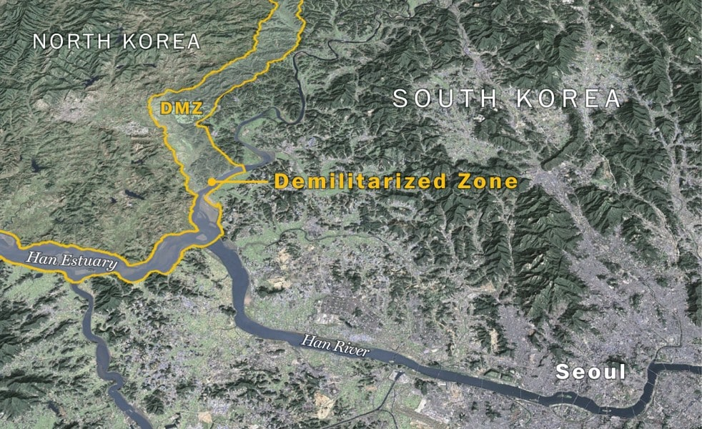

Slide 30
Learning objective (4.B.2)
By the end of this section, you will be able to evaluate the nature and function of international and internal boundaries.
Students will know that
Boundaries are defined, delimited, demarcated, and administered
International boundaries establish the limits of sovereignty and can be the source of disputes
Boundaries can influence identity and promote or prevent international or internal interactions and exchanges
The Law of the Sea has enabled states to extend their boundaries offshore, which sometimes results in conflicts
Voting districts, redistricting, and gerrymandering influence the results of elections at various scales

Slide 31
International and Internal Boundaries
The Law of the Sea
How far horizontally should a country’s influence spread?
Only recently have the water boundaries been systematically addressed.
1973-1982: United Nations Law of the Sea (UNCLOS) was signed by over 150 countries.

Slide 32
International and Internal Boundaries
The Law of the Sea
Four Zones
Territorial Sea – 12 nautical miles of sovereignty; commercial vessels may pass but non-commercial vessels may be challenged.
Contiguous Zone – Coastal states have limited sovereignty up to 24 nautical miles (enforce laws on customs, immigration, and sanitation).
Exclusive Economic Zone (EEZ) – coastal states can explore, extract minerals, and manage up to 200 nautical miles.
High Seas – Water beyond the EEZ is open to all states

Slide 33
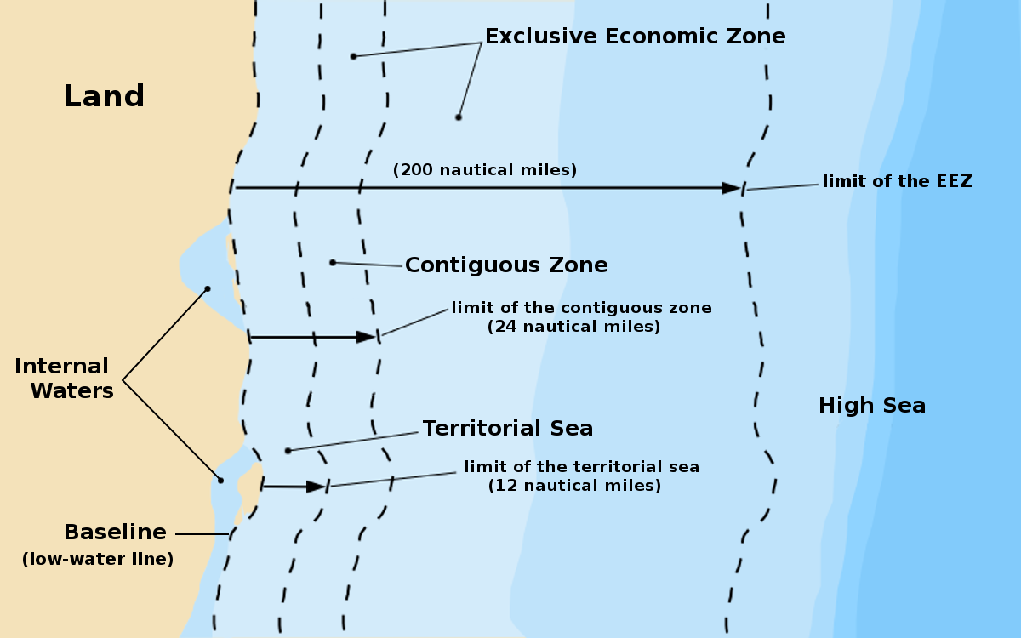

Slide 34
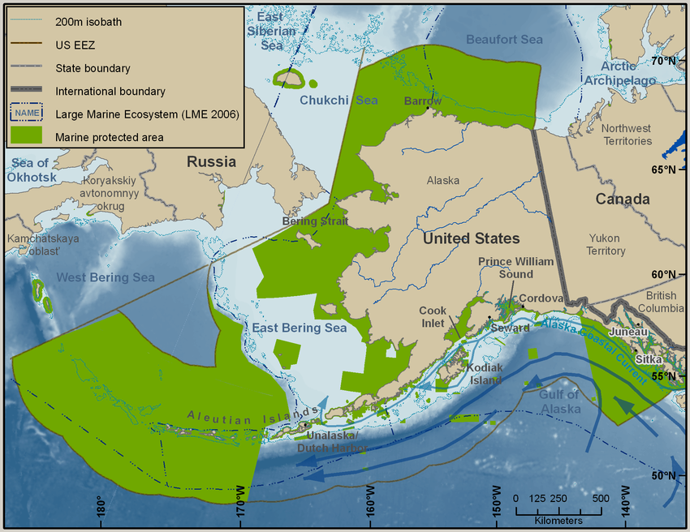
International and Internal Boundaries
The Law of the Sea
What if two coastal states share a waterway and are less than 24 nautical miles apart? The distance between the two coasts are divided in half.
States that have islands have been granted vast areas of space.

Slide 35
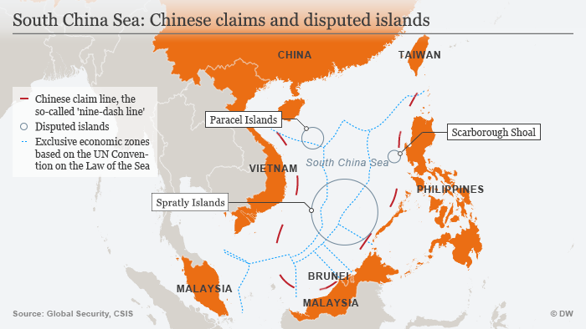

Slide 36
Learning objective (4.B.2)
By the end of this section, you will be able to evaluate the nature and function of international and internal boundaries.
Students will know that
Boundaries are defined, delimited, demarcated, and administered
International boundaries establish the limits of sovereignty and can be the source of disputes
Boundaries can influence identity and promote or prevent international or internal interactions and exchanges
The Law of the Sea has enabled states to extend their boundaries offshore, which sometimes results in conflicts
Voting districts, redistricting, and gerrymandering influence the results of elections at various scales

Slide 37
International and Internal Boundaries
Voting Districts, Redistricting, and Gerrymandering
Internal borders are important as well and citizens vote for leaders to govern on their behalf.
At the national, state/provincial, and local levels, these elected officials represent citizens, known as the electorate, and are designated to defined districts with distinct boundaries.

Slide 38
International and Internal Boundaries
Voting Districts, Redistricting, and Gerrymandering
US Census: a count of the population conducted every ten years to ensure the districts have close to the same number of people.
As a result of the census, the government determines each state’s number of representatives through reapportionment, to reflect the state’s population.
Then the district boundaries are redrawn to contain roughly the same number of people in a process called redistricting.
US House Representatives = 435 seats

Slide 39
International and Internal Boundaries
Voting Districts, Redistricting, and Gerrymandering
Sometimes, politicians maneuver this process by gerrymandering, the drawing of boundaries for political districts by the part or group in power to extend or cement their advantage.
Named after Massachusetts Governor Elbridge Gerry and has been used on a variety of scales.

Slide 40
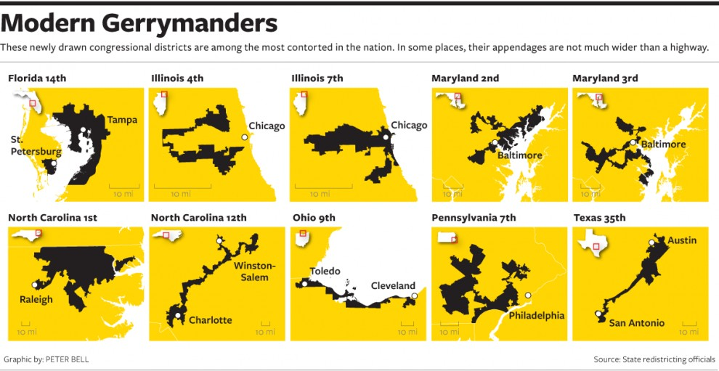

Slide 41
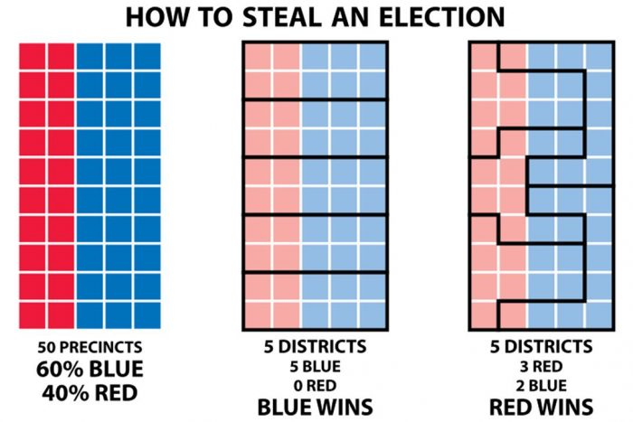

Slide 42
