Slide 1
Cellular Respiration
Assembled and Presented by: Dean Struempf

Slide 2
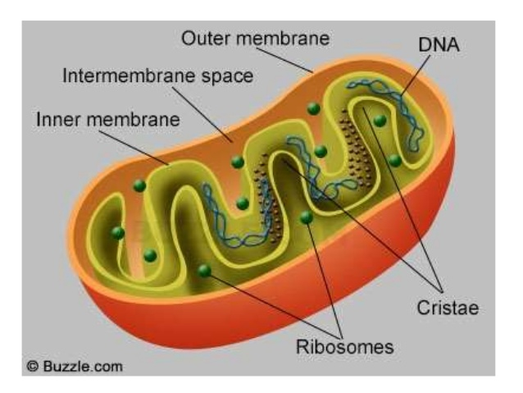
Review of Mitochondria
Cell organelle found in both Eukaryotic Cells (Plant and Animal).
Have two membranes- Inner and Outer.
Contain their own DNA molecules within their structure.
Commonly known to have been inherited by your mother, however, new studies suggest the father can also pass these down.

Slide 3
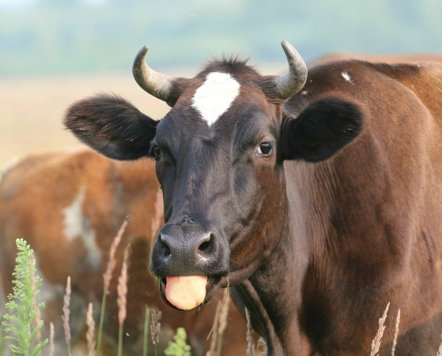
Review of Mitochondria
Convert the chemical energy stored in food molecules into compounds that are more convenient for the cell to use.
In food, energy that is stored is referred to as a calorie, which is the amount of energy needed to raise the temperature of 1 gram of water 1 degree Celsius.
As opposed to a Calorie, with a capital C, which means 1 kilocalorie, or 1000 calories.

Slide 5
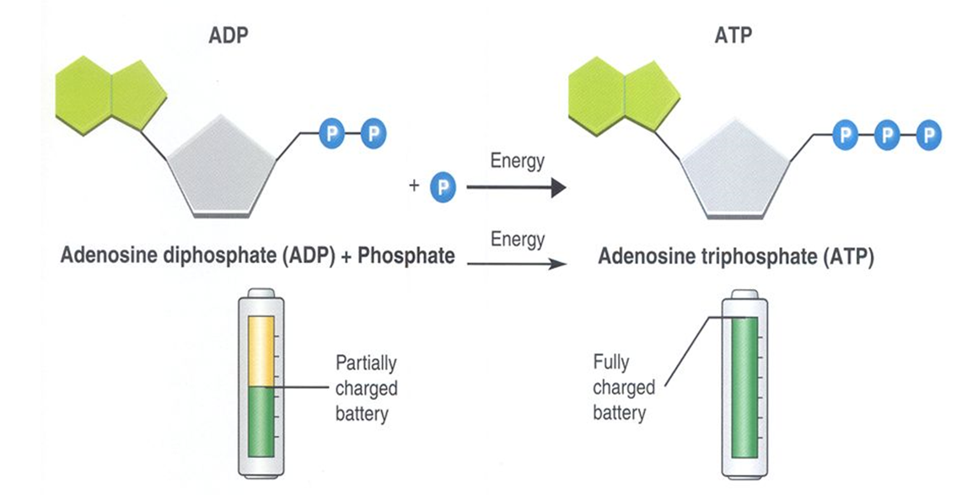
Review ADP & ATP
ATP can release and store energy by breaking and re-forming the bonds between its phosphate groups. This characteristic of ATP makes it exceptionally useful as a basic energy source for all cells.
Think of it like energy currency. If a transaction requires energy, ATP is used to pay for that activity to occur.

Slide 6
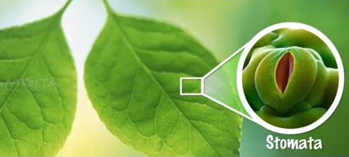
Review of Photosynthesis

Slide 7
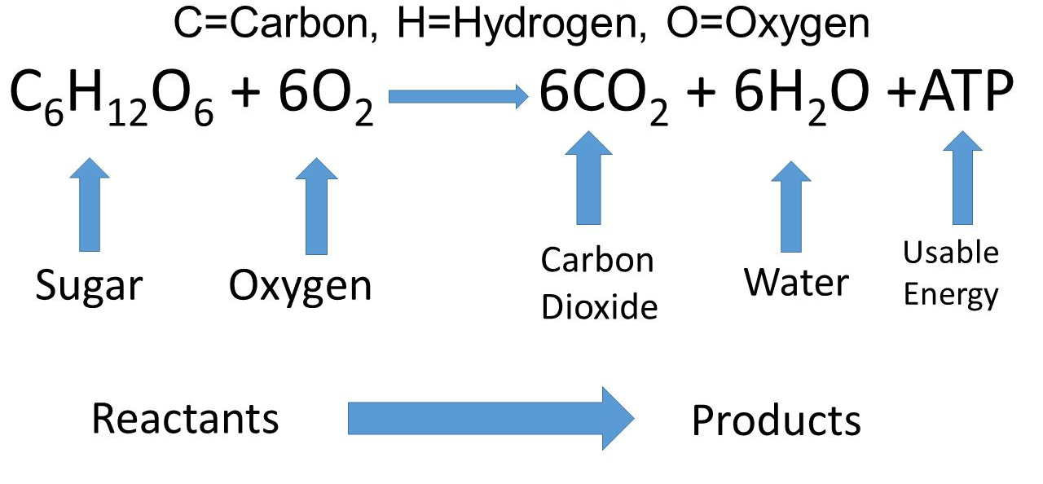
Cellular Respiration
The process of energy conversion that releases energy from food in the presence of oxygen.

Slide 8
Relationship Between Cellular Respiration and Photosynthesis
Photosynthesis removes carbon dioxide from the atmosphere, and cellular respiration puts it back.
Photosynthesis release oxygen into the atmosphere, and cellular respiration uses that oxygen to release energy from food.

Slide 9
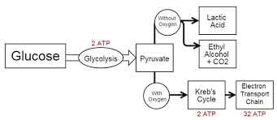
Oxygen and Energy
Most of the energy-releasing pathways within cells require oxygen, which is the reason we need to breathe, or respire. However, there are some energy-releasing pathways that can continue without oxygen.
Aerobic- process that requires oxygen.
Anaerobic- process that does not require oxygen.

Slide 10
Cellular Respiration

Slide 11
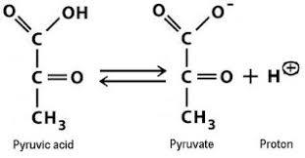
Cellular Respiration: Glycolysis
During Glycolysis, 1 molecule of glucose, a 6-carbon compound, is transformed into 2 molecules of the 3-carbon compound pyruvic acid.
Occurs in the cytoplasm of a cell.

Slide 12
Cellular Respiration: Glycolysis
During Glycolysis, 1 molecule of glucose, a 6-carbon compound, is transformed into 2 molecules of the 3-carbon compound pyruvic acid.
Occurs in the cytoplasm of a cell.
Does not require oxygen to occur. (Anaerobic)
Energy, is needed to breakdown glucose = -2 ATP
4 Electrons are passed to an electron carrier: NAD⁺, converting it into 2 NADH.
4 molecules of ADP are converted to ATP = +4 ATP
Glycolysis yields a net gain of 2 ATP.
Without oxygen, Glycolysis can continue working

Slide 13
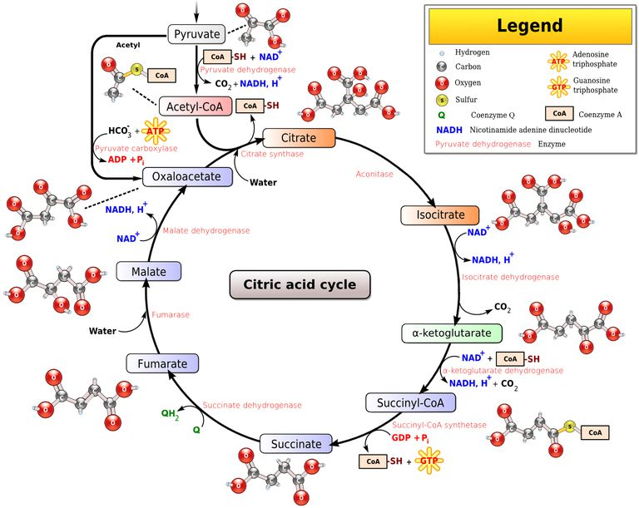
Cellular Respiration: Krebs Cycle

Slide 14
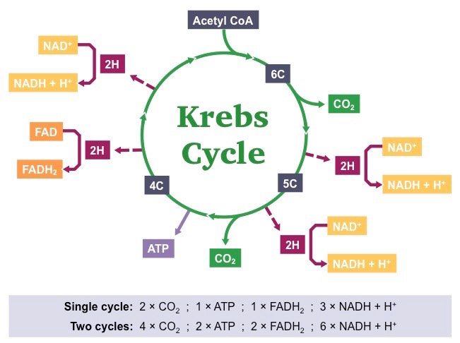
Cellular Respiration: Krebs Cycle

Slide 15
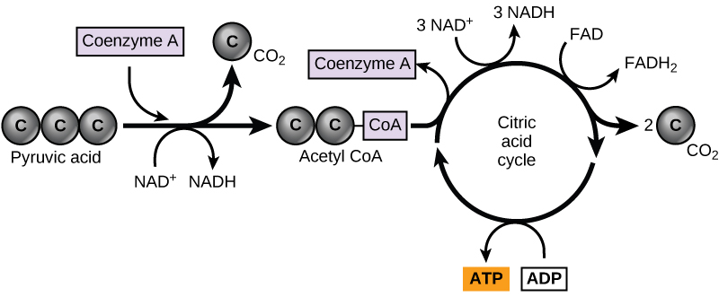
Cellular Respiration: Krebs Cycle
During the Krebs cycle, pyruvic acid from Glycolysis is converted into citric acid and then broken down into carbon dioxide in a series of energy-extracting reactions.
Also known as the Citric Acid Cycle.
Occurs within the matrix (innermost compartment) of the Mitochondria.
“Turns” twice
Glycolysis results in 2 molecules of pyruvic acid.

Slide 16
Cellular Respiration: Krebs Cycle
Pyruvic Acid is converted into Acetyl CoA and Acetyl CoA combines with a four carbon molecule to become citric acid.
Citric Acid is then systematically broken down, producing carbon dioxide, electron carriers (NAD⁺->NADH; FAD->FADH₂) and ATP.
CO₂ diffuses out of the mitochondria, out of the cell, into the bloodstream and exhaled.
ATP is immediately available to power cellular activities.
Electron carriers, in the presence of oxygen, are sent to the Electron Transport Chain to produce large amounts of ATP

Slide 17
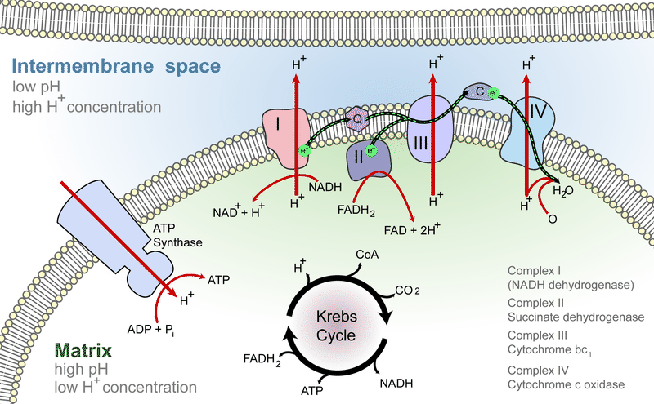
Cellular Respiration: The Electron Transport Chain
The Electron Transport Chain (ETC) uses the high-energy electrons (held by NADH and FADH₂) from glycolysis and the Krebs cycle to synthesize ATP from ADP.
Requires Oxygen to occur, because oxygen is the final electron acceptor.

Slide 18
Cellular Respiration: The Electron Transport Chain
As electrons move down the chain, a concentration gradient is produced with H⁺ ions.
This concentration gradient drives ATP production through ATP synthases, an enzyme that helps convert ADP into ATP. 32 molecules of ATP are produced.

Slide 19
Cellular Respiration
Together, glycolysis, the Krebs cycle, and the electron transport chain release about 36 molecules of ATP per molecule of glucose.
If cellular respiration only extracts about 36% of the energy from glucose, where is the other 64% of energy going?
Body heat!

Slide 21
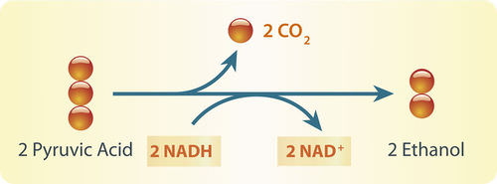
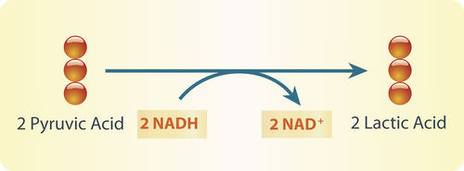
Fermentation
In the absence of oxygen, fermentation releases energy from food molecules by producing ATP.
Also called anaerobic respiration, there are two main pathways of fermentation.
Alcoholic Fermentation carried out by yeast.
Lactic Acid Fermentation carried out by several organisms, including human beings.

Slide 22
Fermentation AKA Anaerobic Respiration

Slide 23
Relationship Between Cellular Respiration and Photosynthesis
Photosynthesis removes carbon dioxide from the atmosphere, and cellular respiration puts it back.
Photosynthesis release oxygen into the atmosphere, and cellular respiration uses that oxygen to release energy from food.

