Slide 1
Spring 2024 Computer-Based Statewide Assessments Grades 3–10 FAST ELA Reading, Grades 3–8 FAST Mathematics, B.E.S.T. Writing, Statewide Science, FCLE, and EOC Assessments
Updated Spring 2024

Slide 2
It’s almost time to take the FAST, B.E.S.T., EOC, Science, and FCLE Assessments!
Here are some important reminders to help you follow the rules and do your very best.

Slide 3
Test Invalidation
Let’s talk about the term test invalidation.
It’s important for you to understand what it means so it won’t happen to you!

Slide 4
Test Invalidation
If your test is invalidated,
it means that your test will not be scored,
and you will not be able to retake the same test during this window.

Slide 5
1. Remove all electronic devices.
To make sure your test is scored…
If you have an electronic device
at your desk,
in your pocket,
or anywhere you can reach it during testing or while on a break,
your test will not be scored.

Slide 6
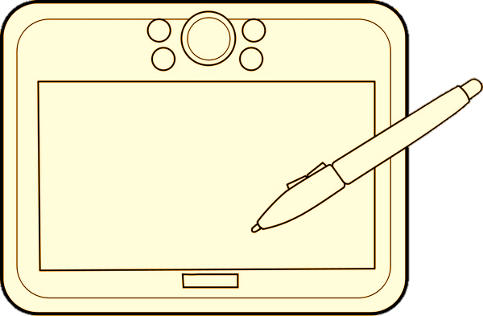
Electronic Devices Include:
Electronic Devices Include:
Cell phones or smartphones
Smartwatches
Handheld video games and tablets
Cameras
Bluetooth/ wireless headphones/ earbuds

Slide 7
Electronic Devices
Electronic Devices
Your teacher may collect electronic devices
or instruct you to put them away (in a locker or backpack away from your desk).
If you aren’t sure if something is an electronic device, please ask your teacher before the test.

Slide 8
2. Do your own work.
To make sure your test is scored…
If you are caught
looking at another student’s answers,
allowing another student to look at your answers,
discussing test content,
or using any kind of unauthorized aid during the test,
your test will not be scored.

Slide 9
3. Don’t be disruptive.
To make sure your test is scored…
It is very important for you to
remain quiet,
respect other students,
and pay attention to and follow the instructions.
If you are disruptive during a test, you may be dismissed from the room, and your test may not be scored.

Slide 10
4. Don’t leave school during a test.
To make sure your test is scored…
If you leave the school’s campus for
lunch,
an appointment,
before you complete a test session,
you will not be allowed to finish taking the test when you return.

Slide 11
Taking the Test
Let’s talk
about the rules during the test
and how to set yourself up for success!

Slide 12
During the test, you may not…
Look at another student’s screen or test materials.
Allow another student to look at your screen or test materials.
Give help to another student in answering test questions.

Slide 13
During the test, you may not…
Have notes or use other materials not provided by the test administrator.
Have electronic devices in your possession at any time, including breaks, even if you do not use them.

Slide 14
During the test, you may not…
Talk to other students
Make any disturbance

Slide 15
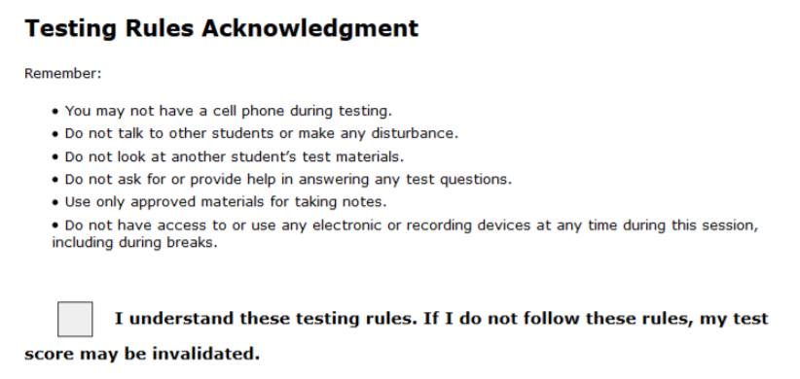
Testing Rules Acknowledgement
On the day of the test, your test administrator will read the testing rules (that were just covered in this presentation) aloud and ask you to read the Testing Rules Acknowledgment.
You will be asked to select a box next to the Testing Rules Acknowledgment to show that you understand the rules.

Slide 16
Remember…
You may not ask for help in answering any test questions or planning your responses.
Your teacher or test administrator is not allowed to discuss the test or help you answer test questions.
Try to answer every question or respond completely.

Slide 17
Remember…
Be sure to read and revise your response or check your answers and answer every question before completing your test.
Once you finish and submit your test, you cannot go back into the test.

Slide 18
Remember…
During breaks and after testing, it’s important that you don’t talk about the specific test questions, responses, or passages with friends, classmates, teachers, or other students.

Slide 19
Last But Not Least…
Get a good night’s sleep.
Relax and do your best!
Eat a good breakfast before the test.

Slide 20
Taking the Test
Let’s talk
about how you will login to a computer-based test
and use the general tools available in all CBT assessments.

Slide 21
FL Secure Browser
You will take the test in the Secure Browser.

Slide 22
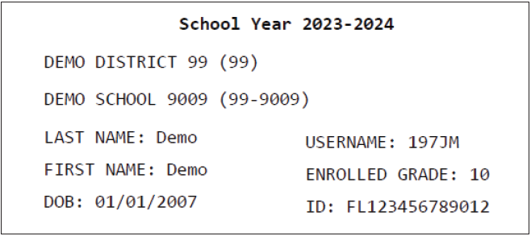
Test Tickets
Prior to testing, your test administrator will give you a test ticket listing your First Name and Username, which you will need to log in to your computer-based test.
Tell your test administrator if you have any issues with your ticket.
Be sure that your test ticket has the correct name and date of birth on it.

Slide 23
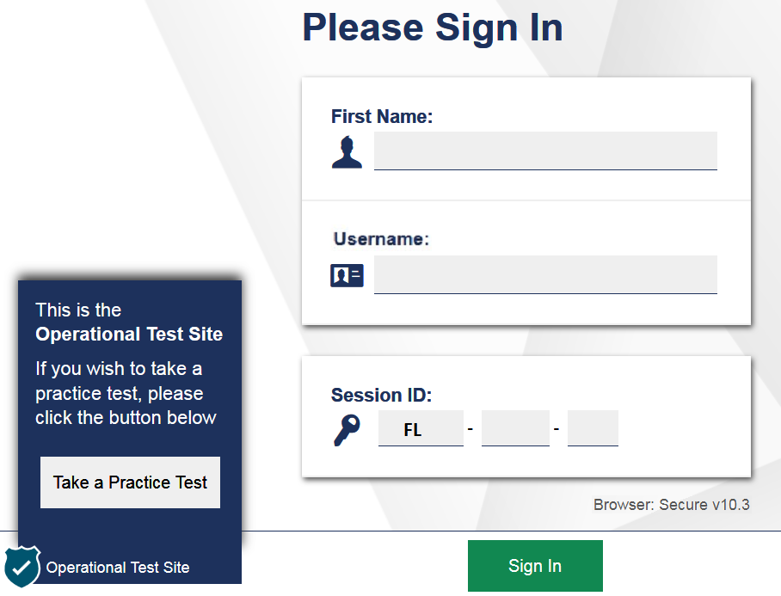
Logging In to the Test
When your test administrator tells you to do so, enter your First Name and Username exactly as they appear on your test ticket.
Next, enter the Session ID, which your test administrator will display for you.

Slide 24
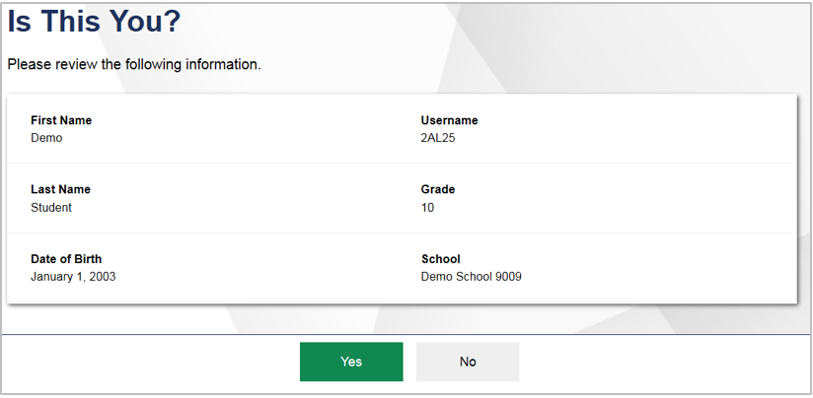
Is This You? Screen
After you log in, you will see a screen that says Is This You?
Verify that the information listed on the screen is correct and select Yes to continue.
If any information on this screen is not correct, raise your hand and notify your test administrator.

Slide 25
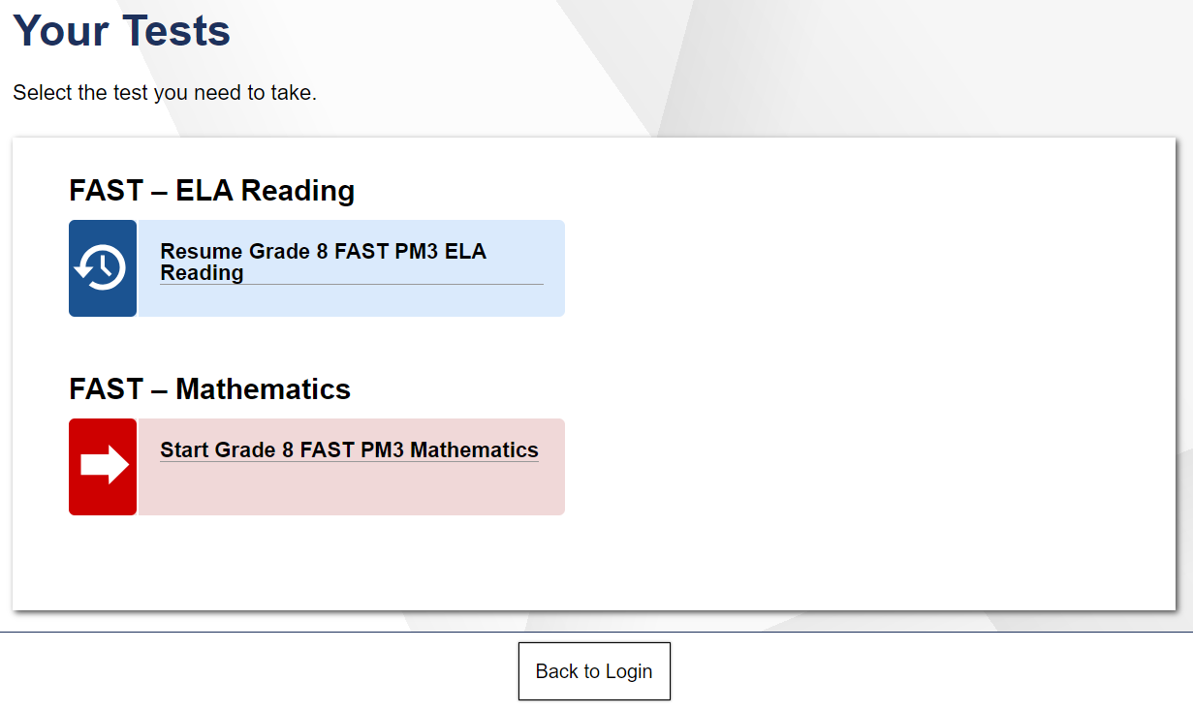
Your Tests Screen
Resume in front of the test name indicates you will be resuming the test. This is what you will see if you paused the test, for example.
After you confirm your identity, the Your Tests screen appears.
Only tests that the Test Administrator has selected will appear on the Your Tests screen.
Start in front of the test name indicates you will be starting the test.
Available tests are in color and indicate whether you will be starting a new test or resuming a test.

Slide 26
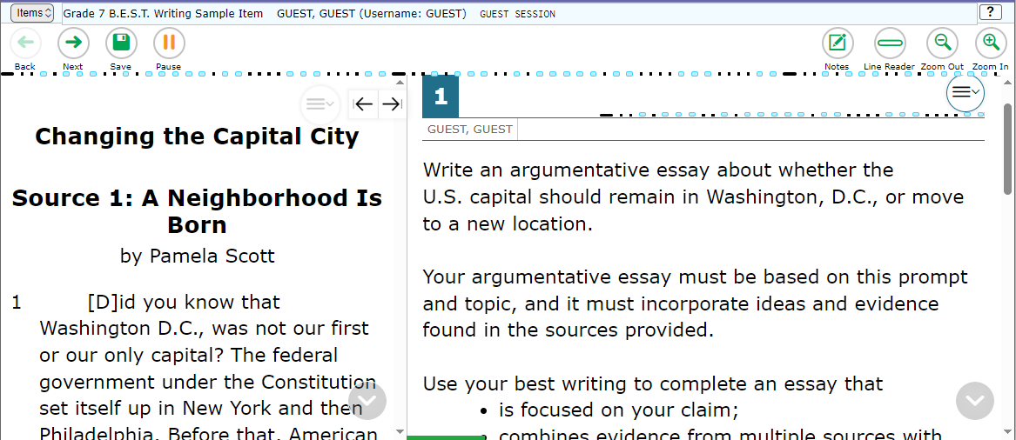
Computer-Based Tools
You may use any of the tools on the screen to help you with your test.

Slide 27
Computer-Based Tools
Back and Next
Zoom Out and Zoom In
The Back and Next buttons can be used to move to through the test.
Use the Zoom Out and Zoom In buttons to decrease and increase the size of text within the test page. Four levels of magnification are available.

Slide 28
Computer-Based Tools
Save
Pause
The Save button allows you to manually save your work. However, this feature is optional.
The Pause button allows you to pause and exit the test. If you pause your test, you will have to log back into the testing system to resume testing.
Your responses are automatically saved every two minutes.

Slide 29
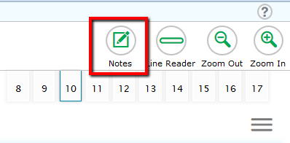
Computer-Based Tools
Notes
The Notes tool opens a pop-up window in which you can type notes for later reference.
For Reading and Writing, there is one notepad for the entire test. The notes you type will remain each time you open the tool unless you delete them.
Remember, you can also make notes on your Writing Planning Sheet.

Slide 30
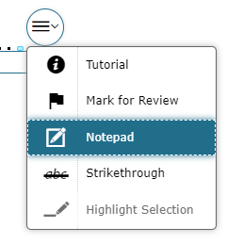
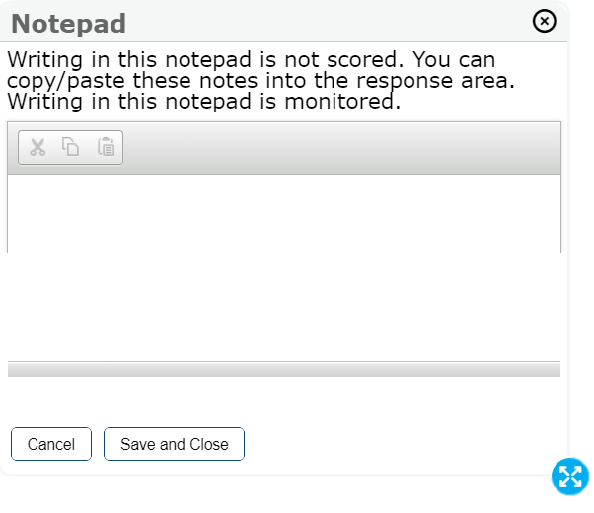
Computer-Based Tools
For Mathematics tests, there is one notepad per item, available under the context menu.
Notepad
You can copy/paste these notes into the response area.
The notes you type are not scored as a part of your test, but they are monitored by the testing contractor.
You can move the Notepad around the screen by clicking the top of the window and dragging it to another part of the screen.

Slide 31
Computer-Based Tools
Line Reader
Highlighter
With the Highlighter tool, you can highlight sections of the passages or items by using your mouse to click and drag from the beginning to end of the section you want to highlight.
The Line Reader tool allows you to emphasize a specific line of text in the prompt or passage to make it easier to read.

Slide 32
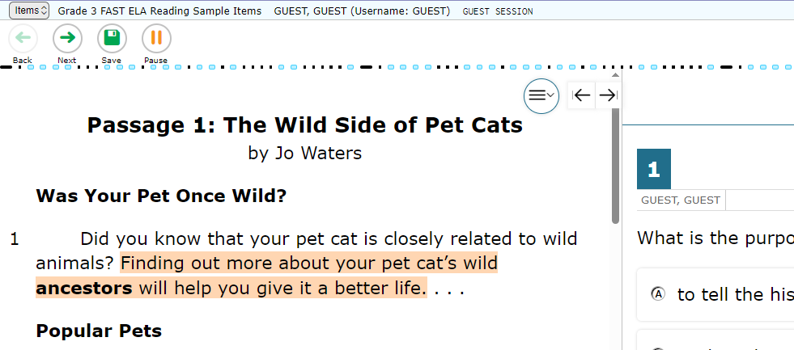
Computer-Based Tools
Expand/Collapse Panel Tool
The Expand/Collapse Panel tool allows you to expand the reading passage or the response panel so that it takes up most of the screen.

Slide 33
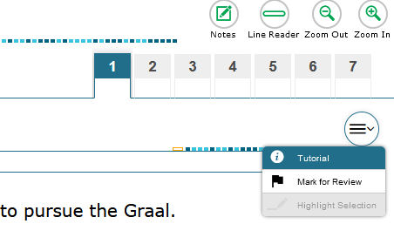
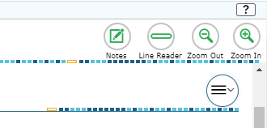
Computer-Based Tools
Context Menu: Tutorial
Help Tool
The Tutorial tool opens a pop-up window that will display a video tutorial of how to respond to the item.
*Note that there is no sound for the tutorial.
The Help tool opens a pop-up window which will remind you how to use the tools and features in the testing platform.
Notes:
- Note: Tutorials are not available on Science or Social Studies assessments.

Slide 34
Computer-Based Tools
Note: this tool does not remove answer choices that have been selected.
To change your answer, select another choice.
Strikethrough Tool
Right-click the option you wish to cross out and choose Strikethrough;
or select Strikethrough in the Context menu and click on the option.
You can use the Strikethrough tool on multiple-choice and multiselect items to cross out options you think are incorrect.

Slide 35
FAST ELA Reading
Students in grades 3–10 will take the FAST ELA Reading assessment on the computer.
PM1 and PM2 have 36 to 40 items on the test.
PM3 has 41 to 46 items on the test.
If you are not finished at the end of the session, you may continue working until the end of the school day.

Slide 36
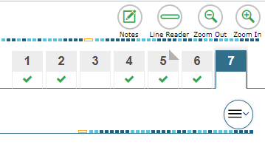
FAST ELA Reading
Passage Panel
In addition to Back and Next and the Item Summary Drop-Down, clicking on the numbers in the Passage Panel also allows you to navigate back and forth between test items.
Unanswered item
The green checkmark indicates an answered item, while the blank area under the number shows an unanswered item.
Answered item
If the corner of the number is folded down, that’s an item you have marked for review.
Item Marked for Review

Slide 37
FAST ELA Reading
Moving Between Items
Within each passage set, you can move between items without marking an answer.
You can click any item number to navigate to that item and you can answer the items in any order.
This functionality also allows you to preview the questions before reading the passages.
However, all items must be answered before you move onto the next passage set.

Slide 38
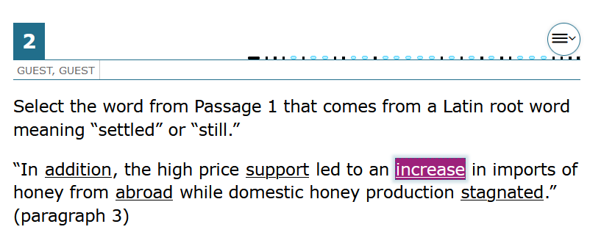
FAST ELA Reading – Item Types
Selectable Hot Text
Selectable Hot Text items direct you to click on a response option.
External copy interaction items direct you to select text from the passage to copy into the answer space.
External Copy Interaction

Slide 39
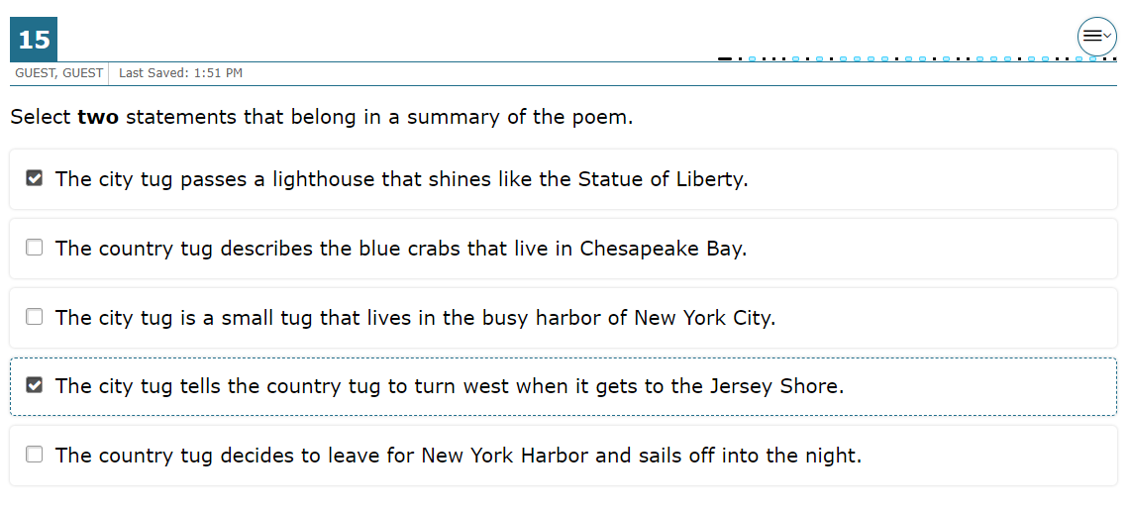
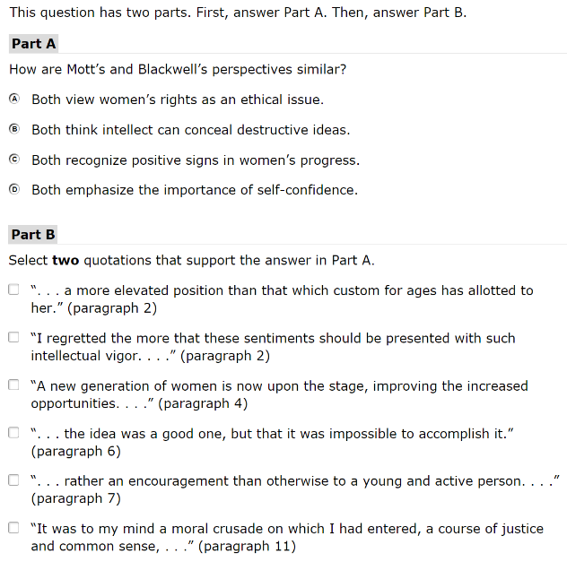
FAST ELA Reading – Item Types
Multiselect
Multiselect items allow you to select more than one answer option.
Evidence-Based Selected Response (EBSR)
EBSR items direct you to select the correct answers from Part A and Part B. Part A and Part B may be multiple-choice, hot text, or multiselect.

Slide 40
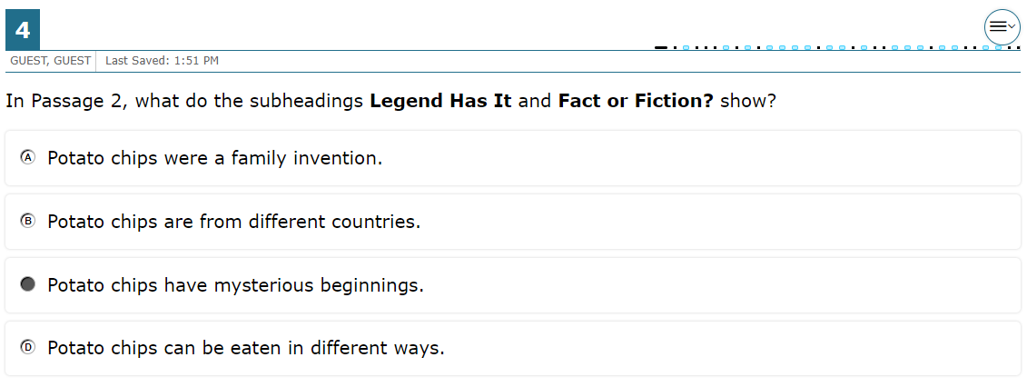
FAST ELA Reading – Item Types
Table Match
Table match items direct you to check a box to indicate if the information in the column headers matches the information in each row.
Multiple- Choice
Multiple-choice items direct you to select a single answer option.

Slide 41
FAST Mathematics
Students in grades 3–8 will take the FAST Mathematics assessment on the computer.
PM1 and PM2 have 35 to 40 items on the test.
PM3 has 39 to 45 items on the test.
If you are not finished at the end of the session, you may continue working until the end of the school day.

Slide 42
B.E.S.T. EOCs
Students enrolled in Algebra 1 or Geometry will take the B.E.S.T. EOC assessment on the computer.
The Algebra 1 EOC and the Geometry EOC have 45 to 50 items on the test.
Students will receive a CBT Work Folder to work the problems.
If you are not finished at the end of the session, you may continue working until the end of the school day.

Slide 43
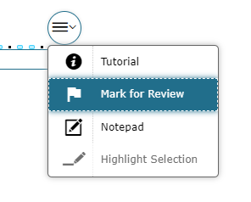
FAST Mathematics and B.E.S.T. EOC
Moving Between Items
Try your best on every item!
For FAST Mathematics and B.E.S.T. EOCs, you must answer each item before moving onto the next item.
Make sure you scroll down to answer all parts of the item.
If you’re unsure about the answer, try your best to answer it. You can flag it for review and revisit the item later.

Slide 44
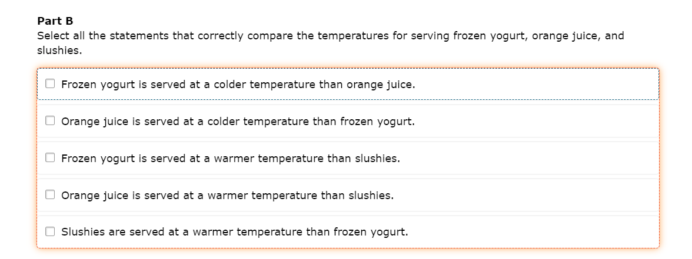
FAST Mathematics and B.E.S.T. EOC
Moving Between Items
If an item or part of an item is unanswered, you’ll receive an error message when trying to move on.
Return to the item and look for highlighting around the missing response area.

Slide 45
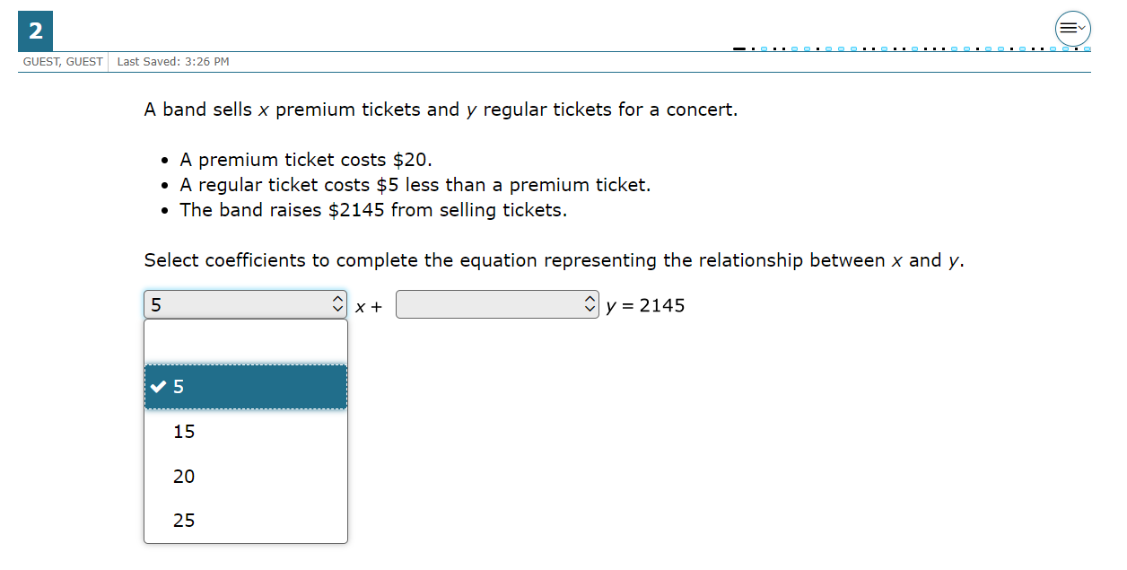
FAST Mathematics/B.E.S.T. EOC – Item Types
Selectable Hot Text
Selectable Hot Text items direct you to click on one or more response options.
Editing Task Choice
To enter responses for editing task choice items, click the blank then select the correct response from the drop-down menu.

Slide 46
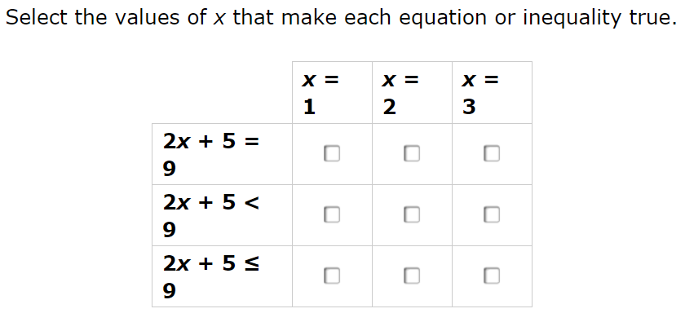
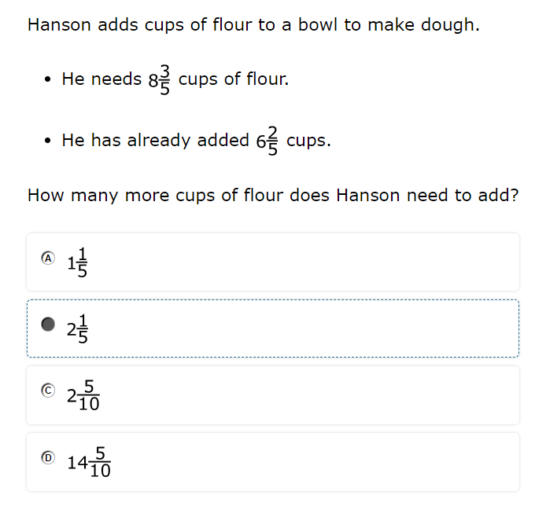
FAST Mathematics/B.E.S.T. EOC – Item Types
Matching
Matching items direct you to check a box to indicate if the information in the column headers matches the information in each row.
Multiple- Choice
Multiple-choice items direct you to select a single answer option.

Slide 47
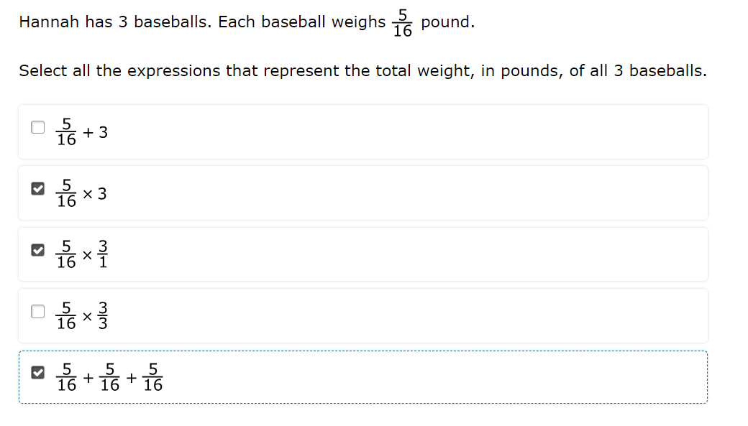
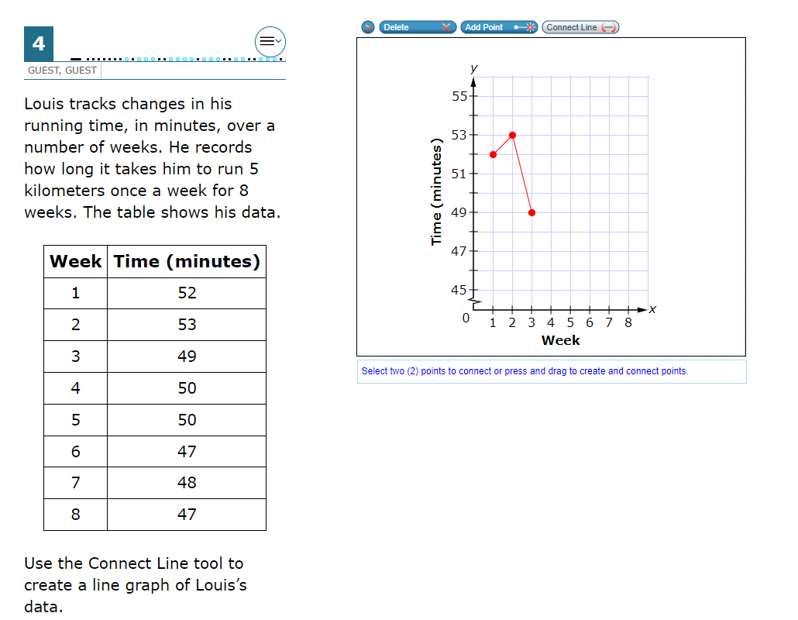
FAST Mathematics/B.E.S.T. EOC – Item Types
Multiselect
Multiselect items allow you to select more than one answer option.
GRID items may direct you to use the point, line, or arrow buttons to create a response. Other GRID items may direct you to select words, phrases, or images and use the drag-and-drop feature to place them into an answer area.
Graphic Response Item Display (GRID)

Slide 48
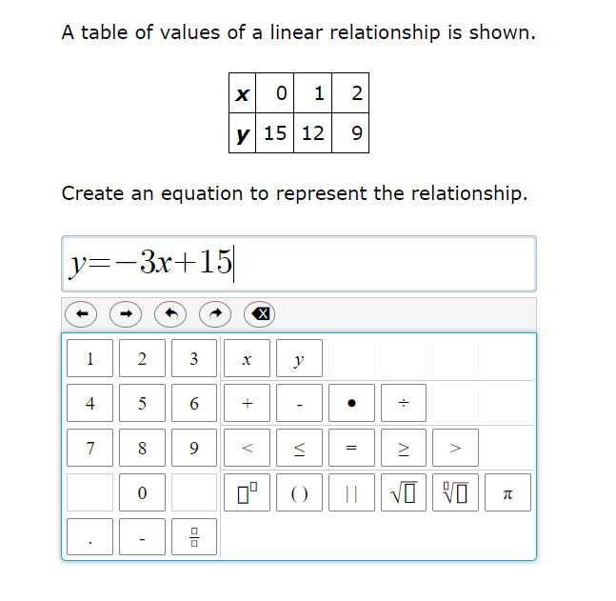
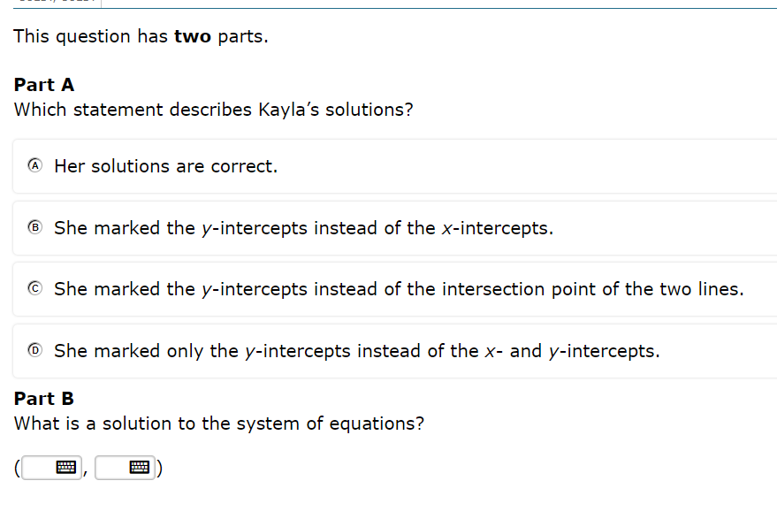
FAST Mathematics/B.E.S.T. EOC – Item Types
Equation Editor
Equation editor items direct you to create a response. Responses may be in the form of a number, variable, expression, or equation, as appropriate to the item.
You will click the button for each letter or symbol to enter your response.
When you see the keyboard symbol, click it to bring up the equation editor keypad.

Slide 49
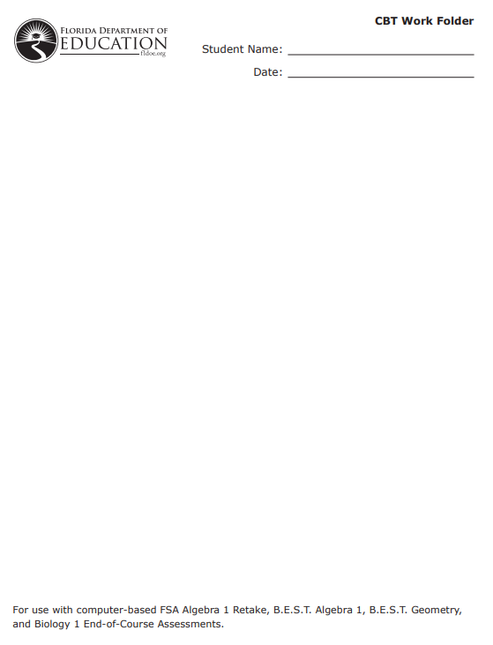
CBT Work Folder
Before you begin, your test administrator will give you a Computer-Based Testing Work Folder.
When you complete a test session, the test administrator will collect your work folder.
The work folder is four pages of paper that you may use to work the mathematics problems on your test. The last page is graph paper.
While testing, make sure that your work folder is not easily visible to other students.

Slide 50
Calculator
The Grade 6 Mathematics test includes a four-function calculator the online testing system.
You can practice using the online calculator in the practice test, available on the portal.
You can use the Calculator by tapping or clicking on the on-screen calculator or by using the appropriate keys on your keyboard.
The Grades 7–8 FAST Mathematics & B.E.S.T. EOC tests include a scientific calculator in the online testing system.

Slide 51
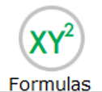
Formulas
Be sure to scroll to the bottom of the reference sheet and use the horizontal scroll bar to see all of the information available.
The Formulas tool opens a pop-up window displaying the reference sheet for your test. (Grades 4–8 and B.E.S.T. EOC only.)

Slide 52
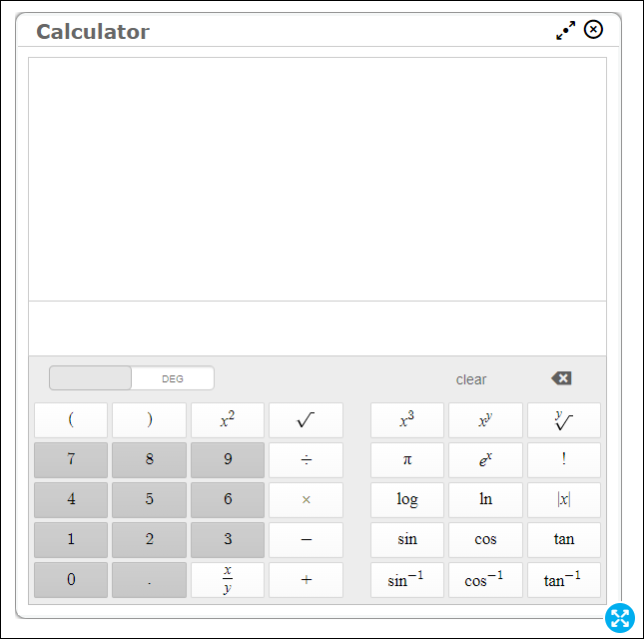
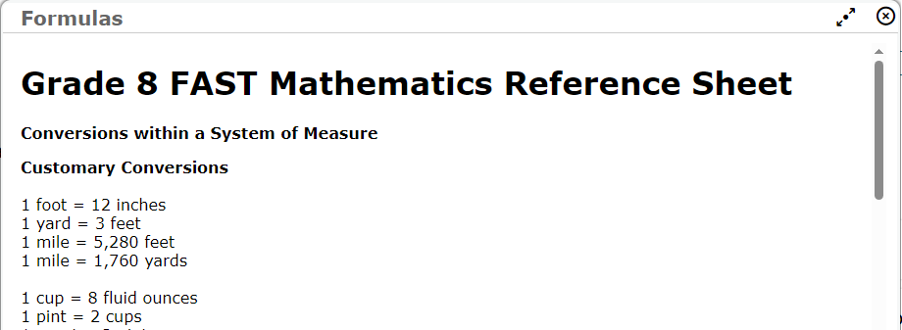
Calculator and Formulas
You can move the Formulas window and the Calculator around the screen by clicking or tapping the top of the window and dragging it to another part of the screen.

Slide 53
B.E.S.T. Writing
Students in grades 4–10 will take the B.E.S.T. Writing assessment on the computer.
There is one 120-minute session for B.E.S.T. Writing.
If you haven’t finished at the end of the session, you may continue working up to half a school day.

Slide 54
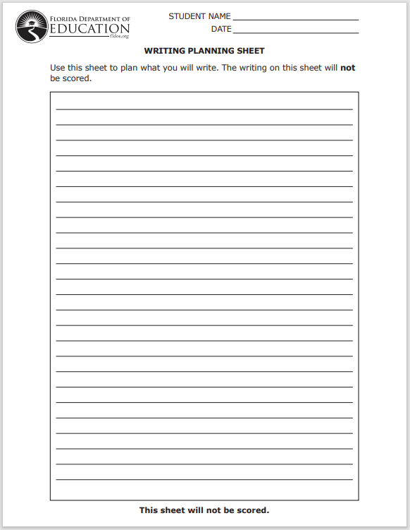
Writing Planning Sheet
Before you begin, your test administrator will give you a Planning Sheet that you may use to take notes and plan your writing.
While testing, make sure that your planning sheet is not easily visible to other students.
Your test administrator will collect your planning sheet at the end of the test session.

Slide 55
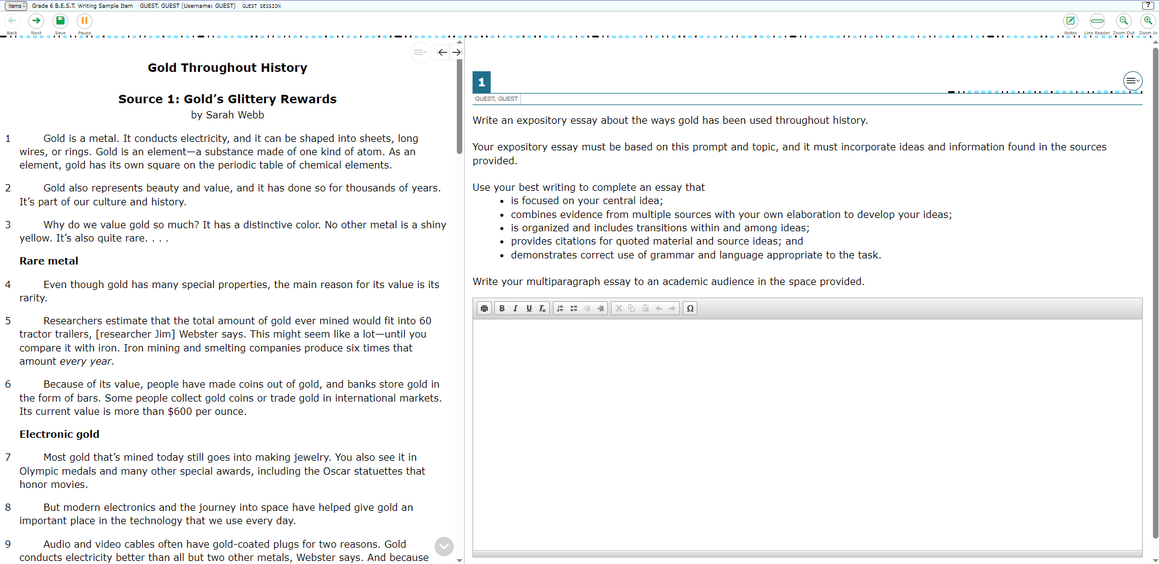
Writing Testing Screen
Your computer-based test contains reading passages,
a writing prompt,
and a text box where you will type your response.

Slide 56
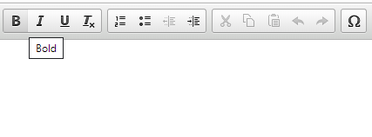
Writing Formatting Toolbar
Above the response area is a Formatting Toolbar. This toolbar allows you to:
To see what each button does, hover your mouse over the button for a description.
apply different styles to your response, such as bold, underline, or bullets
use functions such as cut, copy, and paste
enter special characters

Slide 57
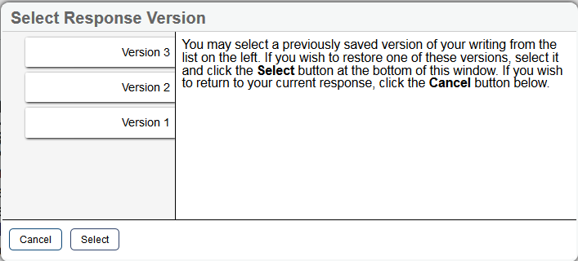
Writing Computer-Based Tool
The Select Response Version tool allows you to view and restore responses you previously entered.
For example, if you type a response, click Save, delete the text, and enter new text, you can use this tool to recover the original response.
Select Response Version

Slide 58
Taking the Writing Test
Your writing should show that you can organize and express your thoughts clearly.
Read each passage carefully and respond completely to the writing prompt.
You are required to write your response in English.

Slide 59
Taking the Writing Test
Manage your time carefully so that you have time to…
write your response on your computer or device
read the passages
and proofread, revise, and edit your response
plan your response

Slide 60
Grade 5 Science & Grade 8 Science
Students will take the Grade 5 and Grade 8 Science assessments on the computer.
There is one session for the Science assessments.
The session will last 160 minutes, and you will answer 48–54 multiple-choice questions.
If you are not finished at the end of the session, you may continue working until the end of the school day.

Slide 61
Grade 8 Science: CBT Worksheet
Before you begin, your test administrator will give you a CBT Worksheet that you may use to take notes.
While testing, make sure that your worksheet is not easily visible to other students.
When you complete the assessment, the test administrator will collect your worksheet.

Slide 62
Grade 8 Science: Periodic Table of the Elements
In the Grade 8 Science test, a button is available along the top row of computer-based tools to access the Periodic Table of the Elements.

Slide 63
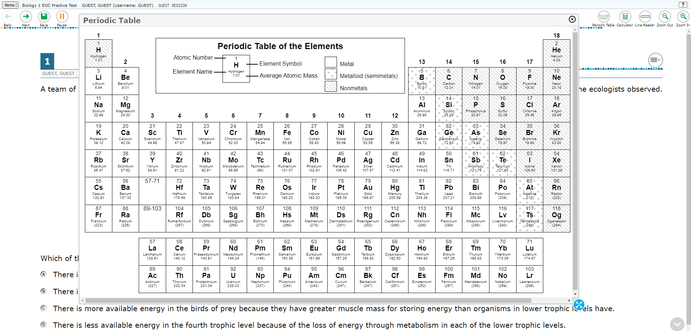
Grade 8 Science: Periodic Table of the Elements
When you click this button, a new window will open displaying the Periodic Table of the Elements.
You can expand and reshape the window by clicking and dragging this blue circle.
To move the Periodic Table of the Elements around the screen, click or tap the top of the window and drag it to another part of the screen.

Slide 64
Grade 8 Science: Calculator
The Grade 8 Science test includes a four-function calculator in the online testing system.
You can use the Calculator by tapping or clicking on the on-screen calculator or by using the appropriate keys on your keyboard.
You can practice using the online calculator in the practice test, available on the portal.

Slide 65
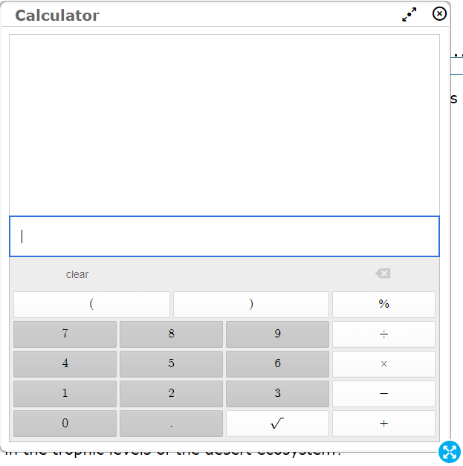
Grade 8 Science: Calculator
You can move the Calculator around the screen by clicking or tapping the top of the window and dragging it to another part of the screen.

Slide 66
Biology 1, Civics, U.S. History EOCs
Students will take the Biology 1, Civics, and U.S. History EOC assessments on the computer.
There is one session for the Science/Social Studies EOC assessments.
The session will last 160 minutes, and you will answer around 48–56 multiple-choice questions.
If you are not finished at the end of the session, you may continue working until the end of the school day.

Slide 67
Biology 1: CBT Work Folder
Before you begin, your test administrator will give you a Computer-Based Testing Work Folder.
When you complete a test session, the test administrator will collect your work folder.
The work folder is four pages that you may use to take notes or solve items on your test. The last page is graph paper.
While testing, make sure that your work folder is not easily visible to other students.

Slide 68
In the Biology 1 EOC Assessment, a button is available along the top row of computer-based tools to access the Periodic Table of the Elements.

Slide 69
Biology 1: Periodic Table of the Elements
When you click this button, a new window will open displaying the Periodic Table of the Elements.
You can expand and reshape the window by clicking and dragging this blue circle.
To move the Periodic Table of the Elements around the screen, click or tap the top of the window and drag it to another part of the screen.

Slide 70
Biology 1: Periodic Table of the Elements
When you click this button, a new window will open displaying the Periodic Table of the Elements.
To move the Periodic Table of the Elements around the screen, click or tap the top of the window and drag it to another part of the screen.
You can expand and reshape the window by clicking and dragging this blue circle.

Slide 71
Biology 1: Calculator
The Biology 1 EOC test includes a four-function calculator in the online testing system.
You can use the Calculator by tapping or clicking on the on-screen calculator or by using the appropriate keys on your keyboard.
You can practice using the online calculator in the practice test, available on the portal.

Slide 72
Biology 1: Calculator
You can move the Calculator around the screen by clicking or tapping the top of the window and dragging it to another part of the screen.

Slide 73
Civics and U.S. History: CBT Worksheet
Before you begin, your test administrator will give you a CBT Worksheet that you may use to take notes.
While testing, make sure that your worksheet is not easily visible to other students.
When you complete the assessment, the test administrator will collect your worksheet.

Slide 74
Science and Social Studies
Moving Between Items
Try your best on every item!
For Grades 5 & 8 Science, Biology 1 EOC, Civics EOC, and U.S. History EOC, you must answer each item before moving onto the next item (except for Science context dependent sets).
Make sure you scroll down to answer all parts of the item.
If you’re unsure about the answer, try your best to answer it. You can flag it for review and return to revisit the item later.

Slide 75
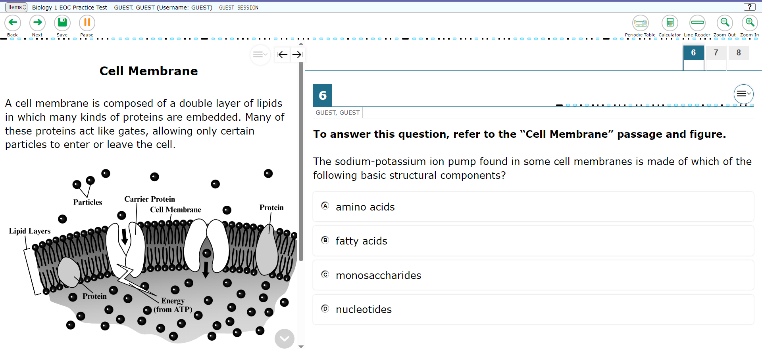
Science: Context Dependent (CD) Sets
On Grades 5 & 8 Science and Biology 1 EOC, you may see a set of items grouped together.
The content will be on the left side of the screen,
and the questions will be on the right.

Slide 76
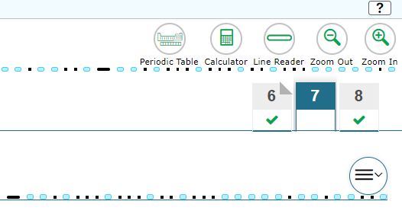
Science: Context Dependent (CD) Sets
Moving Between Items on CD Sets
Within each CD set, you can move between items without marking an answer.
You can click any item number to navigate to that item and you can answer the items in any order.
However, all items must be answered before you move onto the next item in the test.

Slide 77
Florida Civic Literacy Exam (FCLE)
Students will take the FCLE on the computer.
There is one session for the FCLE.
The session will last 160 minutes, and you will answer around 80 multiple-choice questions.
If you haven’t finished at the end of the session, you may continue working up to half a school day.

Slide 78
Taking the Test
Let’s talk
about how you will submit your test
and where to practice using the tools.

Slide 79
Submitting the Test
Review your responses carefully and ensure you are ready to submit.
After you have checked your work, select Next.
The End Test Page will display.

Slide 80
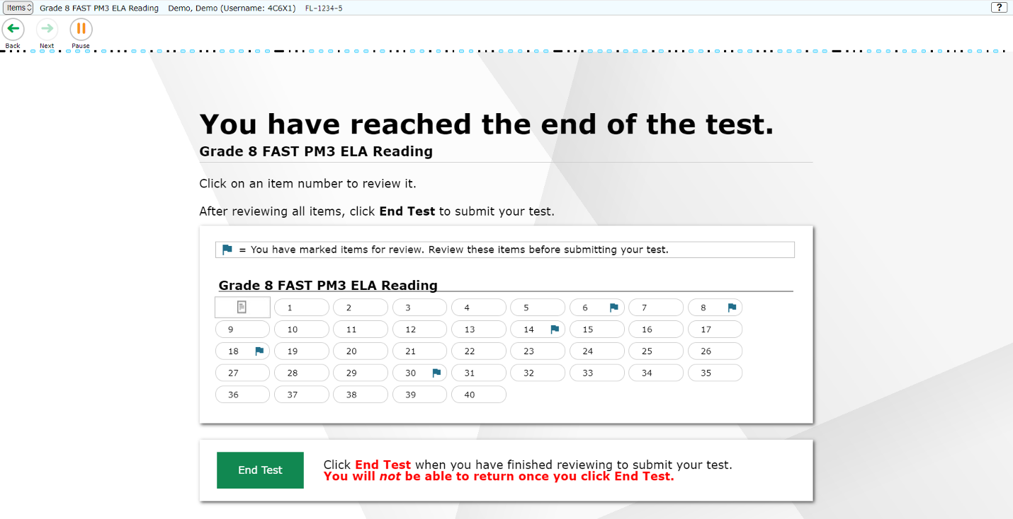
End Test Page
Items marked for review will have a flag next to that item number. Click the item number if you wish to return to and review that item.

Slide 81
Submitting the Test
A pop-up window will ask you to confirm that you want to submit the test.
Select End Test on the Submit Test screen.
If you are ready to submit your test, select Yes.

Slide 82
Practice/Sample Items Test
Before taking the “live” test, you may take a practice test.
The practice test will allow you to:
practice using the test site,
help you learn how to respond to the items,
and learn how to use the tools.
You can take a practice/sample items test any time at: https://fsassessments.org/families.html

