Slide 1
Welcome to Geometry
Mrs. Faulkner
faulknerm@leonschools.net

Slide 2
Take out a sheet of paper and solve the following problem. Explain your steps.
3(x-5) + 42 - $2^{3}=−5$
Given

Slide 3
Take out a sheet of paper and solve the following problem. Explain your steps.
3(x-5) + 42 - $2^{3}=−5$
Given

Slide 4
Take out a sheet of paper and solve the following problem. Explain your steps.
3(x-5) + 42 - $2^{3}=−5$
Given

Slide 5
Geometry
Working with shapes
Working with measurement
Not only doing math, but explaining why it works

Slide 6
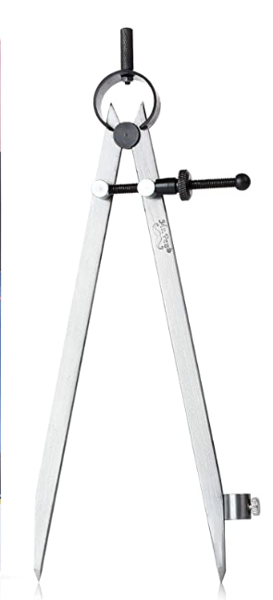
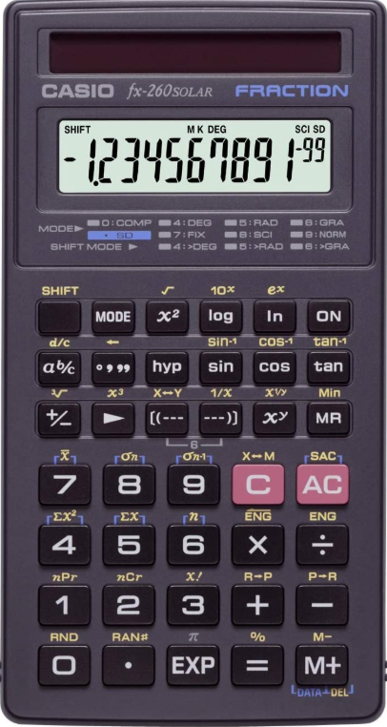
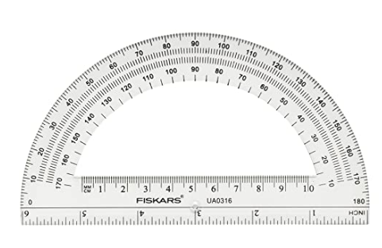
Supplies - FSA approved online calculator: https://demo.tds.cambiumast.com/DesmosForAssessments/TDSCalculator.html?mode=fl_scirestricted

Slide 7
Warm ups
notes
3. Theorems definitions, properties and postulates
4. Assignments
5. Assessments

Slide 8
Electronics are a must

Slide 9
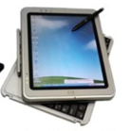
Student username
studentnumber@edu.leonschools.net

Slide 10
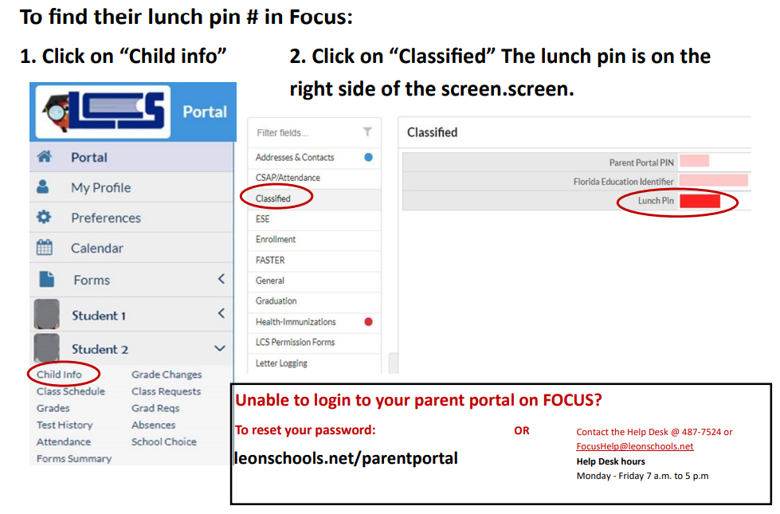

Slide 11
Turning in work
In the top right hand corner of every assignment, write your heading
Put heading on today’s warm up as we prepare to turn it in.
Heading:
First and last name
Today’s date
Period ___
Create a PDF of the assignment
Upload to Canvass

Slide 12
Turning work into a pdf
Android
Download CamScanner from the play store
Click camera then take picture of warm up
Adjust widow to ensure everything is included
Click right arrow and checkmark
Click share then share as PDF
Click share then email to self
IPhone
Open your notes app and create a new note
Click on camera above the keyboard
Click scan documents and take a picture of your warm up
Click keep scan then save
You can also use a PC, IPAD or Mac Book but be careful as some Apple applications are not compatible with PC’s and I have a PC. If I can’t open it, I can’t grade it.

Slide 13
Canvas
We will turn in assignments in Canvas and Focus.
You will be required to turn in a PDF of your work for each assignment and assessment.
Title your assignment
Lastnamefirstinitial_assignmentnumber
ie: Faulknerm_101
Classwork will be assignments, worksheets, or notes
Assignments not completed in class will be do by class time the following day.
Homework will usually be notes but may sometimes be assignments. unless otherwise instructed.
Post notes on due date to canvas – place them in your notebook

Slide 14
Lets go to Canvas
If you have your own devise, you may log in and follow along.

Slide 15
Course information
Rules
Supplies – add compass and protractor
Assignments
Attendance
Assessments
Late work
Extra credit
Office hours
Where do I even begin
Website
Pacing
Zoom vs. Teams
Student menu
Notebooks

