Slide 1
Woods that kendamas are made of.
By Jaylon Watson

Slide 2
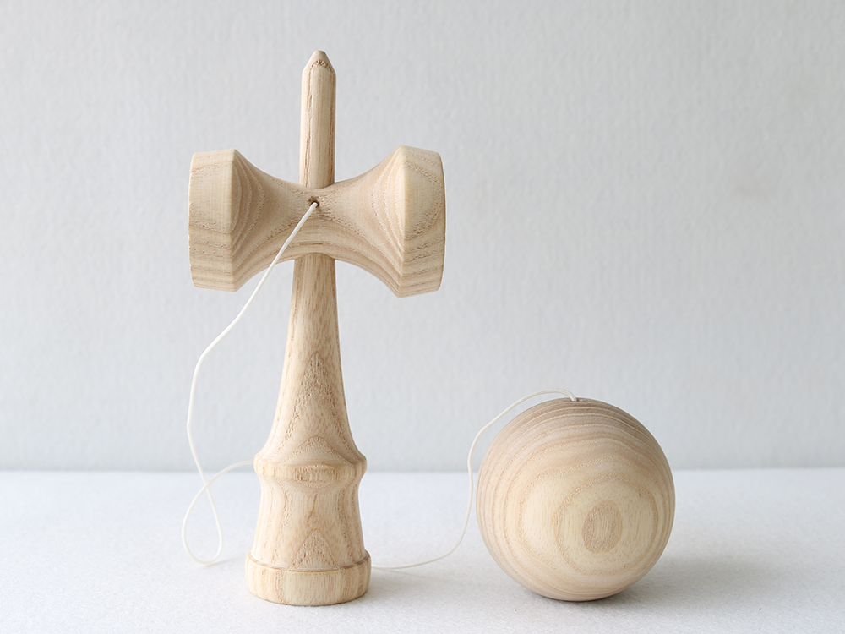
Ash
One type of wood used in kendamas is ash wood.
Some things to know about ash wood is that it :
Fairly inexpensive
Has good durability
Feels smooth
And is of average weight

Slide 3
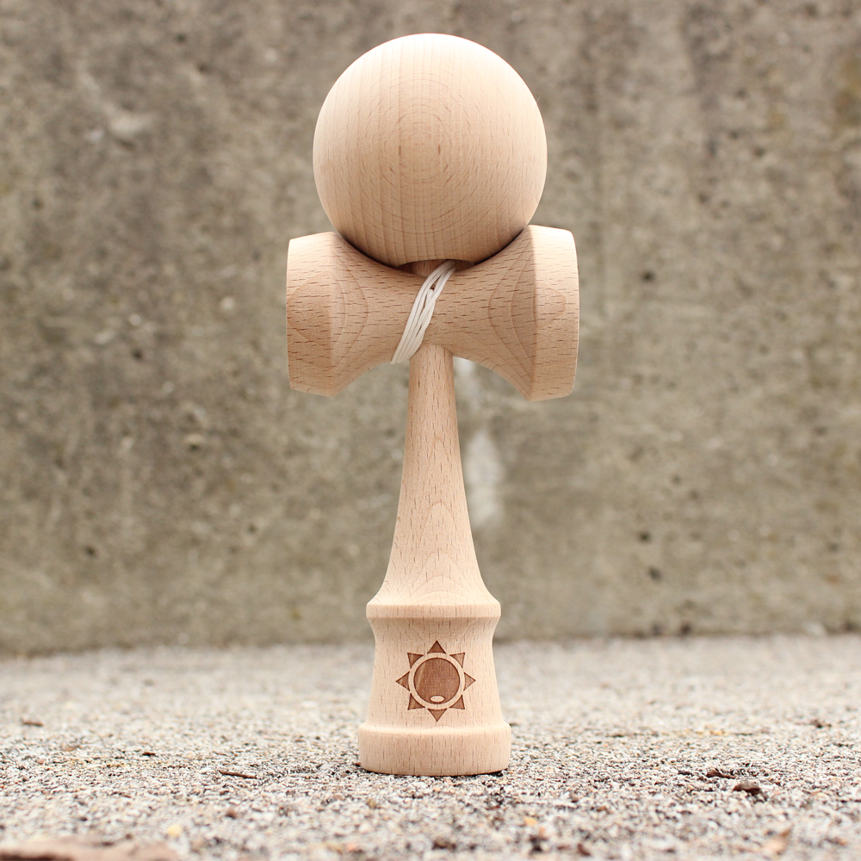
Beech
Beech is the wood most commonly used in the making of kendamas. Therefore beech wood is:
Inexpensive
Average durability
Feels rough to the touch
And weighs average

Slide 4
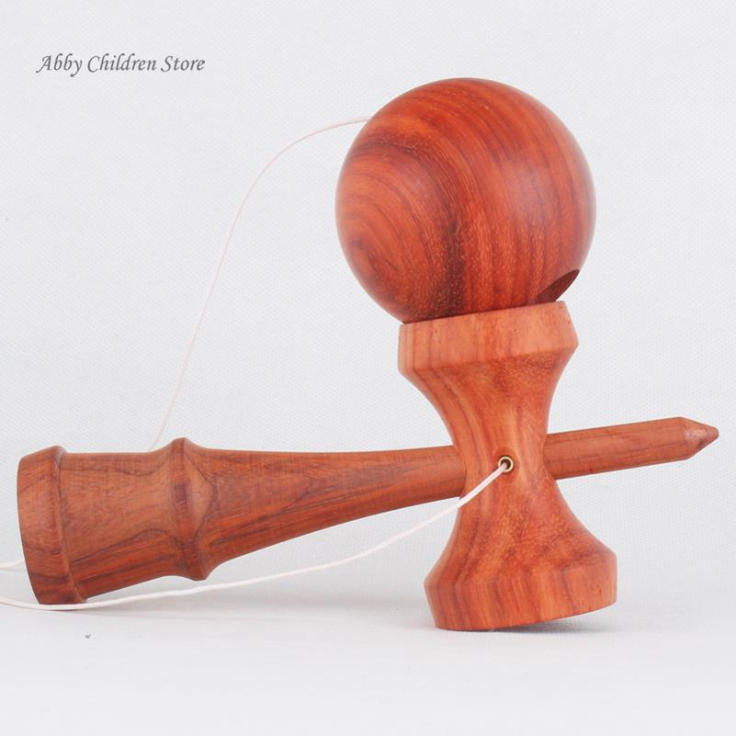
Cherry
Another popular wood used in kendamas cherry. Apparently cherry is a heavier and more dense than beech wood. Cherry kendamas are :
Fairly inexpensive
Reasonably durable
Feels softer
Feels heavy

Slide 5
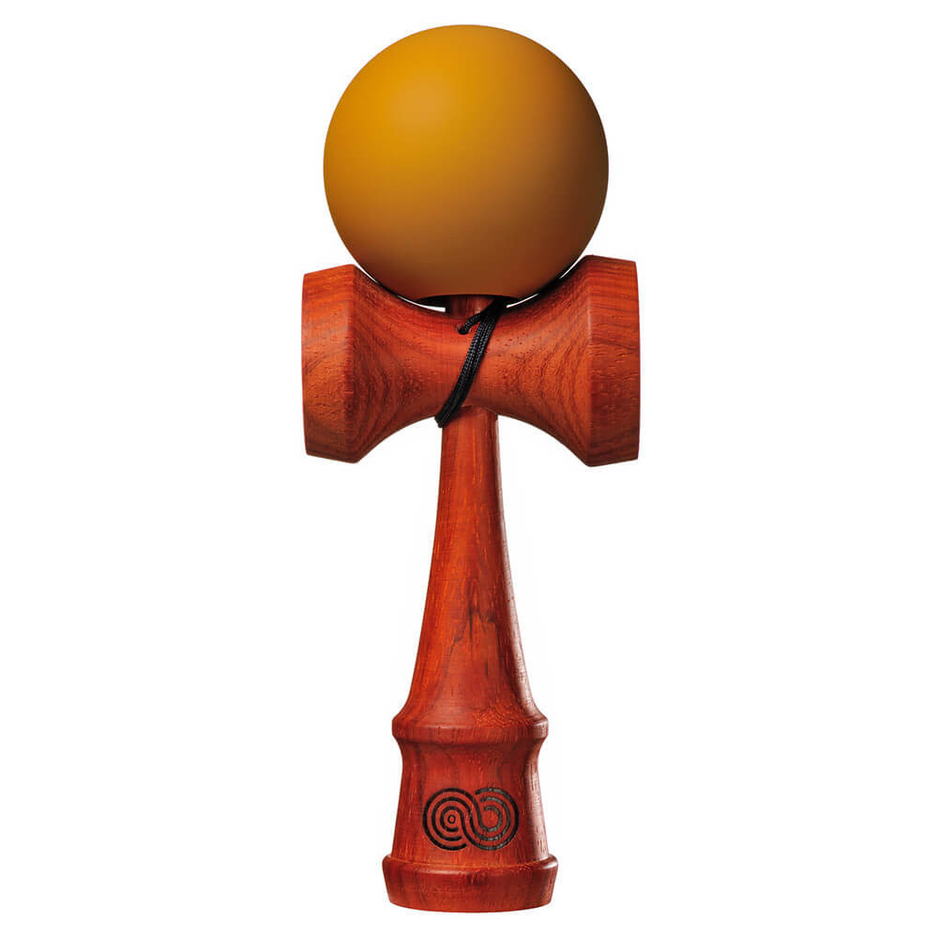
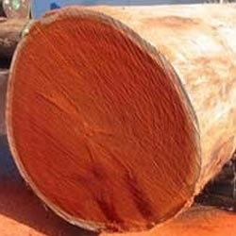
Paduak
Paduak kendamas have a reddish color that darkens over time the more you play. I couldn’t find out very much about this wood but I know that :
More on the expensive side
Average weight
Looks very nice

Slide 6
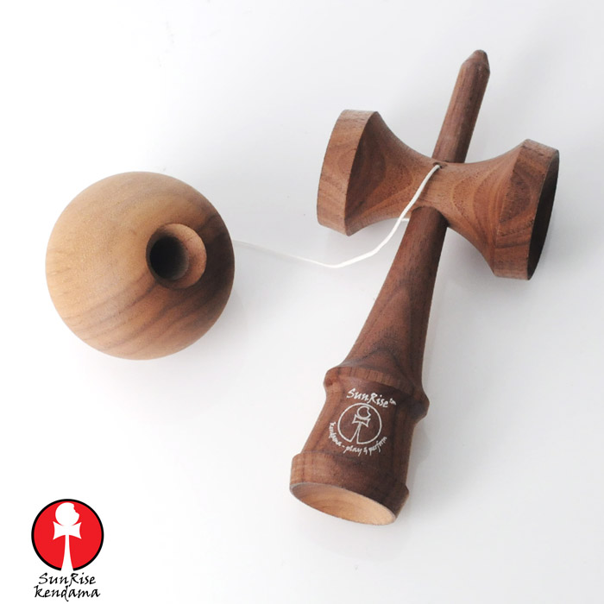
Walnut
Walnut is the wood that isn’t used as much in kendamas. But its good the make striped patterns out of the woo looks very different than others. Walnut wood offers :
Affordability
Good durability
Smooth to touch
Light weight

Slide 7
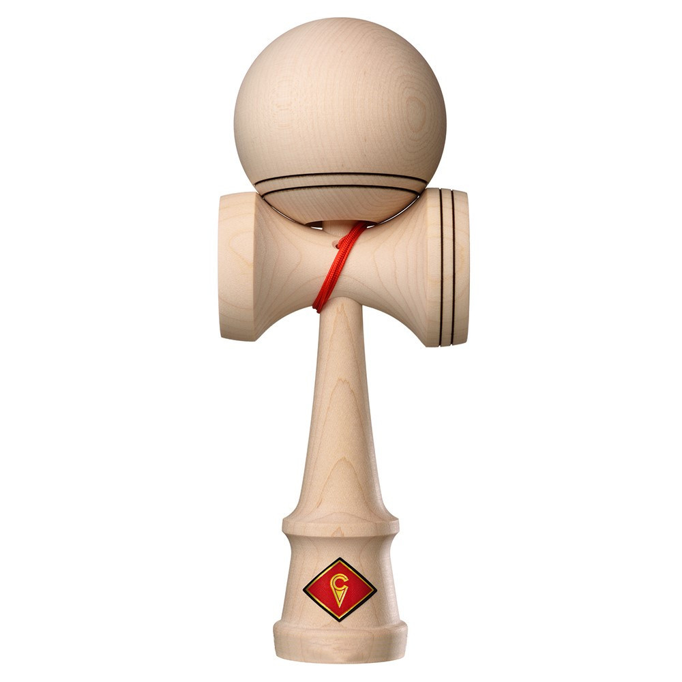
Maple
Maple is a tough wood the looks almost like beech.
Inexpensive
Slightly more dense than beech
Great durability
Smooth to touch
Light Weight

Slide 8
In conclusion
It really doesn’t matter what wood your kendama is made out of. It just depends on, your price range, how much you will play your kendama, your style of play and how long you want it to last. Then you can make a choice on what wood you should get.

