Slide 1
Wonders lesson: Unit 5 Week 4 – day 1

Slide 2
Watch the video (once for pleasure, once for purpose!) and see if you can guess our essential question!
Day 1 – April 13, 2020

Slide 3
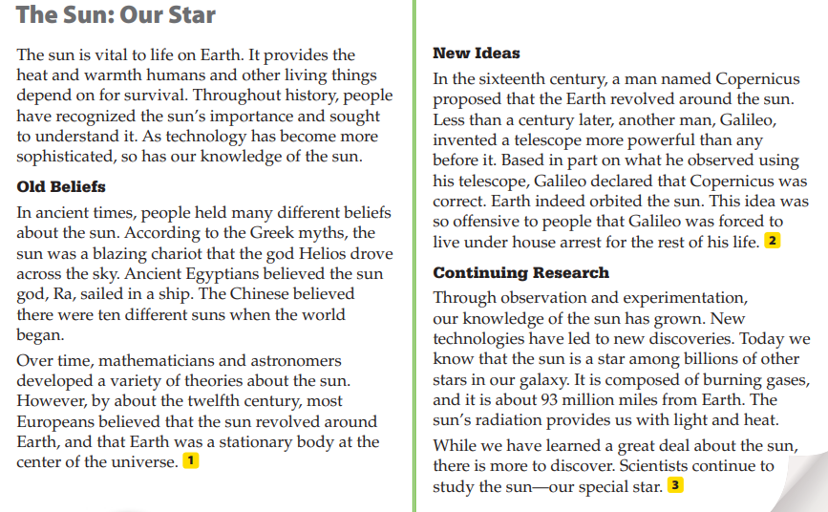
Read the passage:
Day 1 – April 13, 2020

Slide 4
Day 1 – April 13, 2020
After reading the text, what genre, or type of text, do you think we will be exploring? Think about the different types of fiction and non-fiction there are? Which could it be??? Reread the passage if you need to!
LEVEL 1 CHECK
What skill do you think we will focus on? Think of the different text structures we have learned this year…(hint, hint) and go back to the text to look for clues.

Slide 5
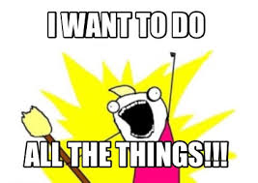
Day 1 – April 13, 2020
Today’s “To-Do” List
Email, text, Remind your answers to the following:
1. Your best guess of the essential question. 2. Your best guess of the genre type. 3. Level 1: Identify the text structure being used in the text : “The Sun: Our Star.”

