Slide 1
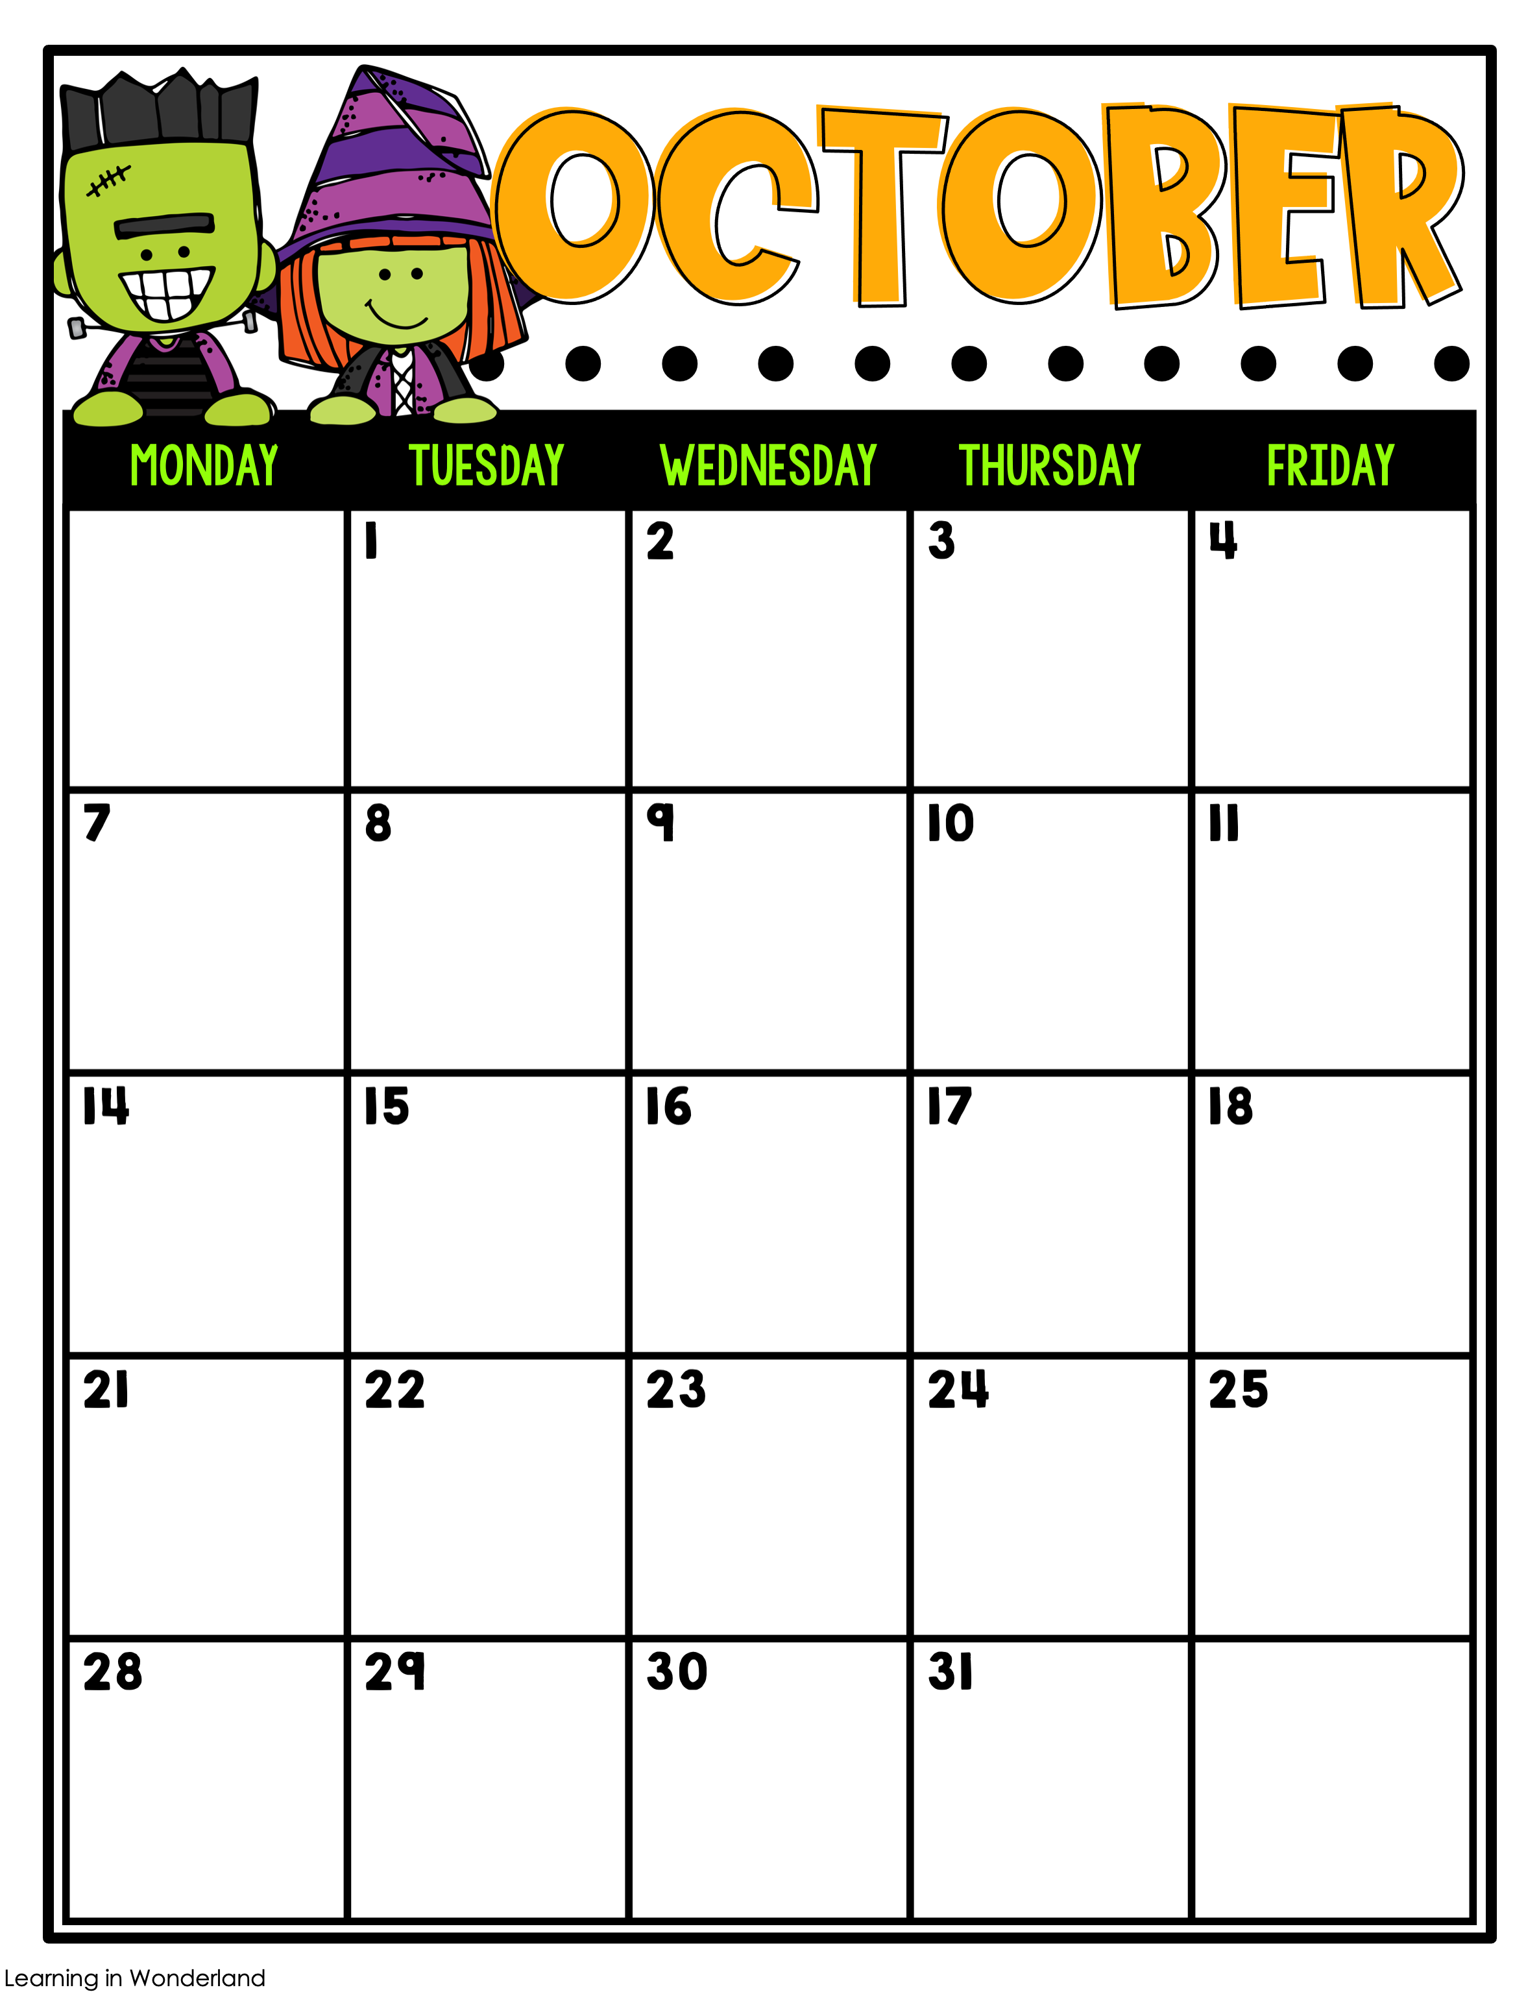
Math 4.5
Sci. Chp. 3 Test
PE
Math 4.6
S.S. Maps
Music
1.4 Spelling Test
Math 4.7
S.S. Maps
Grand Hawks Day
PE
Math 4.6
S.S. Maps
STEM
Fall Holiday/ No School
1.4 Reading Test
Math Chp. 4 Review Quiz
S.S. Maps
Guidance
Math Chp. 4 Test
S.S. Maps
PE
Math 5.1
S.S. Maps
Art
Math 5.2
S.S. Maps
Picture Day
PE
Math 5.3
S.S. Maps
STEM
Math 5.4
S.S. SE Region
Music
Math 5.5
S.S. SE Region
PE
1.5 Spelling Test
Math 5.6
S.S. Maps
Guidance
1.5 Reading Test
Math 5.7
S.S. Maps
100% of AR
PE
Math 5.8
S.S. SE Region
AR Rally
End of 1st Nine Weeks
Art
Teacher Planning Day/ No School
Math 5.9
PE
Math 5.10
STEM
Math Chp. 5 Review Quiz
Music
Math Chp. 5 Test
PE
Math 6.1
Red Ribbon Week
Guidance
Math 6.2
PE
2.1 Spelling and Grammar Tests
Math 6.3
Art
Pirate Day
PE
2.1 Reading Test
Math 6.3
STEM

