Slide 1
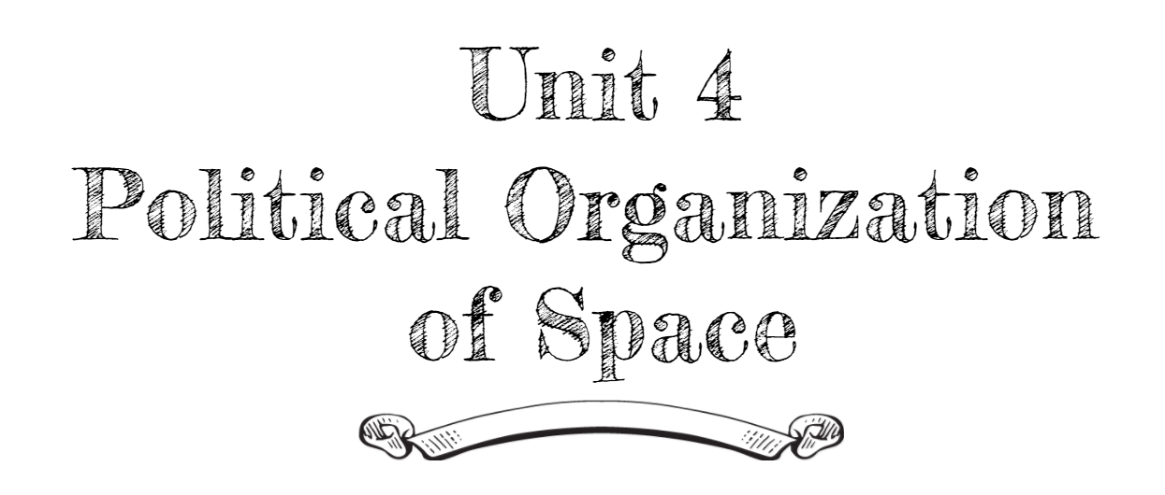
By: Carli Terrell (Orlando, Florida)
This PPT has been created using the information from the AMSCO Human Geography: Preparing for the Advanced Placement Examination book.
Palmer, David. AMSCO Advanced Placement Human Geography. Perfection Learning, 2019.

Slide 2
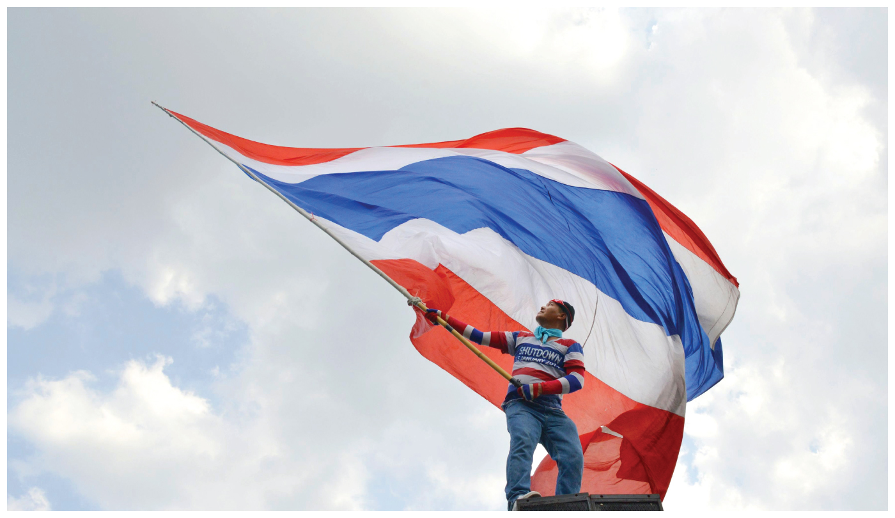
Unit 4 – political organization of space
Ch 9: the shape of the political map

Slide 3
Enduring Understanding (4.A)
By the end of this section, you will understand that the contemporary political map has been shaped by events of the past.

Slide 4
Learning objective (4.a.3)
By the end of this section, you will be able to evaluate the geopolitical forces that influence the contemporary political map.
Students will know that independence movements and democratization have shaped the political map since the end of World War II.
Students will know that the fall of Communism ended the Cold War, led to the creation of newly independent states, and changed the world balance of power.

Slide 5
Geopolitical Forces influencing today’s map
While the European colonies in Africa and Asia did not last long, their legacy was strong.
In can be seen in contemporary maps and the links among countries.

Slide 6
Geopolitical Forces influencing today’s map
Modern Colonial Independence Movements
Colonists often resisted the rule of Europeans, sometimes violently, because they wanted economic control over natural resources, free elections, and changes in society (racial equality, religious freedom)
The United Nations supported these demands for self-determination and within 100 years of the Berlin Conference, almost all European colonial territories gained independence.
This is known as decolonization.

Slide 7
Geopolitical Forces influencing today’s map
Modern Colonial Independence Movements
However, many gained political independence, but not economic independence
Transnational corporations continued to extract natural resources
Mining
Coffee, cacao, bananas, etc.
Neocolonization, remember neo means new, is when control over developing countries is indirect and can be economic, political, or even cultural.

Slide 8
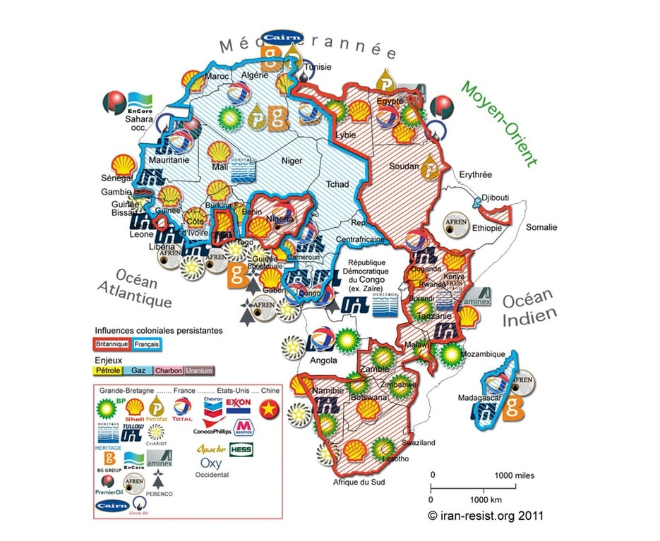
Geopolitical Forces influencing today’s map

Slide 9
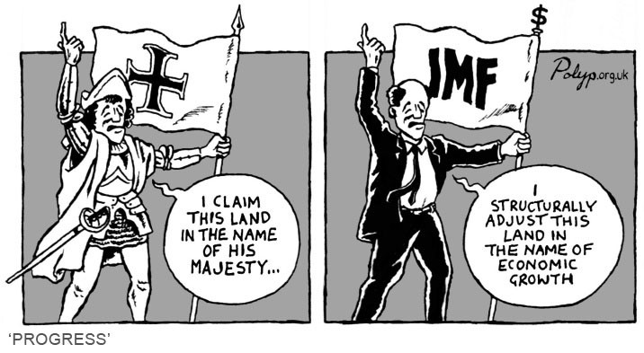
Geopolitical Forces influencing today’s map

Slide 10
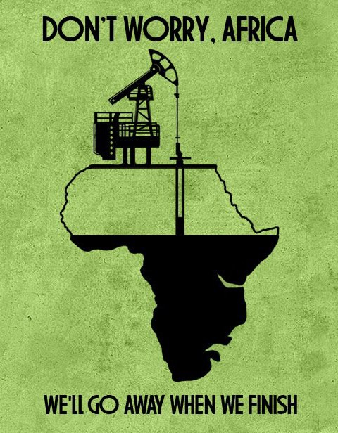
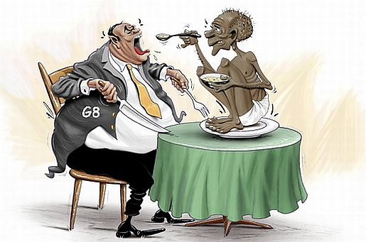
Geopolitical Forces influencing today’s map

Slide 11
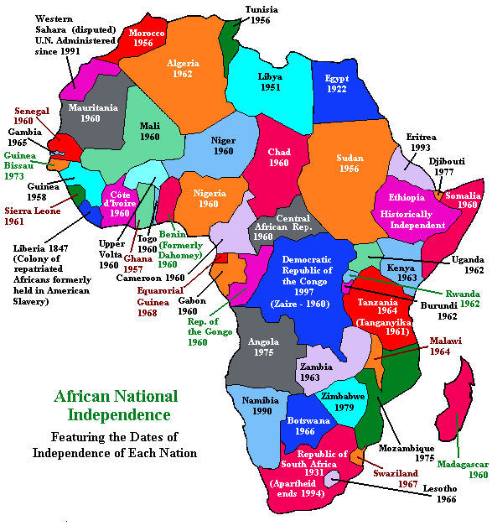
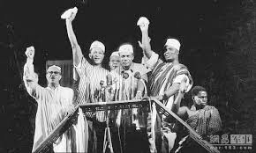
DECOLONIZATION

Slide 12
Geopolitical Forces influencing today’s map
Civil Wars in the Developing World
From 1960-1970, 32 colonies, not cultural groups, gained independence and many imposed boundaries remained.
Cultural and political boundaries did not match leading to civil war
Rwanda, 1994
Hutu and Tutsi
Genocide
Pattern: Independence → civil war and regional conflict

Slide 13
Learning objective (4.a.3)
By the end of this section, you will be able to evaluate the geopolitical forces that influence the contemporary political map.
Students will know that independence movements and democratization have shaped the political map since the end of World War II.
Students will know that the fall of Communism ended the Cold War, led to the creation of newly independent states, and changed the world balance of power.

Slide 14
Geopolitical Forces influencing today’s map
The Cold War
War against the spread of communism
Diplomatic, political, and military rivalry between the United States and the Union of Soviet Socialist Republics (USSR/Soviet Union)
Started after World War I (1945)
Continued through the collapse of the Berlin Wall (1989)
Ended with the breakup of the Soviet Union (1991)

Slide 15
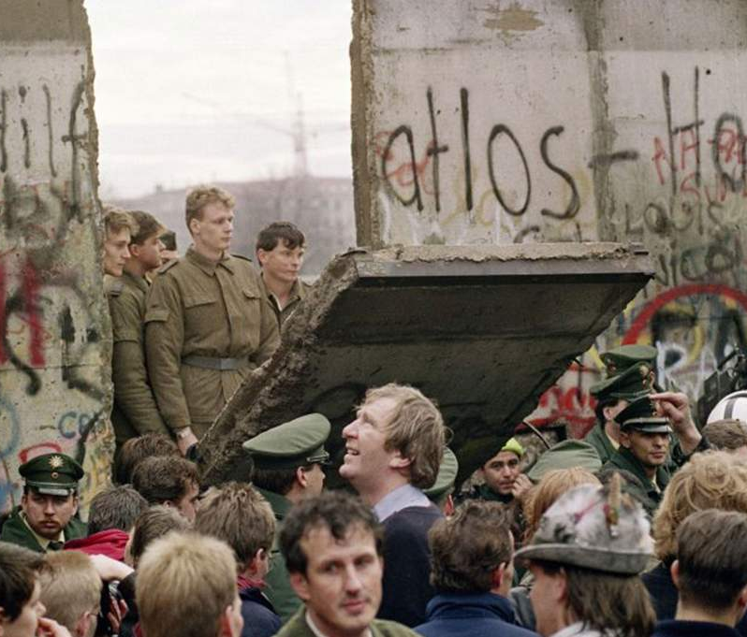
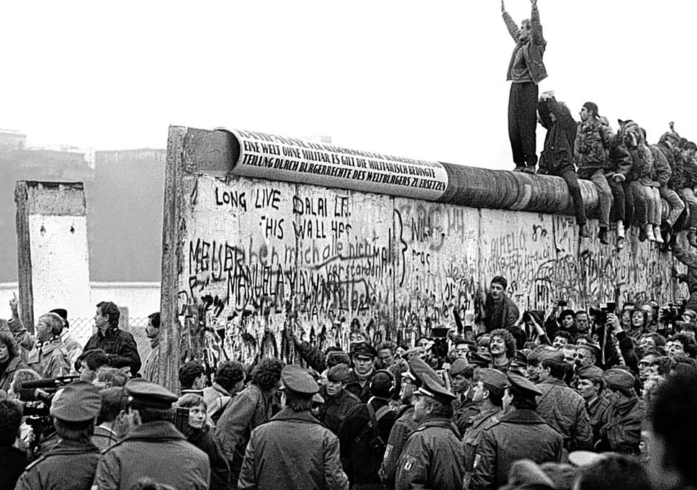
COLLAPSE OF THE BERLIN WALL

Slide 16
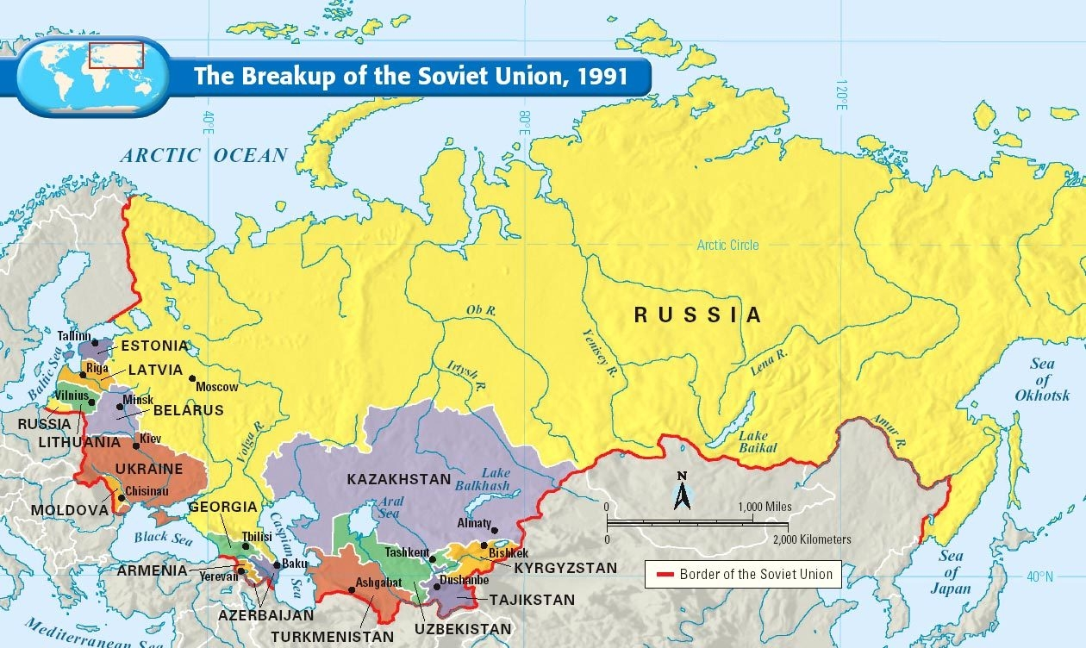
BREAKUP OF THE SOVIET UNION

Slide 17
Geopolitical Forces influencing today’s map
The Cold War
The United States and Soviet Union did not fight directly – they fought proxy wars (proxy: representative)
Korea
Vietnam
Afghanistan
Goal was to extend their sphere of influence

Slide 18
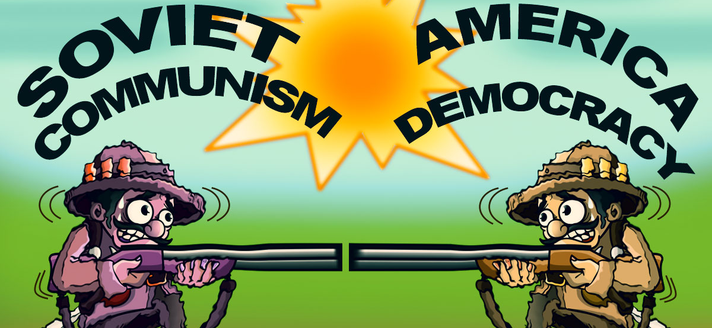

Slide 20
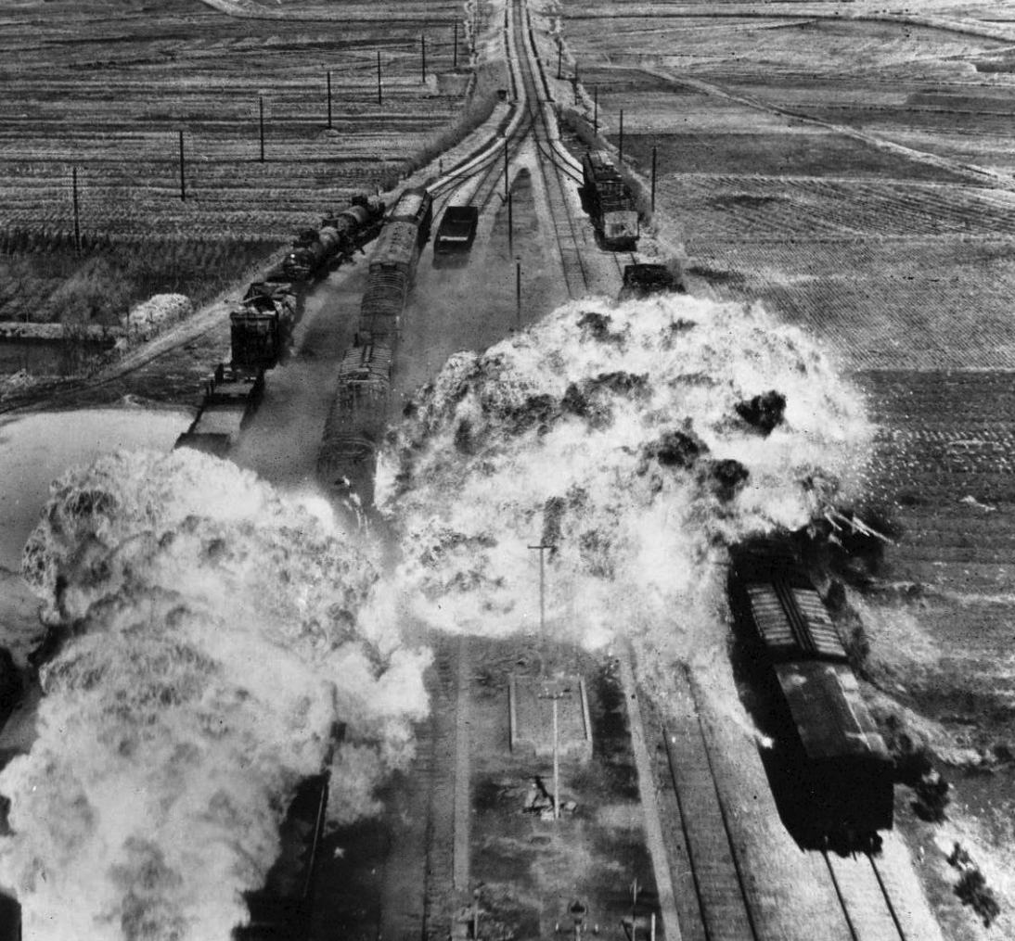
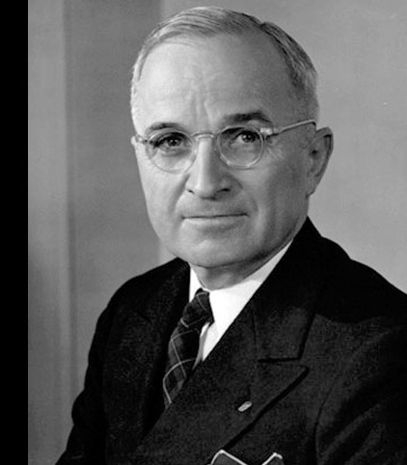
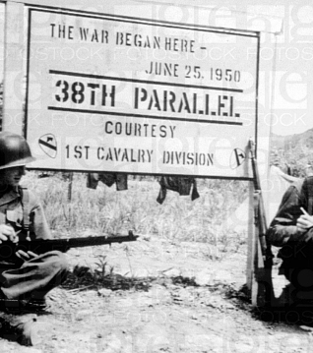
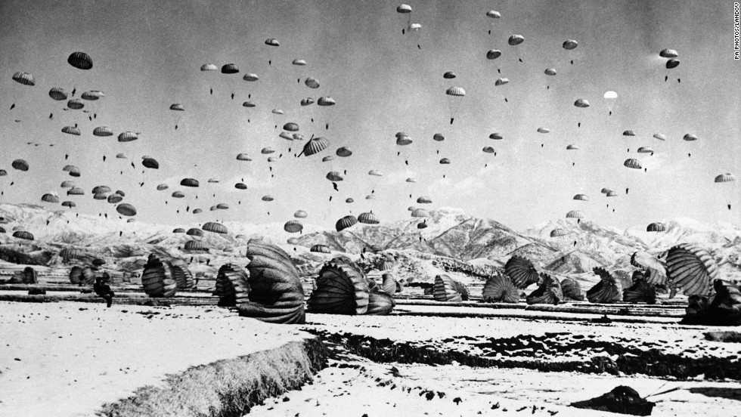
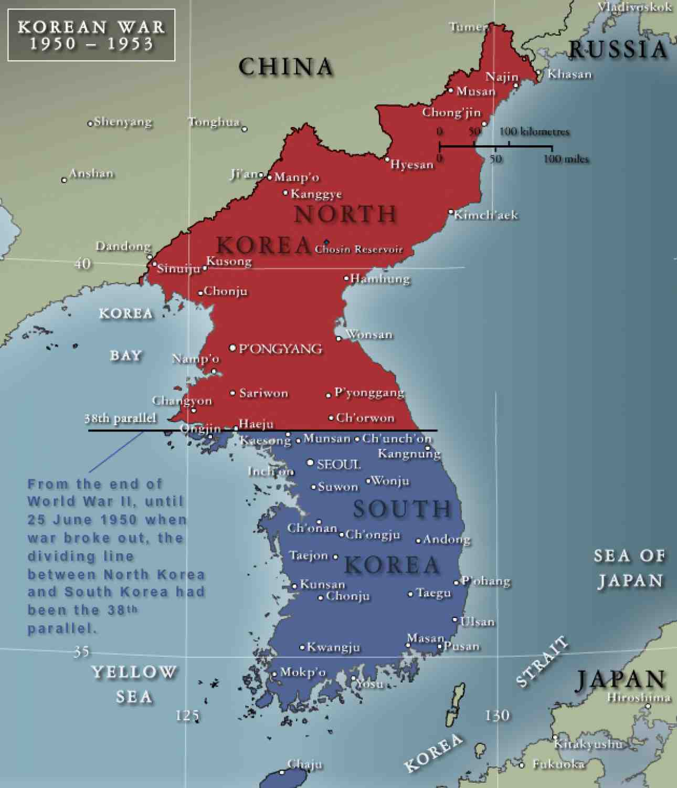
KOREAN WAR

Slide 21
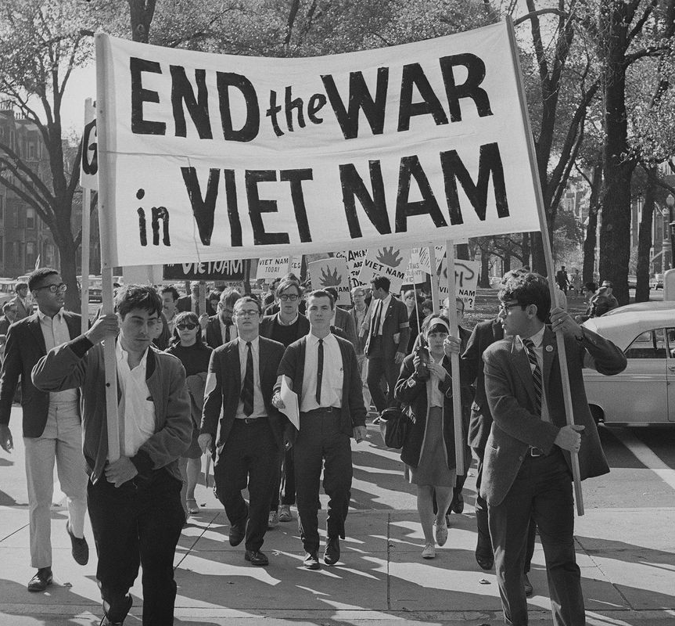
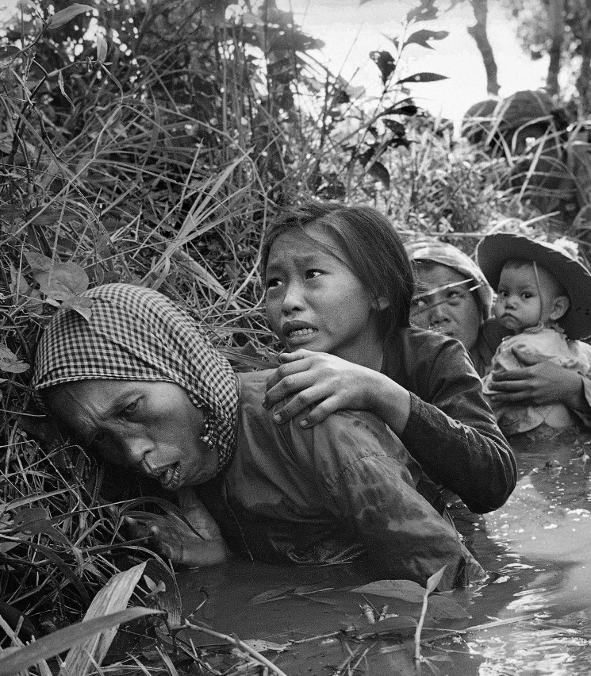
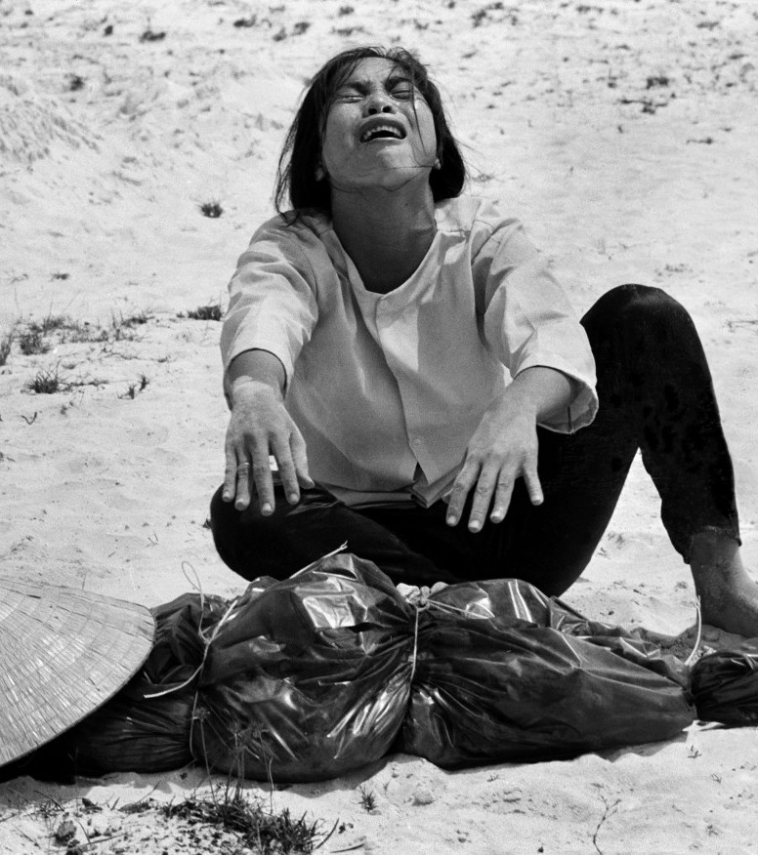
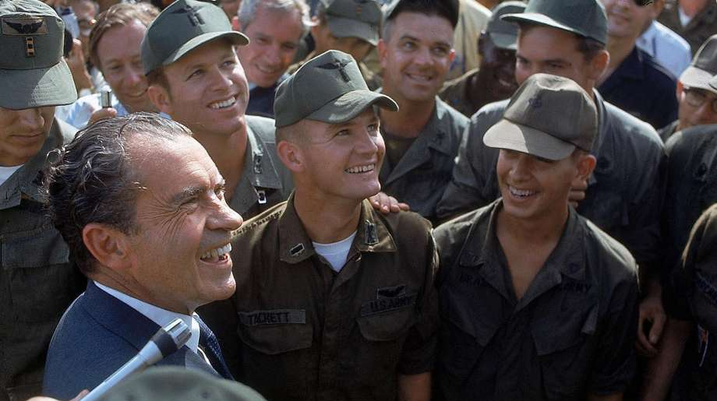
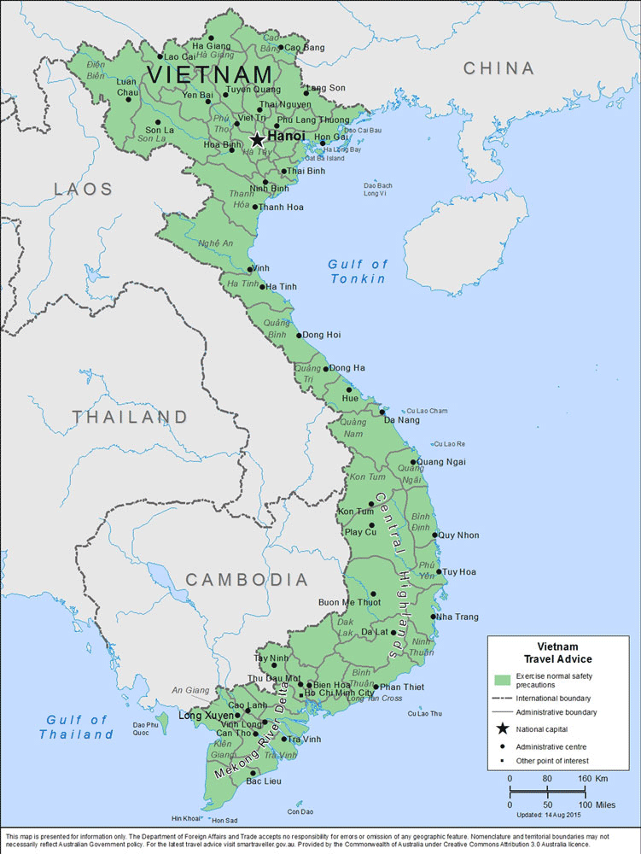
Vietnam WAR

Slide 22
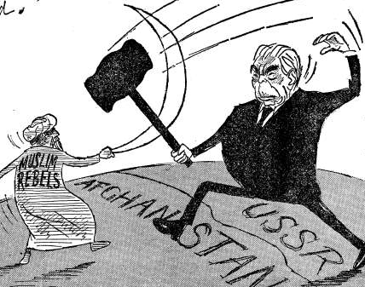
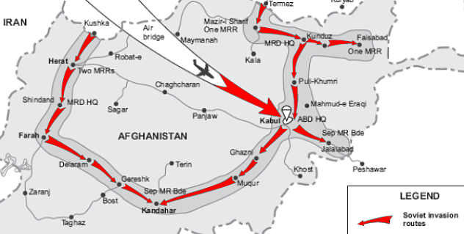
Afghanistan WAR

Slide 23
Geopolitical Forces influencing today’s map
The Cold War
Frontline for the Cold War was in Europe
After defeating the Nazis, Europe was divided between East and West
East became Soviet satellite states (dominated politically and economically by another state)
Hungary (1956) and Czechoslovakia (1968) tried to break away from Soviet domination but were unsuccessful

Slide 24
Geopolitical Forces influencing today’s map
The Cold War
Germany was more complicated and was divided in 4 zones
United States
United Kingdom
France
Soviet Union
First 3 formed the Federal Republic of Germany (West)
Soviet zone became the German Democratic Republic

Slide 25
Geopolitical Forces influencing today’s map
The Cold War
The split carried into the smaller city of Berlin, located inside the Soviet zone.
Divided into four parts
Soviet – East Berlin
Other three – West Berlin (located in East Germany – which is Soviet)

Slide 26
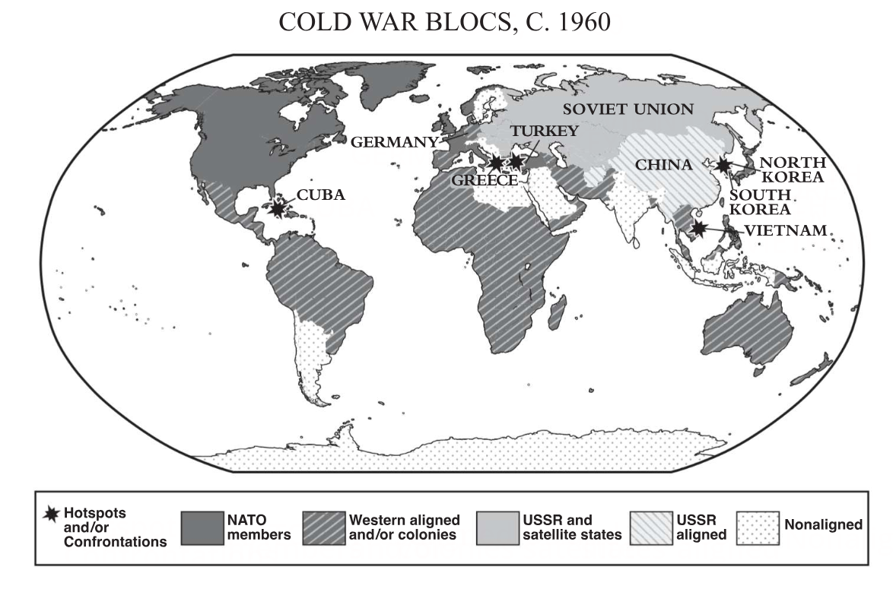

Slide 28
Geopolitical Forces influencing today’s map
The Collapse of Communism
Late 1980s – new leadership relaxes the grip on satellite states
November 1989, Germans on both sides bring down the Berlin Wall
Germany reunites and former satellite states hold free elections
Soviet Union began to collapse and, eventually, all 15 republics became independent states.

Slide 29
Geopolitical Forces influencing today’s map
Newly Independent States
After 1990, political borders changed again
Most of Europe made a smooth transition out of communism
Example: 1993, Czechoslovakia transitioned into the Czech Republic and Republic of Slovakia – called the Velvet Divorce
Some were more violent
Example: 1991, Yugoslavia – ethnic tension erupted and hundreds of thousands died in clashes between the Bosnians, Serbs, and others
Ethnic cleansing – the forced removal of a minority ethnic group from a territory.

Slide 30
Geopolitical Forces influencing today’s map
Changes in the Balance of Power
The collapse of communism and the Soviet Union drastically changed the balance of power in Europe and the world
Some countries joined the European Union (EU) and the North Atlantic Trade Organization (NATO), the western military alliance formed in 1949 to oppose Soviet military power in Europe
The balance of economic, political, and military power tilted toward Western Europe and the United States

Slide 31
