Slide 1
Unit 5
Agriculture &
Rural Land Use
By: Carli Terrell (Orlando, Florida)
This PPT has been created using the information from the AMSCO Human Geography: Preparing for the Advanced Placement Examination book.
Palmer, David. AMSCO Advanced Placement Human Geography. Perfection Learning, 2019.

Slide 2
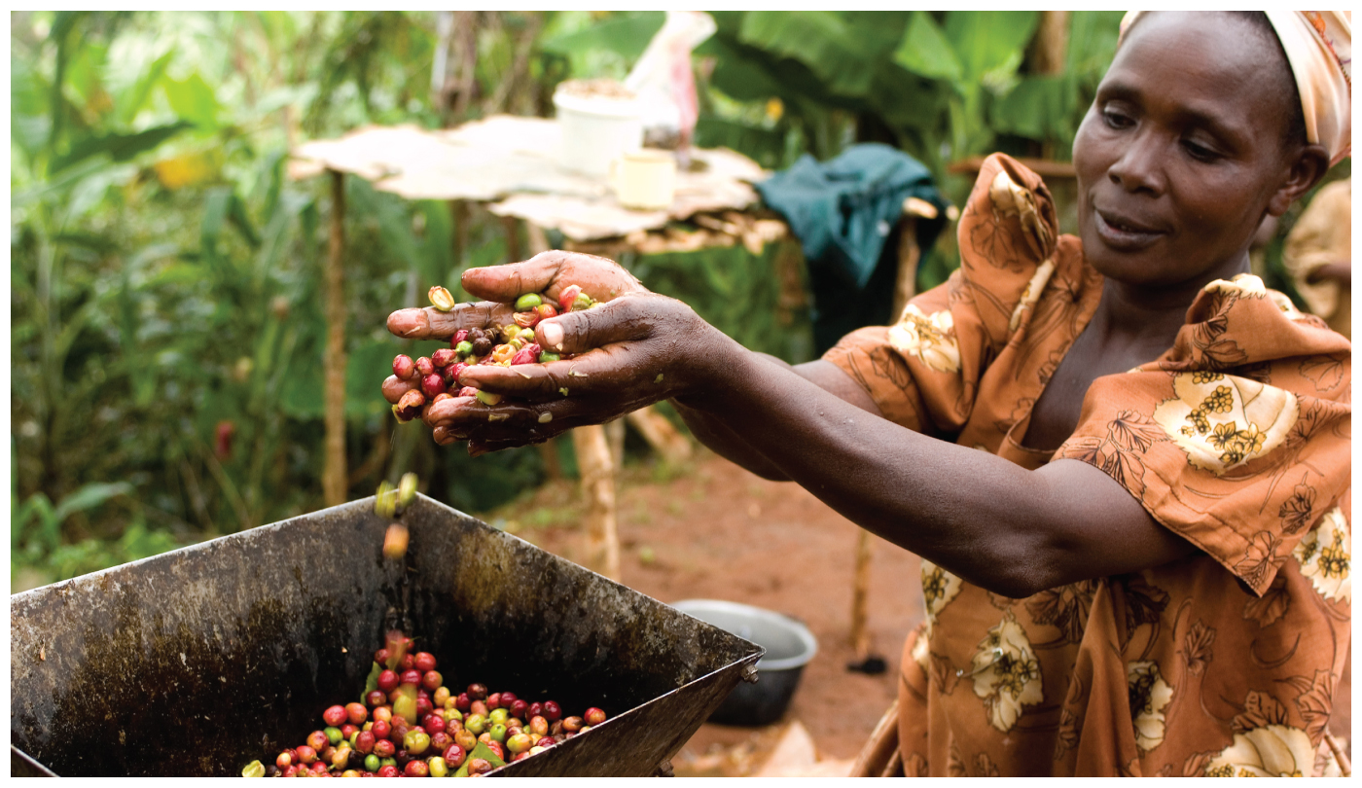
Unit 5 – Agriculture, food, & rural land use
Ch 12: The Development of Agriculture

Slide 3
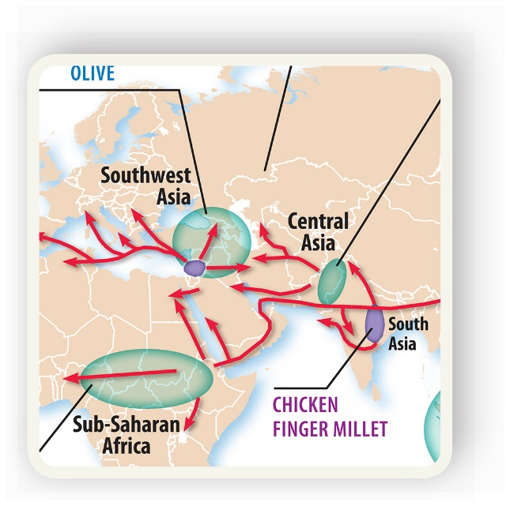
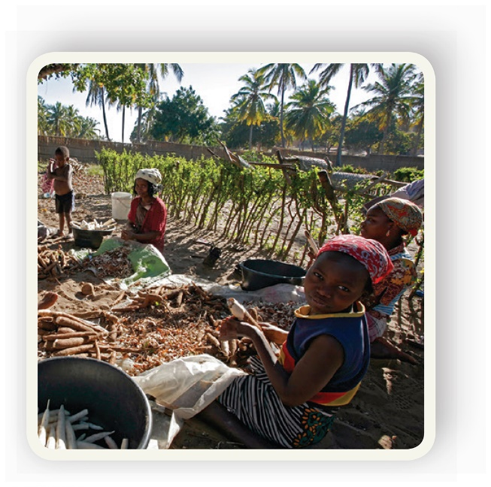
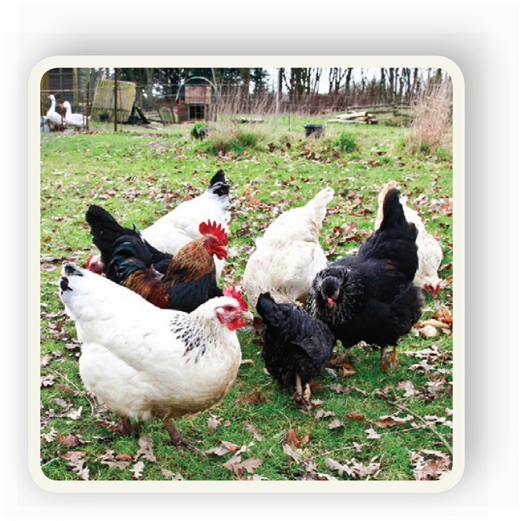
Enduring Understanding (5.A)
By the end of this section, you will understand that the development of agriculture led to widespread alteration of the natural environment.

Slide 4
Learning objective (5.A.3)
By the end of this section, you will be able to explain the advances and impacts of the second agricultural revolution.
Students will know that new technology and increased food production led to better diet, longer life, and more people available for work in factories.

Slide 5
Impact of the 2nd Agricultural rev.
The Second Agricultural Revolution accompanied the Industrial Revolution that began in Great Britain in the 18th century.
It involved the mechanization of agricultural production, advances in transportation, development of large-scale irrigation, and changes to consumption patterns of agricultural goods.
Innovations such as the steel plow and mechanized harvesting greatly increased food production.

Slide 6
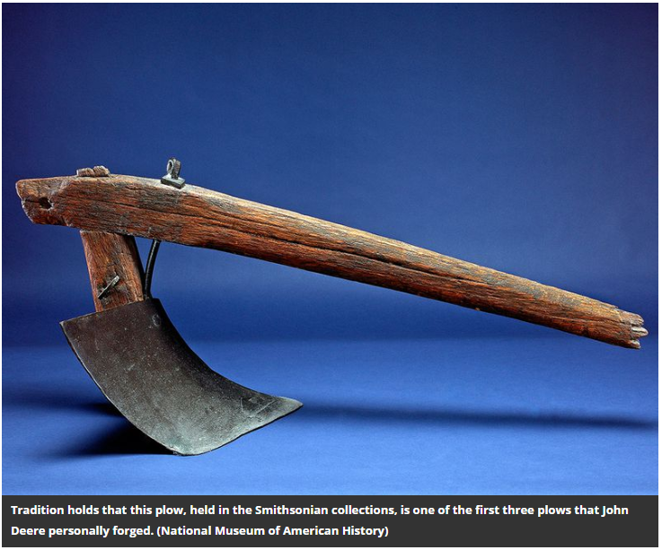
Article:
Did John Deere’s Best Invention Spark a Revolution or an Environmental Disaster?

Slide 7
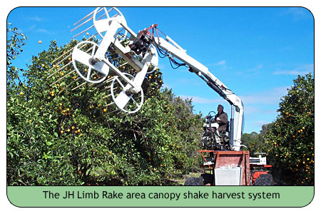

Slide 8
If the video doesn’t play, you can use this link: click here
Notes:
Top 5 Mechanical Harvesters

Slide 9
Effects of Technology
Advances in food production led to better diets, longer life spans, and an increase in population. As population increased, so did the pool for workers in industry. Since most of these jobs existed in cities and new factory towns, mass migration to urban areas began to unfold.
Urbanization, a process that is continuing today, changed the cultural landscape and population distributions throughout the world.

Slide 10
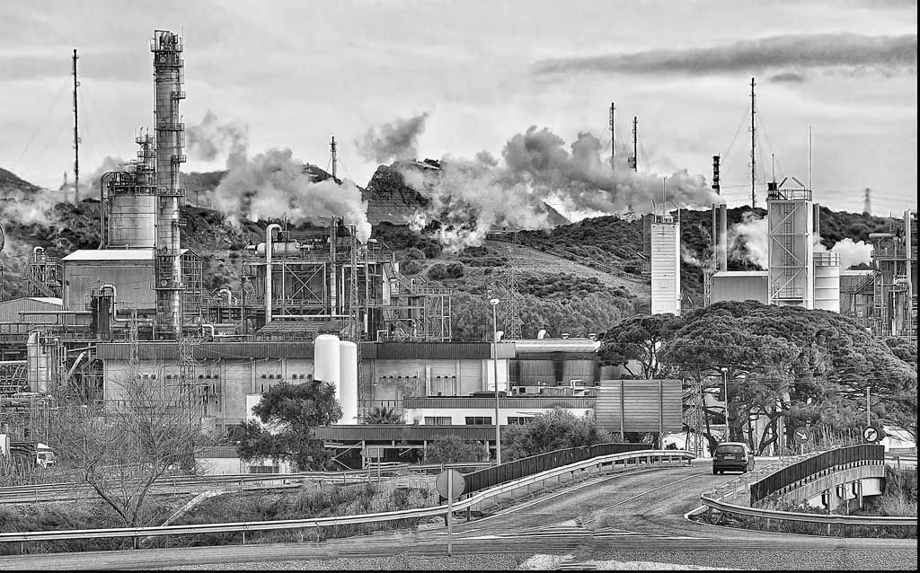

Slide 11
Land use and farming advances
As technology changed, so did the laws.
Enclosure Acts – a series of laws enacted by the British government that enabled landowners to purchase and enclose land for their own use that had previously been common land used by peasant farmers.
Farms became larger, production became more efficient, producers raised crop to sell for profit rather than simply for their own consumption, and people were forced off the land, which created a workforce for the growing factories.

Slide 12
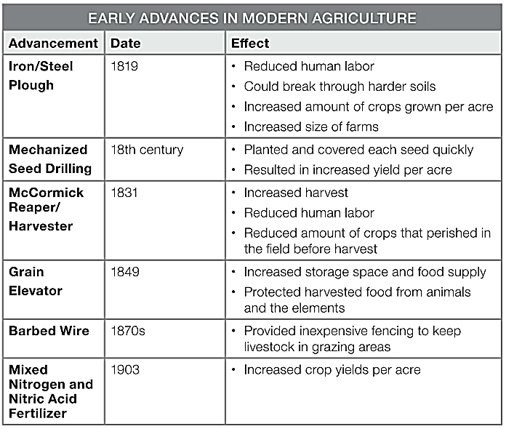
Land use and farming advances
The Enclosure Acts were not popular with everyone and people who lost their traditional way of life suffered greatly.
Several advancements in sowing (planting) and reaping (harvesting), storage, irrigation, and transportation were made in agriculture throughout the 19th century.

Slide 13
Ag. changes and shifting demographics
The Second Agricultural Revolution
Resulted in fewer, larger, and much more productive farms.
Caused a decrease in the number of farm owners and an even greater drop-off in the need for agricultural laborers.
Led to more people living in urban areas than rural areas for the first time in United States history.

