Slide 1
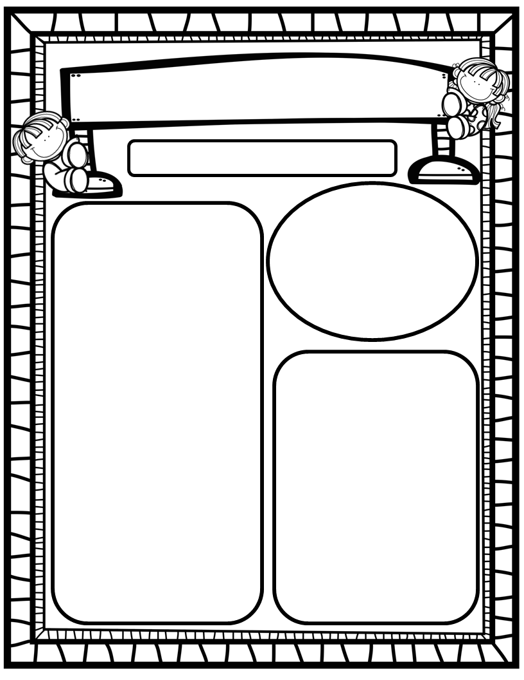
The Deason Digest Weekly Blast
March 3rd, 2025
We Are Learning About…
Reading: We will focus on the FLSZ (Ending ff, ll, ss, zz), & -all/-oll/-ull spelling rules as well as HFW’s your, want, go, no, so. We will work to identify author’s purpose in Dr. Seuss stories. We will look at pictures, get our mouths ready, and use chunky monkey to help us stretchy-snake tricky words faster. EQ: What are our favorite Dr. Seuss books and why?
Writing: We will focus on printing and tracing upper and lowercase letters, as well as using stretchy-spelling and sight words to write complete sentences!
Math: We will end GoM ath Ch. 11: Addition Up to 5 and begin Go M ath Ch. 12: Subtraction Up to 5!
Science: We will end Unit 4: Day and Night!
Social Studies: We will continue to practice I-Care Rules. We will practice what it means to show Courage! In the wake of Read Across America Day (Dr. Seuss’ birthday 3/2), we will learn about author and illustrator Dr. Seuss. We will read several of his books and decide which book is our favorite. We will discuss our opinions!
Homework:
Read to and with your child each night and complete Reading Rally Log!
Practice HFW’s: the, I, and, a, is, as, said, to, do, of, see, he, be, me, from, was, you, have, what, your, want, go, no, so
Go Math Home Practice for Ch. 11
UFLI Home Practice Pages
Go over Weekly Work and discuss
Important Dates:
March 4: Field Day; 8:30-10:00
March 5: Reading Rally Logs Due
March 7: First Friday/Friendship Lunch; AR Reading Celebration; last day of 3rd 9 Weeks
March 10-14: Spring Break-No School
March 17: Teacher Planning Day-No School
March 18: Students Return; First Day of 4th 9 Weeks
March 20: SAC/PTO 6pm/7pm

