Slide 1
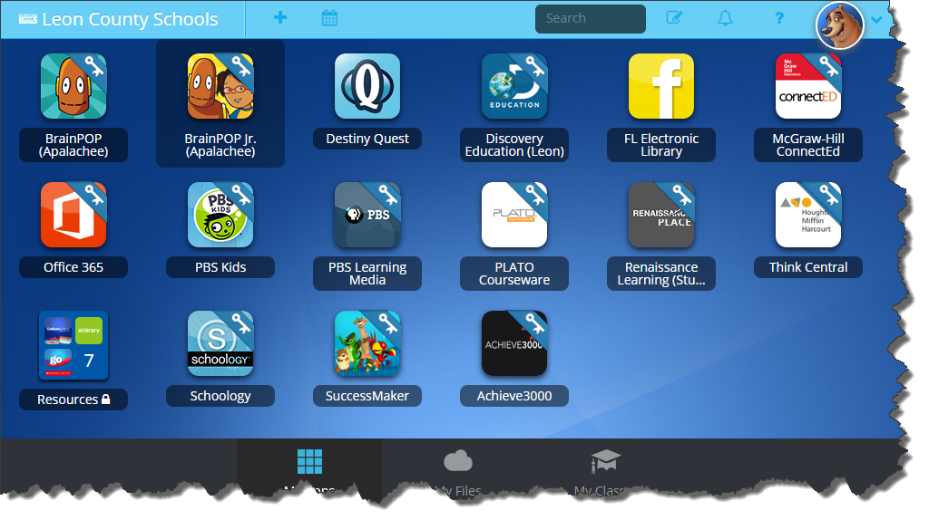
ClassLink SSO Web Portal

Slide 2
Major topic areas
Class Link Sign-in
My Profile
Apps
My Files
My Classes

Slide 3
Topic 1: Class Link Sign-in
Class Link Sign-in
My Profile
Apps
My Files
My Classes
Focus Points-
ADFS – automatic pass through at work
ADFS – off network
QuickCard (K-1)
Remote Login (K-1)

Slide 4
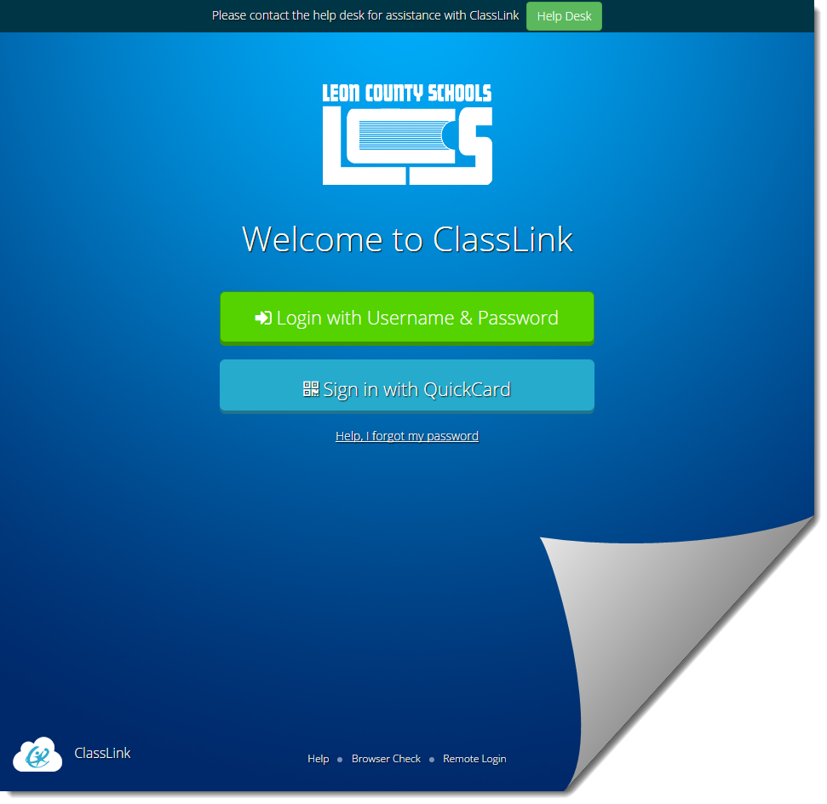
T1a: ADFS – Automatic pass through at work
Open ClassLink from the website
ClassLink will AUTOMATICALLY detect your login username and password information and pass them through to the ClassLink site for you just by clicking the link

Slide 5
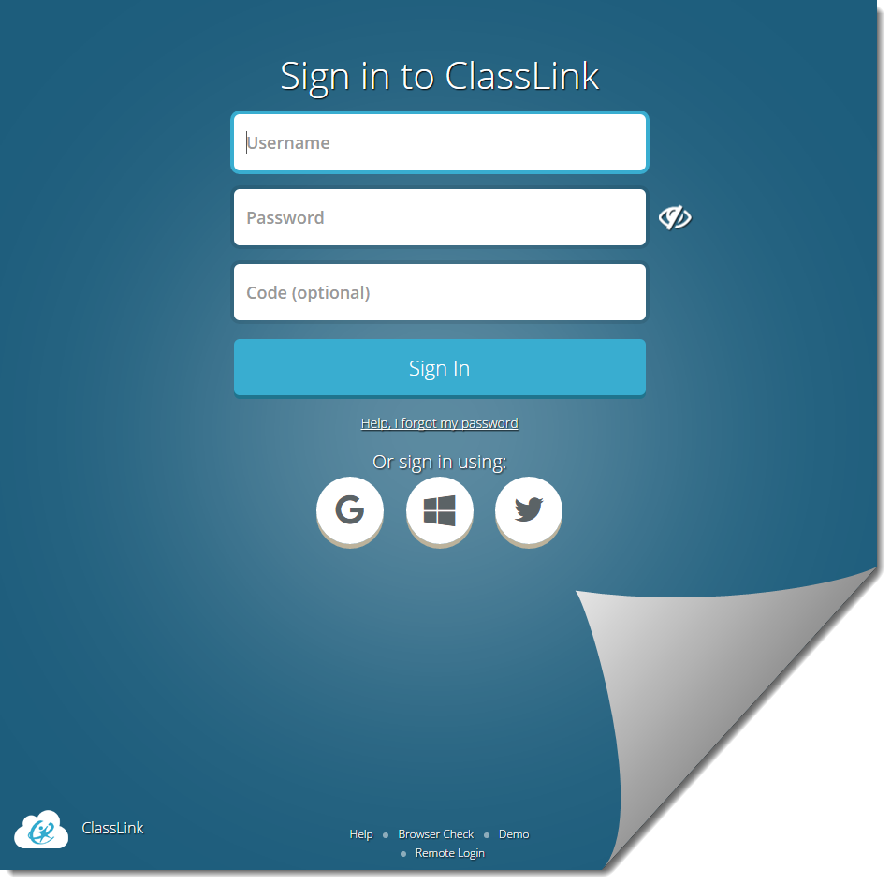
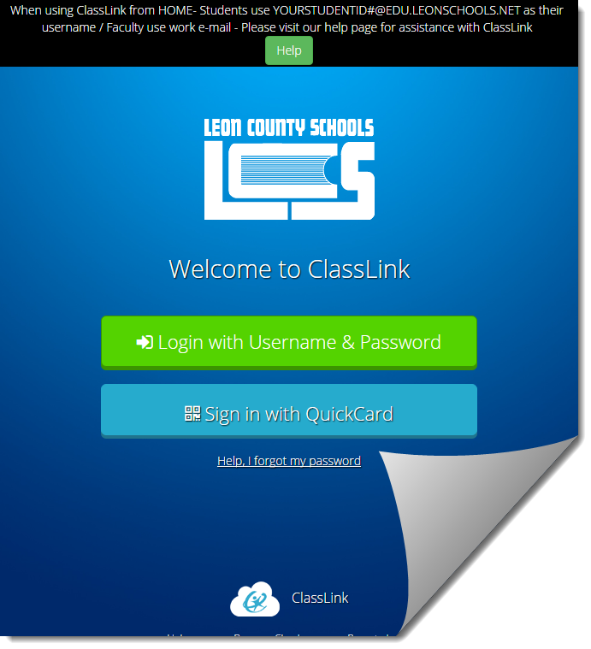
T1b: ADFS – Logging in from home / off network
Open ClassLink from the website
When logging in from home or outside school, click Login with Username & Password
Enter Users LCS Email*
StudentID#@edu.leonschools.net
EmployeeUsername@leonschools.net
Enter users network password

Slide 6
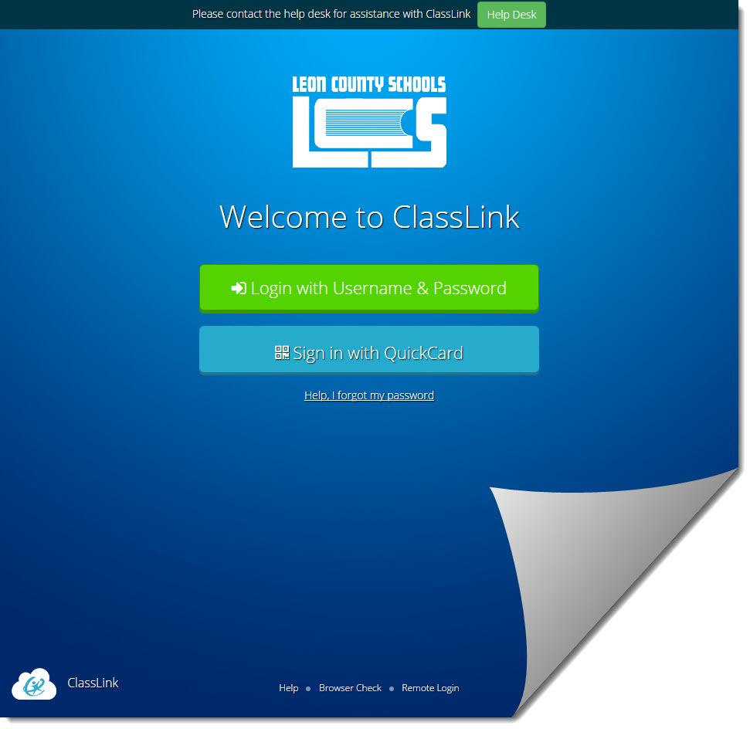
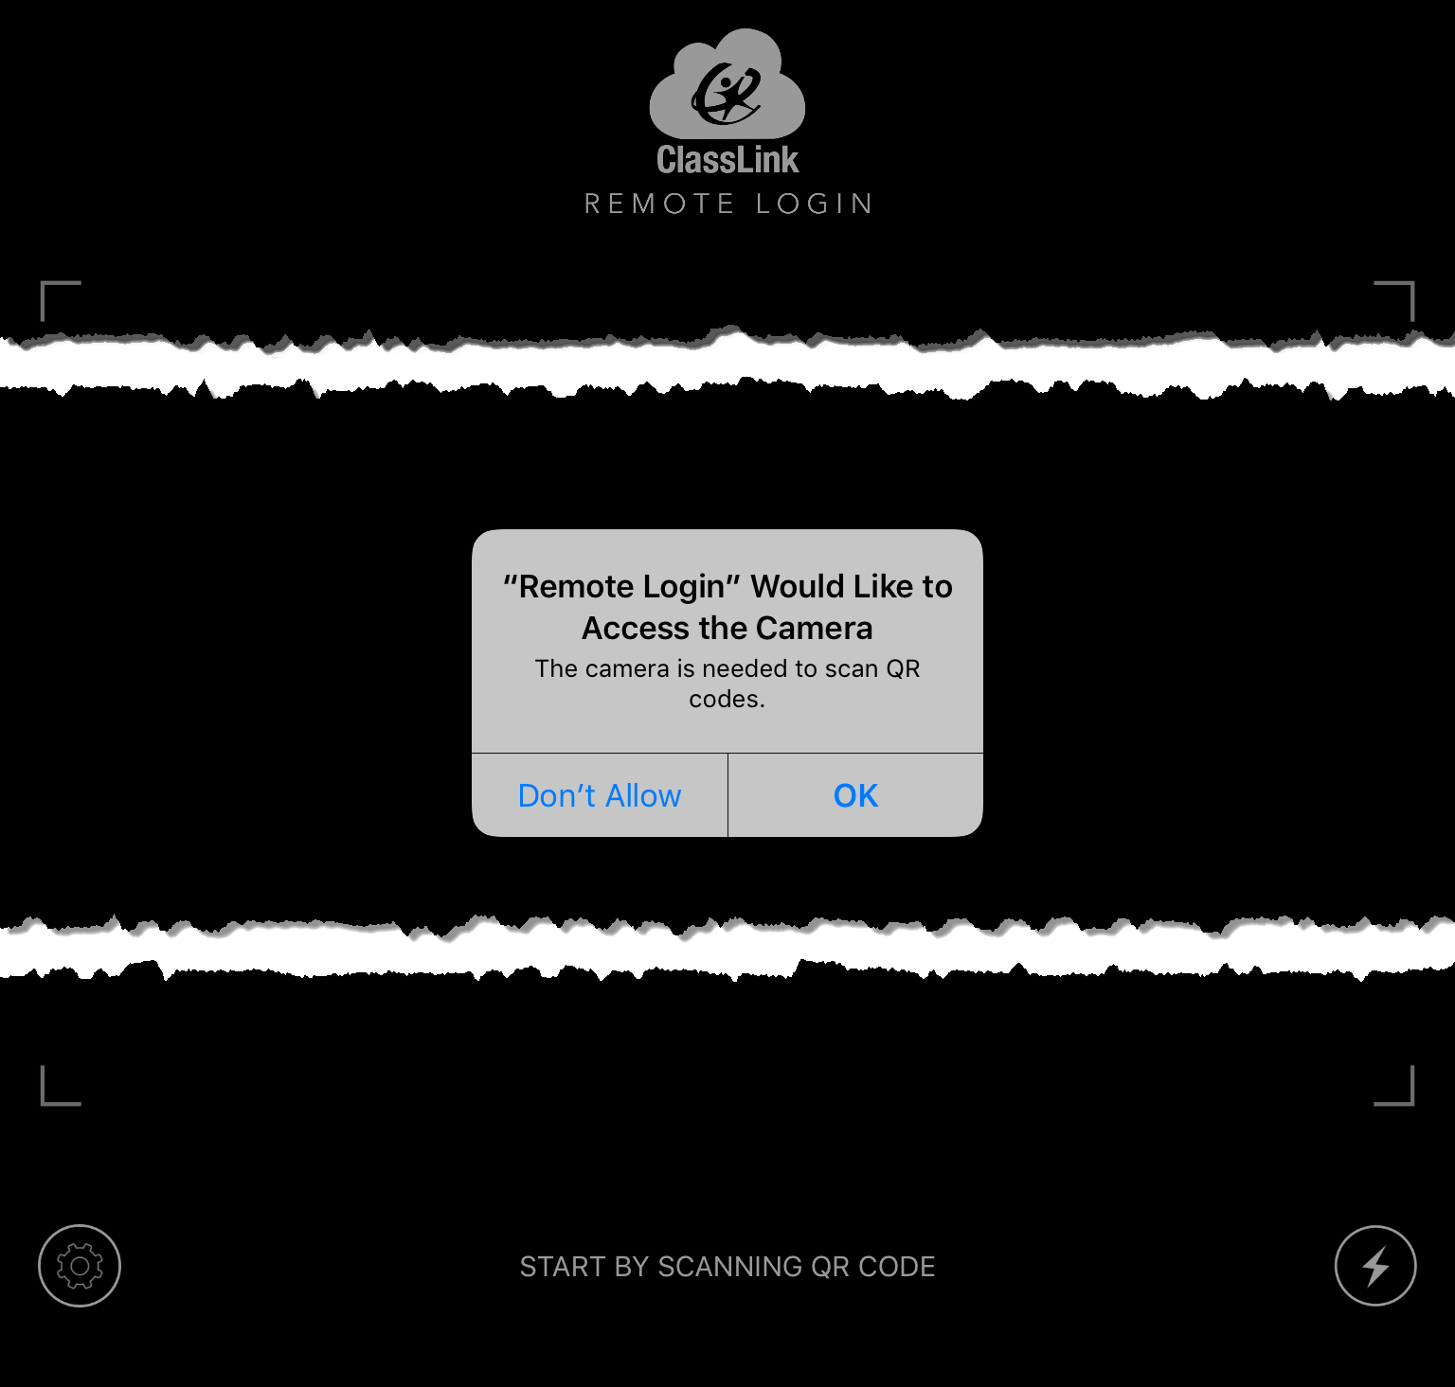
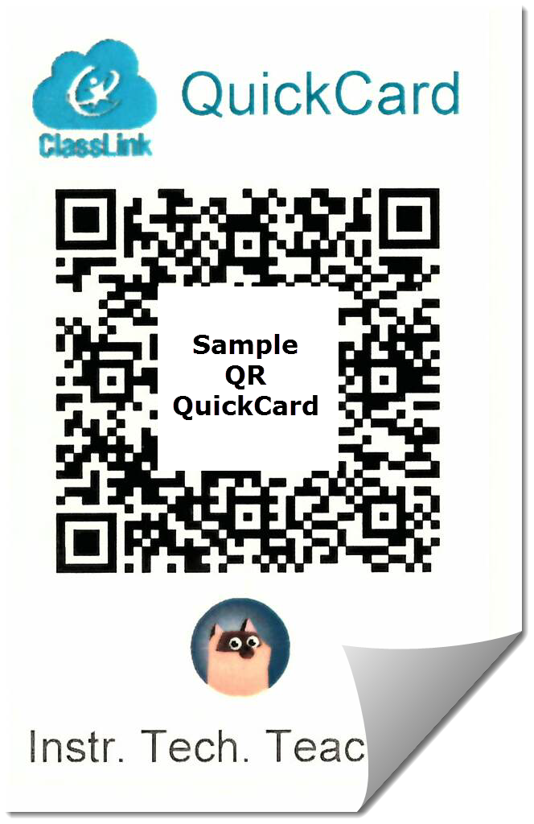
T1c: QuickCard – Using QR code to login (K-1)
If you are a K-1 class/student and you have a camera enabled, you can use the QuickCard option,
Click Sign in with Quickcard
Camera will activate
Make sure to allow system access to your camera!!

Slide 7
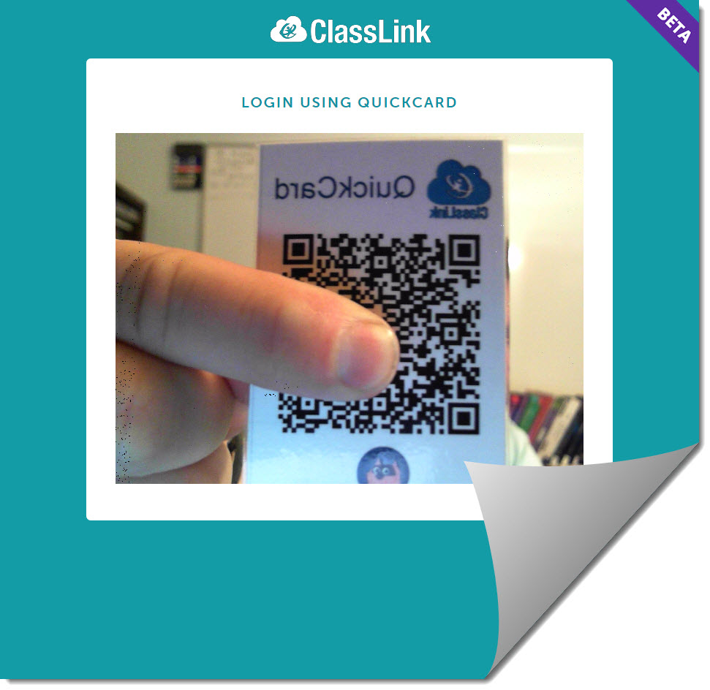
T1c: QuickCard – Using QR code to login (K-1)
Hold your QuickCard in front of the camera where it can see the whole QR code.
Do not block the QR and ensure the camera is in focus. You may need to move the QuickCard closer or farther to be in focus for the camera before it will login.
NOTE: Whole QR should be visible to camera (NO fingers!!)

Slide 8
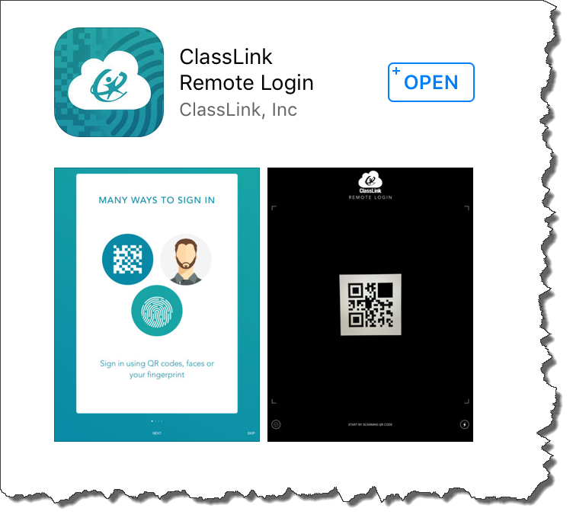
T1d: Remote Login (K-1)
Remote Login is designed primarily for TEACHERS to be able to manage their students QR code logins by storing students QR codes within the remote login app as a class.
It is a SEPARATE APP from ClassLink.
In order to use the Remote Login feature, you must download the ClassLink Remote login app first.
NOTE: Remote Login app is currently only available for Apple iOS (No Android app)

Slide 9
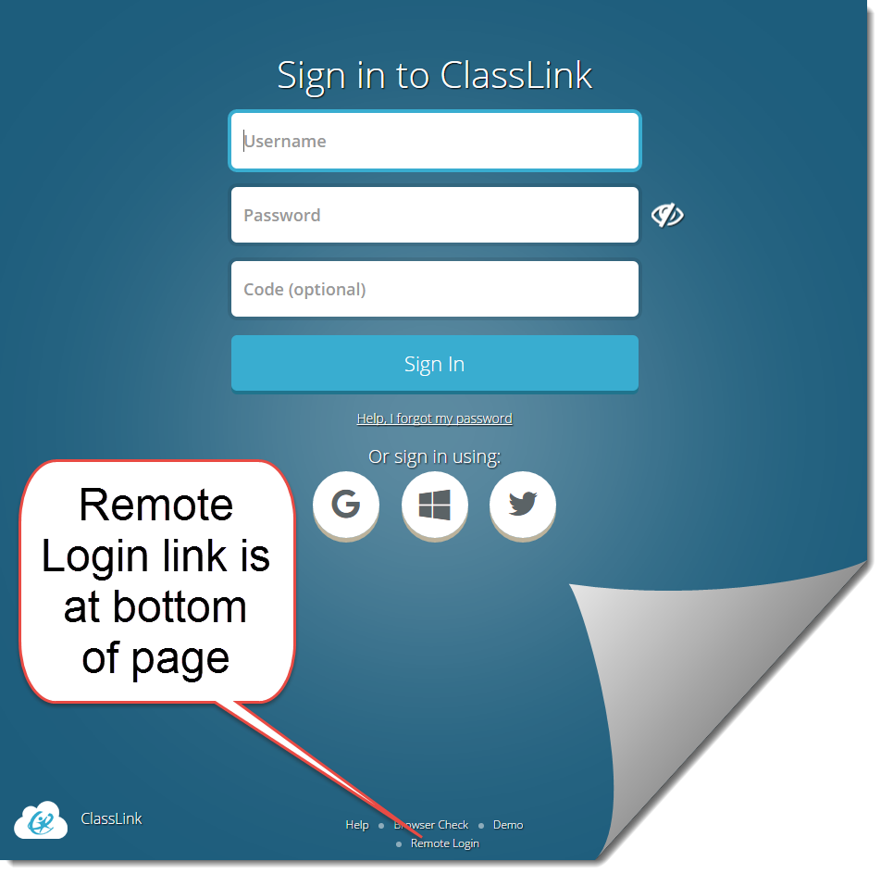
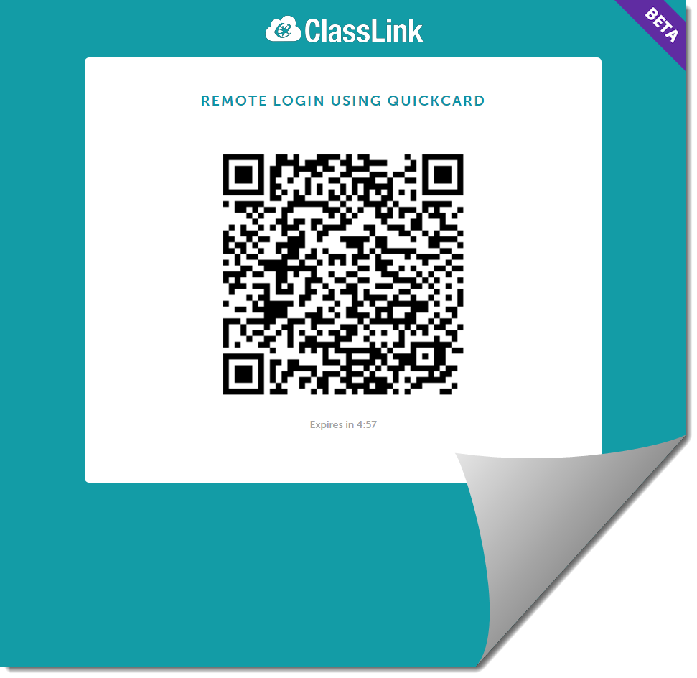
T1d: Remote Login (K-1)
In order to use the Remote Login feature, simply click the Remote login link at the bottom
It will open a QR screen for use with the ClassLink Remote login app
You will need to allow permission for the app to access the devices camera to see the QR code

Slide 10
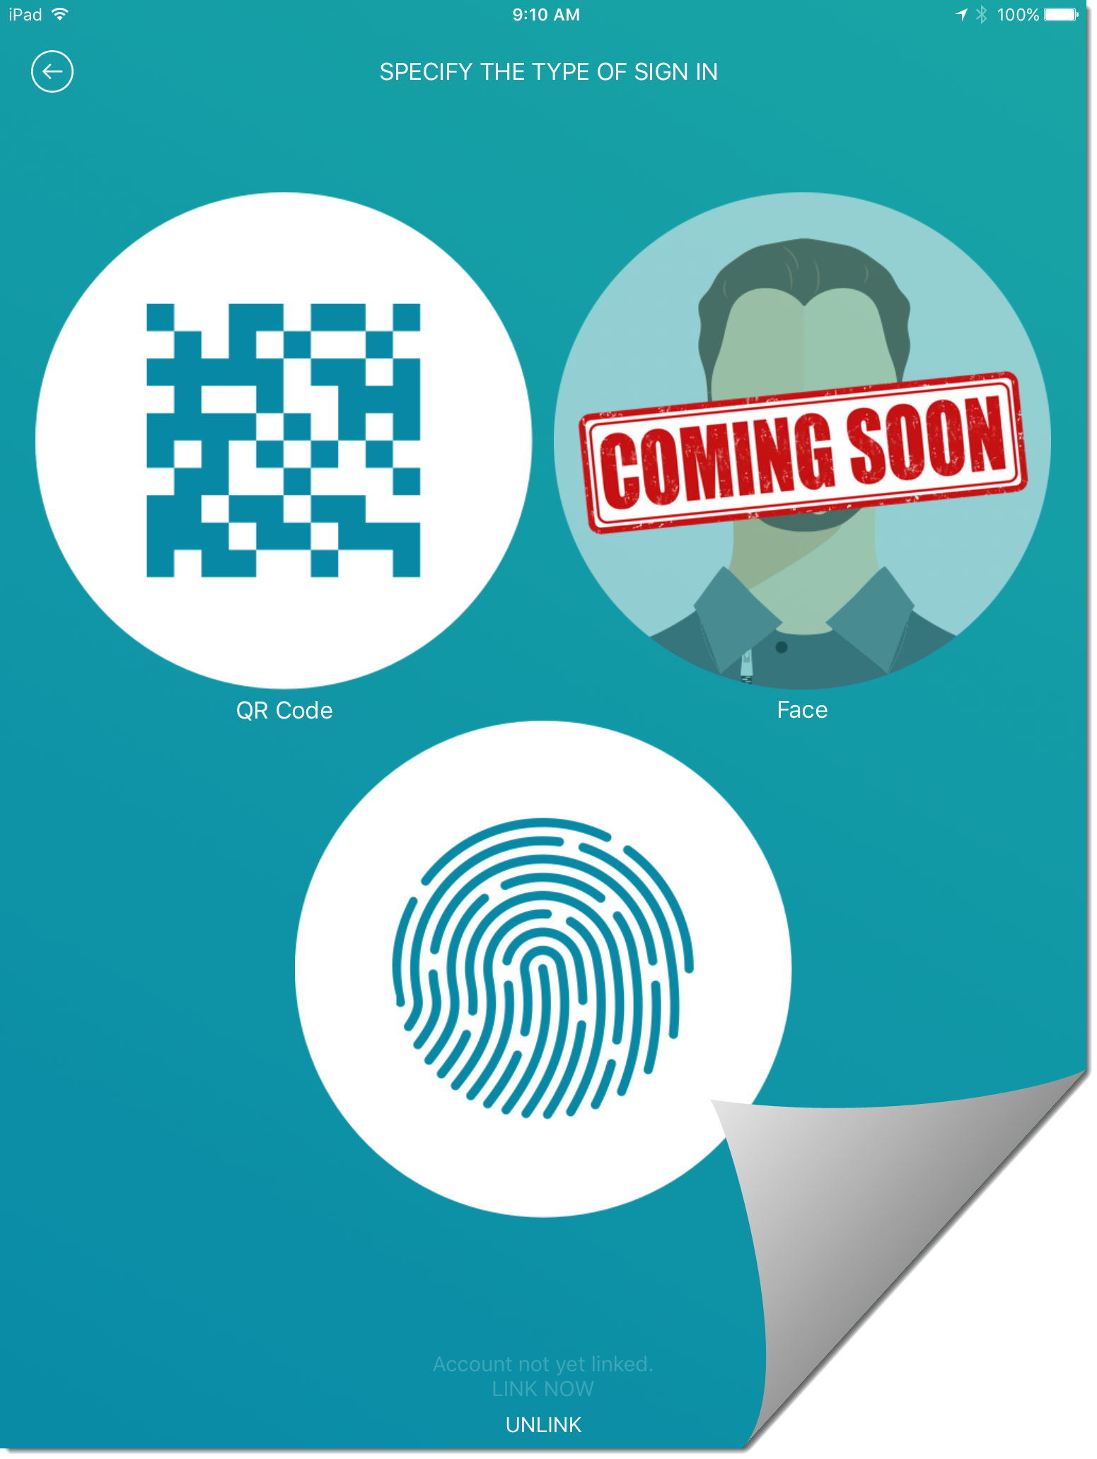
T1d: Remote Login (K-1)
The Remote Login app can capture three different identity login methods for teachers to use for their students, however, teachers are only to use the QR method
IMPORTANT NOTE: Only one login method is legal* in Florida (QR Code).
F.S. 1002.222(1)(a): Educational Data Privacy prevents the capturing of students “biometric information” including fingerprints, or facial recognition by schools. (SB 188)

Slide 11
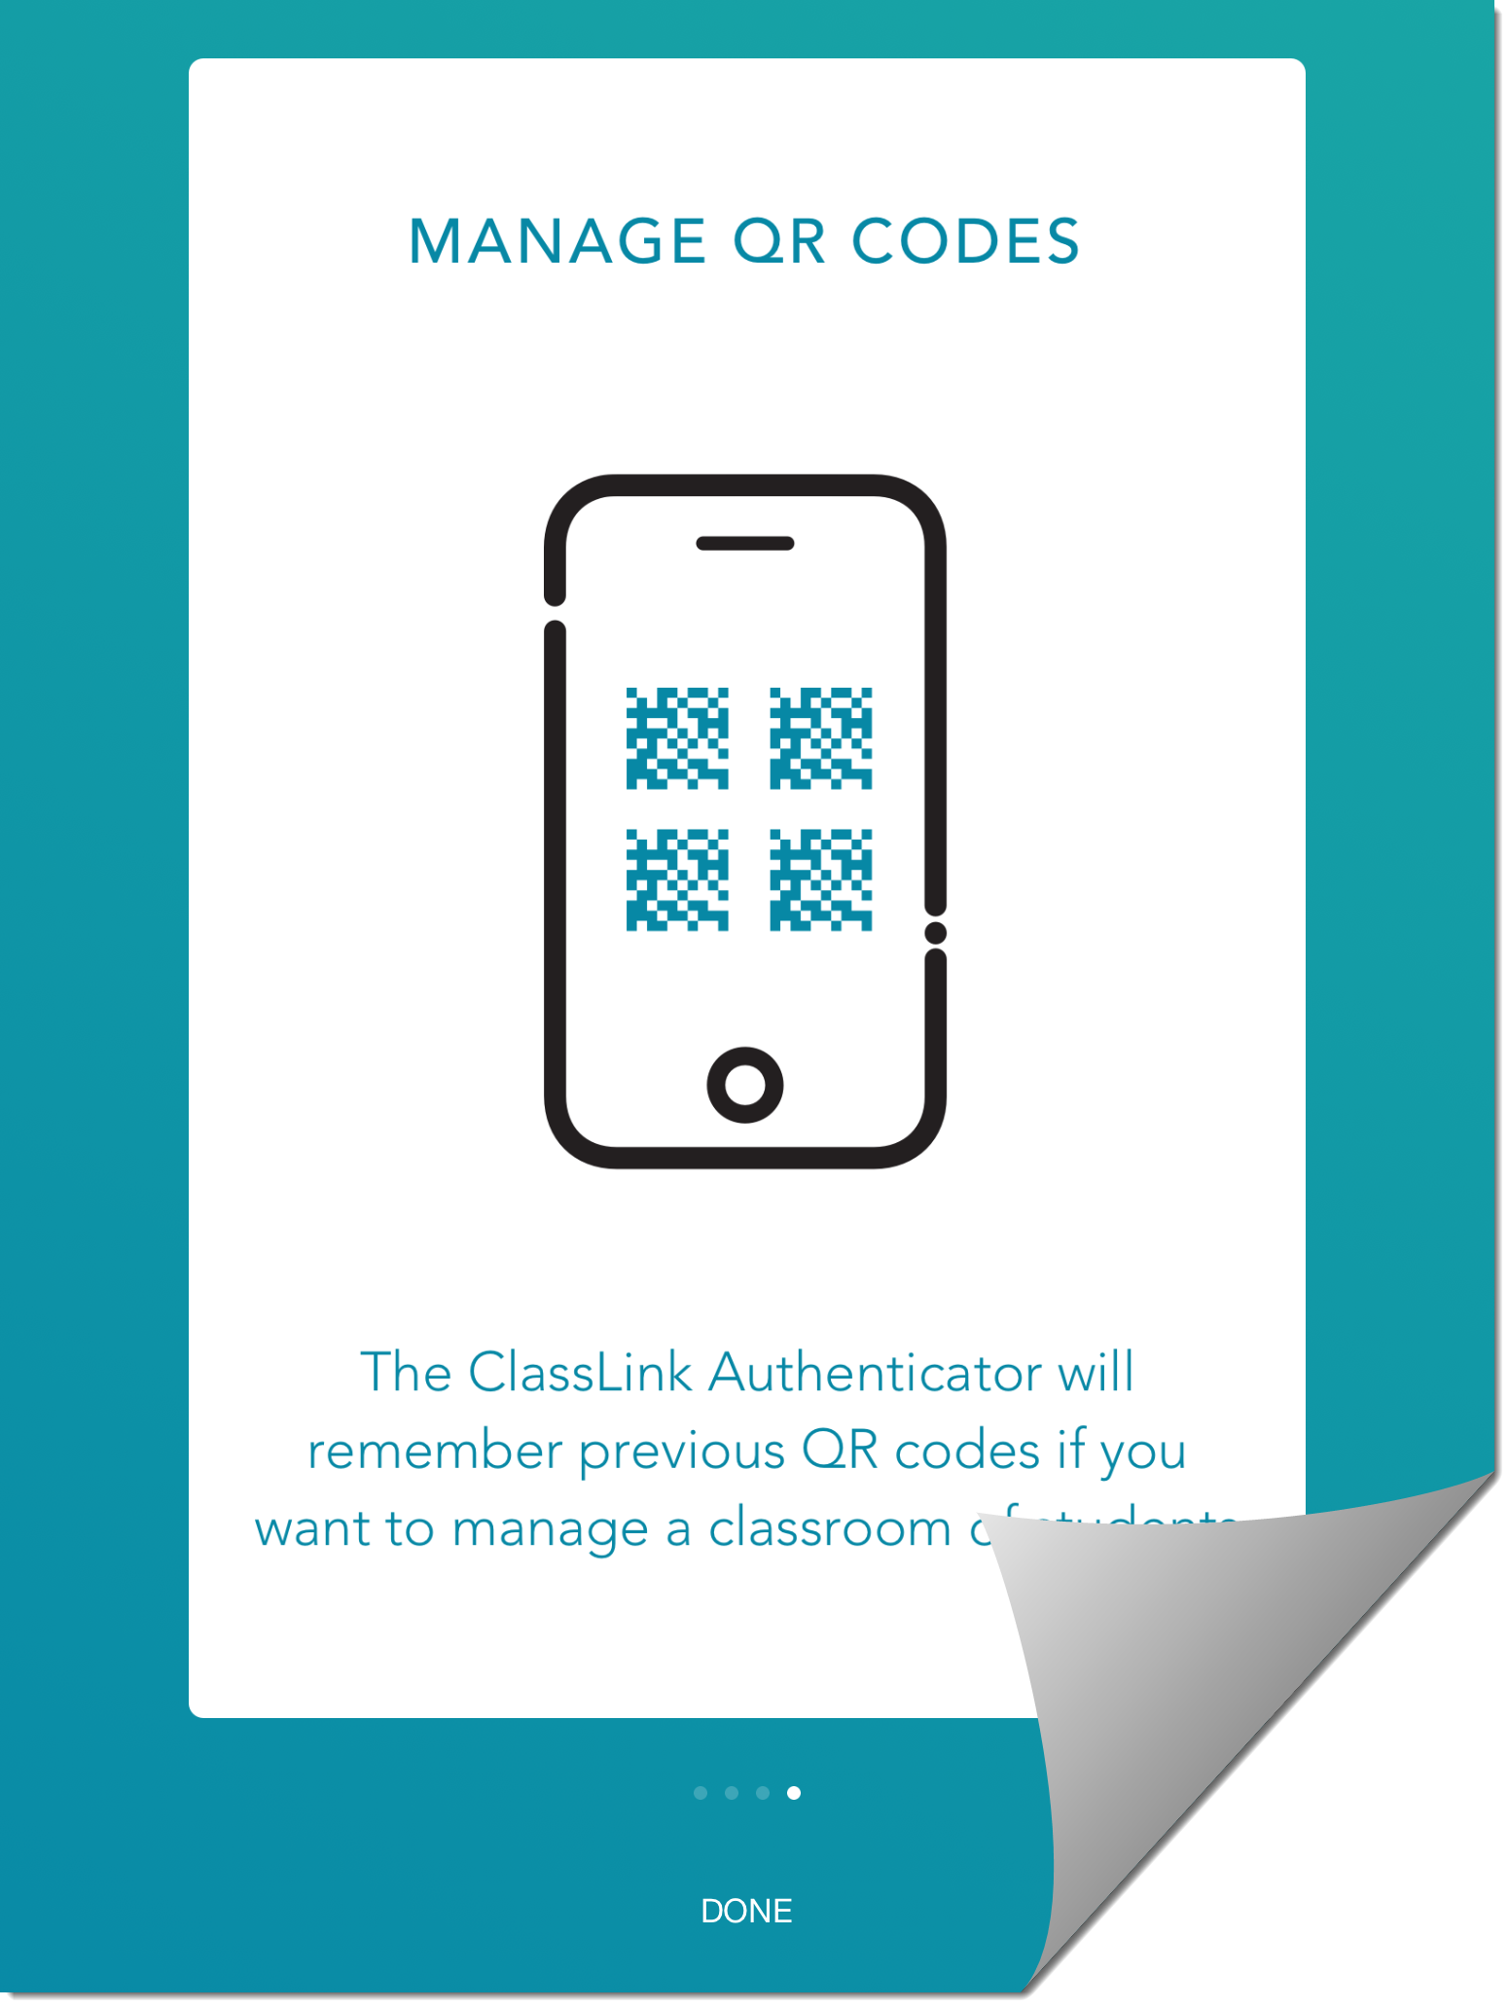
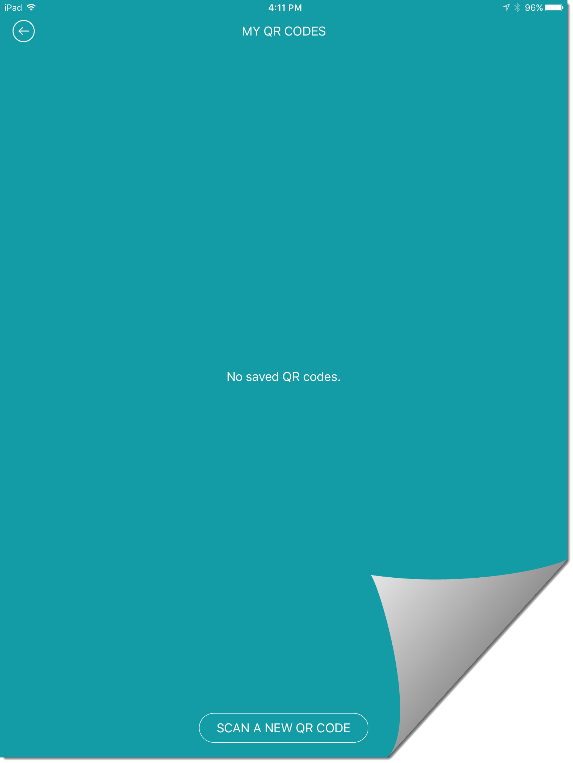
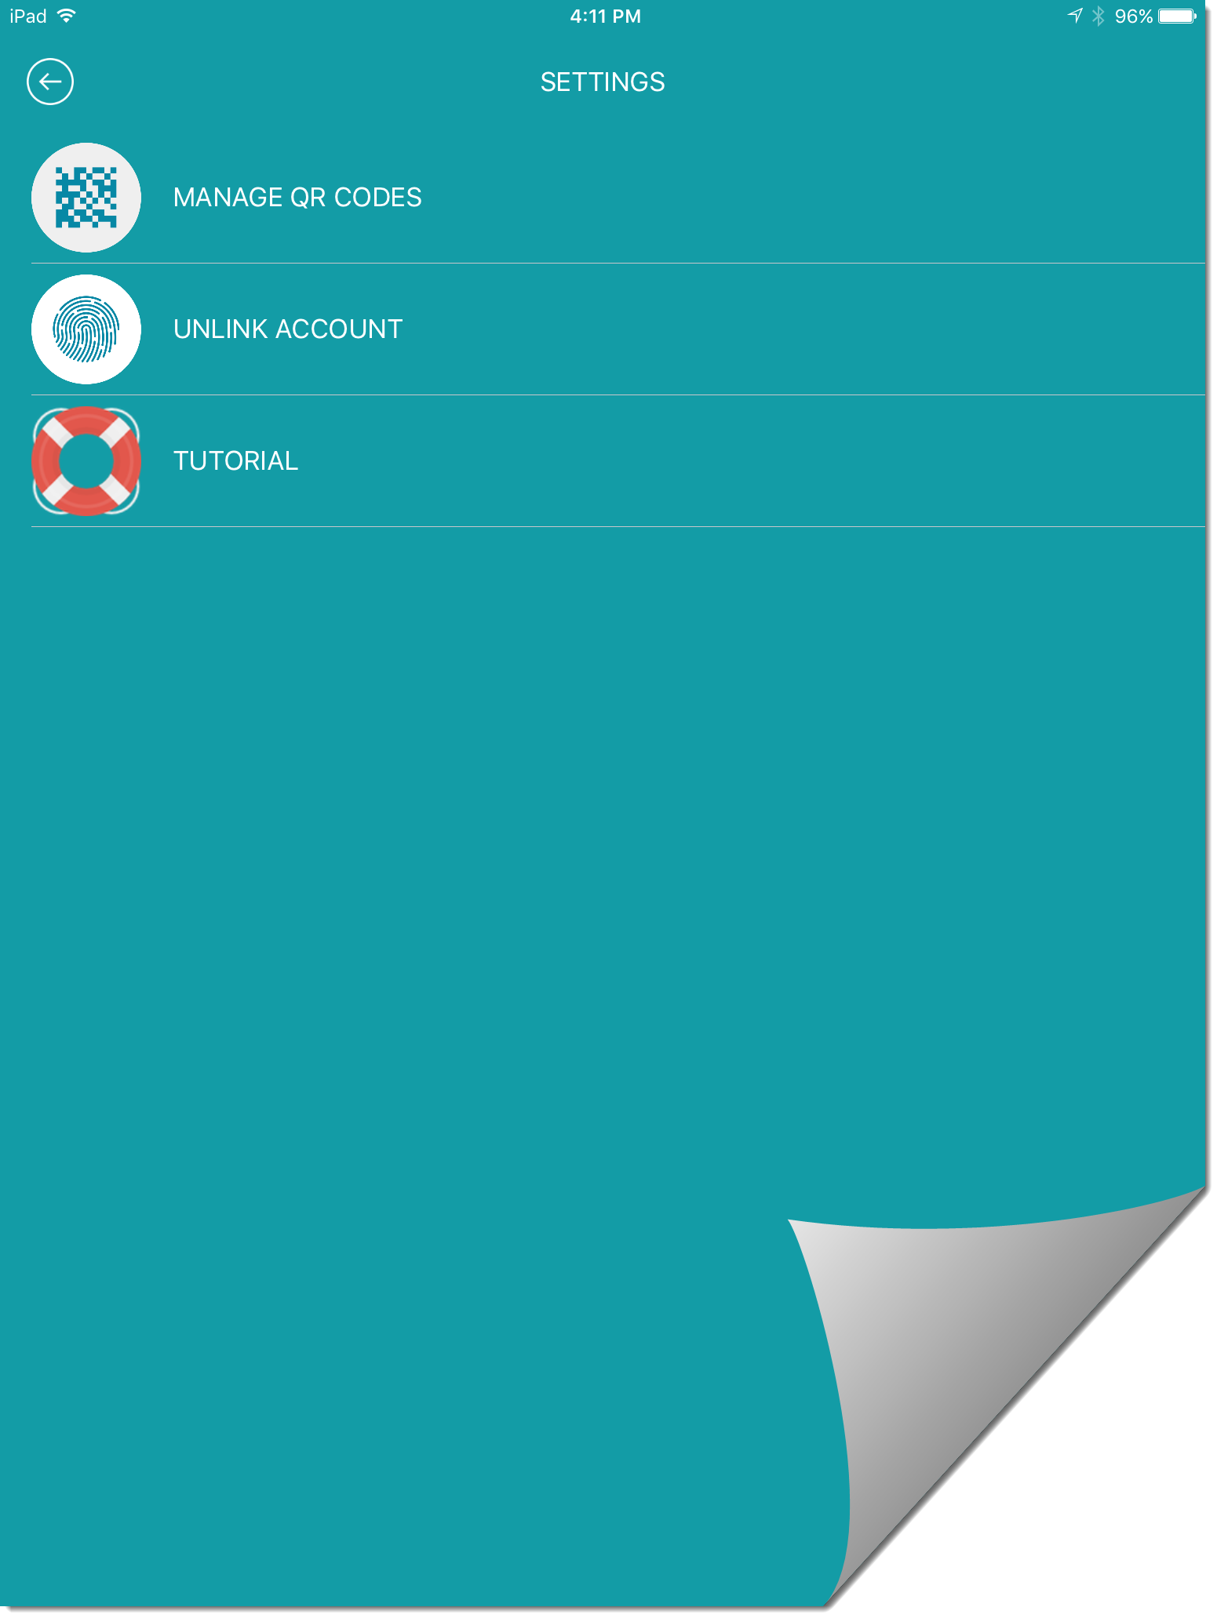
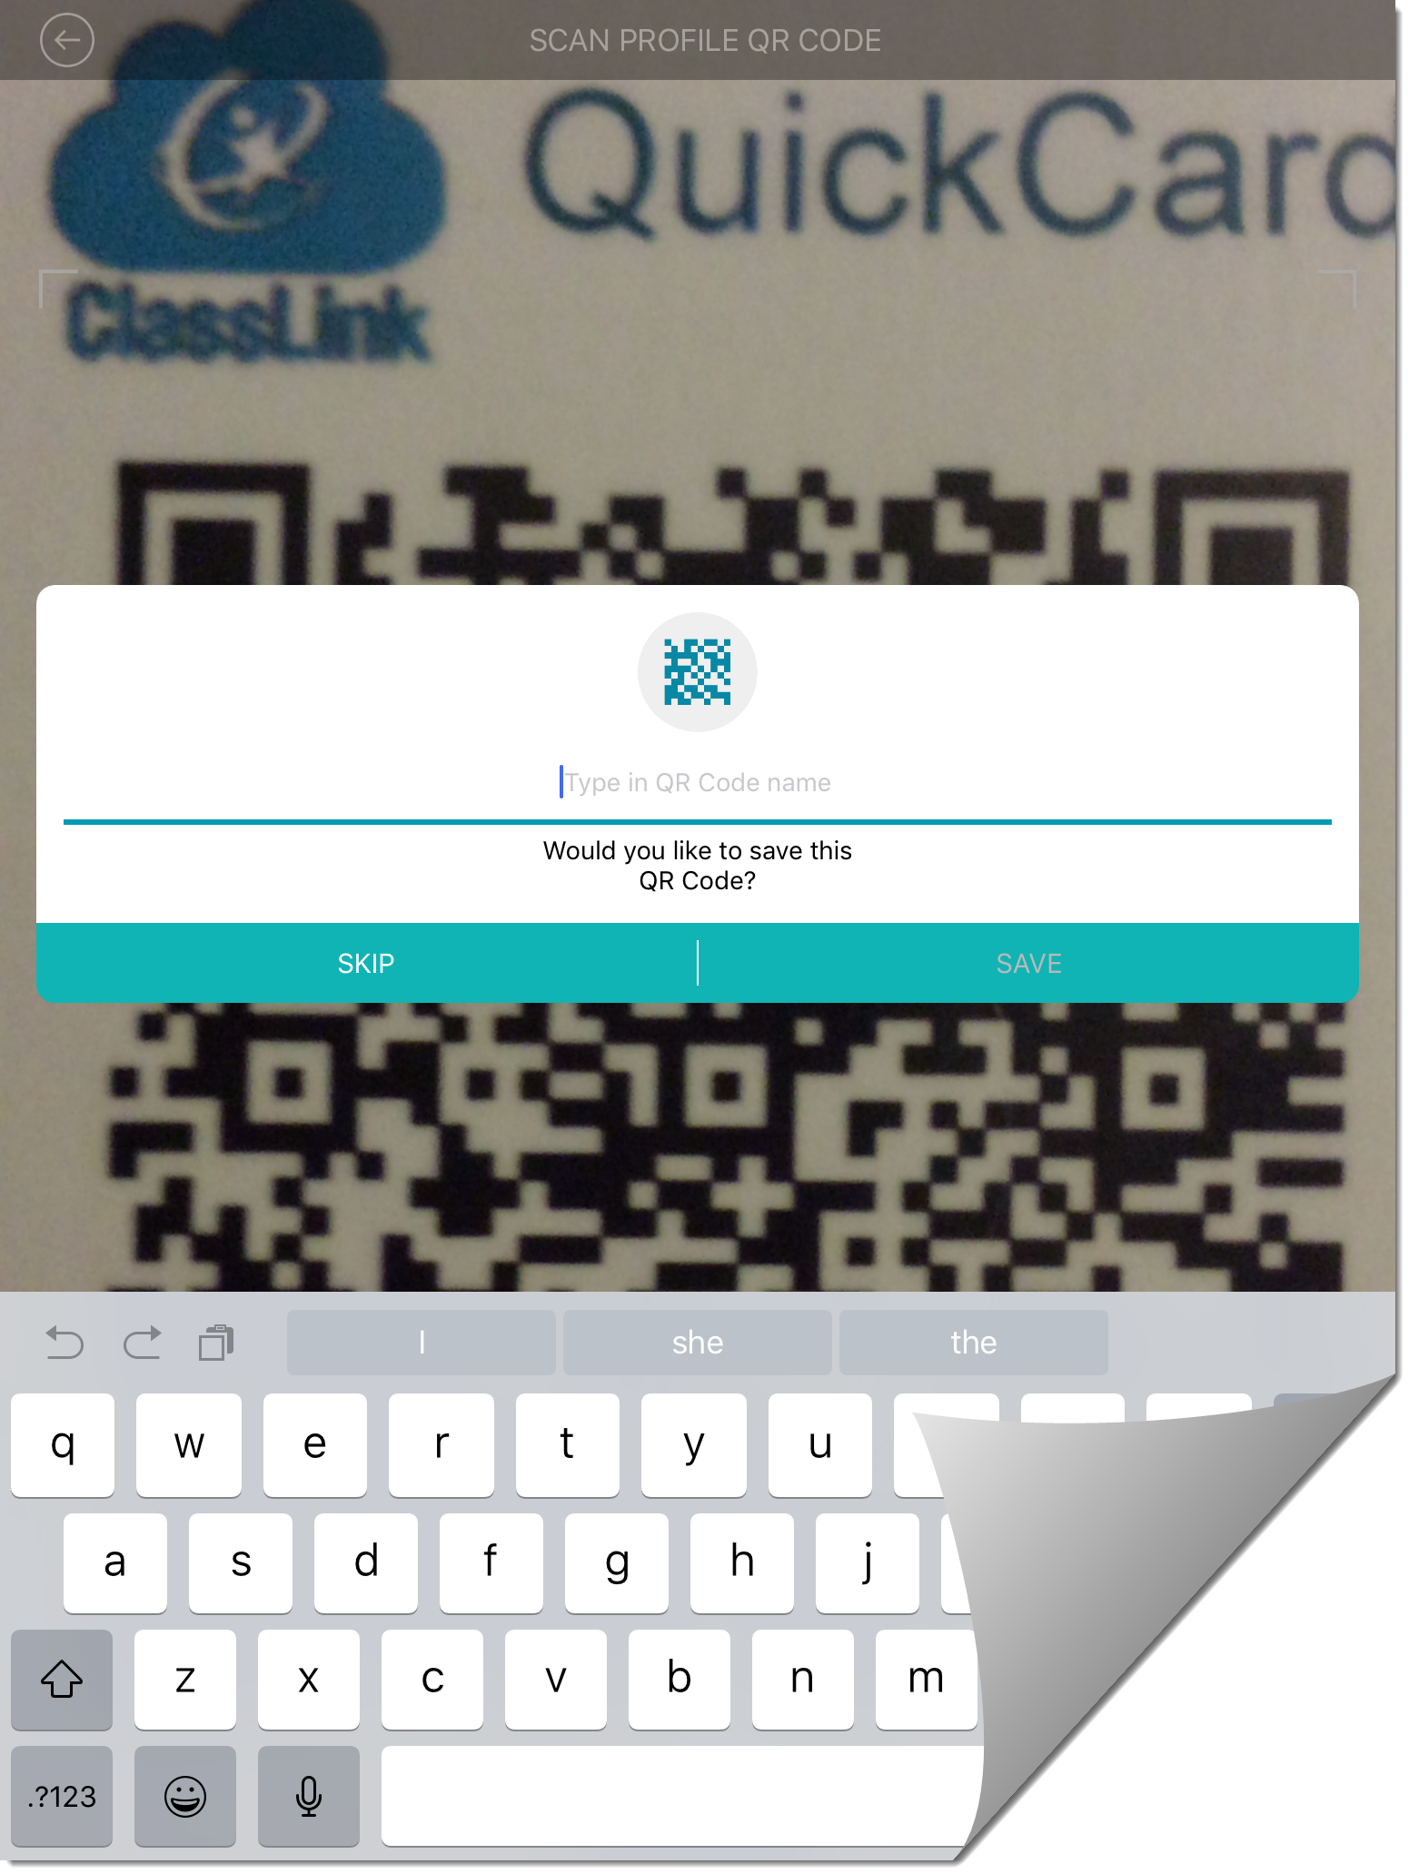
T1d: Remote Login (K-1)
Use the onscreen QR code to link your acct, you must manage students QR codes if you want to build a class (Screen #1)
You will see that there are no saved QR codes (Screen #2)
Select Manage QR Codes in Settings (Screen #3) It will open a QR screen for use with the ClassLink Remote login app
After scanning a students QR code, enter the students name (Screen #4)

Slide 12
Recap Review
4 ways to Login
# 1 Automatically using computer credentials
# 2 Login from outside network - credentials entered manually
# 3 QuickCard QR code w/ Camera
# 4 Remote Login by teacher using Remote Login app

Slide 14
Topic 2: My Profile
Class Link Sign-in
My Profile
Apps
My Files
My Classes
Focus Points-
General Settings
Themes & Colors
Password Locker
Password Recovery
Two Factor Authentication

Slide 15
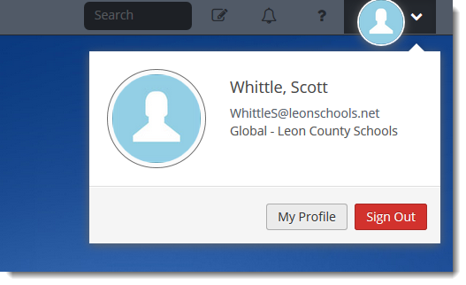
T2a: General Settings
To access your My Profile, press the down arrow next to the avatar icon
From here, you can either sign out, or go to My Profile

Slide 16
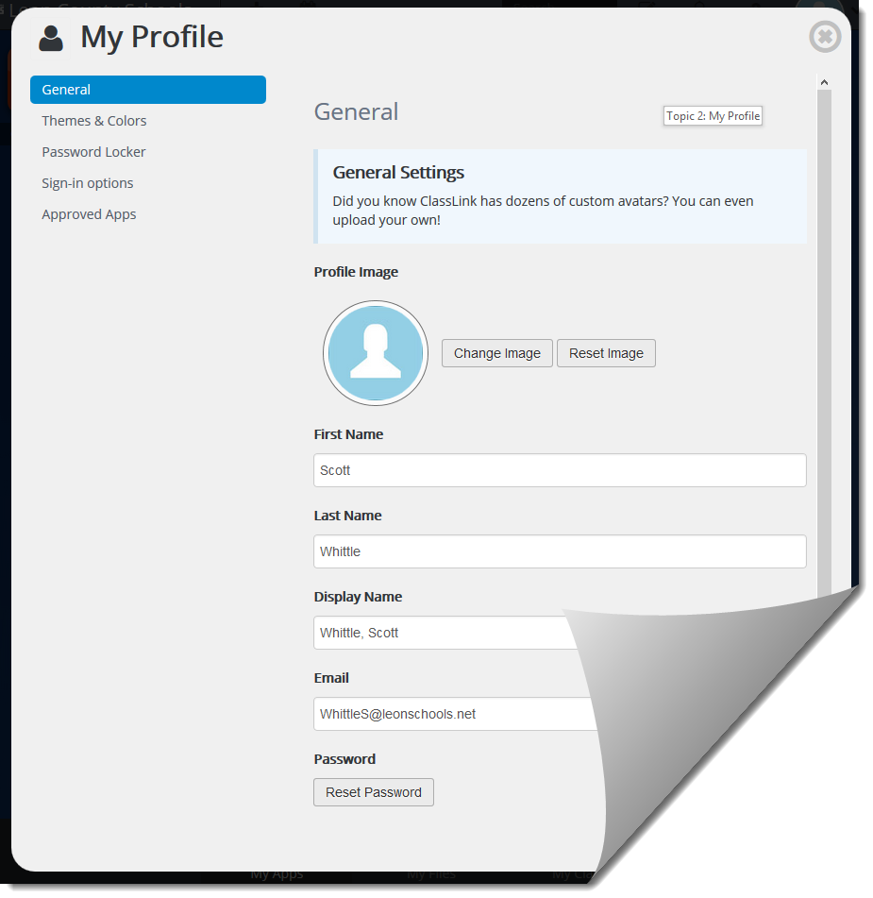
T2a: General Settings
My Profile controls the following:
General
Themes & Colors
Password Locker
Sign-in Options
Or Approved Apps

Slide 17
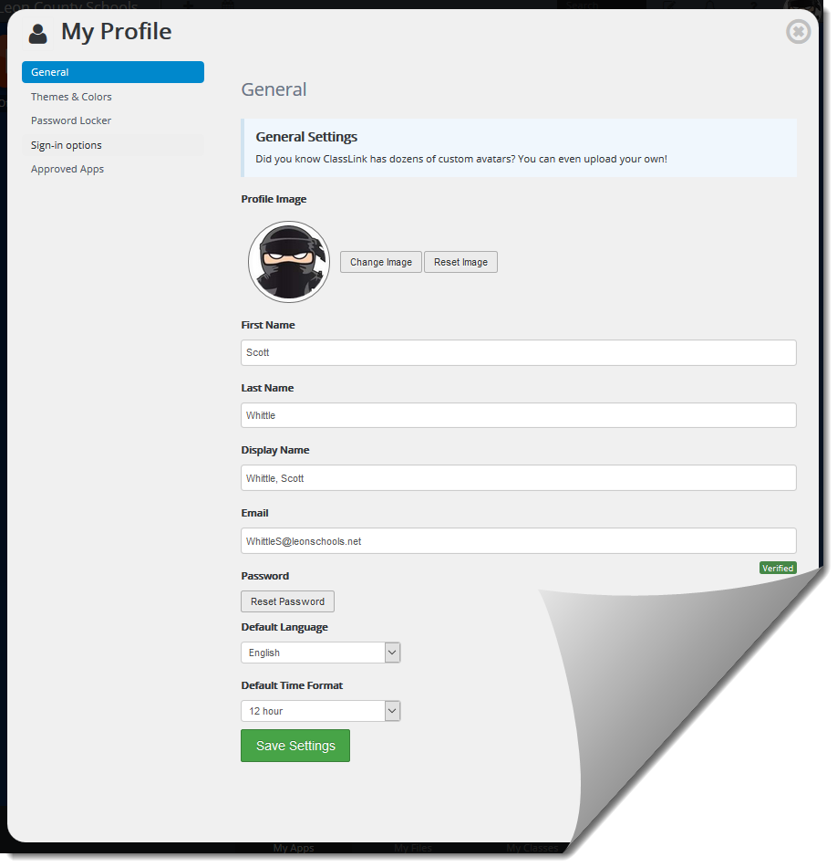
T2a: General Settings
General settings - You can change your avatar by clicking change image on your profile settings. You can choose from our avatar choices or you can upload a photo of yourself
Modify your Profile image
Choose one of the hundreds built-in
Upload your own image (500k max)
Reset your password
Set the default language
Set default time format

Slide 18
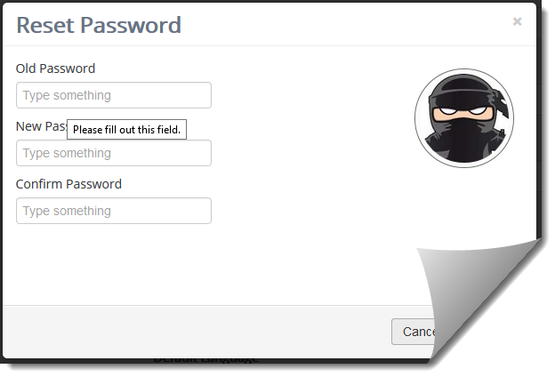
T2a: General Settings
To reset your password
You can reset your LDAP/Active Directory password under My Profile → General → Reset Password
To reset, enter your old password and enter and confirm your new password*. *Note: must meet network security requirements

Slide 19
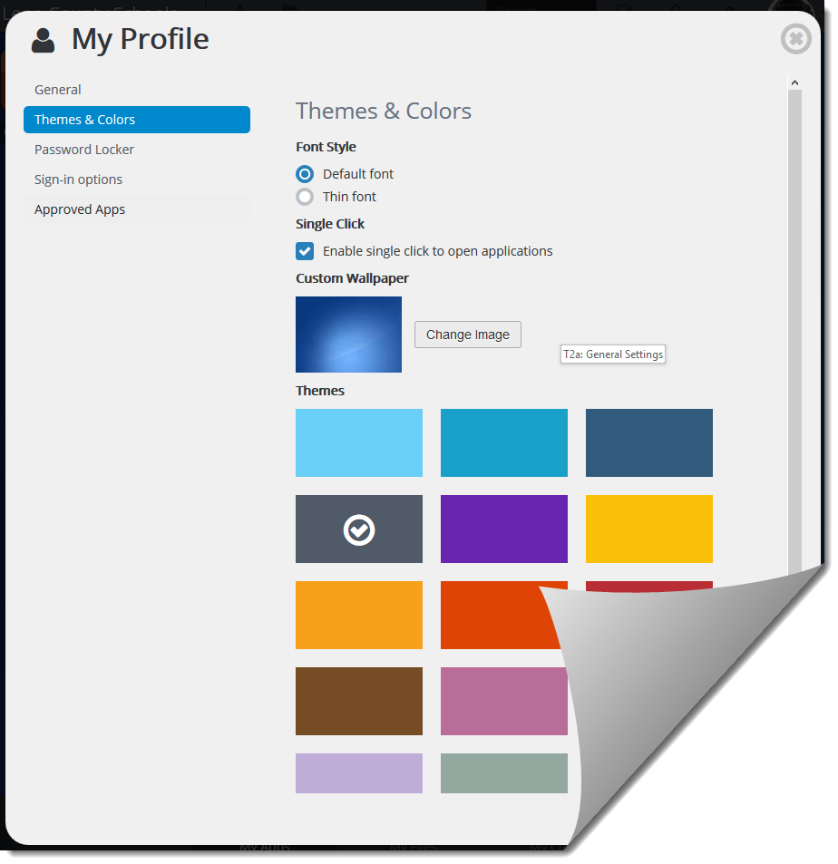
T2b: Themes and Colors
Themes & Colors - Select your wallpaper and theme color.
Select Default or Thin font
Choose whether you want to use a single or dbl click to open apps
Select a theme/different wallpaper
Set the default language
Set default time format

Slide 20
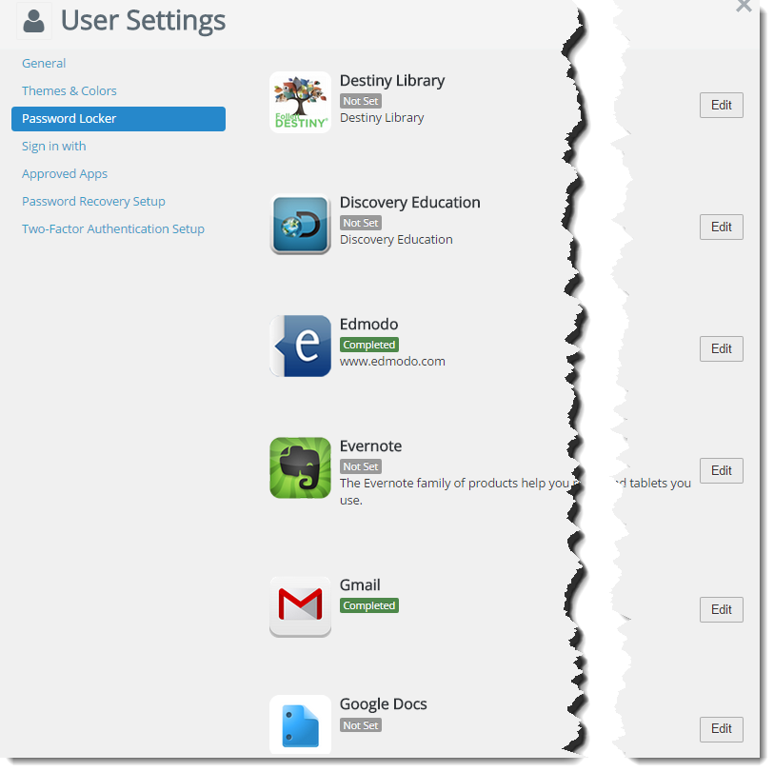
T2c: Password Locker
Password Locker -
Password locker allows the user to enter your log in information for applications that we do not have the login information for by clicking Edit next to that application.

Slide 21
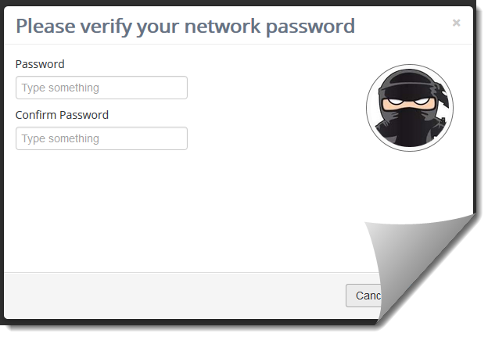
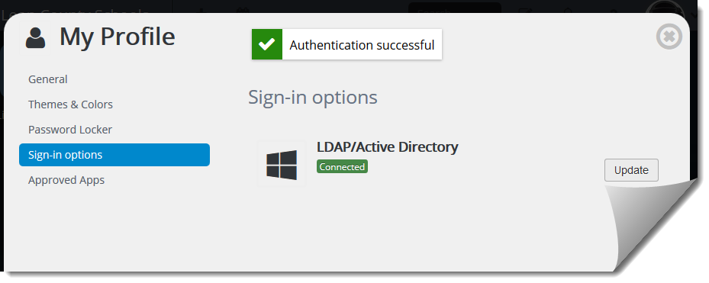
T2d: Sign-in options
Sign-in options
If you are having connection issues within ClassLink, the sign-in options allows you to verify your password within LDAP/Active Directory
You can enter your password and confirm the updated password which will authenticate back to the network
If you are a K-1 student, then the QuickCard option is also available

Slide 22
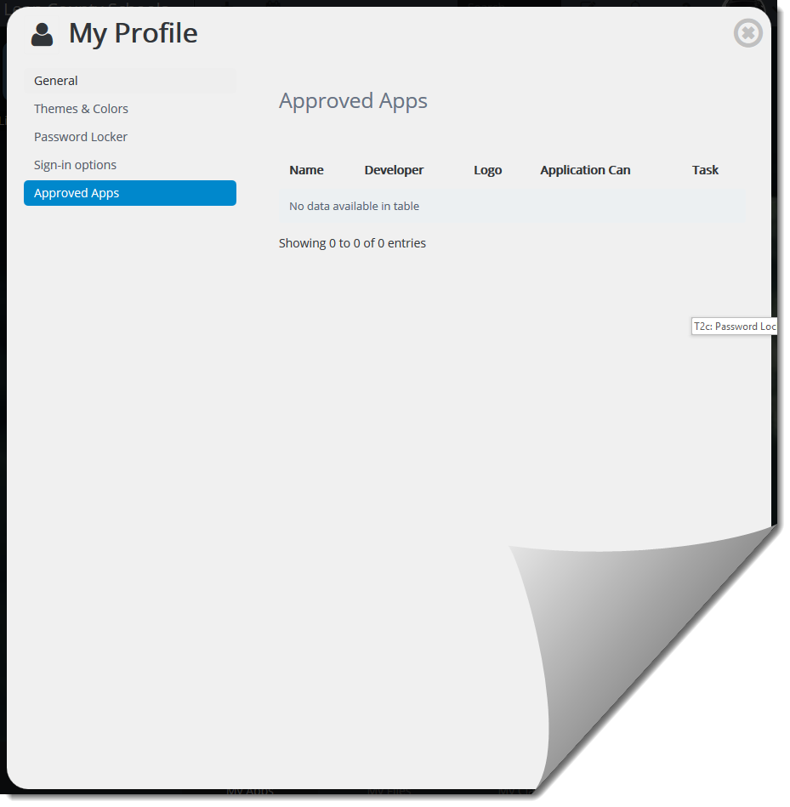
T2e: Approved Apps
Approved Apps
If you are requested a new app to be allowed through ClassLink, it will appear here when approved

Slide 23
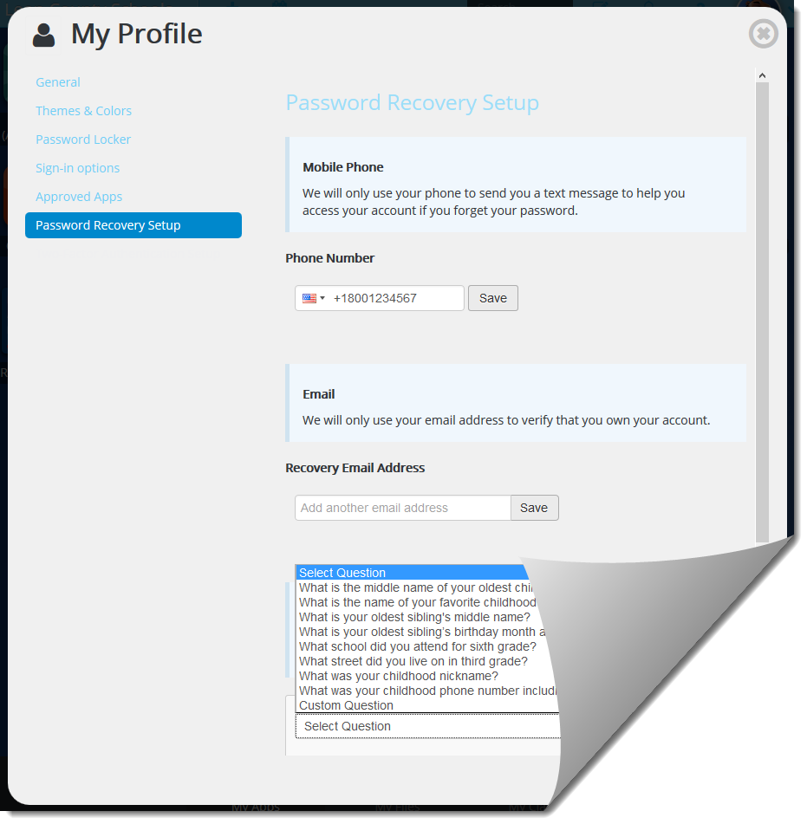
T2d: Password Recovery Setup
Password recovery setup allows the user to get logged back in if they forget their password. There are three options available:
Mobile Phone
E-mail
Secret Questions

Slide 24
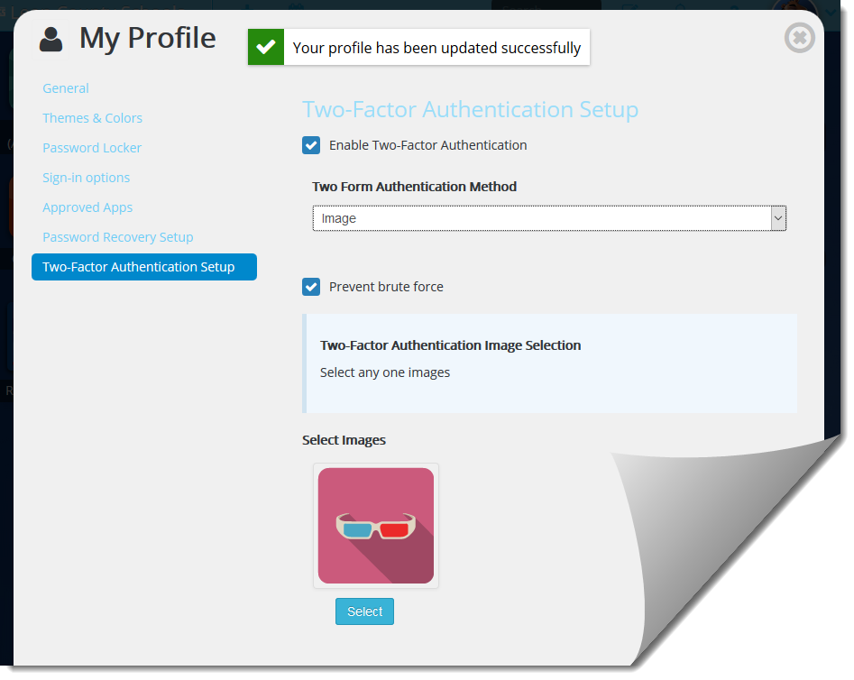
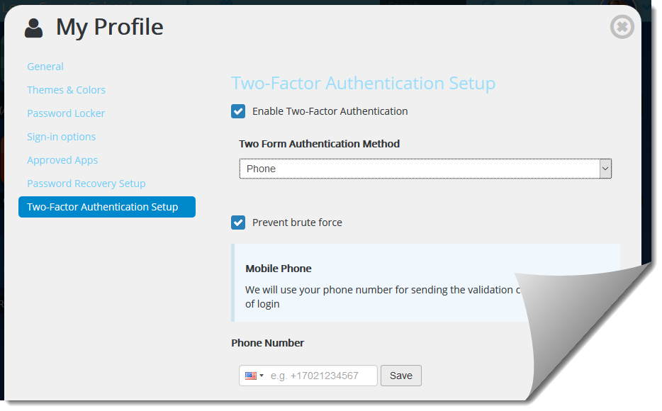
T2e: Two Factor Authentication
Two-Factor Authentication allows a user to increase the security of the system by requiring a secondary method to ensure you are the actual owner of the account.
The two methods available are:
Mobile Phone - texted a code you will have to enter in order to login in
Image - you will have to pick that image during sign in each time

Slide 25
Recap Review
My Profile
General Settings
- Set Profile Avatar and reset password
Themes & Colors
- Change Wallpaper and Theme color
Password Locker
- Create logins to individual apps / URL’s
Password Recovery
– Setup phone, e-mail or secret Q’s to recover forgotten password
Two Factor Authentication
– Use a mobile phone or image to increase security of your acct.

Slide 27
Topic 3: Apps
Class Link Sign-in
My Profile
Apps
My Files
My Classes
Focus Points-
Tool Bar
Adding an app
Requesting a custom app
Updating password locker for apps that aren’t rostered
Edit mode
Rearranging apps
Creating folders & organizing apps
Deleting apps that aren’t assigned
Installing extension on non-LCS computers

Slide 28
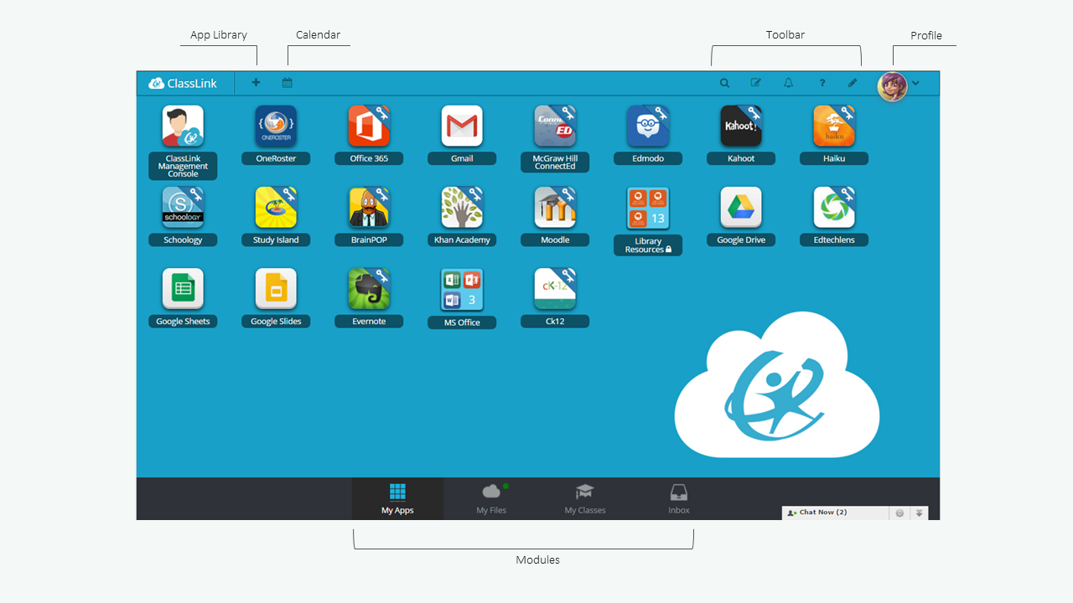
T3a: Interface
App Library
Calendar
Toolbar
Profile
Modules

Slide 29
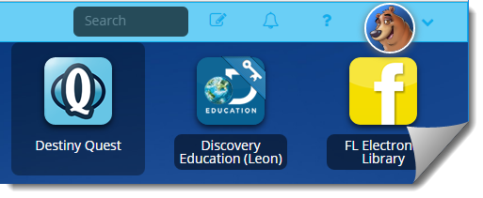
T3a: Toolbar
Search: Allows you to search through your apps to find a specific app. You do not need to click the magnifying glass to start searching, just begin typing the name of the app and it will automatically search your apps.
Edit mode: If you would like to move your apps around, delete apps, moves apps into folders or edit your folder you will have to click this button.
Notifications: View notifications sent out by administrators.
Help: Go to our online help page, contact our help desk, and show the guided tour

Slide 30
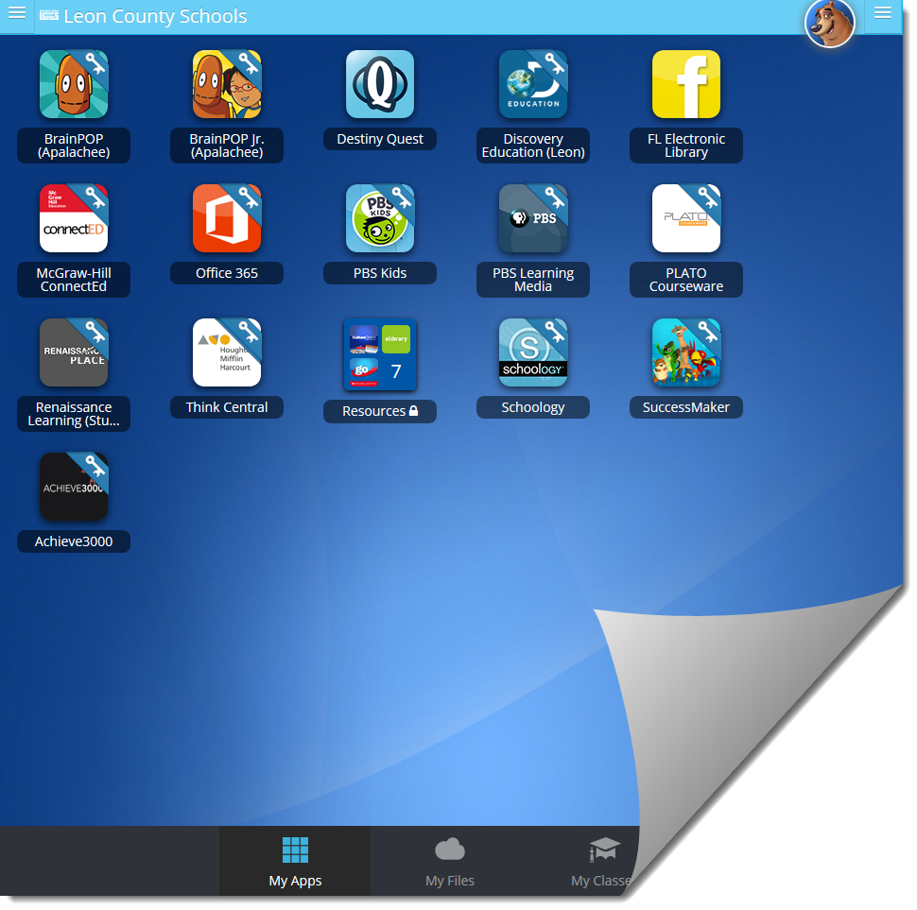
T3b: Adding an App
My Apps is the first thing you will see when you log in to ClassLink. This gives you instant access to the resources that have been provided for you by your school or district.
You can add your own apps to this section using the App library.

Slide 31
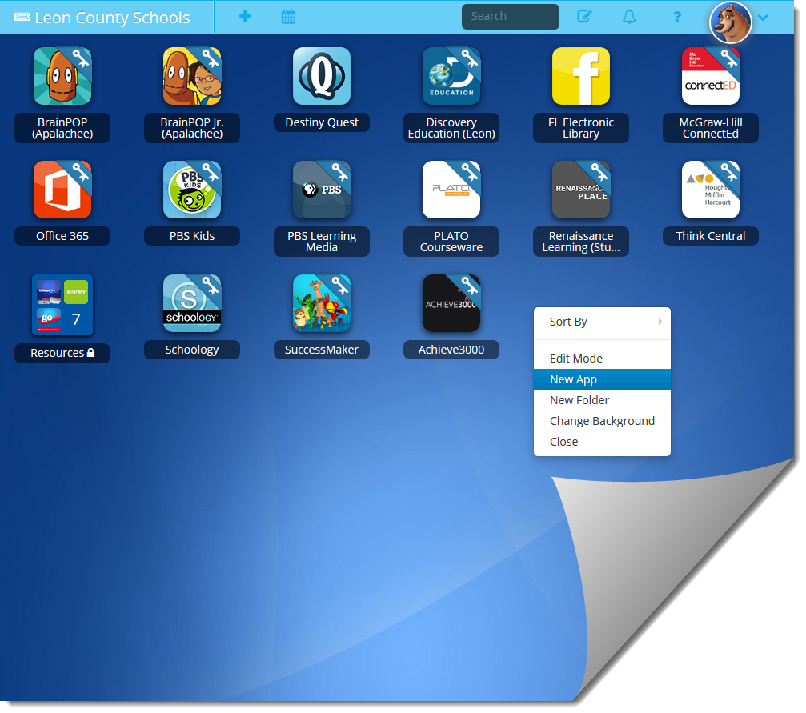
T3b: Adding an App
How to add an App from the App library
Open the library by pressing the “+” symbol at the top, or rt-click and select “New App” from the context menu
ClassLink includes a library that contains over a thousand educational resources that you can choose from.

Slide 32
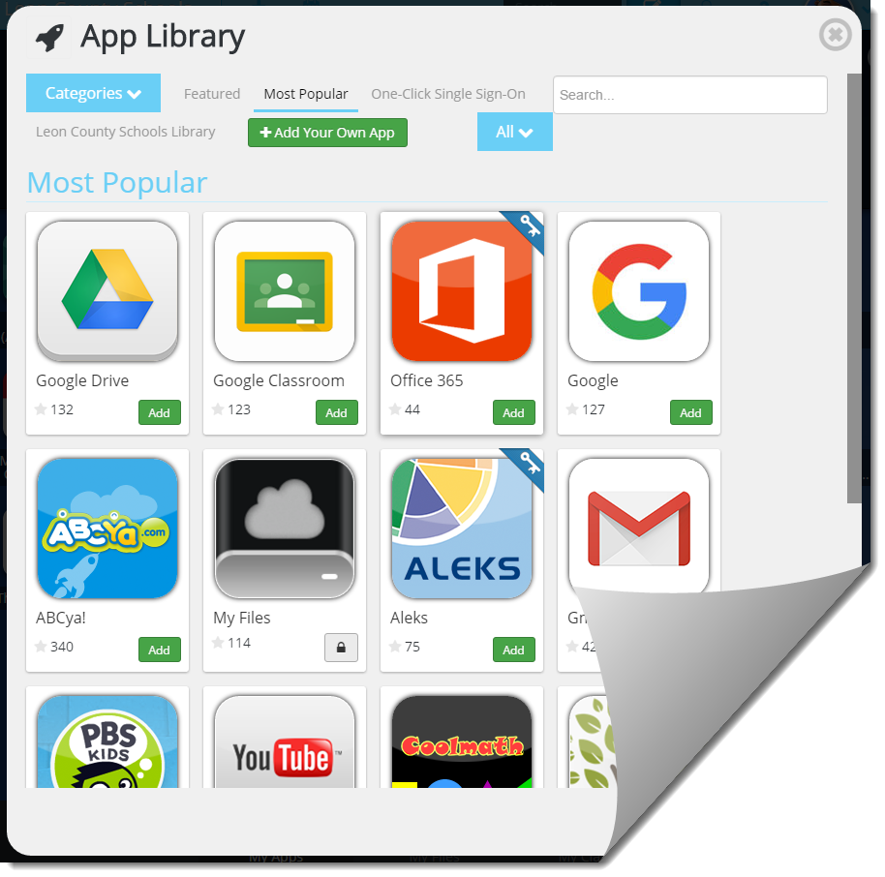
T3b: Adding an App
Select any app from the library and press the “Add” button
That app will now be available on the My Apps screen.

Slide 33
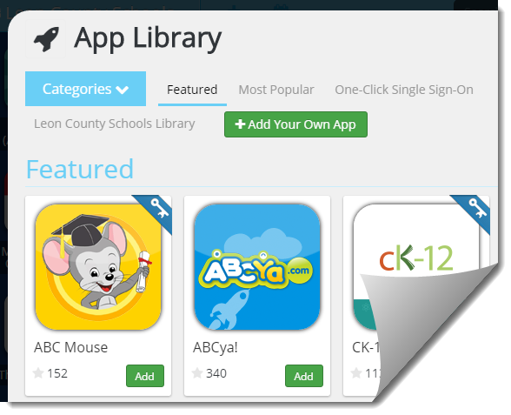
T3c: Requesting a custom app
Apps with keys in the top right corner are Single Sign On’s (Any app with a sign in can become a Single Sign On)
You can create a custom app from any web-based resource.
Press “+Add your own app”

Slide 34
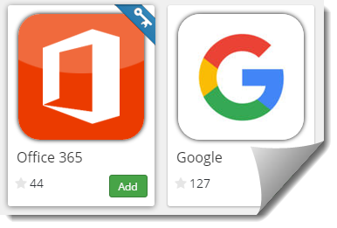
T3b: Adding an App
What are SSO’s (Single Sign-On) Apps?
ClassLink has the ability to link you seamlessly to your various web accounts from within ClassLink.
This handy feature is called ‘single sign-on’ (SSO) which means you will not have to enter your username and password every time you enter that website.
Apps that have single sign-on capabilities can be found in the resource library, they are differentiated by blue ‘SSO’ banners with the white key.
To see a list of all Single Sign On applications, you can navigate to the One-Click Single Sign On section.

Slide 35
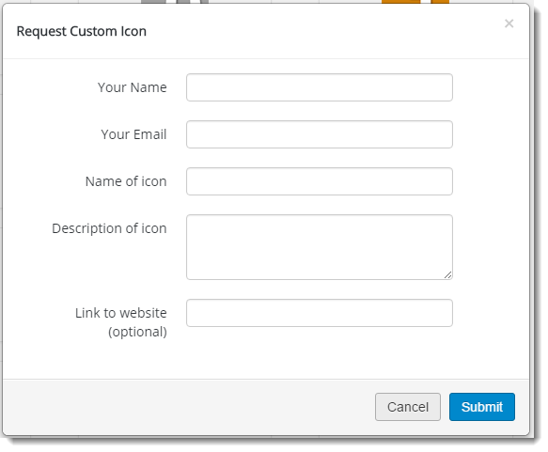
T3c: Requesting a custom app
If you request a custom icon, fill out the form. It it recommended to include a link to the website you are requesting the custom icon for

Slide 36
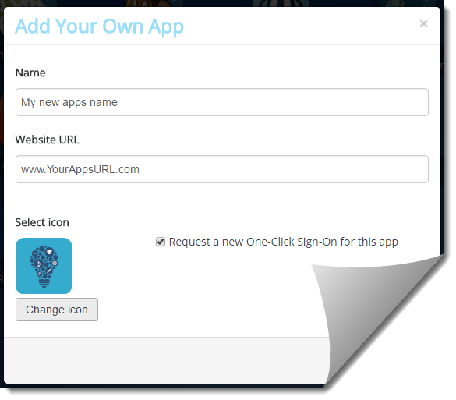
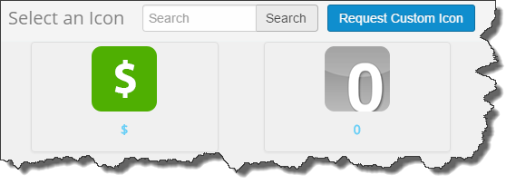
T3c: Requesting a custom app
Enter the name of the app and the website.
If this app requires a username and password, simply check “request a new One-Click Sign-On”
Select any icon you want or request a new icon

Slide 37
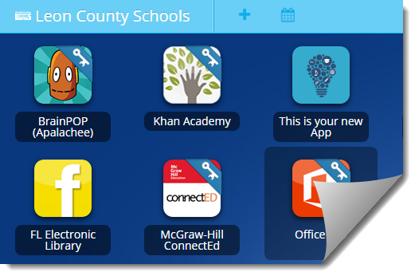
T3c: Requesting a custom app
Your new custom App will appear in your My Apps with all of your other Apps

Slide 38
T3d: Updating password locker for apps that aren’t rostered
Password not set
Password Locker -
Password locker stores login credentials for applications that are not auto-rostered. (Personal sites, non LDAP/ADFS, etc.)
After you have set your initial password in the locker, it will show as “Completed”
Password set

Slide 39
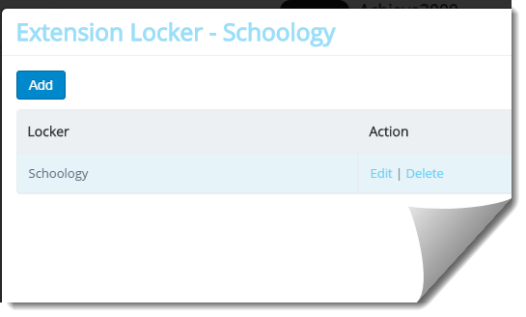
T3d: Updating password locker for apps that aren’t rostered
Password Locker -
Passwords stored in the password locker do NOT automatically update in ClassLink when you update them in the remote system as they are not tied to LDAP/ADFS
To update your password. Click “Edit” under the Action options

Slide 40
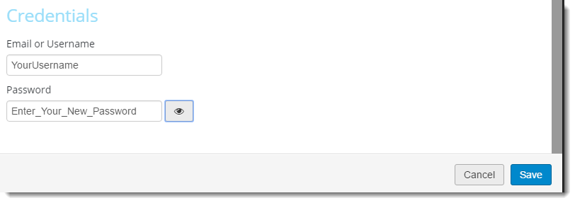
T3d: Updating password locker for apps that aren’t rostered
Password Locker -
In the Credentials section, enter your new password
Press “Save”

Slide 41
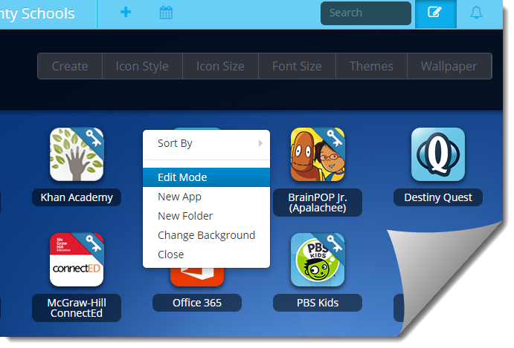
T3e: Edit Mode
Click on the Edit Mode button in the top right
or
Right click to select from the context menu

Slide 42
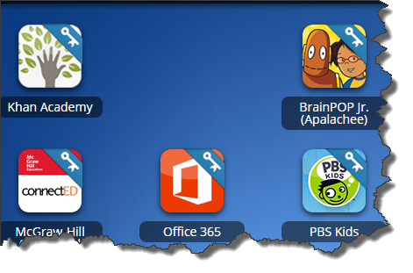
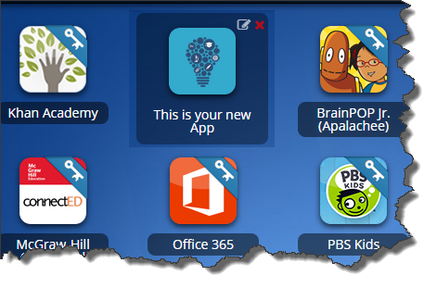
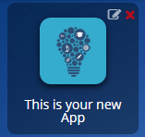
T3f: Rearranging apps
Rearrange apps by dragging them to a different location and dropping them.

Slide 43
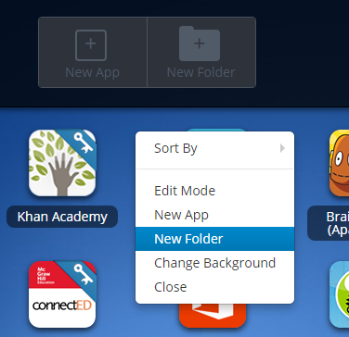
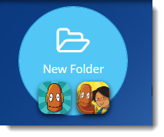
T3g: Creating Folders & Organizing Apps
You can create a new folder manually by selecting “New folder” from the edit menus.
You can also create a folder by hovering one app over another app and dropping it. This will create a new folder with the two apps inside.
You can move apps inside a folder by hovering over the folder and dropping the app inside.
To rename the folder, click on the folder and then click on the name.

Slide 44
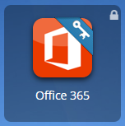
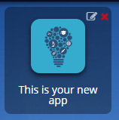
T3h: Deleting apps that aren’t assigned
There are two classifications of Apps
Assigned – Has a lock in the top right
Added – Has a red “X” on the top right
You can delete any ADDED app using Edit Mode.
Assigned Apps can NOT be deleted from your My Apps by user.

Slide 45
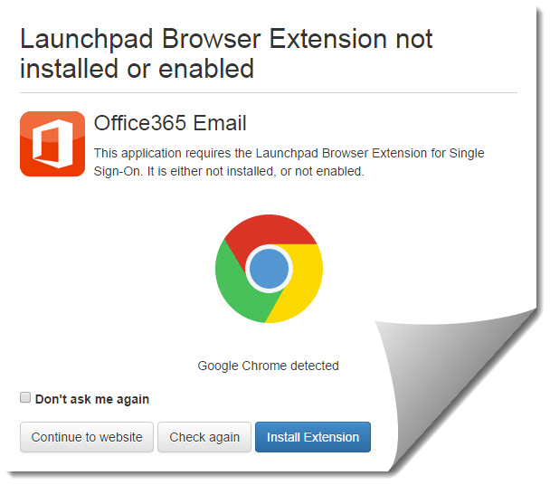
T3i: Installing extension on non-LCS computers
If you are using ClassLink on a Non-LCS computer, it will need the Launchpad extension
Most SSO apps require a browser extension to be installed. When users click an SSO Browser Extension app, a prompt will appear to install the extension
Select “Do Not ask me Again”
Select Install Extension

Slide 46
T3i: Installing extension on non-LCS computers
This will open the browser store and allow you to install the extension

Slide 47
T3i: Installing extension on non-LCS computers

Slide 48
Recap Review
Apps
Adding an App
- Use the + sysmbol to open App Library
Custom Apps
- In Library, choose Add your own App
Updating Password Locker
- In My Profile -> Password Locker, press Edit under locker actions
Edit Mode
– Select notepad symbol by search box or Rt-click and choose Edit Mode

Slide 49
Recap Review
Apps
Rearranging Apps
– In Edit Mode, Drag icon to new location.
Creating Folders
– Drag one icon on top of another, or click New Folder in Edit Mode.
Deleting Apps not Assigned
– In edit mode, press the red “X” by non-assigned apps.
Installing Extension
– SSO apps will ask to install the Launchpad extension. Select do not ask again and install.

Slide 51
Topic 4: My Files
Class Link Sign-in
My Profile
Apps
My Files
My Classes
Focus Points-
Connecting Services
ClassLink Agent – non-LCS computers
Opening Network / Cloud files
Editing and Saving Files in Office 365
Copying files between services

Slide 52
My Files
My Files is your place to access, edit, and store ALL of your files and folders located on your school network and cloud drives from any device.
When you click on My Files, it will open up in its own tab. You will see a tree view of your storage locations on the left.
You will be able to see all of your files and documents that you work on at school. You can view, edit and save these files, from ANY device, instantaneously!
You have the ability to use an online editor (Office Online or Zoho) or a local application to see your files.
Also, you have the ability to connect your cloud storage applications you already use such as Google Drive, Dropbox, Office365 and OneDrive.

Slide 53
T4a: Connecting Services
Open My Files from the bottom section of ClassLink
ClassLink will open the Manage Services area where the allowed connections can be configured with the appropriate credentials

Slide 54
T4a: Connecting Services
Each service will have its own separate credentials that need connecting
Google Drive
Drop Box
OneDrive* (Personal)
Office365**
*IMPORTANT NOTE!! OneDrive is your PERSONAL home acct for those that have a MSN, Live, Hotmail, or personal O365 subscription that you are paying for yourself.
**Office365 is your Leon County School Work acct you use as an employee or Student school issued acct

Slide 55
T4a: Connecting Services

Slide 56
T4b: ClassLink Agent – Non-LS computers
ClassLink Agent (Mac and PC) GREATLY improves the local editing experience! ClassLink Agent is a small applet that is locally installed on your computer and it eliminates the need for Java. Local editing of files is lightning fast!
ClassLink Agent stays in your task tray and you can click it to see status of current files and history of previous ones.
ClassLink detects if Agent is installed and falls back to Java where it is not available.
Provides notifications on upload/download completion.
One click access to documents that fail to upload properly.
Using the ClassLink Agent also means no more Java updates

Slide 57
T4b: ClassLink Agent – Non-LS computers
Steps to install ClassLink agent
Step 1
Locate, then click the grey circle in the My Files module found at the top right of the My Files page.
Step 2
A new window will appear. Click the Download Agent box to download the agent msi file.

Slide 58
T4b: ClassLink Agent – Non-LCS computers
Steps to install ClassLink agent
Step 3
To begin installing the agent, click on the msi file at the bottom of your screen.
To continue installing the agent, click 'Run'

Slide 59
T4b: ClassLink Agent – Non-LS computers
Steps to install ClassLink agent
Step 3
Click 'Next' 3 times in the installation window

Slide 60
T4b: ClassLink Agent – Non-LS computers
Steps to install ClassLink agent
Step 3
When it begins to install, it may request permission to make changes to your hard drive
Click YES

Slide 61
T4b: ClassLink Agent – Non-LS computers
Steps to install ClassLink agent
Step 4
Once installed, return to the Download Agent window, then click 'Verify Agent Installed'

Slide 62
T4b: ClassLink Agent – Non-LS computers
Steps to install ClassLink agent
Step 4
You will receive one of 2 possible results
Agent not installed
Agent installed

Slide 63
T4b: ClassLink Agent – Non-LS computers
Steps to install ClassLink agent
Step 5
If not installed correctly, repeat the previous steps
If the agent is installed correctly Click close.
The My Files module will have a GREEN circle

Slide 64
T4b: ClassLink Agent – Non-LS computers
Important!
Different circle colors have different meanings.
Grey: Agent not installed yet.
Yellow: Agent update available.
Red: Agent update required.
Green: Agent installed.

Slide 65
T4b: ClassLink Agent – Non-LS computers
Great!
Now that the agent is installed, go connect all your services!

Slide 66
T4b: ClassLink Agent – Non-LS computers
Important Note:
Services will require that you allow the web based service Launchpad.classlink.com to have specific permissions to access things such as:
Info
Photos and Documents
Profile and contact

Slide 67
T4b: ClassLink Agent – Non-LCS Computers

Slide 68
T4b: ClassLink Agent – Non-LS computers
ClassLink Extension Installation Instructions
Chrome - https://classlink.com/docs/documents/ClassLink_Chrome_Extension_Install.doc
Firefox - https://classlink.com/docs/documents/ClassLink_Firefox_Extension_Install.doc
Internet Explorer - https://classlink.com/docs/documents/ClassLink_IE_Extension_PC_Install.doc
Safari - https://classlink.com/docs/documents/ClassLink_Safari_Extension_Install.doc
ClassLink Agent Installation Instructions
PC - https://classlink.com/docs/documents/ClassLink_Agent_PC_Install.doc

Slide 69
T4c: Opening Network / Cloud service files
After connecting your Office365 (or any other available services), under My Files you will be able to access any of the files within those separate services in the left bar
Files within Office365 are you WORK OneDrive files.
These can be easily opened by right clicking on them and opening in Office 365

Slide 70
T4c: Working with Network / Cloud service files
Unlike the other connected services, the School Network drive is not a service you configure yourself.
If you have local network file storage on a school based server set up for your AD account (Commonly known as your U:\ drive) , it will automatically attach your school network folder to show with your other services.
You can work with your school files and edit them within O365 without needing to use VPN to access the school network

Slide 71
T4c: Working with Network / Cloud service files
Files within Office 365 are able to be easily opened and edited directly from ClassLink.
These files are also able to be easily copied from one service to another the same way you move files from one folder to another within your local computer

Slide 72
T4c: Working with Network / Cloud service files
Files are able to be easily viewed by list or grid view
You can sort the files by
Name
Type
Size
Last modified date

Slide 73
T4c: Working with Network / Cloud service files
New files or folders can be created using the +New button.
You can make
Documents
Spreadsheets
Presentations
Folders

Slide 74
T4c: Working with Network / Cloud service files
Uploads can be done by
File(s) or
Folders

Slide 75
T4d: Editing and Saving Files in O365
Browse to any file that you want to open
When you click on the file, the following things may happen:
Office files - Click the files and they will be opened in office online automatically*.
Any File - If you would like to open the file locally on your computer you can either right click and select “Download it”, or
Within O365 OneDrive - You can right click the document and choose the “Edit in” option and choose the application.
*Since this file is originating from the Internet, your pop-up blocker may prevent it from opening properly until you allow the pop-up. You should choose “always allow pop-ups from https://myfiles.classlink.com” to prevent having to allow this everytime.

Slide 76
T4d: Editing and Saving Files in O365
Google Drive
Documents being opened from your Google Drive will be opened using Google since that is the original location.
When you save the document, you just need to hit the save icon and it will be automatically saved back to the files in ClassLink.

Slide 77
T4d: Copying between services
To copy between services, you can simply drag and drop any individual file*
To move a folder, either drag and drop a folder from a window open on the local computer or use the upload button
*You can not drag and drop a folder and its contents between services within ClassLink, only upload or drag from within a local window.

Slide 78
T4d: Copying between services
Dragging and dropping to a subfolder is as simple as dropping a file on the folder
If you want the files dropped into the “Home” or Root folder, make sure to let the screen refresh and then drop it into the window to the right side.*
*See video on next slide for dropping files

Slide 79
T4d: Copying files between ClassLink Services

Slide 80
Recap Review
Apps
Connecting Services
- Click My Files – Can Connect network School Network (U://) - Google Drive - Dropbox – Personal OneDrive - or LCS O365 OneDrive
ClassLink Agent
- Agent is used to allow sign in functionality for services such as Dropbox and some others
Opening Network Files
- If you have a U:// drive in AD, this is where you can access your files without using VPN

Slide 81
Recap Review
Apps
Editing and Saving files in O365
– Office files can be either downloaded or opened in O365
Copying files between services
– Drag single file from one service folder to another service folder – Remember Root location must be dropped in left pane. Can’t copy whole folder between services - must upload folders

Slide 83
Topic 5: My Classes
Class Link Sign-in
My Profile
Apps
My Files
My Classes
Focus Points-
Creating a class
Settings
Discussion
Class Apps
Notebook (maybe)
Assignments (maybe)
Inbox
Calendar

Slide 84
T5a: Creating a class
My Classes provides a place for teachers to collaborate and deliver instructional resources to students.
Click on the ‘My Classes’ icon on the bottom of the screen
You will now be able to see the classes you have already and you have the ability to create new ones.

Slide 85
T5a: Creating a class
To create a class, click Add New. You will then be prompted for a few pieces of basic information like the Name, Color (The color option is for how the class will look on the calendar.) and description.
Heads Up! - Make sure to put in a good description because it will be the first thing users see when searching for a class or using the iPad app.
After creating the class, you will immediately be redirected to the class and the first module, Discussion.
The first thing you will want to do is change your class settings.

Slide 86
T5b: Settings - General
Ability to change class name, color and description.
Teachers can:
enable self-enrollment,
add students as members,
create student groups,
share the class with other teachers, and
enable the specific areas of My Classes to be public for those outside of the class.

Slide 87
T5b: Settings – Self Enrollment
Enabling Self Enrollment
You can allow students to enroll themselves in your class under the 'Settings' tab.
Once in settings, check the 'Enable Self Enrollment' box.
You also have an option of selecting an enrollment password for added security. This will ensure that only the students with the password are able to enroll in your class.

Slide 88
T5b: Settings – Self Enrollment
Enabling Self Enrollment
Password Protect: You can create your own password. Students select your class from a list and enter the password when prompted.
Enrollment Key: This opens your class to individuals using ClassLink in schools and districts outside of yours if you provide them with the password.
Tip One: An enrollment key will override a password if you have both enabled in your class settings.
Tip Two: A password and enrollment key are two different things. You cannot enter a password in the enrollment key search window when enrolling in a class.

Slide 89
T5b: Settings - Members
Members are the STUDENTS you want to add to the class
Under the Members tab, you can enroll your students in your class. Heads Up! – You can filter users by groups – Groups are sorted by School and grade level for ease
Simply click ‘Add Users’ and search for your students.
Click ‘Add’ next to each student that needs to be in the class.

Slide 90
T5b: Settings - Groups
Under the Group tab, you can create groups for the students in your class.
Click ‘Create Group’ to make a new group, you will have to enter the name of the group, a color and a description.

Slide 91
T5b: Settings - Groups
Next, click on the number of members below the name of the group to add members from your class. Heads Up! – You can only add students you have already added to your class first!!
Students can be a part of multiple groups.

Slide 92
T5b: Settings - Groups
Students can be a part of multiple groups.
You can edit groups by clicking the notepad next to the group name
Or
you can delete a group by pressing the trashcan

Slide 93
T5b: Settings - Share
Under the Share tab, you can share your class with other teachers in your district.
This is a great option for co-teachers or classes that have a push in/pull-out.
You will both be able to access this class
Click ‘Add Users’ to add teachers from your district.
Once they are added you can toggle between giving them permission
to read only what’s in the class or
to read and write, which means they can read, edit, and add material to the class.
You just need to click ‘Toggle’ below the user to switch between options.

Slide 94
T5b: Settings – Public View
The Public View will give you a public URL that you can hand out to parents in order for them to see what is going on in the class.
You can turn different sections on and off such as Apps, Notebook, Files, and Assignments.
The apps will not be single sign on and the Discussion board will never appear in the public view.

Slide 95
T5c: Discussions
Interactive discussion boards allow you to engage students with questions, polls, attach files and videos. You can do the following:
You can choose to send the discussion to the whole class or to specific users or groups.
Attach a file
Insert a video: Works well with TeacherTube, YouTube, Vimeo. Url is needed
Create a poll: True and False or Multiple Choice
Attach a page (lessons from notebook)
Use an interactive whiteboard

Slide 96
T5c: Discussions - General Settings
You can choose to enable or disable any of these features.
If you want to be able to approve comments before they are posted be sure to uncheck the last option to ‘Auto approve comments’

Slide 97
T5c: Discussions – Setting groups
You can choose to set each discussion to the whole class or just to specific users or groups.

Slide 98
T5c: Discussions – Attaching files
You can choose attach a file

Slide 99
T5c: Discussions – Insert a Video
You can insert a video: Works well with TeacherTube, YouTube, Vimeo. A URL is needed for the video.

Slide 100
T5c: Discussions – Create a Poll
You can create a poll:
True and False
Or
Multiple Choice

Slide 101
T5c: Discussions – Add a Page
Attach a page
Pages added originate from your ClassLink Notebook
You can either Import an existing page from your Notebook
Or
You can create new content on the fly by typing (or copying and pasting) in the editor box

Slide 102
T5d: Adding Apps to Classes
Teachers can add specific applications here that students will need for their class
SSO’s not available here
Click on the Gear to open “Edit” mode.
To Add Apps, choose “Add”

Slide 103
T5d: Adding Apps to Classes
Rearrange apps by dragging them around.
Move apps inside a folder by dropping over it.
Combine two apps into a folder by dropping one over the other

Slide 104
T5d: Deleting Apps to Classes
To Delete an App, hover over the app and click the red x
When you are finished, click Done editing

Slide 105
T5e: Notebook
This is where you can add lessons. You must create a folder before you can add any lessons.
Heads Up! Make folders based on Units or specific topics.

Slide 106
T5e: Notebook
Click Add Page to create a new lesson.
You can import lessons from other classes.
To Edit a lesson, just click on the name.
To Hide a lesson, click on the eye symbol.

Slide 107
T5e: Notebook
When making content for your Notebook, you can easily copy and paste content from electronic teacher resources as well
This allows you to easily distribute materials without the need to print
If a student was out or needs any documents, they can found attached here or printed from the class notebook if needed

Slide 108
T5e: Notebook or OneNote?
If you prefer, you can also make a Class Notebook using OneNote within your Office 365
OneNote is a very robust method to use in a collaborative or flipped classroom environment

Slide 109
T5e: Notebook or OneNote?
If you are not Familiar with OneNote, check out this 2 minute video on the next slide
Source:
http://o15.officeredir.microsoft.com/r/rlidOneNoteGuideVideo15?clid=1033

Slide 110
T5e: OneNote demo video

Slide 111
T5f: Assignments – New Assignments
When creating a new assignment,
enter a name for the assignment,
a due date,
choose who to assign it to.
describe the assignment below.
You also have the option to attach files

Slide 112
T5f: Assignments – Assigning Specific user / Group
Assignments can be assigned to Everyone (Default), or just to a specific user or group.
To assign to a specific entity, select “Custom”
You can select from either
Assign User
Assign Group

Slide 113
T5f: Assignments – Assigning Specific User
When you assign a specific user, you will select from the list created by your members list

Slide 114
T5f: Assignments – Assigning Specific Group
When you assign a specific Group, you will select from the list created by your Groups list

Slide 115
T5f: Assignments – Locking an Assignment
You can lock an assignment on the right, if you are not ready to have student work on it.
This will prevent them from being able to upload work for this assignment

Slide 116
T5f: Assignments – Locking an Assignment
You can lock an assignment on the right, if you are not ready to have student work on it.
This will prevent them from being able to upload work for this assignment

Slide 117
T5f: Assignment Summary
Teachers can post assignments here for students to view.
All assignments will be listed here.
To create a new assignment, click the “New” button next to the Title Assignments.
Each assignment will show their set parameters (Due date, Locked, Private, etc)

Slide 118
T5f: Assignments – Dashboard
When you select a specific assignment, it opens the assignment’s Dashboard
The Dashboard shows the assignment settings and Activity
Students who have this assignment assigned to them will appear on the left bar

Slide 119
T5f: Assignments – Dashboard
When you select a specific student on the left, it opens the students assignment Dashboard
The Dashboard shows the assignment status of any work uploaded and Activity

Slide 120
T5g: Inbox - Compose
Once you click on Inbox, you can compose an email.
Include a subject, your message and you can add recipients.

Slide 121
T5g: Inbox Settings
To add recipients, choose the class and then the students you wish to send a message to

Slide 122
T5h: Calendar
Calendar Button: Located top left, next to the resources.
Calendar View: You can see all assignments posted.
The color you choose when you create your class is the same color the assignment will appear in your calendar

Slide 123
T5h: Calendar
Calendars can be viewed by Month, Week, Day

Slide 124
T5h: Calendar types
ClassLink includes one personal calendar and a calendar for each class you create which is shared among your students.
To display events from each of your calendars, click the box next to the calendar of choice.
To create a new event click ‘Create’.

Slide 125
T5h: Calendar Sharing
Share your personal calendar with your class and colleagues!
To share your personal calendar follow these quick and easy steps.
Click the down arrow next to the desired personal calendar and click "Calendar Settings".
Check the Share box
Click Save Settings
Click the Share link on the left
Select the users or groups tab to share your calendar
Click the Add Users or Add Groups box
Toggle shared permissions: "Read Only" or "Read and Write"

Slide 126
T5h: Calendar Sharing – User (s)
You can share your calendar with a single user or multiple user(s)

Slide 127
T5h: Calendar Sharing - Groups
You can share your calendar with a single a group or group(s)

Slide 128
T5h: Link Google Calendar
Share your Google calendar with everyone. Follow the Google steps at the URL below
Go to your Google calendar's details, locate the XML calendar address
Highlight and copy the address
In ClassLink calendar, open your personal calendar settings
From the General Tab, paste the XML link under Google URLs
Save Settings!
Your Google Calendar can also be viewed from the ClassLink calendar.
Follow the steps to the right to link your Google Calendar
https://support.google.com/calendar/answer/37083?rd=1

Slide 129
T5i: Notes
Ditch that yellow Post-It note pad! Create quick notes in the ClassLink notes section! Create as many notes as you need. Edit, view all, and delete notes later on.

Slide 130
Training Material Downloads
Training Guide Download
Quick Guide Download
New My Files Quick Guide Download
ClassLink Extension Installation Instructions for Chrome Download
ClassLink Extension Installation Instructions for Firefox Download
ClassLink Extension Installation Instructions for Internet Explorer Download
ClassLink Extension Installation Instructions for Safari Download
ClassLink Agent Installation Instructions for PC Download

