Slide 1
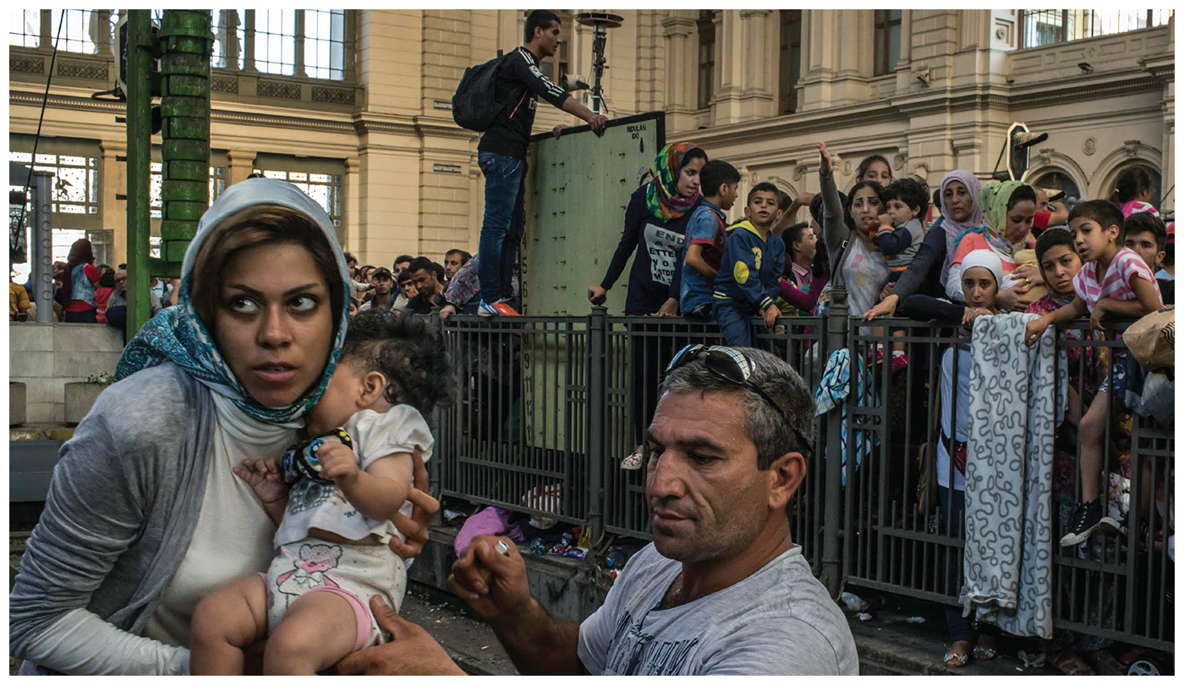
Unit 2 – part II: Migration
Population and migration

Slide 2
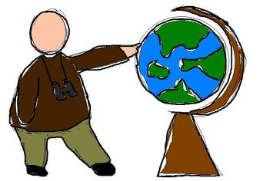
Enduring Understanding (2.C)
By the end of this section, you will understand that causes and consequences of migration are influenced by cultural, demographic, economic, environmental, and political factors.

Slide 3
Enduring Understanding (2.C)
Essential Question
How does migration impact society?

Slide 4
Learning objective (2.C.1)
By the end of this section, you will be able to explain how push and pull factors contribute to migration.
Push and pull factors can be cultural (e.g., religious freedom), demographic (e.g., unbalanced sex ratios, overpopulation), economic (e.g., jobs), environmental (e.g., natural disasters), or political (e.g., persecution).
Push factors are often negative (e.g., poor economic conditions, warfare), while pull factors are often perceived as positive (e.g., a better quality of life, economic opportunities).

Slide 5
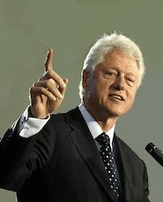
Causes and consequences of migration
“More than any other nation on Earth, America has constantly drawn strength and spirit from wave after wave of immigrants. In each generation, they have proved to be the most restless, the most adventurous, the most innovative, the most industrious of people.” –President Bill Clinton, speech at Portland State University, 1998

Slide 6
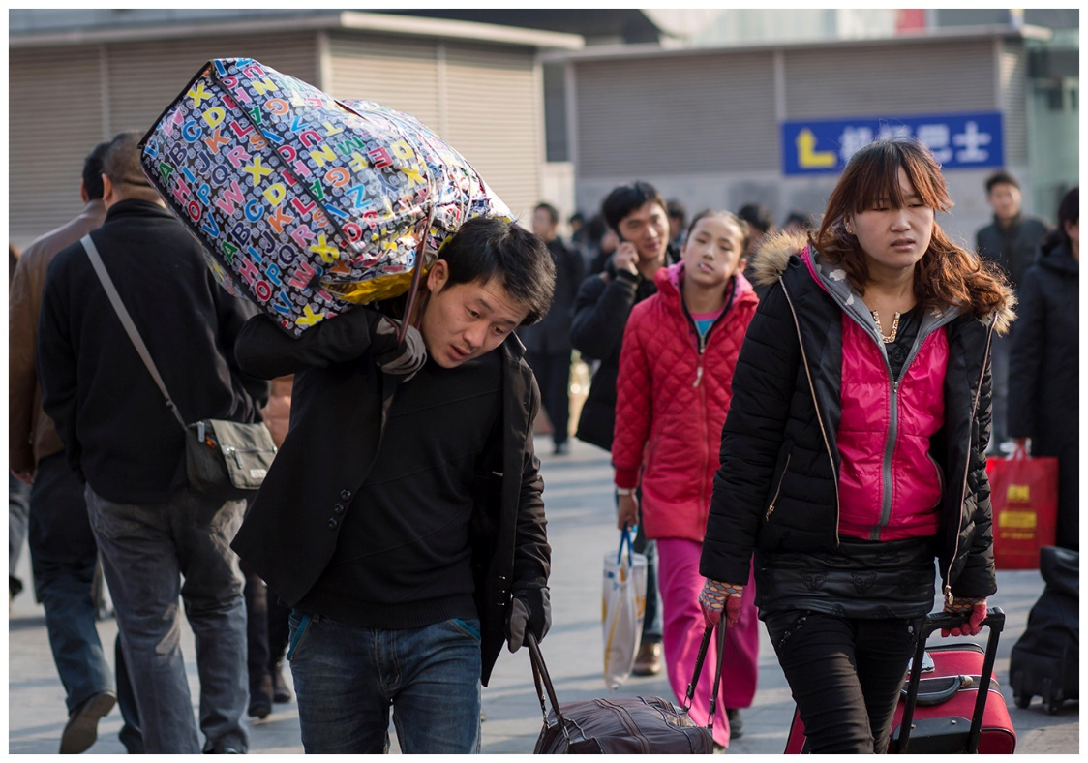
Migration’s push and pull factors
Migration is the permanent or semi-permanent relocation of people from one place to another
First humans lived in Africa but early humans were very mobile, looking for nuts, seeds, and fruits to eat and animals to hunt
As agriculture and urban settlement developed, people began to settle down

Slide 7
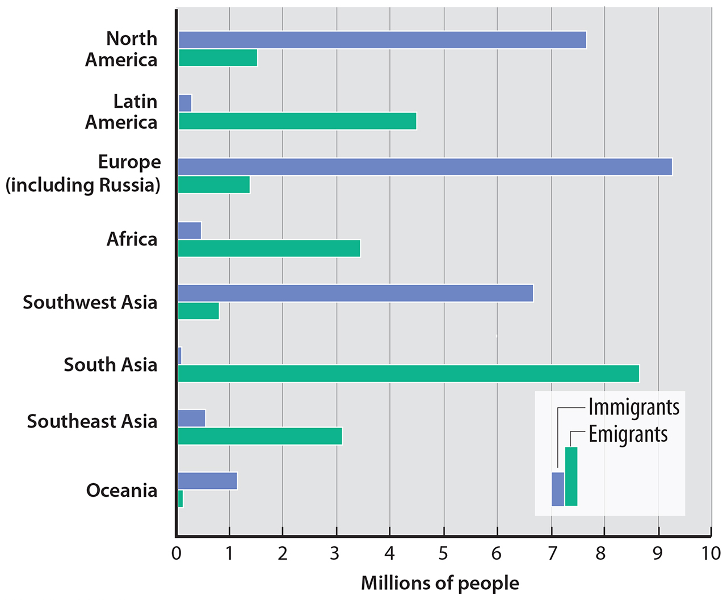
Terminology
Immigration is migration to a location while emigration is migration from a location
The difference between immigrants and emigrants is called net migration
If immigrants > emigrants, then the net migration is positive and has net in-migration
If immigrants < emigrants, then the net migration is negative and has net out-migration

Slide 8
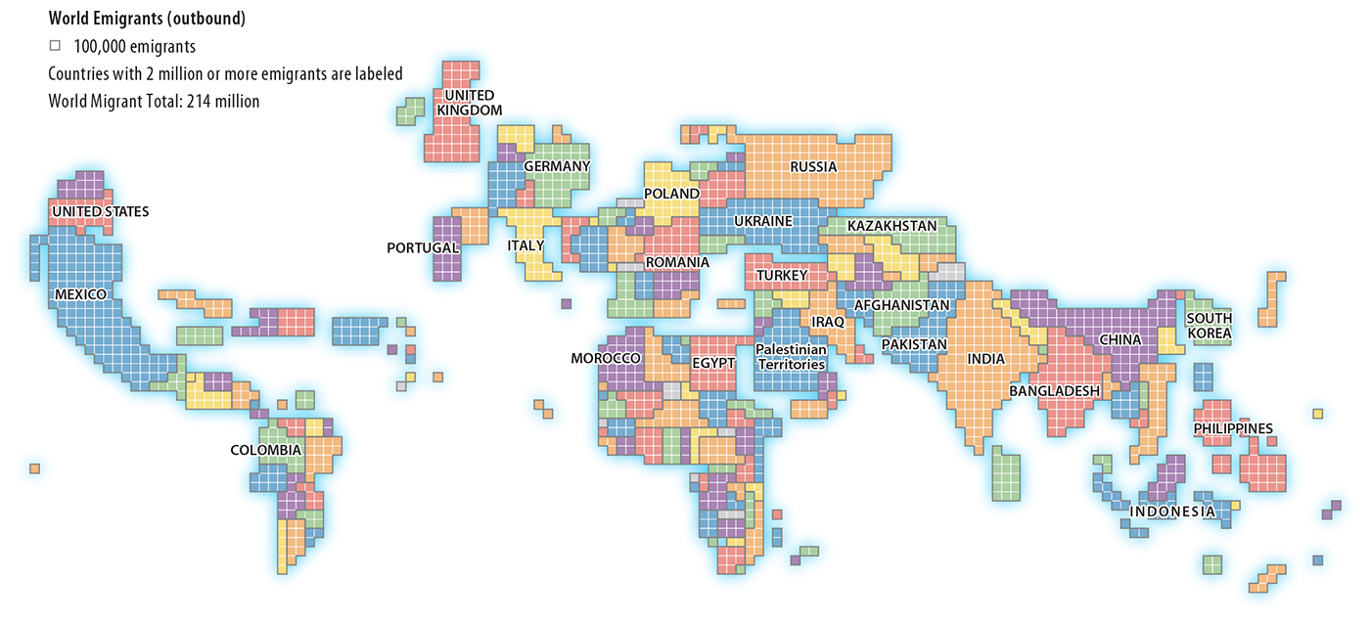
*What kind of map is this?
Notes:
As of 2010

Slide 9
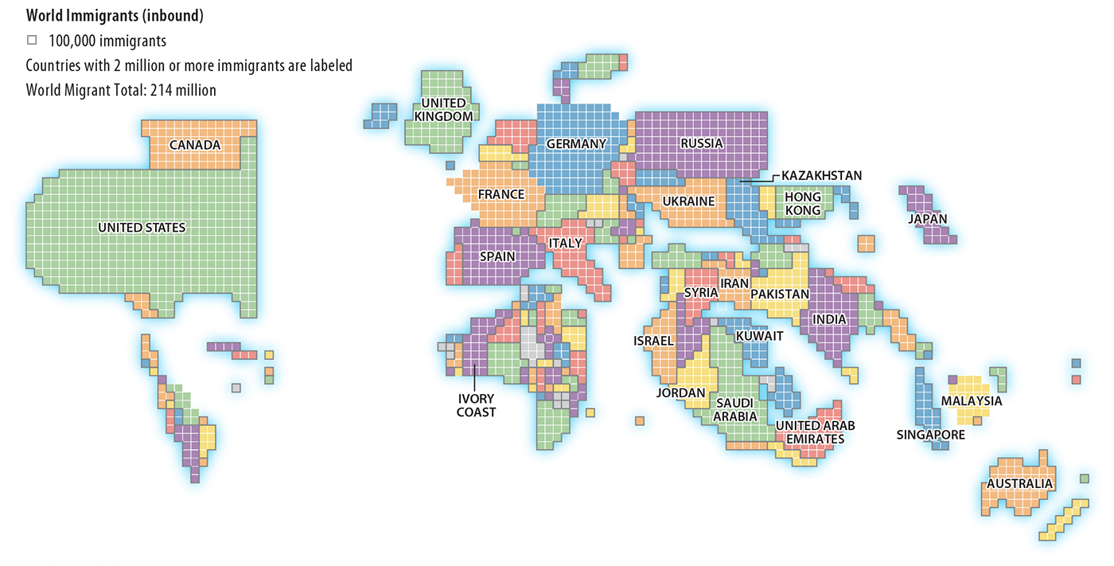
Notes:
As of 2010

Slide 10
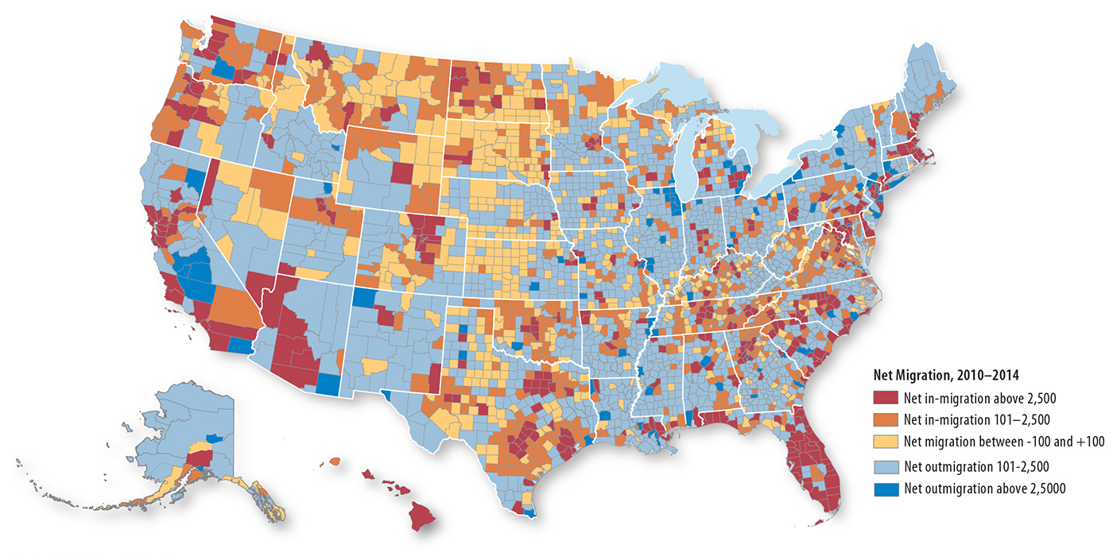

Slide 11
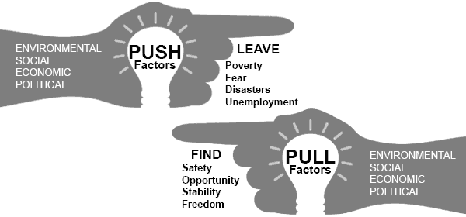
Migration’s push and pull factors
Usually migration is voluntary migration, a movement in search of a better life.
The decision to move usually consists of two main aspects
Away from someplace – push factors (usually negative)
Toward someplace – pull factors (usually positive)

Slide 12
Migration’s push and pull factors
Economic Push and Pull Factors
The most common reason people migrate is lack of jobs and economic opportunities.

Slide 13
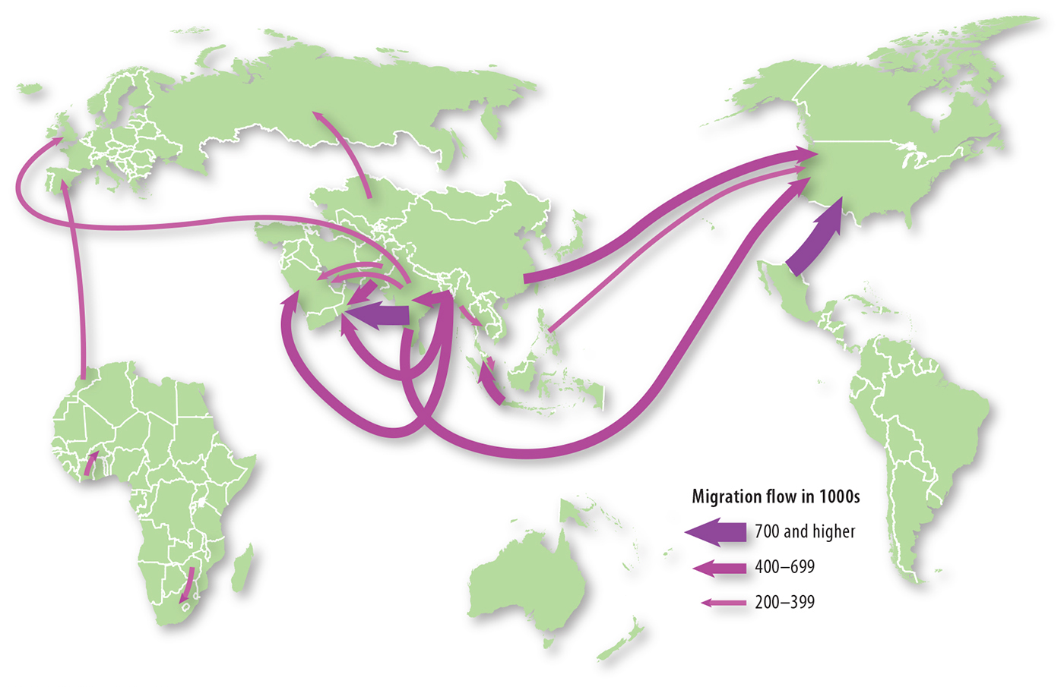
Largest country-to-country migration flows, 2005-2010
Most migration flows originate and/or end in Asia

Slide 14
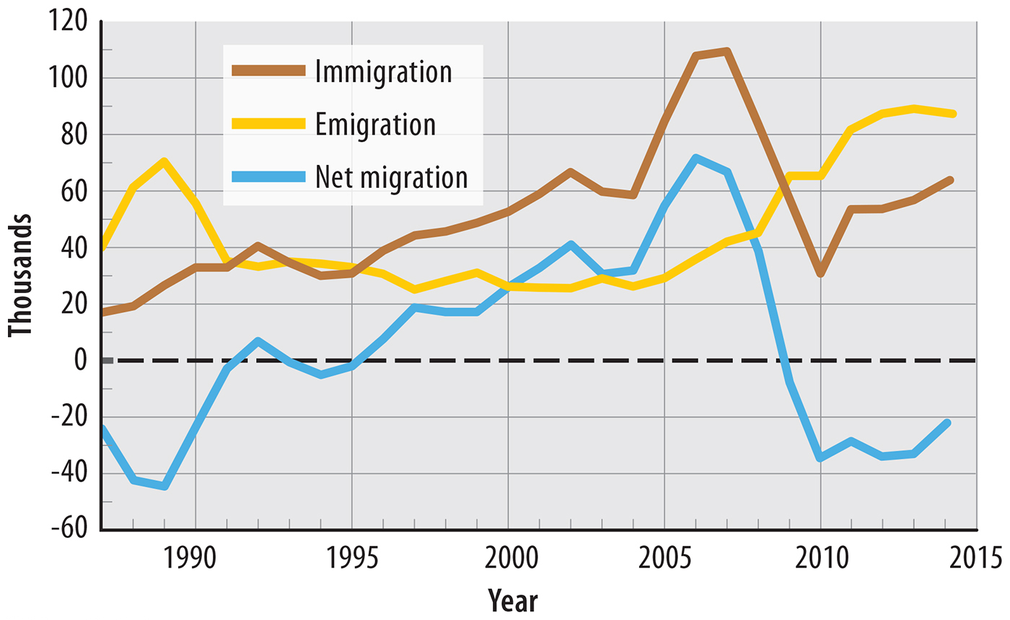
Net migration in Ireland – with few job prospects, Ireland historically had net out-migration until the 1990s.
The severe recession of the early 21st century brought net out-migration back to Ireland

Slide 15
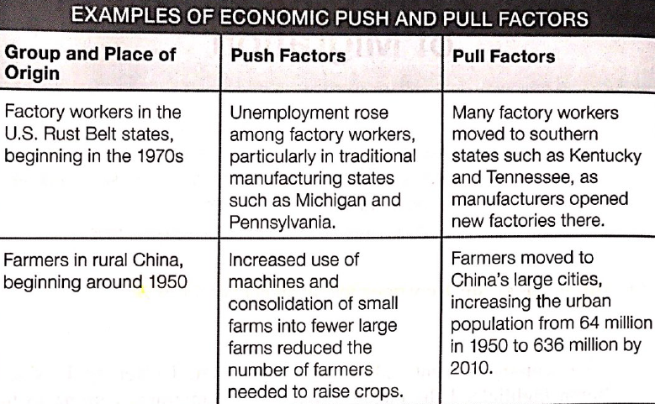
Migration’s push and pull factors
Economic Push and Pull Factors
The most common reason people migrate is lack of jobs and economic opportunities

Slide 16
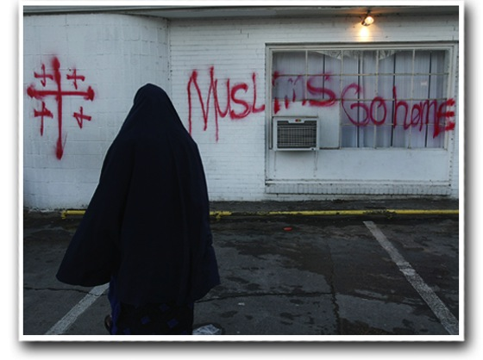
Migration’s push and pull factors
Social Push and Pull Factors
People often migrate when they experience discrimination and persecution because of their ethnicity, race, gender, or religion.

Slide 17
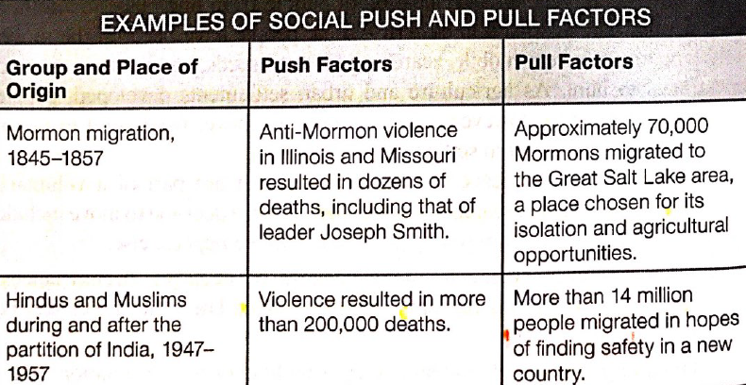

Slide 18
Migration’s push and pull factors
Political Push and Pull Factors
People who oppose the policies of the government often migrate because they face persecution, arrest, and discrimination

Slide 20
Migration’s push and pull factors
Environmental Push and Pull Factors
People often migrate to escape harm from natural disasters, drought, and other unfavorable conditions
Notes:
Nepal Earthquake

Slide 21
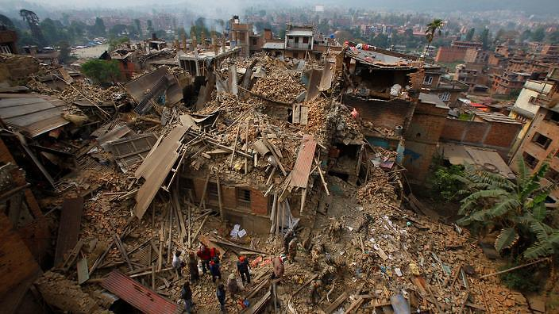
Migration’s push and pull factors
Nepal Earthquake
Notes:
Nepal Earthquake

Slide 22
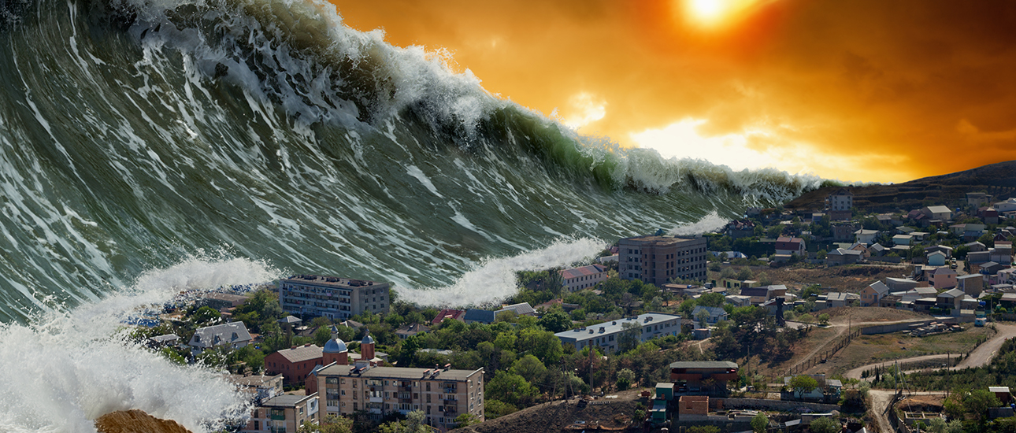
Tsunami

Slide 23
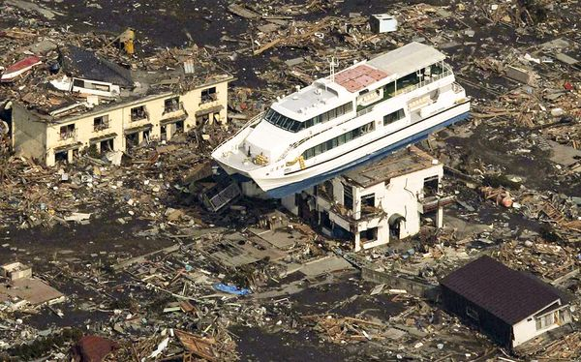
Tsunami Japan

Slide 24
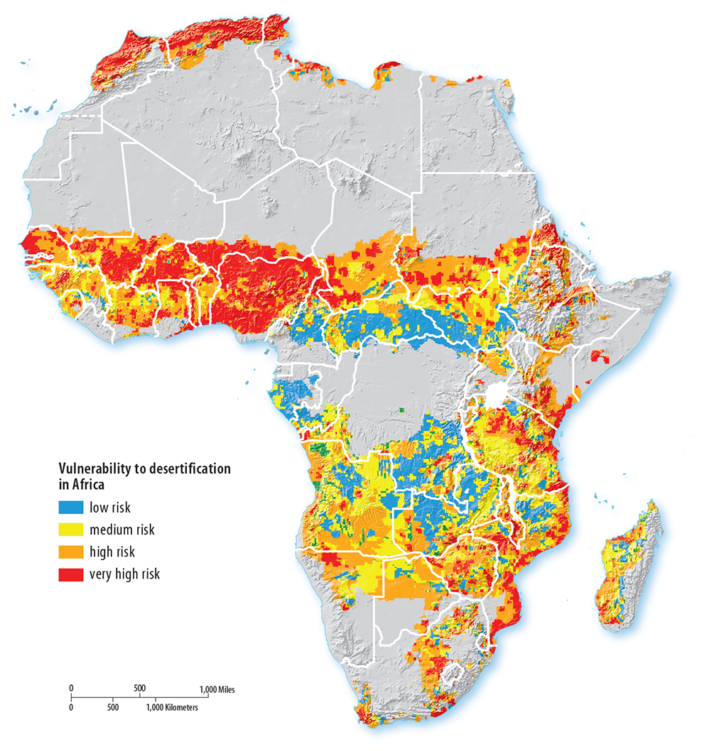
Hundreds of thousands have been forced to move from the drylands in Africa because of drought conditions.
Deterioration of land to a desert-like condition typically due to human actions is called desertification.
Population increase + low rainfall = overpopulation

Slide 25
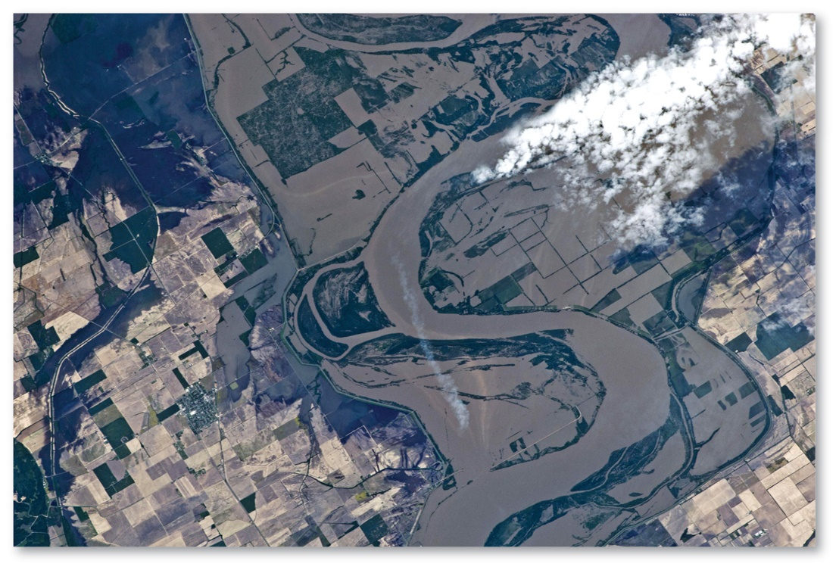
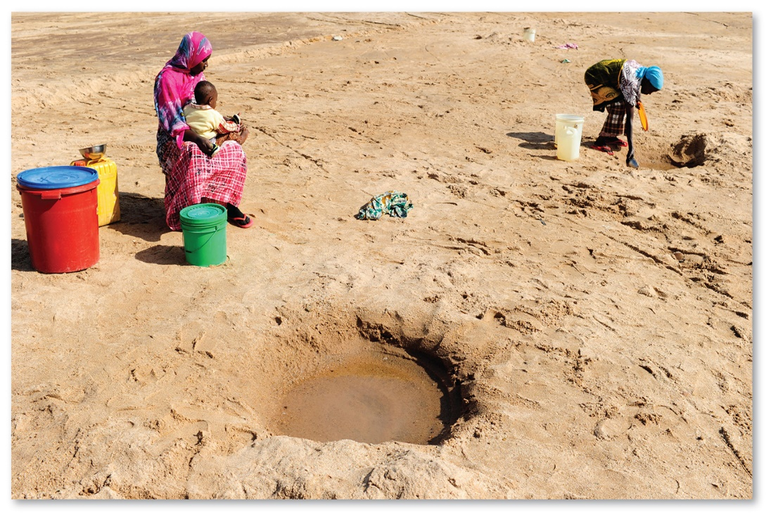
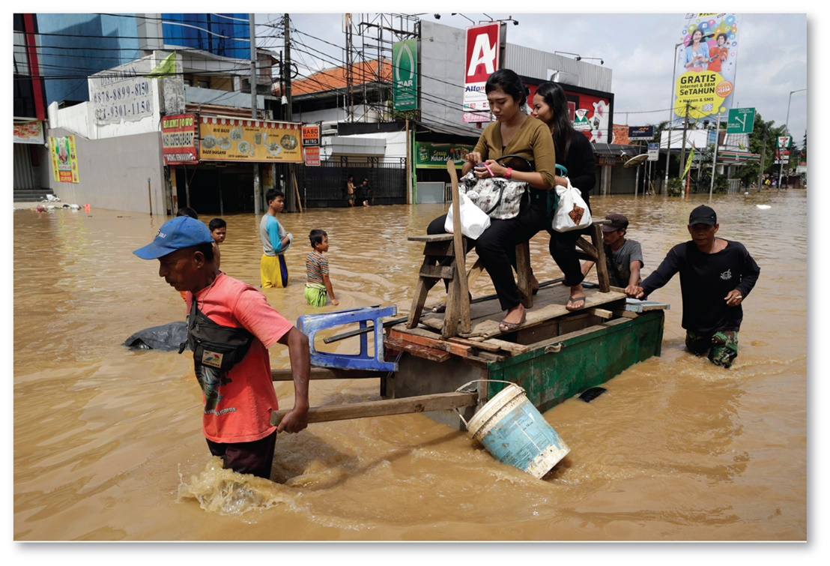
Flooding along the Mississippi River in 2011 covers farmland
Drylands, Tanzania – People are attempting to obtain drinking water from a dry river bed
Flooding in Jakarta, Indonesia

Slide 27
Migration’s push and pull factors
https://www.usatoday.com/story/news/world/2017/09/14/barbuda-hurricane-irama-devastation/665950001/
Notes:
Barbuda – forced environmental migration

Slide 28
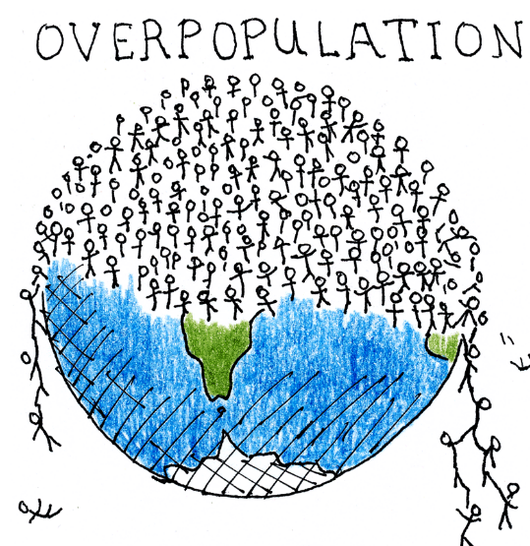
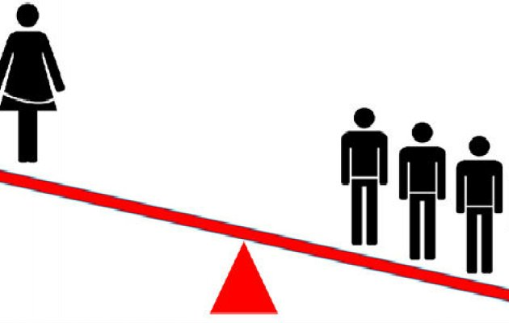
Migration’s push and pull factors
Demographic Push and Pull Factors
Some countries are unbalanced demographically
Gender – young adult might not find someone to marry
Young population – country faces risk of overpopulation
Notes:
Nepal Earthquake

Slide 29
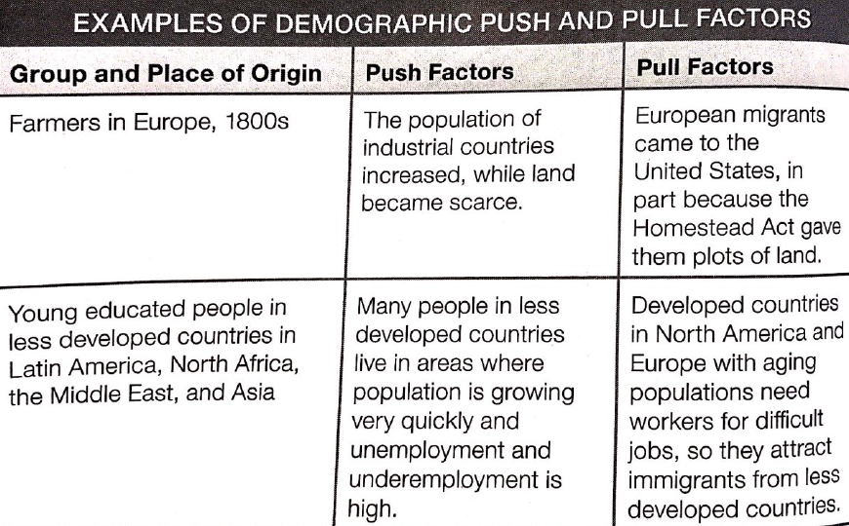

Slide 30
Migration’s push and pull factors
Intervening Obstacles
Barriers that make reaching their desired destination more difficult
Economic – a migrant lacks enough money to reach a destination
Social – a migrant gets married to someone who lives along the migration route and settles in that person’s community
Political – a migrant cannot get a visa needed to enter a country
Environmental – a migrant cannot cross sea, desert, or mountain range

Slide 31
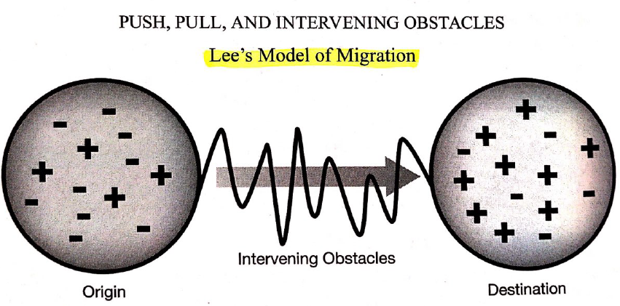

Slide 32
Learning objective (2.C.2)
By the end of this section, you will be able to apply the concepts of forced and voluntary migration to historical and contemporary examples.
Forced migrations include those involving refugees, internally displaced persons, and asylum seekers
Voluntary migrations may be transnational, internal, chain, step, and rural to urban
Patterns of voluntary and forced migration may be affected by distance and physical features

Slide 33
Types of migration
Migration
International
Voluntary
Forced
Internal
Interregional
Intraregional
Usually economic or environmental
Usually cultural or environmental
Historically rural to urban for jobs
Usually within urban areas from older cities to newer suburbs
Refugees, IDPs, and asylum seekers
Transnational, internal, chain, step, and rural to urban

Slide 34
Types of migration
A permanent move from one country to another is international migration
Voluntary
Involuntary (or forced)
A permanent move within the same country is internal migration
Interregional – one region to another (rural to urban)
Intraregional – within a region (older cities to newer suburbs)

Slide 35
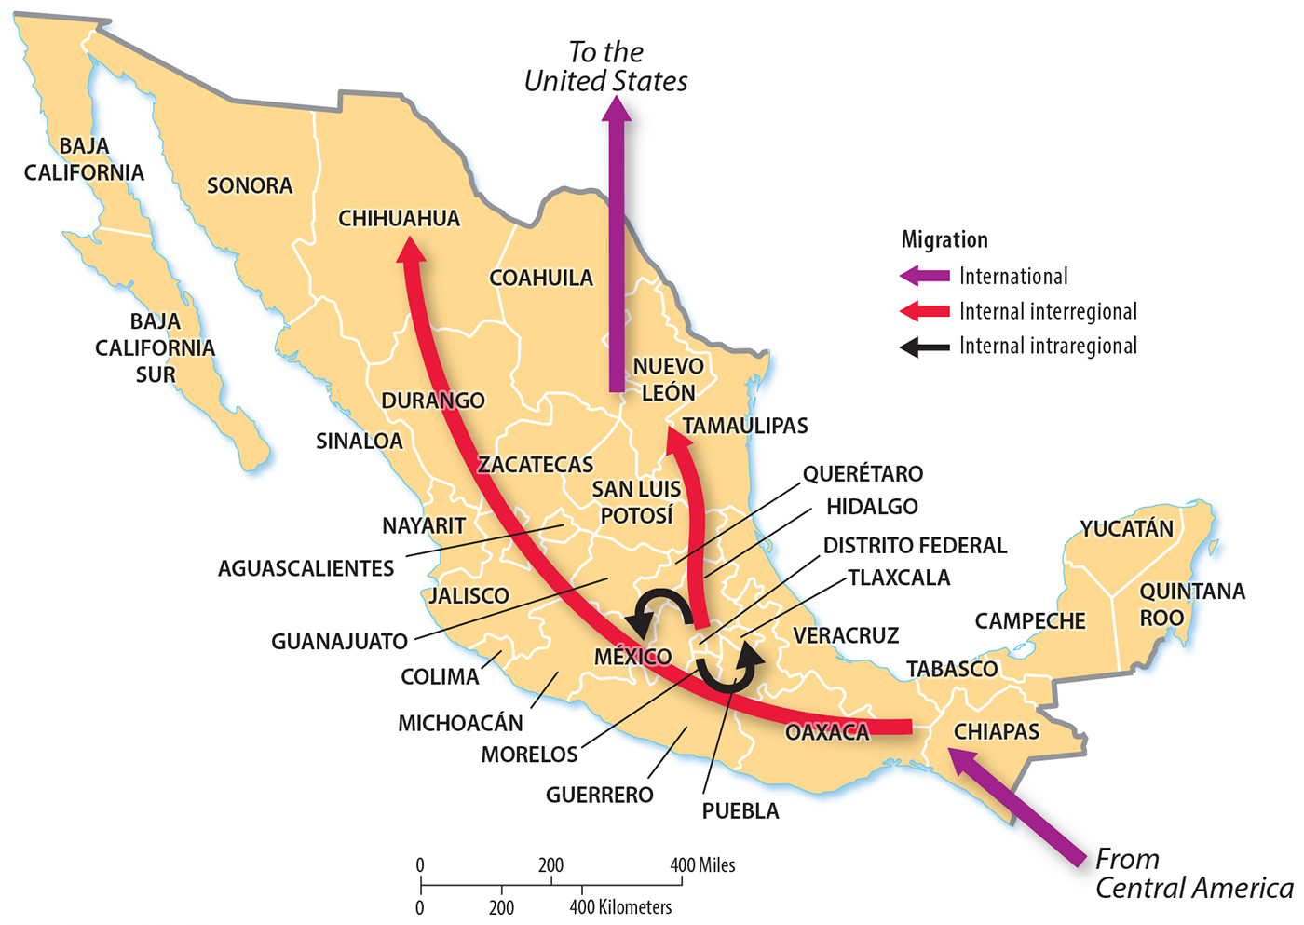
Types of migration
International and Internal
Mexico’s two principal patterns of international migration are net in-migration from Central America and net out-migration to the United States.
Mexico’s two principal interregional migration flows are net migration from the south to the north and from the center to the north.
Mexico’s principal intraregional migration flow is from Mexico City to outer states in the Mexico City metropolitan area.

Slide 36
Voluntary migration
Voluntary migration is a permanent movement undertaken by choice
May be transnational, internal, chain, step, and rural to urban
Transnational – across international borders
Internal – within international borders
Chain – following relatives
Step – series of small, less extreme moves
Rural to urban

Slide 37
Forced migration
Forced migration is a permanent movement, usually compelled by cultural factors
Involves internally displaced persons, refugees, and asylum seekers

Slide 38
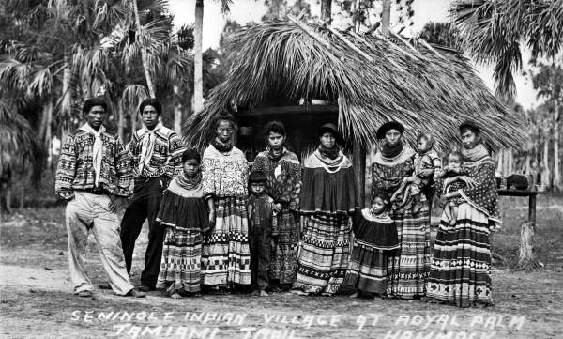
Forced migration
Displaced Persons and Refugees
An internally displaced person (IDP) has been forced to migrate for similar political reasons as a refugee but has not migrated across an international border
Notes:
Seminole Indian Village at Royal Palm Hammock Tamiami Trail, ca. 1920s

Slide 39
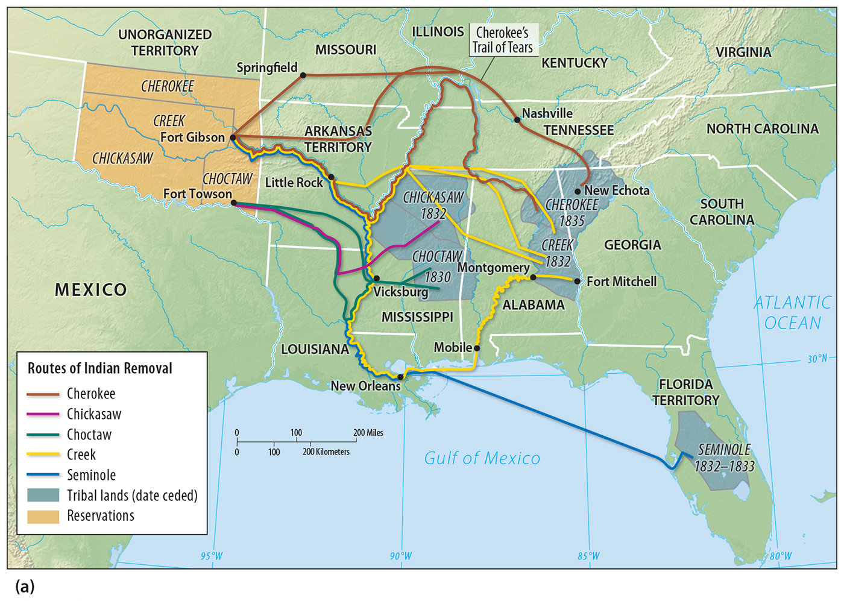
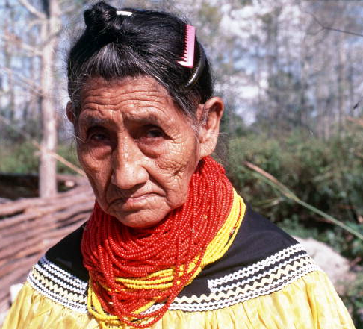
Forced migration
The routes taken by the Cherokee, Chickasaw, Choctaw, Creek, and Seminole tribes when forced westward in the early nineteenth century

Slide 40
Forced migration
Displaced Persons and Refugees
A refugee is someone who is forced to migrate from his or her home country and cannot return for fear of persecution because of his or her race, religion, nationality, membership in a social group, or political opinion.
Montreal turns stadium into welcome centre for asylum seekers from US
Largest numbers of refugees in 2014 were forced to migrate from Afghanistan and from Syria because of continuing civil wars.
Neighboring countries received most of them – Pakistan and Iran from Afghanistan and Lebanon and Turkey from Syria

Slide 41
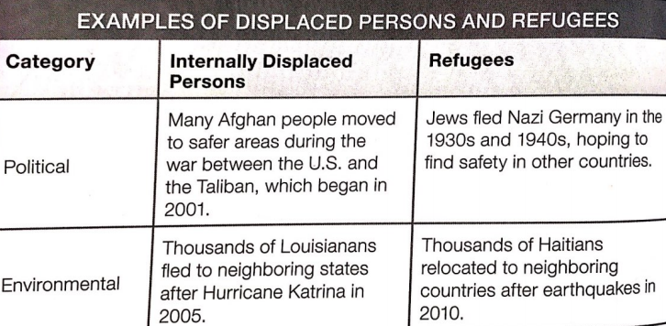

Slide 42
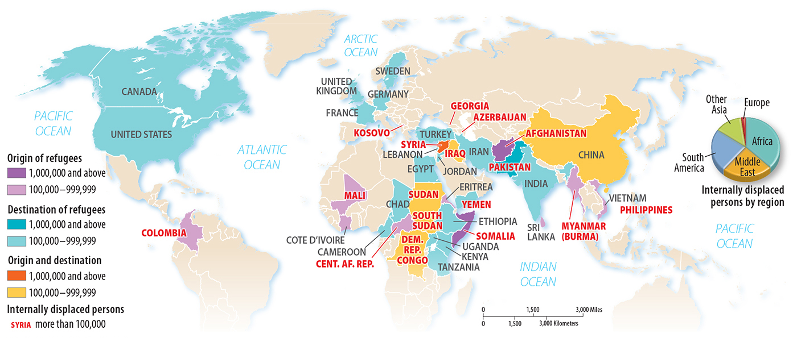
Forced migration
An asylum seeker is someone who has migrated to another country in hope of being recognized as a refugee
The United Nations counted 19.5 million refugees, 38.2 million IDPs, and 1.8 million asylum seekers in 2014

Slide 43
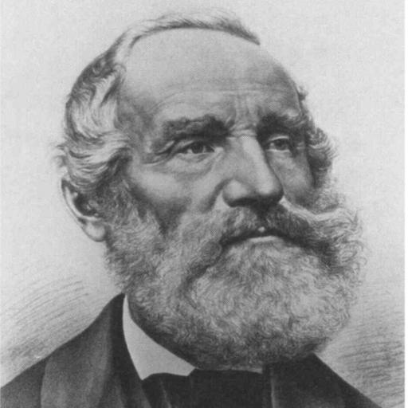
Ravenstein’s laws of migration
1880s, German geographer E.G. Ravenstein noticed eight patterns, or “laws”, about migration tendencies, patterns, and demographics.

Slide 44
Ravenstein’s laws of migration
Short Distances
Most migrants travel a short distance
The farther the distance, the less likely they are to migrate there
Called distance decay
In the 1960s, this was expanded to time-distance decay, the idea that things near each other are more closely connected than things that are far apart

Slide 45
Ravenstein’s laws of migration
Urban Areas
Migrants traveling long distances usually settle in large urban areas because they believe there will be more opportunity
Greater pull in larger communities + the assumption that people tend to leave larger communities than small → gravity model of migration
Example: Cuban migration to the US when Castro took office; most people settled in the closest state (Florida) and in its biggest city (Miami). Today, more than 2/3 of Cuban-Americans in the US live in Florida and half of all Cuban-Americans live in Miami.

Slide 46
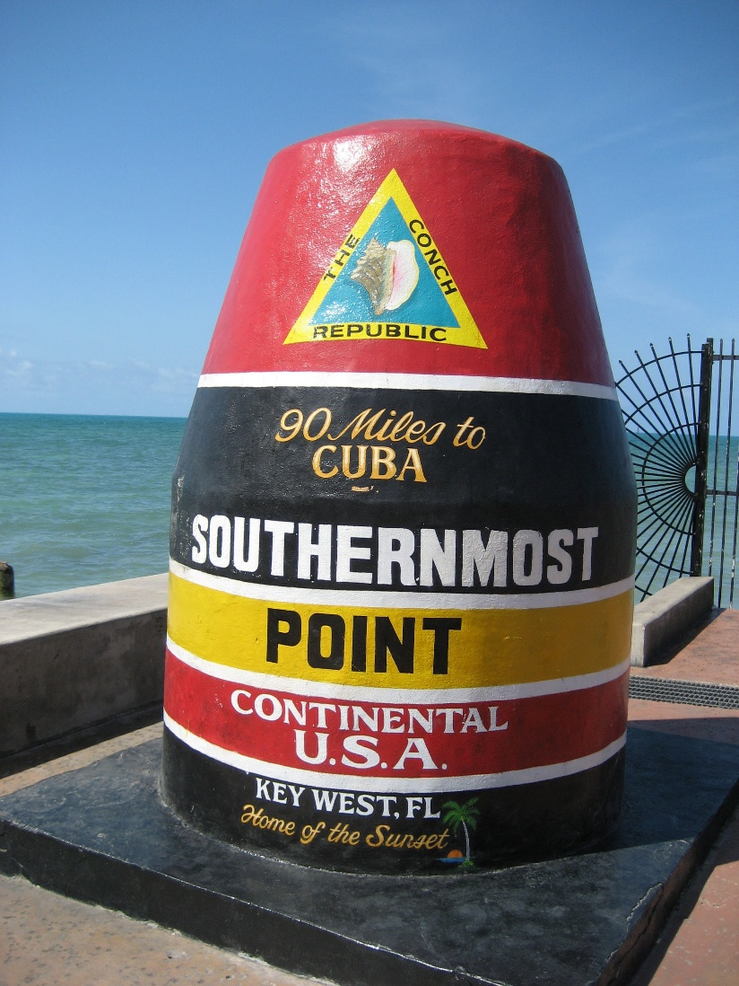
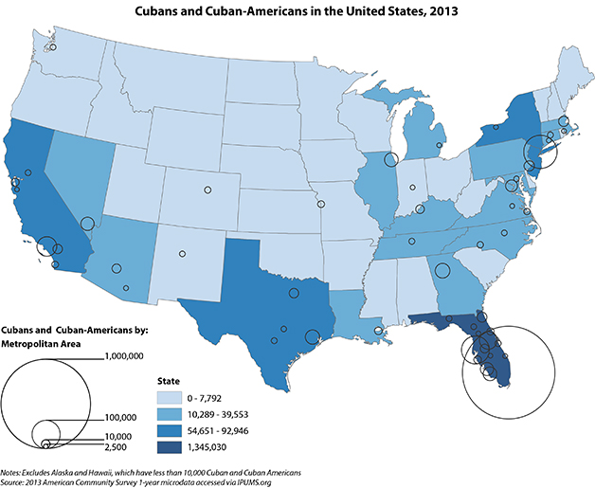
Ravenstein’s laws of migration

Slide 47
Ravenstein’s laws of migration
Multiple Steps
Most migration occurs through step-migration, a process in which migrants reach their eventual destination through a series of smaller moves
Example: in a common pattern in rural-to-urban migration, a migrant from a small town is most likely to move first to a larger town, later a small city, and finally a large city

Slide 48
Ravenstein’s laws of migration
Rural to Urban
Most migration in history has been from rural to urban areas
Industrial Revolution led to a decrease in the need for laborers on farms and cities needed more people to work, first in factories, and then in offices
This rural-to-urban movement remains common today
Within countries (rural residents of India moving to Indian city of Mumbai) and between countries (rural residents of Syria moving to cities in Germany)

Slide 49
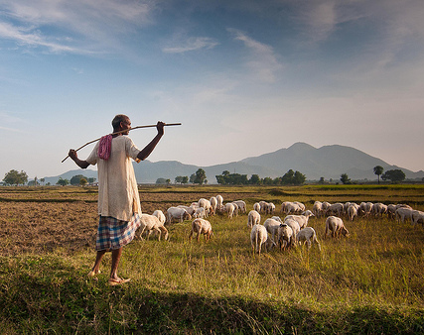
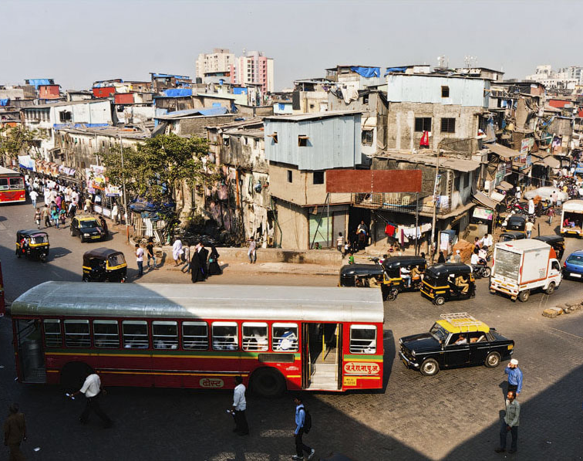
Ravenstein’s laws of migration
Top 10 Things to Do in Mumbai

Slide 50
Ravenstein’s laws of migration
Counter Migration
Each migration flow produces a movement in the opposite direction, called counter migration
Example: 1990s-2000s, as many Mexican migrants were moving to the US, a counter migration of people moved from the US to Mexico (return migration, retirees, etc.)
Today, 1 million retired US citizens live in Mexico

Slide 51
Ravenstein’s laws of migration
Youth
Most migrants are younger adults, between ages 20 and 45
Usually not as established with jobs, homes, and families as older groups and are more likely to move to improve their fortunes

Slide 52
Ravenstein’s laws of migration
Gender Patterns
Most international migrants are young males looking for work, while more internal migrants are females who are moving in with their husbands and husbands’ families
Example: several countries in the Middle East have guest worker programs where they recruit young men from South and Southeast Asia to work in the oil and construction industries

Slide 53
Learning objective (2.C.3)
By the end of this section, you will be able to analyze major historical migrations.
Major historical migrations include forced migration of Africans to the Americas, immigration waves to the U.S., and emigration from Europe and Asia to colonies abroad.

Slide 54
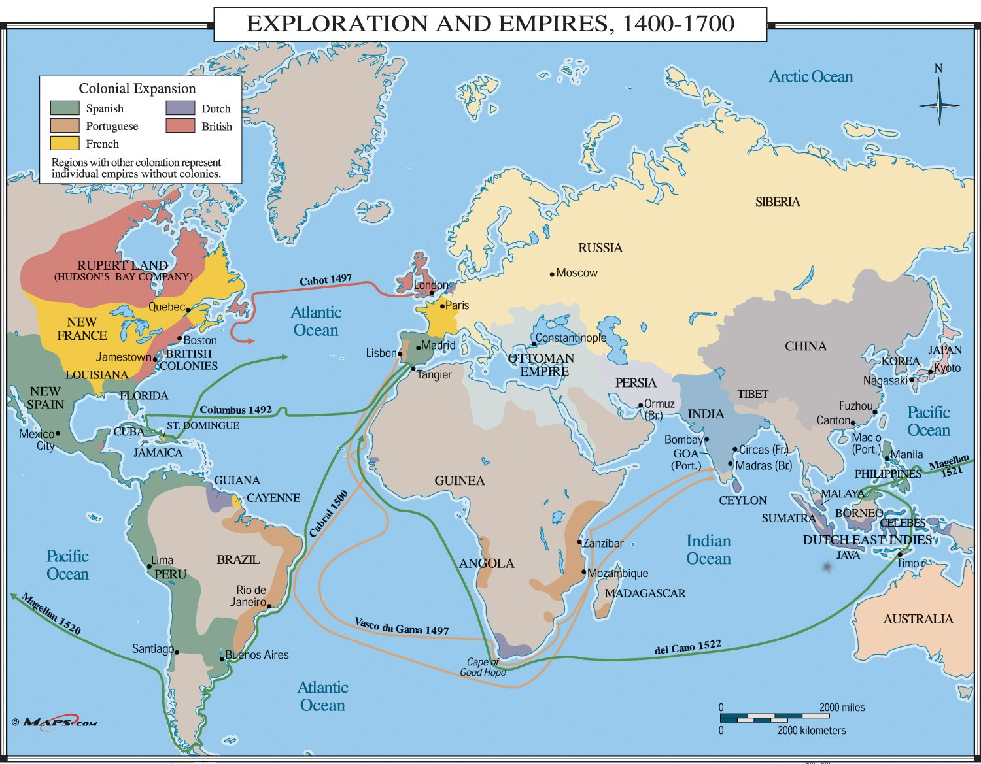
Global migration through history
Colonization is “the action or process of settling among and establishing control over the indigenous people of an area.” The rate and breadth (span) of migration increased drastically during the Age of Exploration.
As countries like Spain, France, Portugal, and Great Britain searched for new resources and new transportation routes around the world, they spread their cultural influences.
Effects of Colonization

Slide 55
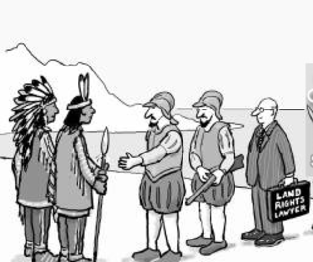
Global migration through history
Effects of Colonization
European culture spread across the globe
Indigenous populations and their cultures were nearly wiped out by European diseases and replaced by European cultures
European languages and Christianity dominated the Western Hemisphere

Slide 56
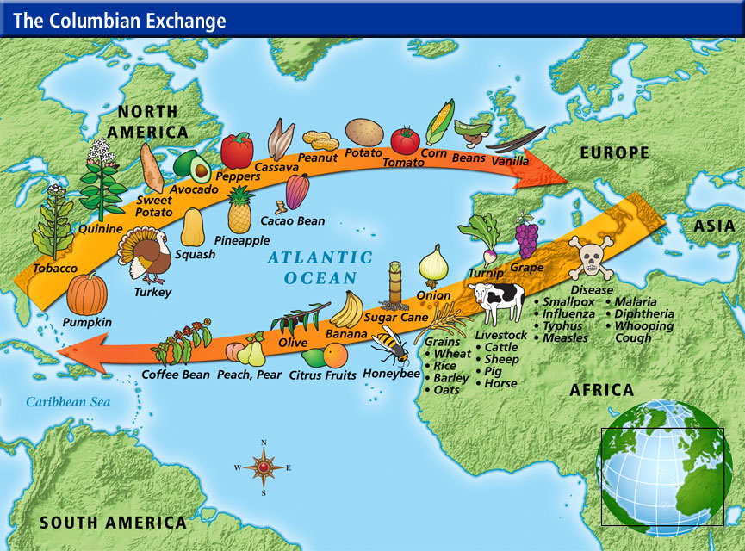
Global migration through history
Effects of Colonization
In contrast, in Asia and Africa, people shared the same diseases carried by Europeans
People kept their traditional languages and religions
The diffusion (spread) of goods and ideas went both ways between Europeans and their colonies – Columbian Exchange

Slide 57
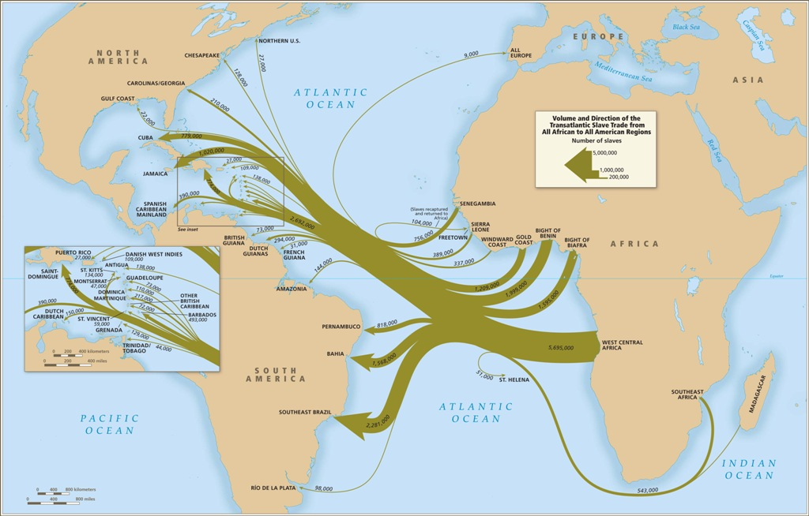
Global migration through history
Forced Migration
Major result of European expansion was the Atlantic Slave Trade
Largest example in history of forced migration – people do not choose to relocate, bud do so under threat of violence
15th-19th centuries – 12.5 million Africans were captured, enslaved, and forcibly moved from Africa to North America, the Caribbean, and South America

Slide 58
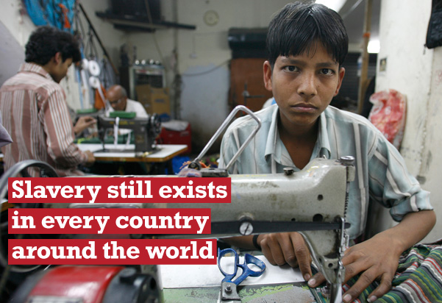
Global migration through history
Slavery Today
Although the Atlantic slave trade ended in the 19th century, slavery still exists today
The United Nations estimates that around 21 million people are victimized by forced labor – five times the number of African Americans enslaved in the United States in 1860

Slide 59
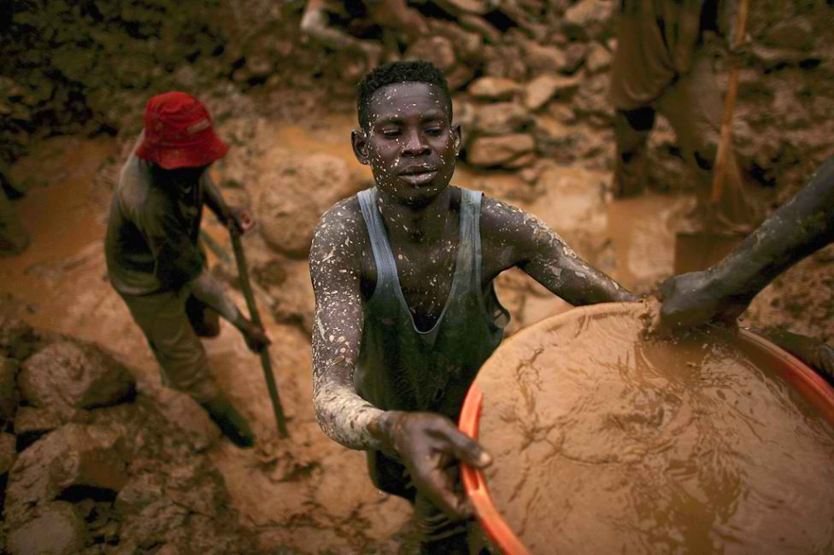

Slide 60
Global migration through history
Reversing Historical Trends
Since the mid-20th century, migration flows have changed
Europe is now a destination for migrants from around the world
Many come from former European countries in the Middle East, South Asia, and West Africa usually seeking jobs or to join family members
Chain migration results in the formation of ethnic enclaves – neighborhoods filled primarily with people of the same ethnic group (Little Haiti, Little Havana, Chinatown, etc.)

Slide 61
Global migration through history
Historical Trends in the United States
1500-1700: European countries raced to colonize North America
1700: North America had been claimed primarily by England, France, and Spain
Other sources of migrants:
1600s – 1808: enslaved Africans
1808 – 1890: northern and western Europe
1890 – 1914: southern and eastern Europe
1945 – present: Latin America and Asia

Slide 62
Geographic perspectives
American Migrations
The first to arrive in the Americas were hunters from Asia and people have been moving to the Americas ever since – most willingly, except for the millions of enslaved Africans
Two major migrations
The Great Migration from the South
Migration to the South

Slide 63
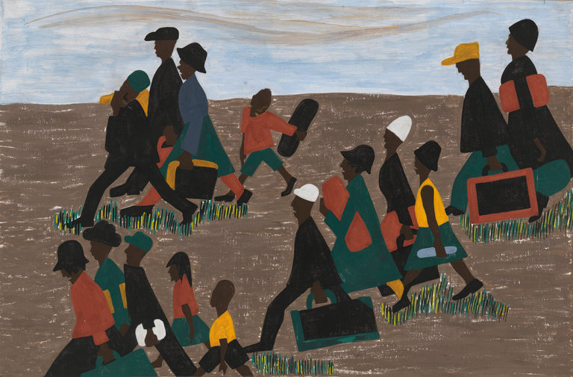
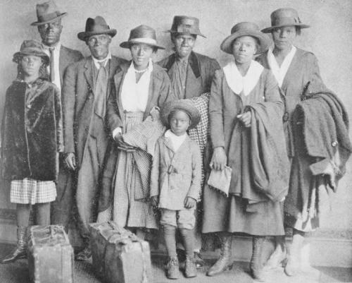
Geographic perspectives
The Great Migration (1916-1970)
Started when the United States entered World War I in 1917
Millions of African Americans migrated from the South to cities in the rest of the country
Push factor: escape severe racial discrimination and violence
Pull factor: factory jobs were increasing and European immigration was decreasing because of the war
Names to know: Emmett Till and Tamir Rice
Notes:
Dates vary based on research…
Early 1900s

Slide 64
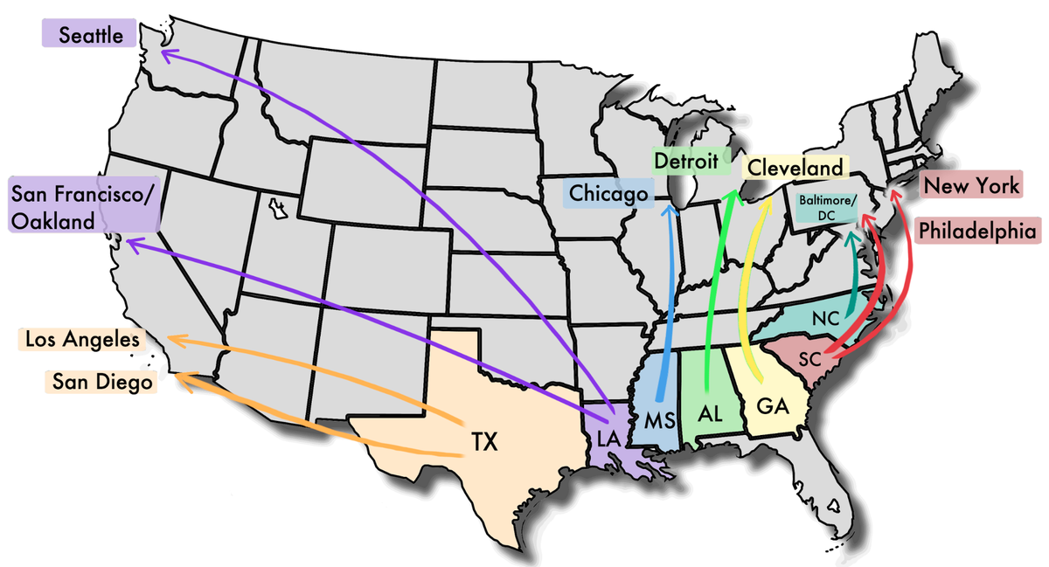

Slide 65
Geographic perspectives
Migration to the South
From the Northeast and Midwest to the South and Southwest
Push factors: harsh winters and decline in jobs due to factory automation
Pull factors: after WWII, government policies made moving anywhere easier, the development of air conditioning made hot climates more pleasant, and the expansion of defense industry jobs

Slide 66
Geographic perspectives
U.S. Immigration
At Independence: from Europe (about ½ from the UK and Ireland) and Sub-Saharan Africa (mostly slaves)
Mid 19th to Early 20th centuries: Ireland and Germany (economic and political push factors); Scandinavia, especially Swedes and Norwegians (overpopulation from Industrial Revolution); Southern and Eastern Europe, especially Italy, Russia, and Austria-Hungary
Late 20th to Early 21st centuries: Latin America (mostly Mexico) and Asia (China, Hong Kong, the Philippines, India, and Vietnam)

Slide 67
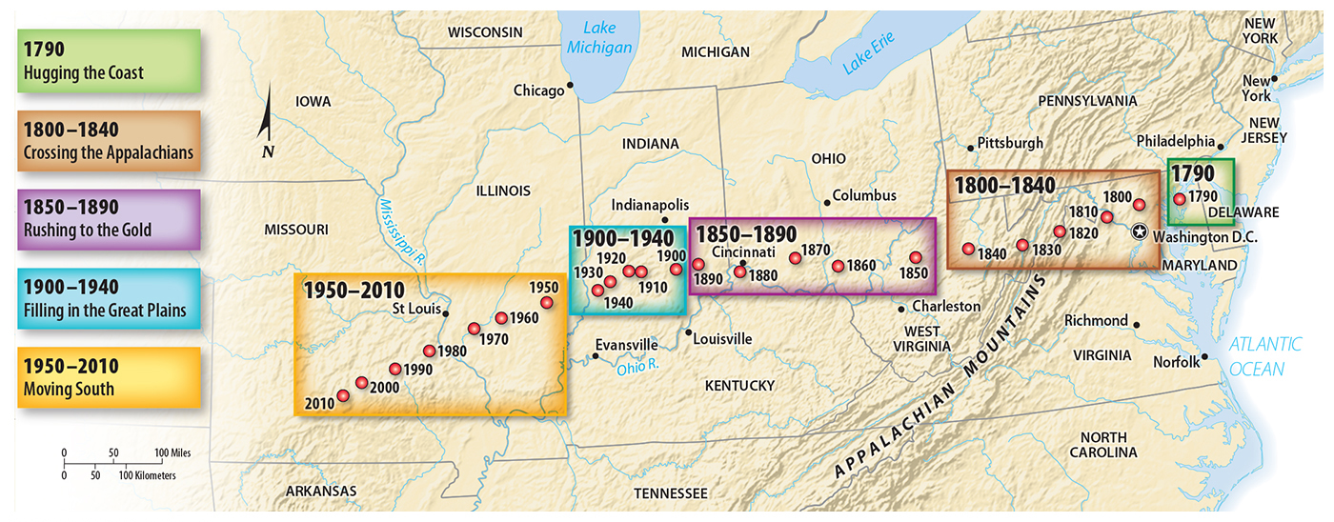
Interregional migration in the U.S.
Hugging the Coast – water for trade, Appalachians blocked westward expansion, and indigenous residents resisted expansion
Crossing the Appalachians – transportation (canals) and low land prices
Rushing to the Gold – Gold Rush (1840s) in California; avoided the Great Plains (unfit climate)
Filling in the Great Plains – Improved agricultural technology (barbed wire, steel plow, windmills, and well-drilling), railroads, and land grants)
Moving South – job opportunities and warmer climate

Slide 68
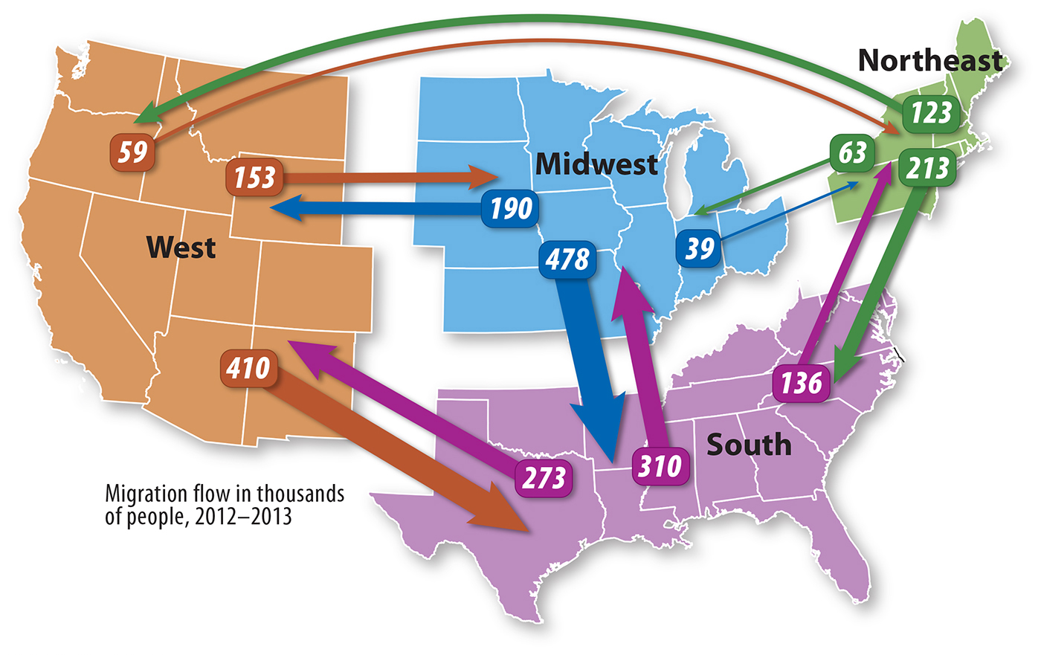

Slide 69
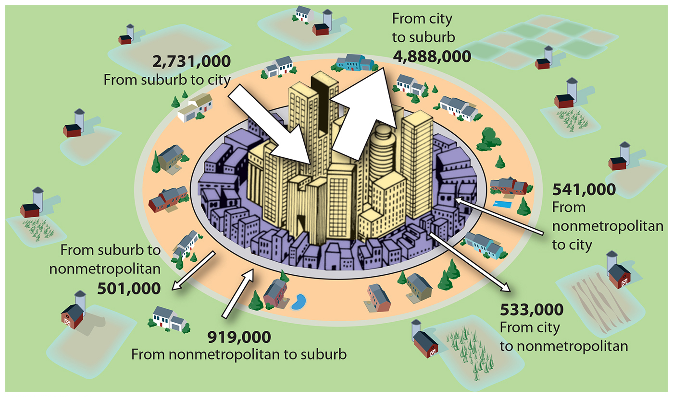
Intraregional migration in the U.S.
Intraregional migration is primarily from cities to suburbs.
The population of most cities has declined since the mid 1900s, while suburbs have grown rapidly.
Comparable patterns are found in Canada and Europe.
Lifestyle – not employment
Notes:
2013

Slide 70
Learning objective (2.C.4)
By the end of this section, you will be able to analyze the cultural, economic, environmental, and political consequences of migration.
Governments institute policies to encourage or restrict migration
Migration has consequences (remittances; spread of languages, religions, innovations, diseases) for areas that generate or receive migrants

Slide 71
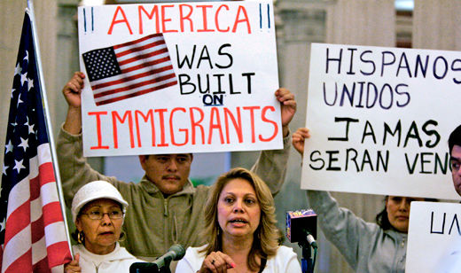
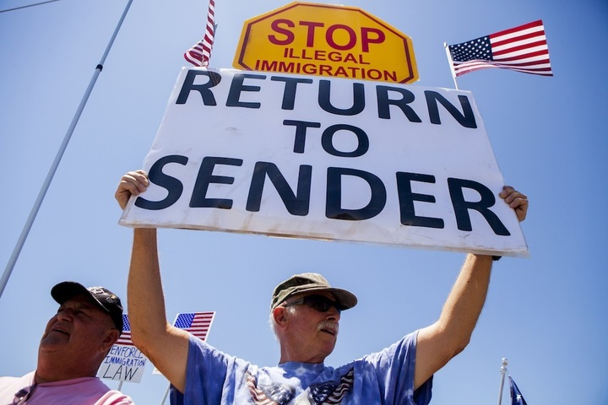
Migration policies and their consequences
While some countries encourage immigration, others actively restricted the flow of migration into their countries
Some countries have relied heavily on immigrants to improve their economy but many people have cultural biases against immigrants and try to keep them out

Slide 72
Migration policies and their consequences
Policies Encouraging Immigration
Few U.S. policies restricting immigration before the 1880s
Farms needed laborers – immigrants were welcomed
Homestead Act (1862) – government gave land to settlers willing to farm it for 5 years
Currently, the U.S. gives visas to well-educated migrants to encourage them to stay
Guest worker programs – hard, unpleasant work
Family reunification policies – sponsor family members
Other policies: quick migration for refugees in emergency situations and foreign college students may become permanent residents after graduation

Slide 73
Migration policies and their consequences
Policies Discouraging Immigration
Some countries establish educational standards or restrict the kind of work they can do
Immigration quotas – Emergency Quota Act of 1921 (<3%) or Immigration Act of 1924 (<2%)
Some policies reflect xenophobia – a strong dislike of people who practice another culture
Economics – immigrants will take jobs
In the U.S., xenophobia and economics led to the passing of the Chinese Exclusion Act
Japan – preserve cultural homogeneity
Notes:
The Immigration Act of 1924, or Johnson–Reed Act, including the National Origins Act, and Asian Exclusion Act (Pub.L. 68–139, 43 Stat. 153, enacted May 26, 1924), was a United States federal law that limited the annual number of immigrants who could be admitted from any country to 2% of the number of people from that country who were already living in the United States as of the 1890 census, down from the 3% cap set by the Emergency Quota Act of 1921, which used the Census of 1910. The law was primarily aimed at further restricting immigration of Southern Europeans and Eastern Europeans, especially Italians and Eastern European Jews.[1][2][3] In addition, it severely restricted the immigration of Africans and outright banned the immigration of Arabs and Asians.
According to the U.S. Department of State Office of the Historian the purpose of the act was "to preserve the ideal of American homogeneity".[4] But though the Act aimed at preserving American racial homogeneity, it set no limits on immigration from other countries of the Americas.[5] Congressional opposition was minimal. According to Columbia University historian Mae Ngai, the 1924 Act put an end to a period where the United States essentially had open borders.[6]

Slide 74
Effects of migration
Effects on Countries of Origin
Positive
Relief from overcrowding
Zelinsky’s Migration Transition Model (Stage 2/3 → Stage 4/5)
Negative
If working-age people leave – population is skewed toward elderly and children, creating a dependency ratio problem and may undercut the traditional family structure (Ex: China’s rural to urban migration – largest migration within a country in history)
Brain drain – about 11% of Africans with advanced degrees live in the U.S., Europe, or other developed countries

Slide 75
Notes:
YouTube: https://www.youtube.com/watch?v=KNXg-kYk-LU
China’s internal migration

Slide 76
Effects of migration
Effects on Receiving Countries
Immigrants make cultural contributions to their new countries (new foods, words, forms of entertainment and religious traditions)
Tend to be highly motivated to get an education, work hard, and succeed
Often open small businesses that are service-oriented (nail salons, restaurants, etc.) but almost 200 of the 500 largest businesses in the world were started by immigrants or their children
Remittances, money sent to family members still in the country of origin, account for nearly 40% of the income of some small countries
Leading countries of origin: United States and Saudi Arabia
Leading countries as recipients: India and China

