Slide 1
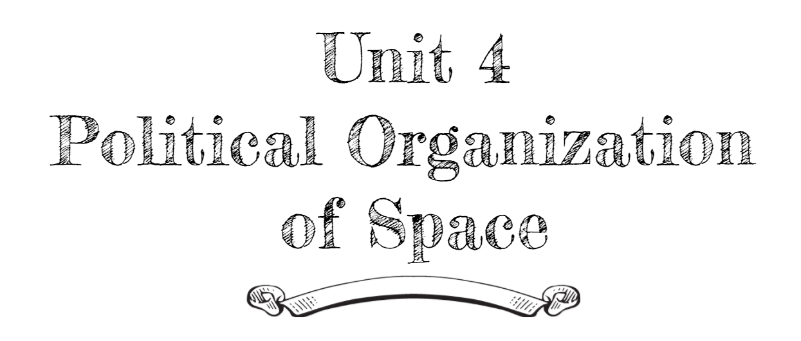
By: Carli Terrell (Orlando, Florida)
This PPT has been created using the information from the AMSCO Human Geography: Preparing for the Advanced Placement Examination book.
Palmer, David. AMSCO Advanced Placement Human Geography. Perfection Learning, 2019.

Slide 2
Unit 4 – political organization of space
Ch 9: the shape of the political map

Slide 3
Enduring Understanding (4.A)
By the end of this section, you will understand that the contemporary political map has been shaped by events of the past.

Slide 4
Learning objective (4.a.2)
By the end of this section, you will be able to explain the evolution of the contemporary political map.
The concept of the modern nation-state began in Europe.
Colonialism and imperialism led to the spread of nationalism and influenced contemporary political boundaries.

Slide 5
EVOLUTION OF THE CONTEMPORARY POLITICAL MAP
Today’s world map includes nations without states, nations in multiple states, and states containing multiple nations.
This reflects the evolution of politics, economics, and warfare over the last roughly 600 years.

Slide 6
EVOLUTION OF THE CONTEMPORARY POLITICAL MAP
Modern Nation-State Concept
Most European history – no relation between language and state
Those who paid allegiance to the King of France in the 1500s did not speak French – they spoke a regional language.
Those speaking Italian in the 1600s were not assumed to be part of the same state.
The idea of the nation state started to take hold by the 1700s in France and England but the map did not reflect this desire.

Slide 7
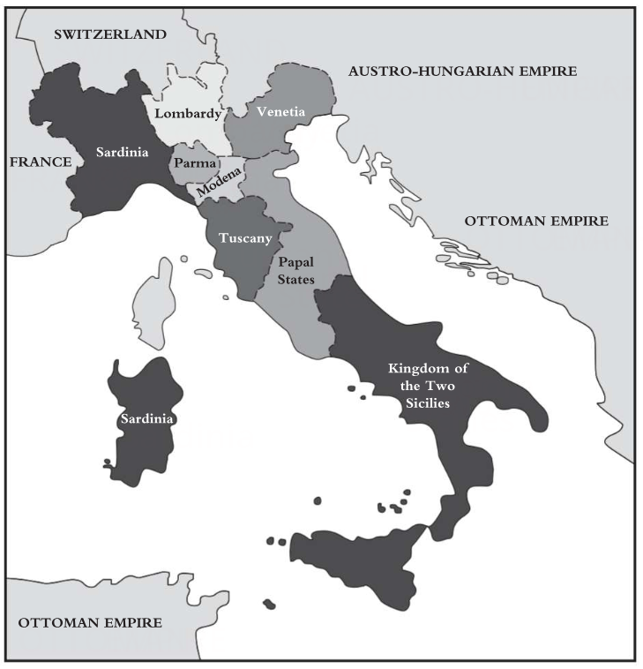
EVOLUTION OF THE CONTEMPORARY POLITICAL MAP
Modern Nation-State Concept
Tiny states and a few multi-ethnic empires (Russian, Ottoman, etc.)
1800s saw an explosion of nationalism in Europe
Some rebelled against being part of an empire that was controlled by another culture and others wanted to consolidate into unified countries (Italy and Germany).

Slide 8
EVOLUTION OF THE CONTEMPORARY POLITICAL MAP
Forces Unifying and Breaking Apart Countries
Nationalism: a nation’s desire to create and maintain a state of its own
Centripetal force: unifies people
Shared religion
External threats
Common language
Centrifugal force: breaks states apart or keeps them from forming
Religion/language – Belgium
Northern Dutch Protestants speak Flemish
Southern Roman Catholics speak French

Slide 9
Learning objective (4.a.2.b)
By the end of this section, you will be able to explain the evolution of the contemporary political map.
The concept of the modern nation-state began in Europe.
Colonialism and imperialism led to the spread of nationalism and influenced contemporary political boundaries.

Slide 10
EVOLUTION OF THE CONTEMPORARY POLITICAL MAP
Imperialism and Colonialism
Similar concepts but not the same
Imperialism
Broader concept
Includes many ways of influencing another country or group of people, by direct conquest, by economic control, or by cultural dominance.
Colonialism
Type of imperialism
People move into and settle on the land of another country

Slide 11
EVOLUTION OF THE CONTEMPORARY POLITICAL MAP
Imperialism and Colonialism
EARLY COLONIALISM
LATER COLONIALISM
Spain and Portugal
Then France and Britain
Focused on the Americas
Gold, God, and Glory
Religious influence, economic wealth, and political power
Terra Nullius led to the dispossession of indigenous people
19th Century
Great Britain, France, the Netherlands, Belgium, Italy, and Germany
Focus: Africa and Asia
Berlin Conference

