Slide 1
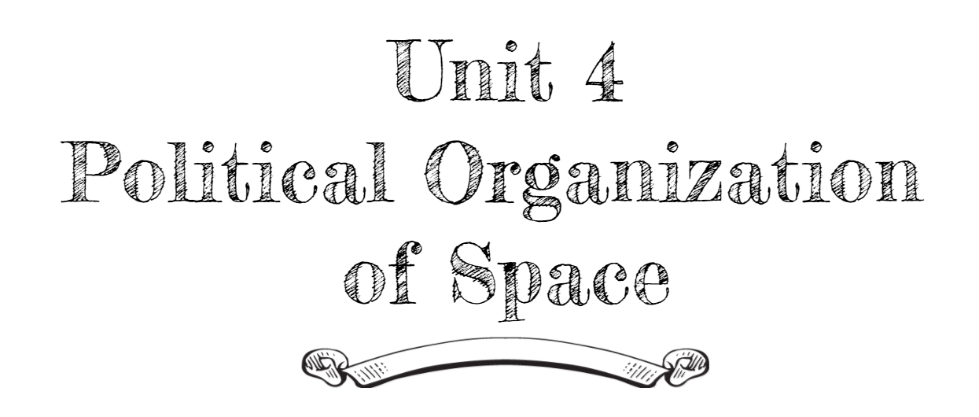
By: Carli Terrell (Orlando, Florida)
This PPT has been created using the information from the AMSCO Human Geography: Preparing for the Advanced Placement Examination book.
Palmer, David. AMSCO Advanced Placement Human Geography. Perfection Learning, 2019.

Slide 2
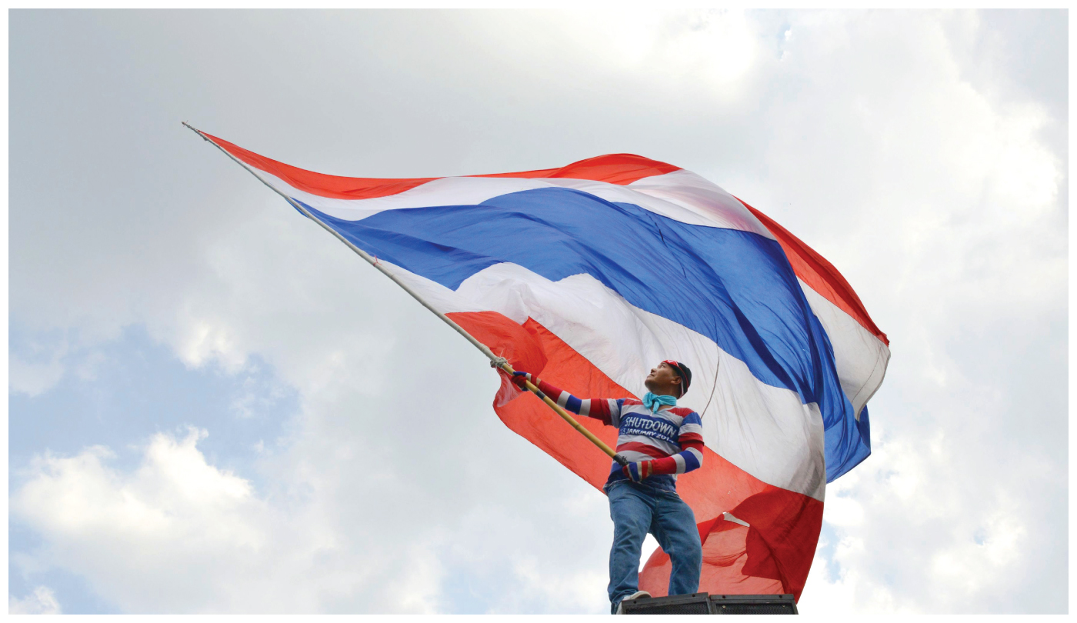
Unit 4 – political organization of space
Ch 10: Territory, Power, and Boundaries
Notes:
http://www.pbs.org/thelinguists/For-Educators/Video-Extras.html

Slide 3
Enduring Understanding (4.B)
By the end of this section, you will understand that spatial political patterns reflect ideas of territoriality and power at a variety of scales.
Territoriality: connection of people, culture, and their economic system to the land.
Power: geographic control over people, land, and resources.

Slide 4
Who rules East Europe commands the Heartland
Who rules the Heartland commands the World Island
Who rules the World Island commands the world.
-Sir Halford John Mackinder, British geographer, 1919

Slide 5
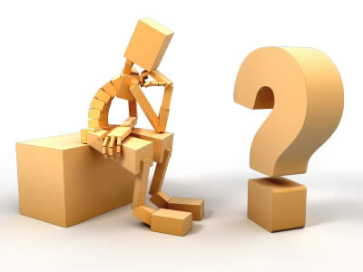
Essential Question
How do boundaries reflect ideas of territoriality and political power on various scales?

Slide 6
Learning objective (4.B.1)
By the end of this section, you will be able to explain the concepts of political power and territoriality.
Students will know that political power is expressed geographically as control over people, land, and resources (e.g., heartland, Rimland, and organic theories)
Students will know that territoriality is the connection of people, their culture, and their economic systems to the land.

Slide 7
Concepts of political power and territoriality
Geopolitics
The study of the effects of geography on politics and relations among states
Relates to trade, resource management, and the environment on a global scale
Territoriality is the willingness by one person or a group of people to defend space they claim
Example: influencing others or shaping events by asserting control over a space

Slide 8
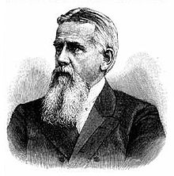
Concepts of political power and territoriality
Why do some states grow powerful while others are weak?
Organic Theory
Friedrich Ratzel (1844 – 1904)
Mnemonic
Rats (Ratzel) are organisms (Organic)

Slide 9
Concepts of political power and territoriality
Organic Theory
Influenced by the beliefs of Charles Darwin and
Claimed that states are similar to organisms and applied the idea of natural selection to relationships among them
States are born and need nourishment and living space (lebensraum), which they gain by annexing territory from weaker states
If weak state stayed weak, it would cease to exist
Examples: westward expansion in the United States and European colonization

Slide 10
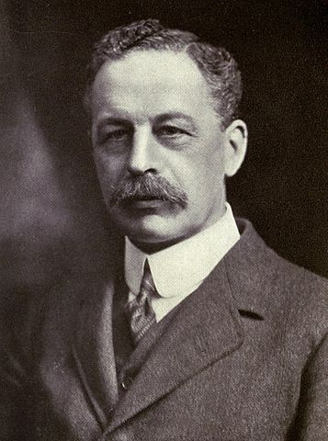
Concepts of political power and territoriality
Heartland Theory
Sir Halford Mackinder (1861 – 1947)
Mnemonic
Kind Heart – Mackinder/Heartland
This theory influenced policy decisions on a global scale through both world wars and many Cold War conflicts

Slide 11
Concepts of political power and territoriality
Heartland Theory
Europeans saw the success of colonial acquisitions and concluded that countries derived power from controlling water routes in the ocean
Mackinder dissented (disagreed) and stated that land-based power was essential for global domination
Domination of Eastern Europe → control of the heartland (Eastern Europe + Russia + Central Asia)
Control of the heartland → World Island (Afro-Eurasia)

Slide 12
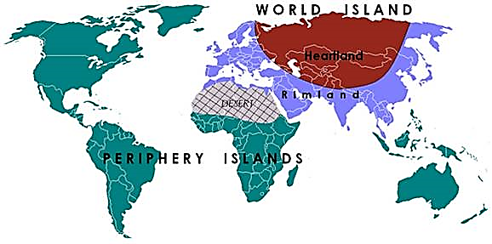

Slide 13
Concepts of political power and territoriality
Heartland Theory
Based on beliefs and geographic facts
Land transportation enabled military to move as fast on land as on water
Therefore control over land was more important than maritime power
Heartland has large coal deposits and other resources
Heartland is mostly landlocked and therefore well-protected
Only way of invasion is through Eastern Europe
“World Island” includes the majority of Earth’s land and population

Slide 14
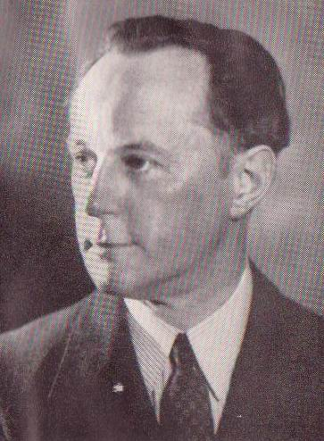
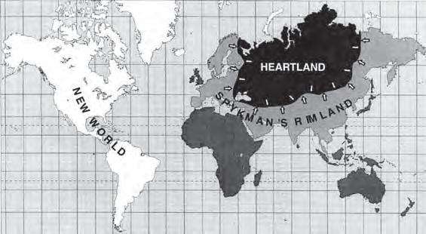
Concepts of political power and territoriality
Rimland Theory
Nicholas Spykman (1892 – 1943)

Slide 15
Concepts of political power and territoriality
Rimland Theory
Argued that power is derived from controlling strategic maritime areas of the world
Comprises densely populated coastal areas outside the heartland.
Spykman believed this area provided more resources including people and access to the sea
His writing influenced western policymakers throughout the Cold War and were reflected in the creation of NATO and Truman’s containment policy

Slide 16
Concepts of political power and territoriality
Territoriality Connects Culture and Economy
Although maps may show boundaries of a state as clear, precise, and well-defined lines, some boundaries spark disagreement or are ignored completely.
Similarly, a state’s sovereignty may be declared on paper but not fully accepted in reality.
Example: Sunni and Shia Muslims – two branches of Islam divided over the question of who should success Muhammed after his death in 632. These groups are still divided and has led to violence.

Slide 17
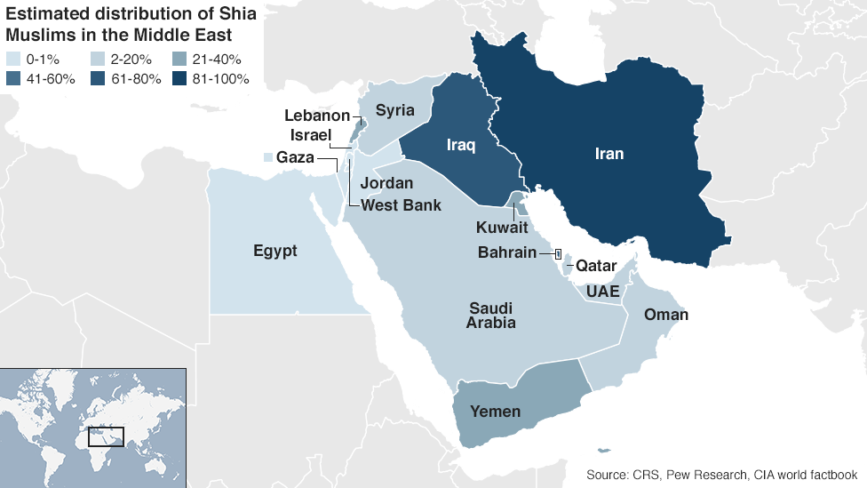

Slide 18
Concepts of political power and territoriality
Territoriality Connects Culture and Economy
Territoriality is closely connected to economic issues
Example: Spratly Islands – Philippines, Malaysia, Brunei, Vietnam, Taiwan, and China claim sovereignty over these islands in the South China Sea. Some economic reasons include unconfirmed access to petroleum, fishing supplies food and work for the people, and major international shipping lanes pass through this region.

Slide 19
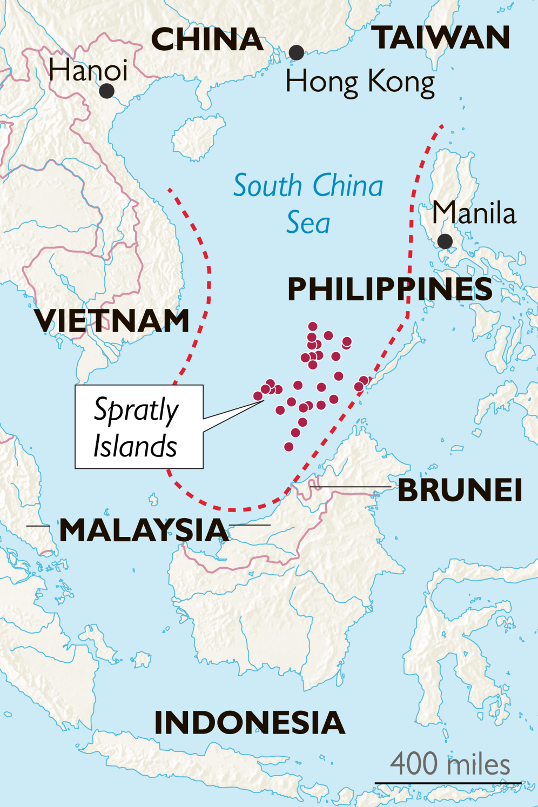
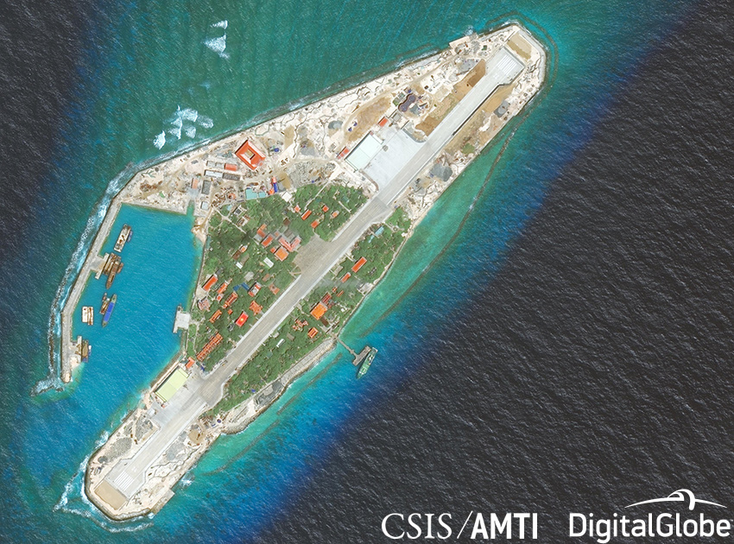

Slide 20
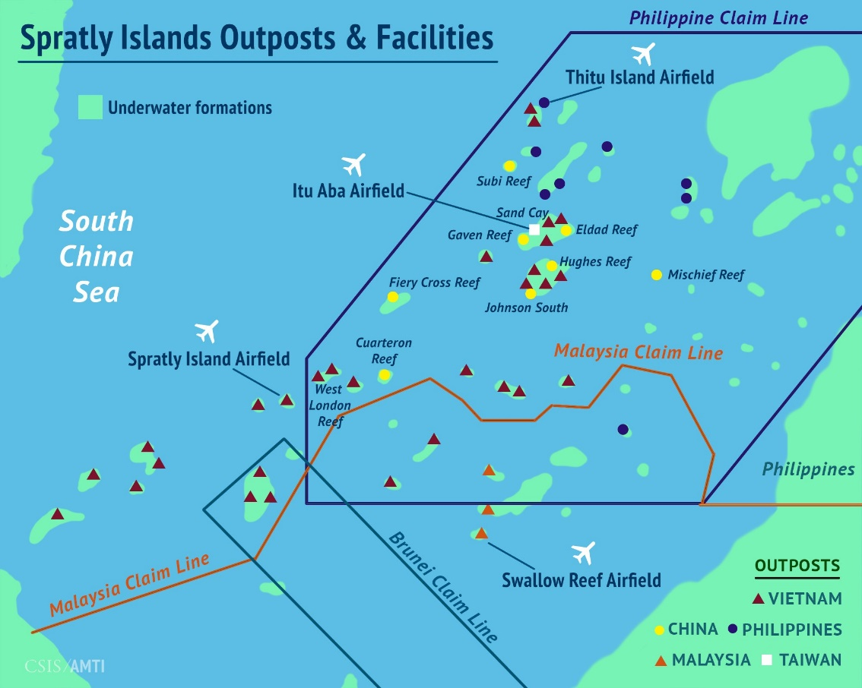
Concepts of political power and territoriality
Territoriality Connects Culture and Economy
As of 2016, each of the countries involved (except Brunei) occupied at least part of the island group
China has attempted to expand the size of its holdings through dredging and land reclamation, building up small reefs into full-fledged islands

