Slide 1
Topic :
ACCEPTANCE – Loving One Another!
Notes:
NOTE:
To change the image on this slide, select the picture and delete it. Then click the Pictures icon in the placeholder to insert your own image.

Slide 2
Topic:
ACCEPTANCE – Loving One Another!
https://www.youtube.com/watch?v=3WKlaMJaE0g
Notes:
NOTE:
To change the image on this slide, select the picture and delete it. Then click the Pictures icon in the placeholder to insert your own image.

Slide 3
First step of loving one another → Questioning ourselves
Have you ever thought about finding the good in the person in front of you?
Have you ever thought about praising the person instead of criticizing him or her?
What would be some things that may stop you from praising the person in your circle?
What are some characteristics, actions, or traits that may push you to have a quick judgment? And what are some of the judgements that you may project?
What about someone who identifies differently than you do, or who rejects your identity?
What about someone who worships or believes differently than you do?

Slide 4
What is my reaction after asking the self assessment questions?
Acceptance
Rejection
It’s recognizing the process or condition of a certain situation without trying to change it or protest it.
It’s trying to find the positive aspect of the situation or the person.
Within your level of your inner peace, it’s possible to find ways and excuses to deal a specific person or a situation.
Refusing to look at or for any positive aspect of a certain person that we interact with or a specific situation as well.
Acting negatively and angrily with the person whom we are not accepting or with others as result of our unacceptance to our circumstances.

Slide 5
How to Accept ???

Slide 6
1. Decide to be open
First step to do anything is to set an intention and a desire. Set your intention as “deciding to open up your mind” in order to better understand the situation or the person from all different aspects.

Slide 7
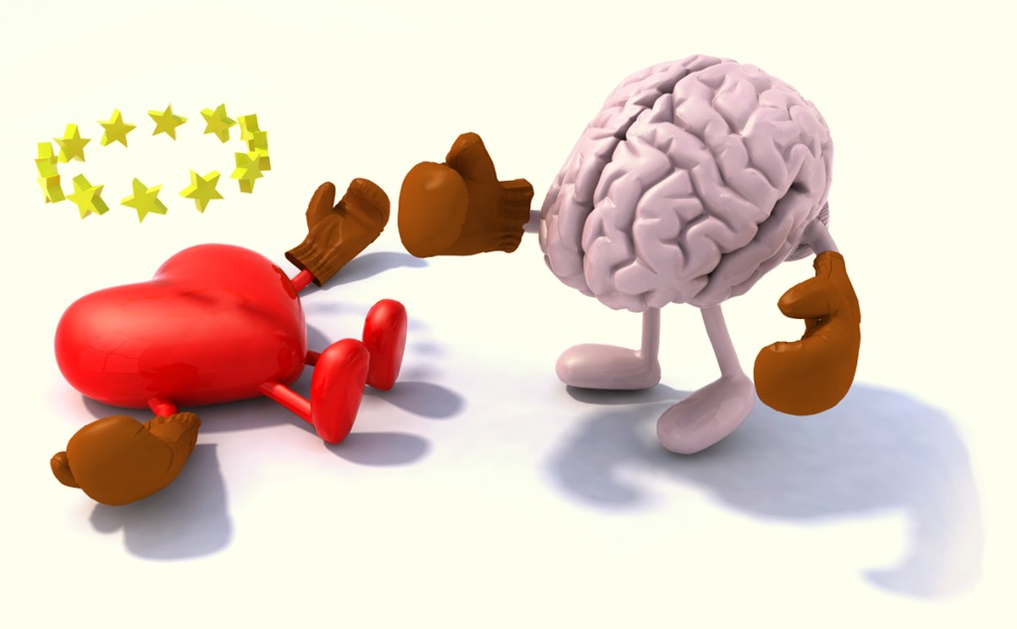
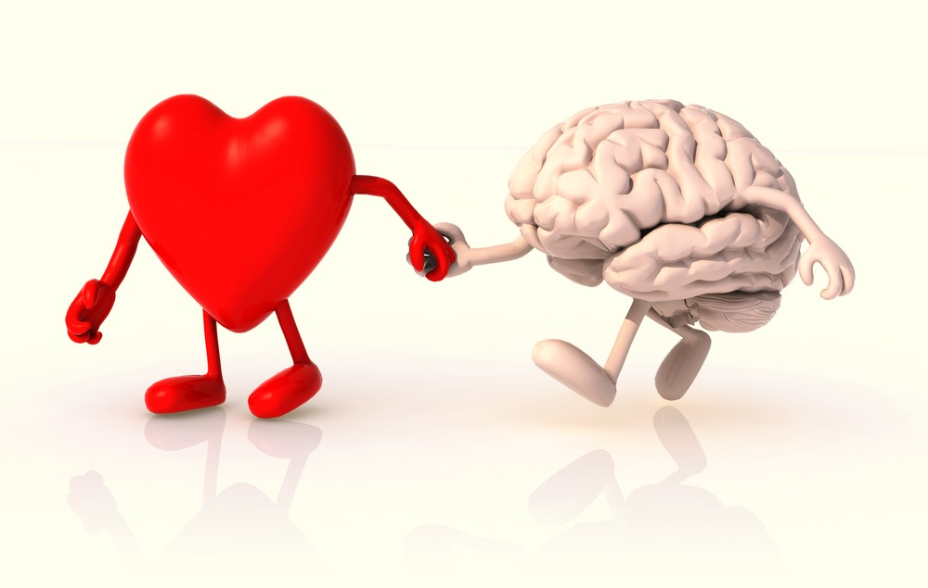
2. Feel
Get beyond your feelings about the person or the situation.
Think about realistically.
The emotional reaction is the judgment, and in truth, it’s not connected with the experience itself.
Why would we gain or change if we think negatively about the situation or the person?
Why can’t we try to put the negative on the side and find a solution instead?

Slide 8
3. Embrace without resistance
Allow yourself to experience the emotions without resisting them.
With allowance, try to open up about those emotions fully appropriately!

Slide 9
4. Tell the truth
Be honest with your own self about how you should truly react regarding the person or the situation that you are facing.
Accept the truth when you follow this specific step.

Slide 10
5. Teaching our child how to accept
When you teach your child acceptance, since it’s a very important principal, you will automatically feel that you are practicing a problem solving strategy.

