Slide 2
Review basic research skills
Reliable Sources
Necessary Information
Taking notes

Slide 3
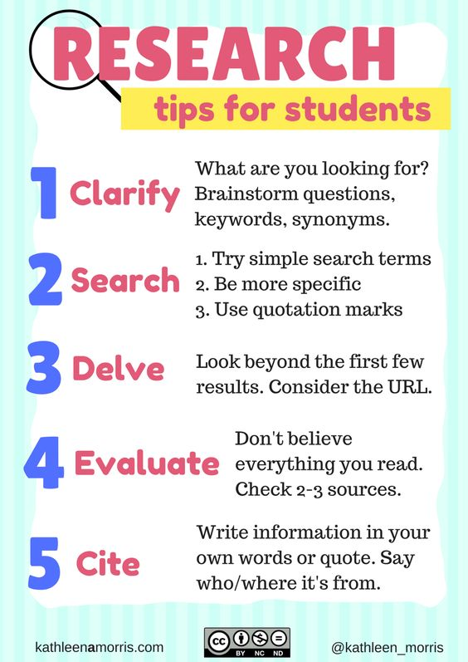

Slide 4
Research information on biomes around the world.
Choose a biome you will research in depth.
After researching basic information, you will create a travel brochure.
Sell your biome to tourist to visit

Slide 5
Create a presentation using PowerPoint from your Classlink.
Research facts on your biome;
Location in the world
Climate and weather
Land Features
Plants and trees
Animals
Fun facts you learned
Include pictures for each of the above facts about your biome.

Slide 6
Land Biomes
Kids Discover Biomes
Biomes

Slide 7
BIOMES:
Tundra
Rainforest
Savanna
Taiga
Temperate forest
Temperate grassland
Alpine
Chaparral
Desert
Marine
Wetlands

