Slide 1
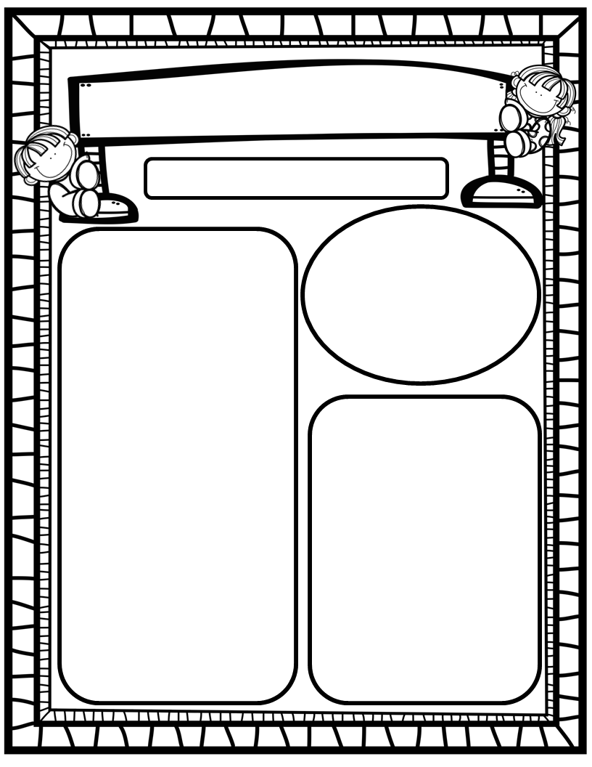
Manuel’s Weekly Blast
January 22nd, 2024
Homework:
Read to and with your child each night/Record books on Reading Rally Logs
Go Math Practice pages for Chapters 1-8
Practice the HFW’s: a, and, I, the, is, in, as, said, do, to, of, see, be, he, me, from, look, are, was, yes
Talk with your kiddos about what they are learning by going over their weekly papers and behavior grades with them!
We Are Learning About…
Reading: We will focus on letters Jj and Yy (identification, mouth placement to make sounds, blending/sounding out words containing these letters), and sight words was, yes. We will continue to compare/contrast two versions of the same story. Weekly Question: How are two versions of the same story the same? How are they different? Which version do you like better?
Writing: We will print letters, sight words, as well as our first names! We will stretchy-spell our words and write to describe our favorite versions of beloved stories!
Math: We will begin GoMath Ch. 8: Count, Represent and Compare Numbers Through 20!
Science: We will continue Unit 7: Force and Motion!
Social Studies: We will review I-Care Rules and our Hawks Rise Character Trait: Cooperation! We will continue learning about Dr. Martin Luther King Jr.!
Important Dates:
January 22-26: Celebrate Literacy Week-More info in weekly email
February 1: 100th Day of School (changed due to storm day)
February 7: Scholastic Book Clubs Order Due

