Slide 1
Unit 4: 1450-1750
Age of Exploration: The Hemispheres Unite!

Slide 2
History in Review
Period 1- 8000-600 BCE: Foundations of history
Humans move out of Africa, start forming societies
Period 2- 600 BCE-600 CE: Classical history
Major world religions founded
Development of world empires
Beginning of interregional trade
Period 3: 600-1450 CE: Post-classical history
Collapse of Period 2 Empires and emergence of new powers (Muslims & Mongols)
Expansion of trade networks & migrations

Slide 3
Big Picture- Period 4
Transatlantic connections
First time we can talk about “world” history
VAST expansion of interregional exchange
COLUMBIAN EXCHANGE
New labor systems
Maritime and land-based (“gunpowder”) empires
Europe’s time to shine

Slide 4
Globalizing networks of communication & exchange
China: Zheng He - last great explorer (1371-1433)
Could have been 1st to discover Americas
Ming Dynasty pulls inward, rejects exploration
Europe: big man on campus
Goes to Africa, Asia, Americas
Beginning of European colonization
Notes:
Key Concept 4.1 Starts here

Slide 5
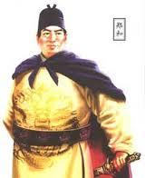

Slide 7
Factors that led to European expansion
Advances in technology
New tools from Asia (astrolabe, magnetic compass, better maps)
New ship designs (caravel)
Need to expand trade routes
Fall of Constantinople to Ottomans in 1453 = bad news for Christian traders
Religious motivations
Protestant Reformation in 1517
Catholic rulers want to expand Catholicism

Slide 8
Why Portugal and Spain First?
Located near ocean
Need to get around Italian grip on Mediterranean
Go west and south!

Slide 9
Portugal Goes South
1418: Prince Henry the Navigator starts a school to teach navigators to sail down west coast of Africa
1488: Bartolomeo Dias sails around Cape of Good Hope
1498: Vasco de Gama reaches India by ocean (1st European)
Kongo, Angola, and Swahili City States all fall to Portuguese rule

Slide 10
Spain Goes West
Christopher Columbus really wants to find glory at sea
Thinks he can sail west to reach Asia (India)
Basically everyone else in the world thinks he’s an idiot
King Ferdinand and Queen Isabella say “eh, why not?”
October 12, 1492: Lands somewhere in Caribbean
Discovers gold on island of Hispaniola- ensures Spaniards will be back

Slide 11
Spain in Americas
Conquer Aztecs and Incas
1521: Hernan Cortes- Aztecs
1532: Francisco Pizarro- Incas
Both men used gunpowder, horses, disease and disgruntled locals to overthrow massive empires
*** Columbian Exchange ***
Crash course video

Slide 13
Europe Goes East
Everyone wants in on the Asian game
Trade American gold & silver for Asian goods
Joint-stock companies formed
British East India Company – 1600
Dutch East India Company – 1602
Dutch West India Company- 1621
French East India Company- 1664
**Mercantilism**- main economic system in Period 4
You want a positive flow of wealth into your country
Zero-sum game with other countries

Slide 14
Spread and Blend of Religions
Christianity spread through Asia and Americas
Syncretic religions:
Vodun (vodou) in Caribbean
Cult of saints in Latin America
Sikhism

Slide 15
Innovations in Art
Renaissance
Italian merchants who were rich off trade could afford to pay artists to make art
Renaissance is born
Innovations in art (1-point linear perspective, depth, anatomy, engineering, etc)

Slide 16
New forms of social organization and modes of production
Social organization
Family size and composition
Social classes change
New races of people creates
Modes of production
Expanded trade & Columbian exchange = big changes
Notes:
Key Concept 4.2 Starts here

Slide 17
Intensification of peasant labor
Indian production of cotton goods
East India Company – 1690s
Cultivation & production in West India
Russian peasants
Settle Siberia
Serfdom
Europe- putting-out system

Slide 18
Coerced Labor
Chattel slavery
Africans imported to Americas
Indentured servitude
Europeans brought for ~ 7 year terms
Encomienda and hacienda system
Labor in exchange for protection and Christian instruction
Mit’a

Slide 19
Existing Elites- Daimyo
Japanese equivalent to European nobility
Enjoyed great freedom until Tokugawa period or Edo Period (1603-1868)
Tokugawa shogunate reined in daimyo
Laws restricting: dress, behavior, marriage, weaponry, etc
Forced to live in Edo (capital) every other year
Forced to contribute to public works projects

Slide 20
New Elites- Manchus in China
Manchu people
Northeastern China
Mix of Jurchen, Mongolian, and Han Chinese
Manchu (Qing) Dynasty
Conquer Ming Dynasty between 1644 and 1673
Took over government
Ethnic minority takes over Chinese government
Adopted Confucianism and Mandate of Heaven

Slide 21
Gender & Family Restructuring
European men depend on Southeast Asian women for trade in that region (Malay Peninsula, Indonesia, Philippines)
Matriarchal societies
Wealth passed from man to woman in marriage
Women were educated, allowed to engage in finance
Trade run by women
Women worked outdoor markets
Engaged in long-distance trade
Wealthiest women controlled mini trade empires

Slide 22
New Ethnic and Racial Classifications
Peninsulares- Iberian Spaniards
Criollos- Descendents of Peninsulares
Mestizos- European/Native American
Mulattoes- European/African
Native Americans
Slaves

Slide 23
Continuities in the Global Networks of Exchange
Period 4 is not “all Atlantic, all the time”

Slide 24
Continuities in Religion
Islam continues its spread across Sub-Saharan Africa and into East and Southeast Asia (Indonesia and Philippines)
Buddhism moves across SE Asia and into parts of Central Asia
Hinduism is core in India

Slide 25
Continuities in Trade
Indian Ocean trade continued to thrive
European merchants could only joined if they cooperated with the local rulers of the port cities because they couldn’t dominate this long-established organization
Atlantic trade volume eventually surpassed the Indian Ocean trade

Slide 26
Continuities in Agriculture
Most people in the world were STILL farmers – most growing just enough for their families to live on with a little left over to sell
Others grew a single crop to be exported for food (initial commercial farming)
Changes occurred because of the flood of new foods from the Americas

Slide 27
Continuities in Migrations
Just before 1492 most mass migrations had ended
Hawaii inhabited by 900
Tahiti by c 1300
Bantu Migration near end – built Great Zimbabwe

Slide 29
Review Questions

Slide 30
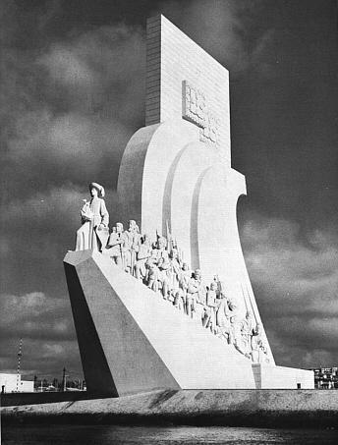
The “Monument of the Discoveries” designed for the 1940 World’s Fair in Lisbon, Portugal shown in the picture above uses monumental architecture to reflect national pride in
Zheng He’s voyages in the Indian Ocean which enhanced Chinese prestige.
Prince Henry’s school of navigation that led to increased travel and trade in Africa.
Columbus’ journey to the Caribbean which began the process of imperialism in the Americas.
John Cabot’s explorations of the North Atlantic and journey to what is now modern Canada.
Notes:
B

Slide 31
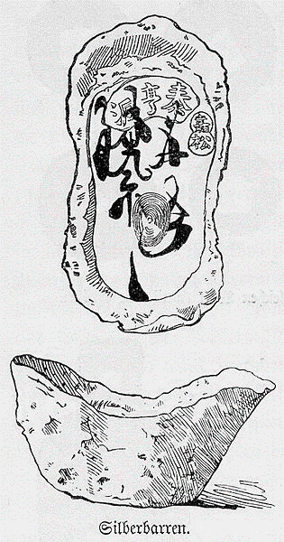
This engraving by a German artist depicts a Ming Dynasty currency called a “tael” that was produced with metals acquired from the newly opened Spanish colonial mines. The engraving best illustrates which of the following features of 18th century economic trade?
Joint-Stock Companies
The Columbian Exchange
Global Circulation of Silver
Japanese Daimyos
Notes:
C

Slide 32
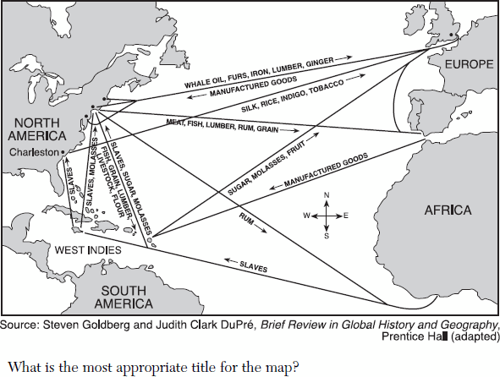
Which of the following historical cultural developments was a direct consequence of the trade networks seen in the map above?
Renaissance art in Europe
Spread of Islam to new regions
The Protestant Reformation
Syncretic religions of the Caribbean
Notes:
D

Slide 33
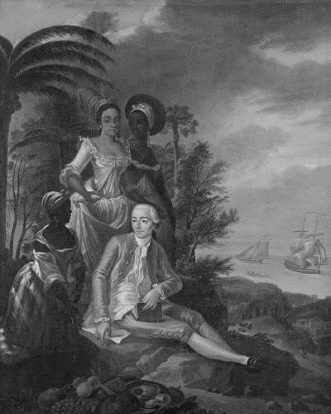
The portrait of Louis Francois Roger Armand Gatereau, a French newspaper editor, on the island of Saint Dominique would best be used by a historian to demonstrate which of the following changes caused by global interactions during the latter eighteenth century?
Transformations in diets that resulted from the Columbian Exchange.
Innovations in visual art during the time of the Renaissance.
Restructuring of gender and racial relationships in elite society.
Emergence of challenges to French imperial control of colonial society.
Notes:
C

Slide 34
Prompt: Discuss the similarities and differences between the reactions of the Russian and Japanese political elite to the West/Westerners from 1450 - 1750.
LEQ:

Slide 35
Prompt: Discuss the changes and continuities between the first age of overseas expansion in the 16th century and the second age of overseas expansion in the 19th century. Discuss the impact on ONE of the following areas: Africa South Asia The Americas East Asia
LEQ:

