Slide 1
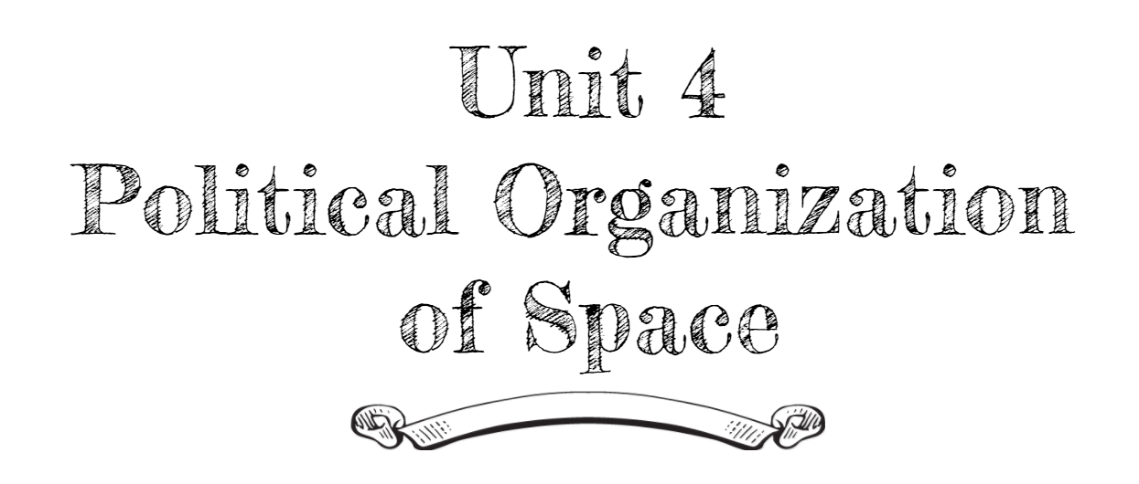
By: Carli Terrell (Orlando, Florida)
This PPT has been created using the information from the AMSCO Human Geography: Preparing for the Advanced Placement Examination book.
Palmer, David. AMSCO Advanced Placement Human Geography. Perfection Learning, 2019.

Slide 2
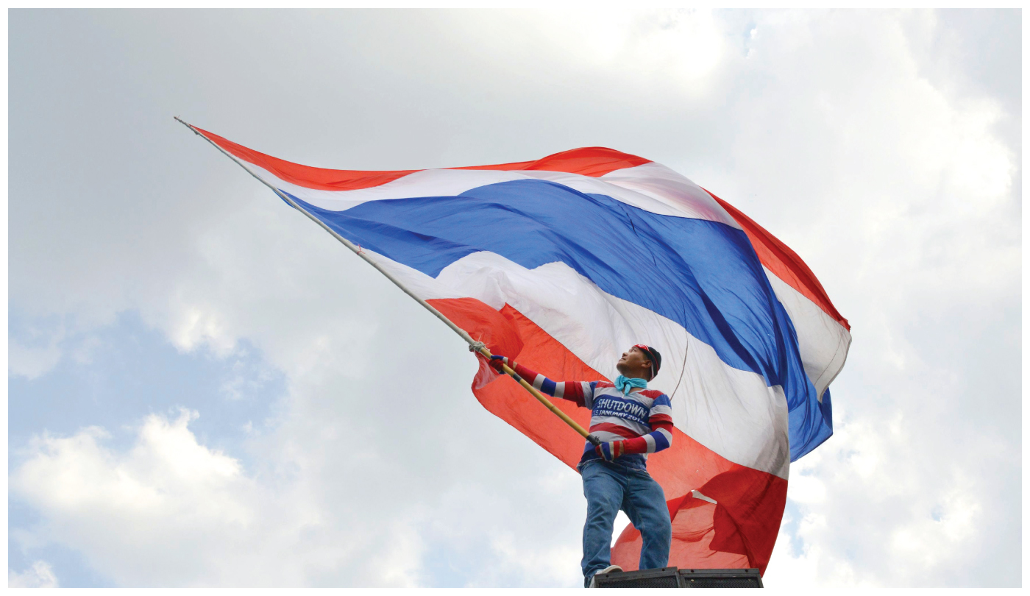
Unit 4 – political organization of space
Ch 9: the shape of the political map
Notes:
http://www.pbs.org/thelinguists/For-Educators/Video-Extras.html

Slide 3
Enduring Understanding (4.A)
By the end of this section, you will understand that the contemporary political map has been shaped by events of the past.

Slide 4
[Soviet] General Secretary Gorbachev, if you seek peace, if you seek prosperity for the Soviet Union and Eastern Europe, if you seek liberalization, come here to this gate. Mr. Gorbachev, open this gate. Mr. Gorbachev, tear down this wall!
-President Ronald Reagan, speech, 1987

Slide 5
Essential Question
What social, historical, and economic factors have influenced modern political maps at various scales?

Slide 6
Learning objective (4.a.1.a)
By the end of this section, you will be able to explain the structure of the contemporary political map.
Independent states are the primary building blocks of the world political map.
Types of political entities include nations, states, nation-states, stateless nations, multinational states, multistate nations, and autonomous regions.

Slide 7
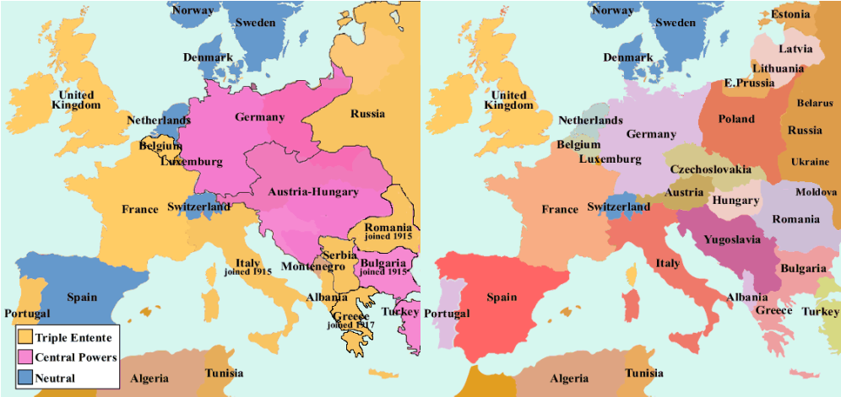
Contemporary political map
Empires and kingdoms were common in most of the world for the past two thousand years.
Global forces, wars, and changing ideas about political power, economics, and self-rule have reshaped the world map over the last 400 years.

Slide 8
Contemporary political map Structure
Independent States as Building Blocks
Political units exist at various scales: town or city, county, state, a country, etc.
Redefining state: the largest political unit – formal term for a country
Must meet these four requirements
Defined boundary
Permanent population (Antarctica)
Maintains sovereignty (Puerto Rico)
Recognized by other states (Kosovo and Somaliland)

Slide 9
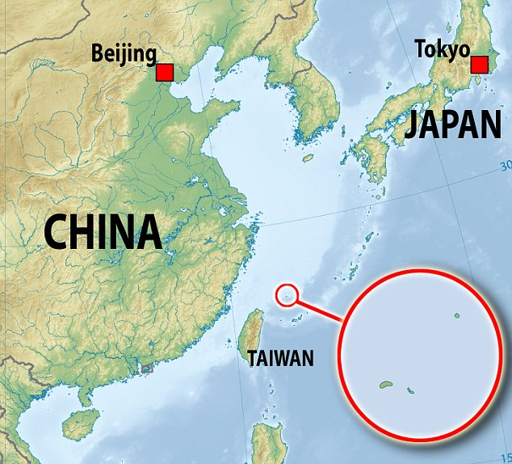
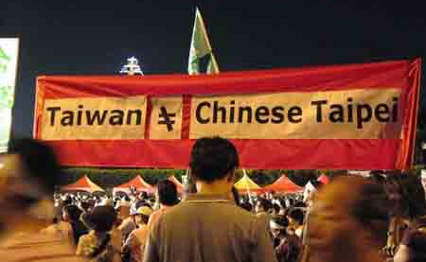
Contemporary political map Structure
Sovereignty is the power of a political unit to rule over its own affairs.
In order for a political unit to have legitimacy, it must have sovereignty.
May be challenged on the local or global scale
China’s claim that Taiwan is nothing more than a renegade province is a direct challenge to Taiwan’s sovereignty.
Taiwan does not fully meet the third and fourth criteria.

Slide 10
Learning objective (4.a.1.b)
By the end of this section, you will be able to explain the structure of the contemporary political map.
Independent states are the primary building blocks of the world political map.
Types of political entities include nations, states, nation-states, stateless nations, multinational states, multistate nations, and autonomous regions.

Slide 11
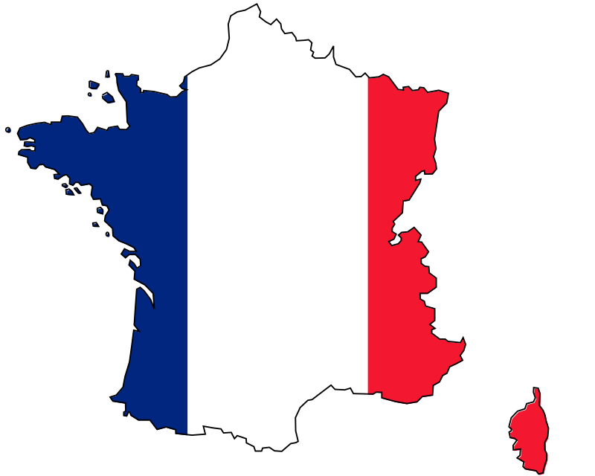
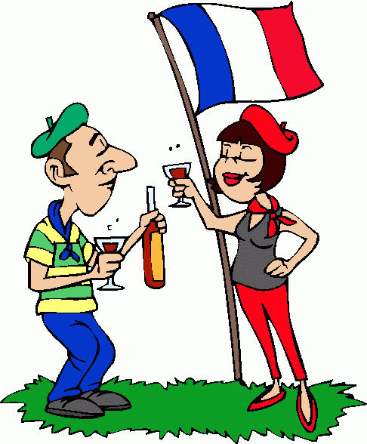
Contemporary political map Structure
Types of Political Entities
Nation
A group of people that share a common cultural heritage
Have beliefs and values that help unify them
Claim a particular space based on tradition as their homeland
Desire to establish their own state or express self-determination in another way
So France is the state and the French are the nation.
State
Nation

Slide 12
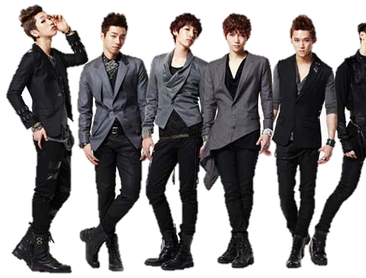
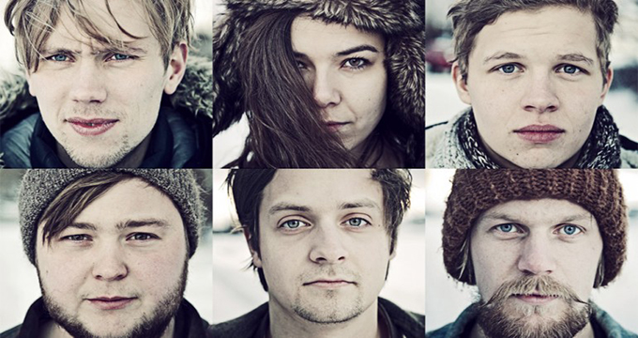
Contemporary political map Structure
Types of Political Entities
Nation-State
A singular nation of people who fulfill the qualifications of a state.
Iceland
94% of population is Icelandic.
Scandinavian settlers founded Iceland on an island that had no indigenous population.
Japan
99% of population are Japanese.
A strong national identity coupled with strict immigration policies have maintained Japan as a nation-state.

Slide 13
Contemporary political map Structure
Types of Political Entities
Nation: the people
State: the country
Nation state: the country with almost all one nation.
Nation
State
Kurds
Catalans
Belgium
Nigeria
Nation- State
Japan
France
Iceland
USA
The French

Slide 14
Contemporary political map Structure
Types of Political Entities
Multinational States
A country that contains more than one nation.
One dominant nation that controls most political power.
Example: Canada
English speakers dominate but 25% speak French
Most live in Quebec
To prevent Quebec from demanding independence, the national government passed laws giving Quebec local autonomy in government and education.
Nunavut: indigenous Inuit region of Canada

Slide 15
Contemporary political map Structure
Types of Political Entities
Autonomous Region
A defined area within a state that has a high degree of self-government and freedom from its parent state.
Usually granted to geographically, ethnically, or culturally distinct areas.
Example: Åland (Aw-land) is a group of islands in the Baltic Sea; part of Finland but lies near Sweden; most residents are Swedish and speak that language. After WWI, Åland asked the League of Nations if they could join Sweden but they ruled that they would remain a non-militarized, largely self-governing entity that belongs to Finland.

Slide 16
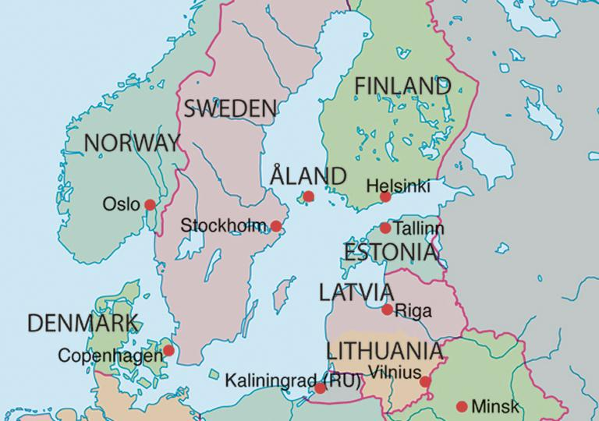
Contemporary political map Structure

Slide 17
Contemporary political map Structure
Types of Political Entities
Stateless Nation
Far more nations than states = many nations do not have a state of their own
Often have a political organization, however
A cultural group that has no independent political entity
Seeking to become independent
Palestinians (Gaza Strip and Occupied West Bank)
Basque (NE Spain and SW France in the Pyrenees mountains)
Kurds – largest stateless nation (Turkey, Armenia, Iraq, Iran, Azerbaijan, and Syria)

Slide 18
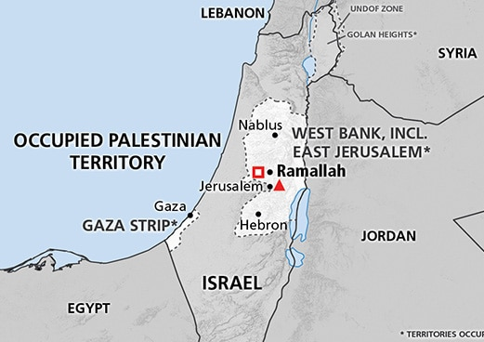
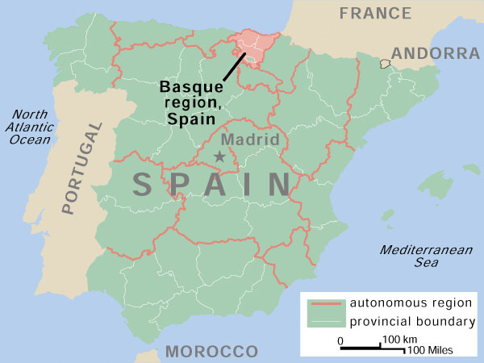
Contemporary political map Structure

Slide 19
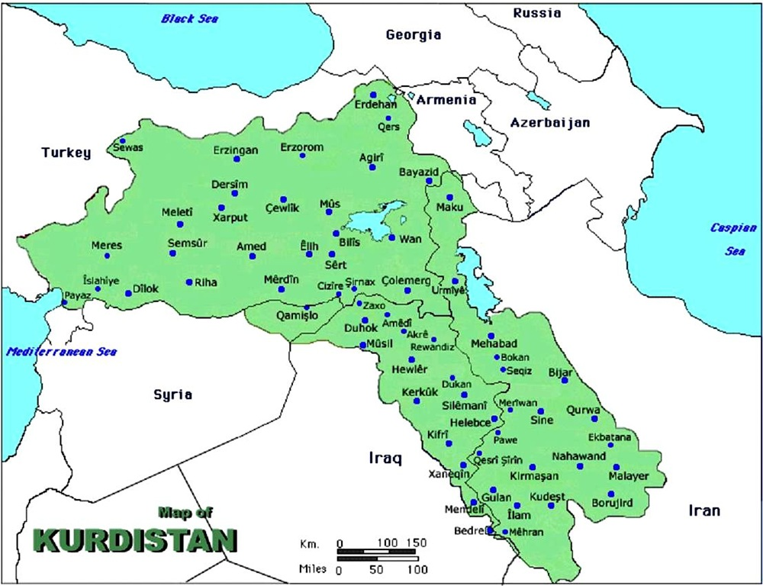
Contemporary political map Structure

Slide 20
Contemporary political map Structure
Types of Political Entities
Multistate Nation
Occurs when a nation of people has a state of its own but stretches across borders of other states.
Examples
Most Hungarians live in Hungary but many live in the Transylvania region of Romania
The Korean nation is divided mostly between North and South Korea but there is a large number in China and the United States

