Slide 1
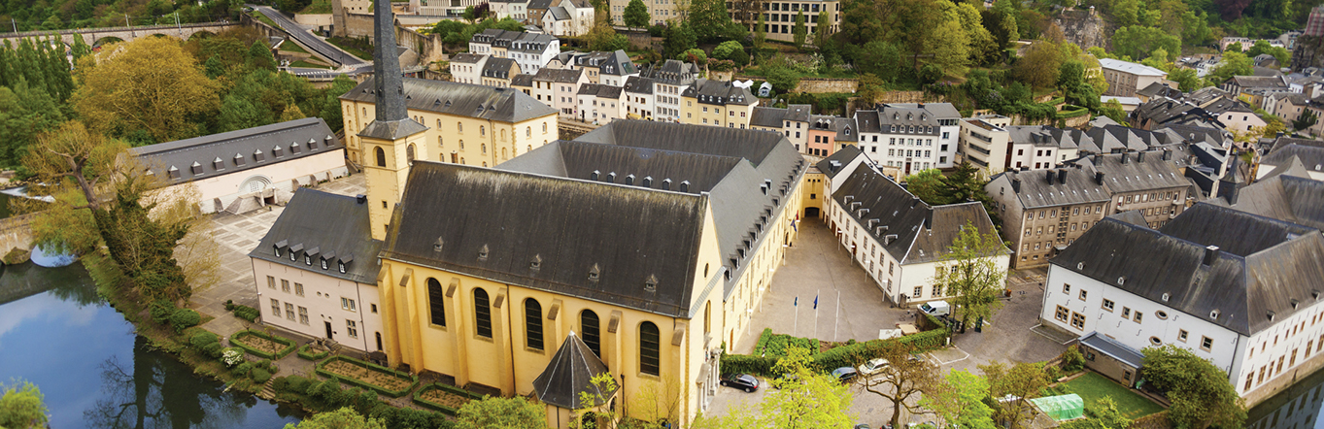
Unit 1 – Part 1
geography – its nature and perspectives

Slide 2
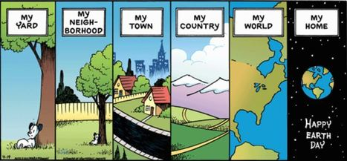
Enduring Understanding (1.A)
By the end of this section, you will understand that geography, as a field of inquiry, looks at the world from a spatial perspective.

Slide 3
Learning objective (1.A.1)
By the end of this section, you will be able to explain the importance of geography as a field of study.
Geographic information provides context for understanding spatial relationships and human-environment interaction.

Slide 4
Part I: The spatial perspective
Essential question: How does the way geographers look at the world differ from that of others scientists?

Slide 5
Part I: The spatial perspective
Geography is the why of where.
Why are things where they are?
How did things become distributed as they are?
What is changing the pattern of distribution?
What are the implications of the spatial distribution for people?

Slide 6
5 Themes of geography
Location
Place
Region
Interaction
Movement
Where? (most basic question)
How can this location be described?
With what other locations does this place share certain characteristics?
How have humans and the environment affected each other in this location?
How has this location been affected by the flow of people, goods and ideas?
Notes:
Insert a map of your country.

Slide 7
5 Themes of geography
Movement
Region
Location
Interaction
Place
= “Mr. Lip”
Notes:
Insert a picture of one of the geographic features of your country.

Slide 8
Geography as a field of study
Geography (Greek)
Geo- (earth)
-graphy (writing)
Subfields
Physical – elements of the physical environment (weather and climate)
Human – spatial characteristics of humans and human activities

Slide 9
Geography as a field of study
Subfields of Human Geography
Population – health, births, migration, etc.
Culture – language, religion, popular music, etc.
Economics – agriculture, level of development, wealth, etc.
Urban areas – cities, suburbs, challenges from growth, etc.
Political - local government, nations, distribution of power, etc.

Slide 10
Early history of geography
Greeks and Romans were first in western Eurasia
Homer’s Iliad and Odyssey
Aristotle observed Earth’s features and how they influenced human behavior
Eratosthenes used geometry to calculate Earth’s circumference and coined the term geography
Ptolemy, 500 years after Eratosthenes, summarized Greek knowledge of geography, including locations and sizes of continents; dominated European thought for 1,000 years.

Slide 11
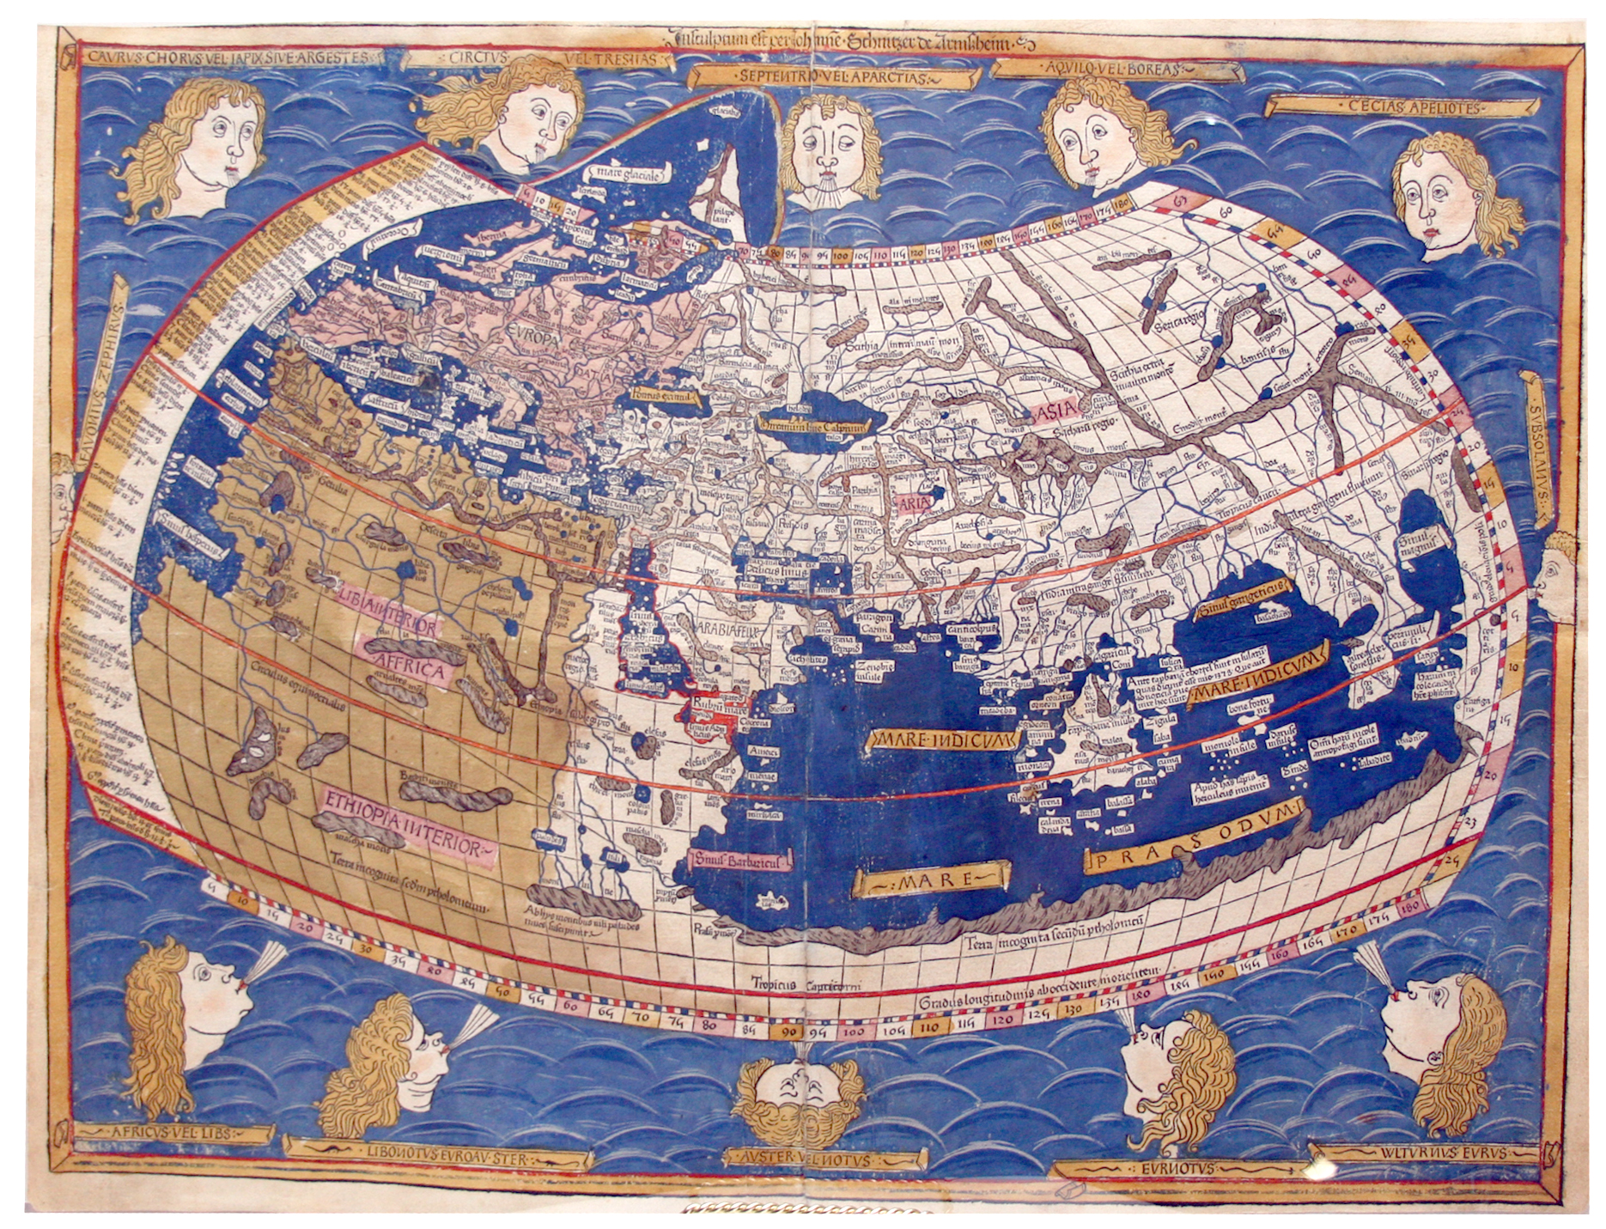

Slide 12
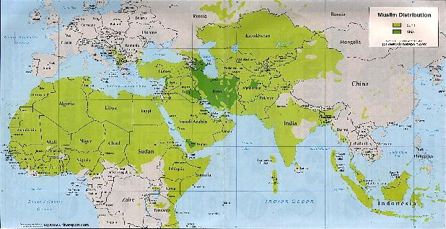
Early history of geography
European Middle Ages
Europeans rarely ventured outside their region but Muslim culture flourished in the Middle East and North Africa.
Built strong trading ties with Africa and East Asia.

Slide 13
Modern history of geography
Age of Exploration
Christopher Columbus (1492) launched a new era in exploration, mapping, and description.
Gerardus Mercator – created a world map for sailors and is still widely used today
More Recently
Carl Sauer (1889-1975) expanded the focus of geography beyond physical traits of the earth to include human activity

Slide 14
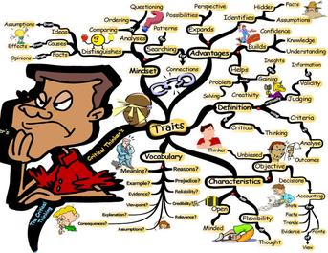
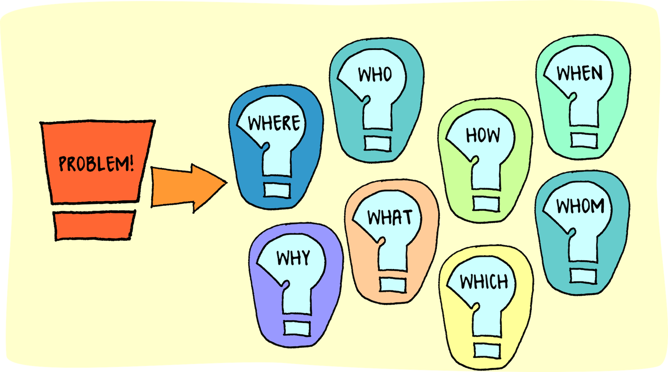
Enduring Understanding (1.B)
By the end of this section, you will understand that geography offers a set of concepts, skills, and tools that facilitate critical thinking and problem solving.

Slide 15
Learning objective (1.B.1)
By the end of this section, you will be able to explain major geographical concepts underlying the geographic perspective.
Geographic concepts include location, place, scale, space, pattern, nature and society, networks, flows, regionalization, and globalization.

Slide 16
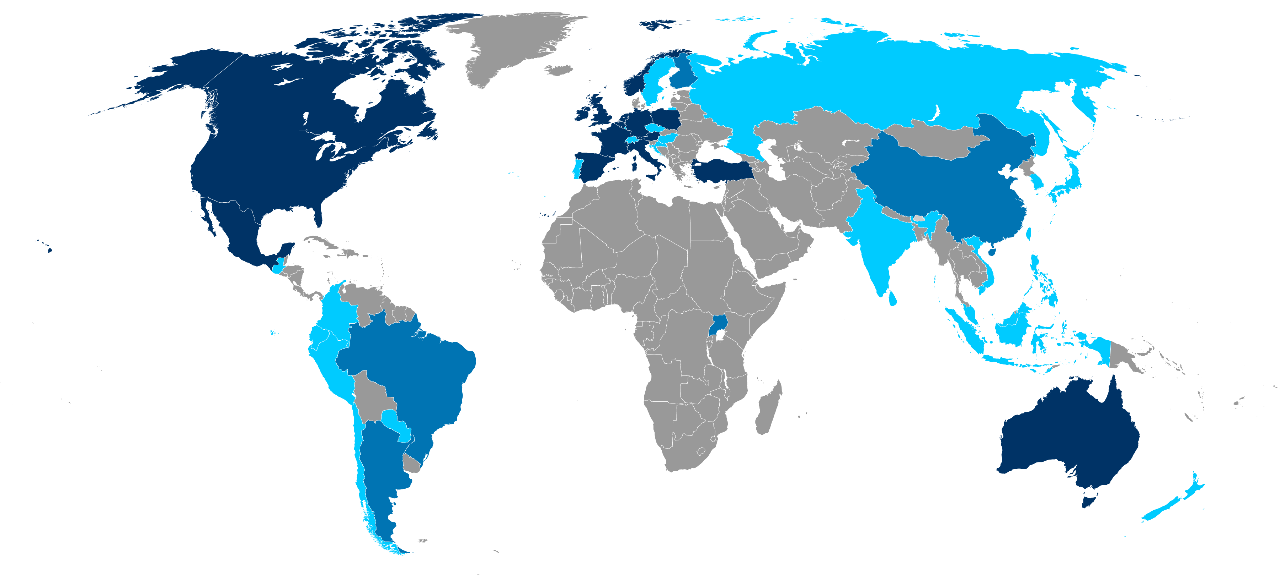
Geographical Concepts
Historians look through the lens of time to understand the past.
Geographers look through the lens of space to understand place.

Slide 17
Location
Absolute location
Absolute location - the precise spot where something is according to some system
Most widely used: latitude and longitude
Latitude: distance north or south of the equator (0° lat)
Longitude: distance east or west of the prime meridian (0° long)
Prime meridian passes through Greenwich, England
International Date Line (180° long)

Slide 18
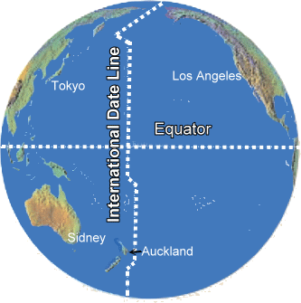
Location

Slide 19
Location
Relative location
Relative location - where something is in relation to other things
Example: Salt Lake City, Utah is located just south of the Great Salt Lake and just west of the Rocky Mountains
Often described in terms of connectivity (how well two locations are tied together by roads or other links) and accessibility (how quickly and easily people in one location can interact with people in another location)

Slide 20
Location
Relative location
Can change over time and as accessibility changes
Example: ghost towns (abandoned settlements) of the western United States once had relative locations near water sources (which dried up), along trade routes (which changed), or near mines (which closed).
Their relative locations lost the advantages (resources or trade) but their absolute locations remain the same.

Slide 21
Place
Place
Place refers to the specific human and physical characteristics of a location.
A group of places in the same area that share a characteristic form a region.
Two ways to refer to place: site and situation
Site: characteristics at the immediate location (soil type, climate)
Situation: location relative to surroundings

Slide 22
Place
Place
Sense of place – humans tend to perceive the characteristics of places in different ways based on their personal beliefs.
Example: the characteristics of Rome, Italy, might be described differently by a local resident than by an outsider or by a Catholic than by a Hindu.
If a place inspires no strong emotional ties in people, it has placelessness.

Slide 23
Place
Place
Toponyms – place names
Some provide insights into the physical geography, the history, or the culture of the location
Example: coast of Florida (beach names), Salt Lake City, Los Angeles
Some can be confusing (Iceland and Greenland) while some are deceiving (Lake City, Iowa not on a lake and Mount Prospect, Illinois is only 665 ft above sea level)

Slide 24
Distance
Distance is the measurement of how far or how near things are to one another
Proximity indicates the degree of nearness
Meters, miles, kilometers, etc.
Straight line distance (as the crow flies) or travel distance
Example: Milwaukee to Kalamazoo is 130 miles by air but 250 miles by car

Slide 25
Distance
Distance and Time
Time-space compression is the shrinking “time distance” between locations because of improved methods of transportation and communication
Example: New York and London are separated by an ocean, but the development of air travel greatly reduced travel time between them and now feel much closer today than in the 19th century
Result: global forces are influencing culture everywhere and reducing local diversity more than ever before

Slide 26
Distance
Distance and Connection
Spatial interaction refers to the contact, movement, and flow of things between locations – physical (through roads) or information (through radio or Internet)
The increasing connection between places is reflected in the growth of spatial interaction
The friction of distance indicates that when things are farther apart, they tend to be less well connected
This inverse relationship is called distance-decay

Slide 27
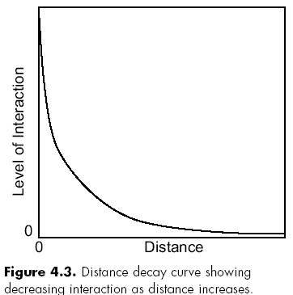
Distance
Example: the weakening of a radio signal as it travels across space away from a radio tower – friction of distance causes the decay, or weakening, of the signal.
Improvements in transportation, communication, and infrastructure have reduced the friction as they have increased the spatial interaction.

Slide 28
Density and distribution
Density
Density is the number of something in a specifically defined area
Population density is the number of people per square mile – count the people and divide by the area
Psychological density – in a full elevator, one person may think it feels fine while one person feels uncomfortable

Slide 29
Density and distribution
Distribution
Distribution is the way a phenomenon is spread out over an area
Clustered or sparse
For example, two city blocks with the same density (amount of people) might have very different distributions – evenly spread out vs. high-rise apartment and empty park
Geographers look for patterns in distribution: linear (towns along a railroad line), circular (homes of people who shop at a store), geometric (squares formed by roads), or random (pet owners)

Slide 30
Density and distribution
Distribution
Matching patterns of distribution is called spatial association and indicates that two (or more) phenomena may be related, or associated with one another
Example: the distribution of malaria matches the distribution of the mosquito that carries it (be careful – correlation does not mean causation)
Example: distribution of bike shops in a large city might be similar to the distribution of athletic wear stores. One does not cause the other but may reflect the distribution of active people

Slide 31
Human-environmental interaction
The relationship between humans and the natural world are at the heart of human geography
The connection and exchange between them is called human-environmental interaction – specifically sustainability, pollution, and environmental issues

Slide 32
Human-environmental interaction
Cultural ecology: the study of how humans adapt to the environment
The belief that landforms and climate are the most powerful forces shaping human behavior and societal development is called environmental determinism
In the 19th and early 20th centuries, some people used this concept to argue that people in some climates were superior to those of other climates

Slide 33
Human-environmental interaction
In reaction came the view known as possibilism – a view that acknowledges limits on the effects of the natural environment and focuses more on the role that human culture plays
Different cultures may respond to the same environment in different ways, depending on their beliefs, goals, and available technologies

Slide 34
Enduring Understanding (1.B)
By the end of this section, you will understand that geography offers a set of concepts, skills, and tools that facilitate critical thinking and problem solving.

Slide 35
Learning objective (1.B.2)
By the end of this section, you will be able to use landscape analysis to examine the human organization of space.
Landscape analysis (e.g., field observations, photographic interpretations) provides a context for understanding the location of people, places, regions, and events; human–environment relationships; and interconnections between and among places and regions

Slide 36
Landscape analysis
Landscape analysis is the task of defining and describing land
Observation and Interpretation
The first part of landscape analysis is field observation
Take notes, sketch maps, count, measure, and interview
Before technology, this was the only way to gather data about a place

Slide 37
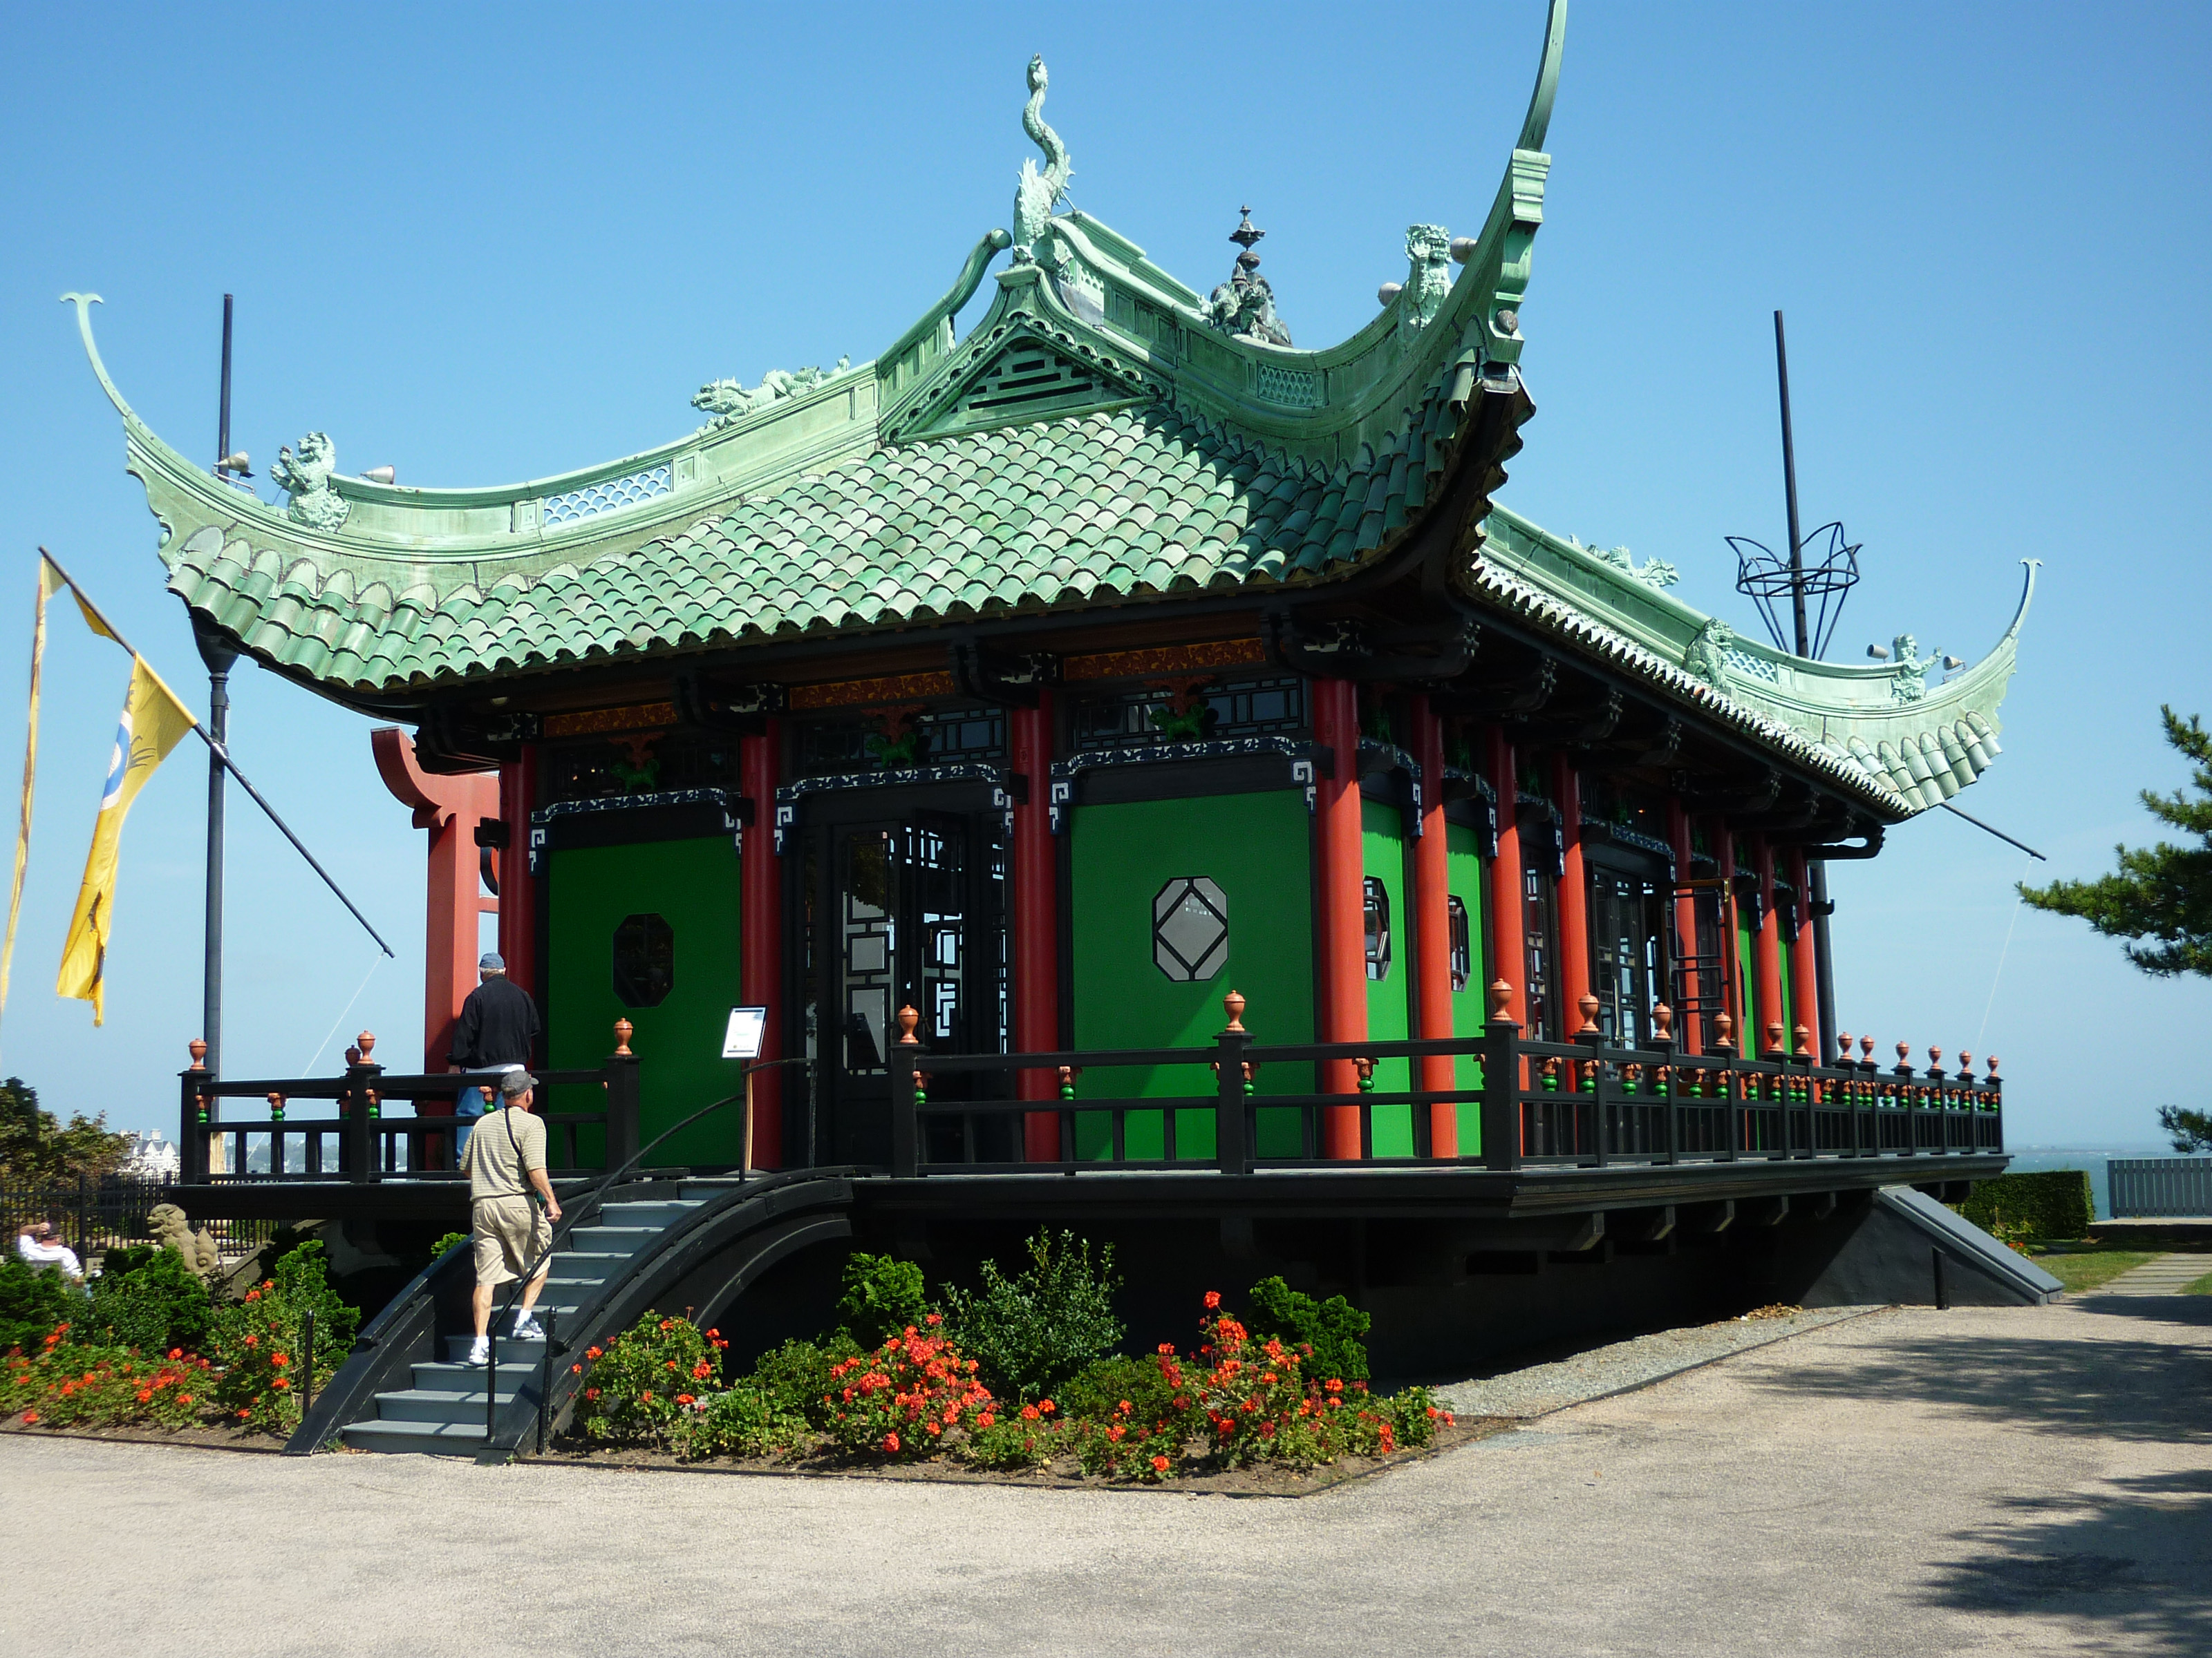
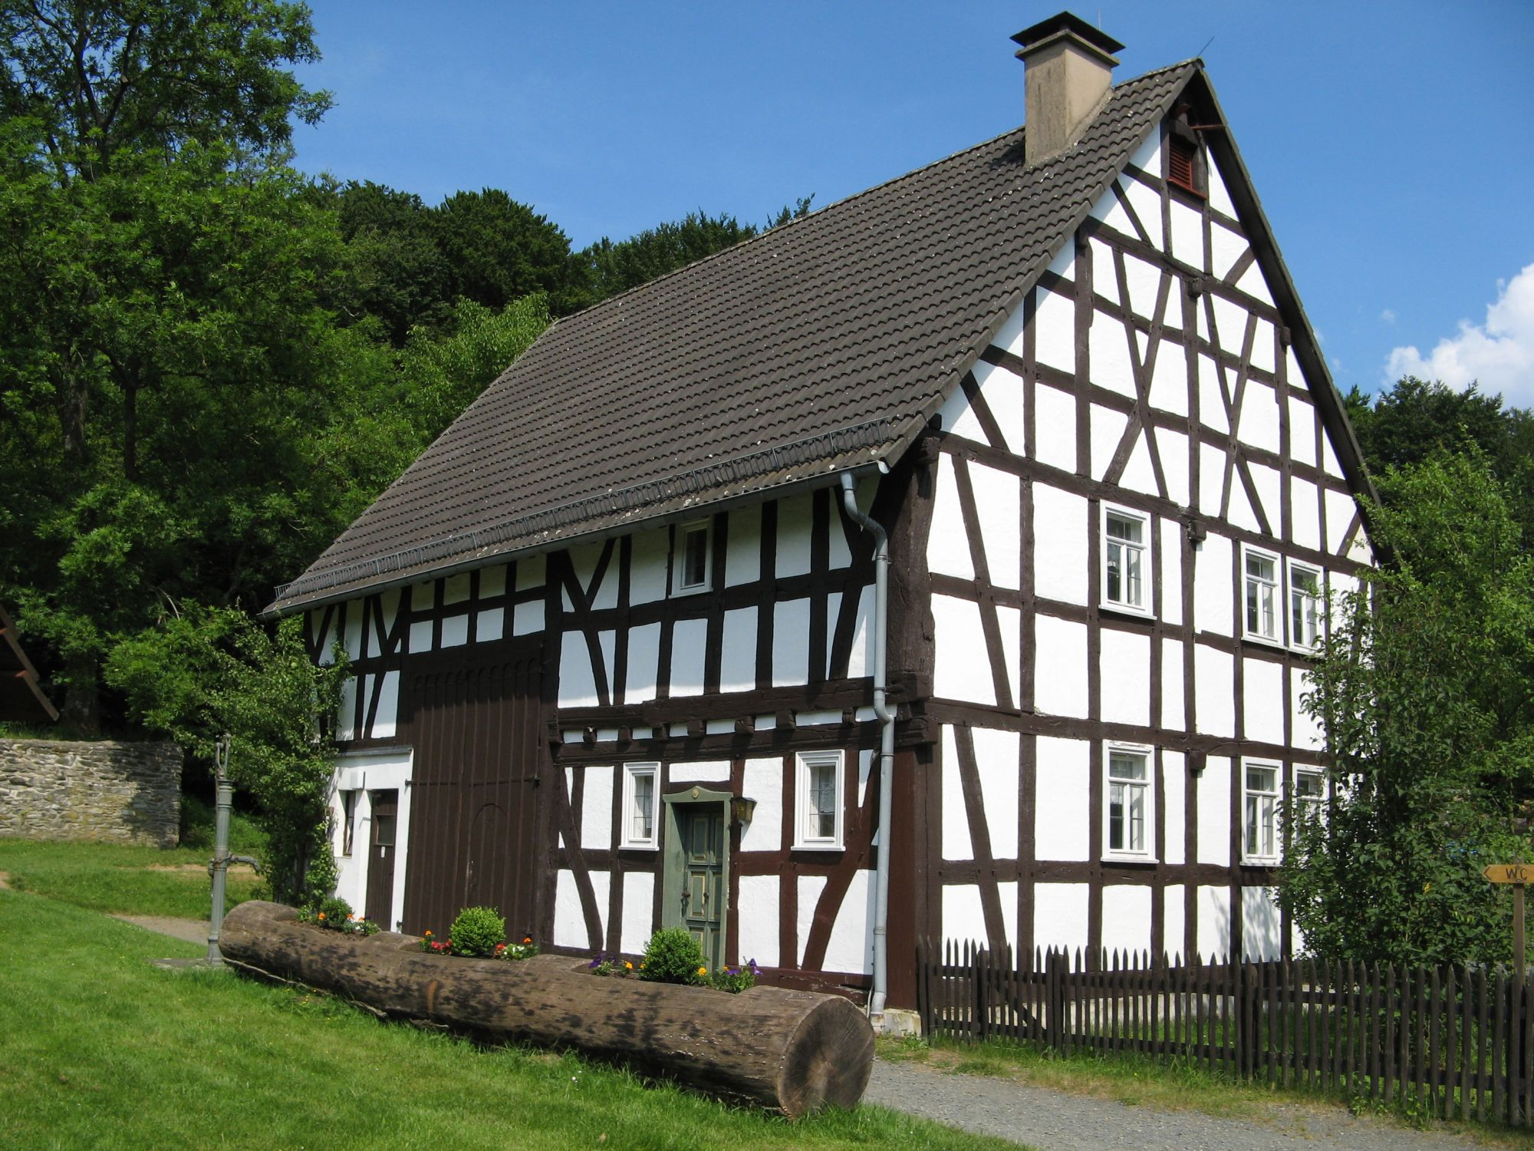
Landscape analysis
Built environment refers to the physical artifacts that humans have created and that form part of the landscape
Examples: buildings, roads, signs, and fences
The built environment varies from place to place (think China vs. Germany)
Anything built by humans is part of the cultural landscape.

Slide 38
Four-level analysis
One systematic way to study geographic phenomena is to use Four-Level Analysis.
Level | Description | Key Questions
1. Comprehension | Establish the basic information clearly | What? Where? When? Scale?
2. Identification | Identify and describe patterns in phenomena | Are phenomena connected?
3. Explanation | Explain how individual phenomena might form a pattern | Why is something where it is? How did it get there?
4. Prediction | Explain why a pattern is important, and predict what it might lead to | So what? What if? What are the effects?

