Slide 1
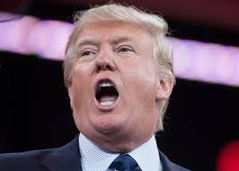
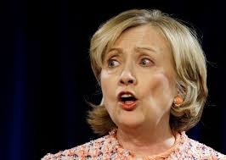
Roman Republic
This is where we came from

Slide 2
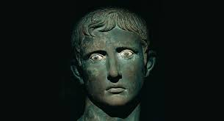
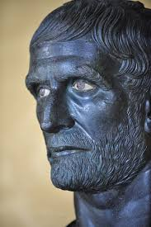
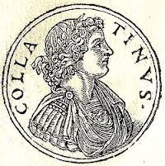
Background
Roman Republic started in 510 BC/BCE, when Romans overthrew their kings
Kings representative of an oppressive foreign power (Etruscans)
Romans granted self rule
No written constitution, sets of guidelines established by precedent
Based around a balance among the one, the few, and the many
Lasted until 27 BC/BCE
Destroyed by a century of civil war and the rise of the first emperor, Augustus
Notes:
One (President) the few (senate) the many (house) in our system? Similarities in our history/ governmental structure?

Slide 3
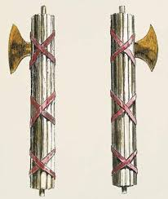
The One: Consuls and the Cursus Honorum
Candidates for office generally came from the highest class in Roman society (patricians)
Magistrates were elected by a committee (comitia tributa)
People running for office wore a special toga whitened by chalk (toga candida)
Romans were supposed to run for offices in a certain order at certain ages
Election to office granted holder admission to Senate and right to wear a toga praetexta
In addition, each office had a set of appointed bodyguards (lictores) who carried axes in bundles of rods (fasces)
Gamut of offices had a name: cursus honorum (lit. “the course of honors”)
Ultimate goal considered the consulship
Cursus honorum still utilized in the early empire
Notes:
Similarities in our electoral system. Why would system still be implemented in the Empire when true political power lay with the Imperial Family in the first place?

Slide 4
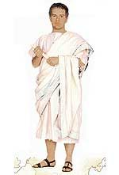
Toga Praetexta Toga Candida

Slide 5
Cursus Honorum: Step 1 Quaestor
Started as prosecutors and murder investigators (come from quaero- to seek)
By the height of the Republic served as treasurers and financial officers
Number elected: 20
Minimum age: 30
Number of lictors: 1
Notes:
Advantages? Disadvantages? Any modern comps?

Slide 6
Cursus Honorum: Step 1.5 Aediles
Responsible for public buildings (aedes- temples), organized games and public festivals, took care of water (sewers and aqueducts) and food supplies
Number elected: 4 (two plebian, two patrician)
Minimum age: 36
Two plebian aediles elected by plebian assembly, two patrician aediles elected by tribal assembly
Not a required step on the cursus honorum, most magistrates ran for it anyone
Notes:
Modern comps? If not required why would people spend TONS of money to run for it?

Slide 7
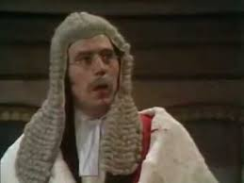
Cursus Honorum: Step 2 Praetor
Originally served as heads of state (praeeo- to go before, lead the way)
By the height of the Republic served as judges
Number elected: 6 to 8
Minimum age: 39
Lictors: 6
Chief/most prestigious praetors were Praetor Peregrinus (chief judge for cases involving foreigners) and Praetor Urbanus (chief justice in Rome)
Praetor Urbanus could overturn any lower court’s verdict and was the judge for cases against provincial governors
Former praetors became governors of Rome’s provinces
Notes:
Any modern comps? Influence on our modern system? Advantages and disadvantages to elective judges

Slide 8
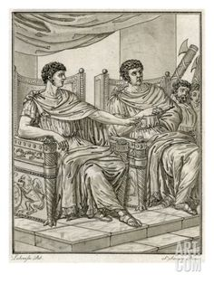
Cursus Honorum: Step the Last Consul
Served as head of the Roman state during the Republic, mere figurehead during the empire
Number elected: 2
Minimum age: 42 (the answer to everything)
Lictors: 12
Carried out decrees and laws passed by Senate and various comitia
Chief diplomats of Rome, could call meetings of the Senate and presided over them
Served as commanders-in-chief of the Roman army
Could only rule by consensus, each consul could theoretically be vetoed by their co-consul
Notes:
Modern comp?

Slide 9
Assorted Other Dudes: Censor
In charge of the five year count (census)
Number elected: 2
Term: 18 months
Elected every five years
Only former consuls were supposed to be able to be censors
Five year census determined societal class based on wealth and organized citizens into tribes
Tribes basis for the voting assemblies

Slide 10
Assorted Other Dudes: Censor
In charge of the five year count (census)
Number elected: 2
Term: 18 months
Elected every five years
Only former consuls were supposed to be able to be censors
Five year census determined societal class based on wealth and organized citizens into tribes
Tribes basis for the voting assemblies

Slide 11
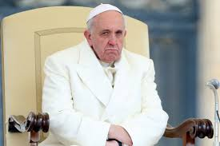
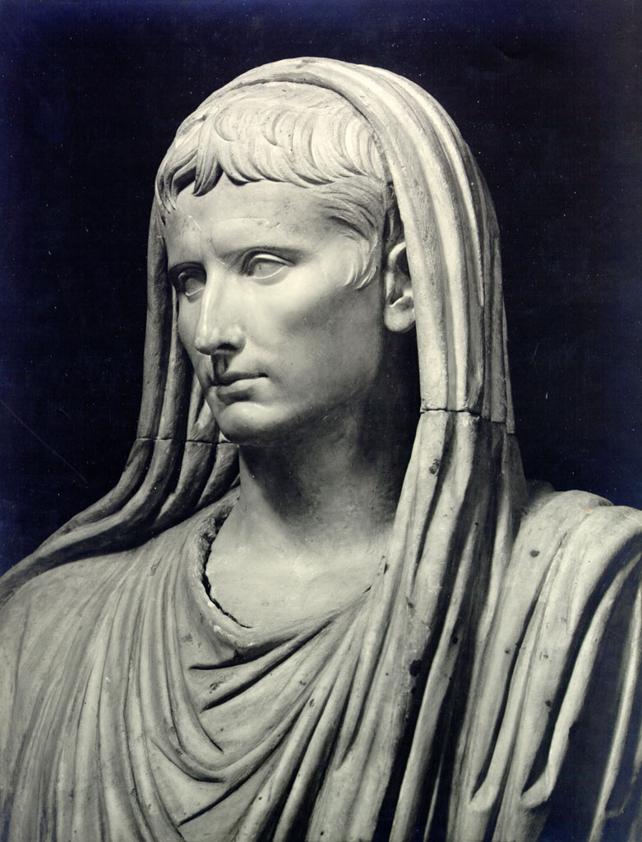
Assorted Other Dudes Pontifex Maximus
Chief priest of Roman state religion
Took over king’s religious duties when kings overthrown in 510
Selected by college of priests (pontifices)
Only patricians could serve as Pontifex Maximus
Served for life
Only magistrate that was given a house by the state (Domus Publica)
Could hold other magisterial positions
Notes:
Drawbacks to this system?

Slide 12
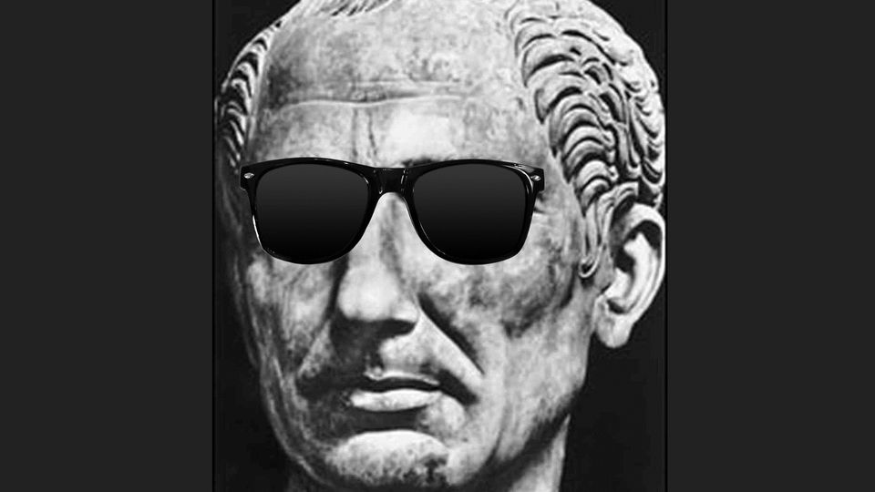
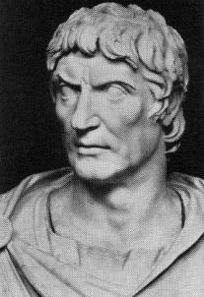
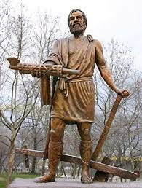
The Ultra Super Special Chosen One: Dictator
Office only used in times of emergencies
Emergencies declared by the Senate
Dictator chosen by consuls
Given absolute power over the state
Lictors: 24
Term of office: Six months or until emergency passed (Cincinnatus)

Slide 13
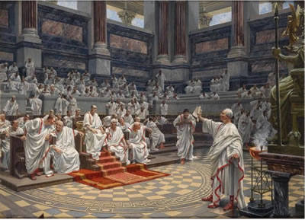
The Few: The Senate
Started as king’s advisory council of elders (senex- old man)
After overthrow of kings, powers greatly expanded
Election to a magistracy conferred automatic membership to senate
Other members appointed by consuls and censors
300-500 members (could expand to more) generally served for life
Gave decrees (senatus consultum) which were “advice” for magistrates on how to do their job
All magistracies (except dictator) were answerable to the Senate
Notes:
Modern comps? Advantages? Disadvantages?

Slide 14
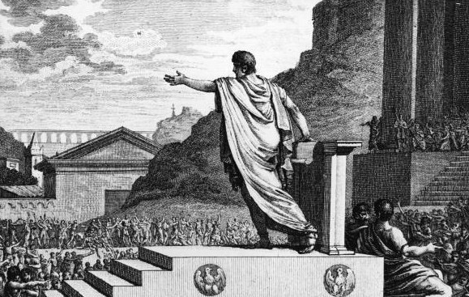
The Many: Tribune of the Plebs & Concilium Plebis
Office created in 493 BC/BCE after plebs seceded
Only plebeians (lowest free class in Roman society) were allowed to hold office
Meant to represent plebeians in government
Could call a Concilium Plebis which passed laws that affected plebeians
Could veto actions of any magistrate, veto any election, and on rare occasions veto all government functions
Originally could be used a stepping stone to higher office
Notes:
Many patricians gave up status to become tribune. Why? Modern comps?

Slide 15
Political Parties: Optimates
Party which backed the power of the senate
Sought to limit powers of Concilium Plebis and Tribune of the Plebs
Tried to keep power in aristocratic families
Opposed extending Roman citizenship to Italians
Opposed plans to enlist Romans in army who couldn’t pay for own weapons and supplies
Opposed land redistribution to urban poor and veterans
Notes:
Where on a political spectrum? Akin to any modern party? How?

Slide 16
Political Parties: Populares
Party sought to expand power of tribune and the concilium plebis
Sought to expand Roman citizenship to Italians
Favored laws expanding subsidized grain for the urban poor
Favored land redistribution for urban poor and veterans
Sought debt relief for small farmers and poor
Notes:
Where on a political spectrum? Akin to any modern party? How?

