Slide 1
Unit 5
Agriculture &
Rural Land Use
By: Carli Terrell (Orlando, Florida)
This PPT has been created using the information from the AMSCO Human Geography: Preparing for the Advanced Placement Examination book.
Palmer, David. AMSCO Advanced Placement Human Geography. Perfection Learning, 2019.

Slide 2
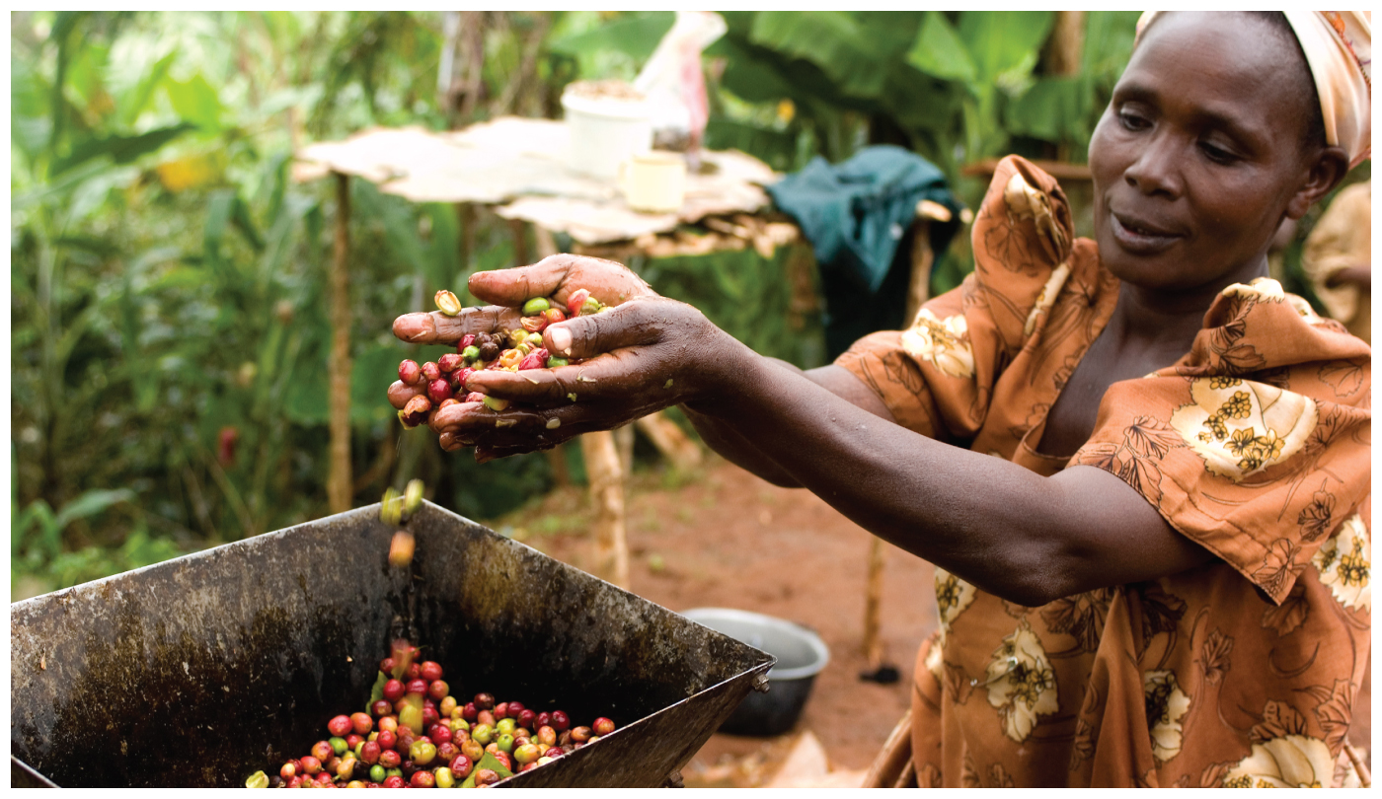
Unit 5 – Agriculture, food, & rural land use
Ch 12: The Development of Agriculture

Slide 3
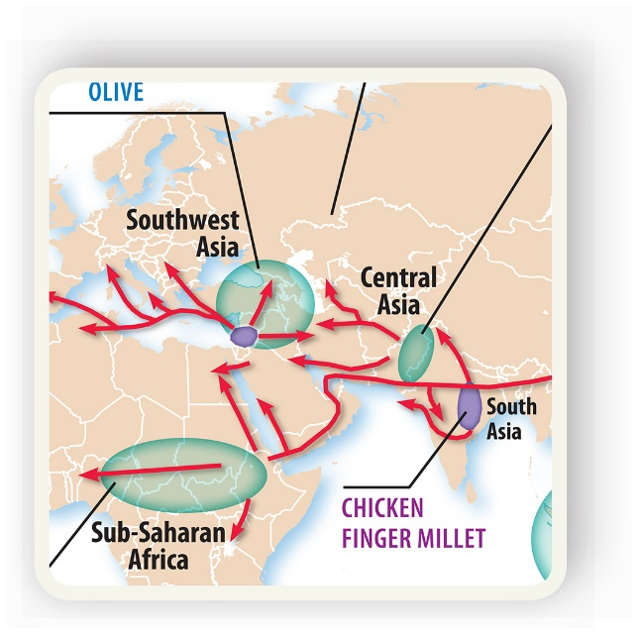
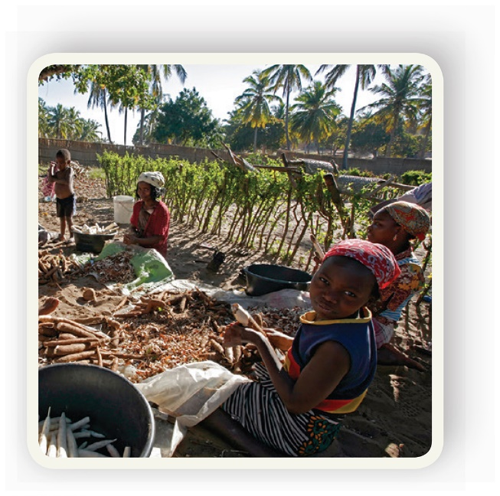
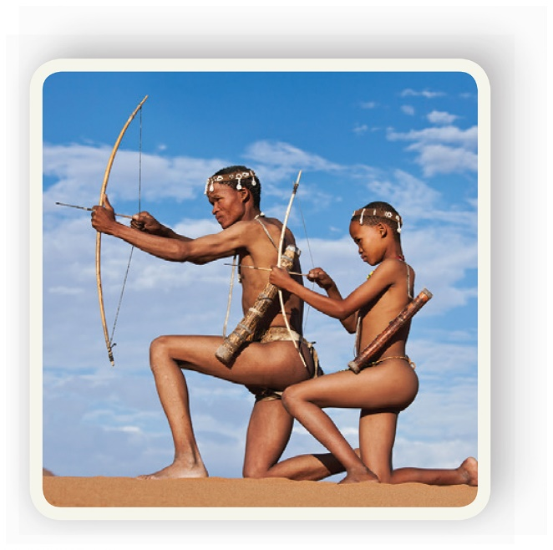
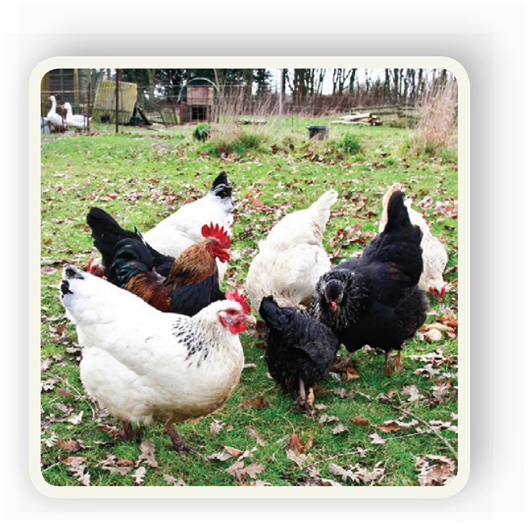
Enduring Understanding (5.A)
By the end of this section, you will understand that the development of agriculture led to widespread alteration of the natural environment.

Slide 4
Learning objective (5.A.2)
By the end of this section, you will be able to explain the connection between physical geography and agricultural practices.
Students will know that agricultural regions are influenced by the natural environment (e.g., climate, soils, landforms).
Students will know that populations alter the landscape (e.g., terraces, irrigation, deforestation, draining wetlands) to increase food production.

Slide 5
Physical Geography and Agriculture
Physical geography features (access to water, climate, soil types, landforms) influence how people farm in a region.
Irrigation, terrace farming, deforestation, desertification, and the drainage of wetlands have occurred as farmers try to increase production to feed an ever-growing human population.

Slide 6
Physical Geography and Agriculture
Access to Water
All crops and animals need water – even the cattle herders in the Sahel, a dry region on the southern edge of the Sahara.
Soil
Nutrient levels in soils influence agriculture. For examples, cotton needs nutrient-rich soil while sorghum can grow in nutrient-poor soils, like tropical rainforests.

Slide 7
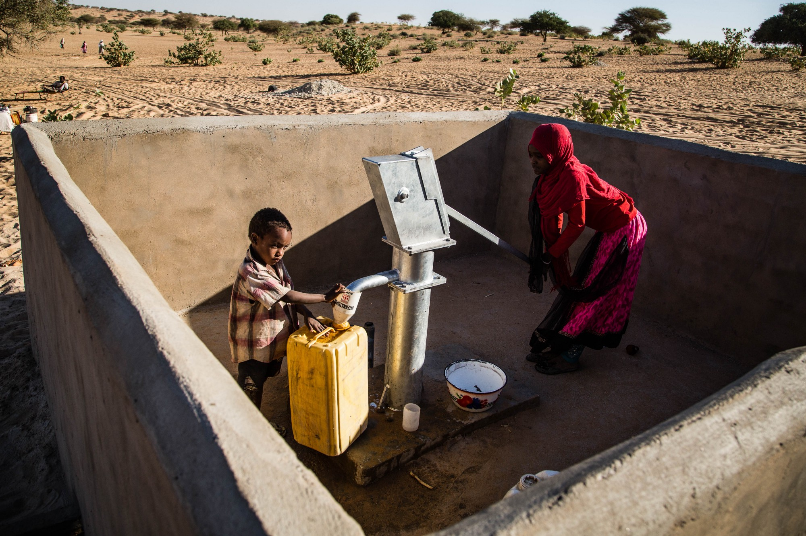
Bringing Clean Water to the Sahel Belt
Notes:
https://medium.com/@UNICEFChad/bringing-water-in-the-sahel-belt-4bbe113ada68

Slide 8
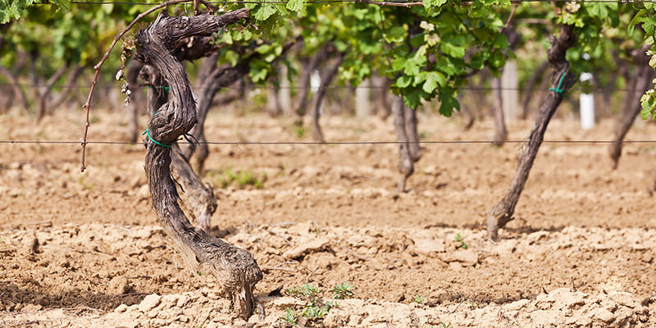

Slide 9
Physical Geography and Agriculture
Climate Differences
Influenced by the latitude and physical geography can impact what crops can be grown.
Landforms
Flat land found in large, expansive valleys provides excellent landscapes for agriculture.
Mountains, ridges, and hills limit agricultural activity and often require more human inputs in order to make the land more useful for agricultural production.

Slide 10
Humans altering the landscape
Terracing
Early form of land alteration in East Asia (rice), northern Africa (fruit and olive trees), and South America (potatoes and corn).
Farmers build a series of steps into the side of a hill creating a flat surface with several benefits:
Planting, tending, and harvesting crops is physically easier for farmers
The land collects rainfall rather than allowing it to run down a sloped hillside, helping to sustain crops
The reduction in water running down the hillside reduces soil erosion.
Can cause mudslides

Slide 11
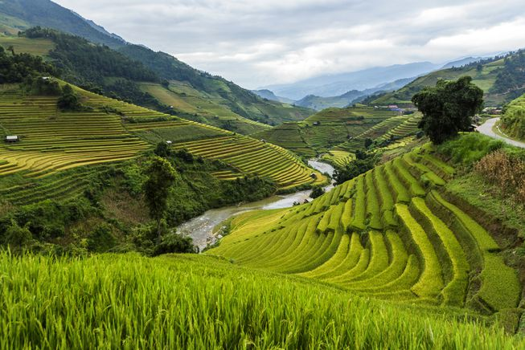
Nine Examples of Terrace Farming Around the World

Slide 12
Humans altering the landscape
Managing Water – Irrigation
Irrigation is the diversion of water from its natural course or location to aid in the production of crops.
Early example: carrying containers of water from a river or lake to pour on plants.
6,000 BCE: early civilizations used organized strategies like digging canals to manage their water resources.
19th and 20th centuries: large-scale irrigation contributed greatly to feeding the rapidly growing population of the world.

Slide 13
Humans altering the landscape
Managing Water – Irrigation
Irrigation systems can damage the local environment and when misused can cause several problems.
Disrupt natural drainage and reduce the normal regeneration of soils caused by natural flooding.
Salinization, increasing the salt content, of soil resulting in decreased crop yield and soil fertility.
Land subsidence – the collapse of land resulting from the removal of underground water that supports the surface land.

Slide 14
Humans altering the landscape
Managing Water – Irrigation
Irrigation in the United States
California – specifically the Central and Imperial Valleys
Nebraska to northern Texas uses an underground water supply called the Ogallala Aquifer.
Draining the wetlands
Provides more farmable land, which is generally nutrient rich, and increases carrying capacity
Major drawback – reduction of biodiversity in both plants and animals and eliminates the natural filter that protects and promotes surface and groundwater quality.

Slide 15
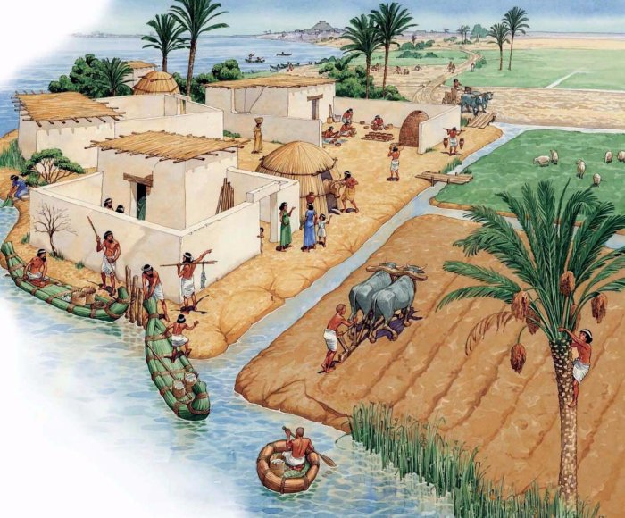
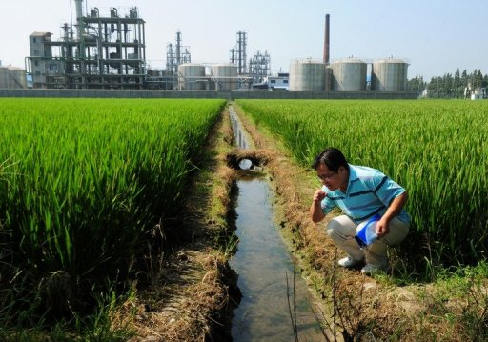
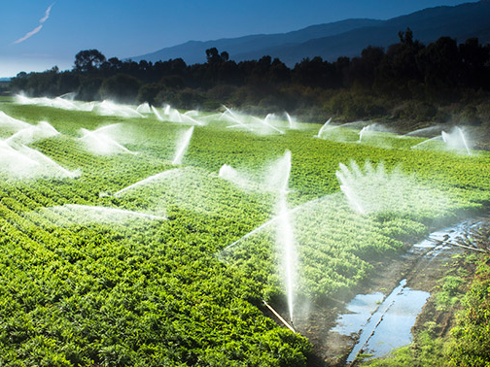

Slide 16
Humans altering the landscape
Clearing Trees and Other Vegetation – Deforestation
Deforestation is the removal of large tracts of forest.
Examples: Northern and central Europe were once heavily forested but are now mostly farmland and urban areas.
Today occurs mostly in Southeast Asia, parts of Africa, and the rainforests of South America.
Global damage – the rainforests absorb so much carbon dioxide that shrinking them leads to an increase in atmospheric carbon dioxide, contributing to climate change.

Slide 17
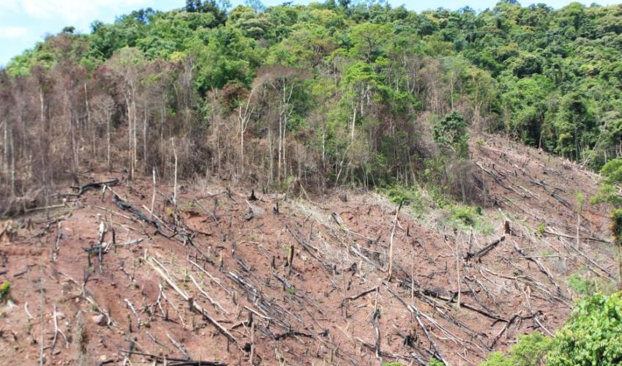

Slide 18
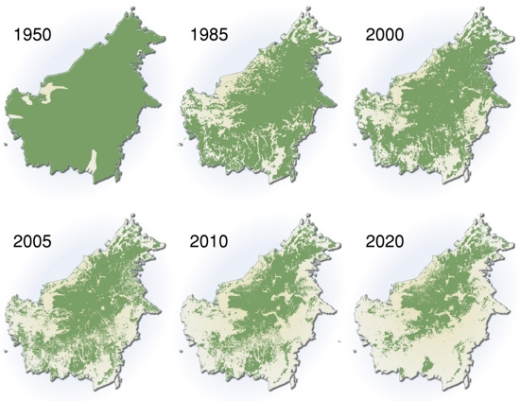
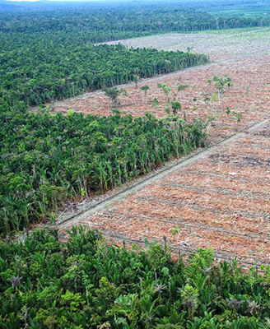
Deforestation of the Amazon Rainforest

Slide 19
Humans Altering the Landscape
Clearing Trees and Other Vegetation – Desertification
Cutting down trees can result in local problems, such as soil erosion, decrease in rainfall, and desertification (the transition of land from fertile to desert).

Slide 20
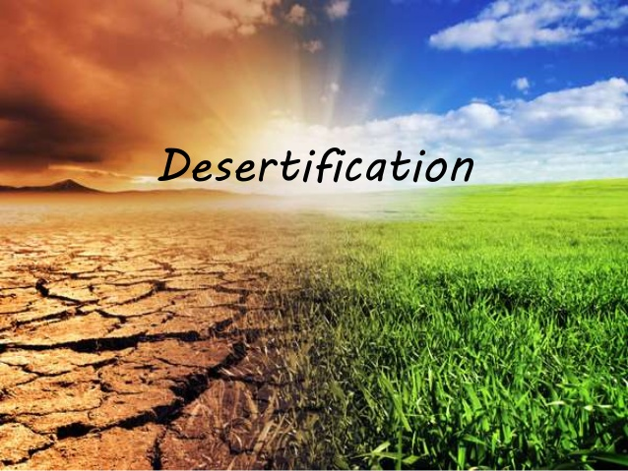

Slide 21
Humans Altering the Landscape
Clearing Trees and Other Vegetation - Slash and Burn Agriculture
All vegetation in an area of forest is cut down and burned in place. The ash provides some soil nutrients, and the land can be farmed for a few years before the soil becomes depleted and the plot is abandoned. The plot then returns to a natural, somewhat altered state, while farmers move on.
Requires people to move regularly - called shifting cultivation.

Slide 22
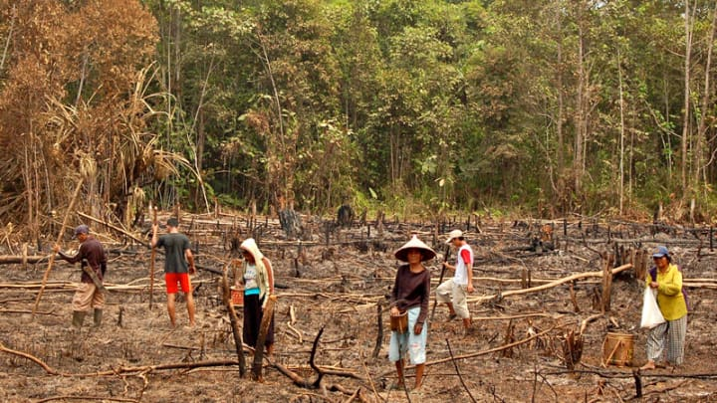

Slide 23
Humans Altering the Landscape
Clearing Trees and Other Vegetation - Slash and Burn Agriculture
Advantages are on a small scale - beneficial to humans and the environment recovers quickly.
Disadvantages are on a large scale - may seriously damage the environment.

Slide 24
Humans Altering the Landscape
Clearing Trees and Other Vegetation - Slash and Burn Agriculture
Example of Disadvantage
Rather than use fire, farmers usually remove vegetation by cutting it down, pulling it out, or killing it with herbicides.
On the Great Plains, farmers removed the tall prairie grasses in order to plant wheat and other grains. These new crops lacked the extensive root systems of prairie grass. Without the strong roots, and with a lack of rain and some wind, the valuable topsoil can simply blow away.

Slide 25
Humans Altering the Landscape
Clearing Trees and Other Vegetation - Slash and Burn Agriculture
Example of Disadvantage
The worst period of this occurred in the 1930s and is known as the Dust Bowl. This era of massive soil erosion was one of the worst ecological disasters in U.S. history.

Slide 26
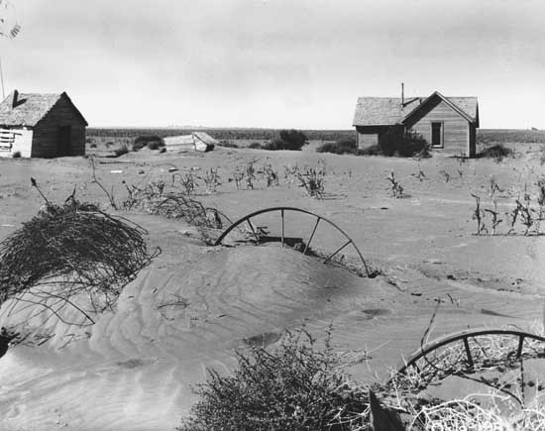

Slide 27
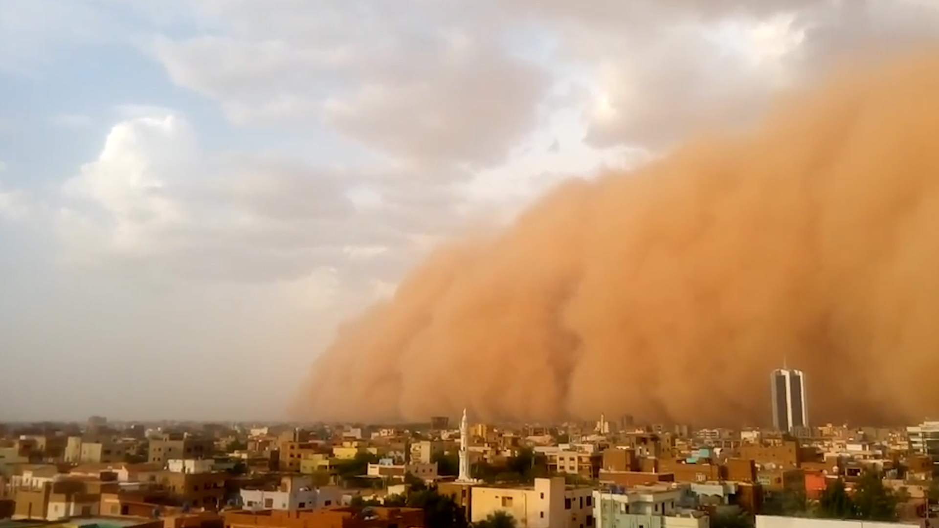

Slide 28
Humans altering the landscape
Recent Trends
In the modern era, commercial agriculture, in which farmers focus on raising one specific crop to sell for profit, has increasingly replaced subsistence farming, in which farmers focus on raising food they need to live.
Increasing numbers of farming operations evolved from small enterprises owned by a single family into large-scale, capital-intensive businesses, putting more stress on the environment than ever before.

