Slide 1
Computer Safety Tips
For oak ridge digital parents like you….
Mr. Williams

Slide 2
Introduction

Slide 3
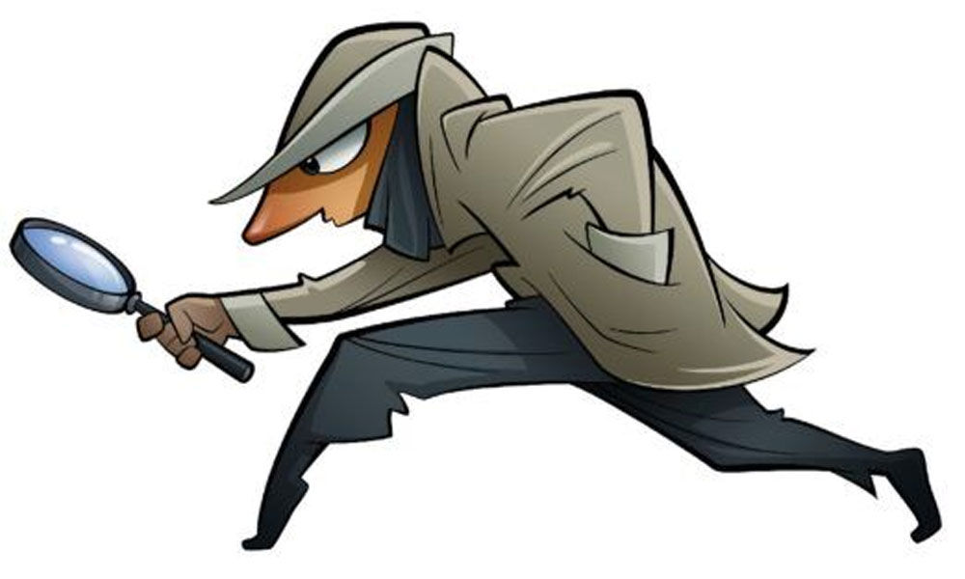
What things to look for….
Fast clicking
Multiple windows opened at once
Unknown websites or browsers
Background sounds
Downloaded music or content

Slide 4
YouTube Kid Secrets

Slide 5
Different Safety Hacks
The incognito mode on the computer.
This mode is hidden from tracking and hides all activity.
Removing a forward slash
(https:/ instead of https:// disables the firewalls and allows students access to unapproved websites.)
Multiple Windows opened simultaneously
Having a lot of tabs open allows for less monitoring of activities.

Slide 6
Beware of the three little dots

Slide 7
Three little dots (Continued)
The three little dots are the secret controls that allow anyone to change the settings on a computer.
By changing the settings students can alter what is seen by others on their device. It also allows them to add hidden extensions

Slide 8
Parents course of action
Most parents fear unsafe browsing but there are many ways to ensure your child’s safety online.
Monitor Browser history
Have open dialogue with your student about the need to be safe online
Routine breeds safety, Safety breeds Success

Slide 9
QUESTIONS ?

