Slide 1
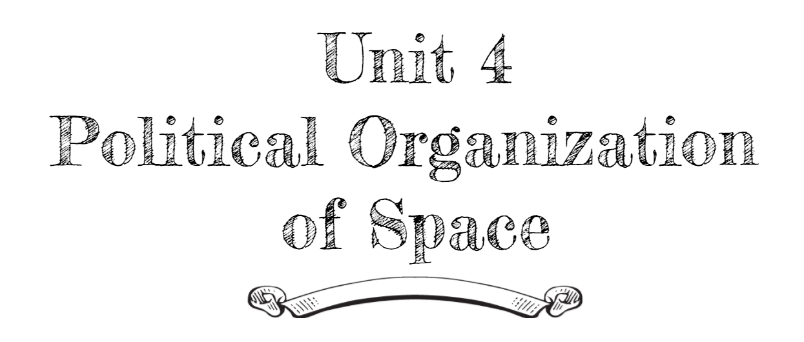
By: Carli Terrell (Orlando, Florida)
This PPT has been created using the information from the AMSCO Human Geography: Preparing for the Advanced Placement Examination book.
Palmer, David. AMSCO Advanced Placement Human Geography. Perfection Learning, 2019.

Slide 2
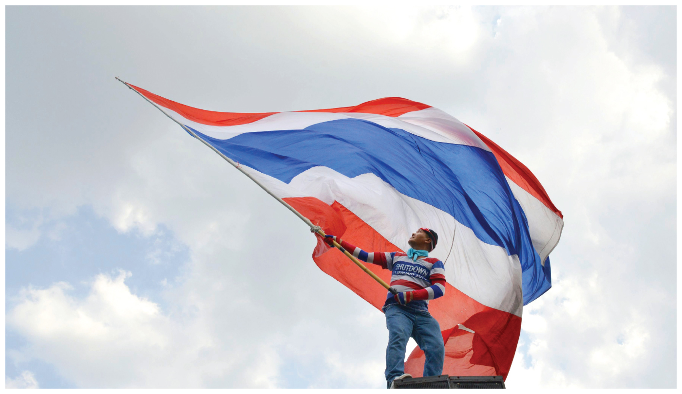
Unit 4 – political organization of space
Ch 10: Territory, Power, and Boundaries
Notes:
http://www.pbs.org/thelinguists/For-Educators/Video-Extras.html

Slide 3
Enduring Understanding (4.B)
By the end of this section, you will understand that spatial political patterns reflect ideas of territoriality and power at a variety of scales.
Territoriality: connection of people, culture, and their economic system to the land.
Power: geographic control over people, land, and resources.

Slide 4
Learning objective (4.B.5)
By the end of this section, you will be able to describe patterns of local and metropolitan governance.
Students will know that local and metropolitan forms of governance (e.g., municipalities, school districts, planning commissions) are subnational political units that have varying degrees of local control.

Slide 5
Patterns of Local & Metropolitan Governance
Most people in the world are under the rule of overlapping levels of government.
Example: the United States has one federal government, over 50 state, commonwealth, and territorial governments, and over 87,000 local governments (roughly 3,000 counties, 20,000 cities, 13,000 school districts, and 35,000 special purpose districts such as police districts).
Sometimes, to increase the tax base, a city may annex, or legally add outlying territory to its domain.

