Slide 1
HOW TO
You are able to edit the time and the writing description on each card. You can change the text in any way you’d like (font, color, size).
I have added a description to each card to give you an idea of what to write, but you can change it to fit your classroom.
Want it to be more colorful? Print on white cardstock and then paste onto colorful paper (Astro brights are great!). Then laminate.
Email me with questions or concerns: MrsDsCorner@outlook.com

Slide 2
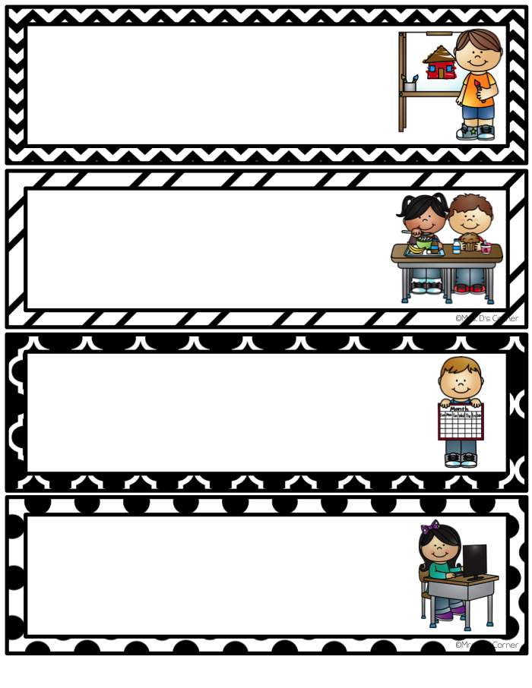
Art
8:00
breakfast
8:45
calendar
11:00
computer

Slide 3
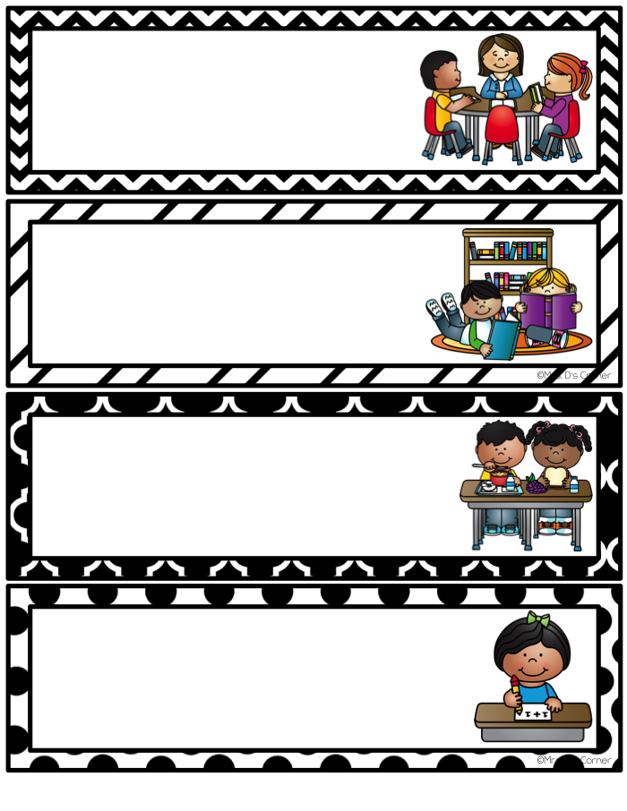
Guidance
Media
1:00
lunch
12:00
math

Slide 4
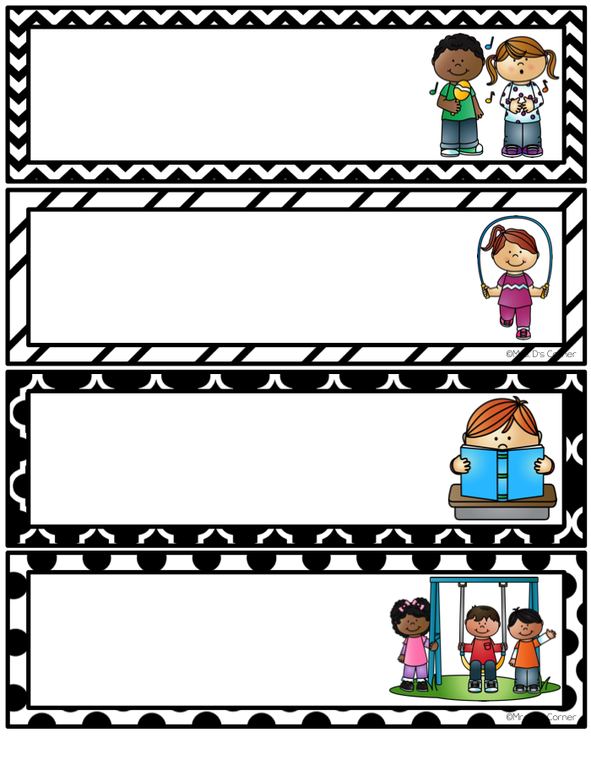
Music
P.E.
10:10
reading
2:00
recess

Slide 5
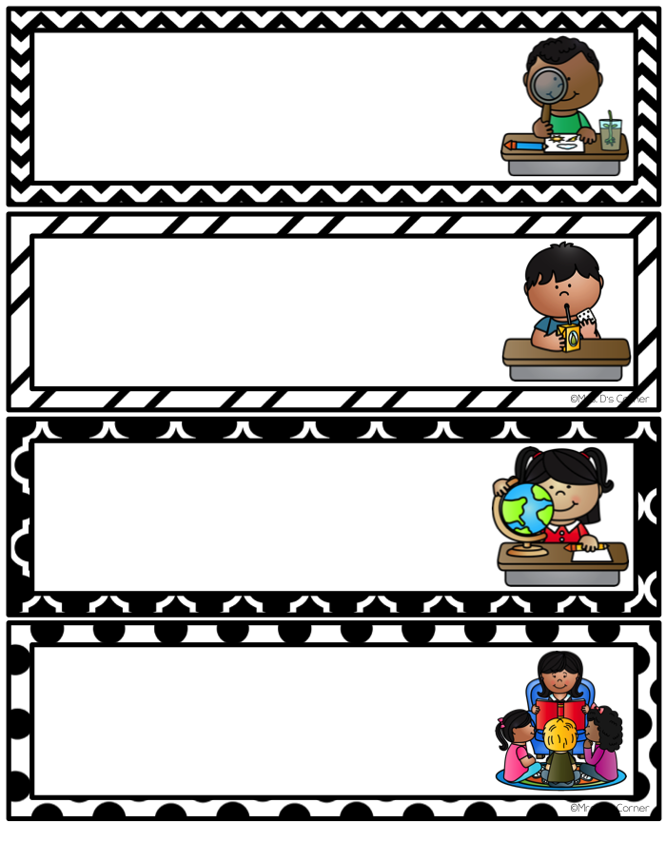
1:30
science
10:00
snack
1:30
social studies
9:40
story time

Slide 6
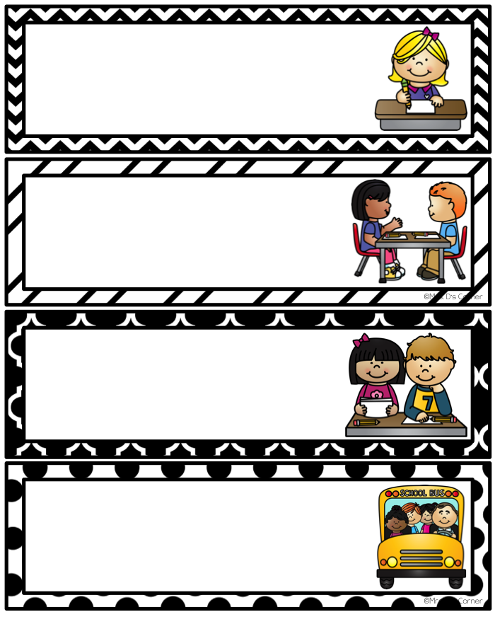
9:00
writing
table work
9:00
inclusion
2:50
dismissal

