Slide 1
Staying home
by Christa joy

Slide 2
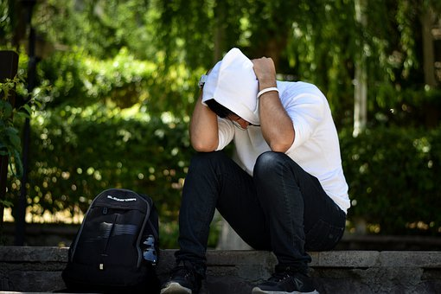
Something is happening.
Christa Joy, Special Needs for Special Kids

Slide 3
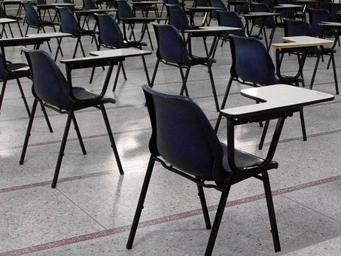
All of a sudden, there is no more school.
Christa Joy, Special Needs for Special Kids

Slide 4
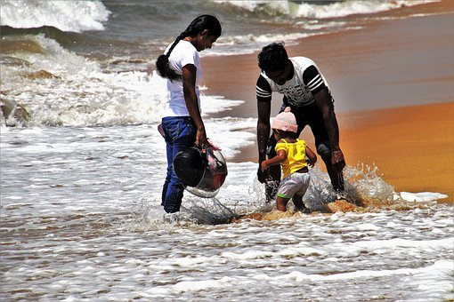
It is not summer. It is not a holiday.
Christa Joy, Special Needs for Special Kids

Slide 5
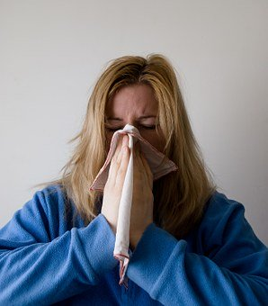
There are some germs that are making people sick.
Christa Joy, Special Needs for Special Kids

Slide 6
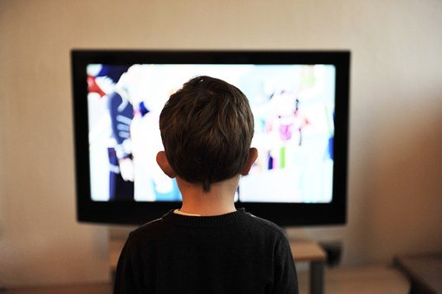
So, to keep everyone healthy, my school closed, and now I am home.
Christa Joy, Special Needs for Special Kids

Slide 7
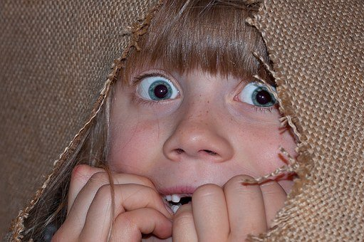
This all happened very fast, and feels a little scary.
Christa Joy, Special Needs for Special Kids

Slide 8
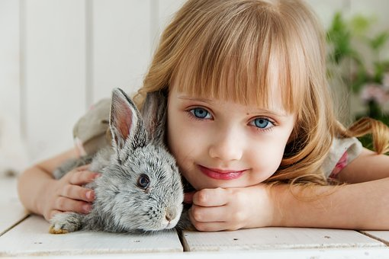
But home is the best place for me to be right now.
Christa Joy, Special Needs for Special Kids

Slide 9
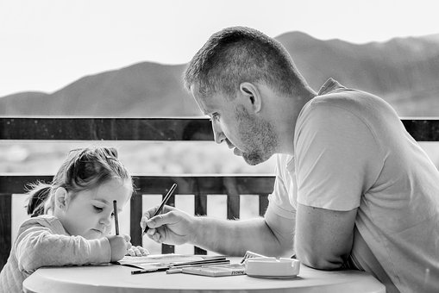
My parents will take good care of me.
Christa Joy, Special Needs for Special Kids

Slide 10
My teachers will also help me keep learning.
Christa Joy, Special Needs for Special Kids

Slide 11
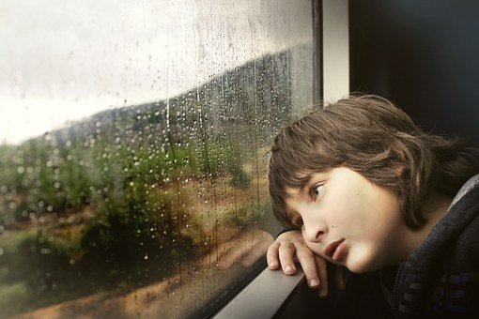
I can’t go visit my friends right now. I have to stay home.
Christa Joy, Special Needs for Special Kids

Slide 12
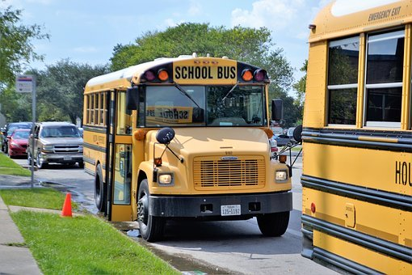
That way, everyone will stay healthy, and I can go back to school soon.
Christa Joy, Special Needs for Special Kids

Slide 13
Everything is all going to be okay.
Christa Joy, Special Needs for Special Kids

Slide 14
Staying home with my family is the best place for me to be right now.
Christa Joy, Special Needs for Special Kids

