Slide 1
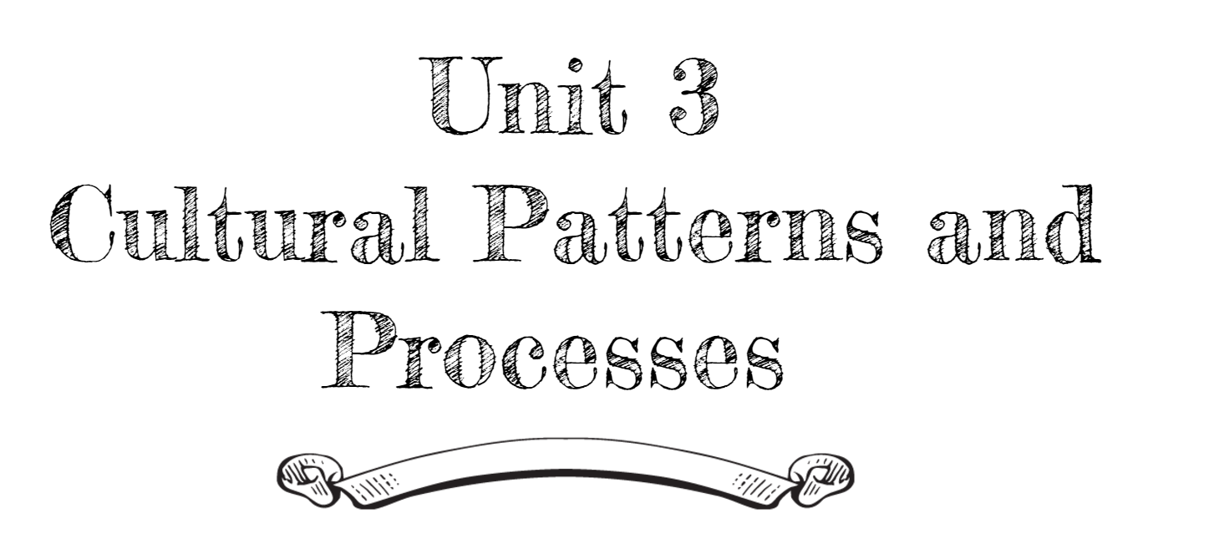
By: Carli Terrell (Orlando, Florida)
This PPT has been created using the information from the AMSCO Human Geography: Preparing for the Advanced Placement Examination book. Please do not delete this and give credit where credit is due.

Slide 2
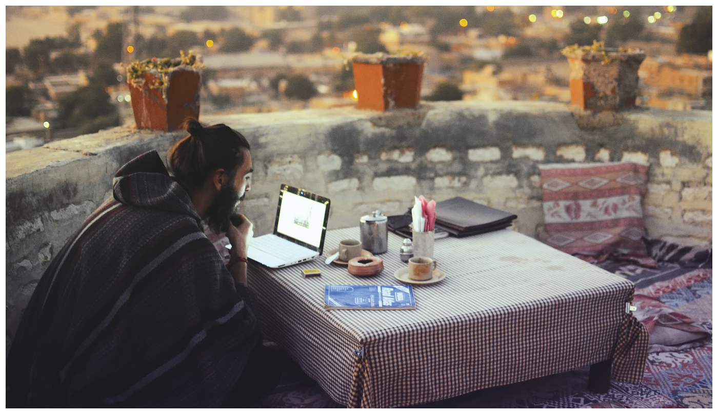
Unit 3 – Cultural patterns and processes
Part 1: concepts of culture and diffusion

Slide 3
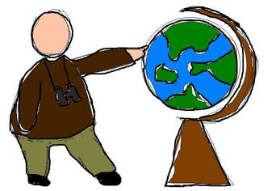
Enduring Understanding (3.A)
By the end of this section, you will understand that concepts of culture frame the shared behaviors of a society.

Slide 4
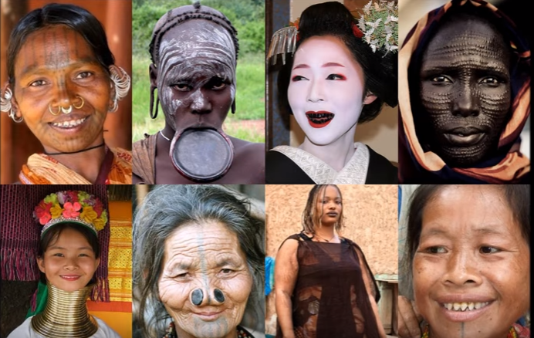
Enduring Understanding (3.A)
Essential Question
How do folk and popular cultures differ in the ways they help form a society’s overall culture?

Slide 5
Learning objective (3.a.1)
By the end of this section, you will be able to explain the concept of culture and identify cultural traits
Culture is comprised of the shared practices, technologies, attitudes, and behaviors transmitted by a society.
Cultural traits are individual elements of culture and include such things as food preferences, architecture, and land use.

Slide 6
Concepts of culture and diffusion
“The Buffalo was part of us, his flesh and blood being absorbed by us until it became our own flesh and blood. Our clothing, our tipis, everything we needed for life came from the buffalo’s body. It was hard to say where the animals ended and the human began.”
– John (Fire) Lame Deer, Lame Deer, Seeker of Visions, 1972

Slide 7
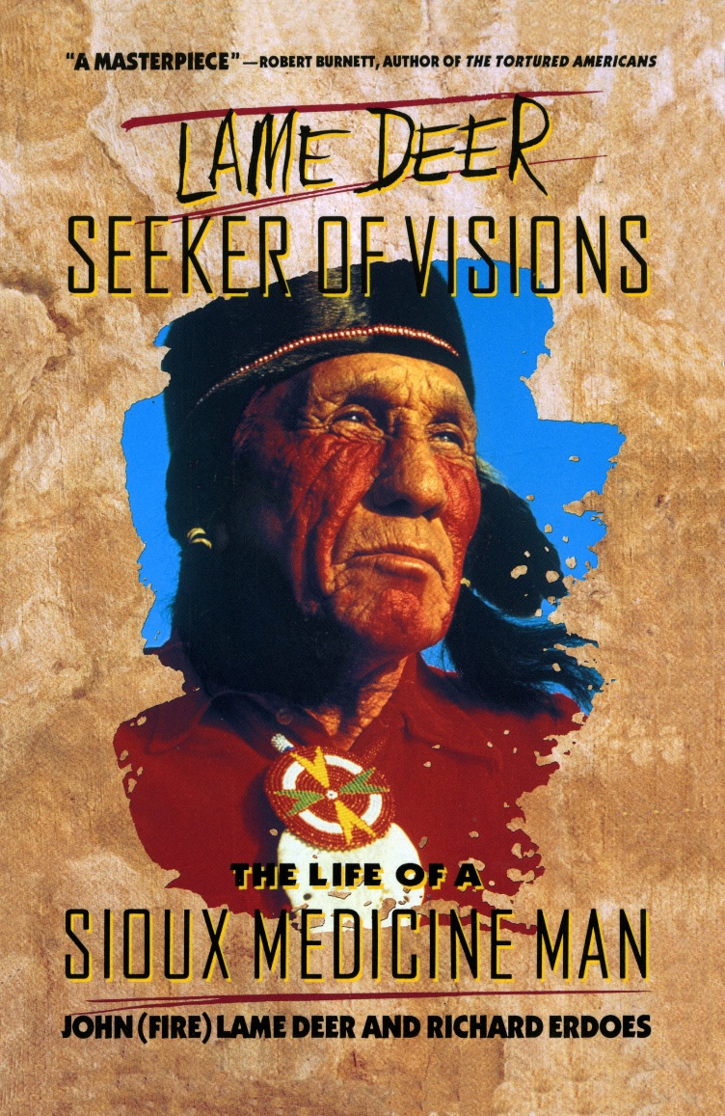
Concepts of culture and diffusion
To the Lakota and other indigenous people on North America’s Great Plains, the bison was an essential part of their culture
Provided meat for nutrition, a hide for clothing and shelter, bones for tools, and fat for soap
Central to their religious beliefs
When European settlers hunted the bison, Lakota culture suffered

Slide 8
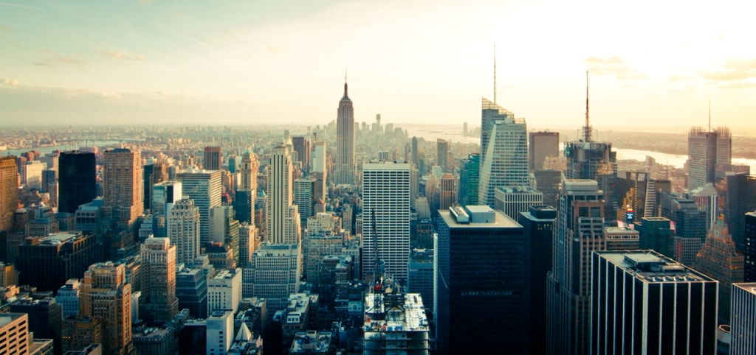
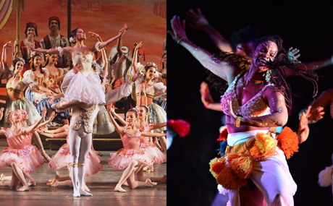
Analyzing culture
Culture includes all of a group’s learned behaviors, actions, beliefs, and objects
Visible force seen in a group’s actions, possessions, and influence on the landscape
Example: in a large city you can see people working in offices, factories, and stores, and living in high-rise apartments or suburban homes. You might observe them attending movies, concerts, or sports events

Slide 9
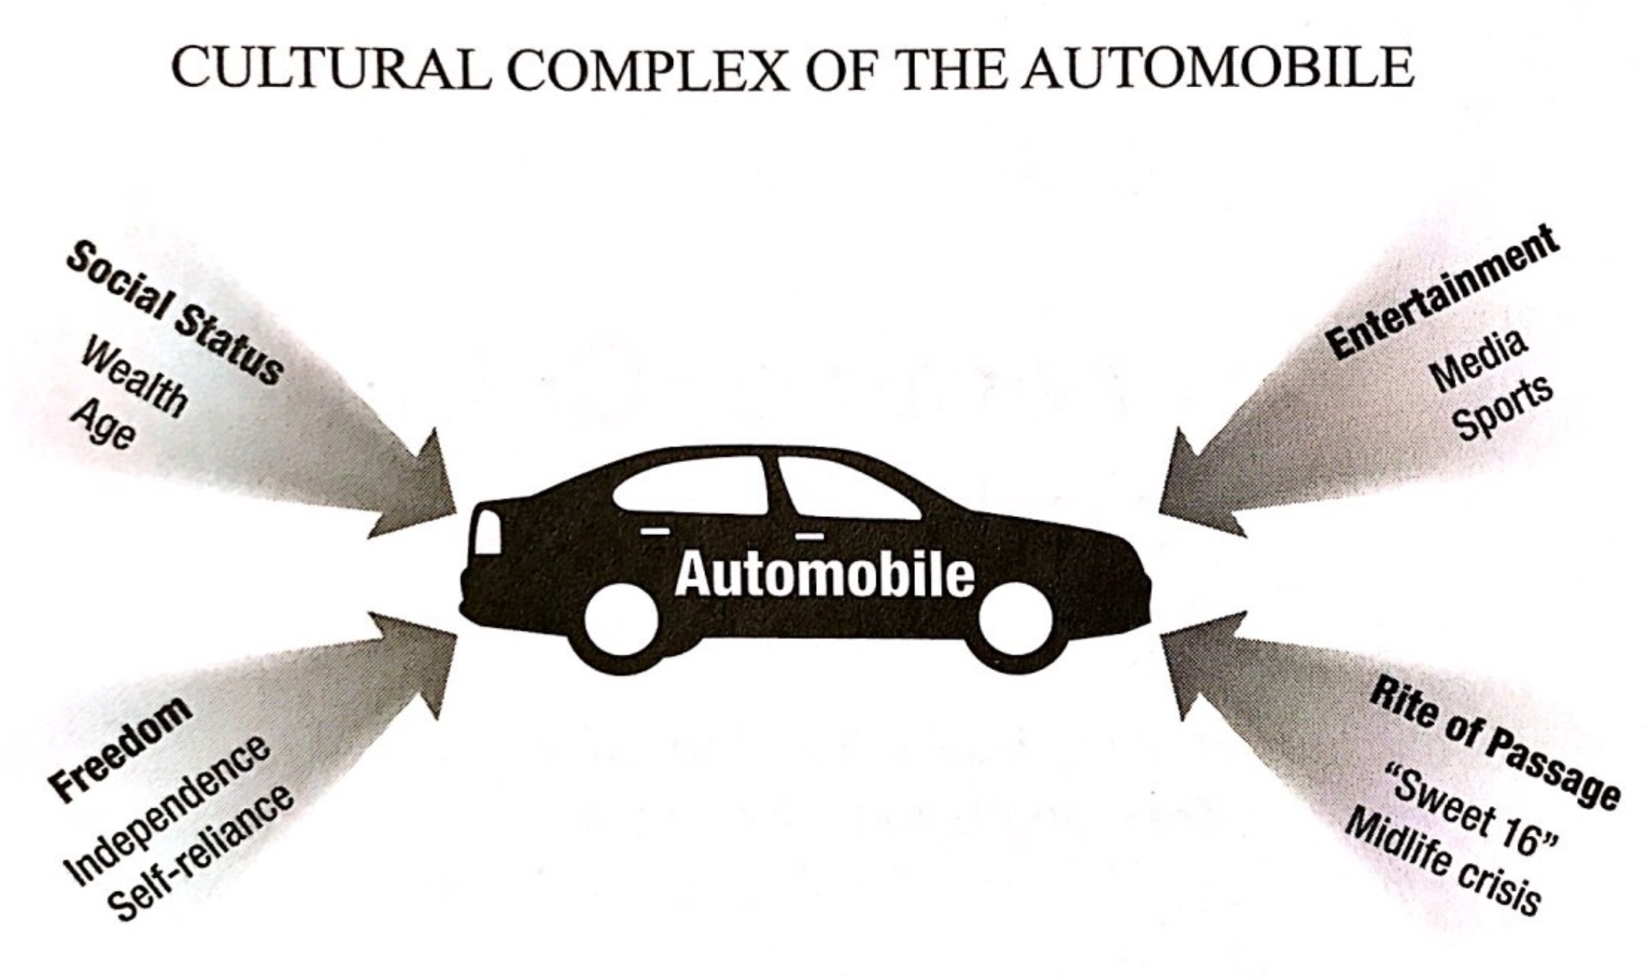
Analyzing culture
Culture is also an invisible force guiding people through shared belief systems, customs, and traditions
Visible + Invisible = cultural traits
Example: a single cultural artifact, such as an automobile, may represent many different values
These interrelated traits make up a cultural complex

Slide 10
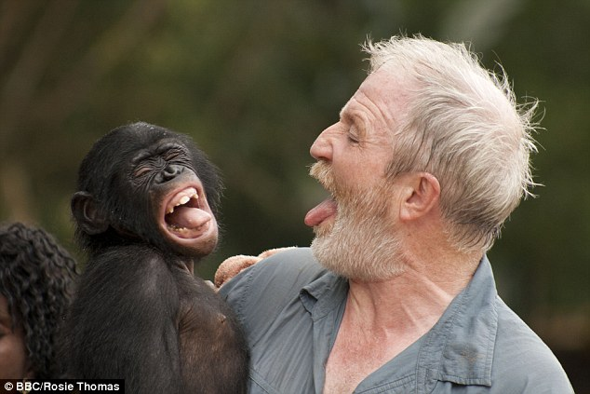
Analyzing culture
One generation passes its culture to the next in many ways
Children learn in three basic ways
Imitation: language – repeating sounds
Informal instruction: a parent reminds a child to say please
Formal instruction: a school teaches history

Slide 11
Origins of Culture
Cultural hearth is the area in which a unique culture or a specific trait develops
Examples
Classical Greece for democracy more than 2,000 years ago
New York City for rap music in the 1970s
Geographers study how cultures develop in hearths and diffuse

Slide 12
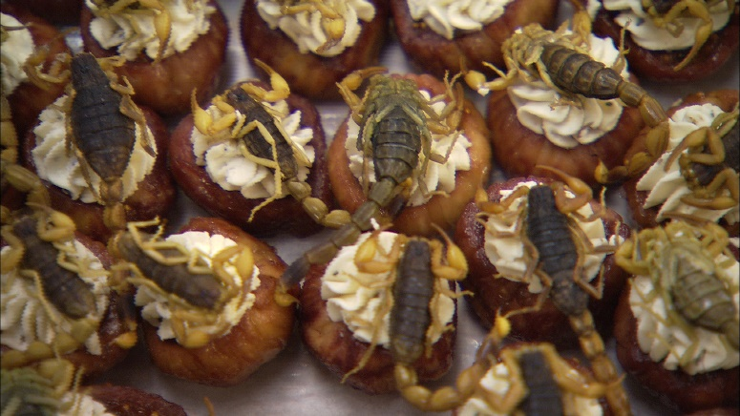
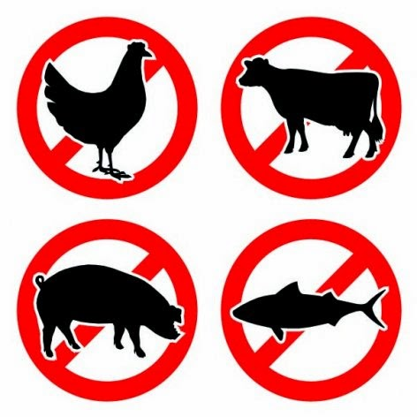
Origins of Culture
Taboos are behaviors heavily discouraged by a culture
Examples
Eating certain foods (pork or insects)
Change over time – in the U.S., it was once taboo for Protestants to marry Catholics but is not widely opposed now

Slide 13
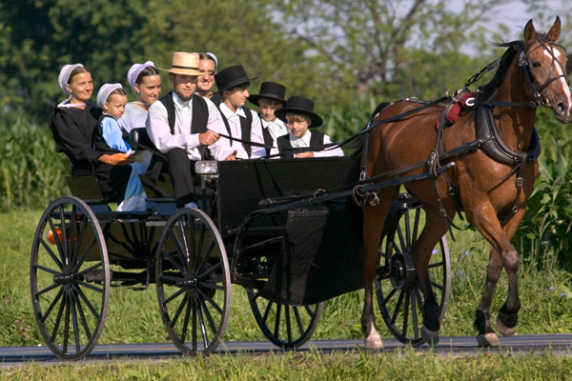
Origins of Culture
Folk Cultures
Small, homogenous groups of people
Often live in rural areas
Relatively isolated
Slow to change

Slide 14
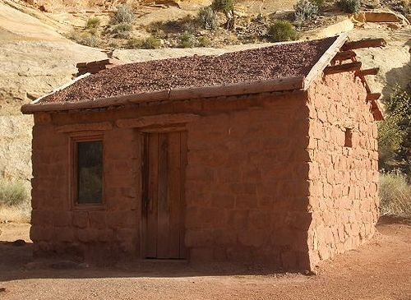
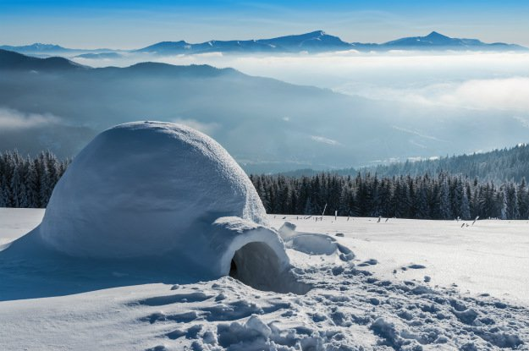
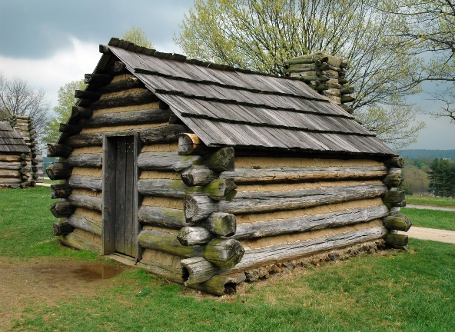
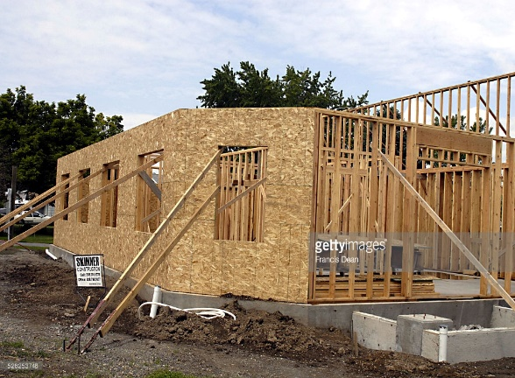
Origins of Culture
Folk Cultures
Demonstrate the diverse ways people have adapted to a physical environment
Example: making shelter out of available resources (snow, mud bricks, wood, etc.)
However, people use similar resources like wood differently
Scandinavia – use entire logs to build cabins
American Midwest – processed trees into boards, built a frame, and attached boards to it

Slide 15
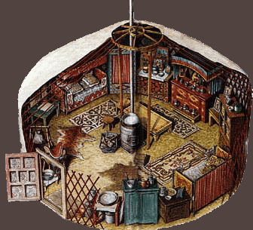
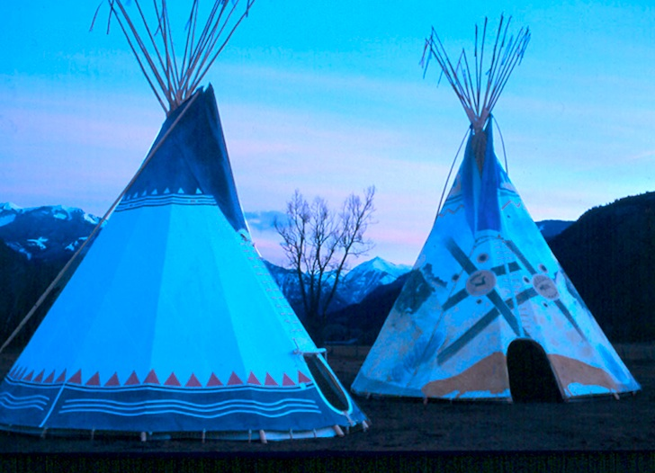
Origins of Culture
Folk Cultures
Sometimes, people independently develop similar responses to similar environments
Mongols in Central Asia and Plains Indians in North America
Flat open land
Extreme weather
Portable, round shelters made of frames and animal skins

Slide 16
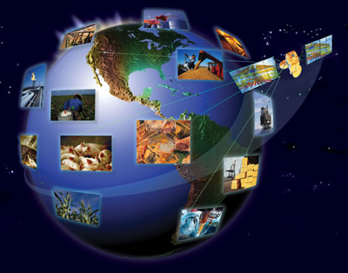
Origins of Culture
The Spread of Cultures
Folk cultures provide a unique sense of place and belonging through homogeneity
Sense of place gives inhabitants ties to the area where they live, thus giving them a sense of ownership
People, goods, and ideas move throughout the world and cultures spread spatially way beyond their hearths
Example: kiwi was only found from China to New Zealand – now it can be found all over the world

Slide 17
Learning objective (3.a.2)
By the end of this section, you will be able to explain how geographers assess the spatial and place dimensions of cultural groups in the past and present.
Geographers use maps and the spatial perspective to analyze and assess language, religion, ethnicity, and gender.

Slide 18
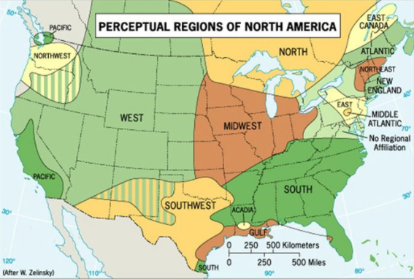
Spatial dimensions of culture
Cultural regions are broad areas where groups share similar but not identical cultural traits
Wilbur Zelinsky divided the U.S. into 12 major cultural regions but people still consider themselves part of a larger American culture

Slide 19
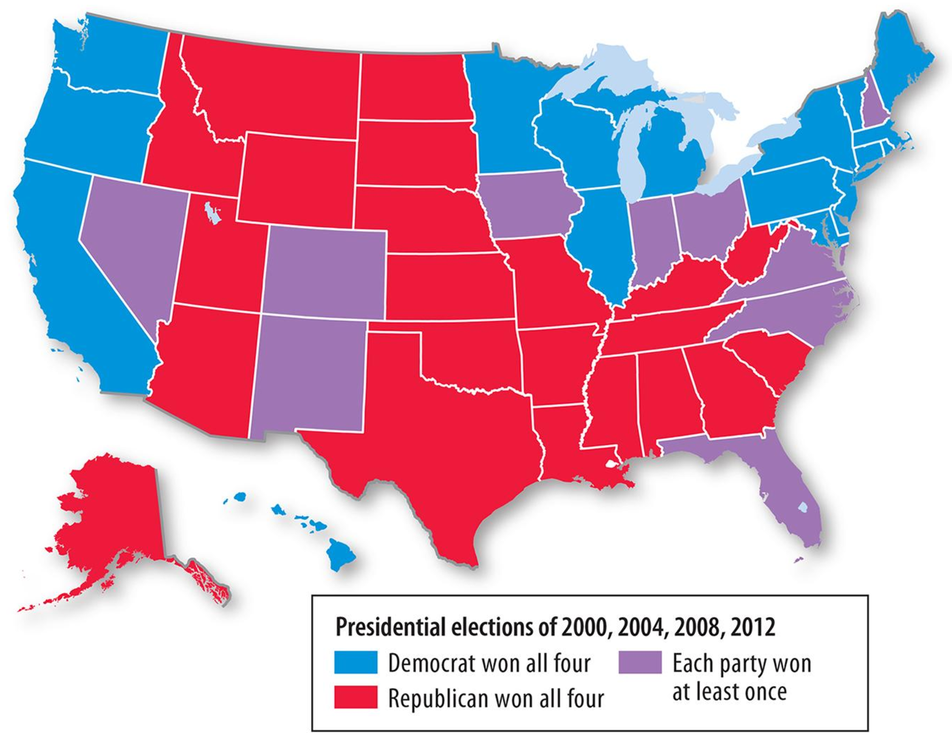
Spatial dimensions of culture
Three types of regions
Formal (Uniform)
An area within which everyone shares in common one or more distinctive characteristic
Share features like language, economic activity (agriculture), or environmental property (climate)
Example: Montana or US (party preferences)

Slide 20
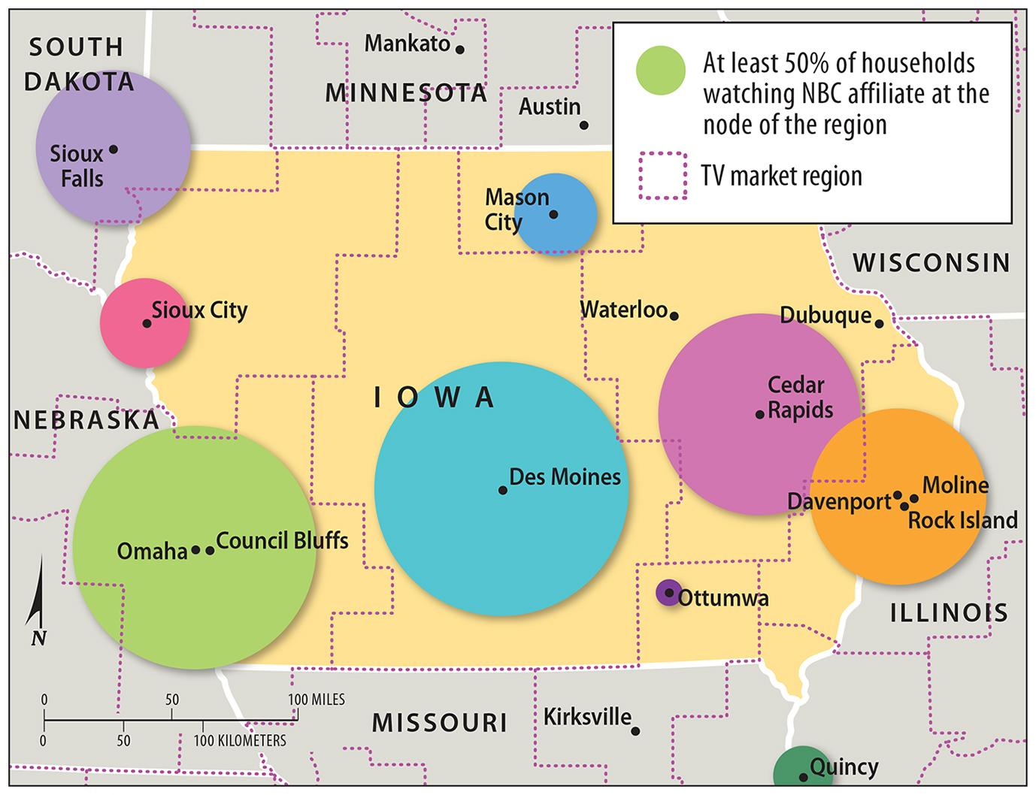
Spatial dimensions of culture
Three types of regions
Functional (Nodal)
An area organized around a node or focal point
Characteristic dominates at a central focus (or node)
Example: TV stations

Slide 21
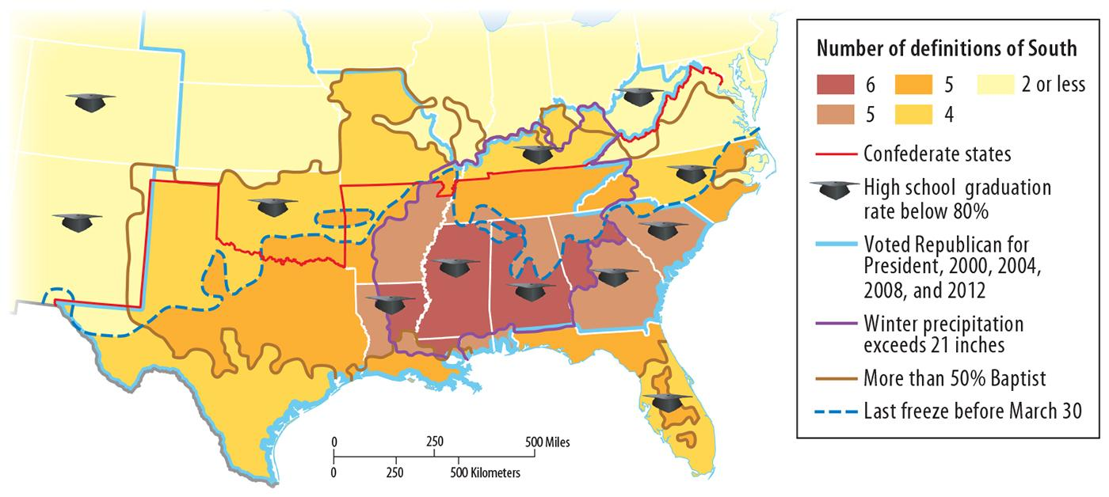
Spatial dimensions of culture
Three types of regions
Perceptual (vernacular)
Based on how people think about a particular area
Boundaries are often blurred
Example: The “South”

Slide 22
Spatial dimensions of culture
Cultural Landscapes
The cultural landscape of a region is the visible reflection of its culture
Examples
National Park (United States) – land set aside from development reflects the desire to preserve unique environments
Signage (Quebec) – Bilingual signs in French and English reflect the desire of French Canadians to retain their heritage
Schools (Pakistan) – Gender-segregated schools reflect attitudes toward male and female roles
Office buildings (Shanghai) – massive skyscrapers reflect economic power and a desire to have businesses in a central, well-known location

Slide 23
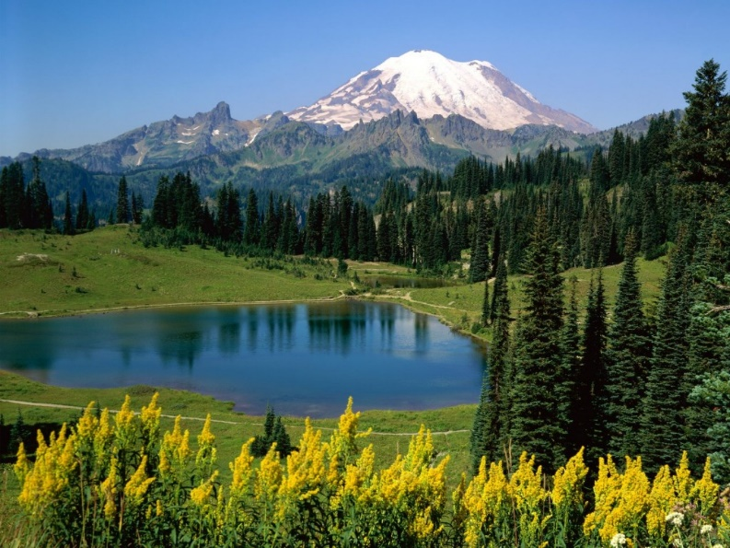
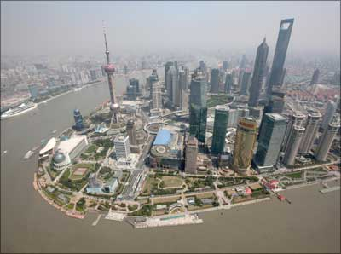
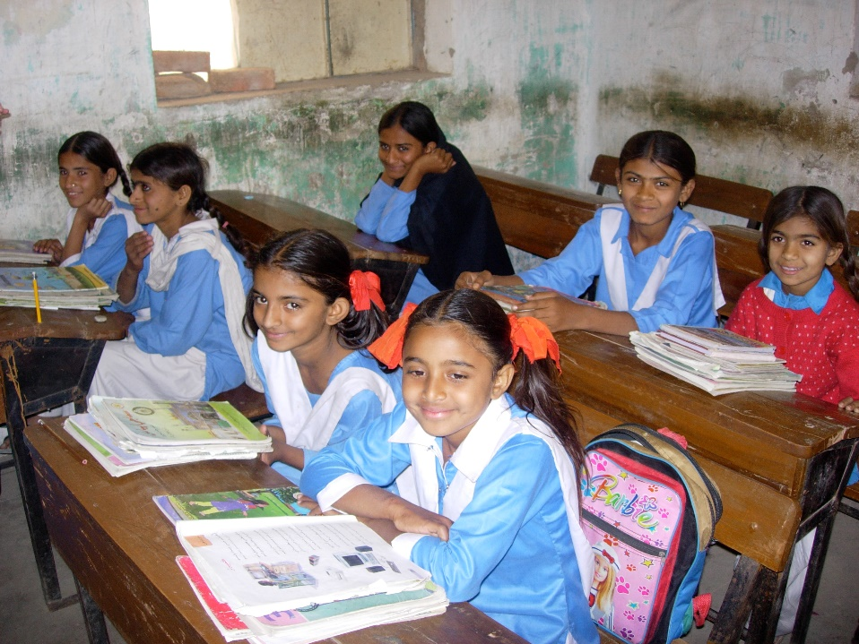
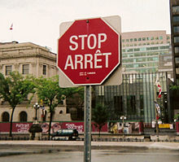
Spatial dimensions of culture

Slide 24
Spatial dimensions of culture
Ethnic Enclaves
Ethnic enclaves are clusters of people of the same culture, but surrounded by people of a culture that is dominant in the region
Sometimes reflect the desire to stay apart from the larger society and other times may reflect the dominant culture’s desire to segregate them
Often contain stores, religious institutions, signs and architecture that reflect the culture
Sometime provide a buffer from discrimination

Slide 25
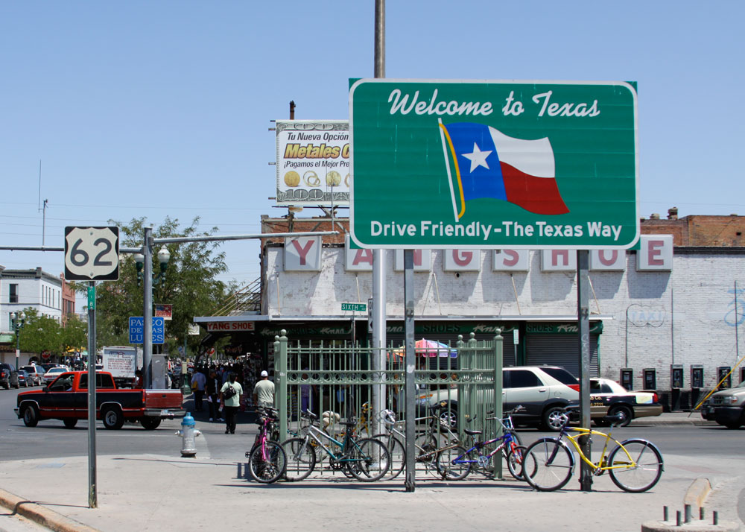
Spatial dimensions of culture
Borders and Barriers
Sometimes identifying cultural borders can be hard
Often contain transition zones where cultures mix and exhibit traits of both
Example: El Paso, Texas (between United States and Mexico)

Slide 26
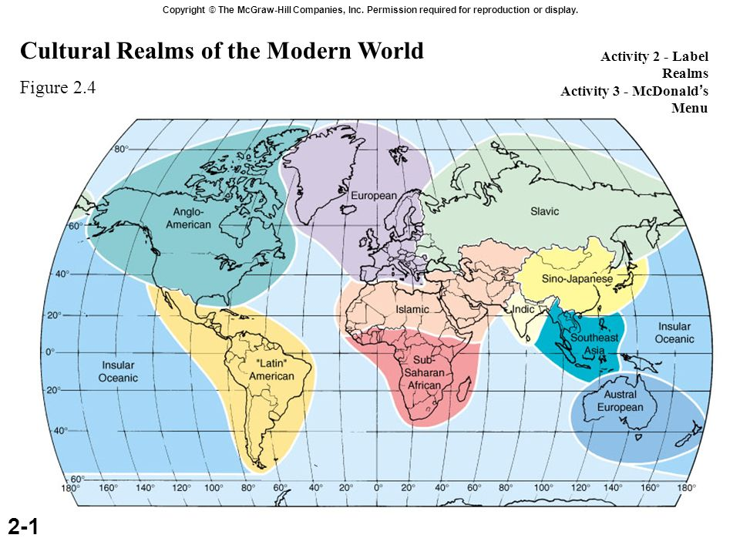
Spatial dimensions of culture
Realms
Cultural realms are larger areas that include several regions
Cultures within these realms have a few traits they all share, such as language families, religious traditions, food preferences, architecture, or a shared history

Slide 27
Learning objective (3.a.3)
By the end of this section, you will be able to explain how globalization is influencing cultural interactions and change.
Communication technologies (e.g., the Internet) are reshaping and accelerating interactions among people and places and changing cultural practices (e.g., use of English, loss of indigenous languages).

Slide 28
Globalization and cultural change
As a result of the Industrial Revolution, improvements in transportation and communication have shortened the time required for movement, trade, or other forms of interaction between two places.
Space-time compression has accelerated culture change around the world, including the spread of English
Example
1817: freight shipment from Cincinnati to New York City took 52 days
1850: canals and railroads cut that time in half
1852: took 7 days
Today: by airplane (a few hours) and digital information (seconds or less)

Slide 29
Globalization and cultural change
Globalization and Popular Culture
Globalization is the process of intensified interaction among people, governments, and companies of different countries around the globe
Popular culture consists of cultural traits (clothing, music, movies, businesses) that spread quickly across over a large area and are adopted by various groups
Usually spreads via media, specifically internet
Examples: European soccer, Indian Bollywood movies, Japanese anime
Often promote uniformity in beliefs, values, and the cultural landscape across many cultures

Slide 30
Learning objective (3.B.5)
By the end of this section, you will be able to compare and contrast popular and folk culture and the geographic patterns associated with each.
Folk culture origins are usually anonymous and rooted in tradition and are often found in rural or isolated indigenous communities
Popular culture origins are often urban, changeable, and influenced by media

Slide 31
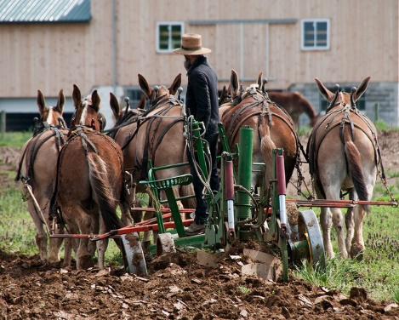
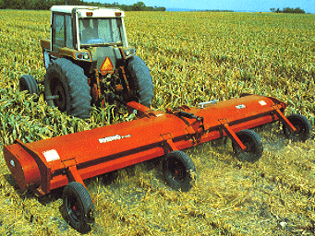
Globalization and cultural change
Popular Culture vs. Folk Culture
Pop culture emphasizes the new rather than preserving tradition
Those who follow a folk culture often resist this change by preserving traditional languages, religions, values, and foods
They may slow down the transition but rarely stop the traditional culture from changing, especially among the younger people

Slide 32
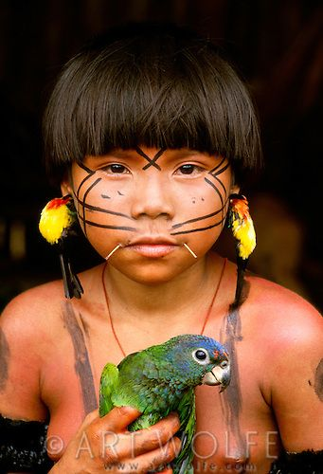
Globalization and cultural change
Popular Culture vs. Folk Culture
Example: Brazil
As the population expands to the interior of the rain forest, many indigenous people are being exposed to outside groups
Many young people continue to integrate into the larger Brazilian society which threatens the existence of their folk culture

Slide 33
Globalization and cultural change

Slide 34
Globalization and cultural change

Slide 35
Globalization and cultural change

Slide 36
Globalization and cultural change
Geography of Gender
In folk cultures, people often have clearly defined gender-specific roles
Women – work in the household
Men - work outside the house to earn money and serve as religious and political leaders

Slide 37
Globalization and cultural change
Geography of Gender
In popular culture, gender-specific roles are diminishing
Women – have more access to economic resources, more opportunity to work outside the home, and more chances to serve as leaders

Slide 38
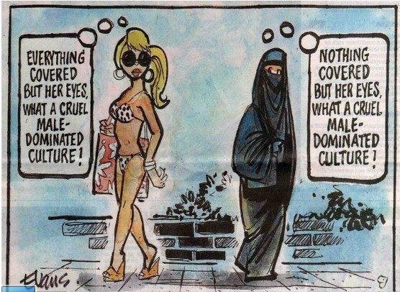
Globalization and cultural change
Geography of Gender
Throughout history, in many cultures, certain behaviors have been acceptable for only one gender, and often only in certain places
Men have operated more freely than women in public spaces while certain private spaces have been reserved for women

Slide 39
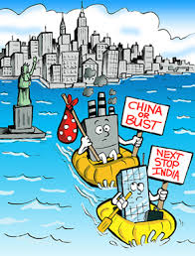
Globalization and cultural change
Resistance to Globalization
The spreading of popular culture has created tension between globalization and local diversity.
Some cultures with strict gender roles often resent the gender equality often seen in Hollywood movies
Workers in the U.S. resist the transfer of their jobs to overseas locations
Speakers of endangered languages resist the spread of English

Slide 40
Learning objective (3.B.2.A)
By the end of this section, you will be able to explain the diffusion of culture and cultural traits through time and space.
Types of diffusion include expansion and relocation

Slide 41
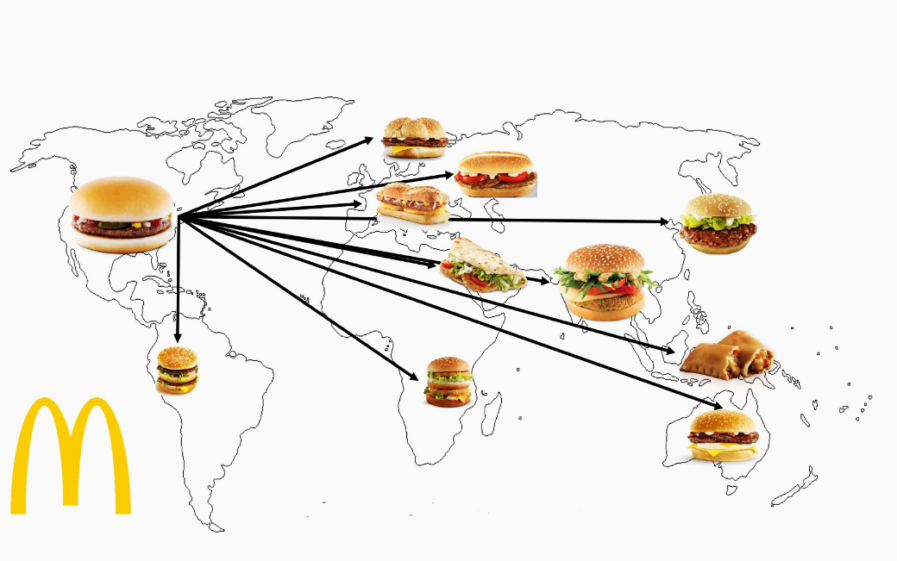
Diffusion of culture
Cultural hearths are the original sources of culture yet many cultures have spread beyond their hearths
The spreading of information, ideas, behaviors, and other aspects of culture over wider areas is known as diffusion
The two major forms of cultural diffusion come through cultural exchanges by migration and by more indirect means

Slide 42
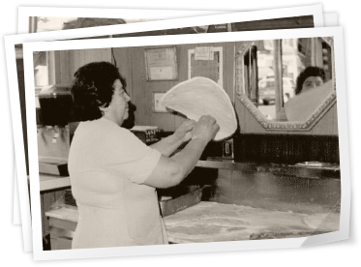
Diffusion of culture - relocation
Relocation diffusion is the spread of a cultural trait by people who migrate and carry their cultural traits with them.
Small scale example: pizza (brought to the U.S. by Italian immigrants in the late 1800s)
Large scale example: European culture (spread around the world starting in the 1500s)

Slide 43
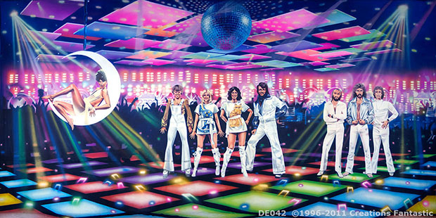
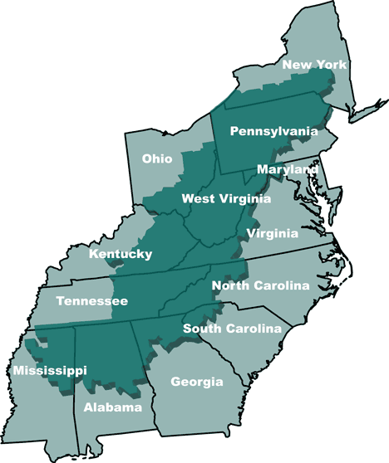
Diffusion of culture - relocation
Sometimes, the areas where migrants settle continue a trait even after it has lost its influence in its hearth.
Example: Disco music evolved in the U.S. in the 1970s but remained popular in Egypt long after it faded in the U.S.
Example: Most people who pronounce English most like Shakespeare live, not in England, but in Appalachia.

Slide 44
Diffusion of culture - expansion
Expansion Diffusion is the spread of cultural traits through direct or indirect exchange without migration.
Contagious
Hierarchical
Reverse hierarchical
Stimulus

Slide 45
Diffusion of culture - contagious
Contagious Diffusion occurs when a cultural traits spreads continuously outward from its hearth through contact among people
Example: Blues music
Hearth – southern United States
As musicians outside the hearth heard the music, they began to play it themselves
Slowly spread northward and eventually reached major cities such as St. Louis, Chicago, and New York

Slide 46
Diffusion of culture - hierarchical
Hierarchical Diffusion is the spread of culture outward from the most interconnected places or from centers of wealth and importance.
First from one important person, city, or powerful class to another important person, city, or social class.
Eventually, the trait is shared with other people, smaller cities, social classes, or less developed countries.
Unlike contagious diffusion, hierarchical diffusion may skip some places while moving on to others.
Most popular culture (music, fashion, fads) follows this path.

Slide 47
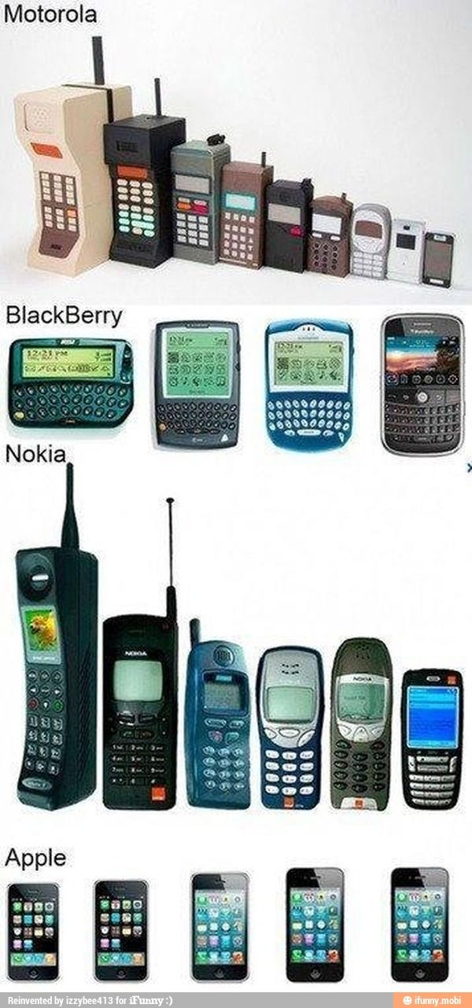
Diffusion of culture
Example: cell phone technology
1980s – expensive and mostly owned by wealthy people in large cities in more developed countries (MDCs)
As cell phone networks grew and cell phones became more mass produced, they eventually spread to a wider market
Today, cell phones have diffused throughout the world

Slide 48
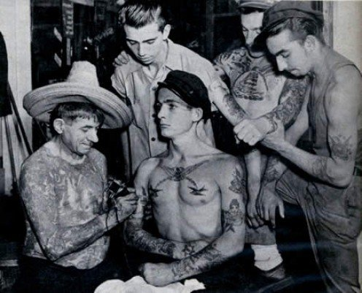
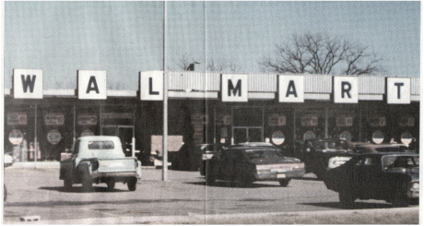
Diffusion of culture – reverse hierarchical
Reverse Hierarchical Diffusion is the processes in which a trait diffuses from a lower class to a higher class.
Example: tattoos
1940-1960, tattoos were a symbol of low social status and were associated with three types of places: seaport towns (dockworkers and sailors), military bases, and prisons.
1970s – the custom has diffused throughout many segments of society and geographic areas
Example: Walmart – from rural Arkansas to nearly every U.S. city

Slide 49
Diffusion of culture - stimulus
Stimulus Diffusion occurs when people in a culture adopt an underlying idea or process from another culture, but modify it because they reject one trait of it.
Example: Hindus in India adopted the practice of eating fast food but rejected eating beef because it would violate their Hindu beliefs. They adapted by making vegetarian and other non-beef burgers.
Example: Europeans adopted the use of lightweight, beautiful porcelain dishes from China but rejected the high cost of importing them. So when Germans found the right type of clay to make their own, they modified the process of obtaining porcelain by making it in Europe.

Slide 50
Learning Objective (3.B.2.d)
By the end of this section, you will be able to explain the diffusion of culture and cultural traits through time and space.
Acculturation, assimilation, and multiculturalism are shaped by the diffusion of culture.

Slide 51
Contact between cultures
Diffusion describes the ways cultures spread.
As they spread, they come into contact with other cultures.
This interaction is one of the driving forces in human history and it can have several types of results:
Acculturation
Assimilation
Multiculturalism
Nativism

Slide 52
Contact between cultures
Acculturation occurs when an ethnic or immigrant group moving to a new area adopts the values and practices of the larger group that has received them, while still maintaining major elements of their own culture.
Example: In the 1880’s, a family migrated from Denmark to a Danish enclave in Iowa. They gave most of their 10 children traditional Danish names, such as Inger and Niels and ate Danish foods. Within three generations, their descendants still ate Danish foods but had names common in U.S. culture, such as Susan, Dave, and Jim.

Slide 53
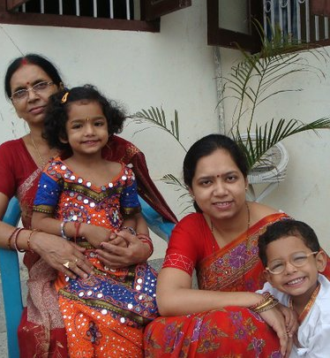
Contact between cultures
Assimilation happens when an ethnic group can no longer be distinguished from the receiving group.
The ethnic groups become more affluent and leave their ethnic areas.
However, complete assimilation is rare as at least one trait usually persists – most commonly religion
Example: the grandchildren of immigrants from India might no longer speak Hindi or eat traditional Indian food daily, but they might still practice their Hindi faith. Often, third or fourth generations will display a resurgence of pride and organize festivals, learn the ethnic language, and revitalize ethnic neighborhoods.

Slide 54
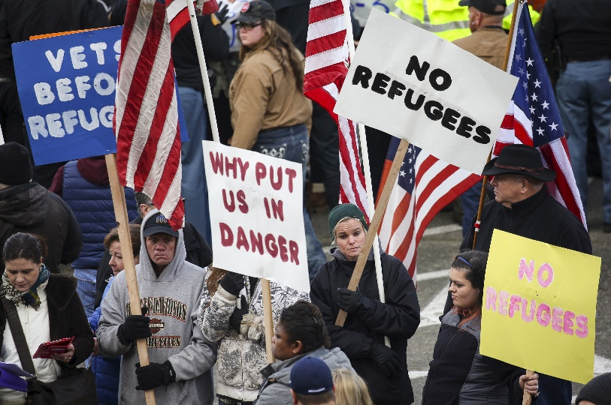
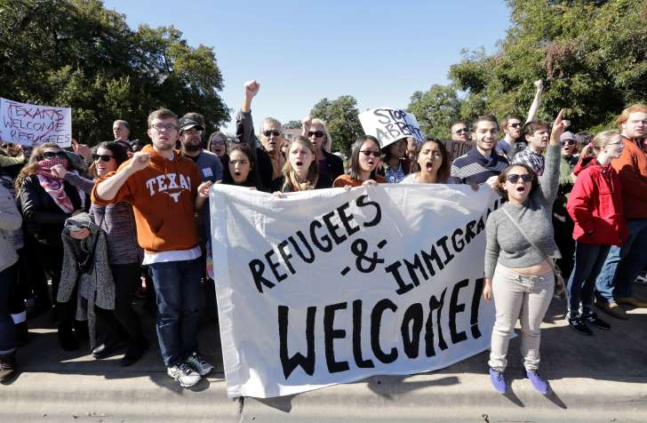
Contact between cultures
Multiculturalism is the coexistence of several cultures in one society, with the ideal of all cultures being valued and worthy of study.
It is believed that the interaction of cultures enriches the lives of all.
Can bring conflicts, as people and groups with different values, beliefs, and customs often clash.
Minority groups face prejudice and discrimination – Syrian refugees fleeing civil war in 2011 faced opposition from some Americans who feared that some refugees could be terrorists.

Slide 55
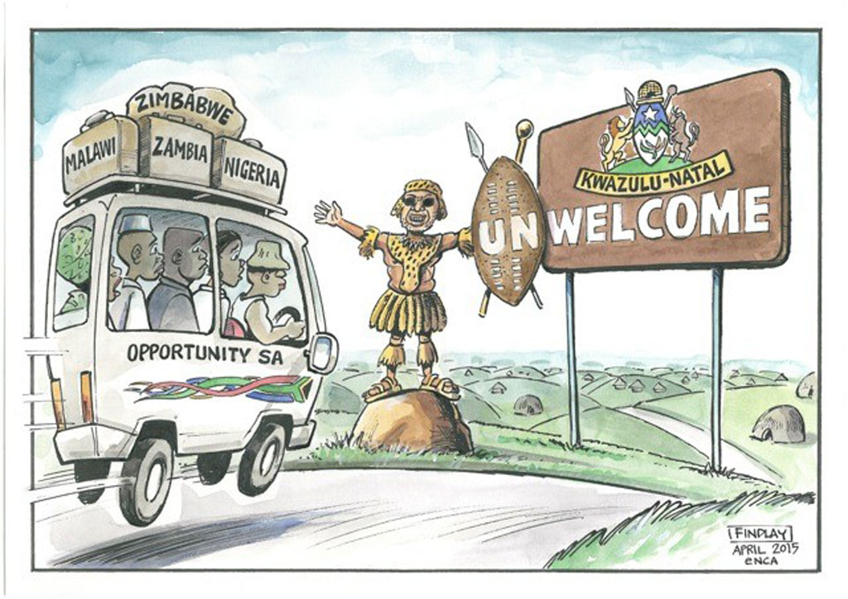
Contact between cultures
Some conflicts between two cultures become harsh
Nativist, or anti-immigrant, attitudes may form among the cultural majority, sometimes bringing violence or government actions against the immigrant or minority group
Can be toward one particular group or a general dislike of people from other countries (xenophobia)
Examples: opposition in the U.S. to Roman Catholic immigrants in the 1800s and early 1900s.

Slide 56
Geographic perspectives
The Diffusion of Deadly Diseases
1918 Influenza Epidemic (contagious diffusion)
Immediately after World War I and killed three times more people than the war itself
Source of outbreak is unclear – Kansas, Great Britain, or France
East coast American cities quickly became hubs for diffusion as soldiers returning home carried the virus or contracted it at the port. Then, traveling home by train, spread it throughout the country
Recent Epidemics
Ebola in West Africa (2013)
Zika virus in South America (2015)

