Slide 1
Trick or Treat
Teach your child NOT to cheat!

Slide 2
Interactive Questions
Do you have a family integrity code?
Do you feel your child(ren) display integrity outside of your presence?
How often do you speak with your child about integrity?

Slide 3
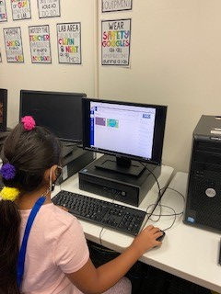
Academic Integrity Means
Students submit their OWN work for assignments and assessments.
Students DO NOT receive unauthorized assistance on assignments and assessments.
Students DO NOT provide unauthorized assistance to other students.
Parents will supervise students to monitor their adherence to the rules of academic integrity.

Slide 4
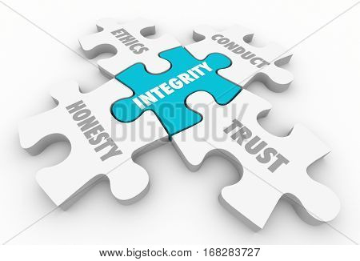
Moral Integrity Means
Student will not display inappropriate images.
Students will not chat, text, or message harassing or inappropriate communication in any digital form.
Students will not chat on any platform not designated by the teacher during scheduled class time.
Students will be in proper dress code when meeting in TEAMS and Zoom.
Sharing passwords or logins is prohibited. Never let another person use your school accounts.

Slide 5
Moral Integrity continued
Students/parents will not make unauthorized recordings of other students, teachers or digital classrooms.
Students will participate and communicate in the classroom virtual setting, not parents or other members of the household.

Slide 6
Video: Kids Talk Cheating: Why Kids Cheat(and Why They Shouldn’t…)

Slide 7
Break the Ice
Watch a movie like Space Jam or Wreck-It Ralph and ask your child what they think about the cheating characters and whether they know anyone who has cheated.
Explain that cheating is wrong because it's unfair to others and people who do it aren't learning things they need to learn.
Some children aren't clear on what's considered cheating, so talk about examples such as looking at a classmate's paper, using the internet, or having someone else complete their assignments.
Be sure to point out the consequences of getting caught cheating too, such as getting a bad grade or not knowing what to do the next time.

Slide 8
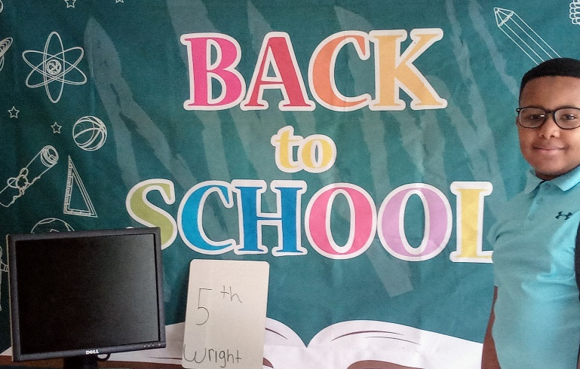
Manage Your Expectations
Since school work stress may lead to cheating, praise your child's efforts rather than focusing exclusively on results.
Assure them that learning and doing their best are more important than top scores. Help them understand that learning is a process and they will eventually reach mastery.
Letting your child know that you don't require perfection the first time they learn something new will decrease anxiety.

Slide 9
Interactive Questions
Have you discussed your academic expectations with your child(ren)?
What do you use to determine your child(ren)’s academic success?

Slide 10
Prep for Peer Pressure
Because students usually want to please, the pressure of not knowing something could make them feel they are disappointing someone. Teach them it is ok to not know and ask for help.
It can be difficult for them to turn away a classmate who is asking for answers to the quiz or to copy homework.
Teach them to shift their body to block their work from rubberneckers and let them know it's okay to tell the teacher after class if someone copies their answers.

Slide 11
Parent Responsibilities
Parents will provide a safe working environment free of distractions.
Parents will NOT engage or attempt to communicate with the teacher via TEAMS or Zoom during instruction time.
Parents will honor, support, and promote the academic integrity of their students.

Slide 12
Video: Academy School District 20 teachers catching students cheating in online classes, parents helping

Slide 13
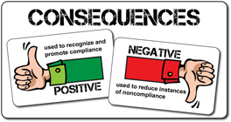
Handle Offenses
If your child cheats despite your warnings, follow through on any consequences you have discussed with them.
Assure your child that learning and doing their best are more important than top scores.

Slide 14
Interactive Questions
How well would you rate yourself as a parent in supporting your child(ren)’s academic integrity?

Slide 15
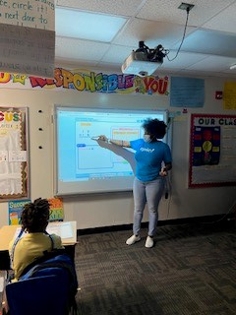
Set a good Example
Help them to avoid cutting corners or being dishonest, practice what you preach.
Allow your child to experience “productive struggle”. Don’t always come to their rescue when they face a difficult task.

Slide 16
Monthly Drawing
There is an opportunity to earn three entries into the drawing.
1. Attending the monthly meeting
Attendance is taken from Zoom
2. Completing the “homework”
Sign and return the Virtual Classroom Policies Agreement
3. Sharing the “Family Involvement” activity
Email a picture of your family engaged in a fall activity to muhammada@leonschools.net by November 12th.

