Slide 1
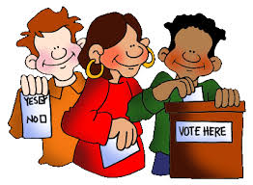
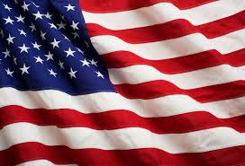
Government
Notes:
Day 1

Slide 2
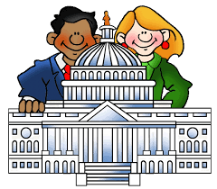
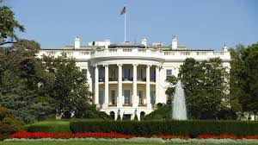
What is a Government?
Government- group of people who work together to run a community!
What do people in government do?
Notes:
Day 1
Decide how to use money for schools, police, and other community needs. They work together to solve problems

Slide 3
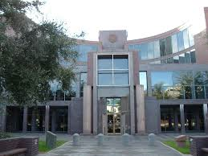
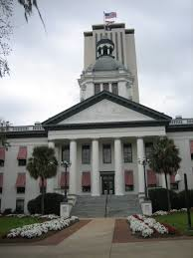
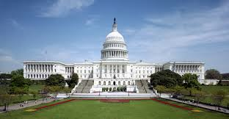
The Three Governments!
What are the three different governments?
Local (located in a city or town hall in your local city)- schools, firefighters, libraries and police
State (located in state capital)- colleges, parks and roads
National (located in Washington D.C)- National Park Service, U.S. Post Office, Military
Notes:
Day 1/Day 2 (depending on time) Must right one example of a service and where they are located

Slide 4
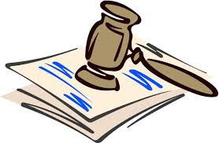
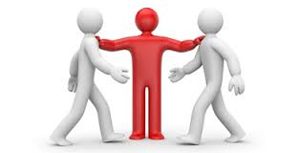
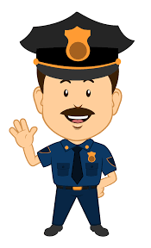
Why Do We Have A Government?
3 Reasons for Government:
To Keep Order; example: having laws
To Manage Conflicts; example: judge
To Protect People; example: police, firemen
Notes:
Day 20 Must write reasons and examples

Slide 5
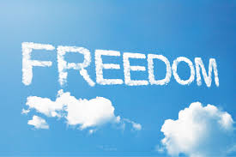
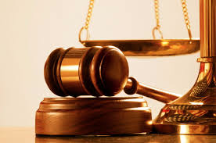
Review: A Government Is…
What is a government?
A group of people working together to run a community!
Add to the back of your “A Government Is…” Foldable:
The U.S. has what kind of government?
Democracy- a government by the people.
Liberty- freedom
Justice- fairness
Notes:
Day 3- Add to “A Government Is…” Foldable on the left side of lapbook
Must add definition of liberty, justice and democracy to back of foldable

Slide 6
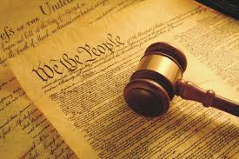
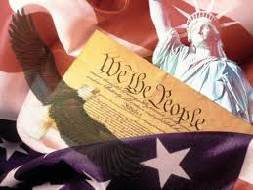
The Constitution
Constitution- a new plan of government for the United States. It describes our government in three different branches.
Why do we need it?
It makes sure that we have a say in how the government is ran. It gives us Liberty and Justice!
Notes:
Day 3: Must write definition of Constitution and provide one reason as to why we need it!

Slide 7
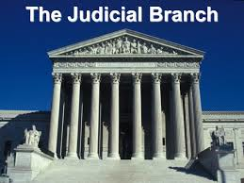
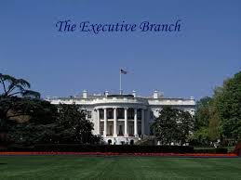
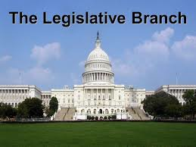
3 Branches of Government!
Legislative Branch (Capital in Washington, D.C.)- They make laws!
Executive Branch (The White House)- Carry out the laws! They see to it that the law is being put into effect.
Judicial Branch (The Supreme Court)- They review the laws and make sure that they follow the Constitution (Make sure that our rights are not taken away and that the laws are fair).
Notes:
Day 3/Day 4: Must write what each branch does

Slide 8
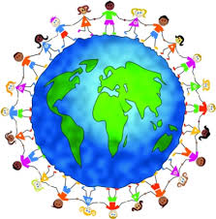
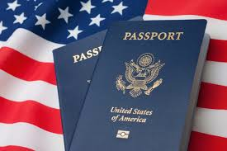
What It Means To Be A United States Citizen!
Citizen- A person who belongs to a place.
We have rights as a citizen!
Rights- something we CAN do; examples?
Notes:
Day 5: Must write definition of citizen and rights

Slide 9
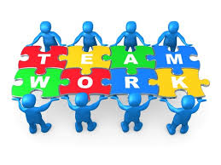
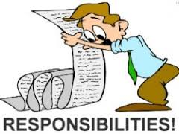
What Good Citizens Do!
Let’s Review! https://jr.brainpop.com/socialstudies/citizenship/rightsandresponsibilities/
We have Responsibilities- Something you should do! Examples?
Good Citizens:
Care about our rights!
Make things fair!
Work together!
Notes:
Day 6: Must write down definition of responsibilities and what good citizens do.

Slide 10
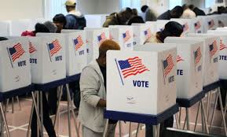
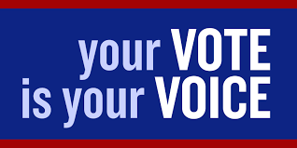
Voting!
Voting- it gives us a say in how the government is run.
Voting is important because it gives us a voice!
When we vote, we are making sure that power is balanced between citizens and the government, our opinion matters!
How can you vote?
Notes:
Day 6/7: Must write down definition of voting and why it is important/why we need it.

Slide 11
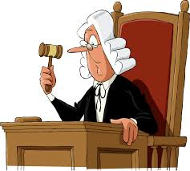
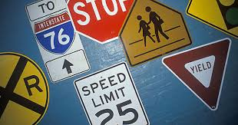
Why We Need Laws!
Law- a rule that everyone in a community, state, or country must follow. Example: traffic laws
Who helps with laws? Police and Judges!
Judge- someone who decides when people don’t agree about laws
Notes:
Day 7: Must write down the definition of Law and Judge, provide one example of who helps enforce laws

Slide 12
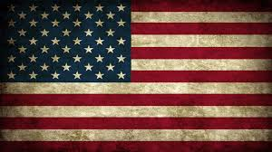
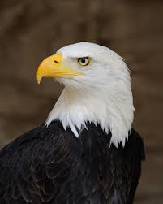
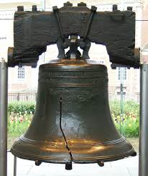
United States Symbols!
https://jr.brainpop.com/socialstudies/citizenship/ussymbols/
Symbol- Something that stands for something else, example: heart is an symbol of love
American Flag represents whole country! 50 stars=50 states; 13 stripes=13 original colonies
Bald Eagle represents strength and freedom. It is the national bird of the United States.
Liberty Bell represents freedom. It hangs in Philadelphia and is rung every July 4th.
Notes:
Day 8: Must have all 6 symbols in their pocket foldable, must have at least 3 with what they represent on the back!

Slide 13
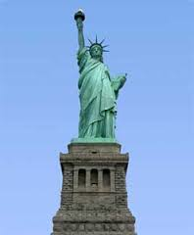
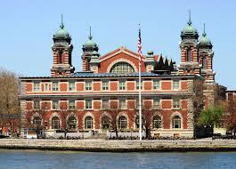
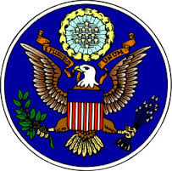
More United States Symbols!
Statue of Liberty represents freedom, hope and friendship. It was a gift from France to represent our friendship.
Ellis Island represents hope and freedom of people who are coming to America.
US Seal represents our country’s values, or what we believe in. It is founded on the back of the one dollar bill.
Notes:
Day 8

