Slide 1
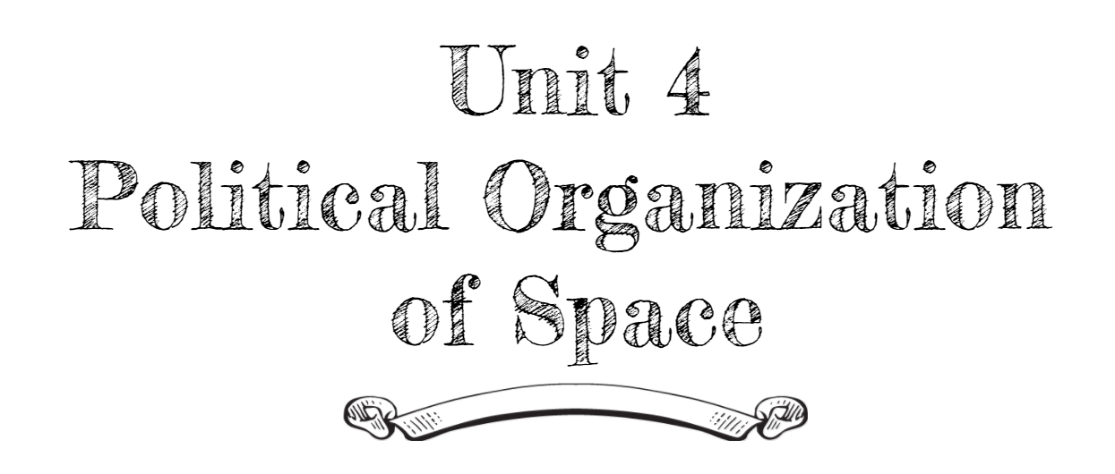
By: Carli Terrell (Orlando, Florida)
This PPT has been created using the information from the AMSCO Human Geography: Preparing for the Advanced Placement Examination book.
Palmer, David. AMSCO Advanced Placement Human Geography. Perfection Learning, 2019.

Slide 2
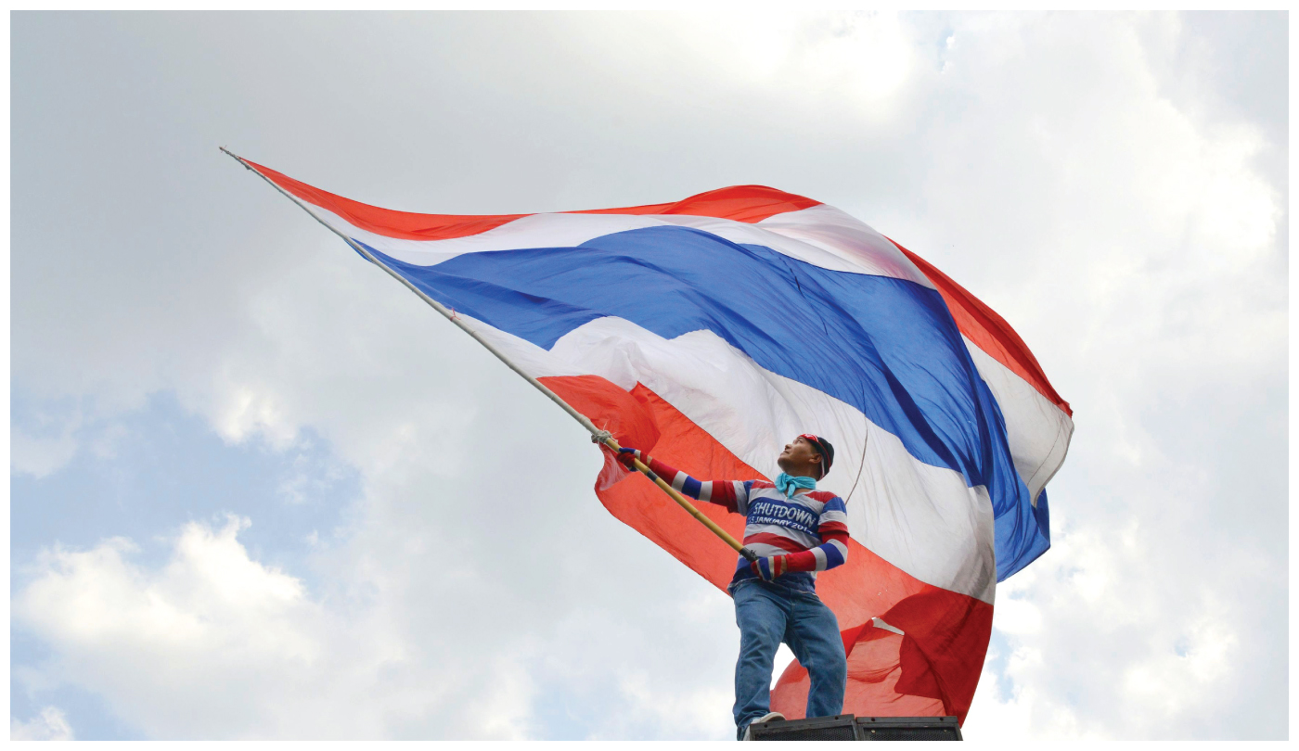
Unit 4 – political organization of space
Ch 10: Territory, Power, and Boundaries

Slide 3
Enduring Understanding (4.B)
By the end of this section, you will understand that spatial political patterns reflect ideas of territoriality and power at a variety of scales.
Territoriality: connection of people, culture, and their economic system to the land.
Power: geographic control over people, land, and resources.

Slide 4
Learning objective (4.B.3)
By the end of this section, you will be able to analyze the spatial relationships between political systems and patterns of culture and economy.
Students will know that political boundaries do not always coincide with patterns of language, religion, ethnicity, nationality, and economy.

Slide 5
THE EFFECTS OF BOUNDARIES
Language and Religion
Sometimes boundaries separate people who speak the same language, practice the same religion, or share other traits.
Example: Berlin Conference/Africa
Other times, a region becomes a Shatterbelt, one that suffers instability because it is located between two very different regions.
Example: Eastern Europe between Western Europe (Roman Catholic/Protestant and capitalist) and Russia (Orthodox and communist)
Example: Caucasus mountain region and the Sudan

Slide 6
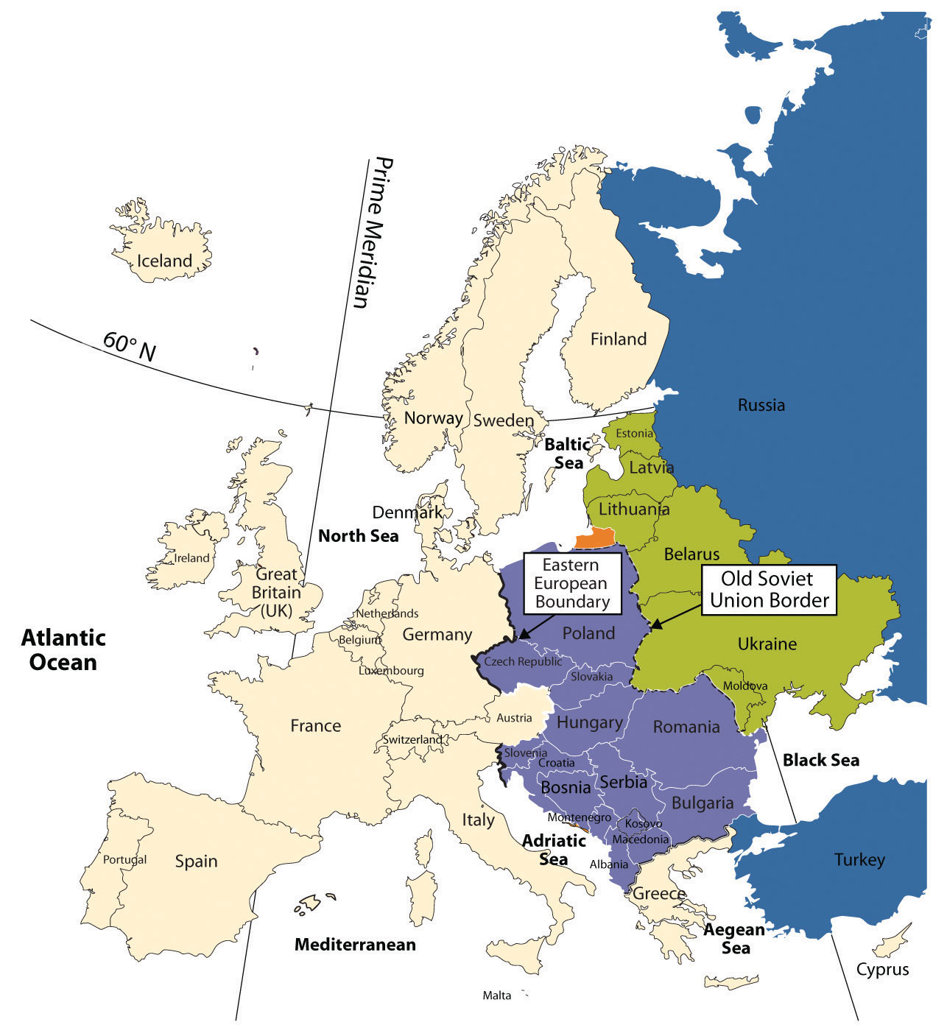
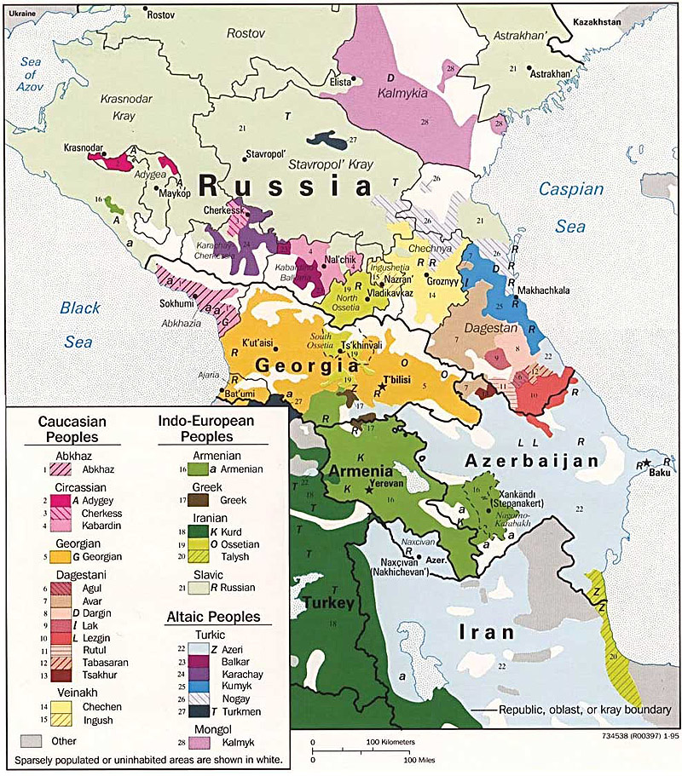
Eastern Europe
Caucasus Region

Slide 7
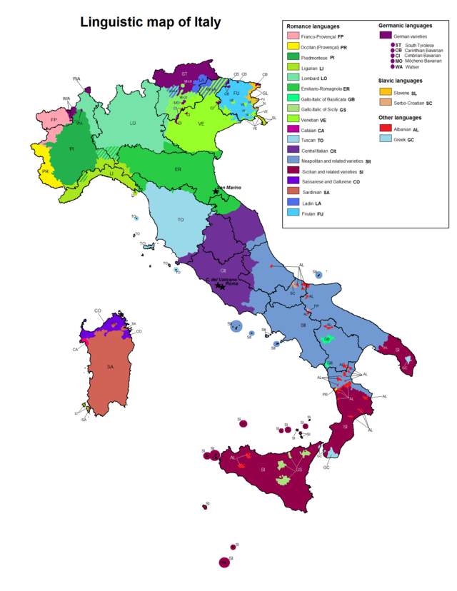
THE EFFECTS OF BOUNDARIES
Language and Religion
As people move and boundaries change, so does language as dialects are developed on different sides of the borders
This can sometimes complicate the process of unification
Example: Italy – after 150 years of unification, people still speak several different languages

Slide 8
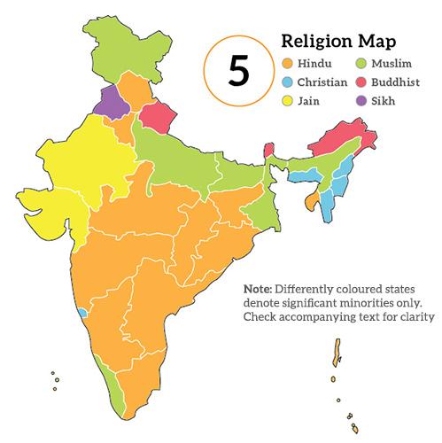
THE EFFECTS OF BOUNDARIES
Language and Religion
Religion and boundaries cause conflict too
Example: India – mostly Hindus but a large minority are Muslims
Not all countries with different faiths have conflict, however.
Non-examples: United States and South Korea

Slide 9
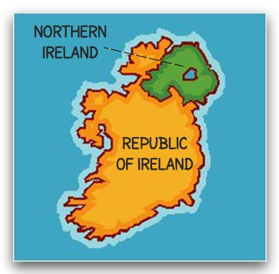
THE EFFECTS OF BOUNDARIES
Language and Religion
Ireland
Won independence from the UK and formed the Republic of Ireland (95% Roman Catholic)
Northern Ireland remained part of the UK (mostly Protestant)
Divided Catholics who wanted to be together in one country
United Catholics and Protestants into one political entity leading to three decades of violence

Slide 10
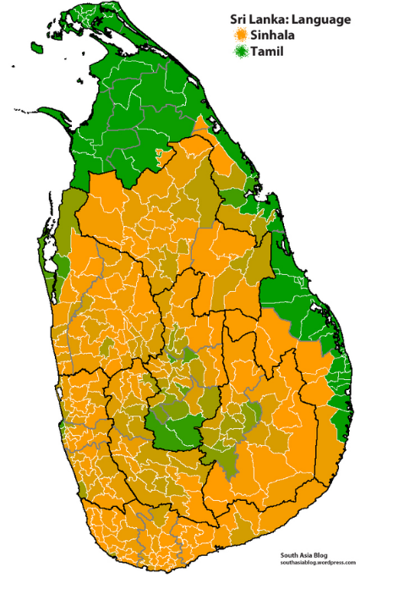
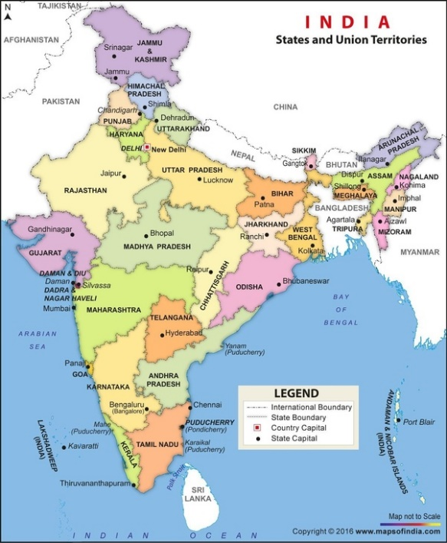
THE EFFECTS OF BOUNDARIES
Ethnicity, Nationality, and Economy
Superimposed boundaries may create conflict when space is being shared by two nations.
Example: Sri Lanka – home to the Sinhalese (majority; Buddhists; southern) and the Tamils (minority; Hindus; north and eastern).
The Tamils feel as if they are treated as second-class citizens and rebelled against the Sinhalese.
They lost but around 75,000 Sri Lankans lost their lives.

