Slide 1
Unit 2 – part iB: population
Population and migration

Slide 2
Enduring Understanding (2.B)
By the end of this section, you will understand that populations grow and decline over time and space.

Slide 3
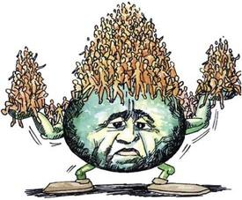
Enduring Understanding (2.B)
Essential Question
What are the political, social, and economic consequences of the rapid population growth of the past 200 years?

Slide 4
Learning objective (2.B.1)
By the end of this section, you will be able to explain contemporary and historical trends in population growth and decline.
Demographic factors that determine population growth and decline are fertility, mortality, and migration.
Rates of natural increase and population-doubling times are used to explain population growth and decline.
Social, cultural, political, and economic factors influence fertility, mortality, and migration rates.

Slide 5
Population growth and decline
“A finite world can support only a finite population; therefore, population growth must eventually equal zero.” –Gerrett Hardin, “The Tragedy of the Commons,” 1968
Before the 19th century, the total human population grew very slowly
Improvements to farming techniques, clearing forested land to expand land for crops, and finding new regions of the ocean dense in fish allowed people to become more efficient at extracting energy from the environment

Slide 6
Population growth and decline
1800 – population reached 1 billion people
In the 200+ years since then, world population exploded – around 7.4 billion today
Prediction – nearly 11 billion by 2100

Slide 7
Population growth and decline

Slide 8
Measuring number of births
Geographers commonly use two different statistics to describe the rate and which children are born
Crude birth rate (CBR) – the number of live births per year for each 1,000 people
Total fertility rate (TFR) – the average number of children who would be born per woman of that group in a country, assuming every woman lived through her childbearing years
TFR more accurately reflects cultural norms

Slide 9
Measuring number of births
In most of the world, the TFR was higher in the past than it is today.
Parts of Europe before 1800s – 6.2 children; more children meant more people to work the land
However, so many children died as infants and people lived, on average, about 40 years.
Despite the high TFR, population growth was slow

Slide 10
Measuring number of births

Slide 11
Changes in fertility
Beginning in the 1800s, Europeans began having less children
Unintentional – countries began keeping larger standing armies so men were away from home for longer periods
Intentional – with the Industrial Revolution replacing manual labor with machinery, fewer children were needed; however, industrialization also enabled people to live longer so even though TFR declined, population growth increased

Slide 12
Changes in fertility – role of women
Cultural, economic, political, and environmental realities have always shaped decisions about whether to have children
As countries have industrialized, women have begun working in factories – lived in small houses near the cities and families became smaller
Children worked in the factories until outlawed by the government – public schools were opened and young women became educated, expanding their work opportunities
More work and school – fewer children

Slide 13
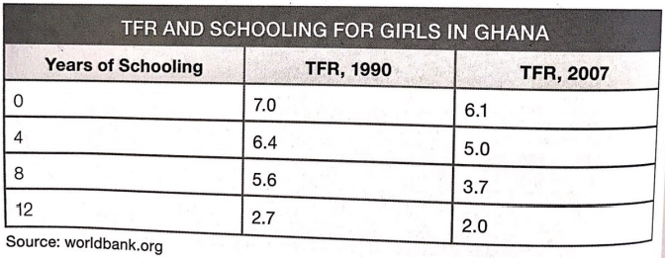
Changes in fertility – role of women
Between 1990 and 2007, as young women gained more education, the number of children they had decreased

Slide 14
Changes in fertility – family planning
Throughout the 20th century, the spread of family planning information and changes in technology aided people who wanted to choose the number of children they had
With access: had their first child later in life, had fewer children, had fewer unintended pregnancies, and had larger intervals between having children
In these places, the TFR continued a decline that began with the Industrial Revolution

Slide 15
Changes in fertility – family planning
Religion
Some traditions oppose certain forms of family planning
Women who follow traditional religious beliefs, regardless of the religion, have higher fertility rates than those who do not
Less likely to use birth control and less likely to be employed outside the home

Slide 16
Life expectancy
Global Population Increase
The most important factor in the increase in global population is the rise in life expectancy – the number of years the average person will live
The most important factor increasing life expectancy is the drop in the infant mortality rate – the number of children who die before their first birthday
Example: Massachusetts – In the 1850s, the IMR was 130 per 1,000. Today, the IMR is about 4 per 1,000.

Slide 17
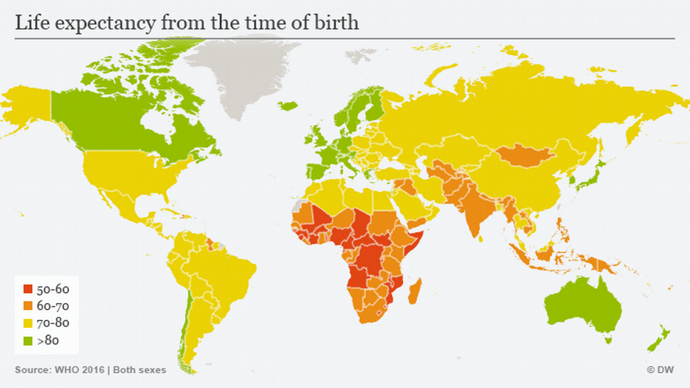

Slide 18
Life expectancy
Better Food Production and Nutrition
Agricultural advances
Mechanized food production, such as replacing horses with tractors
Improving seeds, fertilizers, and farming techniques
Transporting products more efficiently
In the US in 1800, almost everyone farmed. Today, only 3% of the population are farmers, yet they produce enough food to feed everyone in the country and export vast quantities

Slide 19
Life expectancy
Better Food Production and Nutrition
Effects of these Advances
Allowed people to work outside of farming
Food security improved around the world
Farm families became smaller
Small farms were consolidated into one large farm allowing people to move to urban areas

Slide 20
Life expectancy
Advances in Public Sanitation
As industrial cities grew, so did the problems
Spread of cholera and other diseases through water contaminated by human waste
Plague carried by fleas that lived on rodents
Creation of public sewer systems – people used to dump human waste into streets and rivers, contaminating the water and making people sick, especially children and the elderly
Boil water before paying for clean water through taxes
Created Department of Public Sanitation – trash pickup (less rodents)

Slide 21
Life expectancy
Improvements in Healthcare
Improvements in food production kept people healthier
Vaccines prevented disease, antibiotics cured disease, and improved medical procedures boosted life expectancy
Before 1800s – smallpox killed 400,000 people each year but due to the vaccine being administered around the world, no case of smallpox has been reported since 1977
Antibiotics – penicillin in the mid 1900s; before this, in the mid 1300s, the plague killed 20 million Europeans

Slide 22
Learning objective (2.B.2)
By the end of this section, you will be able to interpret and apply theories of population growth and decline.
The demographic transition model (DTM) may be used to explain population change over time and space
Malthusian theory is used to analyze population change and its consequences
The epidemiologic transition explains causes of changing death rates

Slide 23
Demographic transition model (DTM)
Changes in birth rate and death rate in a country are shaped by how a country changes from an agrarian (agricultural) society to an industrial society.
The DTM shows five typical stages of population change as countries modernize
MDCs passed through these stages first while LDCs are still passing through the early and middle stages

Slide 24
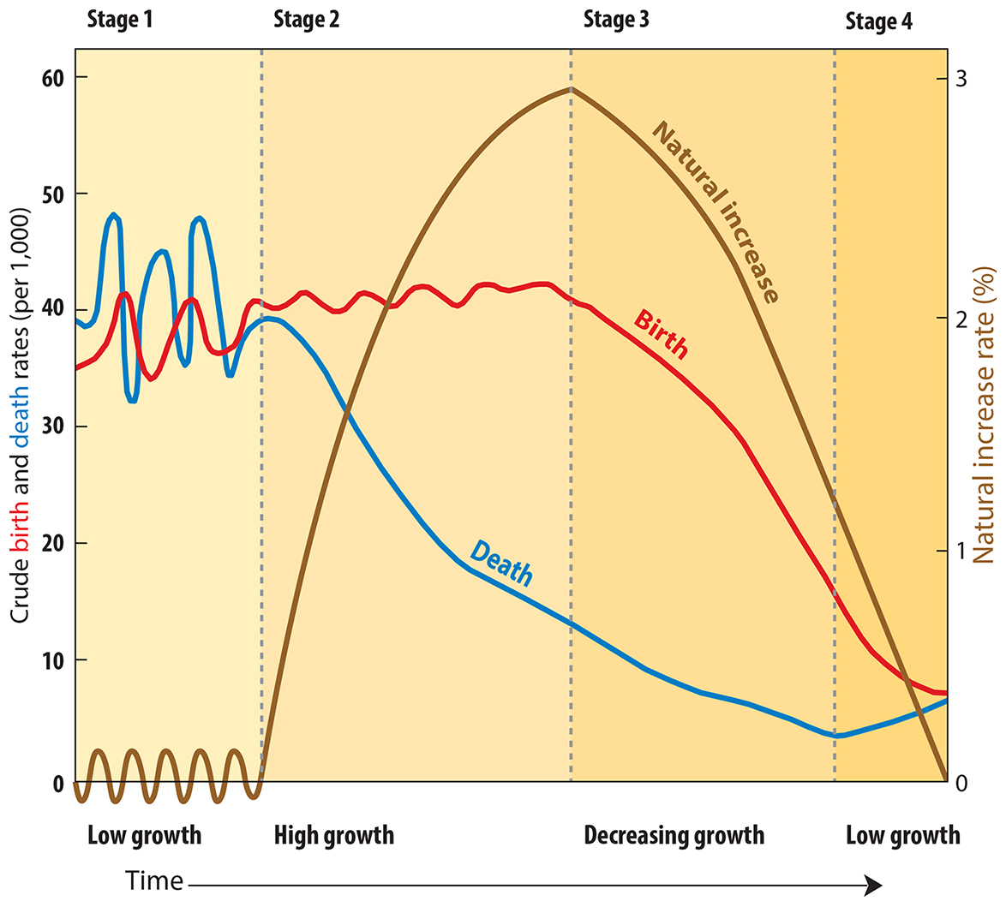
Demographic transition model (DTM)

Slide 25
Demographic transition model (DTM)
Stage 1
Factor: high stationary
Birth rate: high, but fluctuating as need for farm labor changes
Death rate: high, but fluctuating to reflect diseases and poor sanitation
Population change: very low growth (CBR and CDR are both high)
Examples today: scattered isolated groups – “nobody is in stage 1”
Population structure: very young

Slide 26
Demographic transition model (DTM)
Stage 2
Factor: early expanding
Birth rate: high, but fluctuating to reflect desires for big families
Death rate: rapidly declining as nutrition, sanitation, and medicine improve
Population change: rapid growth as CDRs fall faster than CBR
Examples today: Mali, South Sudan, The Gambia
Population structure: very young

Slide 27
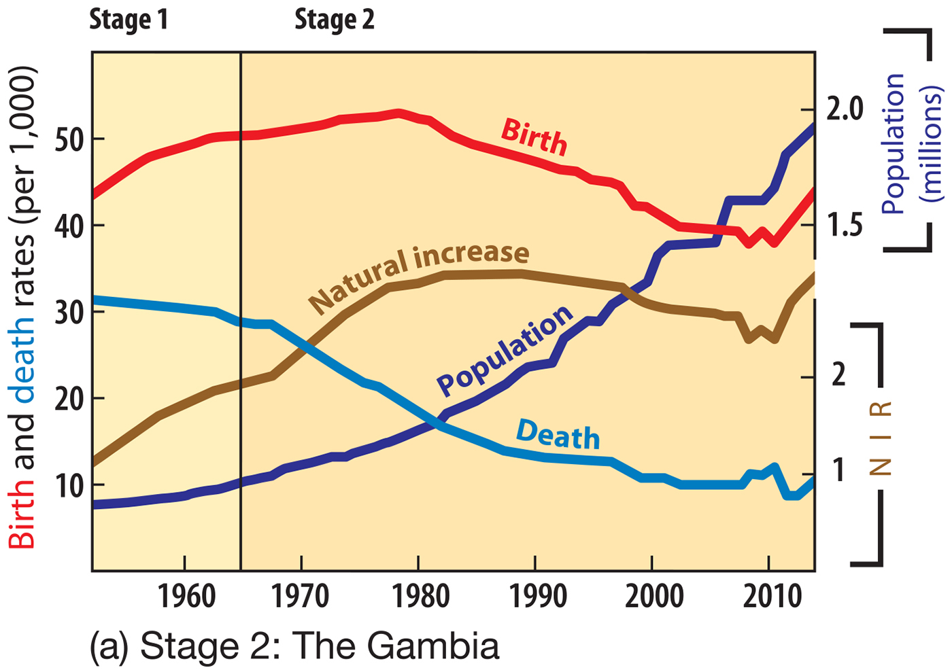

Slide 28
Demographic transition model (DTM)
Stage 3
Factor: late expanding
Birth rate: declining as urbanization decreases the need for child labor
Death rate: declining, but not as fast as in Stage 2
Population change: rapid but slowing growth as CBR declines
Examples today: Mexico, Turkey, Indonesia
Population structure: young, with rising life expectancy

Slide 29
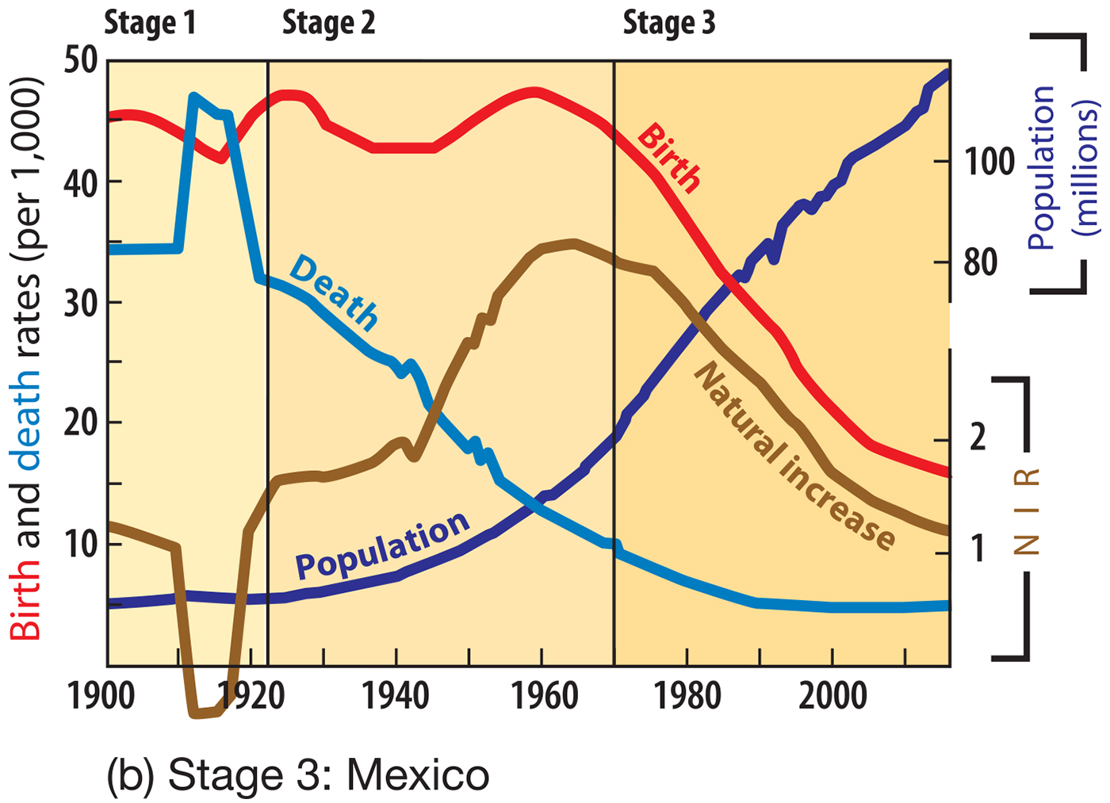

Slide 30
Demographic transition model (DTM)
Stage 4
Factor: low stationary
Birth rate: low, but enough to keep the population stable
Death rate: low and stable
Population change: very low growth because CBR and CDR are low
Examples today: United States, China, Denmark
Population structure: balanced, with more aging

Slide 31
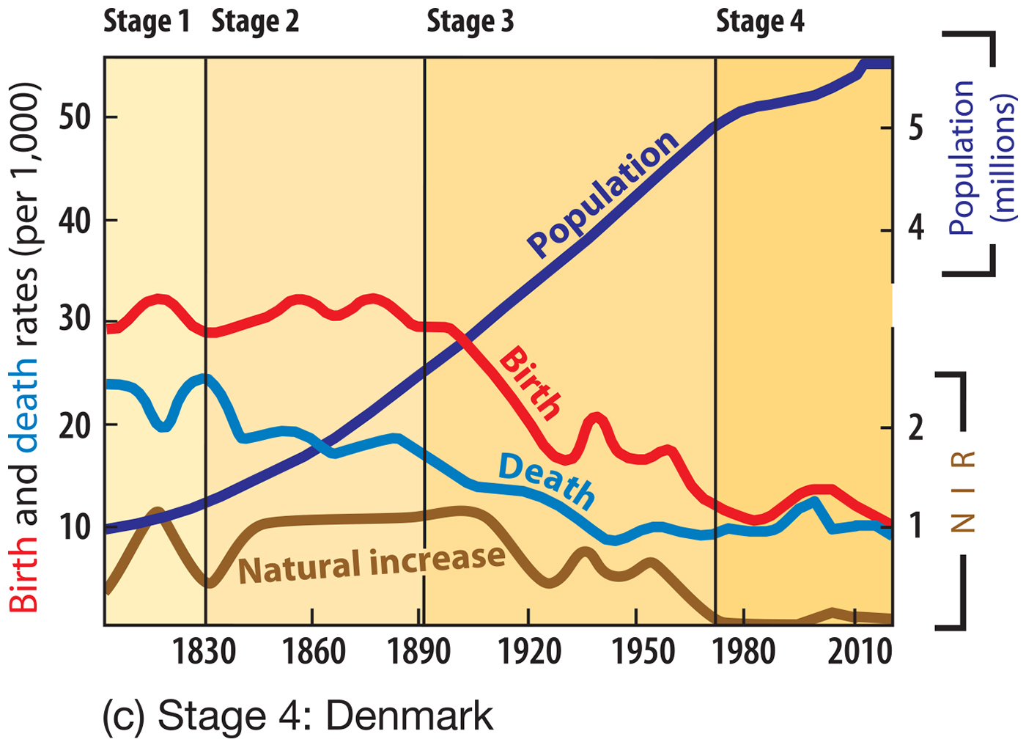

Slide 32
Demographic transition model (DTM)
Stage 5
Factor: declining
Birth rate: so low it falls below the death rate
Death rate: low, sometimes increasing as the population ages
Population change: very low decline as CBR fall below CDR
Examples today: Japan, Germany
Population structure: very old

Slide 33
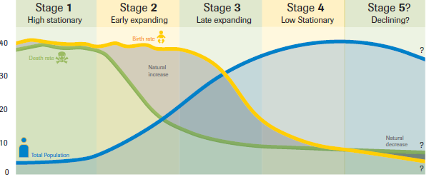

Slide 34
Demographic transition model (DTM)
DTM and Population Pyramids
Stages 2-5 of the DTM each tend to produce a different shaped population pyramid

Slide 35
Demographic transition model (DTM)
Stage 2: Niger has a high birth rate (wide base) and a low life expectancy (narrows earlier) = rapid population growth

Slide 36
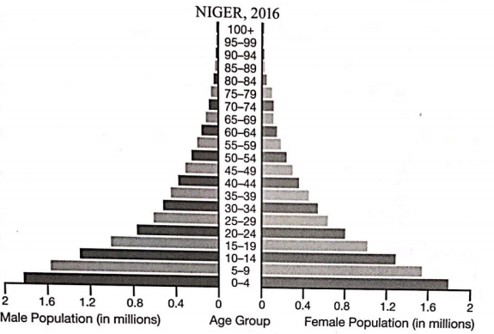

Slide 37
Demographic transition model (DTM)
Stage 3: Turkey has a declining CBR and a more slowly declining CDR – most are under 34 but percentage of elderly is increasing as life expectancy goes up

Slide 38
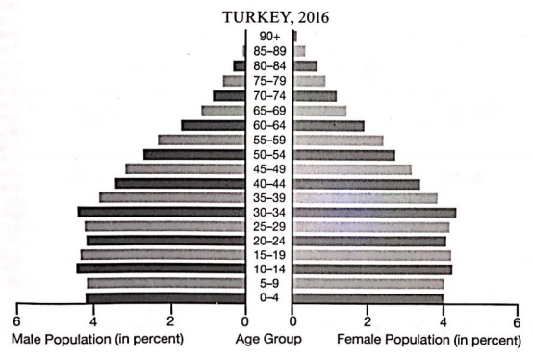

Slide 39
Demographic transition model (DTM)
Stage 4: France’s pyramid indicates a population that is not growing or shrinking – CBR is low but steady and CDR is low

Slide 40
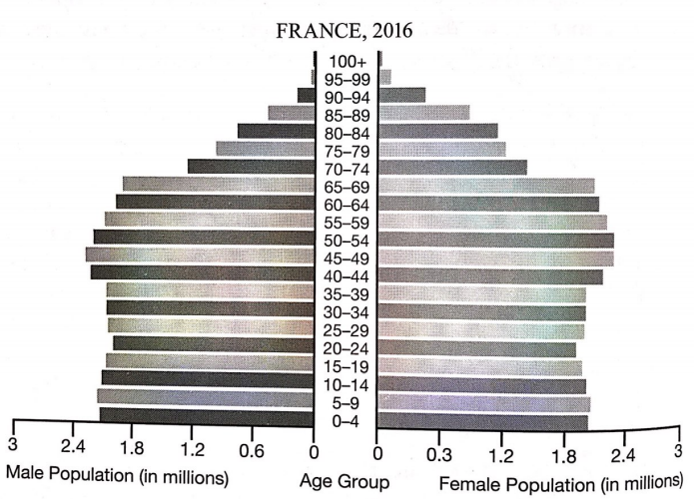

Slide 41
Demographic transition model (DTM)
Stage 5: Japan’s pyramid represents Stage 5; the narrow base reflects a decreasing CBR – the population is aging and declining slightly overall. The largest age group is 65-69.

Slide 42
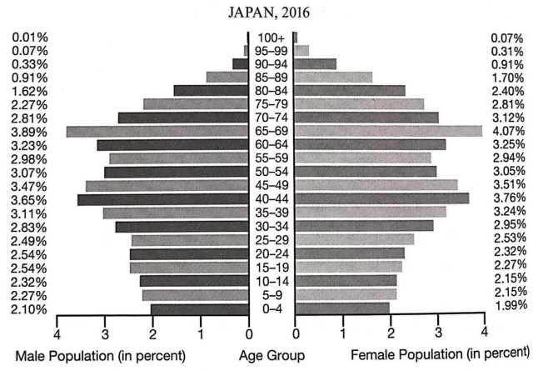

Slide 43
Demographic transition model (DTM)
Policy Implications
As countries move from stage to stage, they face different challenges
Stage 2 or 3 with a relatively high percentage of young people often lacks the resources to educate all children
Stage 4 with a relatively high percentage of old people often faces problems funding healthcare
However, the elderly can vote and therefore have more influence than children

Slide 44
Demographic transition model (DTM)
Rate of Population Increase
Population increase or decrease is measured by subtracting the number of deaths from the number of births
To compare countries of different sizes, demographers use rates instead of numbers
CBR and CDR are per 1,000 people
The percentage at which a country’s population is growing or declining, without the impact of migration, is the rate of natural increase (RNI).

Slide 45
Demographic transition model (DTM)
Use this formula:
RNI = (CBR-CDR)/10
For the entire world, the CBR is about 20 and the CDR is about 8.
RNI = (20-8)/10 = 1.2%
Note: RNI tends to be less than 1% in MDCs and greater than 1% in LDCs

Slide 46
Demographic transition model (DTM)
Demographic Balancing Equation
Natural increase is only part of a country’s total population change
Migration plays a major part and must be added to the equation
Immigration – people who move INTO the country
Emigration – people who move OUT of the country
This formula is called the demographic balancing equation
Total Population Change = Births – Deaths + Immigrants - Emigrants

Slide 47
DTM – Population doubling time
Arithmetic growth
When the increase is a constant number each period
Ex: 1, 2, 3, 4 (add 1) or 1, 5, 9, 13, 17 (add 4)
Exponential growth
When the increase is a constant factor each period
Ex: if the factor is 2, the number doubles each period (1, 2, 4, 8).
Growth by 5 would be 1, 5, 25, 125, etc.

Slide 48
DTM – Population doubling time
Since the early 1800s, global population has been growing exponentially.
The time it takes to double in size can be estimated using the Rule of 70: assuming the growth rate remains steady, the approximate doubling time in years will be 70 divided by the growth rate per year
Example: in 2014, the Ivory Coast had a population growth rate of about 2.0 and since 70/2 = 35, if the growth rate stays the same, the population will double in 35 years.
Example: the US had a population growth rate of .77. What is the doubling time?
About 91 years.

Slide 49
Learning objective (2.B.2)
By the end of this section, you will be able to interpret and apply theories of population growth and decline.
The demographic transition model (DTM) may be used to explain population change over time and space
Malthusian theory is used to analyze population change and its consequences
The epidemiologic transition explains causes of changing death rates

Slide 50
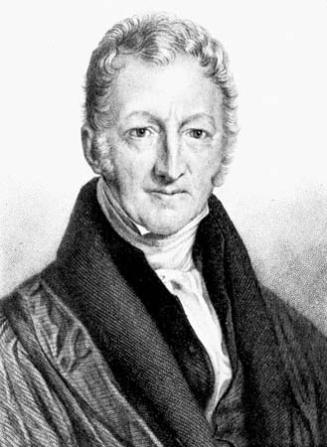
Ideas of Thomas Malthus
Malthus in His Time – Malthusian theory
Early 1800s - member of the clergy and an early economist
Focused on the relationship between people and the earth
During this time, people believed that new technology would make life better but Malthus was not so sure
Analyzed the relationship between agricultural output and the growing number of people – concluded that society was on a path toward massive starvation
Food production was growing arithmetically while population would grow exponentially

Slide 51
Ideas of Thomas Malthus
Malthus Today
Geographers and social scientists have debated his theory
Food production grew more quickly than predicted – so famine did not reach the scale he predicted
Neo-Malthusians are people today who have adapted his ideas to modern conditions and argue that global population is a serious issue
Will lead to depletion of nonrenewable resources (petroleum and metals), pollution of air and water, and shortages of food

Slide 52
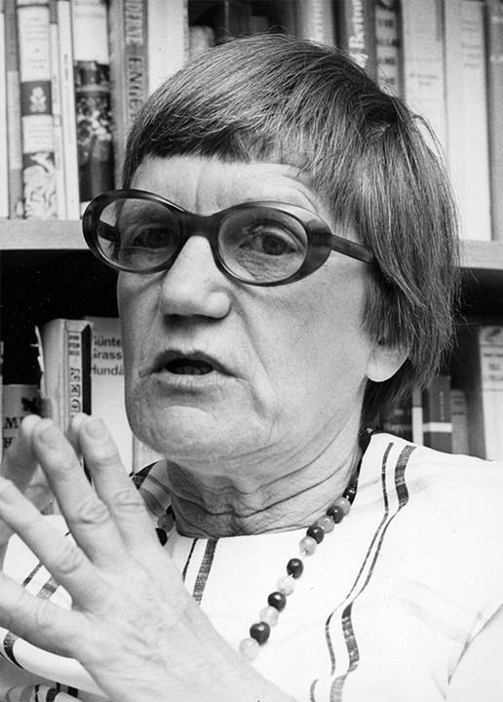
Ideas of Thomas Malthus
Ester Boserup
Economist whose work turned out to be first real opposition to Malthus.
Said Malthus did not take technology into account and said we would find alternatives.
Made a point that widespread misery forecast by Malthus hadn't occurred.
In 1965, published "The Conditions of Agricultural Growth". Also came up with a model of agricultural development.

Slide 53
Learning objective (2.B.2)
By the end of this section, you will be able to interpret and apply theories of population growth and decline.
The demographic transition model (DTM) may be used to explain population change over time and space
Malthusian theory is used to analyze population change and its consequences
The epidemiologic transition explains causes of changing death rates

Slide 54
Demographic transition model (DTM)
Epidemiological Transition Model (ETM)
1970s – epidemiologist Abdel Omran identified predictable stages in disease and life expectancy that countries experience as they develop
The stages of the ETM correspond with the stages of the demographic transition model

Slide 55
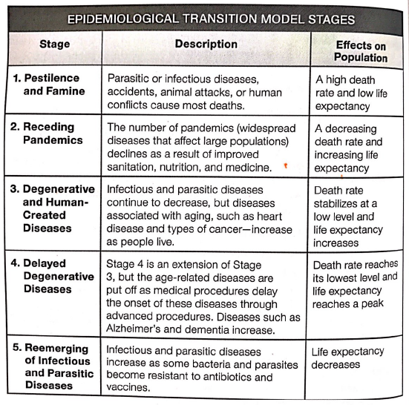

Slide 57
Learning objective (2.B.3)
By the end of this section, you will be able to evaluate various national and international population policies.
Types of population policies include those that promote or restrict population growth (pronatalist, antinatalist)

Slide 58
Changes in fertility
Government Programs to Reduce Births
Concerns about overpopulation have led to anti-natalist policies, programs to decrease the number of births
China – two different policies in the 1970s
Later, longer, fewer
One Child Policy

Slide 59
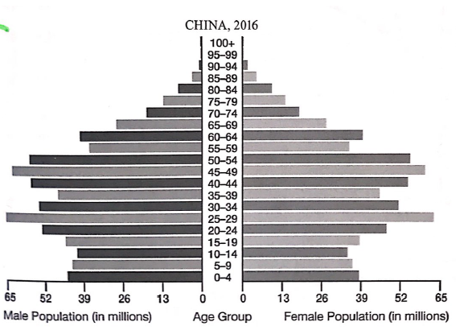
Changes in fertility
Later, longer, fewer
1972, encouraged parents to get married later in life, wait longer between children, and as a result have fewer children
Impact – relatively shorter bars for the 40-44 and 35-39 cohorts
Resulted in reduced fertility but not as quickly as officials wanted → One Child Policy

Slide 60
Changes in fertility
One Child Policy
1979, parents who had more than one child were subject to fines, although the law made exceptions for rural couples and ethnic minorities; ended in 2016
Impact – fertility rate decreased but some argue other factors (educated women, etc.)
Impact – reduced number of adult workers and could potentially reduce economic growth and reduce workers to support the elderly
Impact – unbalanced gender ratio; some girls were aborted or orphaned without registering with the government allowing for another try
Ratio in 210 – 118 males to 100 females
Males outnumber females globally and China accounts for half of that gap

Slide 61
Changes in fertility
2016 – modified to two children
Other countries used more targeted programs
Europe – birth control education decreased teen pregnancy
Africa and South Asia – laws banning child marriage raised the average marriage age and the age that a woman had her first child

Slide 62
Changes in fertility
Government Policies to Encourage Births
Throughout history, some governments have encouraged large families
Stimulate economic growth and increase military power
As fertility rates drop but people lived longer, the percentage of _______ increased?
To keep the economy vibrant, countries such as France, Sweden, and Japan instituted pro-natalist policies designed to increase fertility rate
Notes:
Elderly

Slide 63
Changes in fertility
Examples
Paid time off from jobs held by mothers
Free childcare
Family discounts for government services
Free college tuition
Restrictions on birth control and abortions
Notes:
Elderly

Slide 65
Learning objective (2.B.4)
By the end of this section, you will be able to analyze reasons for changes in fertility rates in different parts of the world.
Changing social values and access to education, employment, health care, and contraception have reduced fertility rates in most parts of the world
Changing social, economic, and political roles for women have influenced the patterns of fertility, mortality, and migration.

Slide 66
Learning objective (2.B.4)
By the end of this section, you will be able to analyze reasons for changes in fertility rates in different parts of the world.
Changing social values and access to education, employment, health care, and contraception have reduced fertility rates in most parts of the world
Changing social, economic, and political roles for women have influenced the patterns of fertility, mortality, and migration.

Slide 67
Learning objective (2.B.5)
By the end of this section, you will be able to explain the causes and implications of an aging population.
Population aging is influenced by birth and death rates and life expectancy
An aging population has social (retirement), economic (dependency ratio), and political (voting patterns) implications.

Slide 68
Learning objective (2.B.5)
By the end of this section, you will be able to explain the causes and implications of an aging population.
Population aging is influenced by birth and death rates and life expectancy
An aging population has social (retirement), economic (dependency ratio), and political (voting patterns) implications.

