Slide 1
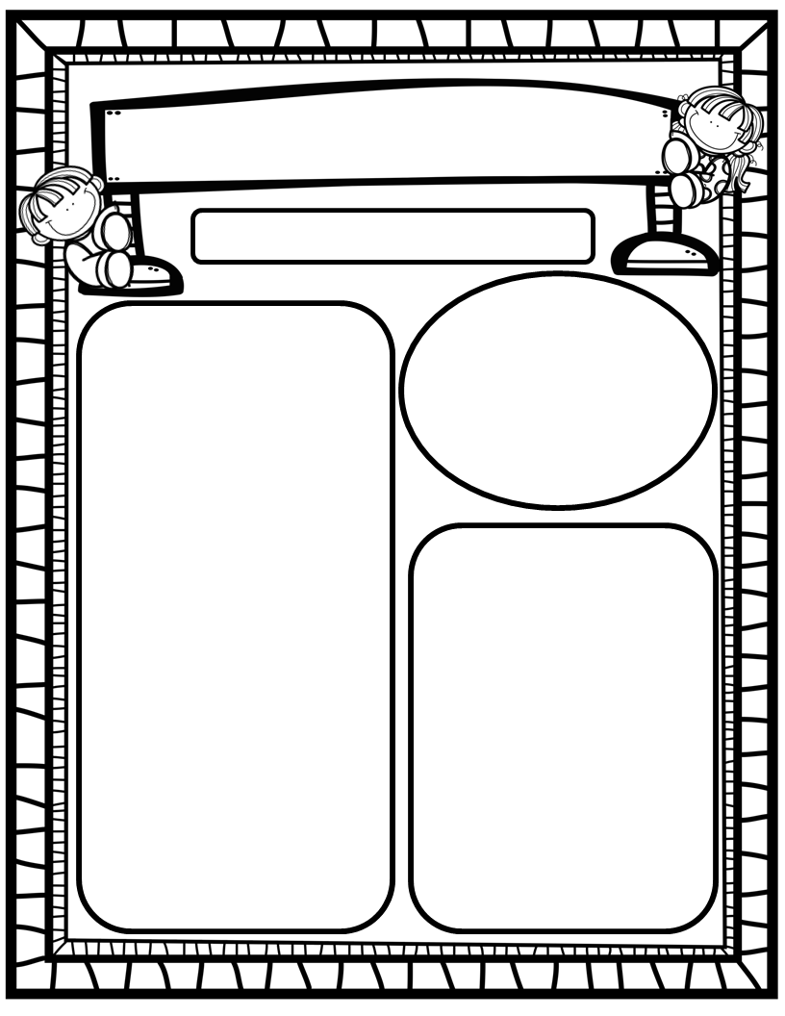
The Deason Digest Weekly Blast
April 28th, 2025
Homework:
Read to and with your child each night and complete Reading Rally Log!
Practice HFW’s: the, I, and, a, is, as, said, to, do, of, see, he, be, me, from, was, you, have, what, your, want, go, no, so, goes, says, she, we, they, their, were, talk, walk, could, would, should, or, for, where, there, who, by, my
Go Math Home Practice for Ch. 18
UFLI Home Practice Pages
Go over Weekly Work and discuss
We Are Learning About…
Reading: We will focus on the long vowels Oo and Ee along with silent/bossy e (spelling pattern o_e/bone, e_e/Pete), as well as HFW’s REVIEW. We will identify main topic and key details in texts we read. We will look at pictures, get our mouths ready, and use digraph chunks to help us stretchy-snake tricky words faster. EQ’s: How can we protect ourselves in bad weather?
Writing: We will focus on printing and tracing upper and lowercase letters, as well as using stretchy-spelling and sight words to write complete sentences!
Math: We will finish Ch. 18: 3-Dimensional Shapes and begin Ch. 19: Measurement!
Science: We will begin Unit 2: Animals. We will wrap-up our plant unit by starting a lima bean investigation!
Social Studies: We will continue to practice I-Care Rules. We will practice what it means to be Resilient! We will also explore Maps and Globes concepts!
Important Dates:
April 23-30: PTO Online Silent Auction
April 29: STAR Early Literacy Computer Test
May 2: First Friday/Friendship Lunch
May 11: Mother’s Day
May 16: Patriotic Performance and Picnic @10:30
May 21-23: Early Release Days, Dismiss at 12:20!
May 23: Last Day of School;

