Slide 1
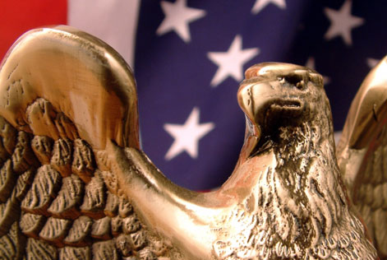
The Powers of Congress

Slide 2
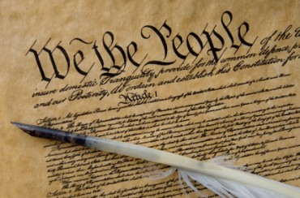
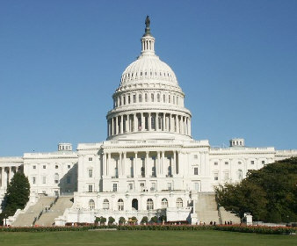
Legislative Powers
Enumerated/Delegated (Expressed) powers are specifically given to Congress in the Constitution.
Article 1, Section 8 of the Constitution spells out the major powers of the Congress.
The first 17 clauses list specific powers granted to Congress. (textbook pages 59 –60 take a minute and read over them)

Slide 3
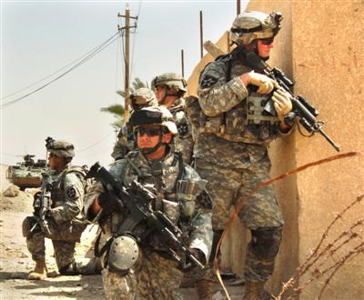

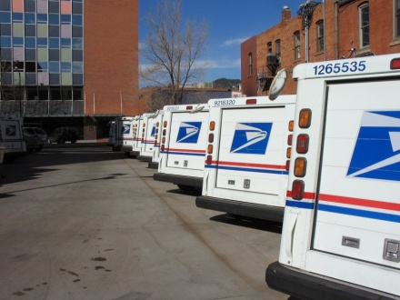
“Enumerated/Delegated/
Expressed” Powers
Examples of Enumerated/Delegated Powers are:
  Raising & supporting an army and a navy
  Establish uniform rules of naturalization (also called “naturalization laws”)
  Print & coin money
  Establish post offices
  Declare War

Slide 4
Legislative Powers
Implied powers are not specifically listed for Congress but are understood according to Article 1, Section 8, Clause 18. (look at page 60)
This is often called the “elastic clause” because it gives Congress authority to stretch its power and do whatever is “necessary and proper” to do their job & carry out their listed powers

Slide 5

“Implied” Powers
Examples of Implied Powers (from the Necessary and Proper Clause) are:
  To raise and support an army implies Congress can implement a draft
  Collecting taxes implies that Congress could use the money to support programs
  Establishing naturalization rules implies that Congress can limit the number of immigrants.

Slide 6
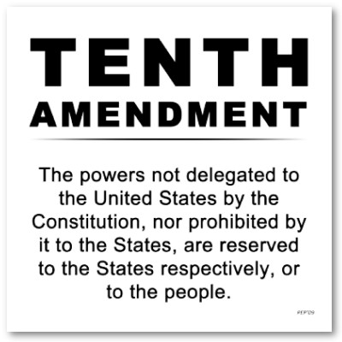
Other Powers
Concurrent Powers are those that the Federal Government and the States “Share”!!!
  Building Roads
  Establishing Courts
  Collecting Taxes
  Law Enforcement
  Prisons
Reserved Powers – Those held only by the States!!! 10th Amendment

Slide 7
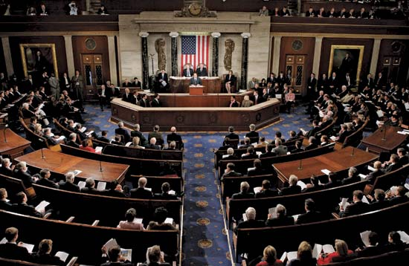

Congressional Powers
Most congressional power is related to making laws for the nation.
However, Congress has many other powers as well:
  Regulating interstate (between states) commerce (business)
  Raising and spending money
  Creating federal courts
  Dealing with foreign countries
  Governing all federal property (military bases, national parks)

Slide 8
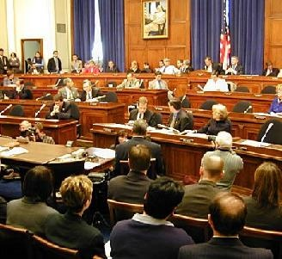

Congress & Funding
To fund the U.S. Government, Congress has the power to levy taxes.
All tax bills are proposed or start in the House of Representatives and must be approved by the Senate. Why do you think they start in the House?

Slide 9
Congress & Trade
Article 1, Section 8, Clause 3 , also called the “Commerce Clause” is the basis for many of Congress’ most important powers – this allows Congress the power to regulate foreign and domestic trade.
  Domestic - interstate

Slide 10

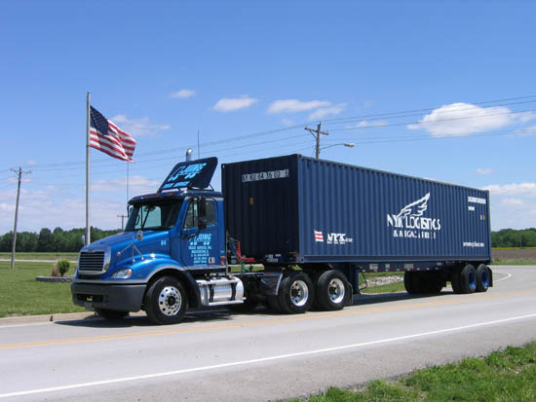
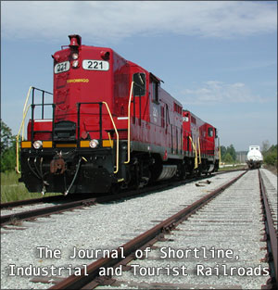

Congress & Trade
Examples of powers from this clause:
  Air Traffic
  Railroads
  Trucking
  Radio / TV
  Pollution
  Stock Market

Slide 11
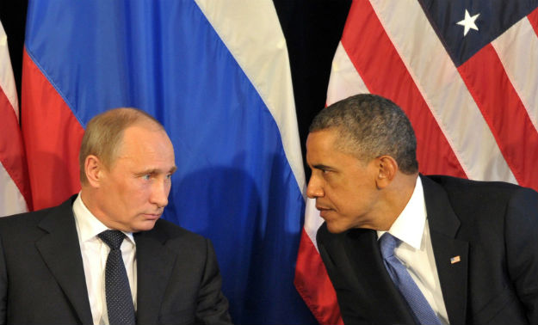
Congress & Foreign Relations
While the President has the authority to negotiate treaties and deal with other nations, all treaties must be approved by the Senate.
This is an example of a _____ and _____?

Slide 12
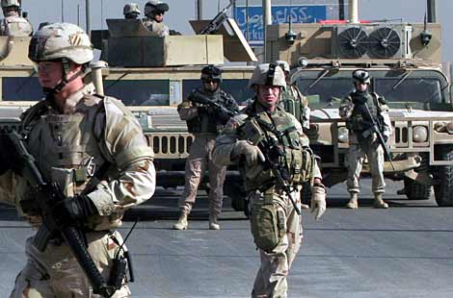
Congress & Foreign Relations
While the President has the authority send troops into combat for up to 60 days, only Congress has the power to declare war or create an army.
World War II was the last “declared war” in the U.S. (1941-1945)

Slide 13
Non-Legislative Powers
“Non-Legislative” Powers are powers that Congress has the does not relate to passing laws.
Examples:
Proposing Amendments
Approvals of Nominations (Senate)
Removal from Office and Impeachments
Investigations

Slide 14
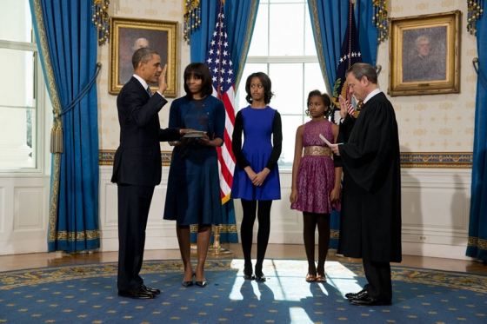
Non-Legislative Powers
Check and Balance --- The Senate can approve or reject presidential nominees or appointments for various offices.
Check and Balance - Congress can also remove any elected officials from office in cases of wrong-doing.

Slide 15
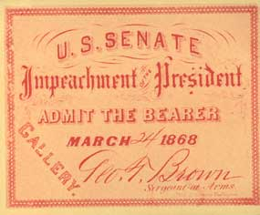
“Impeachment”
“Impeach” means to formally accusing officials of misconduct or wrong-doing.
Impeachments are usually handled by a trial.
The House always begin impeachment procedures.
  If the majority of the House votes for impeachment, it moves to the Senate.
The Senate acts as jury, while the Chief Justice of the Supreme Court acts as judge.
  2/3 needed for guilt to be found in the impeachment (67 Senators)

Slide 16
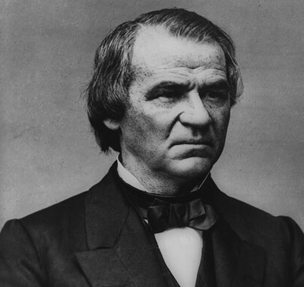

“Impeachment”
Only two presidents have ever been impeached (neither removed from office).
Andrew Johnson (1868) and Bill Clinton (1998)

Slide 17
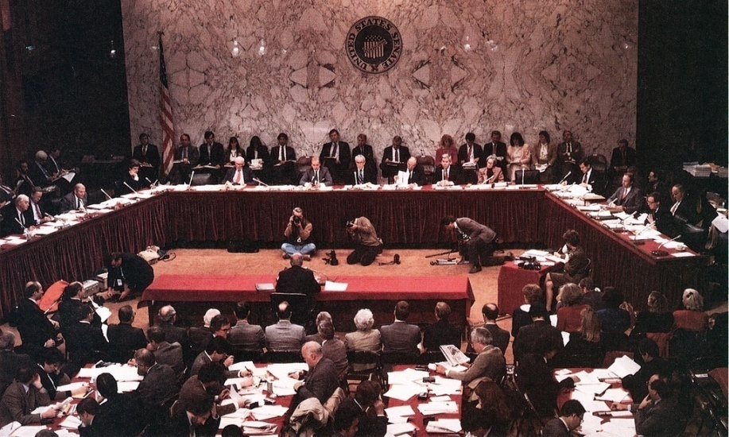
Non-Legislative Powers
Congress also conduct investigations into serious issues.
Organized crime, fund raising, Watergate, Iran-Contra, etc.

Slide 18
Limits to Congressional Power
The Constitution limits the power of Congress, placing restrictions on their power.
Congress may not favor one state over another, tax exports, tax interstate trade.

Slide 19
Ways that Congressional Power is Limited
The Constitution also reserves many powers to the states and other branches (10th Amendment)
Congress can not interfere with these Reserved powers.
The Supreme Court can declare laws unconstitutional and the President can veto laws.

Slide 20

Limits to Congressional Power
Congress can not pass “bills of attainder” (laws that punish a person without a jury trial)

Slide 21

Limits to Congressional Power
Congress can not suspend the “writ of habeas corpus” (court order requiring police to bring a prisoner to court to explain why they are holding that person).

Slide 22

Limits to Congressional Power
Congress can not pass “ex post facto laws” (or laws that make an act a crime AFTER it has been committed)

