Slide 1
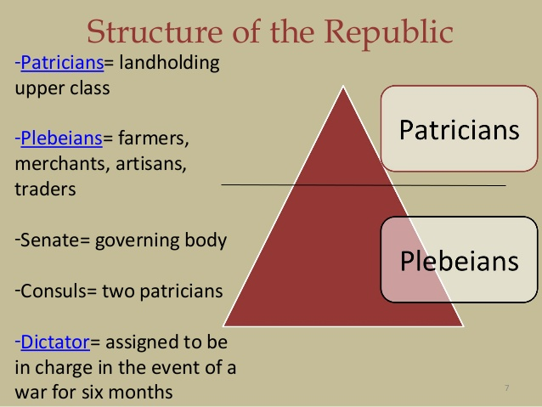
Lesson 11.2 -- Rome as a Republic
I. Governing Rome
Rome's government reflected divisions within its society. Early Romans were divided into two classes: Patricians and Plebeians.
1. Patricians, the ruling class, were wealthy landowners that came from Rome's oldest and most prominent families.
2. Most Romans were Plebeians, who were not as wealthy as the Patricians, and included artisans, shopkeepers, and small-farm owners.

Slide 2
I. Governing Rome
3. Both Patrician and Plebeian men were Roman citizens and had the right to vote. Both groups paid taxes and served in the army. Plebeians, however, had a lower social position than that of Patricians.
4. Rome's Republic was shaped by a struggle between the Patricians and the Plebeians over the right to govern.

Slide 3
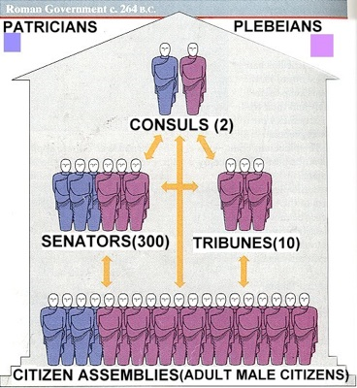
A. Government of the Republic
1. The government of the Roman Republic was organized into three branches:
one branch made laws,
another ran daily affairs
and a third acted as judges.
The republic had a system of checks and balances.
2. Two patrician consuls headed the government and were administrators and army leaders. Each consul could veto, or reject, the other's decision.

Slide 4
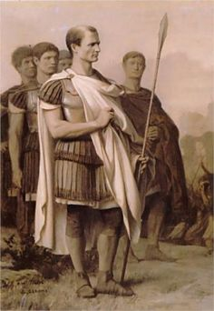
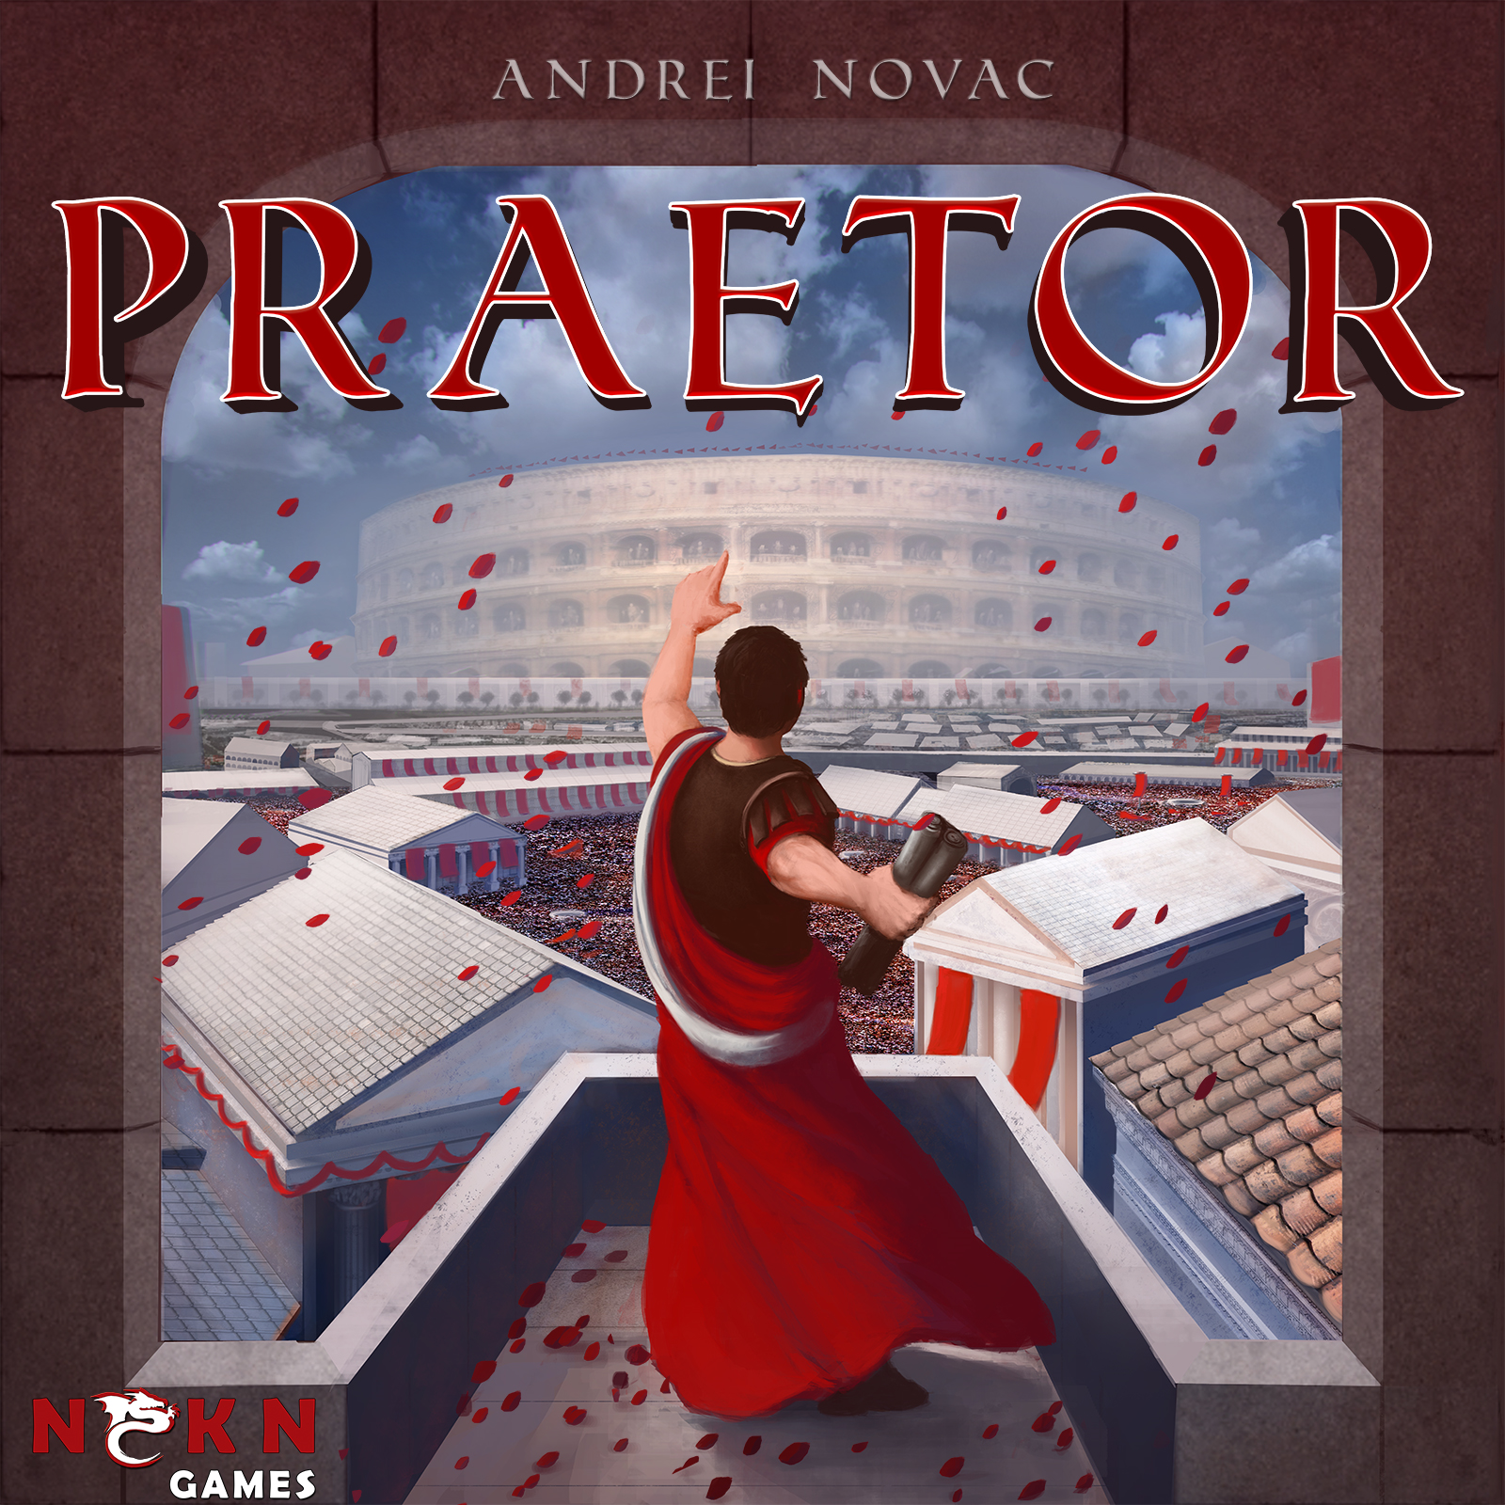
A. Government of the Republic
3. Rome also had major government officials called praetors who interpreted the law, served as judges in court, and could lead armies.
4. The Senate, Rome's legislature, was a group of 300 Patrician men, each of whom served the Republic for life. By the 200s B.C. Senators debated foreign policy, proposed laws, and approved the construction of roads and temples.

Slide 5
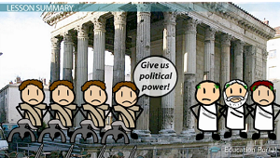
B. Conflict Between Classes
1. Over time, Plebeians grew frustrated because they had to serve in the army and pay taxes, but they had no power in the government.
2. The Patricians allowed the Plebeians to have their own body of representatives called the Council of Plebs. This council elected officials called tribunes who voiced Plebeian concerns to the government. Tribunes could also veto government decisions.
3. In 287 B.C., the Council was given the right to pass laws for all Romans. Now, the Republic was more representative, but it was still not democratic.

Slide 6
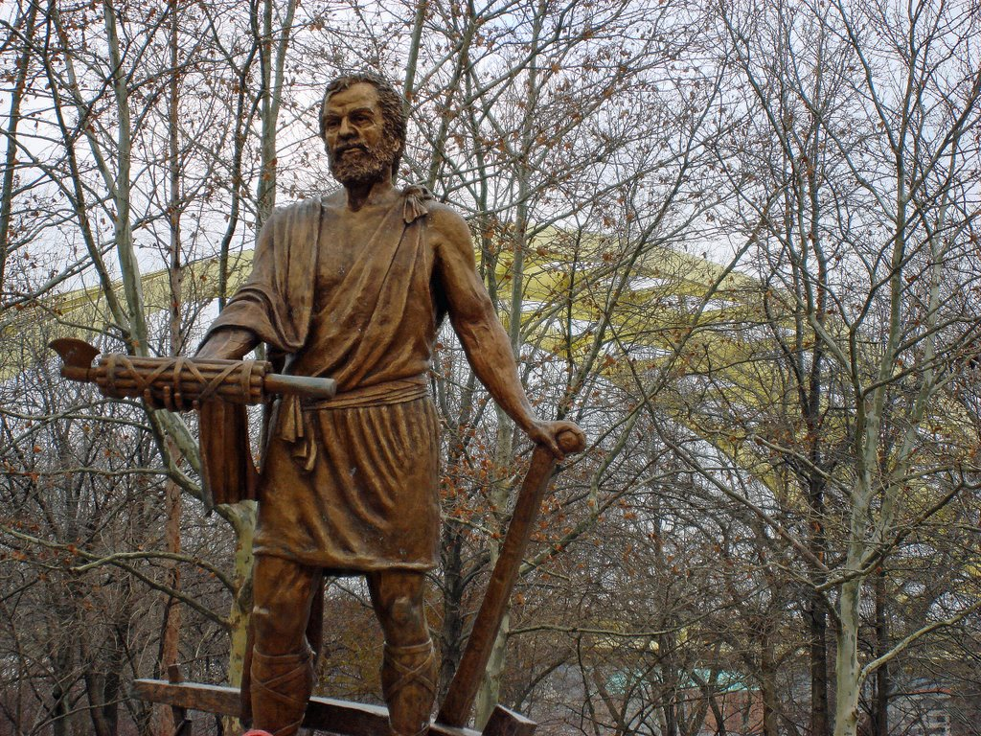
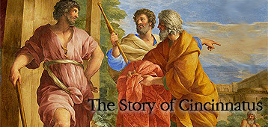
C. Cincinnatus and Civic Duty
1. To lead Rome, the Romans created the office of dictator, so that during a crisis the dictator had complete control over Rome. It was thought that after the crisis, the dictator would give up his power and the regular government's power would be restored.

Slide 7
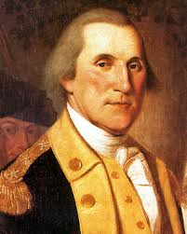
C. Cincinnatus and Civic Duty
2. One of the most famous Roman dictators was Cincinnatus, who upon accepting the role of dictator immediately created an army. The, he led the army into battle, defeated the enemy, marched them back to Rome and resigned as dictator ... all only 16 days after taking control of the Republic.
3. He was widely admired because he fulfilled his civic duty -- the idea that citizens have a responsibility to help their country. This idea was important to the Romans and has been valued by other people as well, like George Washington.

Slide 8
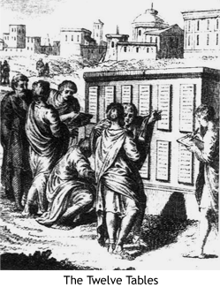
D. Rome's System of Law
1. Roman law has influenced the legal systems of the United States and other countries.
2. Rome adopted its first written code of laws know as the Twelve Tables in 451 B.C. These laws served as the foundation for all future Roman laws and supported the ideal that all free citizens had the right to be treated equally in the Roman legal system.
3. As the Romans conquered more people, they created laws that would apply to people who were not Roman citizens -- these became know as the Law of Nations and applied to all people everywhere in the Roman lands.

Slide 9
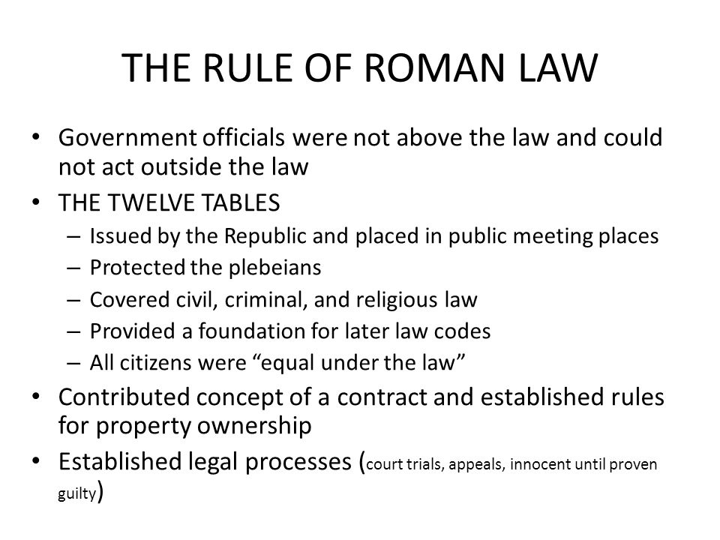
E. Roman Justice
1. The ideas found in Roman laws are woven throughout the American legal system today.
2. The Rule of Law is one of the key ideas that the Romans passed on to the world, meaning that laws apply to everyone equally and that the legal system should treat everyone the same way.
3. The Romans extended the idea of the rule of law to all their lands. Today, the Rule of Law is the guiding principle of the American legal system.

Slide 10
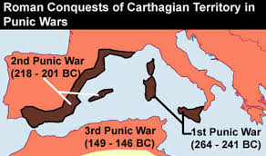
II. The Punic Wars
Carthage, a powerful trading empire based along the North African coast, became Rome's main rival.
1. Both Carthage and Rome wanted to control the entire Mediterranean world. This rivalry grew into a series of wars that took place over a period of nearly 120 years.

Slide 11
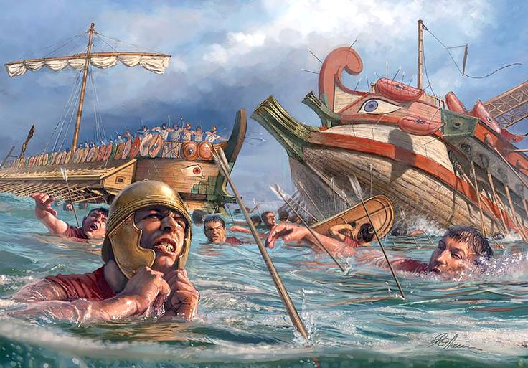
A. The Punic Wars Begin
1. The First Punic War began when Rome sought control of the fertile island of Sicily. Carthage used its strong navy to protect its trading kingdom. Rome, although they had a powerful army, did not have a navy. It was forced to build a fleet to fight Carthage.
2. In 241 B.C., a Roman fleet badly defeated Carthage's Navy off the coast of Sicily and Carthage was forced to give up Sicily and pay a huge fine to the Romans.

Slide 12
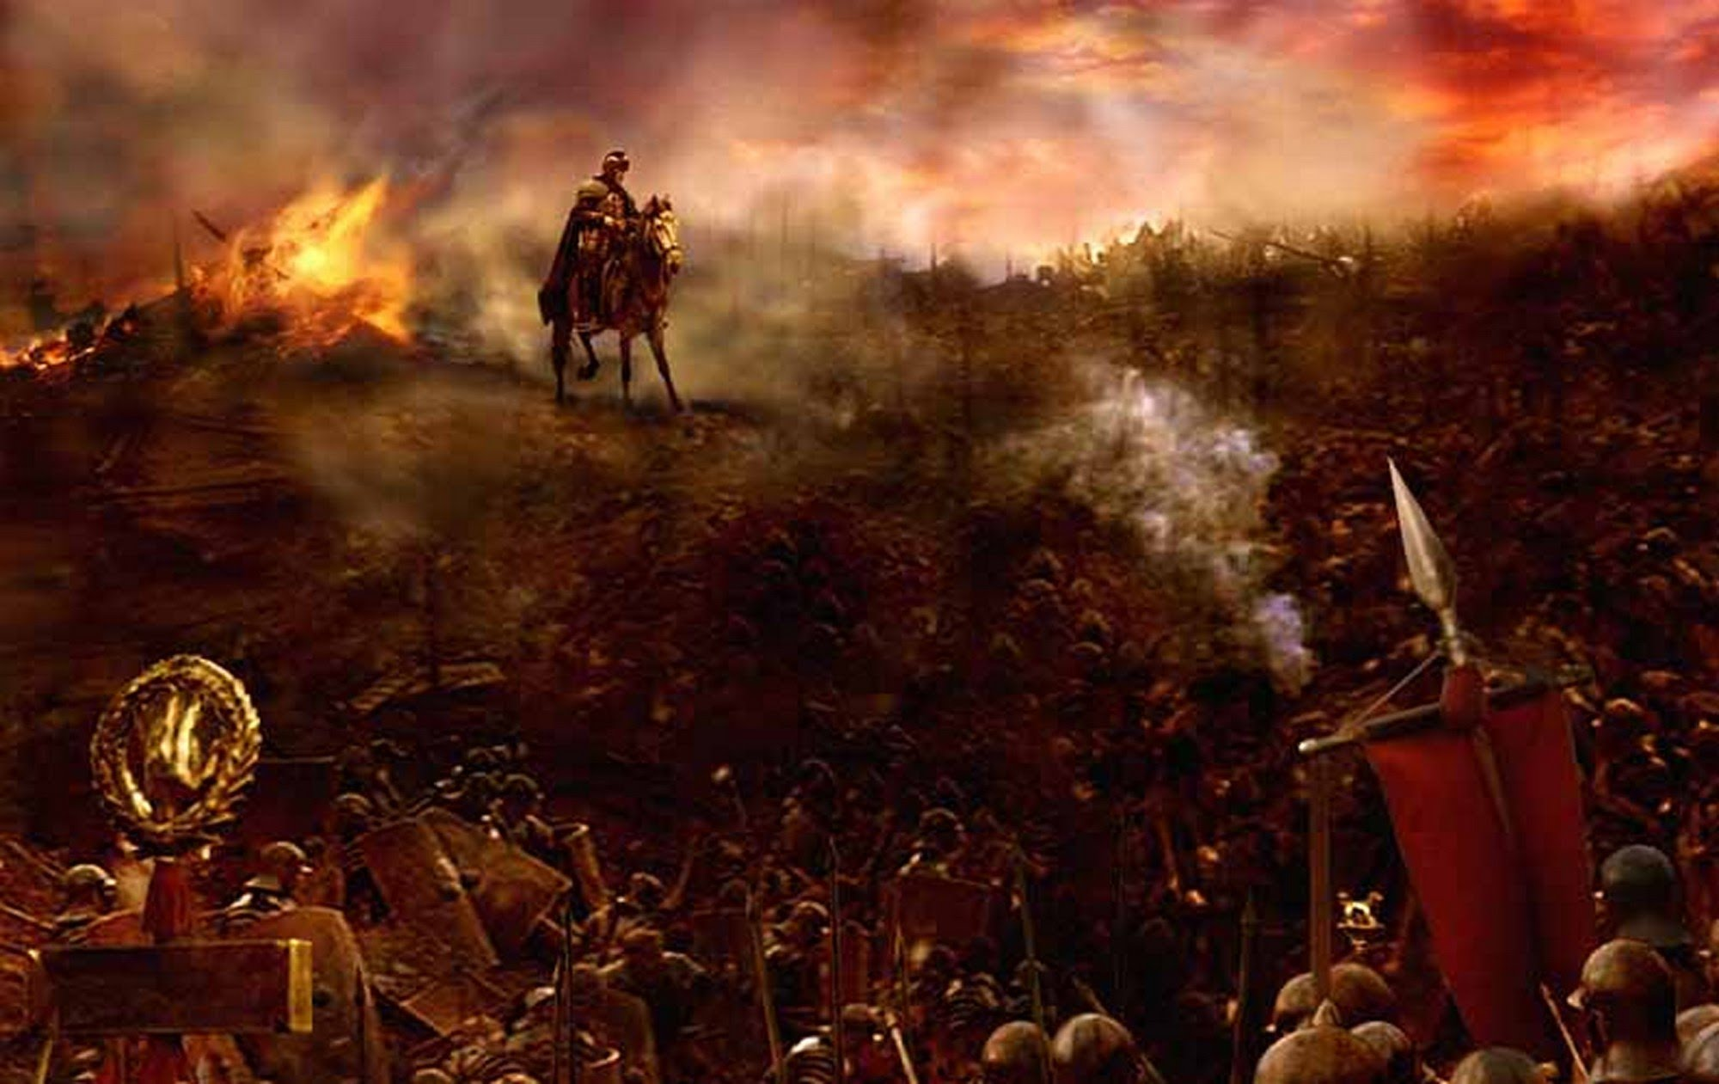
B. Hannibal Attacks: The Second Punic Wars
1. When Carthage tried to expand its empire into Spain, the Romans bitterly opposed their attempt to establish territory so near to Rome.
2. The Romans encouraged the Spanish to rebel against Carthage, so Carthage sent Hannibal, its greatest general, to attack Rome. This started the Second Punic War.

Slide 13
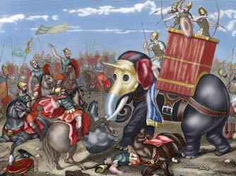
B. Hannibal Attacks: The Second Punic Wars
3. Hannibal gathered an army, including 37 elephants, marched through Gaul before crossing the Alps into Italy. The bitter cold and attacks by mountain tribes killed almost half of the Carthaginian soldiers and most of the elephants. But the remaining army pushed on.
4. Although Hannibal defeated the Romans at the Battle of Cannae, the Carthaginians were defeated at the Battle of Zama and were forced to give up tis Navy and pay Rome a large sum of money.
5. Rome became the supreme power in the Western Mediterranean.

Slide 14
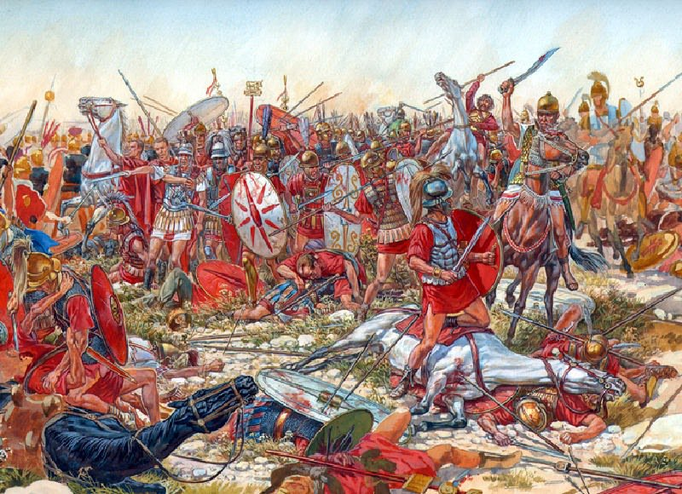
C. The Third Punic War
Still considering Carthage as a military threat, Rome finally destroyed it in the Third Punic War. At the same time, Rome took control of the Eastern Mediterranean region and eventually acquired its first province in Asia.

