Slide 1
Obtaining and Removing Materials Topic 8 Lesson 3
Learning Goal: Students will be able to explain how cells maintain Homeostasis
Essential Question: What is the primary role of the cell membrane in cellular function?
Standard SC.6.L.14.3

Slide 2
Essential Question: What is the primary role of the cell membrane in cell function?
Stayin’ Alive
What is homeostasis?
Homeostasis is the maintenance of a constant internal state in a changing environment.
Homeostasis ensures that cells can obtain and use energy, make new cells, exchange materials, and eliminate wastes in a changing environment.
Notes:
2

Slide 3
Homeostasis
Essential Question: What is the primary role of the cell membrane in cell function?
Unicellular organisms exchange materials directly with the environment.
Multicellular organisms have systems that transport materials to cells from other places within the organism.
Examples: The cardiovascular system in humans and xylem and phloem in plants are transport systems.

Slide 4
How do cells exchange materials?
Essential Question: What is the primary role of the cell membrane in cell function?

Slide 5
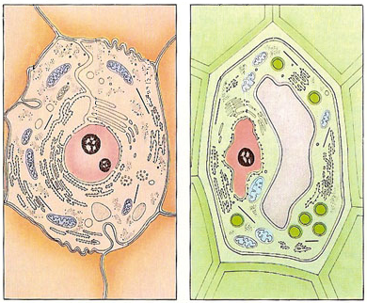
How do cells exchange materials?
Cell Membrane and Cell Wall:
ALL cells have a cell membrane made of proteins and lipids
protein channel
Cell Membrane
Layer 1
Layer 2
SOME cells have cell membranes and cell walls – ex: plants, fungi and bacteria
lipid bilayer
protein pump
Cell Membrane
Cell Wall

Slide 6
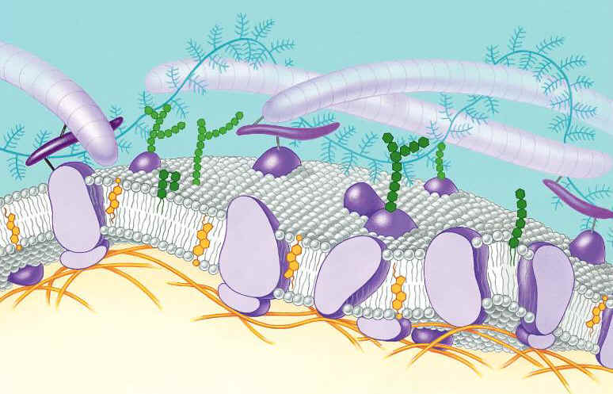
Essential Question: What is the primary role of the cell membrane in cell function?
Function of the Cell Membrane:
Cell membrane separates the components of a cell from its environment—surrounds the cell
“Gatekeeper” of the cell—regulates the flow of materials into and out of cell—selectively permeable
Cell membrane helps cells maintain homeostasis—stable internal balance

Slide 7
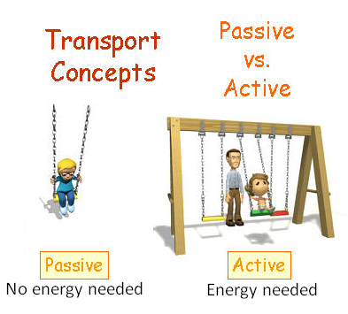

Slide 8
How do cells exchange materials?
Passive Transport
cell Does NOT use energy
Diffusion
Osmosis
Active Transport
cell does use energy
Endocytosis
Exocytosis
Weeee!!!
high
low
This is gonna be hard work!!
high
low

Slide 9
Diffusion is the movement of small particles across a selectively permeable membrane until equilibrium/balance is reached.
These particles move from an area of high concentration to an area of low concentration.
outside of cell
inside of cell

Slide 10
Diffusion
HIGH to LOW` concentration

Slide 11
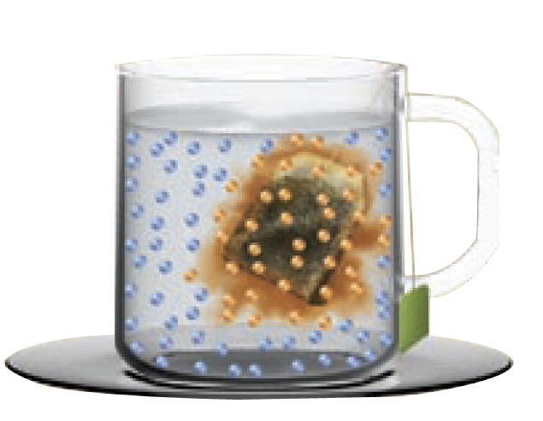
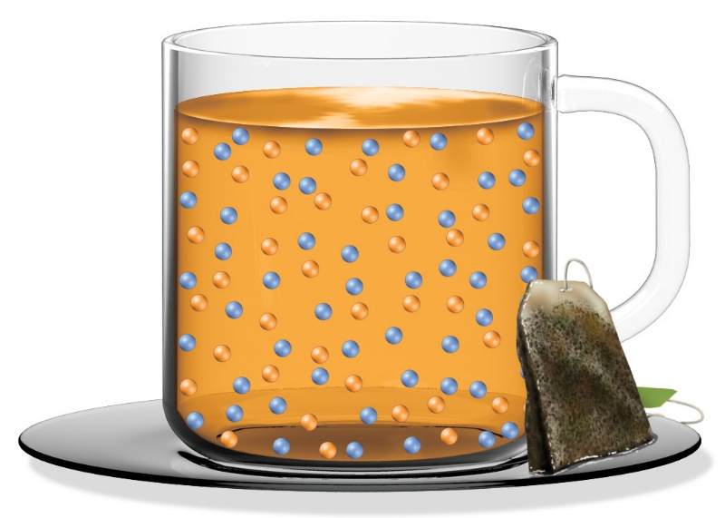
Essential Question: What is the primary role of the cell membrane in cell function?
How do cells exchange materials?
At some point, the movement of tea out of the bag stops or slows down considerably. Why?
Notes:
11

Slide 12
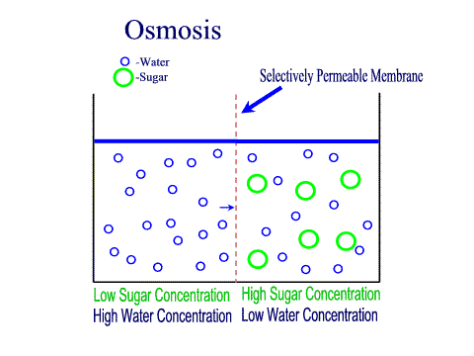
Osmosis is the diffusion of water through a selectively permeable membrane
Water diffuses across a membrane from an area of high concentration to an area of low concentration.
Semi-permeable membrane is permeable to water, but not to sugar

Slide 13
Active Transport
Active transport is the movement of molecules from LOW to HIGH concentration. Energy is required.
Proteins in the cell help with this movement
Ex: Body cells must pump carbon dioxide out into the surrounding blood vessels to be carried to the lungs for exhale. Blood vessels are high in carbon dioxide compared to the cells, so energy is required to move the carbon dioxide across the cell membrane from LOW to HIGH concentration.
outside of cell
Carbon Dioxide molecules
inside of cell

Slide 14
ANALOGY:
NO ENERGY NEEDED:
Diffusion
Osmosis
ENERGY NEEDED:
Active Transport

Slide 15
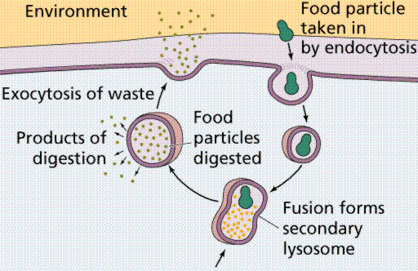
Endocytosis and Exocytosis is the method used for very large molecules (such as food and wastes) get into and out of the cell
Food is moved into the cell by Endocytosis
Wastes are moved out of the cell by Exocytosis

Slide 16
How do organisms maintain homeostasis?
Cells and whole organisms must work to maintain homeostasis in a constantly changing environment.
Some animals adapt their behavior to control body temperature.
Trees can show seasonal responses to changes in the environment.
Notes:
16

