Slide 1
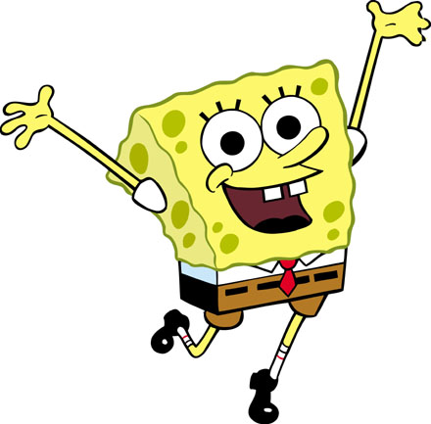
SpongeBob Genetics 1 Review
To be used with
http://sciencespot.net/Pages/classbio.html#Anchor-genetics

Slide 2
Scientists at Bikini Bottoms have been investigating the genetic makeup of the organisms in this community.
Use the information provided and your knowledge of genetics to answer each question.
For each genotype below, indicate whether it is a heterozygous (He) OR homozygous (Ho).
TT _____ Bb _____ DD _____ Ff _____ tt _____ dd _____
Dd _____ ff _____ Tt _____ bb _____ BB _____ FF _____
Which of the genotypes in #1 would be considered purebred?
Which of the genotypes in #1 would be hybrids?

Slide 3
Scientists at Bikini Bottoms have been investigating the genetic makeup of the organisms in this community.
Use the information provided and your knowledge of genetics to answer each question.
For each genotype below, indicate whether it is a heterozygous (He) OR homozygous (Ho).
TT Ho Bb He DD Ho Ff He tt Ho dd Ho
Dd He ff Ho Tt He bb Ho BB Ho FF Ho
Which of the genotypes in #1 would be considered purebred?
TT Ho DD Ho tt Ho dd Ho ff Ho bb Ho BB Ho FF Ho
Which of the genotypes in #1 would be hybrids?
Bb He Ff He Dd He Tt He

Slide 4
2. Determine the phenotype for each genotype using the information provided about SpongeBob.
Yellow body color is dominant to blue.
YY ________________ Yy ________________ yy ________________
Square shape is dominant to round.
SS ________________ Ss ________________ ss ________________

Slide 5
2. Determine the phenotype for each genotype using the information provided about SpongeBob.
Yellow body color is dominant to blue.
YY - Yellow Yy - Yellow yy - blue
Square shape is dominant to round.
SS –square Ss – square ss - round

Slide 6
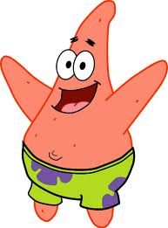
3. For each phenotype, give the genotypes that are possible for Patrick.
A tall head (T) is dominant to short (t).
Tall = _______________ Short = _______________
Pink body color (P) is dominant to yellow (p).
Pink body = _____________ Yellow body = _________________

Slide 7
3. For each phenotype, give the genotypes that are possible for Patrick.
A tall head (T) is dominant to short (t).
Tall = TT, or Tt Short = tt
Pink body color (P) is dominant to yellow (p).
Pink body = PP, or Pp Yellow body = pp

Slide 8
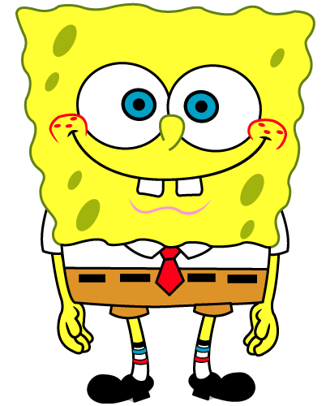
4. SpongeBob SquarePants recently met SpongeSusie Roundpants at a dance. SpongeBob is heterozygous for his square shape, but SpongeSusie is round. Create a Punnett square to show the possibilities that would result if SpongeBob and SpongeSusie had children.
HINT: Read question #2!
List the possible genotypes and phenotypes for their children.
B. What are the chances of a child with a square shape? ____ out of ____ or ____%
C. What are the chances of a child with a round shape? ____ out of ____ or ____%

Slide 9
4. SpongeBob SquarePants recently met SpongeSusie Roundpants at a dance. SpongeBob is heterozygous for his square shape, but SpongeSusie is round. Create a Punnett square to show the possibilities that would result if SpongeBob and SpongeSusie had children.
HINT: Read question #2!
List the possible genotypes and phenotypes for their children. Ss or ss, square, round
B. What are the chances of a child with a square shape? 2 out of 4 or 50 %
C. What are the chances of a child with a round shape? 2 out of 4 or 50 %
SpongeBob
 | S | s
s | Ss | ss
s | Ss | ss
SpongeSusie

Slide 10
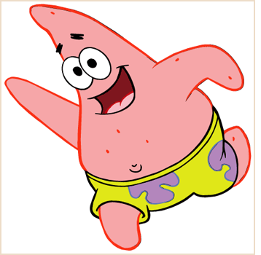
5. Patrick met Patti at the dance. Both of them are heterozygous for their pink body color, which is dominant over a yellow body color. Create a Punnett square to show the possibilities that would result if Patrick and Patti had children. HINT: Read question #3!
List the possible genotypes and phenotypes for their children.
B. What are the chances of a child with a pink body? ____ out of ____ or ____%
C. What are the chances of a child with a yellow body? ____ out of ____ or ____%

Slide 11
5. Patrick met Patti at the dance. Both of them are heterozygous for their pink body color, which is dominant over a yellow body color. Create a Punnett square to show the possibilities that would result if Patrick and Patti had children. HINT: Read question #3!
List the possible genotypes and phenotypes for their children. PP, Pp, pp, pink, yellow
B. What are the chances of a child with a pink body? 3 out of 4 or 75 %
C. What are the chances of a child with a yellow body? 1 out of 4 or 25 %
Patrick
 | P | p
P | PP | Pp
p | Pp | pp
Patti

Slide 12
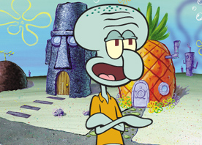
6. Everyone in Squidward’s family has light blue skin, which is the dominant trait for body color in his hometown of Squid Valley. His family brags that they are a “purebred” line. He recently married a nice girl who has light green skin, which is a recessive trait. Create a Punnett square to show the possibilities that would result if Squidward and his new bride had children. Use B to represent the dominant gene and b to represent the recessive gene.
List the possible genotypes and phenotypes for their children.
B. What are the chances of a child with light blue skin? ____%
C. What are the chances of a child with light green skin? ____%
D. Would Squidward’s children still be considered purebreds? Explain!

Slide 13
6. Everyone in Squidward’s family has light blue skin, which is the dominant trait for body color in his hometown of Squid Valley. His family brags that they are a “purebred” line. He recently married a nice girl who has light green skin, which is a recessive trait. Create a Punnett square to show the possibilities that would result if Squidward and his new bride had children. Use B to represent the dominant gene and b to represent the recessive gene.
List the possible genotypes and phenotypes for their children. Bb, blue
B. What are the chances of a child with light blue skin? 100%
C. What are the chances of a child with light green skin? 0%
D. Would Squidward’s children still be considered purebreds? Explain! No, hybrids
Squidward
 | B | B
b | Bb | Bb
b | Bb | Bb
Nice Girl

Slide 14
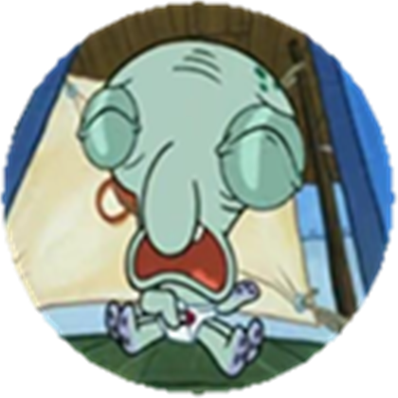
7. Assume that one of Squidward’s sons, who is heterozygous for the light blue body color, married a girl that was also heterozygous. Create a Punnett square to show the possibilities that would result if they had children.
List the possible genotypes and phenotypes for their children.
B. What are the chances of a child with light blue skin? ____%
C. What are the chances of a child with light green skin? ____%

Slide 15
7. Assume that one of Squidward’s sons, who is heterozygous for the light blue body color, married a girl that was also heterozygous. Create a Punnett square to show the possibilities that would result if they had children.
List the possible genotypes and phenotypes for their children. BB, Bb, bb, blue, green
B. What are the chances of a child with light blue skin? 75%
C. What are the chances of a child with light green skin? 25%
Squidward’s son
 | B | b
B | BB | Bb
b | Bb | bb
Nice girl

Slide 16
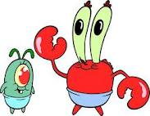
8. Mr. Krabbs and his wife recently had a Lil’ Krabby, but it has not been a happy occasion for them. Mrs. Krabbs has been upset since she first saw her new baby who had short eyeballs. She claims that the hospital goofed and mixed up her baby with someone else’s baby. Mr. Krabbs is homozygous for his tall eyeballs, while his wife is heterozygous for her tall eyeballs. Some members of her family have short eyes, which is the recessive trait. Create a Punnett square using T for the dominant gene and t for the recessive one.
List the possible genotypes and phenotypes for their children.
B. Did the hospital make a mistake? Explain your answer.

Slide 17
8. Mr. Krabbs and his wife recently had a Lil’ Krabby, but it has not been a happy occasion for them. Mrs. Krabbs has been upset since she first saw her new baby who had short eyeballs. She claims that the hospital goofed and mixed up her baby with someone else’s baby. Mr. Krabbs is homozygous for his tall eyeballs, while his wife is heterozygous for her tall eyeballs. Some members of her family have short eyes, which is the recessive trait. Create a Punnett square using T for the dominant gene and t for the recessive one.
List the possible genotypes and phenotypes for their children. TT or Tt
B. Did the hospital make a mistake? Explain your answer. Yes, they can’t have short eyeballed children
Mr. Krabbs
 | T | T
T | TT | TT
t | Tt | Tt
Mrs. Krabbs

